Slide 1
Creating 3D Flood Visualizations Using GIS for West Virginia Community Information Dissemination
Kevin Shrader
West Virginia University
Dept. of Geology and Geography
MA Project Defense
Committee Members:
Aaron Maxwell (Chair)
Maneesh Sharma
Jamison Conley
Thursday, December 10 – 1 pm

Slide 2
Outline
Introduction
Data and Study Area
Software and Hardware
Methods
Results and Evaluation
Limitations and Further Research
Notes:
Outline for this presentation
First we will take a step back and discuss some of the background information of flooding, emergency management mitigation, why 3D is important and necessary for this research
For the Methods, given the amount (10), discuss a few and present some of the outputs; this is to lead up to the community flood videos and web application where all the data outputs are put together

Slide 3

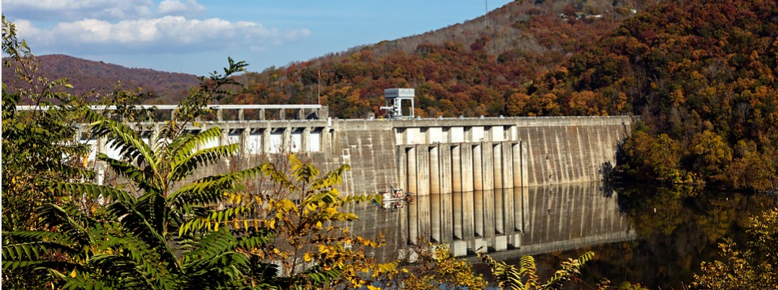
Introduction - Flooding
Risk of Severe Flooding Increasing
  Climate change
  Increase in population near water bodies and streams
Importance of emergency management
  Mitigation
    Structural
    Non-structural
Notes:
Flooding is a common occurrence; but with rarer occasions of severe flooding. However, the risk of severe flooding is increasing due to climate change and more people and infrastructure being built near streams and bodies of water
A combination of increases in severe weather due to climate change and more people moving and infrastructure being constructed in or near water is leading to more risk. A 2003 study showed that total flood damage increased between 1934 and 1999 (University of Colorado Boulder Center for Science and Technology Policy Research 2003) and flood fatalities have a median 81 deaths per year between 1959 and 2005 (Ashley and Ashley 2008).
Given the increased risks from flooding and other natural disasters, emergency management is more important now than ever for protecting civilians and reducing or even preventing property damage. This can be accomplished through mitigation.
Mitigation, the act of preventing or reducing the risk of loss for a flood, is one of the most important phases of emergency management, given it can effectively make the preparedness, response, and recovery phases much easier established effectively
Structural - Structural mitigation strategies usually involve “large-scale construction efforts to actively protect communities” (Highfield and Brody 2012, 230) such as levees and dams. These can be costly, disrupt the natural environment, and can change the natural flow of rivers that can cause increased flooding in other locations
Non-structural mitigation – preferred option, involves policies and planning that are low cost (comparably to structural) and can be implemented on the community level

Slide 4

Non-structural Mitigation
FEMA’s National Flood Insurance Program (NFIP)
  Community Floodplain ordinances
  Flood insurance availability
Public education and information dissemination
  Trainings
  Maps and Web Applications
Notes:
Community’s Adoption of floodplain ordinances that meet or exceed minimum building construction requirements (land use planning, preventing construction in floodway, requiring flood preventative measures for new structures; in exchange flood insurance was made available for that community (FEMA 2019).
Another part of non-structural mitigation is
Educating the public through trainings, seminars, and publicly available data, maps such as the Flood Insurance Rate Map, and web applications such as the WV Flood Tool

Slide 5
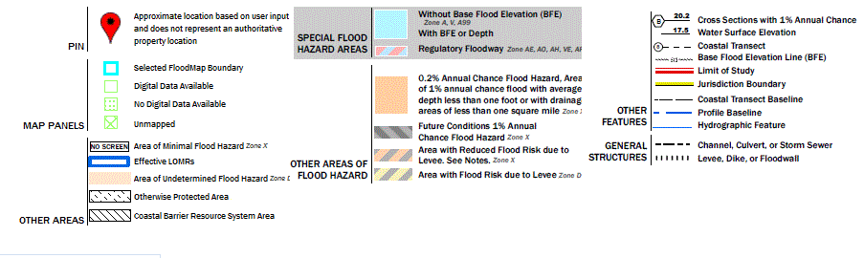
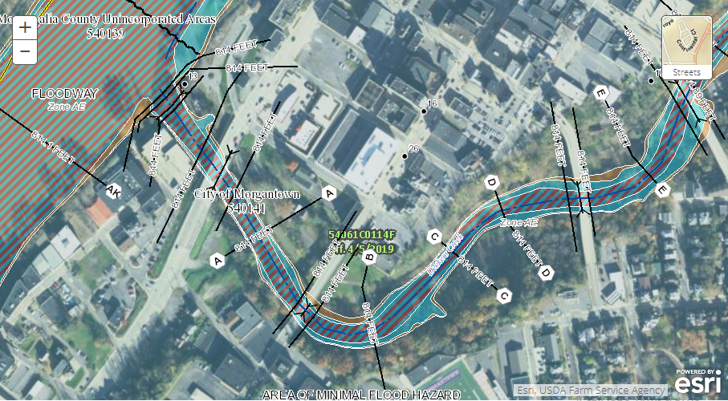
Flood Insurance Rate Map (FIRM)
Indication of the special flood hazard area and the level of risk for the community
Most often a 2D Map
Problems exist with data and the presentation medium
Not new user friendly
Notes:
SFHA – 100-year floodplain
2D maps, although newer versions are digital with some interactive elements
Data is not always most recent or most detailed
The use of 2D also has its limitations that will be discussed in a later slide
Not really public friendly, a lot of data, a lot of symbology, create a lot of confusion

Slide 6
FEMA FIRM and Riverine Flood Terminology
Floodplain: areas near a stream where naturally occurring flooding occurs
1% annual chance (100-year or Base Flood) floodplain: a flood that has a 1-percent chance of occurring any given year
Special Flood Hazard Area: area inundated by the base flood
Floodway: channel of the stream and areas adjacent to the channel; area where the highest water flow velocities will occur
  Fringe: areas on either side of the floodway; inundation with little to no water flow velocity
Regulatory (Effective): current FEMA-approved 1% annual chance floodplain boundaries
  Zone AE – determined using detailed hydrologic and hydraulic engineering studies; includes base flood heights and floodway
  Zone A (Approximate): determined using an approximate study; delineates the extent of the floodplain but does not determine base flood heights or floodway
Non-regulatory (Advisory/Preliminary): newly calculated boundaries that have yet to be approved by FEMA (Advisory) or within a 6-month window for community review (Preliminary); once approved, boundaries will become effective
Notes:
Now to understand some of the terms that will be brought up during this presentation
Floodplains can and are often disrupted by human built infrastructure that changes the depth of the water and the shape of the floodplain
1% annual chance floodplain DOES NOT mean occurring once every 100 years; it actually has a 26% chance of occurring over a 30-year mortgage
Floodway – usually the most destructive areas; many communities prevent new construction from being built in the floodway
Fringe – Little to no water flow velocity DOES NOT mean no damage; 10 feet of water still means 10 feet of water whether it is moving or not
Now moving into how a FIRM classifies the base flood
Zone AE- require field work and are expensive, why there are more A than AE
Zone A – created by reviewing historical data and if that data does not exist, a rough hydrologic analysis is performed to determine the width of the floodplain

Slide 7
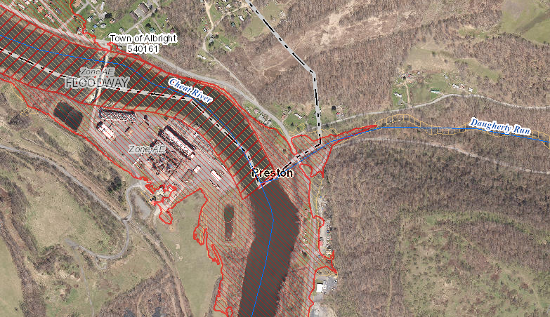
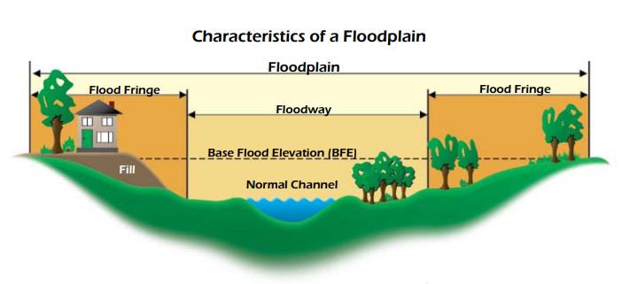
Notes:
Town of Albright in Preston County, View from the Flood Tool

Slide 8
2D and 3D
2D limitations
People experience and live in 3D world
By using a 3D form, there is a way for both non-experts and experts to associate representation with reality more clearly
Notes:
2D limits a map to an abstracted representation of a spatial landscape ((University of Nebraska Omaha Cartography and GIS Laboratory, n.d.)
-Yes 3D can and often use abstractions as well, the use of a 2D medium is poor at represent 3D real world objects can be difficult to interpret without experience and a detailed legend
Biggest limitation of 2D is the lack of the Z axis, 2D features can be symbolized to represent objects, but it can be a waste of symbology when height can be shown on a 3D dimensional plane
Non-expert - (public), Expert – Those that work with such information; provide the same level of understanding

Slide 9
Infusion of GIS
Use of GIS and GIS-based software allows for the infusion of different cartographic representations with additional functionality
  GIS-linked attribute information
  Conversion of 2D Maps to 3D Scenes
  Representing 2D data in a 3D environment
  Greater interactivity
Notes:
With the use of GIS, a map is no longer just a traditional 2D paper map with a legend. Data can be interacted with and provide additional information not shown with symbology. GIS Softwares (ArcGIS Pro) and ArcGIS Online

Slide 10
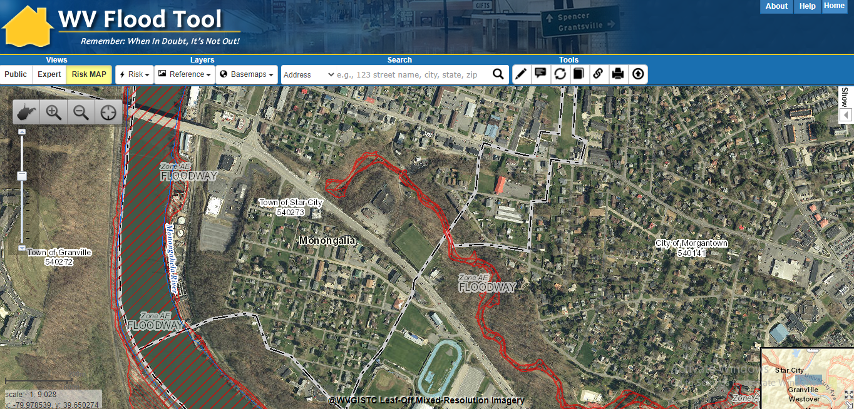
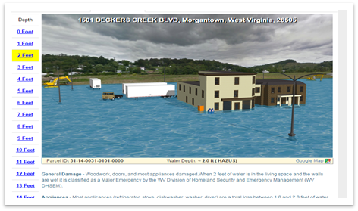
Notes:
Screenshot of the WV Flood Tool, multiple views for different audiences, plus interactivity; generic Sketch-Up 3D Visualization
Although simplistic and generic, this 3D visualization can provide more information about depth than just looking at a 2D map

Slide 11
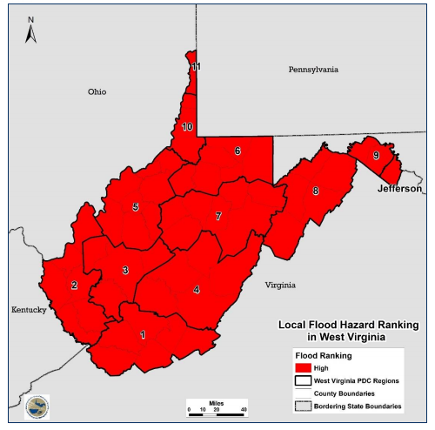
Flooding in West Virginia
All areas are at a high risk for flooding
2018 WV Statewide Multi-Hazard Risk Assessment
  WV Flood Risk Assessment project
Notes:
As part of the 2018 WV Hazard Mitigation Plan report: Risk is based on a number of different analyses such as Total area impacted, property damage, and population vulnerability analyses
Between January 1993 and July 2017
2,302 flood events
$1.8 billon
103 deaths
23 of those were from the 2016 flood event
(Be aware some communities do not have floodplains)
WV GIS Technical Center is the lead
Creation of building exposure inventory for all primary structures within the 1-percent annual chance floodplain; A structure is primary I enclosed and is considered a home (apartments, single-family, and mobile home), businesses, industrial buildings, or critical infrastructure (police departments, government buildings)

Slide 12
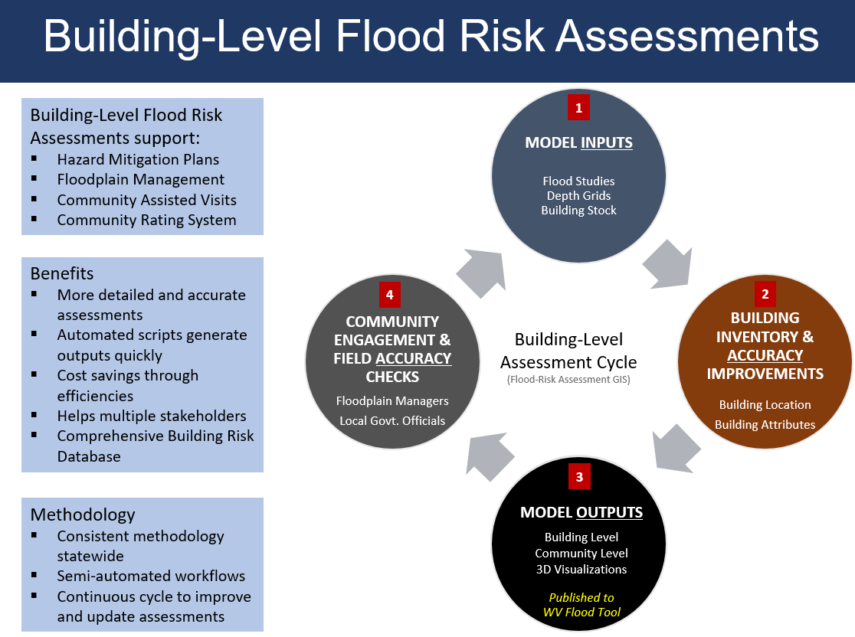
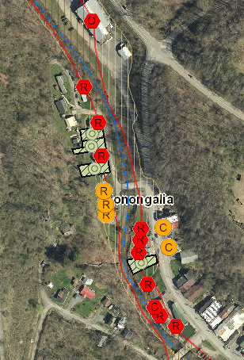
Notes:
2- identifying and updating the structures
3- building count GIS, BLRA table, community reports, and the creation of 3D visualizations <- My research
4- Most important part Community engagement (the dissemination of information)

Slide 13
Goal
With the support of the West Virginia GIS Technical Center through the FEMA funded WV Flood Risk Assessment, my graduate research was to create and export 3D flood visualizations of West Virginia communities using existing data, including the completed building inventory dataset as well as creating a supporting interactive ArcGIS Online web application for displaying 3D data that was developed to provide an effective way to disseminate crucial floodplain information to West Virginia communities.

Slide 14
Objectives
Create new and adjust current 2D Building footprints to accurately match the shape of structures overlapping with the 1-percent annual chance floodplain
Use ESRI based tools and R libraries for converting 2D building footprints to 3D features
Transform the 2D 1-percent annual chance floodplain depth grid into 3D data
Employ ESRI ArcGIS Pro to symbolize and label data for more effective communication in a 3D environment
Use ArcGIS Pro to create exported video animations of each 3D visualization community scene
Use ArcGIS Online to create a web application to interact with the 3D data in each community
Establish a workflow for replicability that is both detailed, structured, and time efficient
Notes:
Quality of footprint accuracy varies

Slide 15
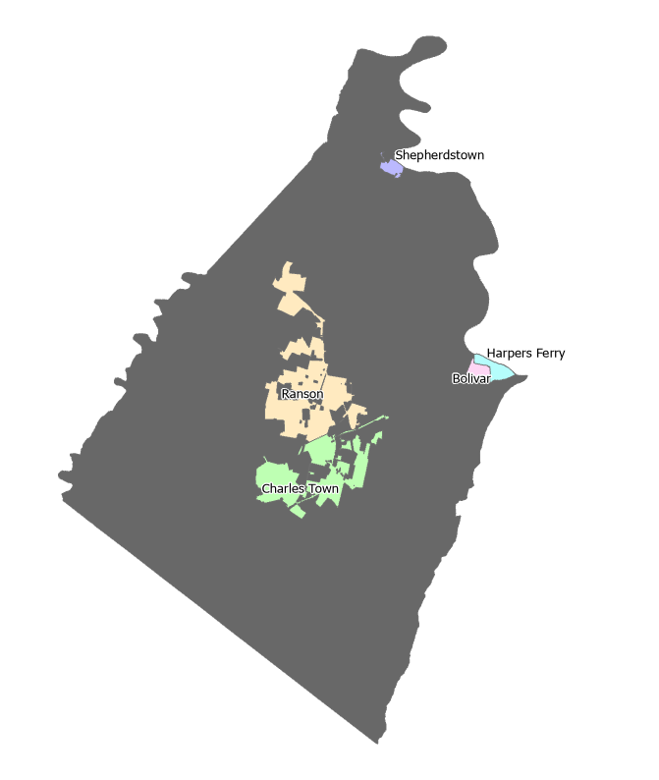
Study Area – Jefferson County
One of the first counties completed in the WV Flood Assessment
737 primary structures in 100-year floodplain
5 communities
Classified LiDAR and 2020 leaf-off imagery are available
Notes:
City - Charles Town (county seat)
Ranson
Shepherdstown
Harpers Ferry
Bolivar
53,498 total population (2010 Census)
Communities range from 286 (Harpers Ferry) to 5,259 (Charles Town)

Slide 16
Data
Raster
  Digital Elevation Model (DEM)
  Advisory A/AE flood depth
Other
  LiDAR point clouds
  Building Level Risk Assessment (BLRA) Excel table
  Leaf-off imagery service
  100-year floodplain feature service
Vector
  Building footprints
  Building count (Flood Hazard)
  Streams
  Roads
  100-year floodplain
  Community boundaries
  County boundaries
Notes:
All data is the extent of West Virginia and was acquired from the WV GIS TC clearinghouse or Tech Center’s internal servers with permission
Microsoft building footprints – national dataset
Building count – GIS data product from the Flood Hazard Assessment project
WV streams and waterways
All WV roads
Floodplain boundaries represent all Updated AE and Advisory A base flood boundaries
County and community boundaries for WV
LiDAR-derived Digital Elevation Model with a 1m spatial resolution
Flood depth grid – matches the extent of floodplain boundaries
LiDAR – collected in 2012 by Dewberry and was produced using a nominal pulse spacing of 0.5m, some data classified such as Ground, Noise, and water
BLRA – tabular version of GIS building count data with additional flood damage information for the structure created using the Hazus natural disaster analysis software
Floodplain feature service – includes all 100-year floodplains including outdated Effective floodplains

Slide 17
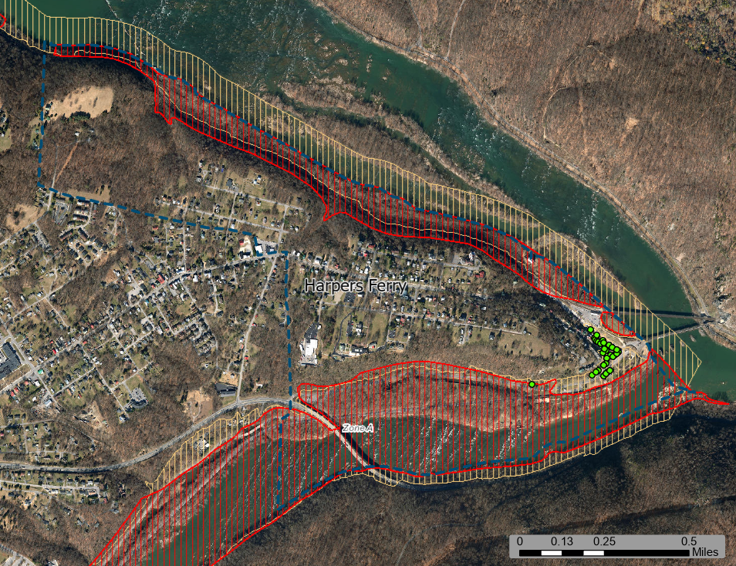
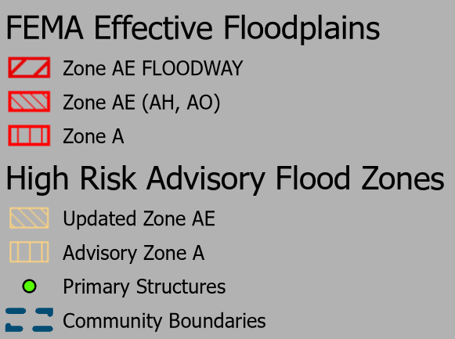
Notes:
Shows some of the data, community boundaries, Floodplain boundaries are part of a feature service, Primary structures shown are the building count data

Slide 18
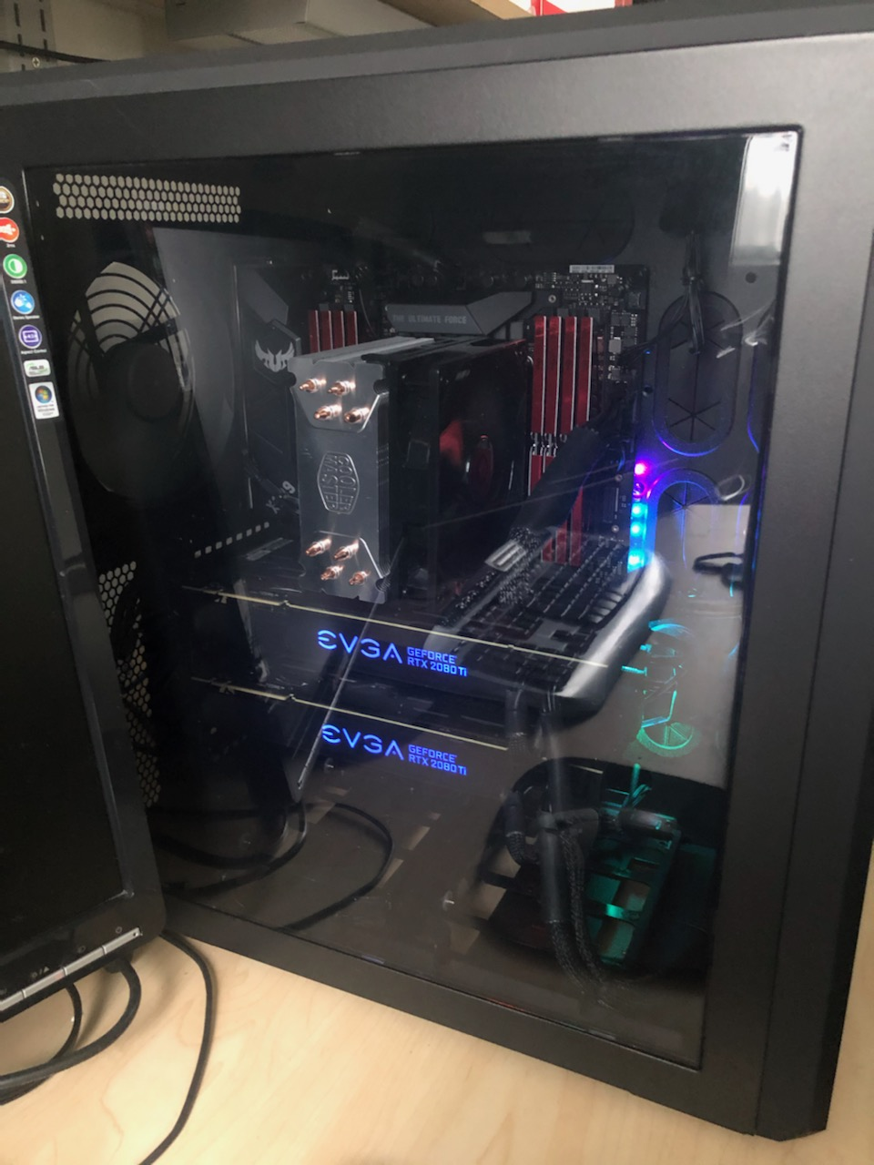

Hardware and Software
Two computers
ArcGIS Pro
ArcGIS Online
R
Notes:
Tech Center computer – Intel i7 CPU, 4 cores, and 32 GB RAM, and an AMD Radeon R7 450 GPU
G&G Computer – Intel i9 CPU, 12 cores, 128 GB RAM, and two NVIDIA GeForce RTX 2080 Ti GPUs

Slide 19
Methods (M) Outline
M1 - Adding and Clipping Data to Community Boundaries within an ArcGIS Pro Scene
M2 – Adding and Classifying LiDAR Data
M3 - Editing Building Footprints
M4 - Joining Additional Data with Building Footprints
M5 - 3D Building Footprint Extraction
M6 - Creating “3D” Water Depth Grids
M7 - Labelling and Symbology
M8 - Animation Creation and Exportation
M9 - Web Application Development
M10 – Documentation and Procedures
Notes:
Little to no previous studies for these methods. Used ESRI guides, and forums from geospatial community, or had to come up with them on my own

Slide 20
Product Summary
Five community flood videos
Interactive web application
Procedure manual
Technical report
Notes:
These will be the products at the end of this research
Web Application that presents both 2D and 3D

Slide 21
M1: Adding and Clipping Data to Community Boundaries
3D Global Scene in ArcGIS Pro
Data were clipped to Jefferson County community boundaries
M2: Adding and Classify LiDAR Data
50 LiDAR tiles were downloaded from the WV LiDAR File Download Tool
Buildings LAS data were classified using the ESRI LAS Building Tool
Notes:
M1: Some data (floodplain boundaries, flood depth grid, and streams) were clipped to a 1-mile buffer of the community boundaries <- Data appears to going into the horizon and doesn’t just abruptly end
M2: Overlapped the community study areas
Building type was not previously classified: Default settings (at least 2m above the ground and points were located within a 6m² area)
Moderate tolerance for classifying point outliers

Slide 22
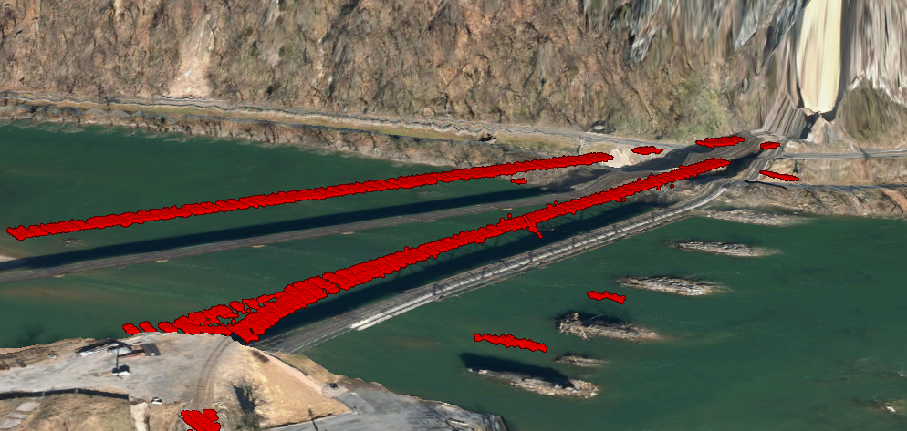
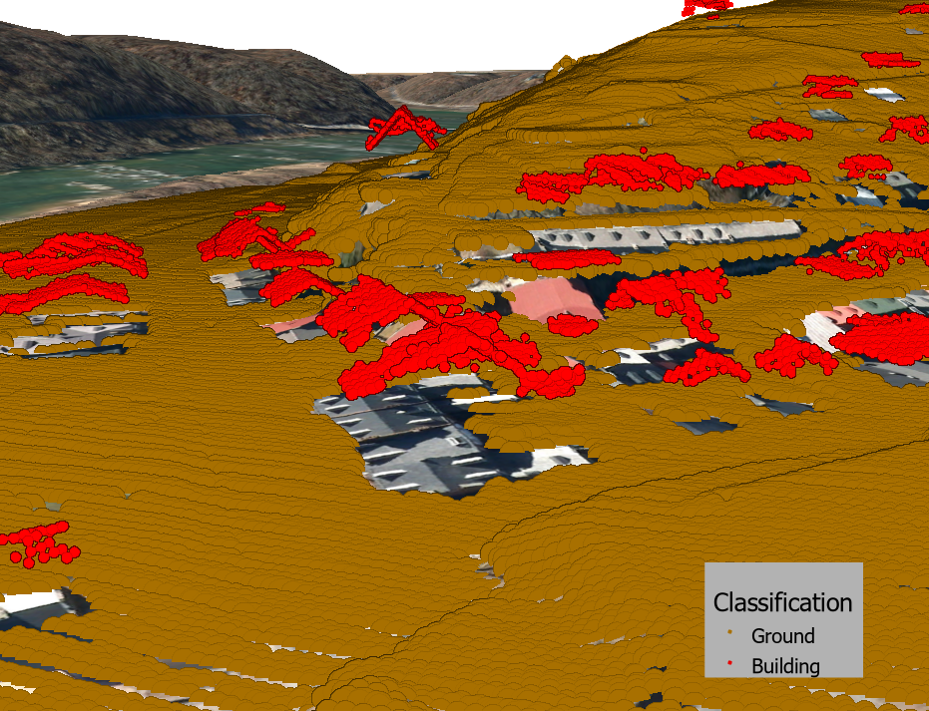
Notes:
Ground classified LiDAR and Building Classified LiDAR
Bridges were misclassified as Building but did not need to be fixed given the 3D Building Footprint extraction methods need footprints to be created. Bridge do not have footprints so LAS points would be ignored

Slide 23
M3: Editing Building Footprints
National scale dataset was created by Microsoft
Many footprints are missing or inaccurate
Footprints intersecting with the 1-percent annual chance floodplain were manually added or corrected
Notes:
Semantic segmentation deep learning
Polygonization of imagery for footprint extraction
Although there is a 99.3% building match precision, this is on a national scale
Updated to match the shape of the structures within the leaf-off imagery
Whole study area would be time consuming

Slide 24
M4: Joining Additional Data with Building Footprints
Building footprints, on their own, lack useful attribute information
Tabular joining and Spatial joining between datasets
Add Surface Information Tool
  Building heights attributes were calculated using these values
    Ex. Max Building Elevation – Minimum Ground Elevation = Building Height
Notes:
Tabular join: building count and BLRA Excel table;
Spatial join: Spatial join between building footprints and building count data that intersected with footprints
Add Surface Information Tool
Adds elevation information from LiDAR data to the building footprints
Minimum ground elevation
Minimum building elevation (Base of the structure’s roof)
Maximum building elevation (Top of structure’s roof)

Slide 25
M5: 3D Building Footprint Extraction
Realistic Building footprints
  ESRI LAS Building Multipatch Tool with simplification tolerance
  WhiteboxTools LiDAR R toolset
    LidarThin function – thins LiDAR point cloud by reducing the point density LidarThinHighDensity function – thins points within high density clusters
    LAS Building Multipatch Tool was executed without a simplification tolerance
Notes:
Realistic footprint: looks like the actual shape of the structure, correct dimensions, and rooftop shape
ESRI Las Building Multipatch: Creates a 3D multipatch dataset based on:
Dimensions of the 2D building footprints
Height of the building classified LiDAR data
Minimum Ground Elevation
Simplification tolerance
LidarThin: based on resolution (size of the square area to evaluate nearby points) and method used to reduce points (ex. First return, last return, lowest elevation, highest elevation, nearest elevation)
LidarThinDensity: based on resolution and maximum point density (points/m³)

Slide 26
If the first two options fail, “Sugar Cube” building footprints
  3D Extrusion of 2D data based on elevation height attributes
  Could be converted to multipatch data but was not necessary
Risk of issues for creating realistic building footprints for intricate rooftops
  Balance between data accuracy, under simplification, and oversimplification
Notes:
Sugar Cubes – simple representations of the structure;
Conversion to multipatch but would look the same
Issues: is the data accurate enough? Under simplifying over simplifying

Slide 27
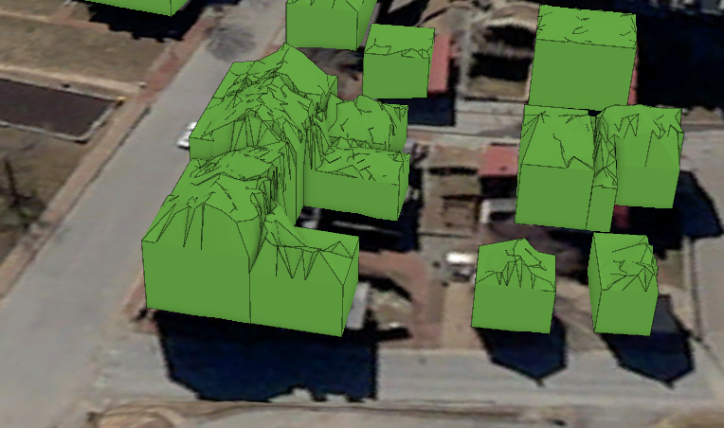
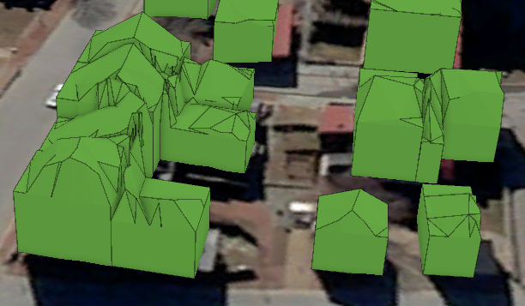
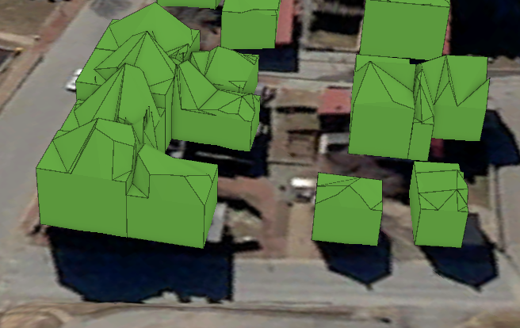
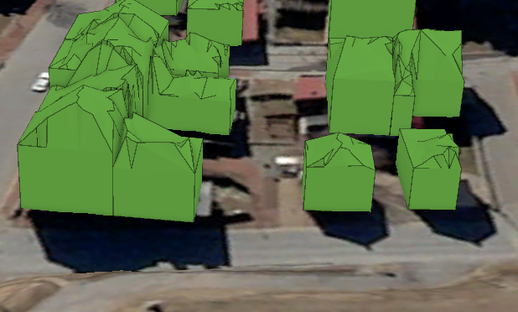
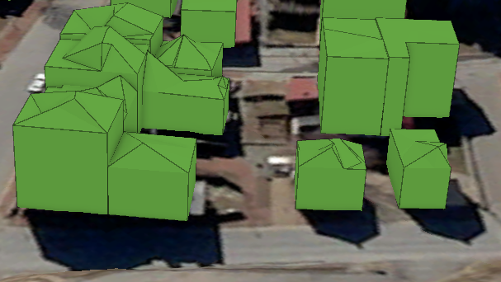
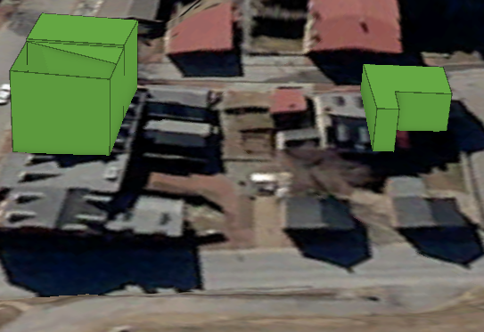
No tolerance
2m tolerance
5m tolerance
LidarThin 1m res, Highest method
LidarThin 3m res, Highest method
LidarThin 5m res, Lowest method
Notes:
First row is the LAS Building Multipatch tool outputs : Any higher simplification tolerance provided no noticeable differences
2nd LiDARThin
Results show not enough thinning, show data inaccuracies and noise; overthinning with gaps in multipatch geometry

Slide 28
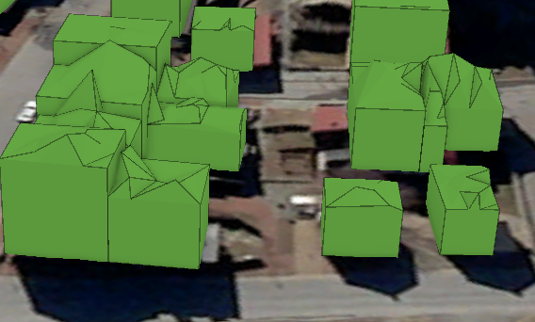
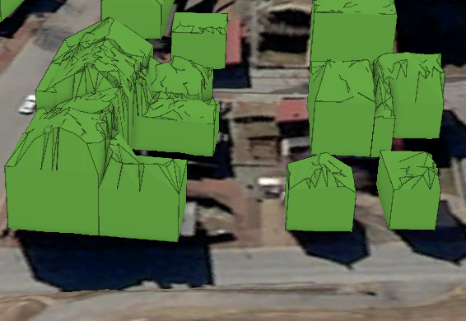
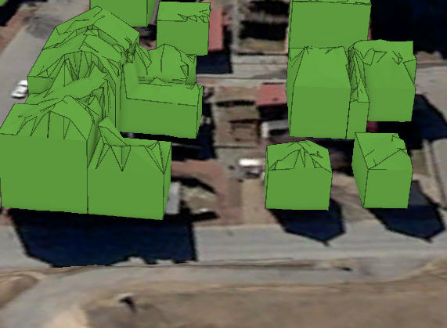
LidarThinDensity
1m res, 1 pt/m³ density
1m res, 5 pts/m³ density
5m res, 1pt/m³ density
Notes:
Preferred setting appeared to be 1m res and 1m density, any other options are undersimplified
Uncanny valley

Slide 29
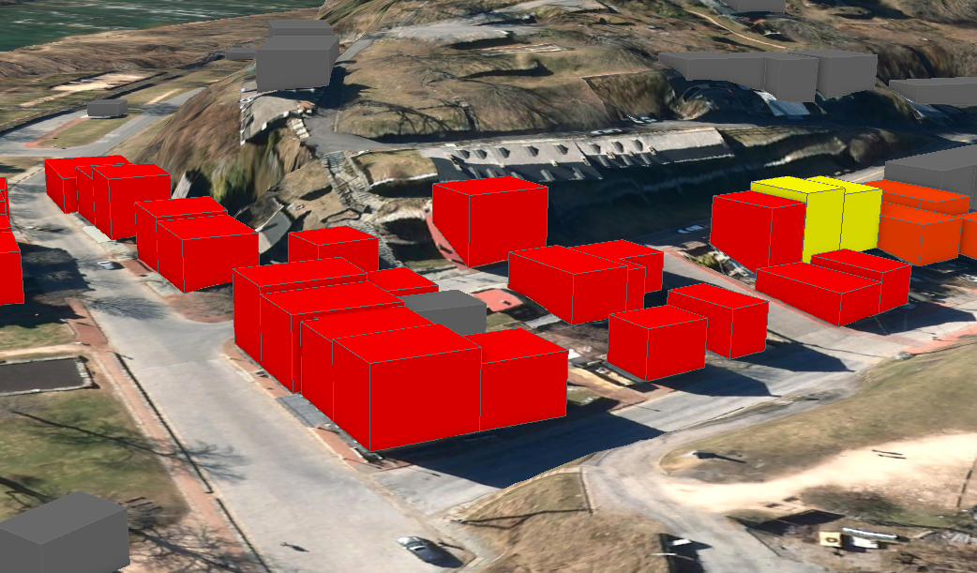
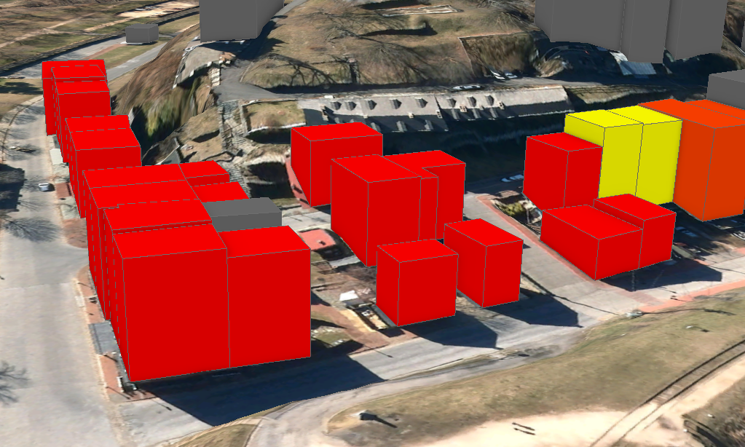
Base of Roof Extrusion
Top of Roof Extrusion
Notes:
For sugar cubes, represented the height of the structure well; some versions of the realistic footprint outputs distorted the heights of the structures; (comparing to a projection) if I cannot maintain both, height was more important to maintain over shape
Moved forward with the Base of Roof Extrusion <- Top of the livable area of the structure
Top of Roof<- Make structures appear like skyscrapers; deceiving given the highest point is most like a chimney or ridge of the rooftop

Slide 30
M6: Creating “3D”Water Depth Grids
Need for conversion of 3D flood depth grid
  However, raster data cannot become 3D
Options include conversion to extruded polygons or multipatch data
Creation of custom water surface (flood depth grid + ground elevation) for flood depth grid to be “3D”
Flaws in the flood depth data
To avoid “floating” depth grid, a “walled” depth grid was created
Notes:
Similar to imagery conforming to ground elevation
Other options: Not preferred <- Loss of accuracy due to rounding or truncating of data; if not too many features would be and would be difficult to work with in ArcGIS Pro
Flaws in data: Erroneous raster edge cell values (especially in Harpers Ferry); flood data should decrease to near 0 for edge cell values; this is not the case in some areas; this creates a floating raster depth grid

Slide 31
Smoothing of the flood depth grid edges
20m buffer of floodplain boundaries
  Converted to a raster based on newly created attribute
Flood depth grid and floodplain buffer raster grid were mosaiced
Water surface was created
Notes:
What I mean by “walled” , “enclose” the exposed area, extending the flood depth grid, and having this extended area with negative cell values so the edge of the flood depth grid will descend down and below the ground elevation
Smoothing: Resampled from 1m to 0.1m cell size
Clipped to floodplain boundaries
Buffer: Created; Value of -50; the use of a negative number is to eventually extend the flood depth grid below the ground surface
Mosaic: Maintained 0.1m cell size and 32-bit float type
Flood depth grid values tool priority
Water surface: Combined mosaiced flood depth grid with the DEM
Mosaiced flood depth raster was then set to the water surface elevation height

Slide 32
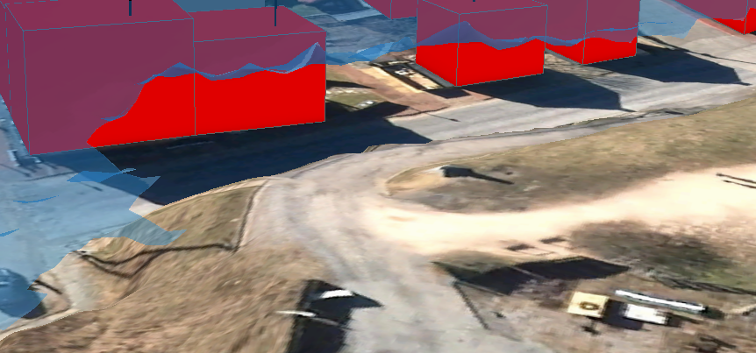
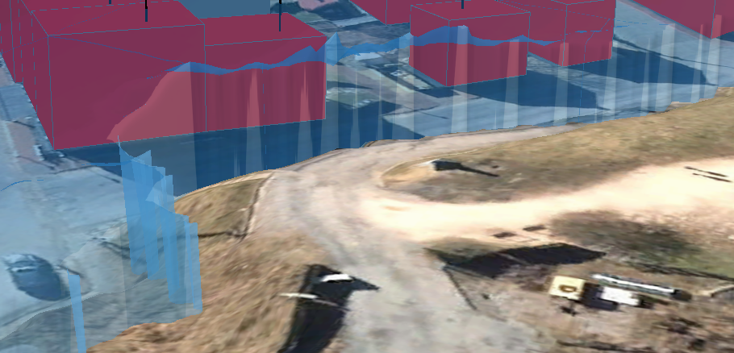
Notes:
Example near Harpers Ferry

Slide 33
M7: Symbolizing and Labelling Data
Symbology
  Flood depth grid
  3D Building footprints
Labelling
  Labels are not consistent in a 3D environment
  Limited number of labelling options for 3D data
  Workaround method using building count points for building footprints
    Two layers of the building count
      Anchor (Leader Line)
      Label
    Billboard effects
Notes:
Symbology
Flood Depth grid: blue continuous range (lighter is shallow; darker is deeper), 50% transparency
3D Building footprints: graduated color scheme based on the Building Damage percentage
Labelling
Especially Polyline and Polygon; more flexibility with points
Workaround method (treating the point dataset as the label and leader line for the building footprints
Anchor: Data is symbolized using a black 3D standing cylinder, extruded to an absolute height of n (e.g. 25m)
Label: : Data are given 100% transparency, labels are turned on, assigned the Building Damage in Dollars attribute, given an absolute height of n + 1 (e.g. 26m)

Slide 34
Points of Interest data created
  Workaround method
  Visibility range set
Streams and Roads
  Generate Points Along Line Tool
  Workaround method used without the anchor
Notes:
Points of Interest was created to identify locations within each community that residents may be familiar with
Visibility range: so this data and building count do not appear at the same time
Generate Points Along Line: Every 0.25mi
Anchor was not really needed given the roads and streams were clearly seen in the imagery

Slide 35
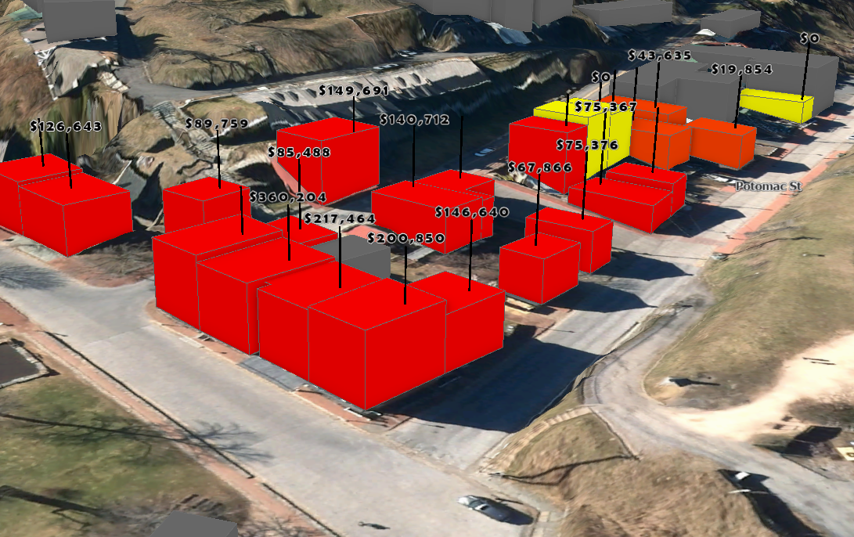
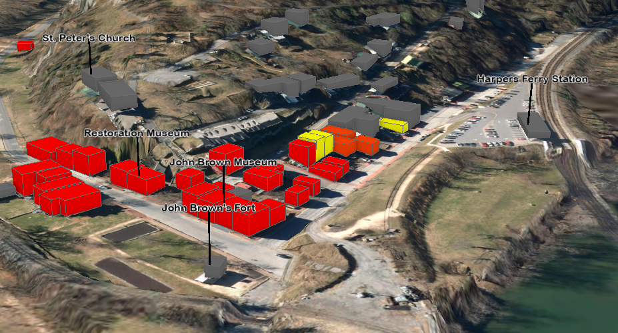

Slide 36
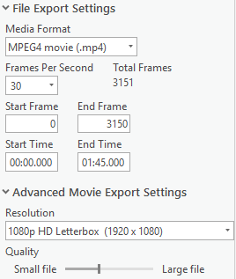
M8: Animation Creation and Exportation
ESRI Animations
  Video exportation settings
    Media format
    Frames per second (FPS)
    Resolution
    Quality (based on file size)
Comparison in video settings and computers used for export time and video quality
Notes:
ESRI Animations:
Videos of 3D Scenes (bring GIS content to life and to tell a story about the data)
“On Rails” Camera with Keyframes <- Move to different locations in the Scene, configure the camera direction, and set a keyframe, a path is created between each keyframe. Have the ability to decide how long it takes to get between Point A and B
Addition of overlays (legend, images, text)
Media format: Video export type
Resolution: Is the threshold; possible to have a 1080p video with low quality
Quality: changes the file size: higher quality videos will have high resolution and a large file size

Slide 37
5 total animations
Length: 1 to 2 minutes
Overlays: title, legend image, text that describes the labels
Media format: MPEG-4 Part 14 (mp4)
FPS: 30 and 60
Resolution: 1080p and 720p HD Letterbox
Quality: small file (0%), small to medium (25%), medium (50%), and large (100%)
Notes:
Settings for animations and export
Legend had to be created and imported into the animation as an image overlay

Slide 38
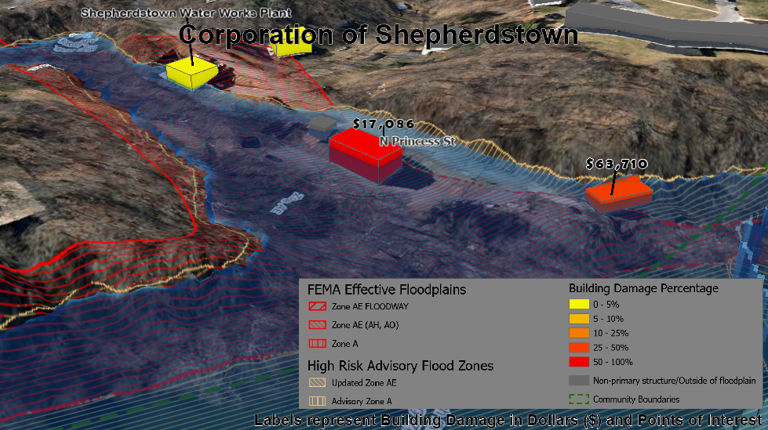
\\gistc-filesrv2\ftp\pub\RA\_resources\3Dflood\Jefferson_All_3D_Flood_2020_mp4.mp4
Notes:
Talk about the filming direction of the animations
Lower the frames, lower the quality the faster the export
However, all exports were slow (minimum 12-16 hours, max (high settings) 2-3 full days)
1080p, 60fps, low to medium quality
Preferred the more powerful computer
Video export times; preference of settings
Balance between export time and quality
“Walled” feature in the Harpers Ferry in Shepherdstown

Slide 39
M9: Web Application Development
Interactive, opposed to 3D community videos
Displaying of 2D and 3D data
Widgets
Experience Builder and ArcGIS Online
Notes:
Interactive: community videos are limited to starting and stopping video, selecting data and viewing attributes, turning on and off data and changing visibility
Although the goal was to display in only 3D; the possibility of creating a product that syncs a 2D WebMap and a 3D WebScene
Can be accomplished using ArcGIS Javascript API, but more recently the Experience Builder (came available this year); similar to Web AppBuilder allow for the use of 2D and 3D data, currently less widgets

Slide 40
Symbology and data are similar to Animations
  Excluding building footprints and flood depth grid
Flood Depth Grid cannot use custom elevation for ArcGIS Online
  Raster to Polygon to Multipatch
  Interpolate Polygon to Multipatch Tool
Published from ArcGIS Pro to ArcGIS Online
WebMap (2D) and WebScene (2D and 3D)
Added to the Experience Builder and then customized
Notes:
Building footprints were exported to multipatches given 3D extrusion of 2D data it appeared as not possible (not the case)
Flood depth grid – same method with the animations could not be used (custom elevation)
Raster to Polygon to Multipatch - Conversion of the flood depth grid to a polygon with truncated depth values then converted to a multipatch (Layer 3D to Feature Class tool)
Interpolate Polygon to Multipatch Tool – Creates a surface-conforming multipatch feature by draping floodplain boundary over the surface (Surface had to be a Triangulated Irregular Network (TIN) . Flood depth grid converted to polygon so depth values are maintained but values were needed to be truncated
Data symbology and attribute table were customized for both 2D and 3D data and published to ArcGIS Online from ArcGIS Pro
A 2D WebMap and 3D WebScene were created and data was added to each
Both were then added to the Experience Builder and synced together

Slide 41
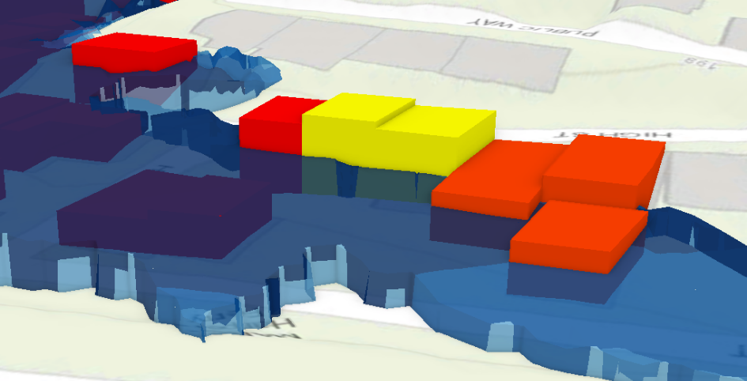
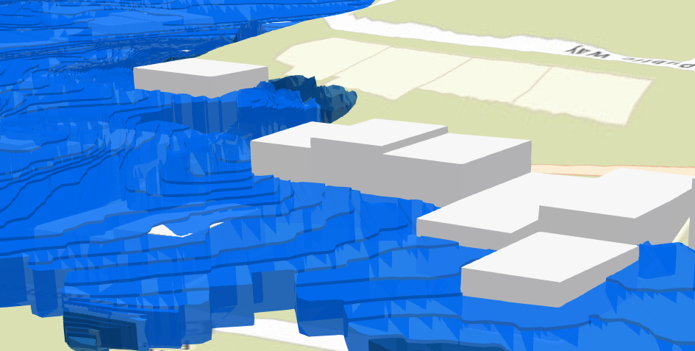
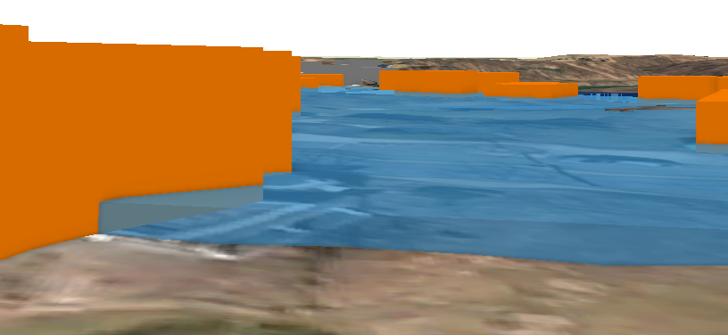
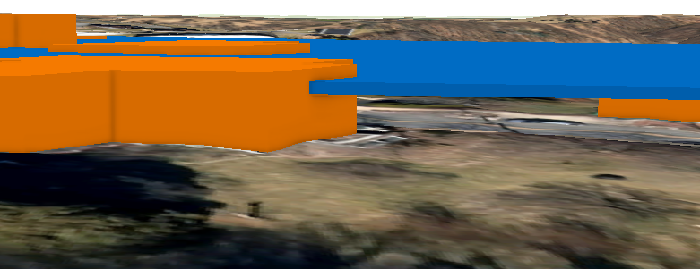
Notes:
Both methods truncated the flood depth values to the closest foot; some accuracy loss
First Image – Raster to Polygon to Multipatch method
It doesn’t look awful, but a stepped pattern is created given the data is discrete. Quality decreases in area of less dramatic changes in water depth
Second Image – In Shepherdstown, there is a large area with 2-3 feet of water depth. When converted to a multipatch, the feature does not conform to the elevation surface, just simply extruded (absolute height), some areas it appears on the ground while others it appears 10-20 feet in the air
3rd image – Interpolate Polygon to Multipatch, appears much smoother in appearance; additionally, even though polygon depth values were truncated, the created water surface has the original float type values
Attribute information may say 3 ft but the actual geometry Z height is 3.54 ft or a similar value.
4th image – This method creates a multipatch that actually conforms to the ground elevation

Slide 42
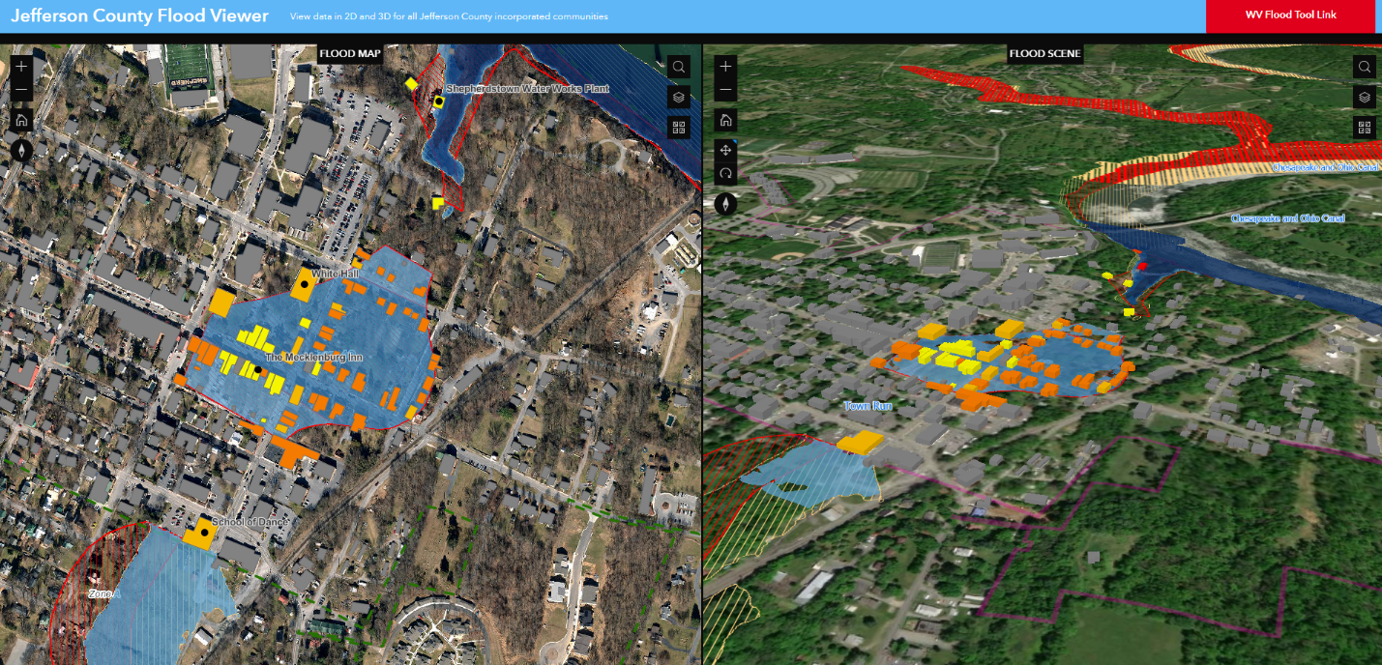
https://experience.arcgis.com/experience/5493618dcccd4dec912e106affc25005
https://wvu.maps.arcgis.com/home/webscene/viewer.html?webscene=48d27ace33ef495e8865fe94851dde99
Notes:
Screenshot of Web Application

Slide 43
M10: Documentation and Procedures
Procedure Manual Developed
  Detailed all methods, excluding web application development
Produced for replicability for the other 54 WV counties
Notes:
Used within the Tech Center for future workers

Slide 44
Result Summary
Sugar Cube building footprints chosen
  Realistic footprints failed to replicate rooftops
“Walled” and water elevation conforming flood depth grid
Workaround method for “3D” Labels
Community Videos
  WVU G&G Computer
  MP4, 1080p, 60 FPS, and small to medium file (25%)
  Slow exports no matter the settings
Jefferson County Flood Viewer (Experience Builder)
  Works great, limited on widgets, WebMap and WebScene linked
35-page procedure manual
Notes:
For sugar cubes, represented the height of the structure well; some versions of the realistic footprint outputs distorted the heights of the structures; (comparing to a projection) if I cannot maintain both, height was more important to maintain over shape
Limitations on 3D Labelling; best possibly result given the limitations
Tech Center computer: normally close to maxing out on CPU usage, unavailable to execute other tasks

Slide 45

Objectives Evaluation
Create new and adjust current 2D Building footprints to accurately match the shape of structures overlapping with the 1-percent annual chance floodplain
Use ESRI based tools and R libraries for converting 2D building footprints to 3D features
Transform the 2D 1-percent annual chance floodplain depth grid into 3D data
Employ ESRI ArcGIS Pro to symbolize and label data for more effective communication in a 3D environment
Use ArcGIS Pro to create exported video animations of each 3D visualization community scene
Use ArcGIS Online to create a web application to interact with the 3D data in each community
Establish a workflow for replicability that is both detailed, structured, and time efficient
Notes:
Given the data software limitations I would call it a success

Slide 46
Limitations
Data Inaccuracies and Inconsistencies
ESRI Software
Future Research
Non-ESRI Open-Source Software
Voice-over Narration
LiDAR Derived Footprints
3D Extruded 2D Data for WebScene
Community Outreach and Feedback
Notes:
Limitations –
Data Inaccuracies – Building footprints – manually matching to the leaf-off imagery; however, needed to be matched with the LiDAR point cloud, potentially why the 3D multipatches were poor
Flood depth grid – Harpers Ferry shows many issues with flood depth grid edge values, potential issues in the detailed study that were not corrected may have caused this issue
ESRI software – Examples include lack of 3D functionality with labelling, elevating the raster grid on ArcGIS Online. Slow feature drawing performances, lengthy export times. Some issues such as labels have not been corrected since at least 2018
Future Research –
Non-ESRI Open Source – I have a bias toward ESRI products, one of the reason I used it for the study. However, the software is not the end all be all of software and open source GIS software (QGIS) can move much quicker at resolving issues even if it requires a bit more research in finding tools. I ventured into some R programming but still brought the results back to an ESRI platform.
Open source non-GIS software (Unity or Unreal Engine) may have the best possibility for 3D creation; with detailed textures, physics, and possibility of integration of AR and virtual reality
But this type of software cannot handle GIS data; cannot easily recognize the coordinate system and attributes linked to the geometry; it can be achieved but time consuming and requires a large learning curve. Example of Mapbox: Unity plug-in for the retention of UTM coordinates and attribute information for GIS data. Not as familiar of how well this works
Voice-over Narration – would provide additional information to the viewer (telling the story with audio of the data and the community) and allow users that are visually impaired to experience as well, help guide the viewer to interesting features; Research is beginning in the Tech Center for the animations in the next couple of weeks
LiDAR Derived Footprints – I was trying to match up the footprints with the imagery when I should have been matching the footprints with the LiDAR; however, issues would still occur and would be very time consuming; potentially provide a better result for footprints; edges would theoretically match up between the 2D footprint and the edges perfectly; additionally, more recent and more detailed LiDAR would be beneficial
3D Extruded 2D Data for WebScene – I originally thought 3D Extrusion of 2D Data was unavailable in ArcGIS Online, but was incorrect. There is the potential option for improving labels in the WebScene by using 3D extruded data .
Community Outreach and Feedback – So once when the videos web application are accessed and viewed by the communities, what then? Are they going to like them. Will they perceive these as a threat to the future of their community. “How can we have new businesses and grow if these videos show massive flooding in the town?” Messaging is key from the start. The additions of disclaimers and including positive content such as zoom to a structure that was elevated to show how flood preventive construction measures can limit damage to the structure.

Slide 47
Acknowledgments
Aaron Maxwell
Kurt Donaldson and the rest of the WVGISTC
Maneesh Sharma
Caleb Malay, David Coleman, Liz Hanwell, and Rachel Yesenchak, and Rachael Taylor
Jamison Conley
Thank you!
Notes:
Aaron Maxwell – signing off as my committee chair after Dr. Hong departed and being a great resource throughout my undergraduate and graduate studies
Maneesh Sharma – staying on my committee after the transition from my thesis to project; providing plenty of input for my research; being a great co-worker
Jamison Conley – agreeing to apart of my committee
Kurt and the Tech Center – keeping me employed and funded since 2017; the Tech Center is the reason why this project could happen
Caleb, David, Liz, and Rachel Yesenchak – for providing feedback for this project’s many products as well as a lot of support
Rachael Taylor – going through the highs and lows of grad school together and happy to be able to graduate at the same time.

Slide 48
References
Ashley, S. T., & Ashley, W. S. (2008). Flood fatalities in the United States. Journal of Applied Meteorology and Climatology, 47(3), 805-818.
FEMA. (2019). Flood Insurance Reform. https://www.fema.gov/flood-insurance-reform on October 14, 2019.
Goble, M., & Wright, L.. (2018). Conduct Clearing Operations with Military Tools for ArcGIS. ArcGIS Blog. Access at https://www.esri.com/arcgis-blog/products/arcgis-pro/national-government/conduct-clearing-operations-with-military-tools-for-arcgis/?adumkts=product&adupro=ArcGIS_Pro&aduc=email&adum=list&utm_Source=email&aduca=ArcGIS_Pro_Announcements&aduat=newsletter&adut=308027-ArcGIS_Pro_News_-_Winter_2018-2019&adupt=community&sf_id=701f2000000rpgnAAA&aducp=newsletter_tertiary_body_cta on October 19, 2020.
Highfield, W. E., & Brody, S. D. (2012). Evaluating the effectiveness of local mitigation activities in reducing flood losses. Natural Hazards Review, 14(4), 229-236.
LaFone, H. F. & Harris, T. M., (2019) (in press). Communicating flood risk in Appalachia through 3D GIS visualization and Virtual Reality
Parker, D. J. (2014). Floods. Routledge.
Stevens, A. J., Clarke, D., & Nicholls, R. J. (2016). Trends in reported flooding in the UK: 1884–2013. Hydrological Sciences Journal, 61(1), 50-63.
University of Colorado Boulder Center for Science and Technology Policy Research (2019). Flood Damage in the United States, 1926-2003 A Reanalysis of National Weather Service Estimates. Accessed at https://sciencepolicy.colorado.edu/flooddamagedata/use_interpretation.html on October 7, 2019
University of Nebraska Omaha Cartography and GIS Laboratory. (n.d.). Cartographic Abstraction and Generalization. Access at http://maps.unomaha.edu/Peterson/carta/Notes/CARTABS.HTM on December 4, 2019
West Virginia Division of Homeland Security and Emergency Management (DHSEM). (2018). 2018 West Virginia Statewide Standard Hazard Mitigation Plan. Accessed at https://emd.wv.gov/MitigationRecovery/Documents/WV%20State%20Hazard%20Mitigation%20Plan%20FINAL%2011-2018.pdf on November 19, 2020.
West Virginia GIS Technical Center (WVGISTC). (2020). WV Flood Tool. https://www.mapwv.gov/flood/map/.

Slide 49
Questions?

