Slide 1
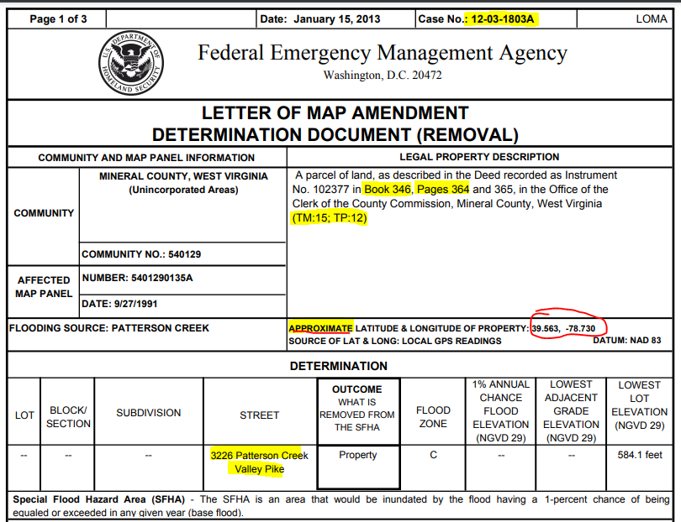
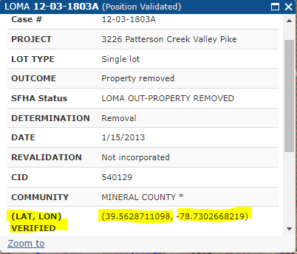
LOMA Coordinate and Address Inaccuracies
LOMA 12-03-1803A
Verified LOMAs Coordinates on WV Flood Tool
FEMA should update LOMA latitude/longitude with more accurate coordinates available from WV Flood Tool
Old Street Address 3226 Patterson Creek still listed in Tax Assessor’s Database. Correct E-911 address is 3942 Patterson Creek Valley Pike

