Slide 1
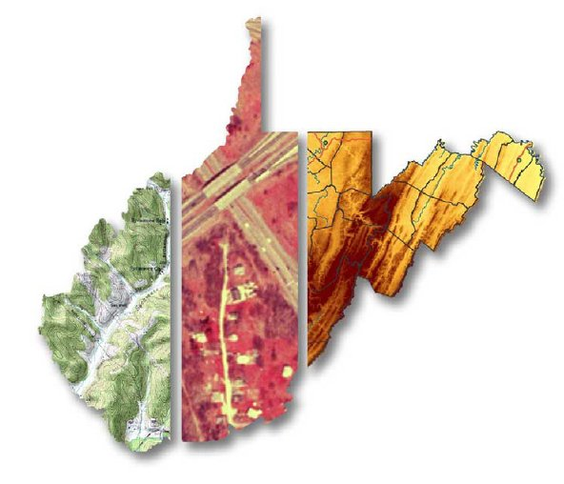
GIS Data Development
Kurt Donaldson, GISP, CFM
Member, Property Valuation Training & Procedures Commission
Manager, WV GIS Technical Center, WVU (kdonalds@wvu.edu)
5/20/2025 WV Assessors Conference

Slide 2
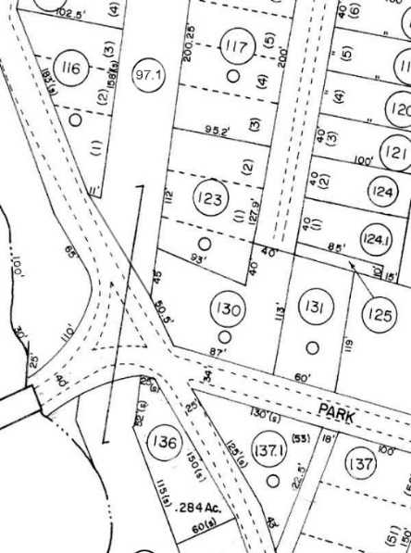
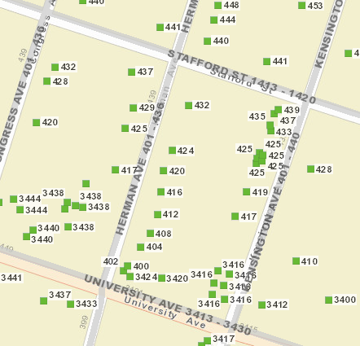
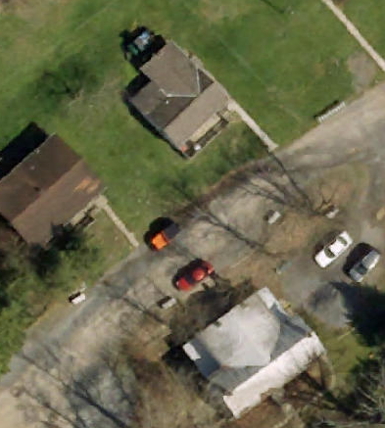
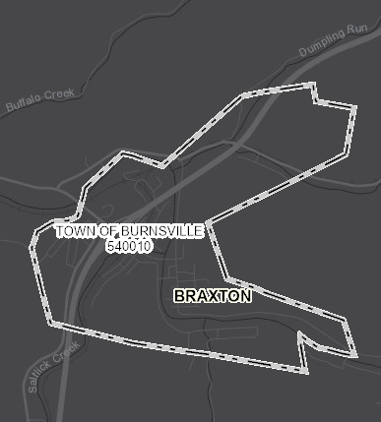
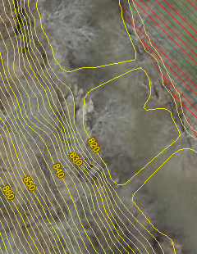
Key Reference Layers: GIS Data Development
Parcels Addresses Aerial Imagery Boundaries Elevation
Parcel geometry not misaligned or shifted
Assessment attributes of improvements or structures tagged to correct parcel
E-911 addresses current and accurate
County Leaf-off imagery < than 5 years
Current and Accurate Cadastral, Legal, & Election Boundaries
Statewide 1-meter DEM and 1-ft. contours.
Local and State Spatial Data Infrastructures

Slide 3
Data Development & Integration
  Local-Level → Data Development
  State-Level → Integration

Slide 4
State-Level Integration
Parcels
Addresses
Imagery
Boundaries
Elevation
SOURCE:
County Assessors
WV Property Tax Division
Statewide Master Parcel File / IAS
SOURCE:
Local Addressing Offices
WV Emergency Management Division
Statewide
Addressing & Mapping System
SOURCE:
County Offices
WV GIS Technical Center
Statewide
Leaf-Off Imagery Service
SOURCE:
Local Offices, County Clerks
WV GIS Technical Center
Statewide Boundary
Web Services
SOURCE:
Local, State, Federal
WV GIS Technical Center
Statewide Elevation
Web Services
LOCAL
DATA SOURCE
STATE INTEGRATION
STATE
WEB SERVICES
(WVGISTC)
State-level integration allows for statewide mapping products and services.
At the state level, WVGISTC creates and hosts these framework spatial data layers.

Slide 5
Map Reference Layers
Aerial Imagery
Accessibility to quality, up-to-date aerial photography

Slide 6
Statewide Imagery Contract (2019-25)
Unit Costs: All counties using the state contract typically acquire imagery at 4- or 3-inch pixel resolution.
Pixel Resolution (Detail Level) | 3-inch | 4-inch | 6-inch | 12-inch
Cost per square mile^{1,2} | $106 | $77 | $62 | $42
Map Scale | 1” = 50’ | 1” = 67’ | 1” = 100’ | 1” = 200’
Horizontal Accuracy (ASPRS 1) | 0.5 feet | 0.66 feet | 1.0 feet | 2.0 feet
¹ 2.5% annual inflation rate increase ² The county border buffer is 1000 feet
Vendor: Thrasher Group.
Flying Season: February to Mid-April (during leaf-out and no snow conditions).
Non-Exclusive Contract: County offices still had the option to contract with other companies for the same services.
Public Domain: State-contracted “top-down” aerial imagery resides in the public domain.
Oblique Imagery: Not part of contract; oblique imagery usually requires proprietary software.

Slide 7
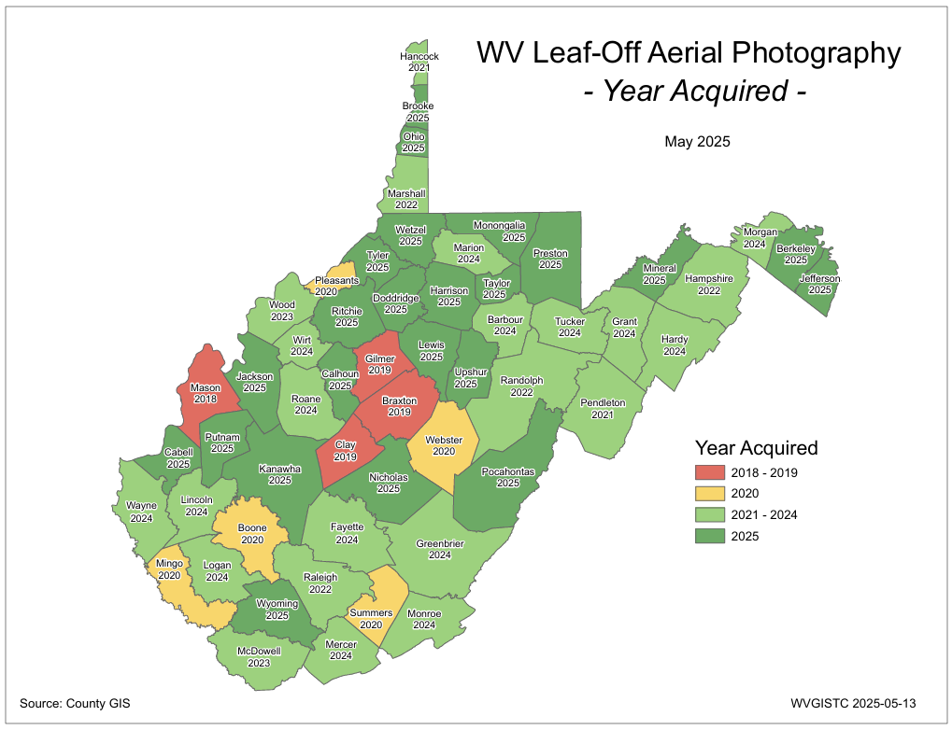
County Aerial Imagery: Year Acquired
Trend: More counties are routinely purchasing aerial imagery
Some counties fly annually or every two years
Ideally, leaf-off imagery should not be older than 5 years
Make sure “top-down” imagery is licensed to county for sharing purposes
PDF Map

Slide 8
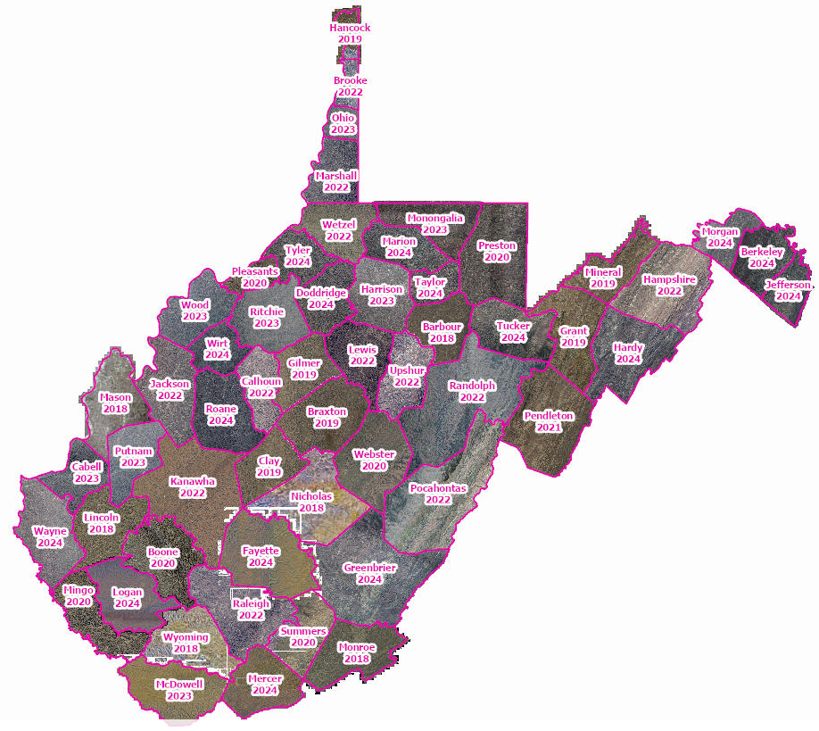
Statewide Mosaic
West Virginia does not have a statewide orthophoto program
WV GIS Technical Center creates a statewide mosaic of county imagery from different county acquisition dates, formats (e.g., GeoTIFF, MrSID), and resolutions
WV Leaf-Off Mosaic Imagery Map Service
PDF Map

Slide 9
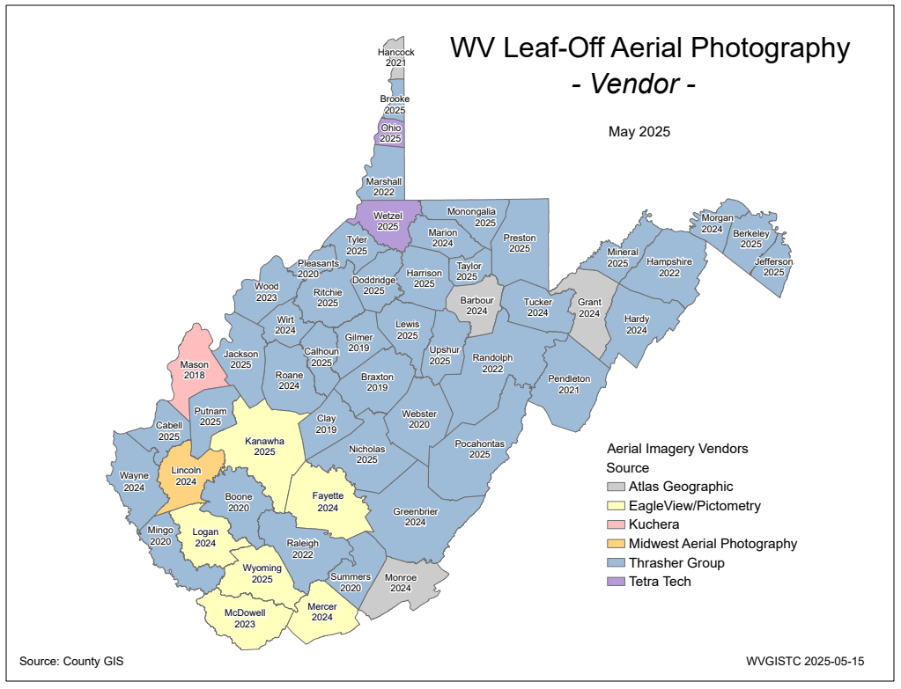
County Aerial Imagery: Vendor
6 companies have acquired imagery for counties
Majority of counties have been acquired via the state contract
Select counties for 2019-22 received funding support through HMGP grant
PDF Map

Slide 10
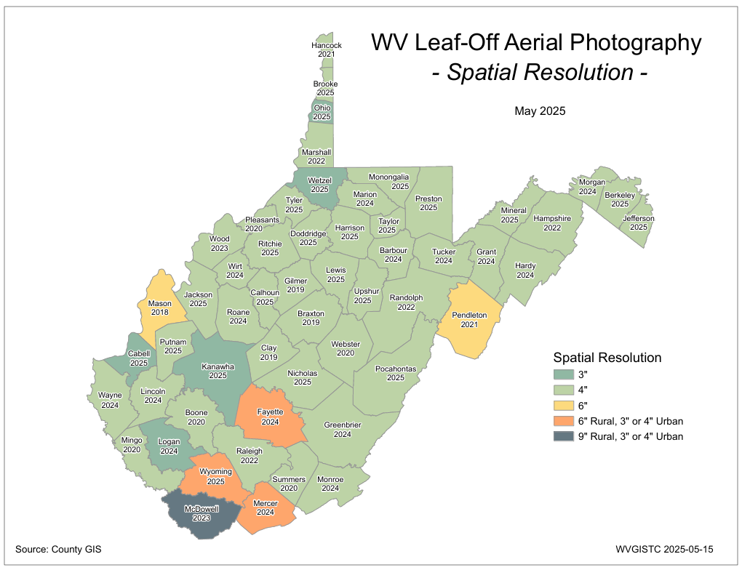
County Aerial Imagery: Resolution
Aerial Imagery of most counties (98%) is captured at a countywide spatial cell resolution of 6 inches or higher
Trend: Past decade spatial resolution has increased from 12” to 6”, with more counties flying 3”
A target spatial resolution of 6” is recommended for counties that can afford this level of detail
Select counties for 2019-22 received funding support through HMGP grant
PDF Map

Slide 11
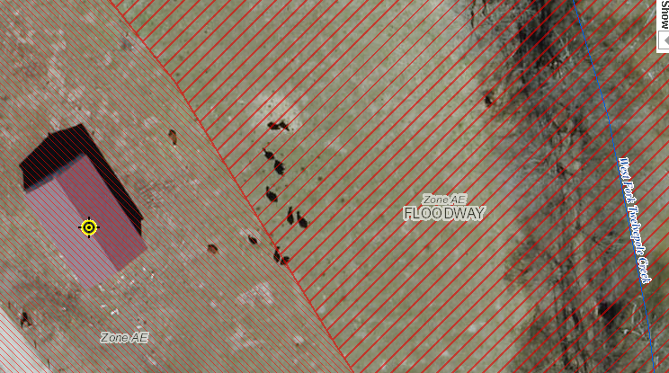
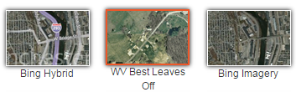
Resolution (Cows in Wayne Co.)
4-Inch Pixel Resolution
https://www.mapwv.gov/flood/map/?wkid=102100&x=-9176629&y=4583554&l=13&v=1
Choose WV Best Leaves Off Base Map
Cows in the Floodway
West Fork Twelvepole Creek, Wayne County

Slide 12
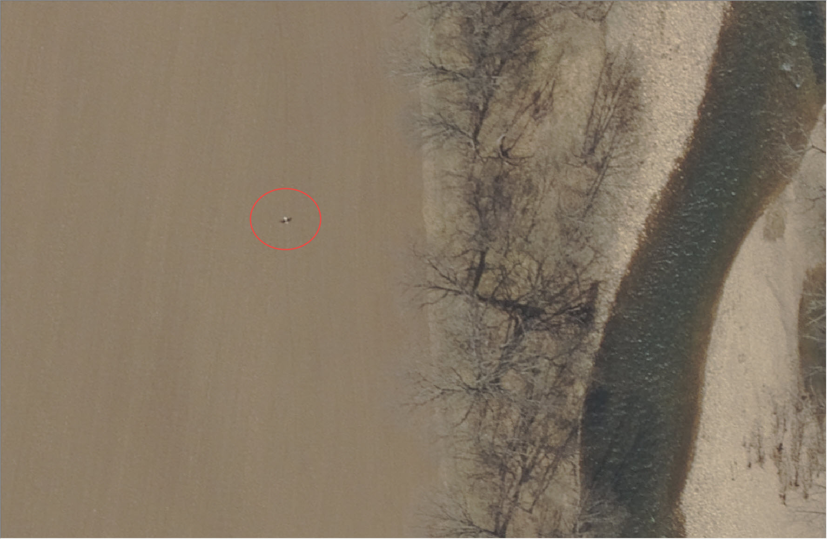
Resolution (Eagle in Pendleton Co.)
6-Inch Pixel Resolution
Bald Eagle in Pendleton County

Slide 13
Map Reference Layers
Parcels / Assessment Records

Slide 14
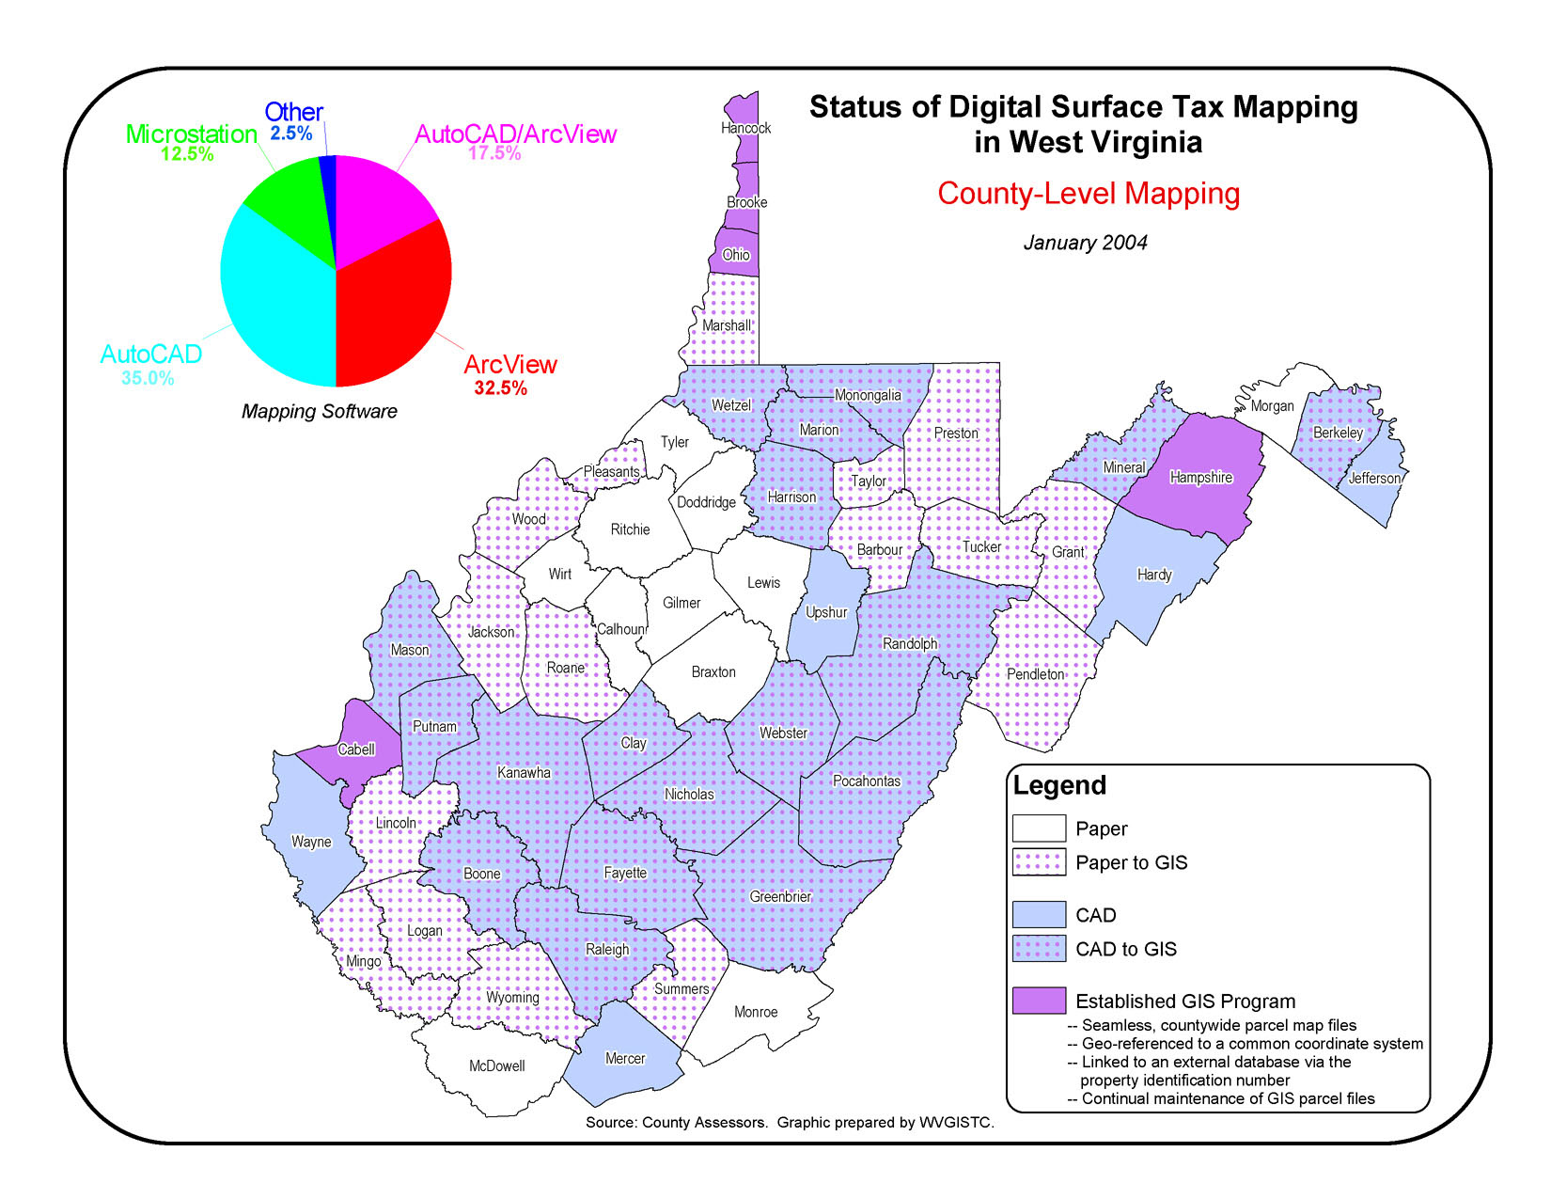
Digital Parcel Mapping in 2004
January 2004
In 2004 only five counties had GIS parcels.
Early digital parcels systems were CAD and not GIS.
GIS ADVANTAGE
Geographic Information Systems (GIS) link to IAS
By 2021 all 55 counties had converted their tax maps from paper to digital

Slide 15
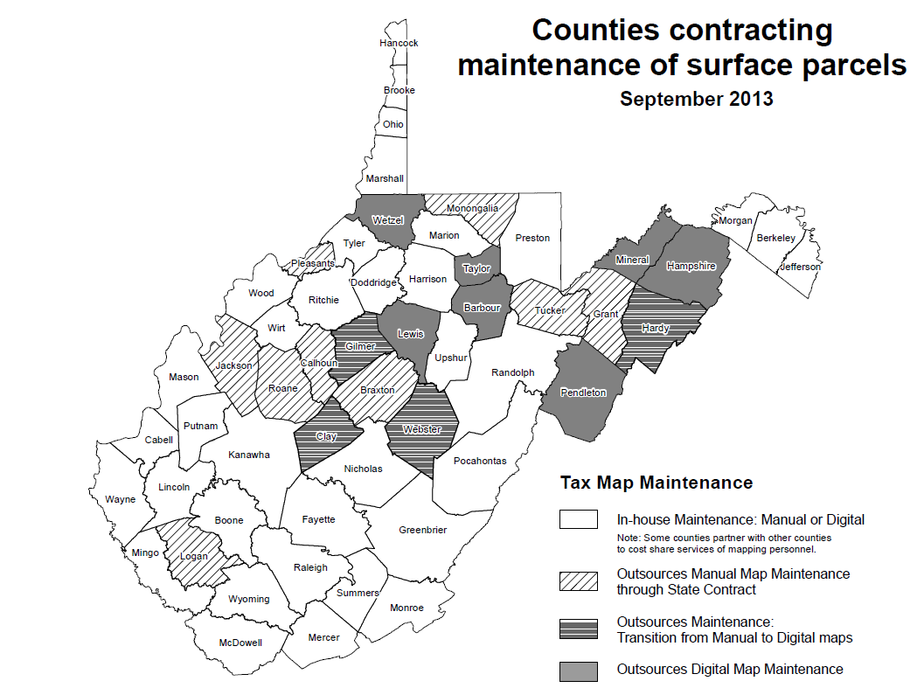
Tax Map Maintenance in 2013
In 2013, 20 counties outsourced their tax map maintenance
In 2025, 37counties outsource their tax map maintenance

Slide 16
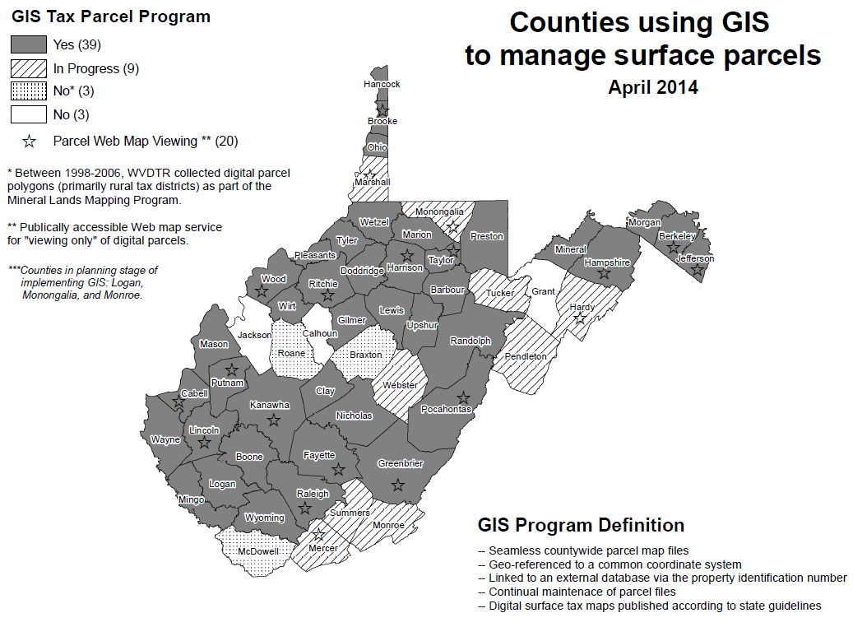
Digital Parcel Mapping in 2014
In 2014, 39 counties had GIS parcels
By 2021, all 55 counties had converted their tax maps from paper to digital

Slide 17
In 2015… Future Mapping 15-YR Predictions
All 55 counties will have adopted GIS mapping
  Successful State Digital Maintenance Program
  Digital Conversion Funding Support from State
The Property Tax Division will have integrated all 55 counties into a seamless GIS database linked to the IAS and viewable to authorized users
Map maintenance and publishing standards for manually drafting paper tax maps will be dropped
Funding from FEMA Grant (2019-2021)
Open Public Access
Revised Tax Map Procedural Rule 189-3 standard needs to be published

Slide 18
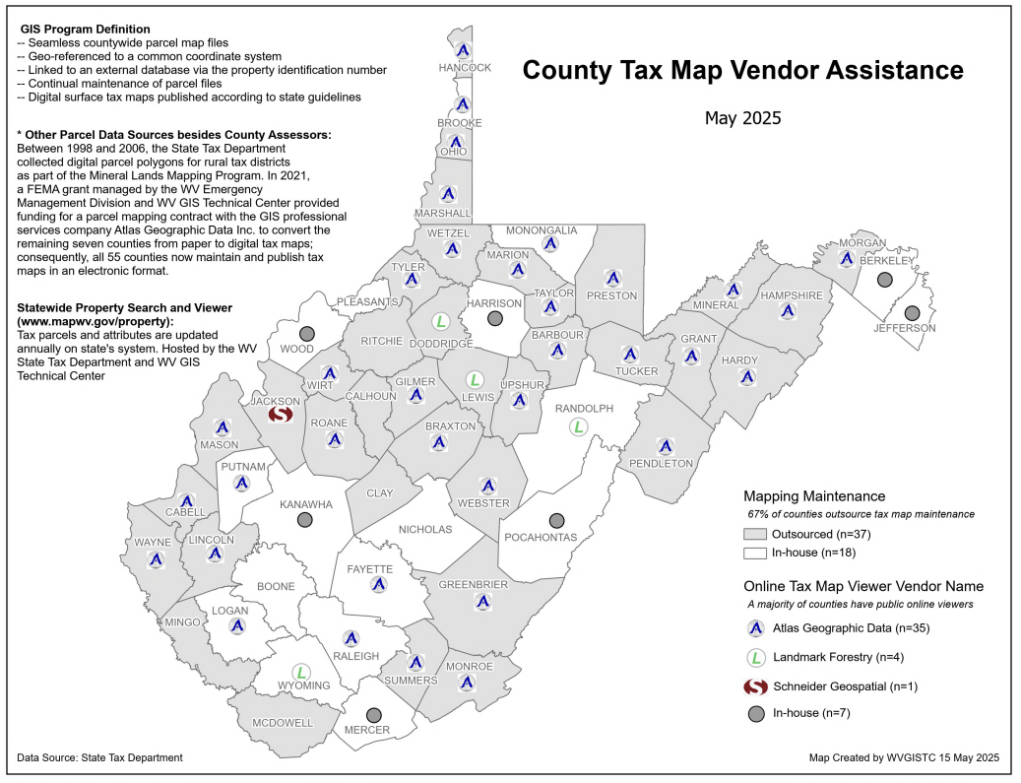
Digital Parcel Mapping in 2025
COUNTY TAX MAP VIEWER
85% of counties have public online viewers
MAP MAINTENANCE
All counties use GIS
67% of counties outsource map maintenance
Trend: More counties are outsourcing their tax maintenance
PDF Map

Slide 19
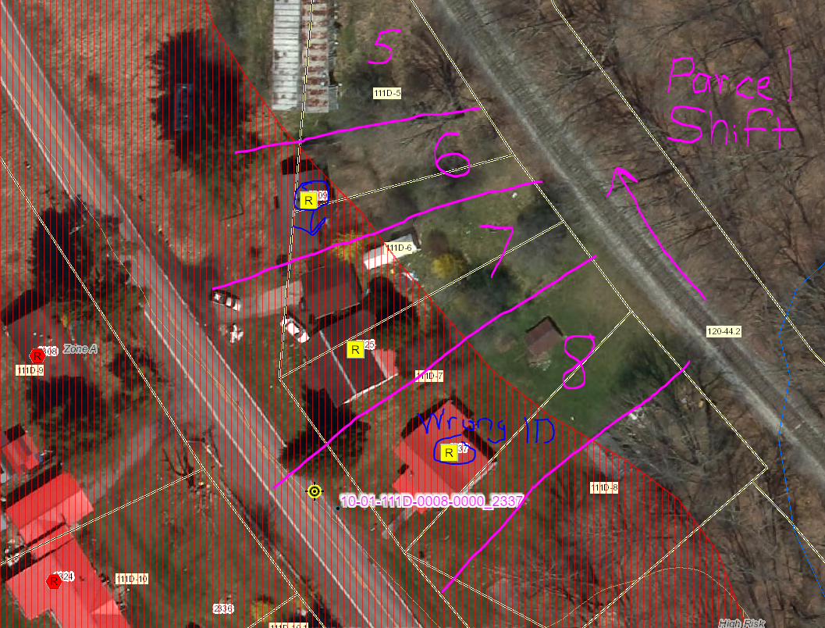
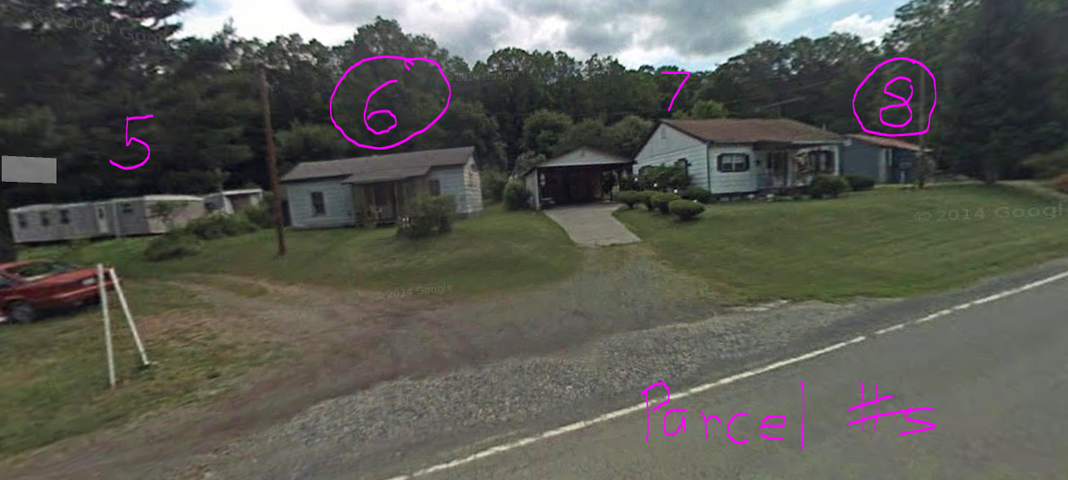
Tax Map Issue 1: Parcel Misalignment
Parcel Shift
Tax parcel geometry shifted or misaligned
Tax maps do not represent legal boundaries but should be remapped when parcels are shifted and do not align with the correct structure on accurately geo-referenced aerial photography

Slide 20
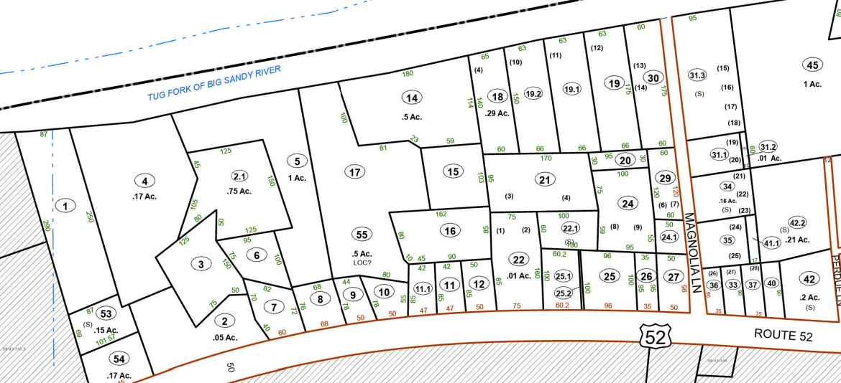

Tax Map Issue 2: IAS-Parcel Mismatches
USACE Tract 812FP: Switch IAS Records of Parcels 43A-17 and 43A-11
USACE Tract 811FP: Copy IAS Record IAS 43A-11.1 to IAS Record 43A-12
USACE Tract 808FP: Replace IAS Record 43A-22 with IAS Record 43A-27
USACE Tract 809: Copy IAS Record/Geometry of 43A-24.1 to north end of 43A-22
Replace IAS Record 43A-25.2 with IAS Record 43A-22
IAS-Parcel Mismatches
Missing IAS records or parcel geometry
IAS records mapped erroneously to wrong parcel, or not tagged to parcel with location of improvement
USACE 2006 Nonstructural O&M Manual (Page 96)
809
807FP
811FP
808FP
813FP
812FP
817
816FP
814FP
826FP
824FP
Harry’s Market
819FP

Slide 21
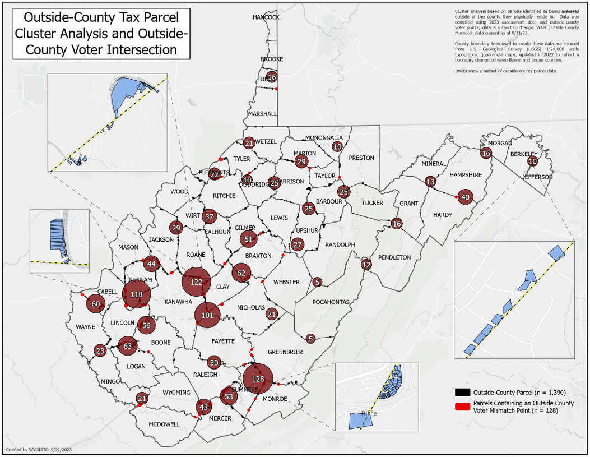
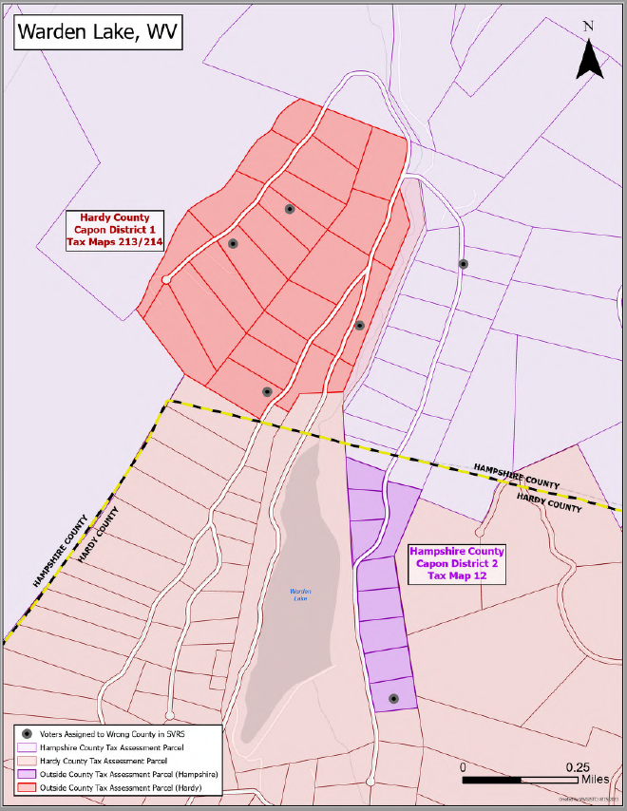
Tax Map Issue 3: Outside Parcels
Fall 2023 Audit
Hampshire County
Hardy County
Outside Parcels
Parcels assessed in the wrong county
Outside County Parcel Viewer | Graphic 1 | Graphic 2 |
Assessor & County Clerk Transfer Recommendations

Slide 22
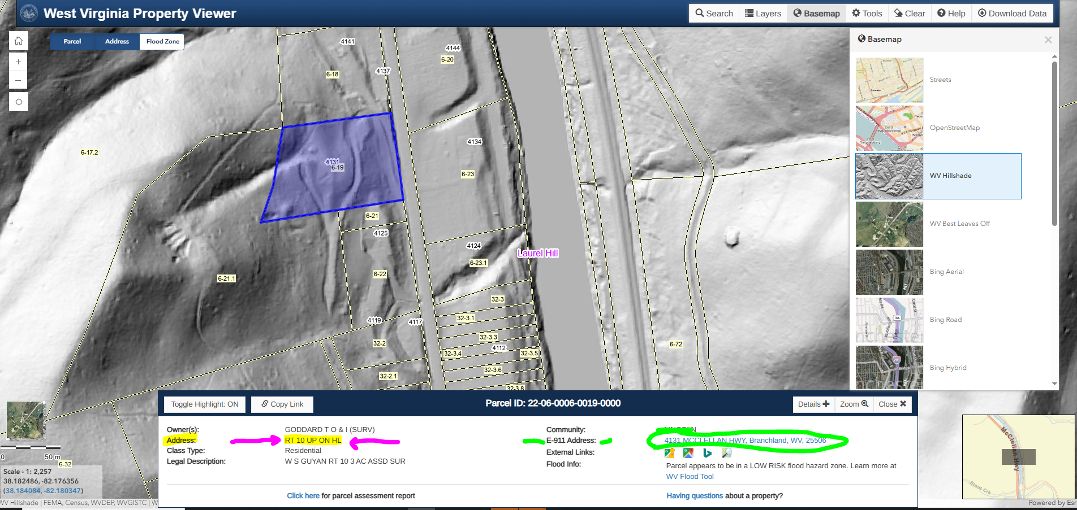
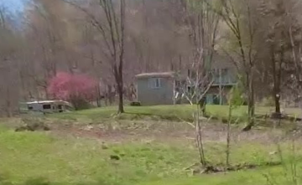
Tax Map Issue 4: E-911 Addresses
Parcel Physical Address
IAS physical address of parcel should be E-911 address

Slide 23
Daniel’s Privacy Law
§ 5A-8-24. Protection of personal information relating to judicial officers, prosecutors, and law-enforcement officers. Effective: July 9, 2021
When we receive Daniel’s Law requests, we perform the following actions on the following statewide geodatabases:
• E-911 Address: Coordinate with WV Emergency Management Division. Flag the address in the E-911 database as a “sensitive record” and do not display the address label on applications.
• Parcel Record: Coordinate with WV State Tax Department. Remove the owner's name, address, and legal description from the tax assessment database while preserving the parcel geometry. Update the data records on the Data Clearinghouse so sensitive parcel records cannot be downloaded. County assessors are responsible for redacting “covered people” from their publicly accessible databases and map viewers.
• State Voter Registration System (SVRS): Coordinate with the Secretary of State’s Office which is responsible to set a sensitive flag for voting records in the SVRS

Slide 24
Map Reference Layers
Boundaries

Slide 25
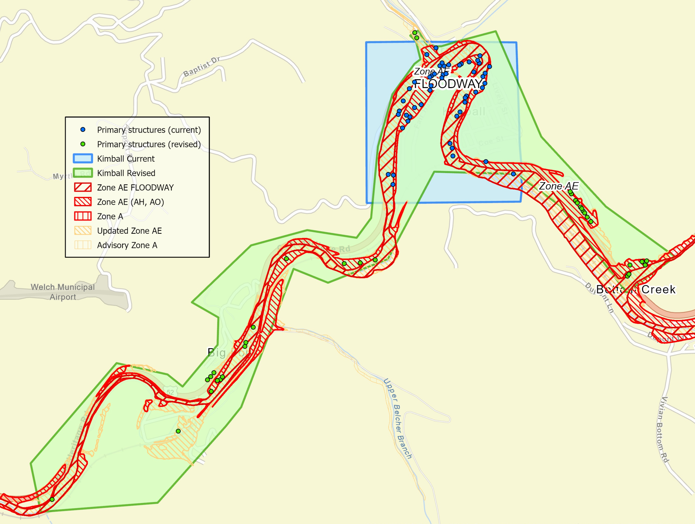
Kimball, McDowell County
Legal Boundaries (Municipal)
Previously Incorrect Boundary
Legal Boundaries
Official municipal boundary changes need to be submitted to the State and U.S. Census BAS Program
Tax Boundaries: Corporation Tax District Boundaries & Tax Sales
Election Boundaries: Municipal Precincts & Census Redistricting
Correct Boundary
51 primary structures in current Kimball municipality
85 primary structures in revised Kimball municipality
Legal Boundaries are referenced in many applications such as floodplain management

Slide 26
Map Reference Layers
Elevation (Topographic)

Slide 27
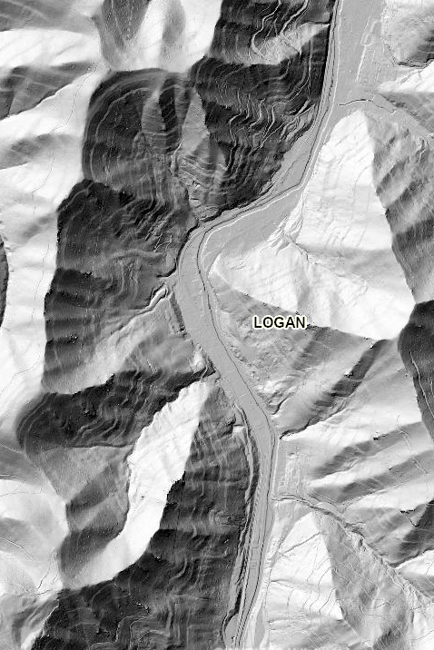
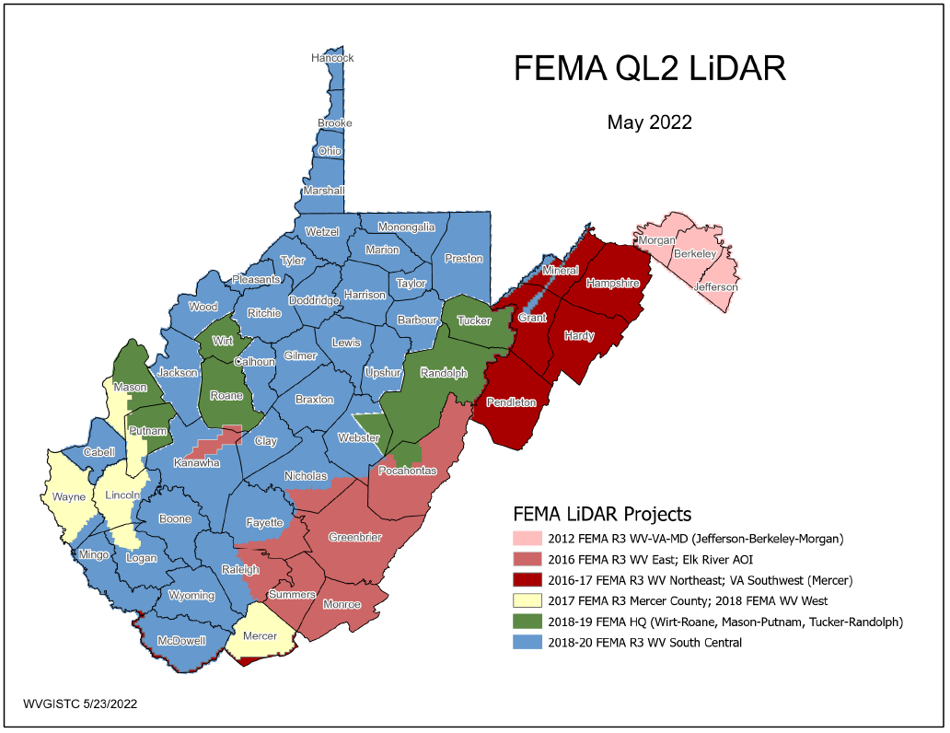
Elevation Data
This past decade FEMA purchased $10 million QL2 LiDAR (2012-2020) consisting of 6 major project acquisitions
Quality 2 (QL2) LiDAR support 1-foot contours
2020
2012
2017
2019
2017
2016
2020
PDF Map

Slide 28
Contact:
Kurt Donaldson, GISP, CFM
Member, Property Valuation Training & Procedures Commission
Manager, WV GIS Technical Center, WVU (kdonalds@wvu.edu)
5/20/2025 WV Assessors Conference

