Slide 1
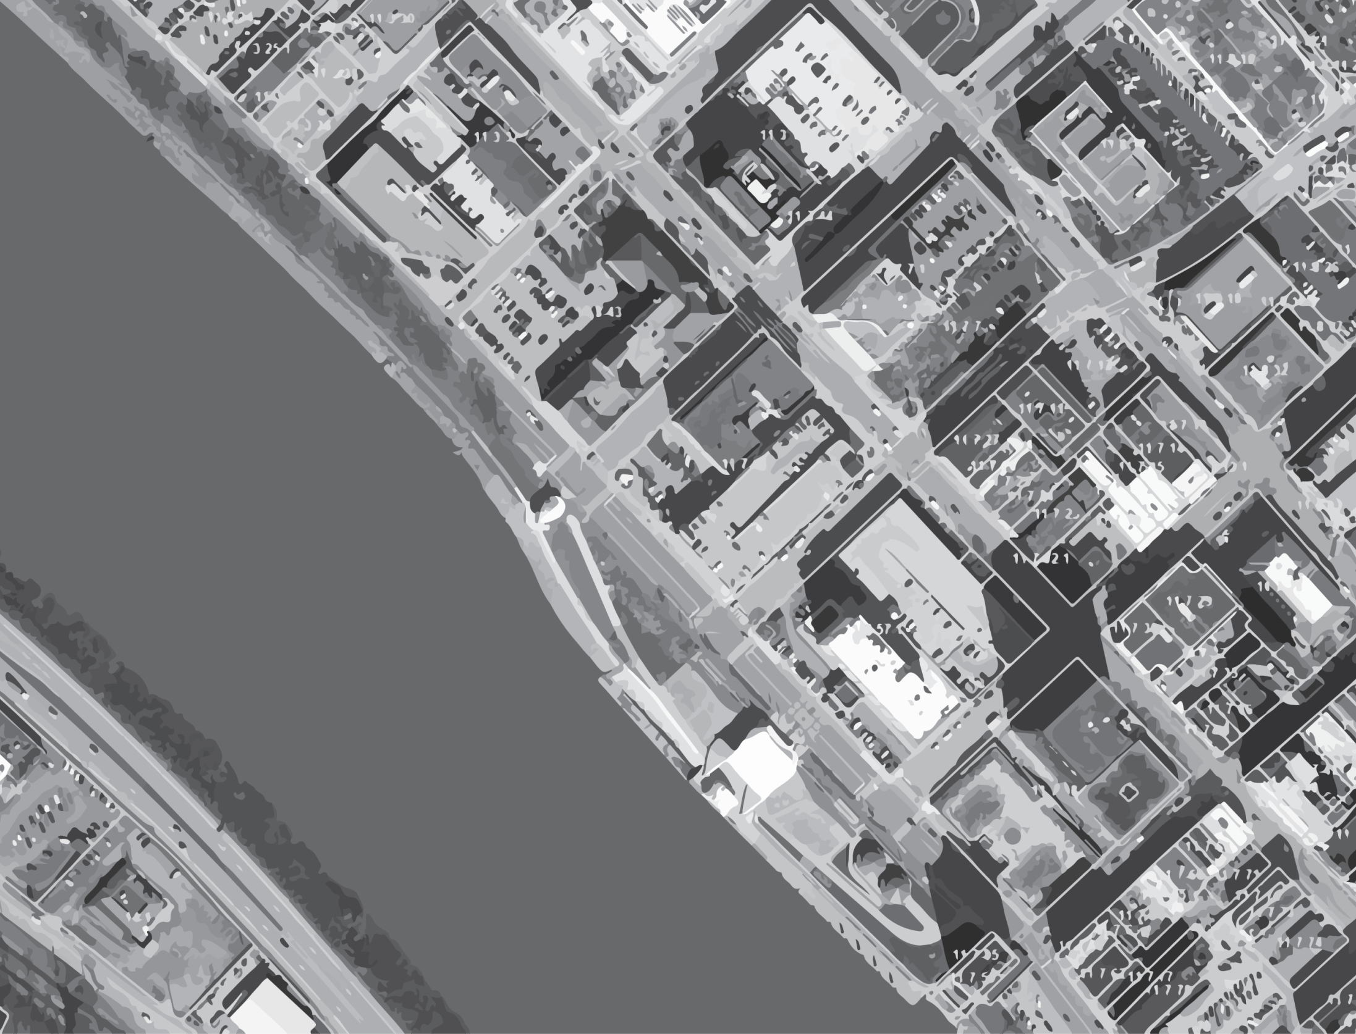
SB 588
Tax Map Sales
PRESENTED BY:
Douglas McElwee
for the
2017 State Tax Commissioner’s Annual In-Service Training for Assessors and Deputies

Slide 2
Why am I here?
Douglas McElwee
Member at Robinson & McElwee PLLC
Practicing Real Estate Law for the past 33+ years
With input from many sources, I was involved in the preparation of SB 588
Lead proponent of SB 588

Slide 3
Problems with Old System
1
The price of the maps was too high.
2
Tax map sales produced very little revenue
An average of $1,211.34 in revenue per county.

Slide 4
SB 588
SB 588 adds $10 to the fee charged for the recording of any deed, trust deed, fixture filing or security agreement (i.e, the current fee of $15.00 will increase to $25.00) by amending WV Code §59-1-10 .

Slide 5
SB 588
The additional $10.00 will be allocated:
$5.00 to the county assessor’s office.
$3.00 to the Courthouse Facility Improvement Fund.
$1.00 to the county clerk’s office.
$1.00 to the County 911

Slide 6
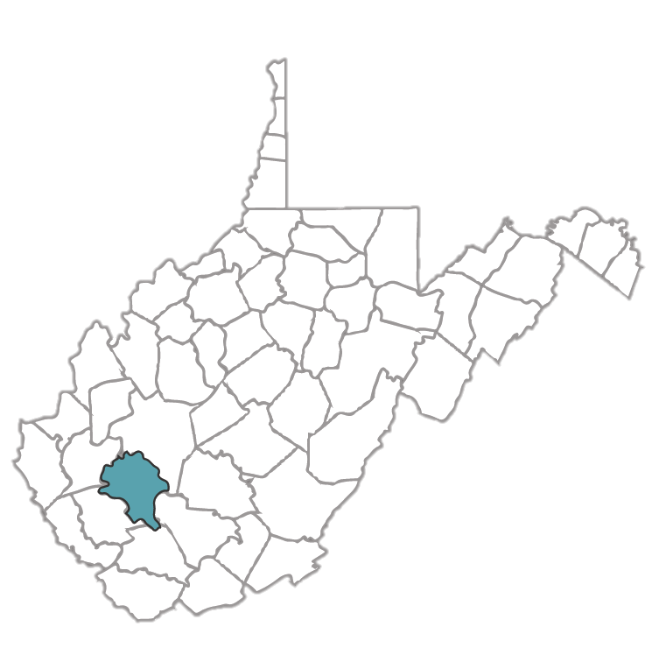
Boone County Example
Old System
Tax map sales – FY15 = $196.00 (not clear if this is the net).
SB 588
Deed recordings = 700 x $5.00 = $3,500 (not counting any revenue from deeds of trusts or fixture filings).
Net Assessor Benefit
$3,304 + ($3,500 - $196)

Slide 7
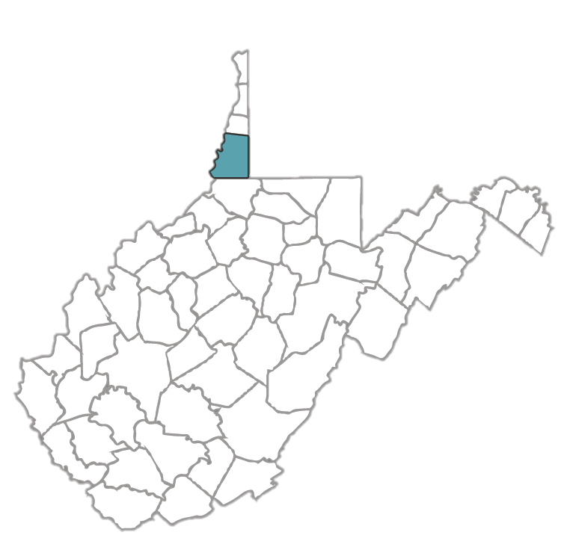
Marshall County Example
Old System
Tax map sales – FY15 = $5,600 (not clear if this is the net). FY15 was a very good year for map sales in Marshall County not likely to be duplicated.
SB 588
Deed recordings = 1,425 x $5.00 = $7,125 (not counting any revenue from deeds of trusts or fixture filings).
Net Assessor Benefit
$1,525 + ($7,125 - $5,600)

Slide 8
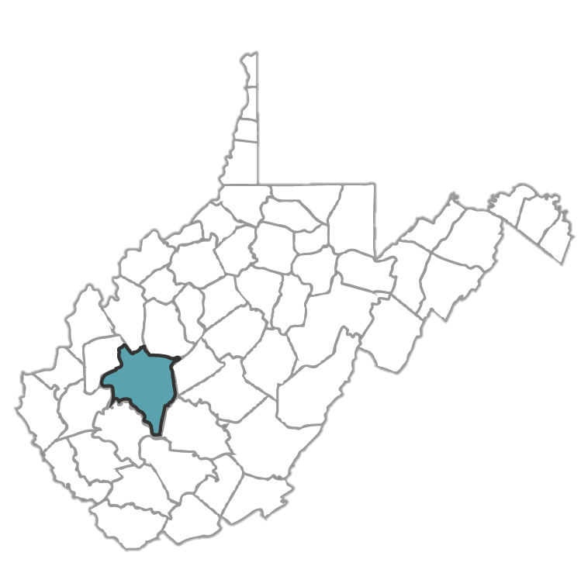
Kanawha County Example
Old System
Tax map sales – 2016 = $1,194
SB 588
Recordings = 10,000⁺ x $5.00 = $50,000
Net Assessor Benefit
$48,806 + ($50,000 – $1,194)

Slide 9

Courthouse Facility Improvement Fund
Old System
FY16 - $40,999.25
SB 588
Assuming the average deed recordings in all 55 counties are 1,425 (like Marshall County = 1425 x 55 x $3.00 = $235,125+

Slide 10
SB 588 - Interpretation
?
What happens to the provisions of WV CSR §189-5 that conflict with SB 588?
"Although an agency may have power to promulgate rules and regulations, the rules and regulations must be reasonable and conform to the laws enacted by the Legislature.” Lovas v. Consolidation Coal Company, 662 S.E.2d 645 (WV 2008).

Slide 11
SB 588 - Interpretation
?
What does it mean to offer the electronic tax
maps “with all underlying map data”?
This general statement does not authorize the release of confidential data that is specifically made confidential under WV Code §11-1A-23(a), WV Code §11-1C-10(d)(2), WV Code §11-1C-14. UMWA v. Kingdon, 174 W.Va. 330, 325 S.E.2d 120 (W.Va., 1984) (“The general rule of statutory construction requires that a specific statute be given precedence over a general statute relating to the same subject matter where the two cannot be reconciled.”)

Slide 12
SB 588 - Interpretation
?
Important for assessors to consistently interpret what is disclosed.
There is no obligation under SB 588 to include data that the assessor does not currently maintain.

Slide 13
SB 588 - Interpretation
?
How much can be charged for the tax maps?
An amount “reasonably calculated to reimburse it for its actual cost in making reproductions of such records (i.e., the charge shall be no more than what is reasonable for disclosure of the information under a Freedom of Information Act request under article one, chapter twenty-nine(B) of this code).”

Slide 14
SB 588 - Interpretation
?
How much can be charged for the tax maps continued
“The public body may establish fees reasonably calculated to reimburse it for its actual cost in making reproductions of such records.” W.Va.Code § 29B–1–3(5).
“[P]ursuant to West Virginia Code § 29B–1–3(5), a public body is vested with the authority and discretion to impose a search or retrieval fee in connection with a FOIA request to provide public records provided that such fee is reasonable.” King v. Nease, 757 S.E.2d 782 (WV 2014).
There is no obligation under SB 588 to prepare customized maps.

Slide 15
No Liability Provision
“Tax maps are prepared for taxation purposes only and the assessor and map sales unit of the property Tax Division of the Department of Revenue shall have no liability to any third party for any errors or omissions associated therewith or in connection with the use of tax maps for any other purpose.”

