Slide 1
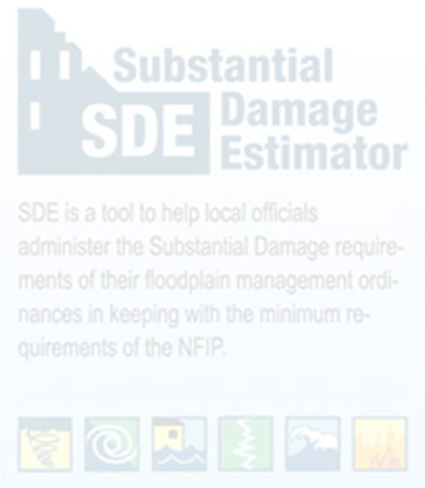

Using WV Flood Tool Property Data in Substantial Damage Estimator (SDE) Software, Version 3.0
Substantial Damage Estimator (SDE 3.0) Tool
Prepared by: WV GIS Technical Center
08/01/2023

Slide 2
Pre-Loading Available Structure Data into SDE 3.0 Tool
Using the Enterprise Import Function, available SDE data regarding the structures in the SFHA and Advisory High-Risk Floodplains can be pre-loaded into the SDE 3.0 Tool during the preparations for the SDE inspections. This property data is compiled from tax assessment and flood map information displayed on the WV Flood Tool.
Structure data can be pre-loaded into the data fields on the first three tabs of the SDE tool – Address, Structure/Damage/NFIP Info, and Cost.
In addition, set the Default Values pre-loading function to populate the Inspector / Damage Information sections.
A user can pre-load nearly 40 data variables into the SDE tool, thereby saving time and accuracy.
Import
Non-SDE Property Data from
WV Flood Tool
Pre-Load Structure/Property Data using Template Guide
Assess Damages
SDE 3.0 Application
Set Default Values for Inspector/Damage Information
Import Photos
Export
Damage Assessments & Property Data
Complete Export to SDE Database (JSON plus photos)
Export to Excel Spreadsheet
Import Non-SDE Property and FIRM Data
Create Damage Assessments
Send SDE Determination Letters

Slide 3
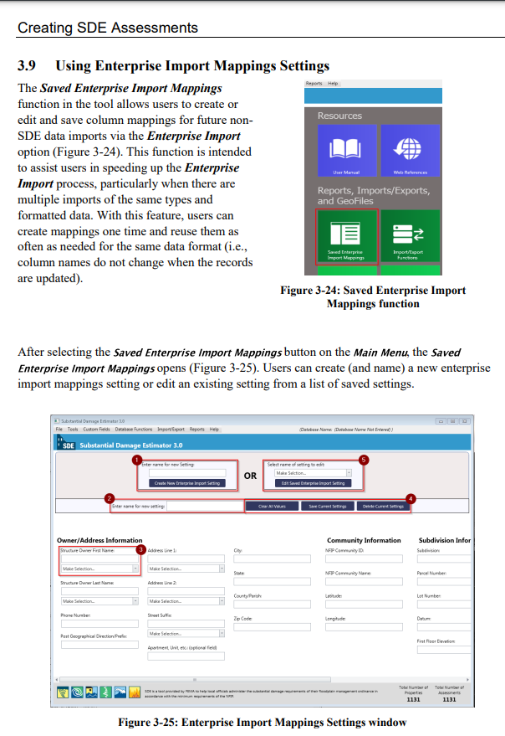

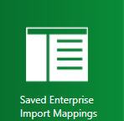
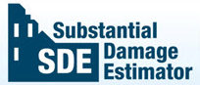
A. Download the Template
Why GISTC_Template?
West Virginia GIS Tech Center developed a template that is a supplement for the property record data spreadsheet, also prepare by GISTC for all … communities in West Virginia.
Checked!
By implementing this template, the time-consuming "Saved Enterprise Import Mapping" step is eliminated, leading to quicker data processing.
Template: Pre-defined import data settings to cross-walk WV Flood Tool property and flood data into SDE application. The template maps the data for the "Enterprise Import" of Non-SDE data so not required by the user.

Slide 4
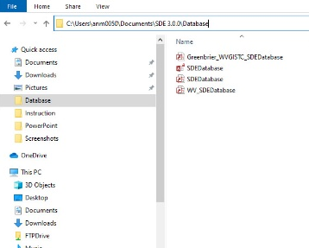
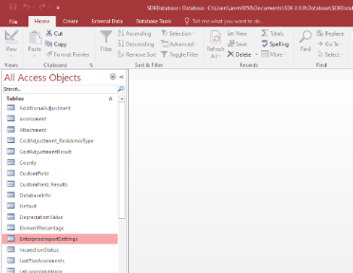
Download the WV_Template_2022 file at this link: Template for Spreadsheet. Open the Excel file template.
A. Download the Template
TO DO THIS STEP, YOU NEED TO HAVE MICROSOFT ACCESS ON YOUR SYSTEM. OTHERWISE, YOU’LL NOT BE ABLE TO USE THIS TEMPLATE AND SHOULD MAP THE FIELDS MANUALLY.
1
2
Copy the Second Row
Open SDEDatabase from: C:\Users\xxx\Documents\SDE 3.0.0\Database\SDEDatabase
Double Click on EnterpriseImortSettings. (Close macro Single Step window).
3
4

Slide 5
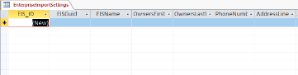
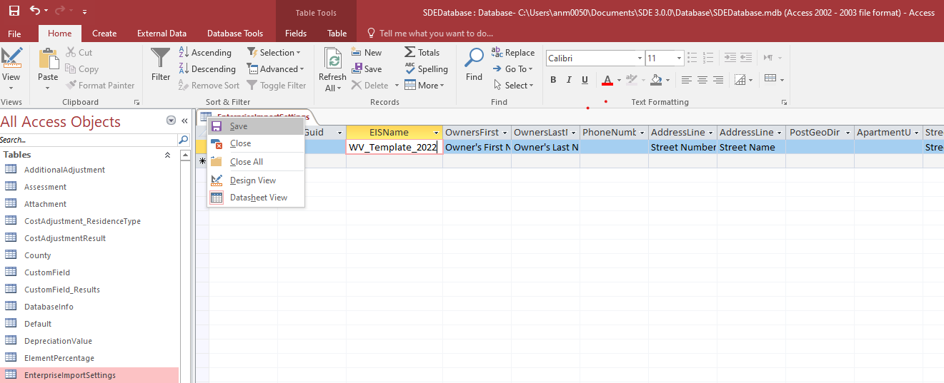
A. Download the Template
5
Click on asterisk and paste record Paste WV_Template_2022
Save and then close the tab
6

Slide 6
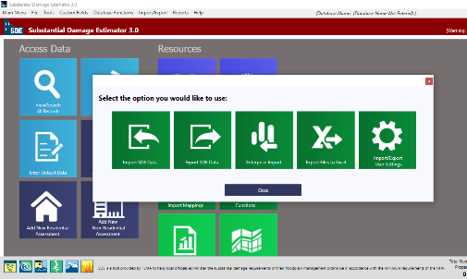
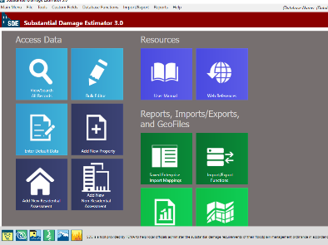
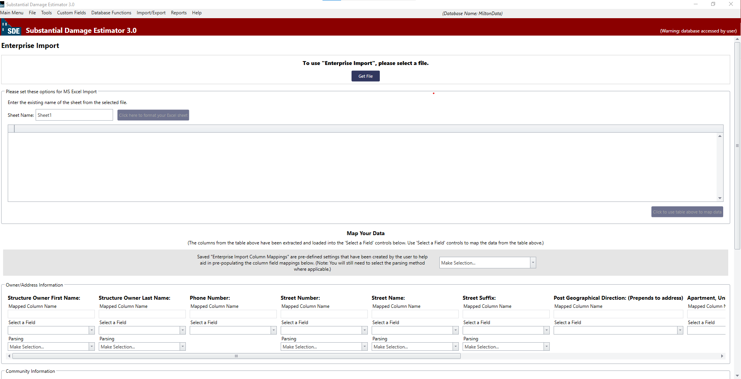
B. Importing the Spreadsheet
7
10/10/2021
Download the Non-SDE community data Spreadsheet and paste in on your local drive (incorporated/unincorporated place, countywide)
8
Open SDE and click on Import/Export Function
9
Select Enterprise Import.
10
The Enterprise Import page will be opened.

Slide 7
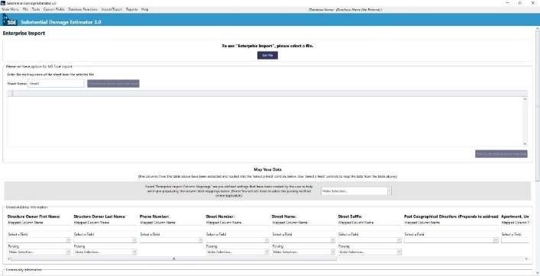

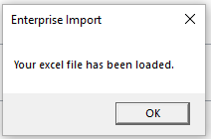

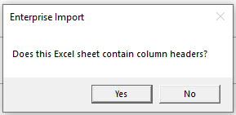

B. Importing the Spreadsheet
11
Click on “Get file” and navigate it to the Spreadsheet
10/10/2021
Wait until this message shows up. Click “OK”.
12
13
Leave the sheet name as it is or “sheet1”, then click on “click here to format your Excel sheet”
14
Click “Yes”.
15
Scroll down to end of records and select “click to use table above to map data” to map your community data into SDE database

Slide 8
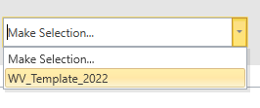
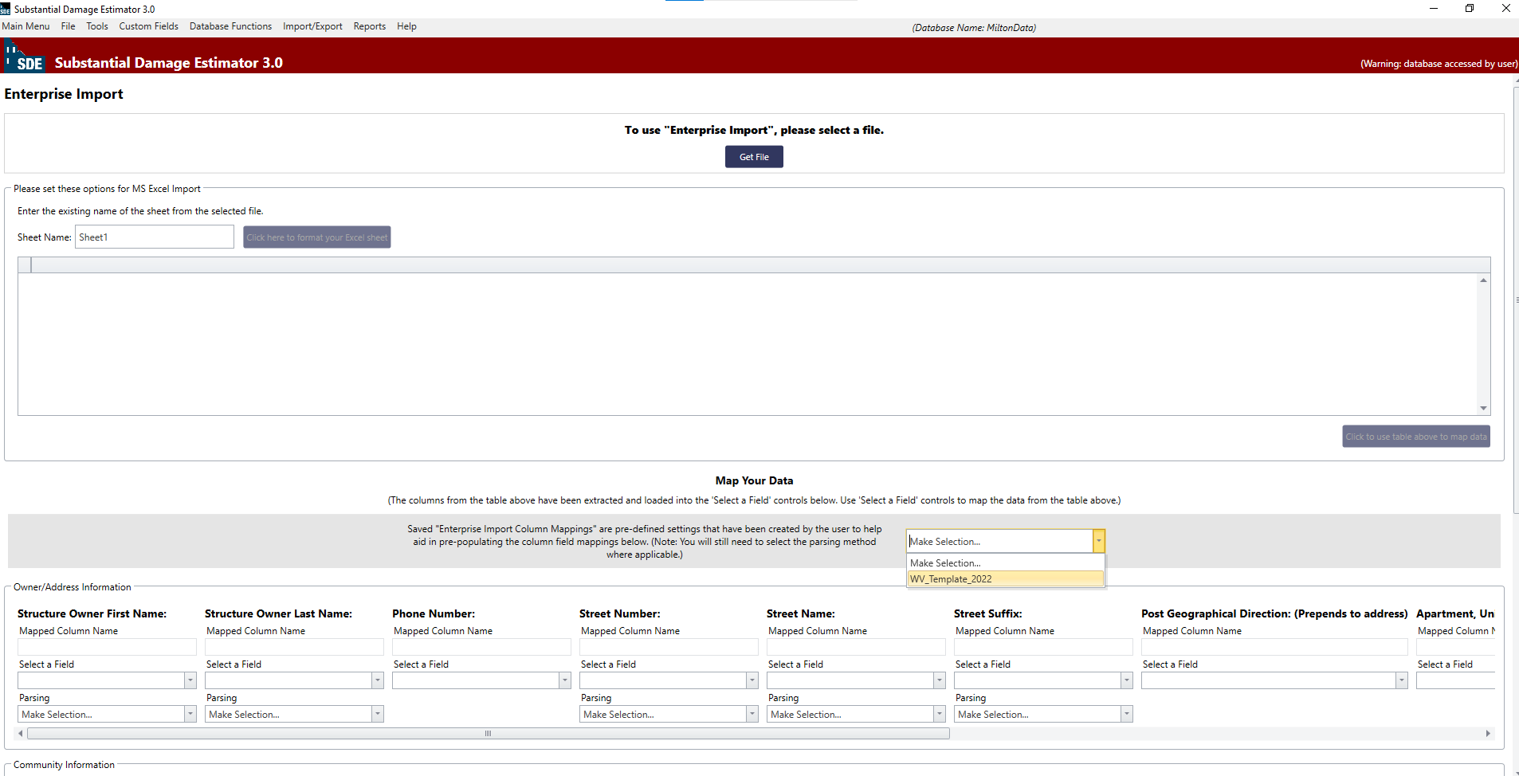
B. Importing the Spreadsheet
Scroll further down to the Map Your Data section and select WV_Template_2022 file from pull-down menu to load pre-defined settings.
16
10/10/2021

Slide 9
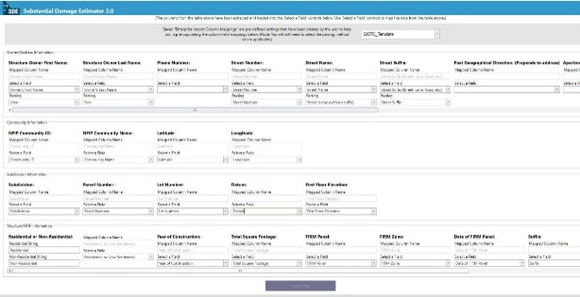

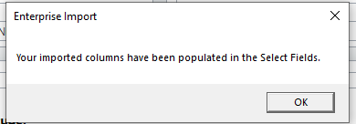
B. Importing the Spreadsheet
10/10/2021
17
The template shows up in the bottom fields. Then click on “Import Data”.
18
Click “OK”. Data mapped and imported includes Owner/Address, Community, Subdivision, and Structure/NFIP Information

Slide 10
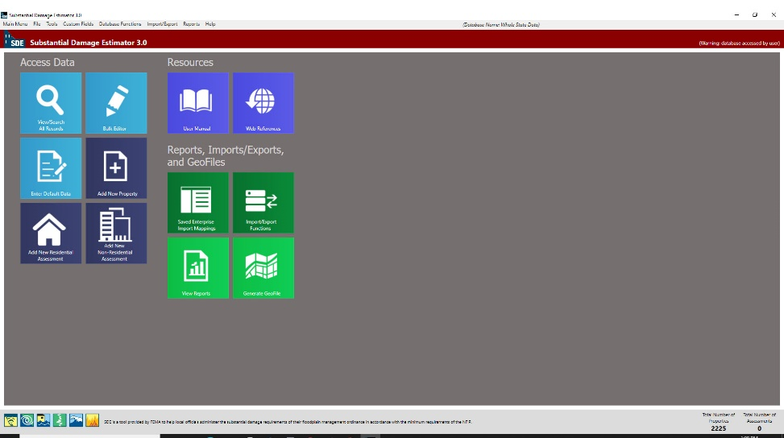
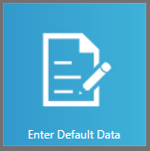
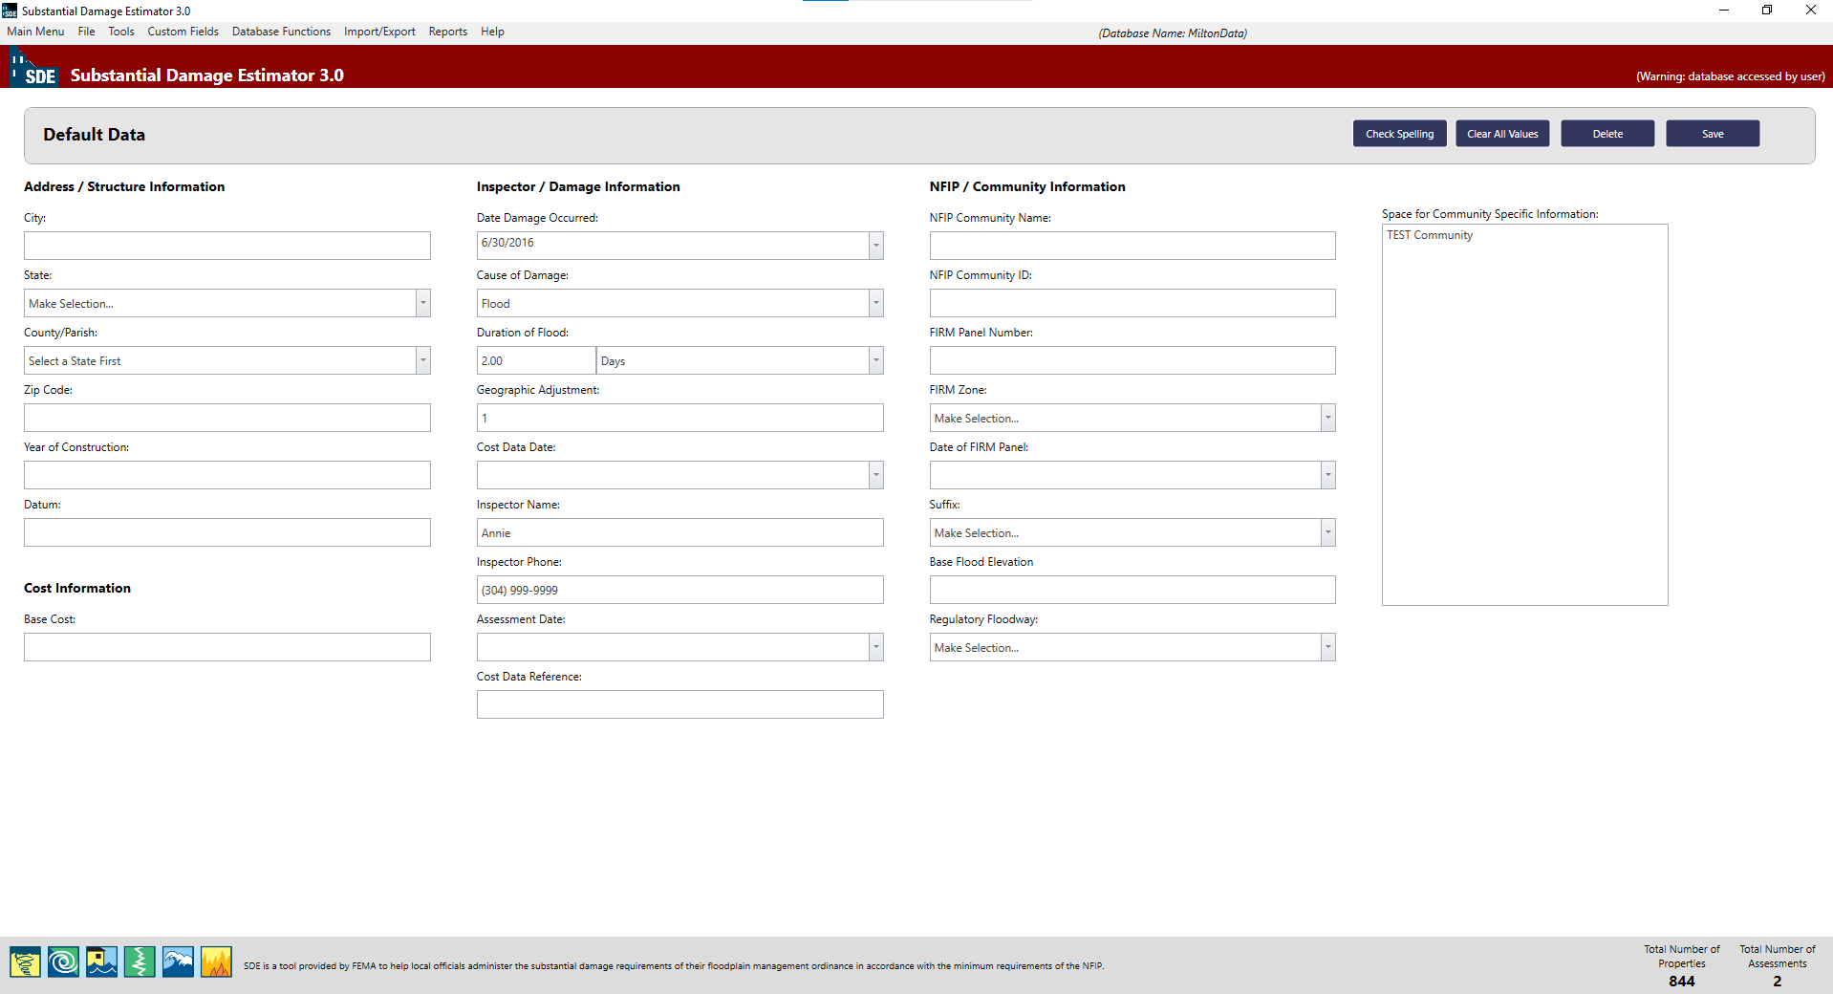
C. Estimating Damage
10/10/2021
It returns to the Main Menu. The total number of properties should be shown up at the right bottom of the page.
To add more data, in addition to the data you’ve already imported, click on Enter Default Data
Default Data page will be opened. Now you can add more information to your property records.

Slide 11
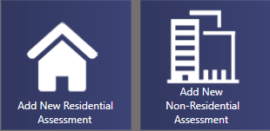
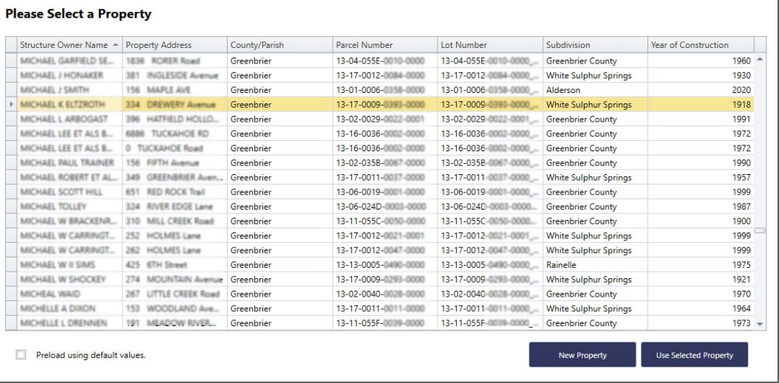
In the main menu, based on the building’s function, click on one of these dark blue icons: “Add New Residential Assessment” or “Add New Non-Residential Assessment”.
C. Estimating Damage
10/10/2021
Wait until this table displays. Right click the Data Field headers to sort, show search panel, or use filter editor. Using filter option, you can look for a specific building. Then select the structure.

Slide 12
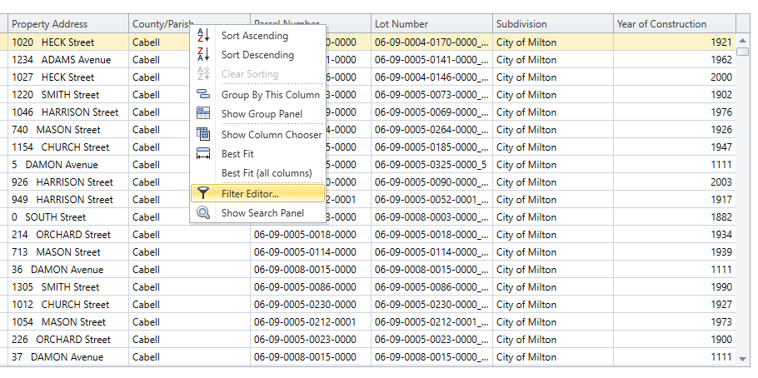
C. Estimating Damage
10/10/2021
To filter the Data right click on one of the columns’ header (Name, Community, City, Parcel Number, etc.) and select Filter Editor

Slide 13
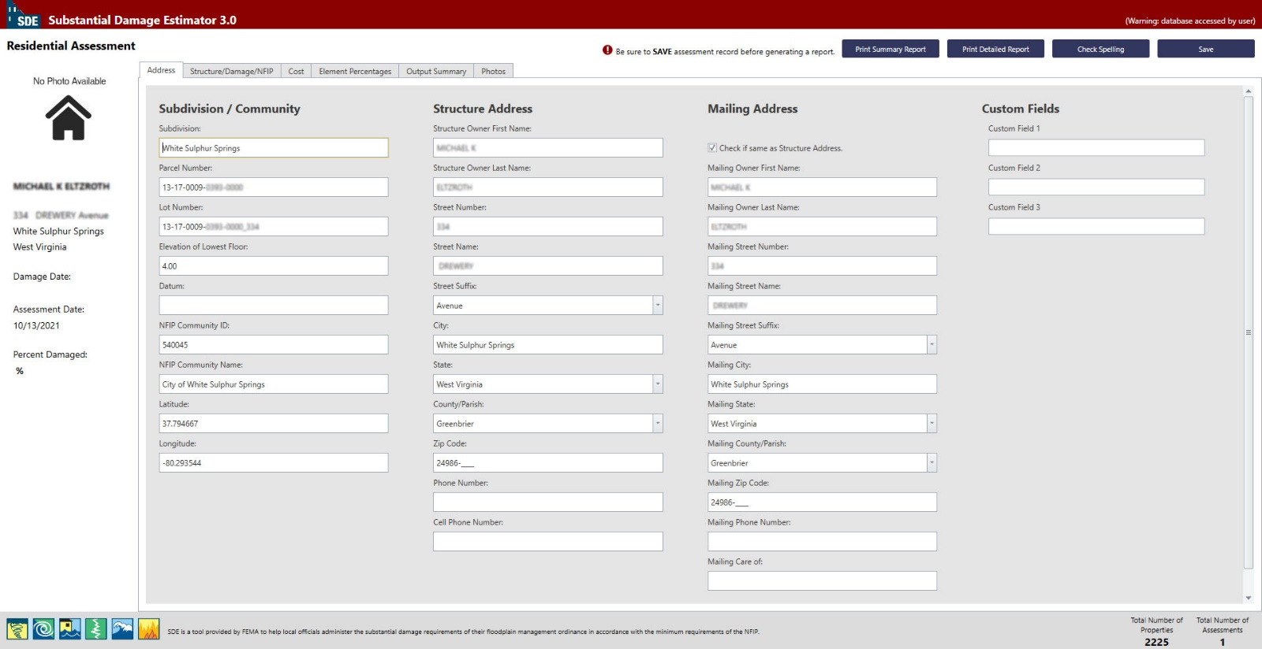
C. Estimating Damage
1
10/10/2021
Owner’s Name and Address
Check it if the Mailing Address and Structure’s Address are the same. Owner Address is on WV Flood Tool.
Parcel’s Geographic Data
Further information can be imported here
Total Number of Assessment should be changed to “1”
When this page displays, review the filled fields of the Non-SDE community data imported from Spreadsheet. Verify or add property and flood information from WV Flood Tool Website

Slide 14
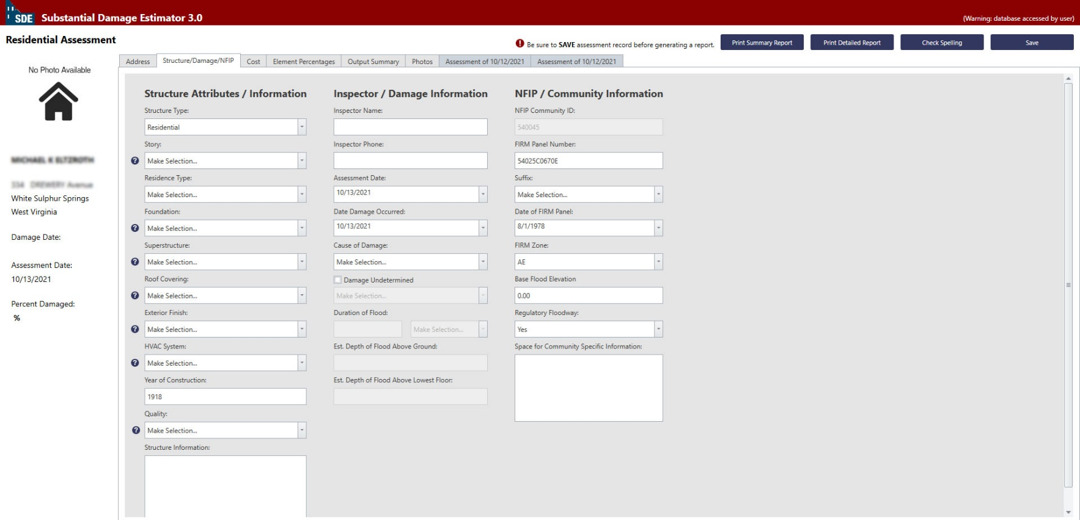
C. Estimating Damage
2
Now, click on Structure/Damage/NFIP.
Required fields
Optional fields
Some fields have been loaded automatically from the Spreadsheet, but there are some other that should be manually filled.

Slide 15
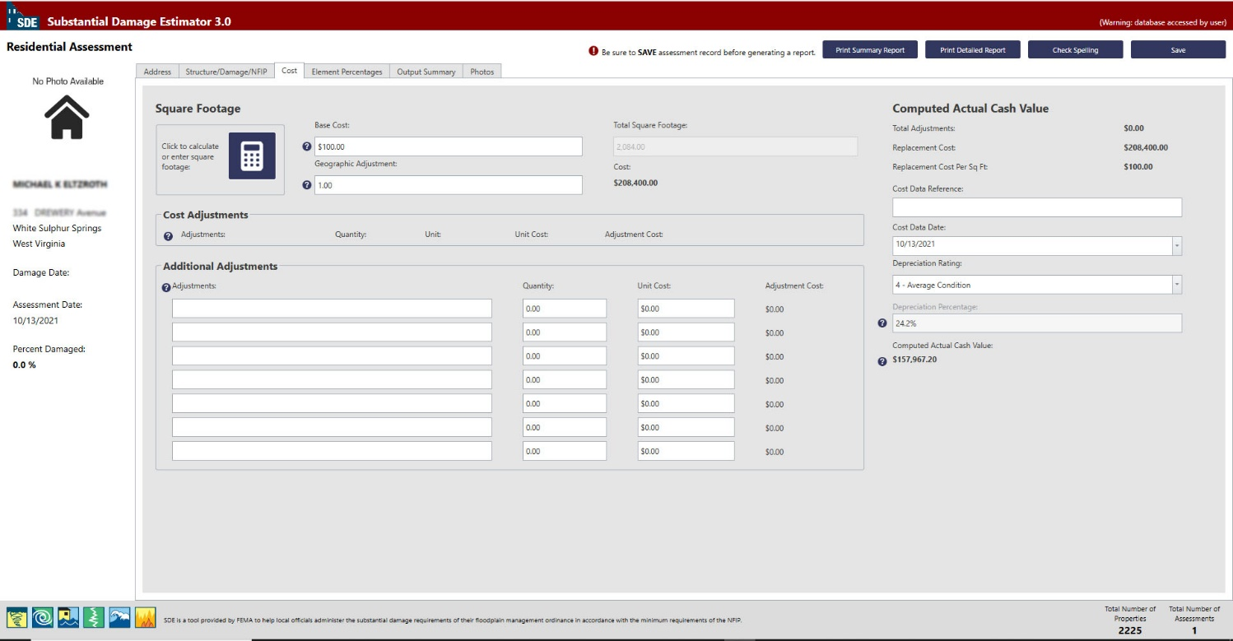
C. Estimating Damage
3
10/10/2021
Now, click on Cost.
Residential:100
Required fields
Should be “1”
Non-Residential:200

Slide 16
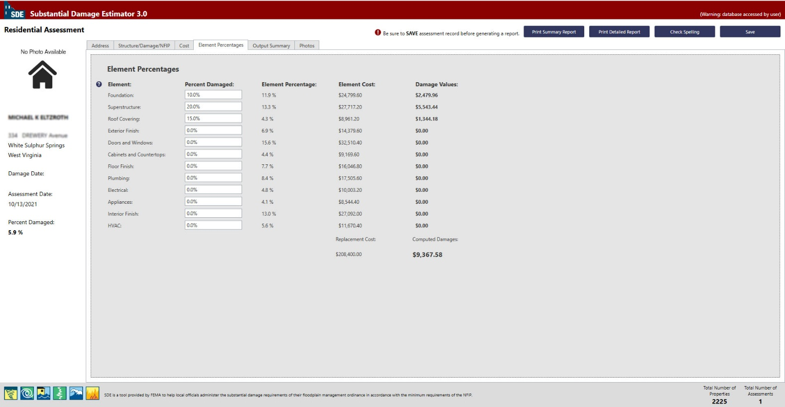
C. Estimating Damage
4
10/10/2021
Now, click on Element Percentage.
If you know the amount of percentage damage on the elements of the buildings, fill the related fields. Remember that it may not be necessary for all the threshold makers to be met to achieve the indicated level of damage.

Slide 17
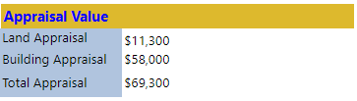
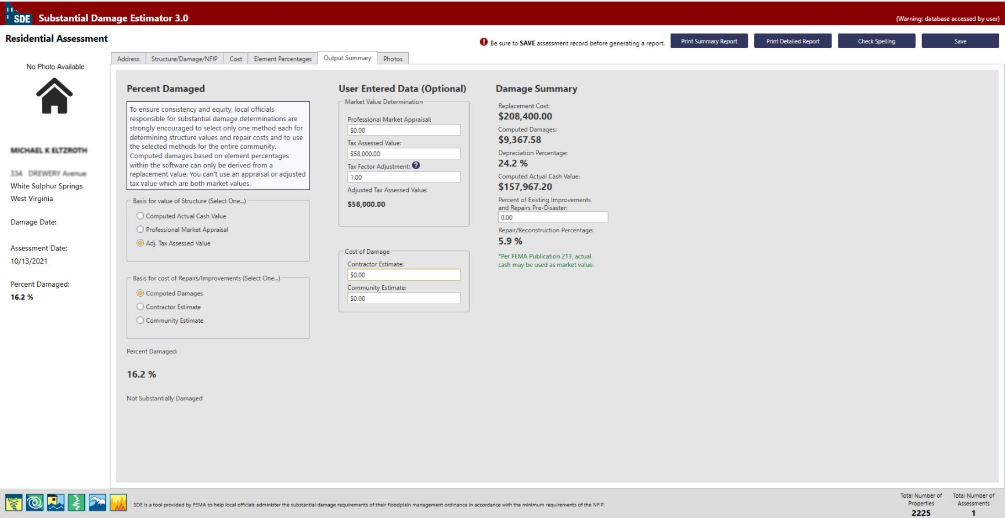
C. Estimating Damage
5
10/10/2021
Basis for value of structure should be set on: Adj. Tax Assessed Value
Tax Assessment Value is found in WV Assessment
If you’re not sure about Tax Factor Adjustment write 1.
Damage Summary will be calculated and shown up here.

Slide 18
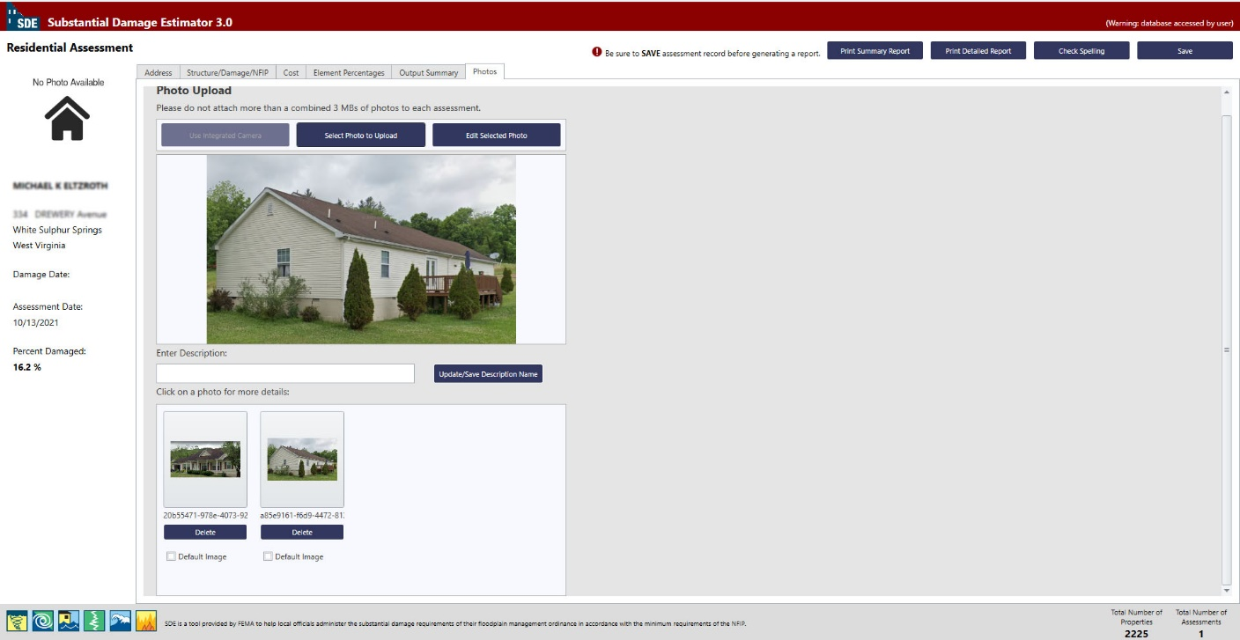
C. Estimating Damage
6
10/10/2021

Slide 19

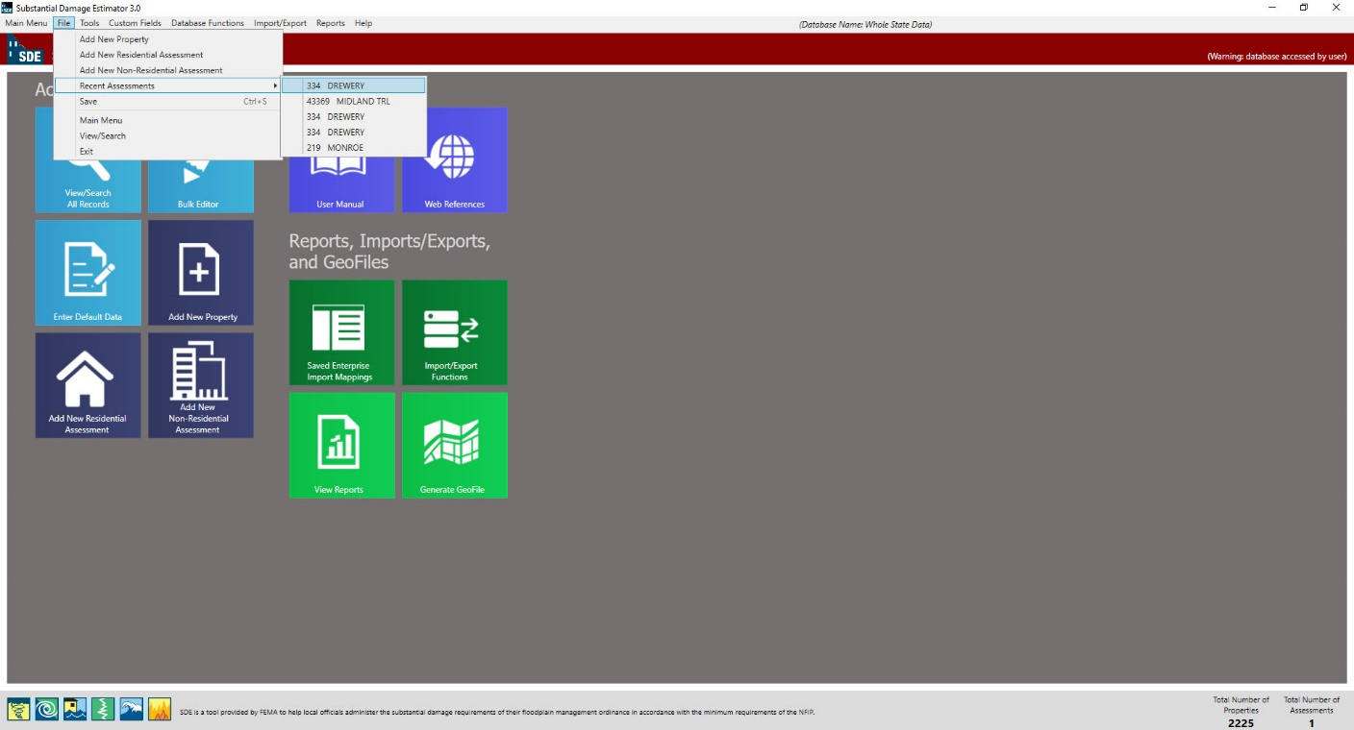
C. Estimating Damage
Make Sure to Save Data before closing.
10/10/2021
You can Print Summary Report or Print detailed Report at the end.
During working, you can save and exit the software if needed. When come back, to find the recent assessment you were working, go to: file/Recent Assessment and find it among five recent assessments.

Slide 20
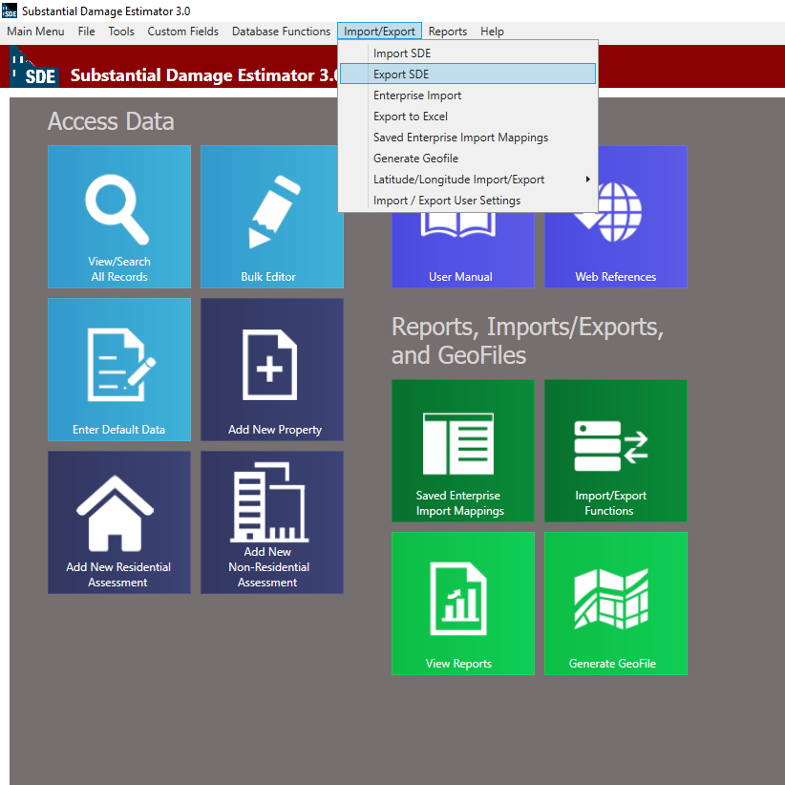
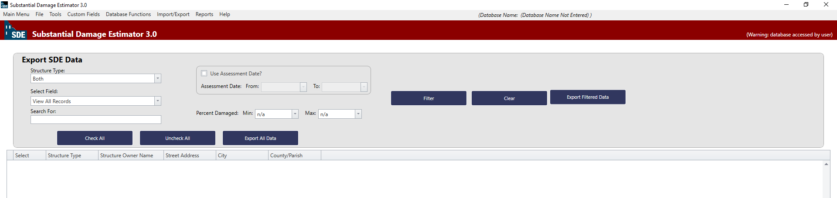
D. Exporting SDE Data
After Estimating the damage, or during the process it is possible to export SDE data as “Json” files, to be used in another computer.
Select Export SDE and then this page will appear:
1- Select Structure Type, or leave it as it is
2- You can search for a specific property based on owners name, address, city, community, parcel number, etc.
3- Then Press filter to data be displayed

Slide 21
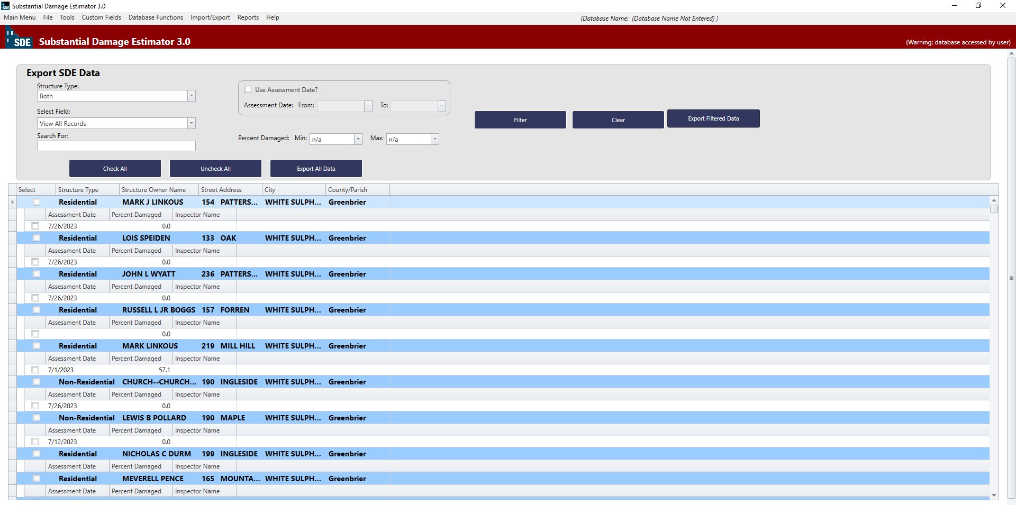
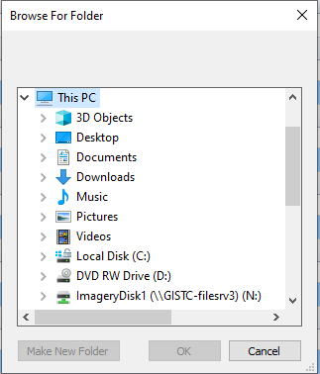
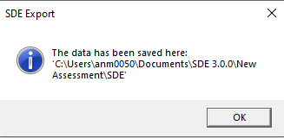
D. Exporting SDE Data
The imported property records will be appeared:
4- Check one/some or all the data and then click on Export All Data or Export Filtered Data
Save the Exported file on your Local Drive

Slide 22

Instructions drafted by the WVGISTC Team in support of State NFIP Office. If you have any Questions, please Contact Kurt Donaldson: Kurt.Donaldson@mail.wvu.edu Or Annie Mahmoudi: anm0050@mail.wvu.edu

