Slide 1
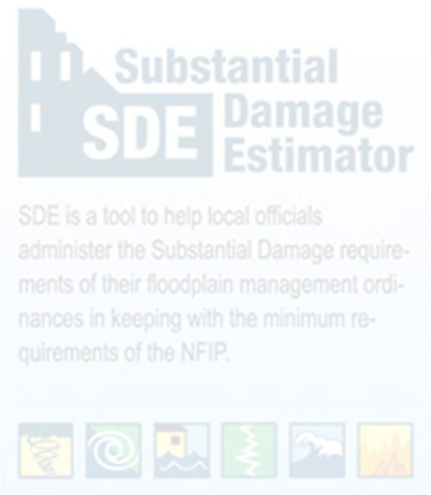

Using WV Flood Tool Property Data in Substantial Damage Estimator (SDE) Software, Version 3.0
Substantial Damage Estimator (SDE 3.0) Tool
Prepared by: WV GIS Technical Center
07/01/2026

Slide 2
Pre-Loading Available Structure Data into SDE 3.0 Tool
Using the Enterprise Import function, available property information for structures located in the SFHA and Advisory High-Risk Floodplains can be pre-loaded into the SDE 3.0 Tool before conducting substantial damage inspections. These data are compiled from tax assessments and flood hazard information available through the WV Flood Tool.
Alternatively, County-specific SDE Database (.mdb) files can be used to automatically load all pre-processed property records into the SDE application, eliminating the Enterprise Import step.
Structure data can be pre-loaded into the first three SDE tabs, Address, Structure/Damage/NFIP Info, and Cost, while the Default Values feature can be used to automatically populate the Inspector and Damage Information fields.
Both methods reduce manual data entry, improve consistency among users, and significantly speed up damage assessments.
Import
WV Flood Tool Property Data (as Excel Spreadsheet or County SDE Database (.mdb))
Assess Damages
SDE 3.0 Application
Export
Damage Assessments & Property Data
  40 fields automatically populated
  Property and FIRM information pre-loaded
  Import using Excel (Enterprise Import) or County SDEDatabase (.mdb)
  Set Default Values for Inspector/Damage Information
  Create Damage Assessments
  Import Photos
  Complete Export to SDE Database (JSON plus photos)
  Export to Excel Spreadsheet
  Send SDE Determination Letters

Slide 3
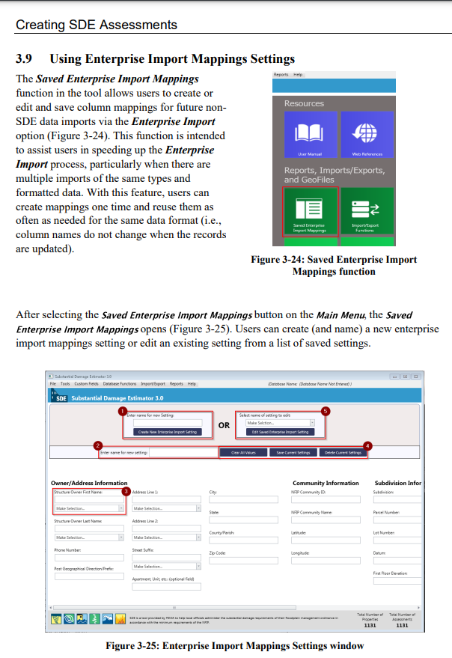

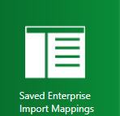
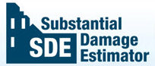
A. Why Use the WV Template?
The West Virginia GIS Technical Center (GISTC) developed the WV Template to complement the Property Data Spreadsheet prepared for communities throughout
West Virginia.
Checked!
Using the WV Template eliminates the need to manually create and save Enterprise Import Mapping settings, reducing setup time and improving consistency.
WV Template: A predefined Enterprise Import mapping that automatically matches WV Flood Tool property data to the appropriate SDE fields. This eliminates repetitive field mapping during Excel imports

Slide 4
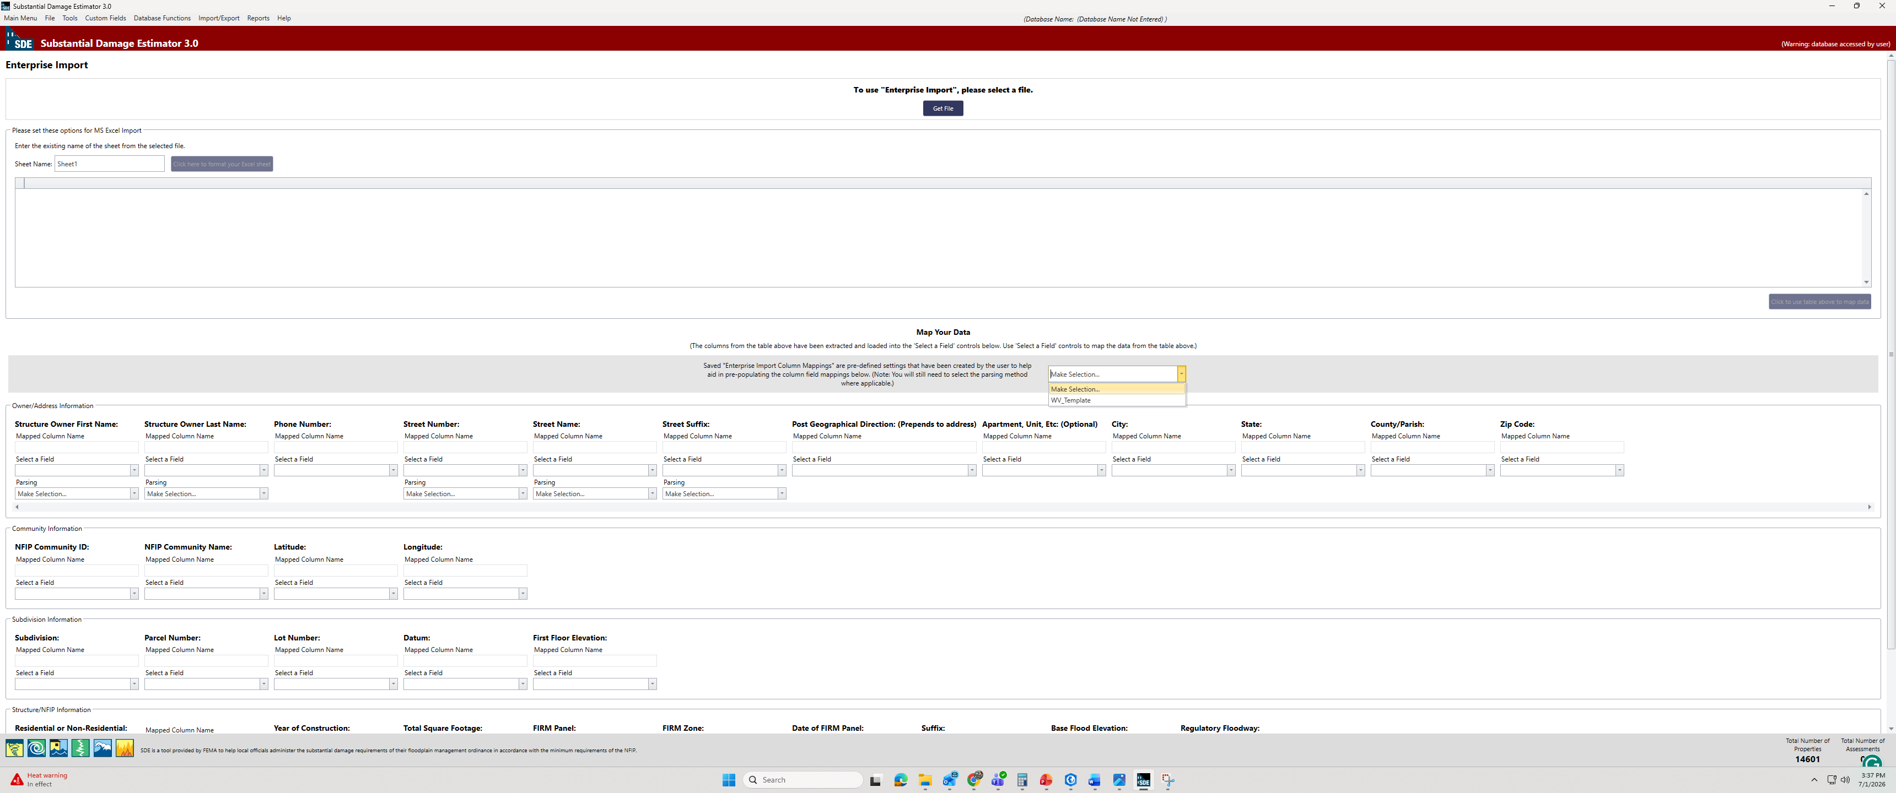
B. How to Use the WV Template?
TO DO THIS STEP, YOU NEED TO HAVE MICROSOFT ACCESS ON YOUR SYSTEM. OTHERWISE, YOU’LL NOT BE ABLE TO USE THIS TEMPLATE AND SHOULD MAP THE FIELDS MANUALLY ( Go to Slide 9)
1
Download the WV_Template file from this link: _Template_for_Spreadsheet.
Please note that importing (copying) the template is not necessary in the assessment process; you can map the buildings’ data manually. However, importing the template simplifies the process.
2
Open the Excel file template and copy the second row

Slide 5
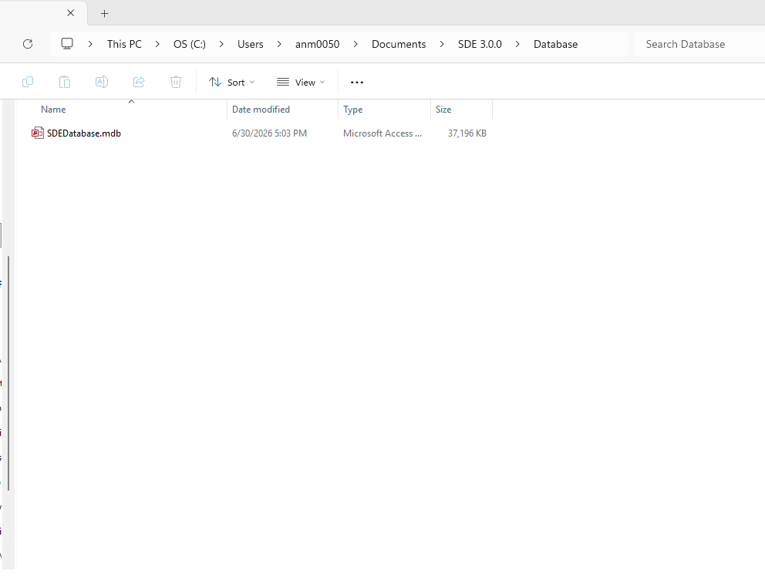
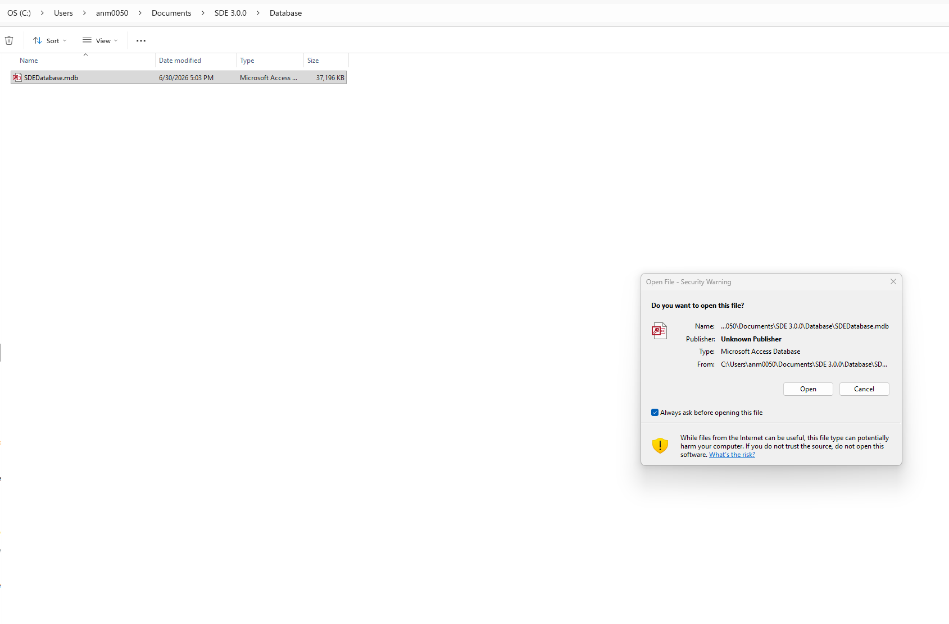
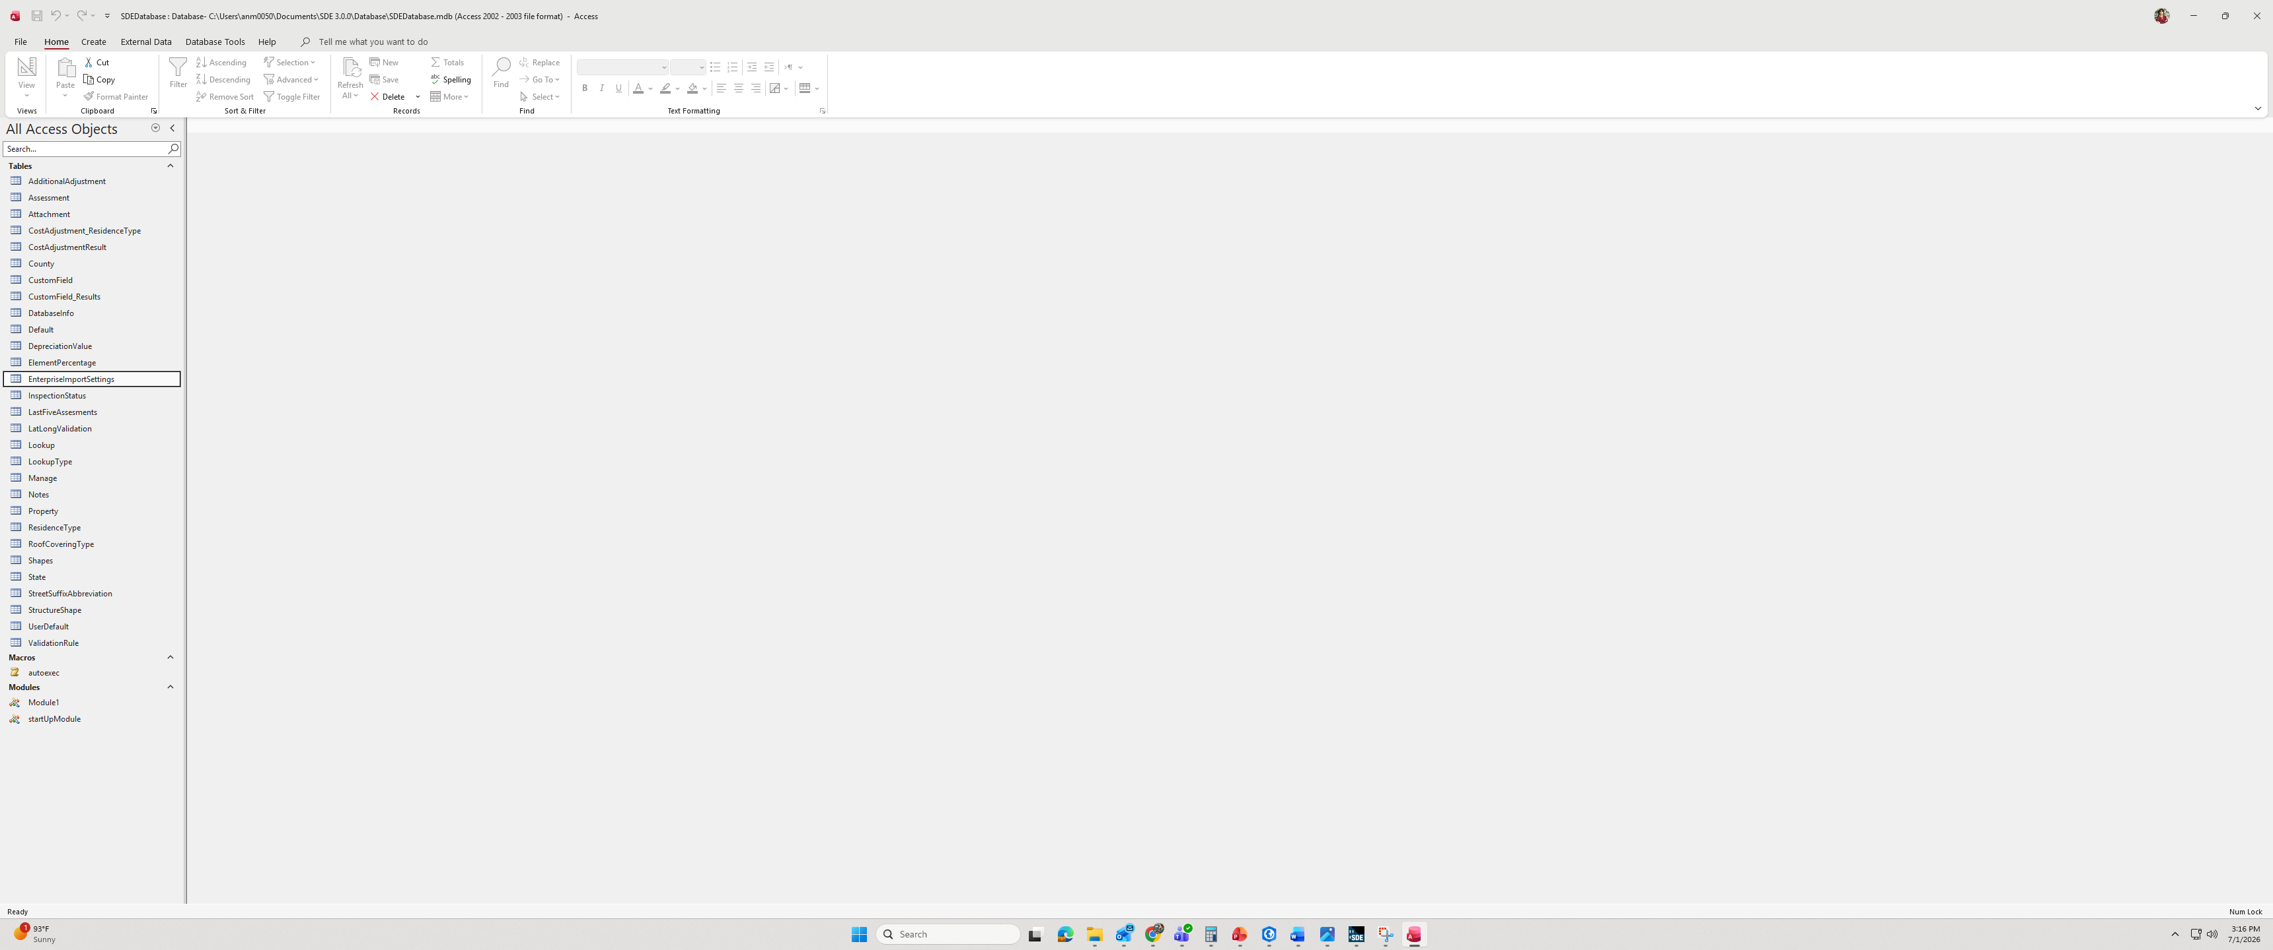
B. How to Use the WV Template?
3
Open SDEDatabase from: C:\Users\xxx\Documents\SDE3.0.0\Database\SDEDatabase
4
Double-click on SDEDatabase.mdb to open it.
1
3
2

Slide 6
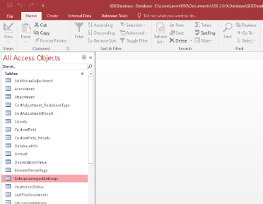
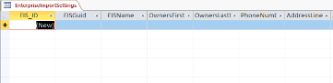
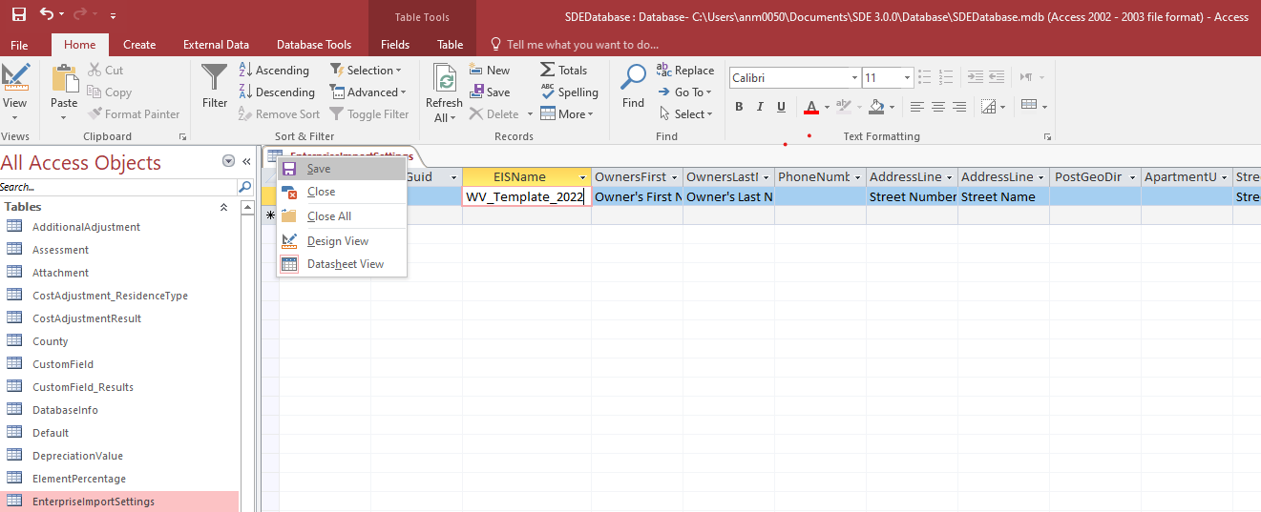
B. How to Use the WV Template?
5
Double-click on EnterpriseImportSettings.
6
Click on asterisk and paste WV_Template
7
Save and then close the tab

Slide 7
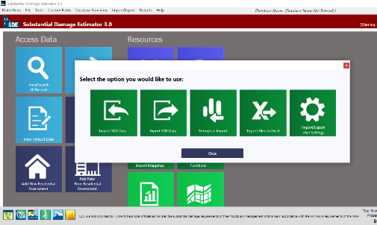
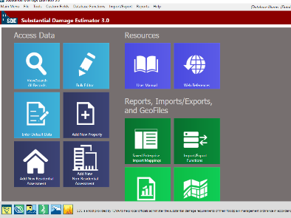
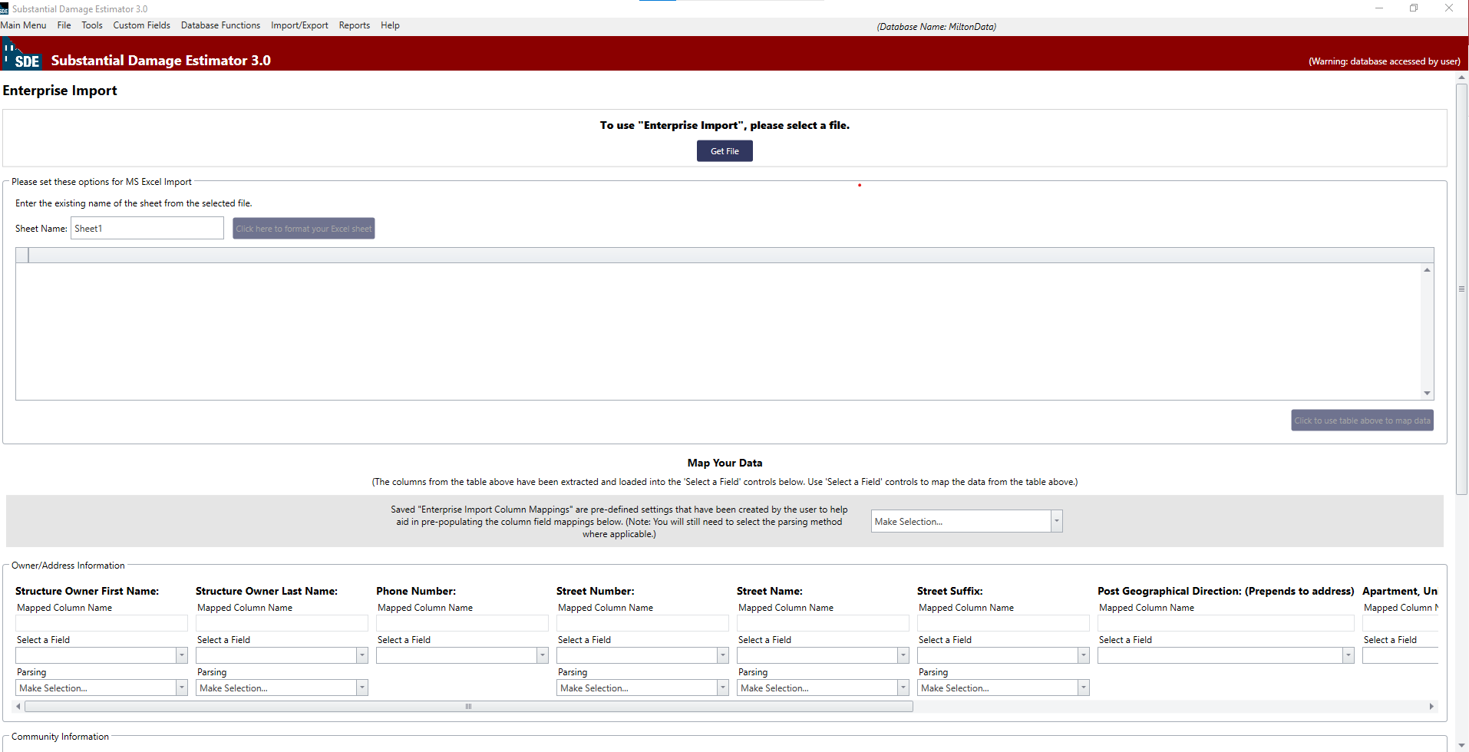
B. Importing the Spreadsheet
8
10/10/2021
Download the County data SDE_Data_Excel and paste it into your local drive
9
Open SDE and click on Import/Export Function
10
Select Enterprise Import.
11
The Enterprise Import page will be opened.

Slide 8
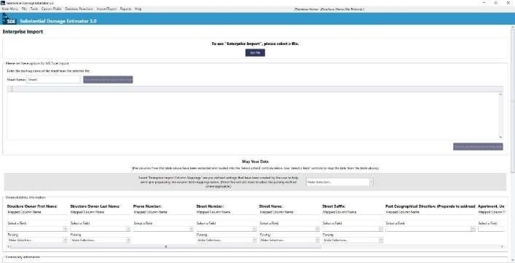

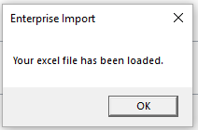

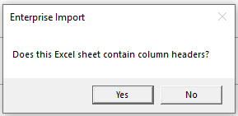

B. Importing the Spreadsheet
11
Click on “Get file” and navigate it to the Spreadsheet
10/10/2021
Wait until this message shows up. Click “OK”.
12
13
Leave the sheet name as it is: “SDE_Import”, then click on “click here to format your Excel sheet”
14
Click “Yes”.
15
Scroll down to end of records and select “click to use table above to map data” to map your community data into SDE database

Slide 9
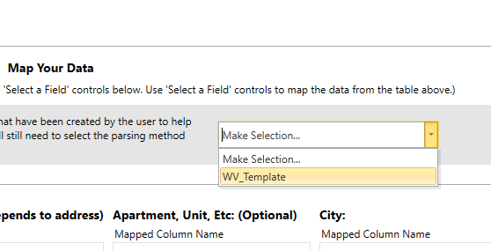


B. Importing the Spreadsheet
16
Scroll further down to the Map Your Data section and select the WV_Template file from the pull-down menu to load pre-defined settings.
10/10/2021
This is where you will need the WV Template. If you had a problem with downloading/entering it, or did not have Microsoft Access on your computer, it doesn’t matter. You just need to map each field manually, one by one.

Slide 10
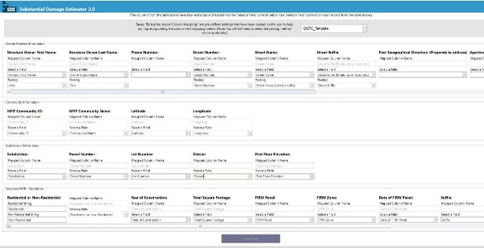

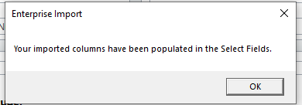
B. Importing the Spreadsheet
10/10/2021
17
The template shows up in the bottom fields. Then click on “Import Data”.
18
Click “OK”. Data mapped and imported includes Owner/Address, Community, Subdivision, and Structure/NFIP Information

Slide 11

Why Use the SDE Database?
C. Entering Whole County Building Data by Using Database
The SDEDatabase (.mdb) contains all property records already imported into the SDE application.
Instead of importing an Excel spreadsheet each time, users can simply replace the SDEDatabase with a prepared county database.
This method automatically loads all available property information into SDE when the software is opened.
The database preserves all predefined settings, lookup tables, and import configurations required by the SDE application.
Using a county-specific SDEDatabase reduces setup time and minimizes the possibility of import or field-mapping errors.
Note: The county SDEDatabase contains **only pre-loaded property information. Damage assessments, inspection results, photographs, and reports will be created after the database is used in the field.

Slide 12
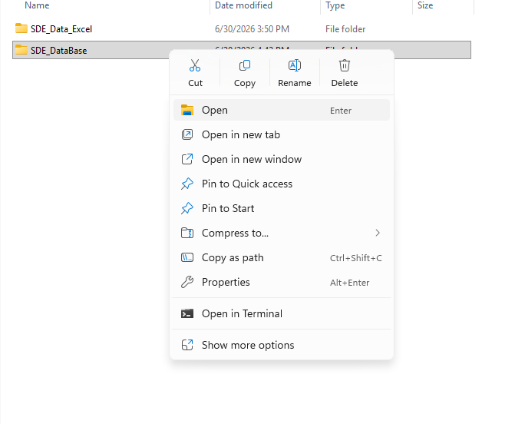
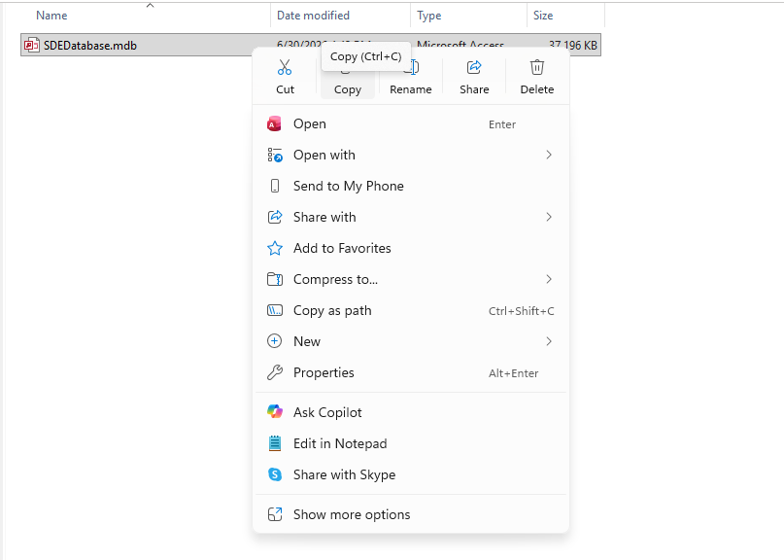
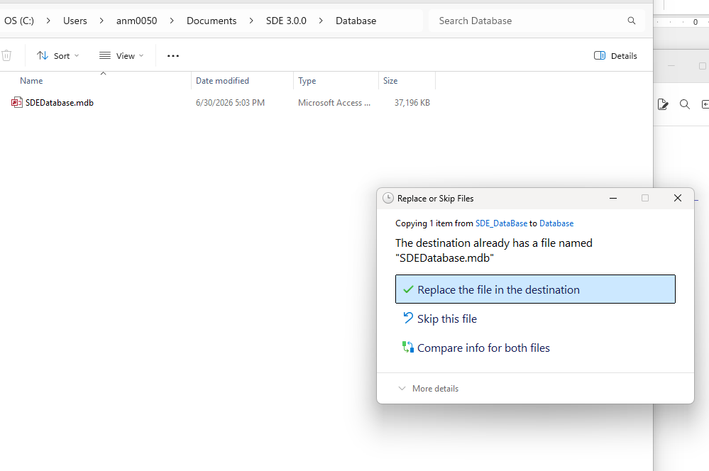
Open the County Data. There are two folders in it. Click on SDE_Database and open it.
C. Entering Whole County Building Data by Using Database
BEFORE STARTING, MAKE SURE SDE APPLICATION IS CLOSED.
1
2
After opening the SDE_Database Folder, copy the SDEDatabase.mdb file
3
Open SDEDatabase from:
C:\Users\xxx\Documents\SDE3.0.0\Database\SDEDatabase
Paste the file that you’ve copied from the County Folder in step 2. When it asks you to replace the file, click on “Replace the file in the destination”.
4

Slide 13
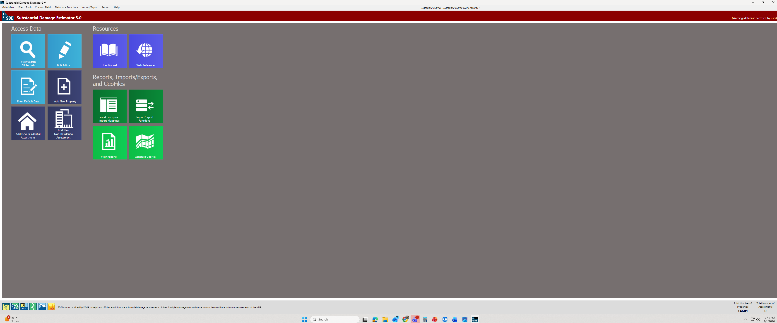
C. Entering Whole County Building Data by Using Database
5
Now open the SDE tool. You can see the total number of imported buildings on the bottom right of the screen.
6
It is ready to start the assessment.

Slide 14
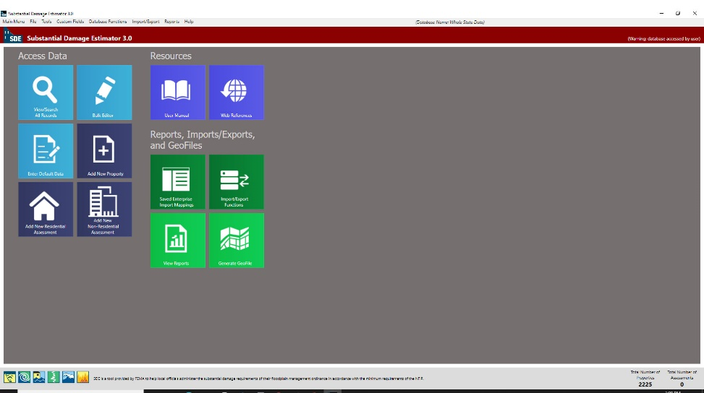
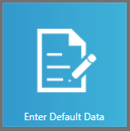
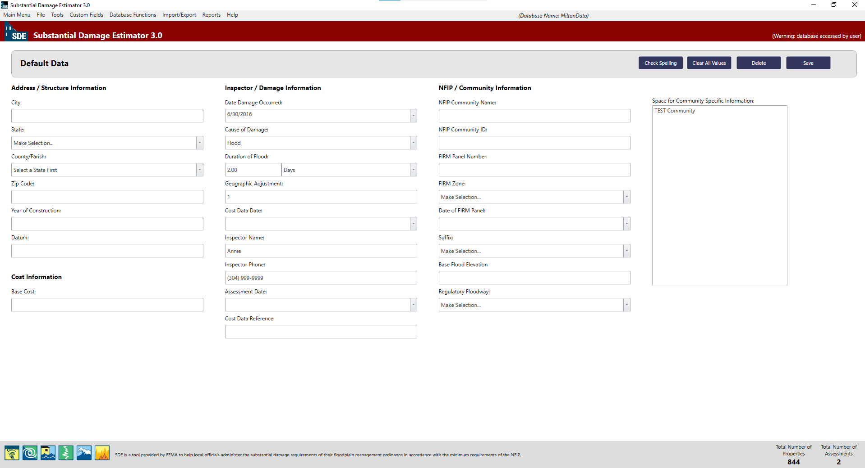
D. Estimating Damage
10/10/2021
It returns to the Main Menu. The total number of properties should be shown up at the right bottom of the page.
To add more data, in addition to the data you’ve already imported, click on Enter Default Data
Default Data page will be opened. Now you can add more information to your property records.

Slide 15
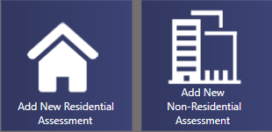
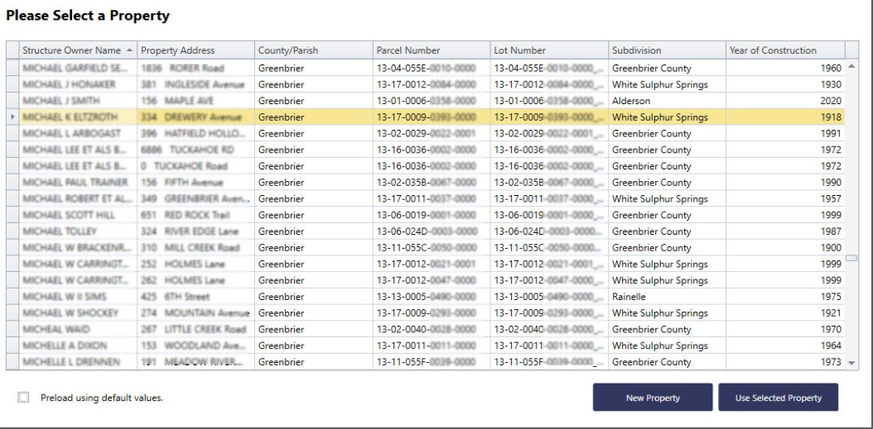
In the main menu, based on the building’s function, click on one of these dark blue icons: “Add New Residential Assessment” or “Add New Non-Residential Assessment”.
C. Estimating Damage
10/10/2021
Wait until this table displays. Right click the Data Field headers to sort, show search panel, or use filter editor. Using filter option, you can look for a specific building. Then select the structure.

Slide 16
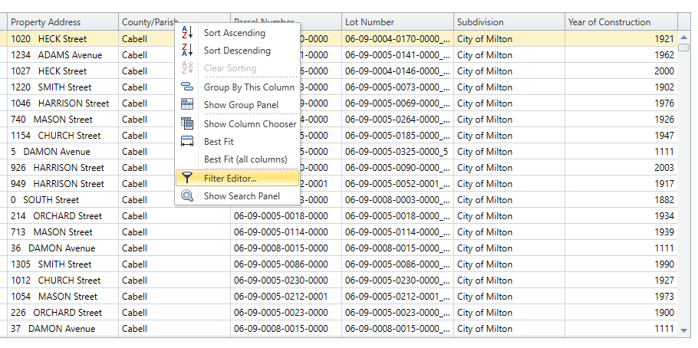
D. Estimating Damage
10/10/2021
To filter the Data right click on one of the columns’ header (Name, Community, City, Parcel Number, etc.) and select Filter Editor

Slide 17
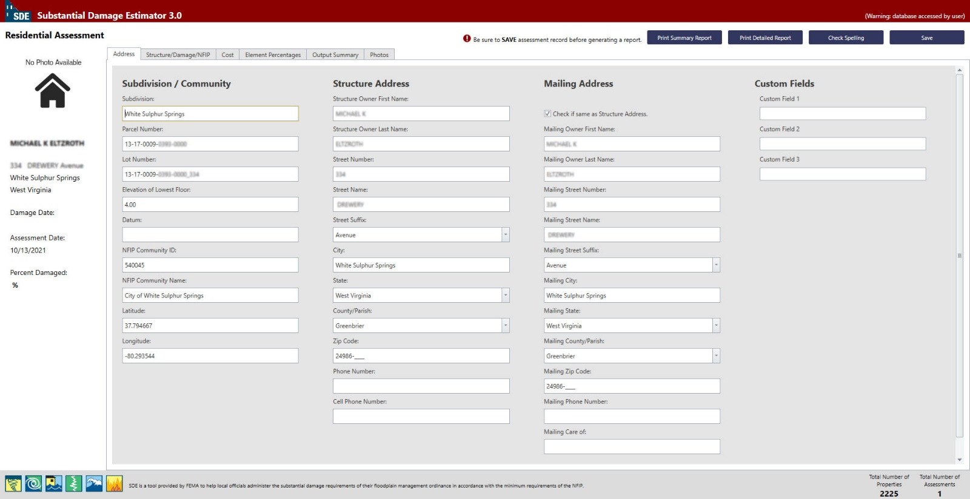
D. Estimating Damage
1
10/10/2021
Owner’s Name and Address
Check it if the Mailing Address and Structure’s Address are the same. Owner Address is on WV Flood Tool.
Parcel’s Geographic Data
Further information can be imported here
Total Number of Assessment should be changed to “1”
When this page displays, review the filled fields of the Non-SDE community data imported from Spreadsheet. Verify or add property and flood information from WV Flood Tool Website

Slide 18
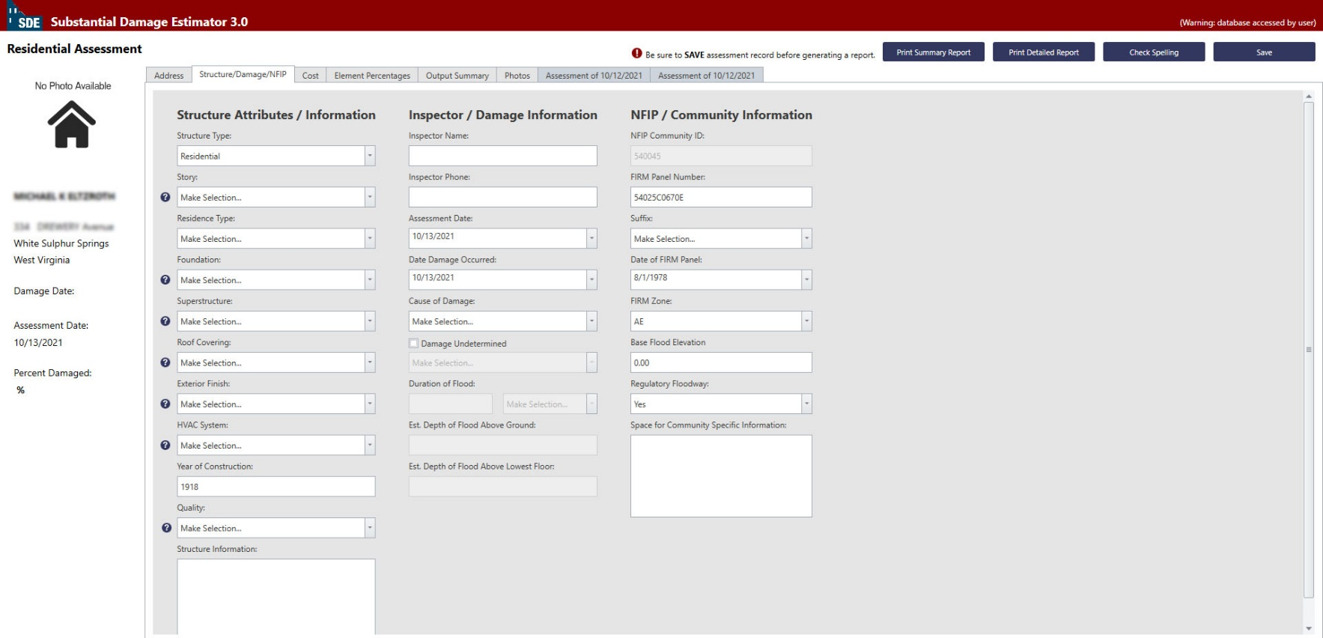
D. Estimating Damage
2
Now, click on Structure/Damage/NFIP.
Required fields
Optional fields
Some fields have been loaded automatically from the Spreadsheet, but there are some other that should be manually filled.

Slide 19
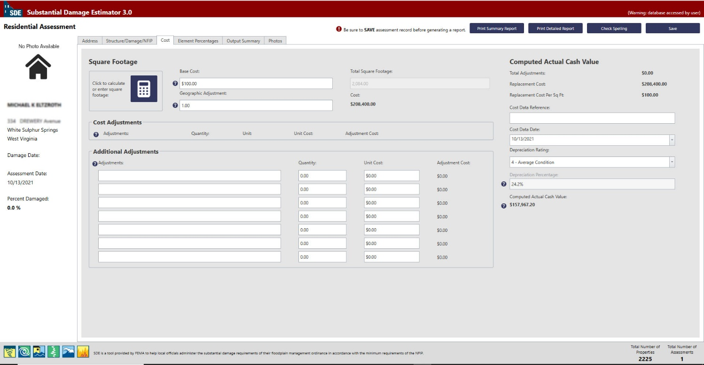
D. Estimating Damage
3
10/10/2021
Now, click on Cost.
Residential:100
Required fields
Should be “1”
Non-Residential:200

Slide 20
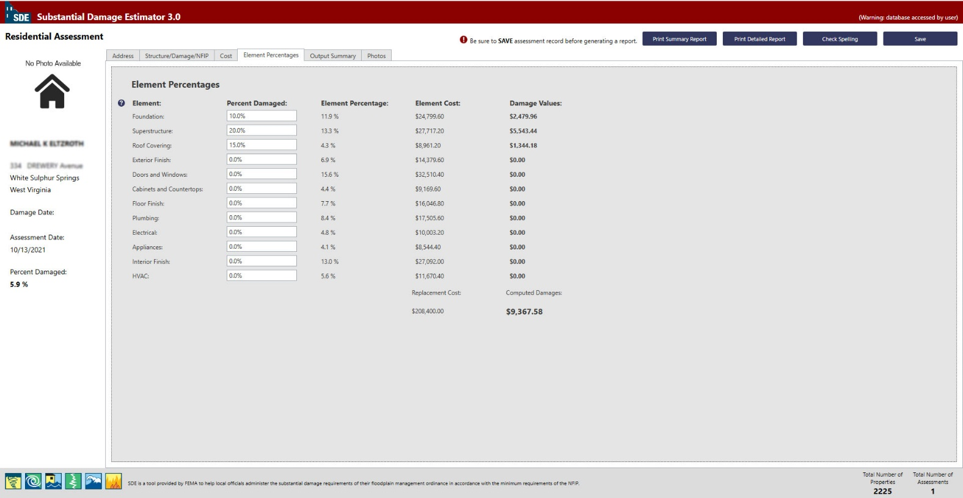
D. Estimating Damage
4
10/10/2021
Now, click on Element Percentage.
If you know the amount of percentage damage on the elements of the buildings, fill the related fields. Remember that it may not be necessary for all the threshold makers to be met to achieve the indicated level of damage.

Slide 21
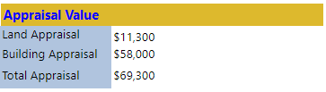
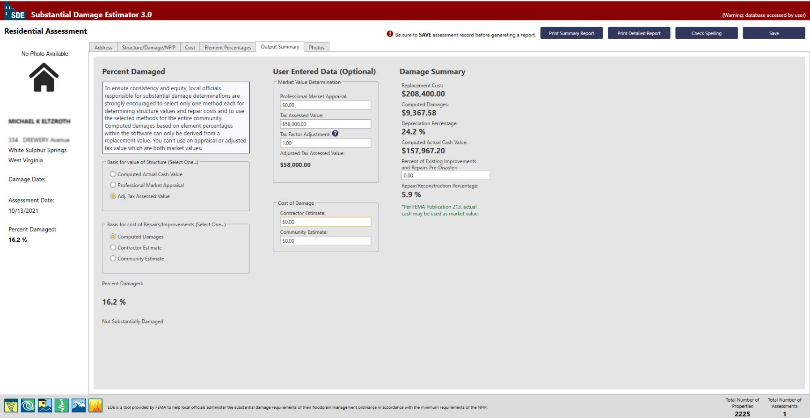
D. Estimating Damage
5
10/10/2021
Basis for value of structure should be set on: Adj. Tax Assessed Value
Tax Assessment Value is found in WV Assessment
If you’re not sure about Tax Factor Adjustment write 1.
Damage Summary will be calculated and shown up here.

Slide 22
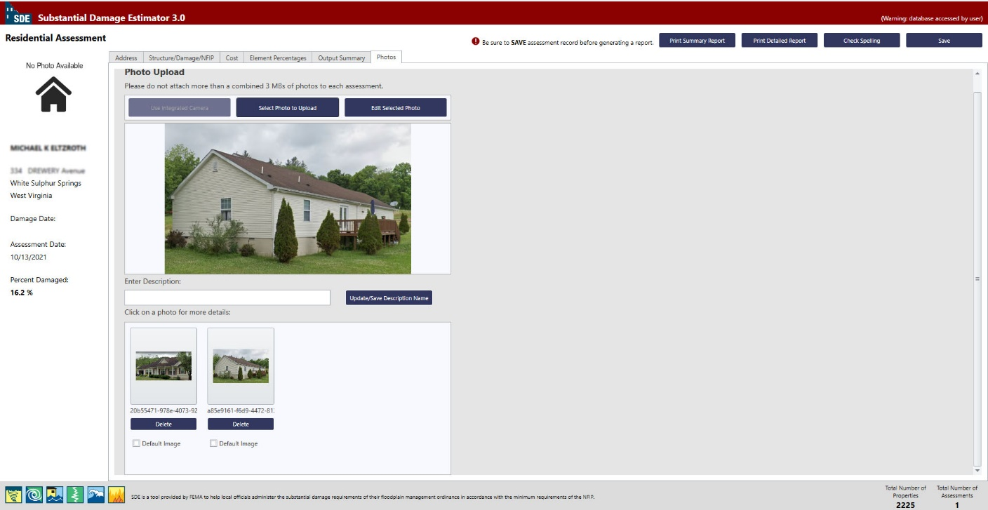
D. Estimating Damage
6
10/10/2021

Slide 23

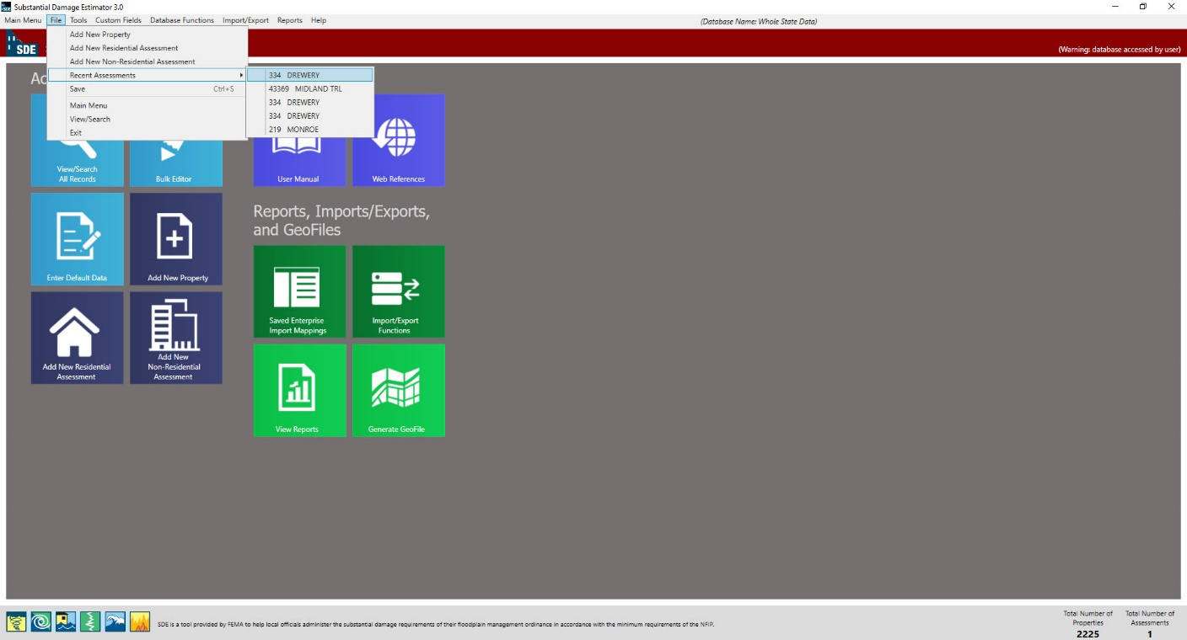
D. Estimating Damage
Make Sure to Save Data before closing.
10/10/2021
You can Print Summary Report or Print detailed Report at the end.
During working, you can save and exit the software if needed. When come back, to find the recent assessment you were working, go to: file/Recent Assessment and find it among five recent assessments.

Slide 24
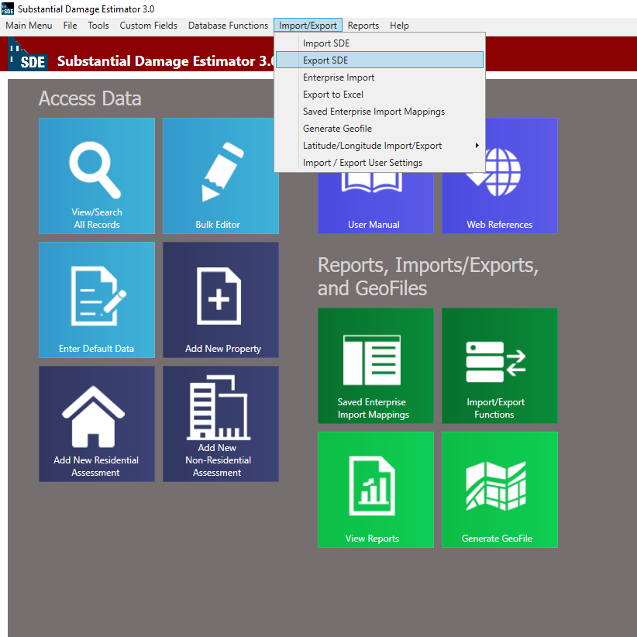
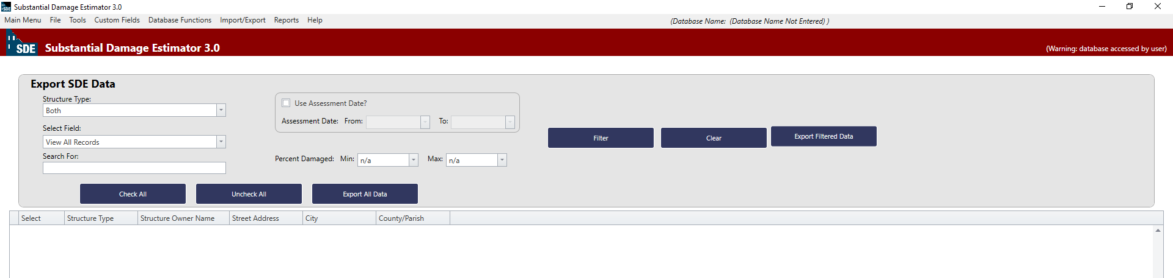
D. Exporting SDE Data
After Estimating the damage, or during the process it is possible to export SDE data as “Json” files, to be used in another computer.
Select Export SDE and then this page will appear:
1- Select Structure Type, or leave it as it is
2- You can search for a specific property based on owners name, address, city, community, parcel number, etc.
3- Then Press filter to data be displayed

Slide 25
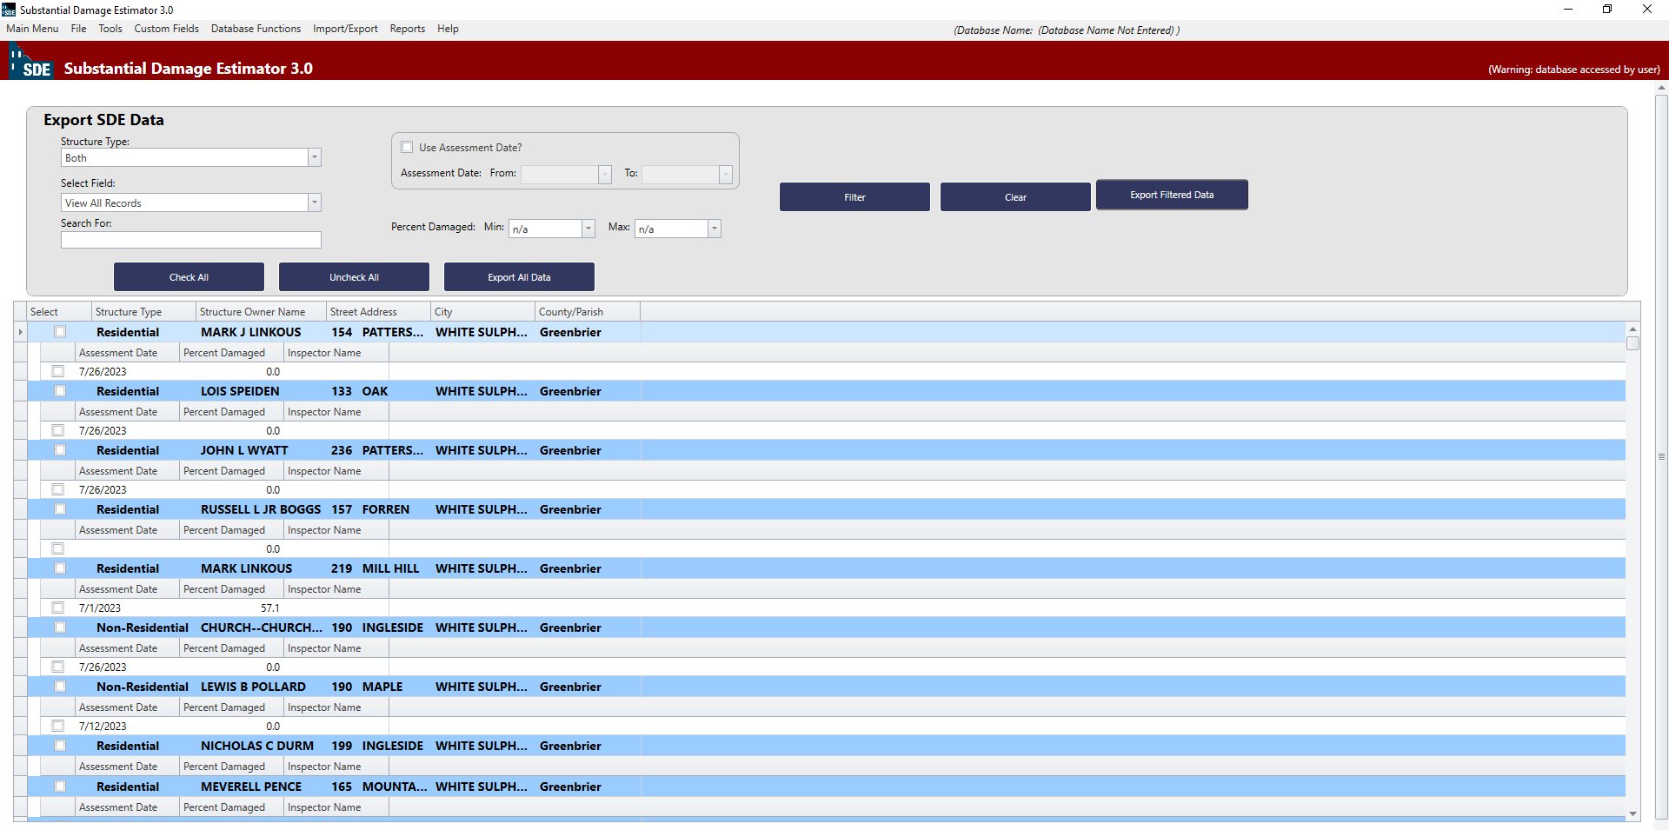
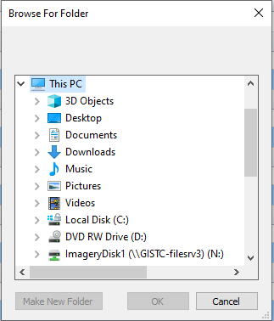
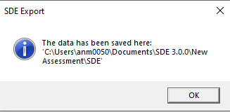
D. Exporting SDE Data
The imported property records will be appeared:
4- Check one/some or all the data and then click on Export All Data or Export Filtered Data
Save the Exported file on your Local Drive

Slide 26

Instructions drafted by the WVGISTC Team in support of State NFIP Office. If you have any Questions, please Contact Kurt Donaldson: Kurt.Donaldson@mail.wvu.edu Or Annie Mahmoudi: anm0050@mail.wvu.edu

