Slide 1
Flood Risk Review Meeting
FEMA Region 3
Flood Risk Review Meeting
Berkeley County, WV April 4, 2025

Slide 2

Agenda
Welcome and Introductions
Where We Are - Draft Maps
Flood Study Update
Using Flood Risk Data to Reduce Risk
Floodplain Management
Discussion

Slide 3

Introductions
  Please Introduce Yourself
  Name.
  Position.
  Organization.

Slide 4
Where We Are – Draft Maps

Slide 5

3 Reasons We Are Here Today
To preview and discuss the updated Flood Insurance Study (FIS) report and Flood Insurance Rate Map (FIRM) for Berkeley County, West Virginia
To examine the new study areas, discuss how the analysis and mapping have changed since the previous FIRM, and discuss current and future implications for these changes
To present a timeline of next steps

Slide 6

Timeline – Looking Back
Current Effective Maps
July 2009
Risk MAP Study Notification
January 2023
Preliminary Maps and CCO Meeting
End of Appeal Period
Updated Effective Maps
Kick-Off/Discovery Meeting
November 2021
Flood Risk Review Meeting
Appeal Period Start
FEMA Issues Letter of Final Determination (LFD)

Slide 7
Timeline – Looking Ahead
Current Effective Maps
Risk MAP Study Notification
Preliminary Maps and CCO Meeting
Fall 2025
End of Appeal Period
90 days after Appeal Start
Updated Effective Maps
6 months after LFD
Discovery Meeting
Flood Risk Review Meeting
April 4, 2025
Appeal Period Start
Spring 2026
FEMA Issues Letter of Final Determination (LFD)
Winter 2026

Slide 8
Flood Study Update

Slide 9
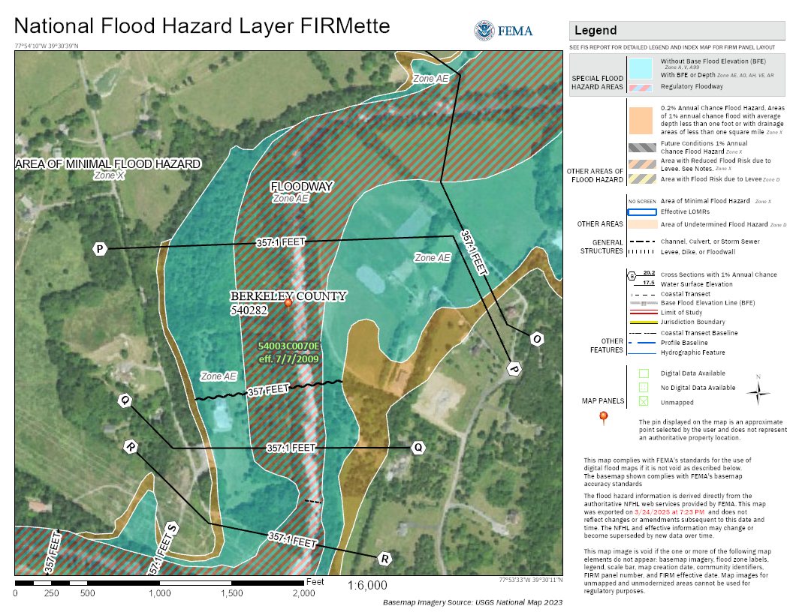
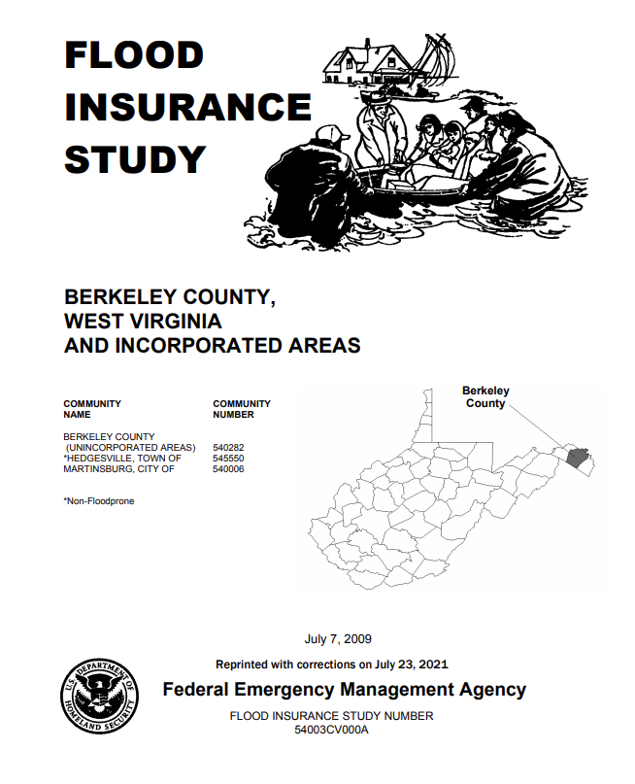
Flood Insurance Rate Maps and Studies
Key Terms:
Flood Insurance Rate Map (FIRM)
Flood Insurance Study (FIS) Report
Special Flood Hazard Area (SFHA)
Flood Zone
Base Flood Elevation (BFE)
Regulatory Floodway
Cross Section

Slide 10



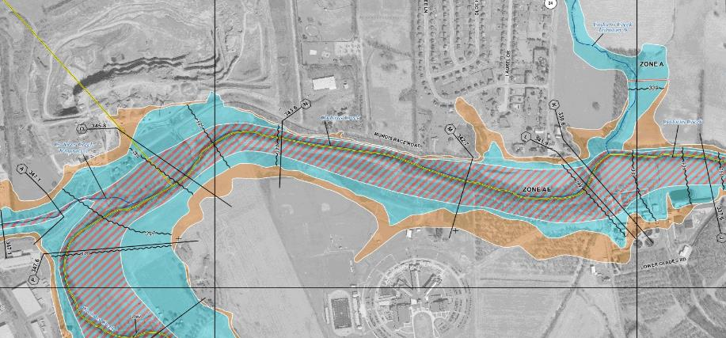
Typical FIRM Panel and Flood Zones
Zone AE
Floodway
Zone AE
Zone X
Shaded
Zone X
Zone A

Slide 11

Floodplain Map Overview
HIGH RISK (Special Flood Hazard Area) |  |  | Regulatory Floodway
 |  |  | 1%-Annual-Chance Flood Hazard Area with BFEs
 |  |  | 1%-Annual-Chance Flood Hazard Area without published BFEs
MODERATE RISK |  |  | 0.2%-Annual-Chance Flood Hazard Area
 |  |  | Cross Sections with 1%-Annual-Chance Water Surface Elevation Value
ZONE AE
ZONE A
Notes:
Discuss 1% floodplain and 0.2% floodplain, floodway, cross sections, and BFEs
“Cross sections now show water surface elevations.”
“Transparent fills over aerial photography”
“new maps will look different”

Slide 12
Floodplain Map Overview
HIGH RISK (Special Flood Hazard Area)
MODERATE RISK
 |  |  | Cross Sections with 1%-Annual-Chance Water Surface Elevation Value
Development is not allowed unless “no rise” in flood levels is certified
ZONE AE
Flood insurance is mandatory for structures with federally backed mortgages
ZONE A
Flood insurance is not mandatory
Notes:
It is highly recommended that owners get flood insurance in areas of moderate risk even though it is not required

Slide 13

Study Overview
Revised Modeling and Mapping, including:
        Updated GIS-based regulatory products, including:
          Updated FIRMs / GIS database / FIS report formats based on new FEMA guidelines and specifications
        Used high-resolution topographic data (for modeling and mapping)
        Detailed “Zone AE” Studies – 48 miles
        Model-backed Approximate “Zone A” Studies – 225 miles
        Floodplains on the Potomac River are NOT being updated as part of this study

Slide 14
Study Overview (continued)
Revised Modeling and Mapping, including:
        Evaluation of Letters of Map Change (LOMCs)
          Case-by-case results shown in a Summary of Map Actions (SOMA) that is sent to applicable communities with Preliminary Maps and Letters of Final Determination (LFDs)
          Letters of Map Revision (LOMRs)
          Letters of Map Amendment (LOMAs) – including rectified LOMA locations on the WV Flood Tool
      Production of associated non-regulatory flood risk
Notes:
Presenter should define LOMC, LOMA, LOMR, and talk about reasons why some LOMCs might be revalidated, incorporated, or superseded.

Slide 15
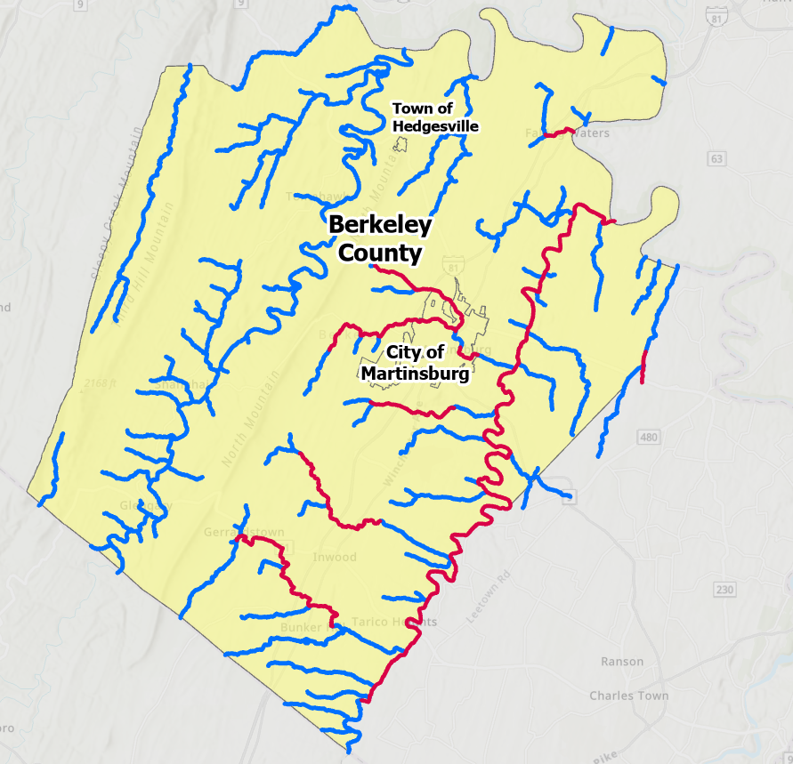
Study Area
Zone AE
Zone A

Slide 16
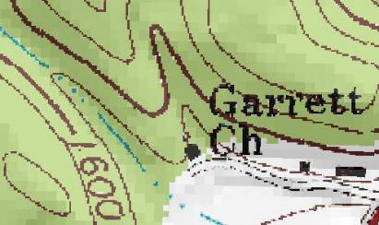
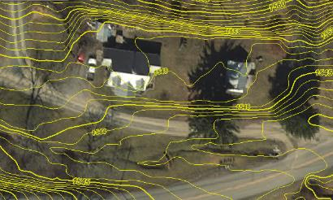
Topographic Data
2012 LiDAR-Based Digital Elevation Model
LiDAR = Light Detection and Ranging
  Uses light pulses and GPS to survey elevation data
  Improves the level of detail for hydraulic modeling and floodplain delineation

Slide 17
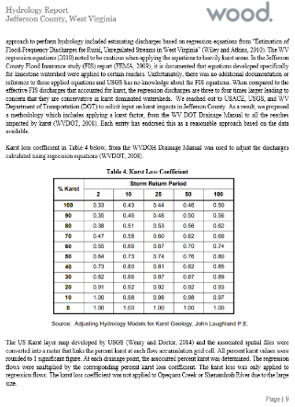
Hydrologic Analyses
Hydrologic study methods included:
  Rainfall Runoff Model (HEC-HMS 4.6)
  USGS Regression Equations
  Regression Equations Supplemented with USGS Gage Analysis (Bulletin 17C)
A comprehensive Hydrology Report details the study methods for each reach and compares the effective and proposed discharges.
The hydrologic study methods will also be published in the FIS Report.
Sample page from the Risk MAP Hydrology Report
Notes:
The study used updated hydrologic analyses to estimate 1-percent-annual-chance flow rates.

Slide 18
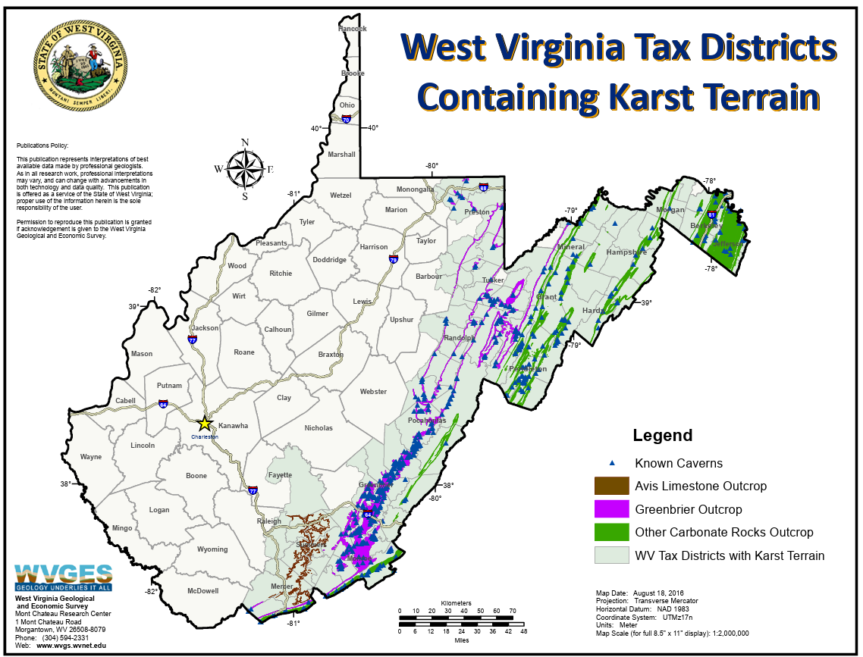
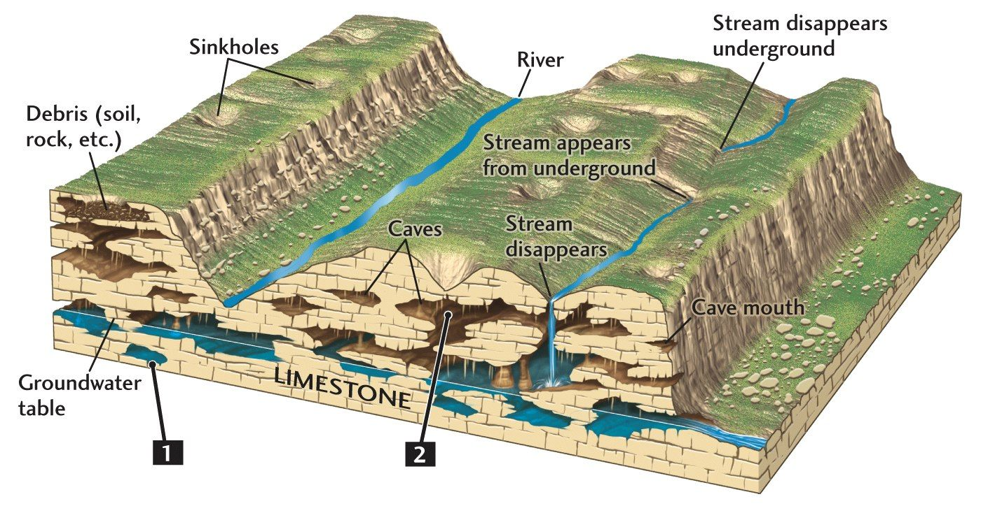
Karst Topography

Slide 19
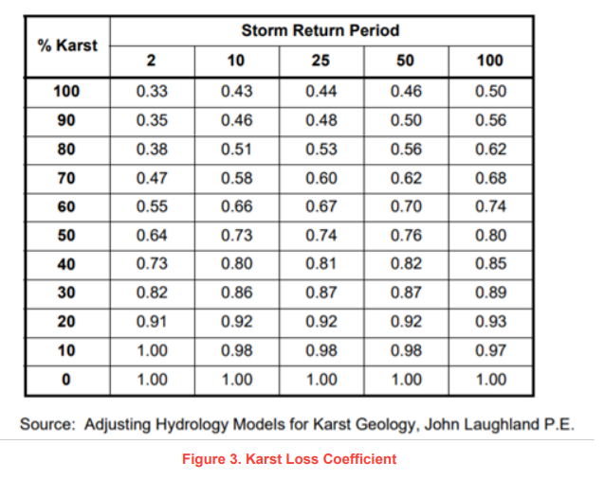
Karst Correction Factor
Karst Correction Factor applied to estimate discharges in watersheds where karst was present.
  Karst Correction Factor values taken from West Virginia Department of Transportation Drainage Manual (2008)
  Water flow during flood events reduced to account for higher amount of rainfall infiltrating into the limestone bedrock instead of running into streams

Slide 20
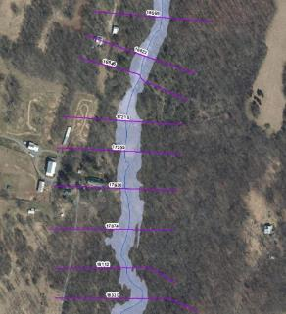
Hydraulic Analyses – Zone A
Approximate "Zone A" Base Level Study (225 miles)
Generally used in areas with lower development or lower development potential
Cross sections generated from LiDAR (automated processes)
  Does not include channel bathymetry
  No hydraulic structures are surveyed or modeled
FIRM will not show Floodway or BFEs (but FIRM database will include cross sections and their associated water surface elevations in the FIRM GIS Database)
FIS Report will not show flood profiles for Zone A reaches

Slide 21
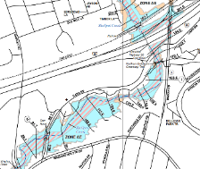
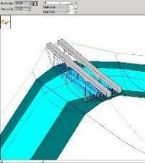
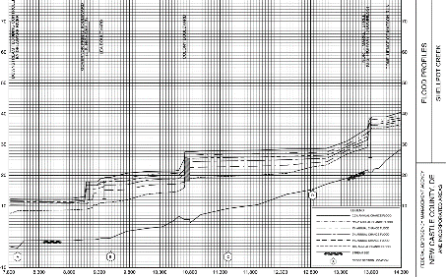
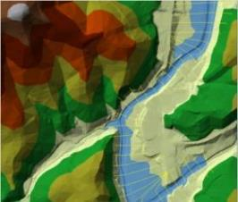
Hydraulic Analyses – Zone AE
Detailed "Zone AE” Study (48 miles)
Generally used in areas with higher development or higher development potential
Cross sections use information from survey and field reconnaissance
  Include channel bathymetry
  Structures are modeled (e.g., culverts, bridges)
Detailed hydraulic parameter refinement (coefficients, obstructions, Manning's ‘n’ values)
FIRM will show Floodway, BFEs, 1% and 0.2%-annual-chance event floodplains
FIS Report will show flood profiles for 10-, 4-, 2-, 1-, 0.2-, and 1% Plus flood frequencies

Slide 22
Study Impacts

Slide 23
Significant Impacts Overview
Compared to the effective NFHL, widening and narrowing of the 1%-annual-chance floodplain (SFHA) extent was observed throughout the county.
Extended study reaches (with drainage areas of 2 square miles and greater, and not on current effective FIRM) result in new properties within the SFHA.
Most streams experienced both increases and decreases when comparing
the computed model WSELs to the current regulatory BFEs.
More structures will be mapped out than mapped in. Basic estimate: -350 / +120
WV Flood Tool – SFHA Future Map Conditions
No Change SFHA | Mapped In SFHA | Mapped Out SFHA | Total Structures
343 (+30 Floodway) | 122 (+3 Floodway) | 276 | 774

Slide 24
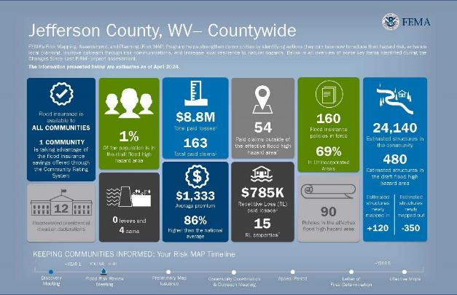
Flood Risk Dashboard
CLAIMS OUTSIDE OF THE SFHA
NFIP FLOOD CLAIM
PAYOUTS
NFIP FLOOD
POLICIES
AFFECTED RESIDENTS
HIGH-RISK
STRUCTURES
AVERAGE PREMIUM
REPETITIVE
LOSSES

Slide 25
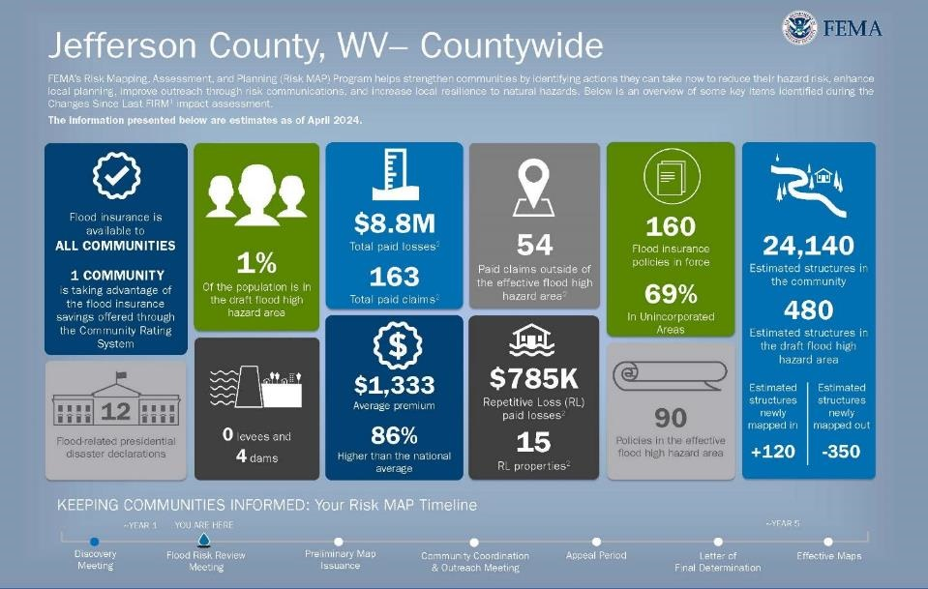
Flood Risk Dashboard
Notes:
Messaging - how are you going to message to your community about these new maps.

Slide 26
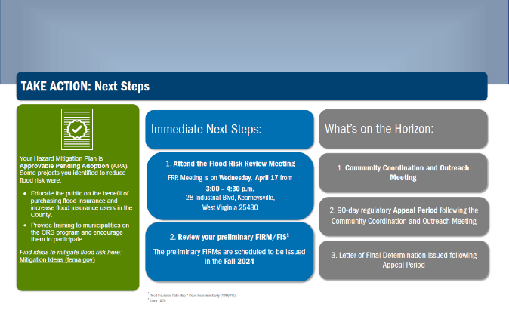
Flood Risk Dashboard (page 2)
HMP EXPIRATION INFO
STEPS BEFORE PRELIMINARY ISSUANCE
FLOOD MITIGATION ACTIONS
STEPS AFTER PRELIMINARY ISSUANCE

Slide 27
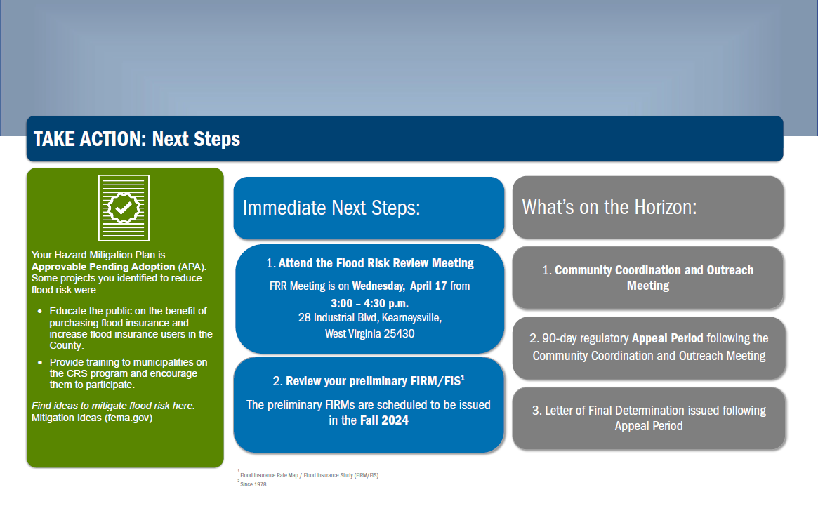
Flood Risk Dashboard (page 2)
Notes:
This is the second page of the jurisdictional dashboard.

Slide 28
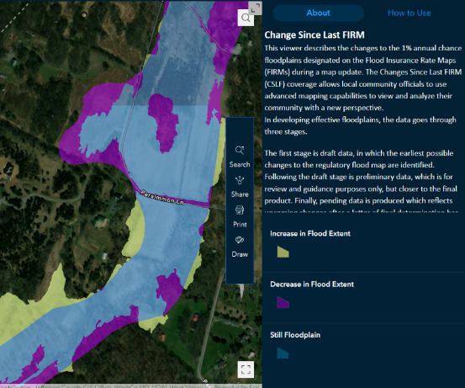
How Did the Floodplain Maps Change?
FEMA Region 3
Changes Since Last FIRM (CSLF) Viewer:
https://arcg.is/ijSne
Change in Floodplain Extents:
  Purple – Decrease
  Blue – Still Floodplain
  Yellow – Increase
*Map view has scale-dependent layers

Slide 29
Using Flood Risk Data to Identify and Reduce Risk

Slide 30
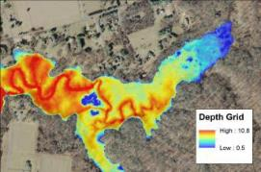
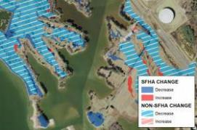
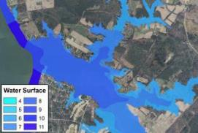
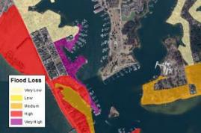
FEMA Flood Risk GIS Datasets
Flood Depth
and Analysis
Grids
Changes Since Last FIRM
Water Surface Elevation
Grids
Flood Risk
Assessment

Slide 31

Where to Find Flood Risk Data
FEMA’s Flood Map Service Center (MSC)
  Here, you can view effective maps online. You can also download current effective flood hazard data and additional hazard and risk data.
  https://msc.fema.gov/portal/home
National Flood Hazard Layer (NFHL)
  This geospatial data viewer contains current effective flood hazard data.
  https://www.fema.gov/flood-maps/national-flood-hazard-layer
State Flood Tool
  This geospatial data viewer contains current effective flood hazard data and additional hazard and risk data.

Slide 32
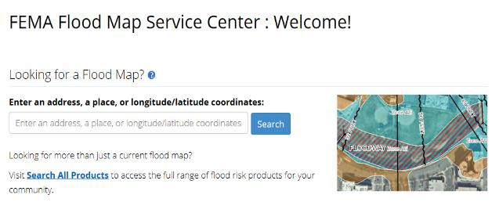
Where Can I Find My Flood Maps?
The FEMA Map Service Center (MSC) is the official public source for flood hazard information: https://msc.fema.gov/portal/home.
Enter an address for location search

Slide 33
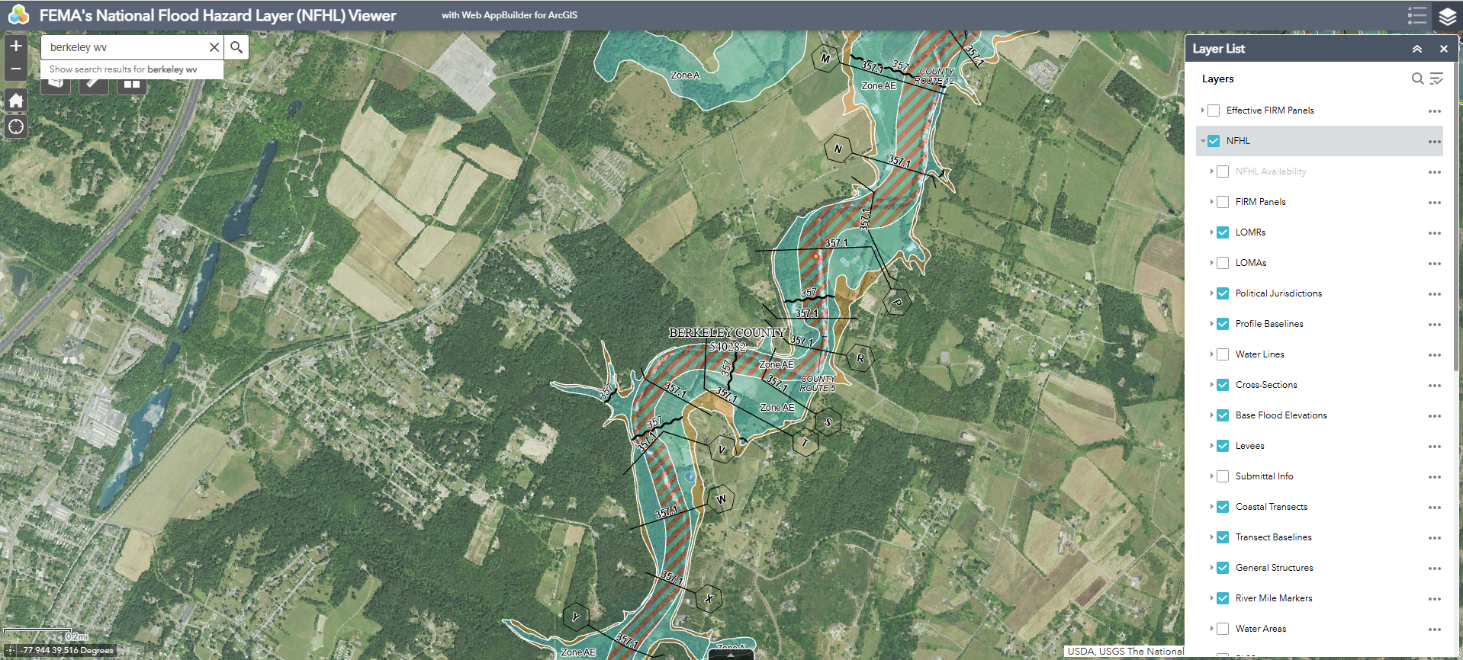
National Flood Hazard Layer
The NFHL shows the effective FEMA flood map data, including Letters of Map Revision (LOMRs).Visit https://www.fema.gov/national-flood-hazard-layer-nfhl for multiple options to view and download NFHL data.

Slide 34
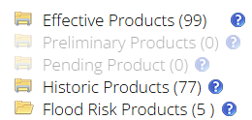
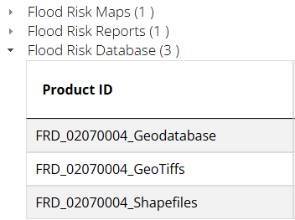
Additional Hazard and Risk Data
If additional hazard and risk data are available for your community, the MSC Search Results will allow you to expand the Flood Risk Products folder.

Slide 35
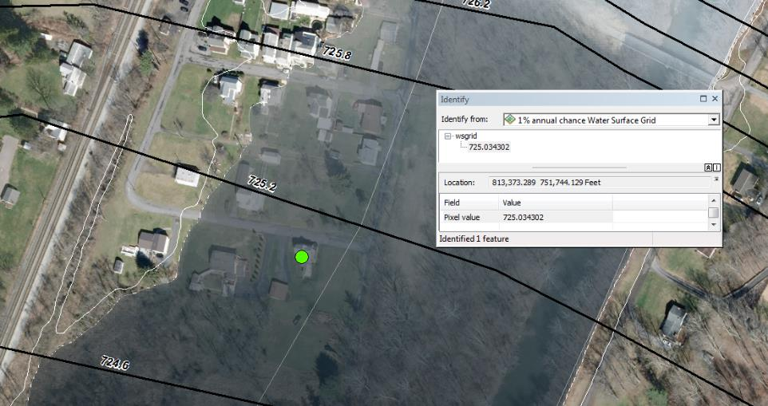
Water Surface Elevation Grids
Represents the continuous water surface elevations (as determined at modeled cross sections and interpolated between cross sections) for each of the modeled flood frequencies.

Slide 36
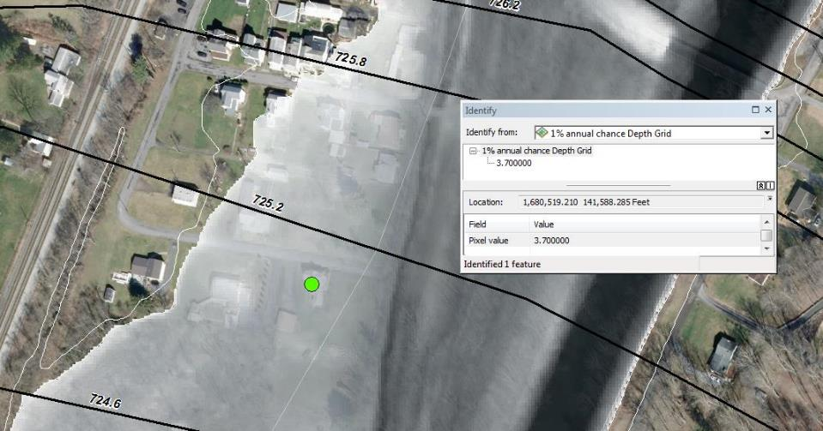
Depth Grids
Represents the difference between the ground surface elevation and the water surface elevations in feet for each of the modeled flood frequencies.

Slide 37
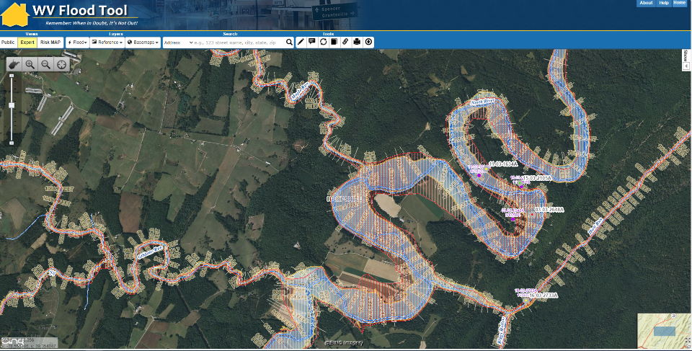
West Virginia Flood Risk Tool
WV Flood Tool (mapwv.gov)

Slide 38
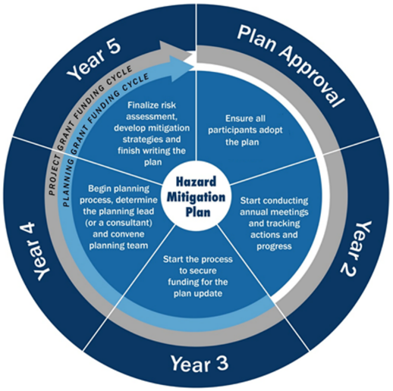
Flood Hazard Mitigation Planning
It’s time to update the risk assessment in your hazard mitigation plan
The Berkeley County HMP is here

Slide 39
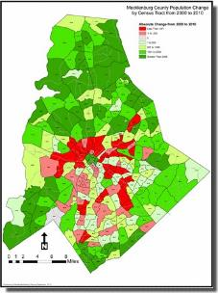
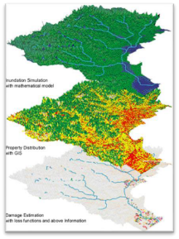

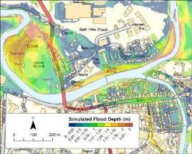
Using Flood Risk Data to Manage Development
Structure-based depth of flooding analyses
Prioritization of mitigation action
Residential/commercial density in the floodplain
Location/inundation area of historic events
Properties with insurance policies and as a percentage of the population
Areas of population growth
Areas requiring protection

Slide 40
Floodplain Management

Slide 41
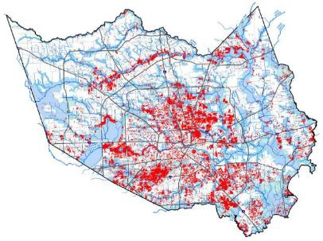
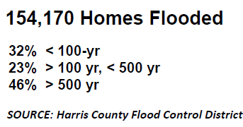
Flood Risk Doesn’t Stop at a Line
40% of all flood insurance claims come from outside high-risk areas.
Your community can regulate to standards higher than the NFIP minimum standards. Consider strengthening regulations using:
  0.2%-annual-chance flood zone
  “Freeboard” – require additional feet above a BFE
  Buffer around SFHA
  Flood depth grids
HURRICANE HARVEY
GREATER HOUSTON

Slide 42




Floodplain Management at FRR
Look at where there are changes to the SFHA in your community
Share with permitting, planning, and other colleagues to direct development outside of the SFHA today and in future
Consider higher standards or joining the Community Rating System to support your community
FRR:
SFHA:
Flood Risk Review
Special Flood Hazard Area
Notes:
It is not too early to plan ahead.

Slide 43


Floodplain Management Big Picture
Build it right and lower the impact of future flood losses while improving resiliency | Build it wrong and the result could be increased flood losses and higher flood insurance premiums
Notes:
Where it rains it can flood - A significant number of NFIP claims are outside the SFHA
Flood risk changes
FRR draft maps represent change for you community
Climate change could further increase flood risk in your community

Slide 44
Discussion

Slide 45
Timeline – Looking Ahead
Current Effective Maps
Risk MAP Study Notification
Preliminary Maps and CCO Meeting
Fall 2025
End of Appeal Period
90 days after Appeal Start
Updated Effective Maps
6 months after LFD
Discovery Meeting
Flood Risk Review Meeting
April 4, 2025
Appeal Period Start
Spring 2026
FEMA Issues Letter of Final Determination (LFD)
Winter 2026

Slide 46
Project Contacts – West Virginia
State NFIP/CTP Office:
Gabriel Reed
State Hazard Mitigation Officer
(304) 414-7673
Gabriel.a.reed@wv.gov
Kevin Sneed
CTP Project Officer
304-957-2571
kevin.l.sneed@wv.gov
Julia Sears
State NFIP Coordinator
304-989-8330
julia.r.sears@wv.gov
FEMA Region 3:
Amanuel Ghebreegziabher
FEMA Project Officer
(202) 718-2759
amanuel.ghebreegziabher@fema.dhs.gov
Bill Kuhn
Community Planner
william.kuhn@fema.dhs.gov
Betsy Ranson
Floodplain Management Specialist
(215) 347-0686
elizabeth.ranson@fema.dhs.gov
Bill Bradfield
Insurance Specialist
(202) 880-5906
william.b.bradfield@fema.dhs.gov

Slide 47

Department of Homeland Security logo - FEMA

