Slide 1
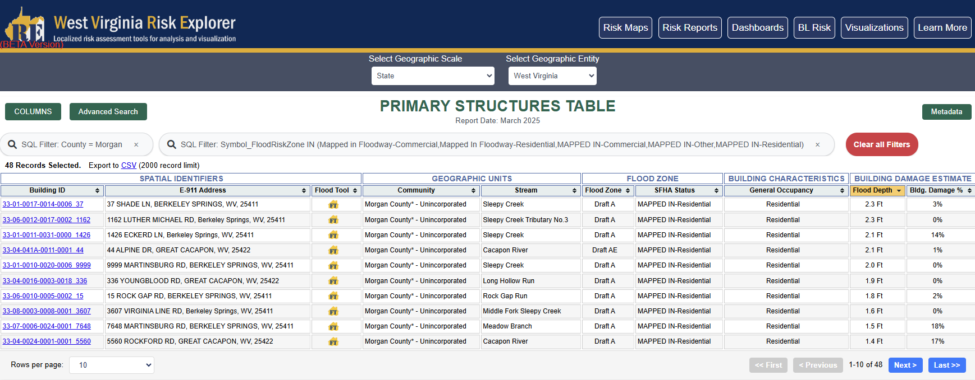
West Virginia Risk Explorer
New Building-Level Risk Tools enable further exploration of impacted buildings:
Morgan Mapped-In Structures
Morgan Mapped-Out Structures
Morgan Risk Index (incl. Top 20% Risk Indicators Report)
Mapped into SFHA

Slide 2
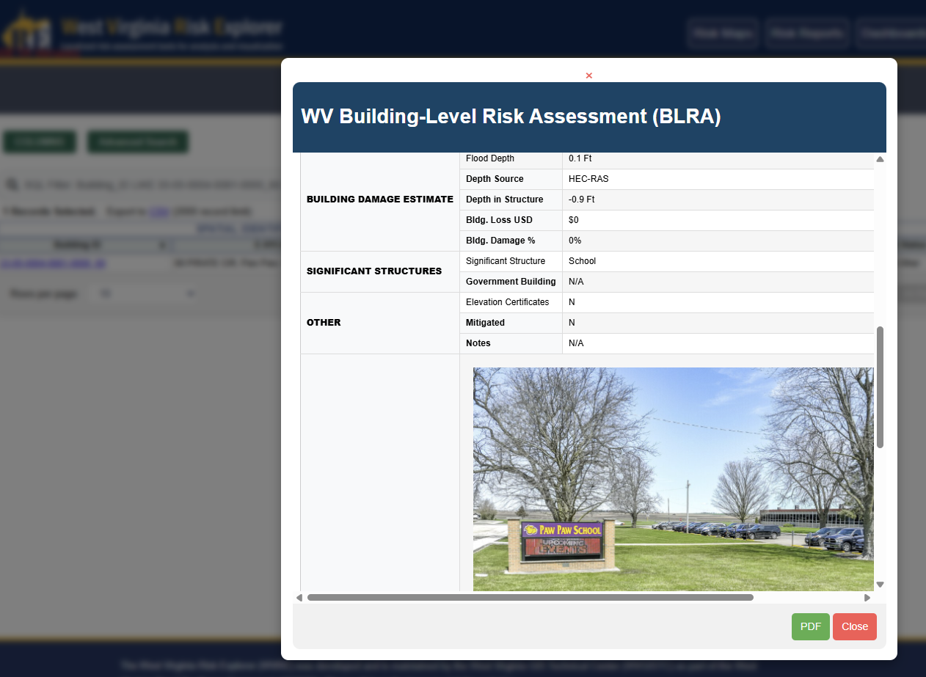
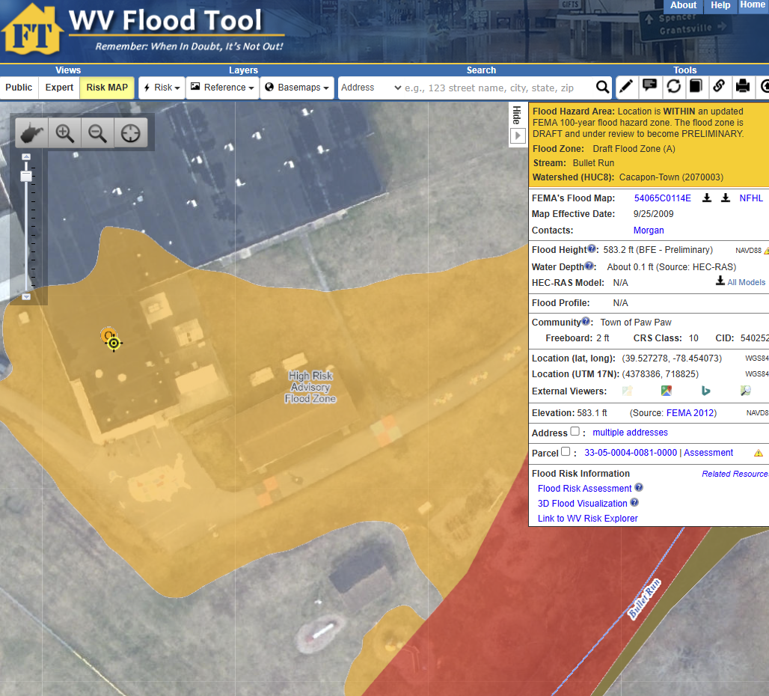
West Virginia Risk Explorer
New Building-Level Risk Tools enable further exploration of impacted buildings:
Morgan Mapped-In Structures (Essential Facility: Paw Paw Elementary School)
Morgan Mapped-Out Structures
Morgan Risk Index (incl. Top 20% Risk Indicators Report)
Paw Paw Elementary School
Paw Paw Elementary School
BL Tool Link
WV Flood Tool Link

