Slide 1
Flood Risk Review Meeting
FEMA Region 3
Flood Risk Review Meeting
Morgan County, WV - May 9, 2025

Slide 2

Agenda
Welcome and Introductions
Where We Are - Draft Maps
Flood Study Update
Using Flood Risk Data to Reduce Risk
Floodplain Management
Discussion

Slide 3

Introductions
Please Introduce Yourself
Name.
Position.
Organization.

Slide 4
Where We Are – Draft Maps

Slide 5

3 Reasons We Are Here Today
To preview and discuss the updated Flood Insurance Study (FIS) report and Flood Insurance Rate Map (FIRM) for Morgan County, West Virginia
To examine the new study areas, discuss how the analysis and mapping have changed since the previous FIRM, and discuss current and future implications for these changes
To present a timeline of next steps

Slide 6

Timeline – Looking Back
Advisory Flood Height Modeling/Mapping
~2012
Preliminary Maps and CCO Meeting
End of Appeal Period
Updated Effective Maps
Risk MAP Study Notification
October 2021 and November 2022
Current Effective Maps (Digital Conversion)
September 2009
Kick-Off Meeting
November 2021
Flood Risk Review Meeting
Appeal Period Start
FEMA Issues Letter of Final Determination (LFD)

Slide 7
Timeline – Looking Ahead
Advisory Flood Height Modeling/Mapping
Risk MAP Study Notification
Preliminary Maps and CCO Meeting
Fall/Winter 2025
End of Appeal Period
90 days after Appeal Start
Updated Effective Maps
6 months after LFD
Current Effective Maps (Digital Conversion)
Kick-Off Meeting
Flood Risk Review Meeting
May 9, 2025
Appeal Period Start
Spring 2026
FEMA Issues Letter of Final Determination (LFD)
Fall/Winter 2026

Slide 8
Flood Study Update

Slide 9
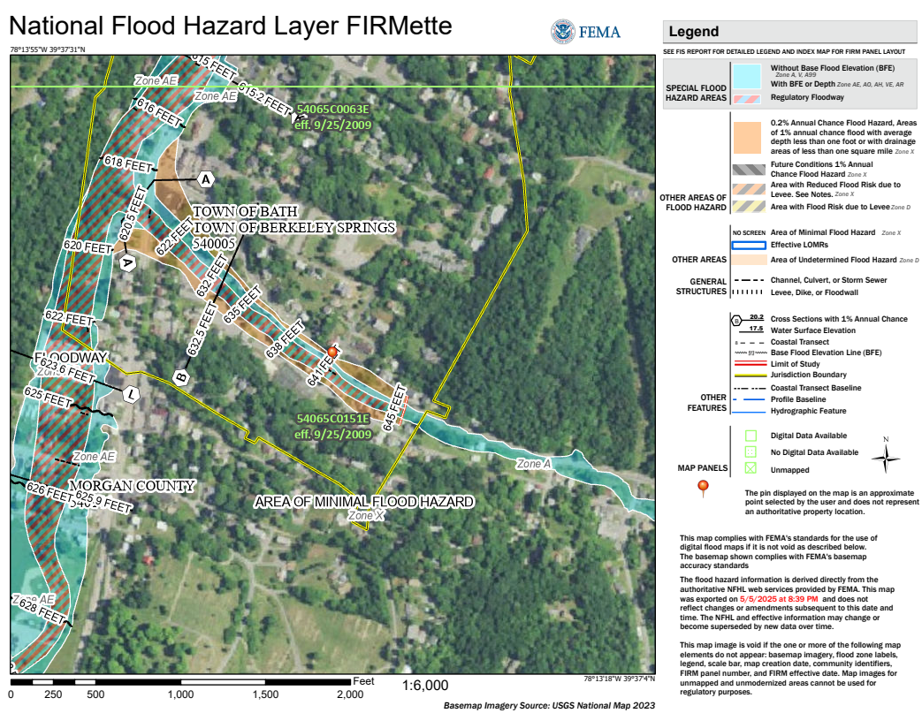
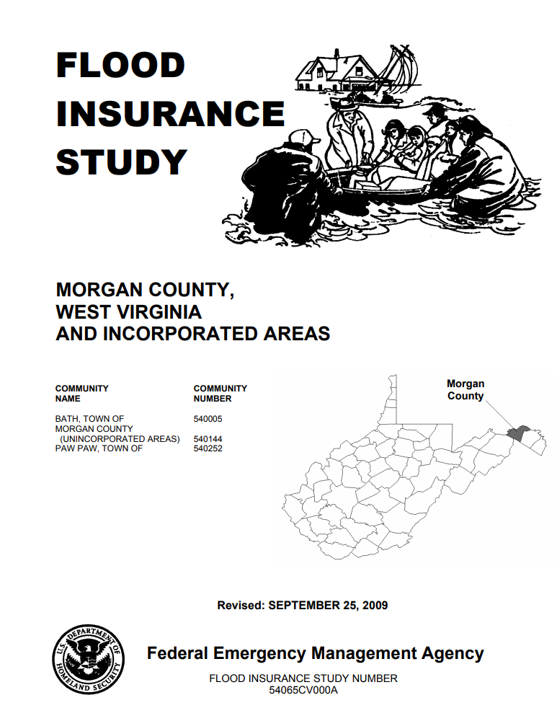
Flood Insurance Rate Maps and Studies
Key Terms:
Flood Insurance Rate Map (FIRM)
Flood Insurance Study (FIS) Report
Special Flood Hazard Area (SFHA)
Flood Zone
Base Flood Elevation (BFE)
Regulatory Floodway
Cross Section

Slide 10



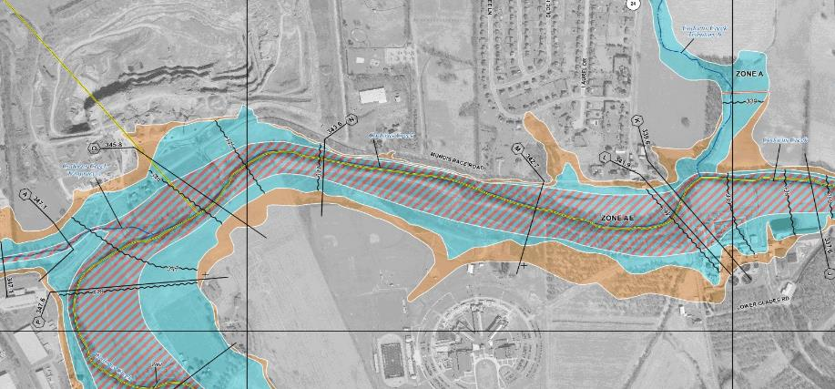
Typical FIRM Panel and Flood Zones
Zone AE
Floodway
Zone AE
Zone X
Shaded
Zone X
Zone A

Slide 11

Floodplain Map Overview
HIGH RISK (Special Flood Hazard Area) |  |  | Regulatory Floodway
 |  |  | 1%-Annual-Chance Flood Hazard Area with BFEs
 |  |  | 1%-Annual-Chance Flood Hazard Area without published BFEs
MODERATE RISK |  |  | 0.2%-Annual-Chance Flood Hazard Area
 |  |  | Cross Sections with 1%-Annual-Chance Water Surface Elevation Value
ZONE AE
ZONE A
Notes:
Discuss 1% floodplain and 0.2% floodplain, floodway, cross sections, and BFEs
“Cross sections now show water surface elevations.”
“Transparent fills over aerial photography”
“new maps will look different”

Slide 12
Floodplain Map Overview
HIGH RISK (Special Flood Hazard Area)
MODERATE RISK
 |  |  | Cross Sections with 1%-Annual-Chance Water Surface Elevation Value
Development is not allowed unless “no rise” in flood levels is certified
ZONE AE
Flood insurance is mandatory for structures with federally backed mortgages
ZONE A
Flood insurance is not mandatory
Notes:
It is highly recommended that owners get flood insurance in areas of moderate risk even though it is not required

Slide 13

Study Overview
Revised Modeling and Mapping, including:
Updated GIS-based regulatory products, including:
Updated FIRMs / GIS database / FIS report formats based on new FEMA guidelines and specifications
High-resolution topographic data (for modeling and mapping)
Detailed “Zone AE” Studies – 22 miles
Model-backed Approximate “Zone A” Studies – 165 miles
Floodplains on the Potomac River are NOT being updated as part of this study

Slide 14
Study Overview (continued)
Revised Modeling and Mapping, including:
Evaluation of Letters of Map Change (LOMCs)
Case-by-case results shown in a Summary of Map Actions (SOMA) that is sent to applicable communities with Preliminary Maps and Letters of Final Determination (LFDs)
Letters of Map Revision (LOMRs)
Letters of Map Amendment (LOMAs) – including rectified LOMA locations on the WV Flood Tool
Production of associated non-regulatory flood risk
Notes:
Presenter should define LOMC, LOMA, LOMR, and talk about reasons why some LOMCs might be revalidated, incorporated, or superseded.

Slide 15
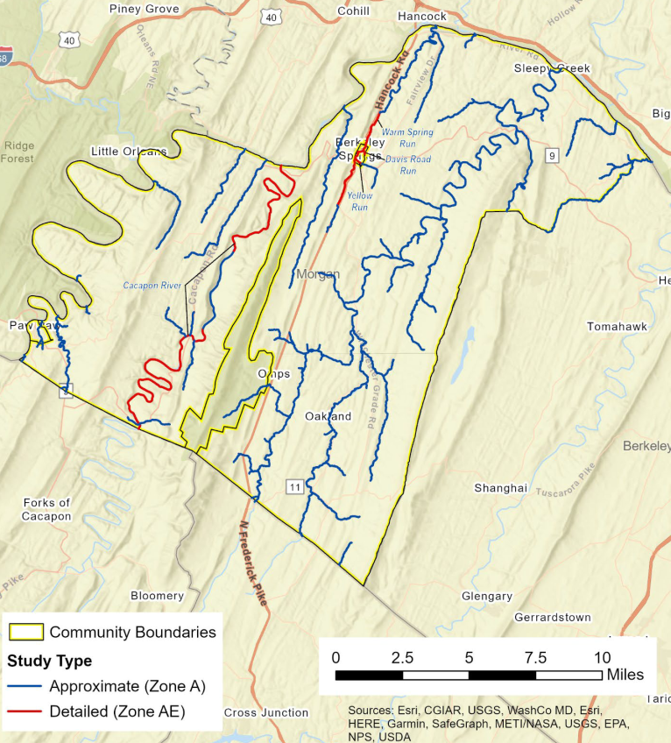
Study Area

Slide 16
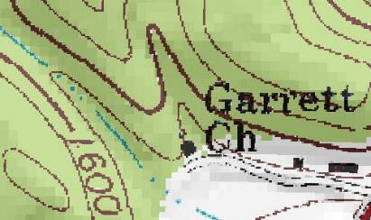
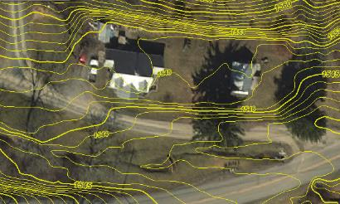
Topographic Data
2012 LiDAR-Based Digital Elevation Model LiDAR = Light Detection and Ranging
Uses light pulses and GPS to survey elevation data
Improves the level of detail for hydraulic modeling and floodplain delineation

Slide 17
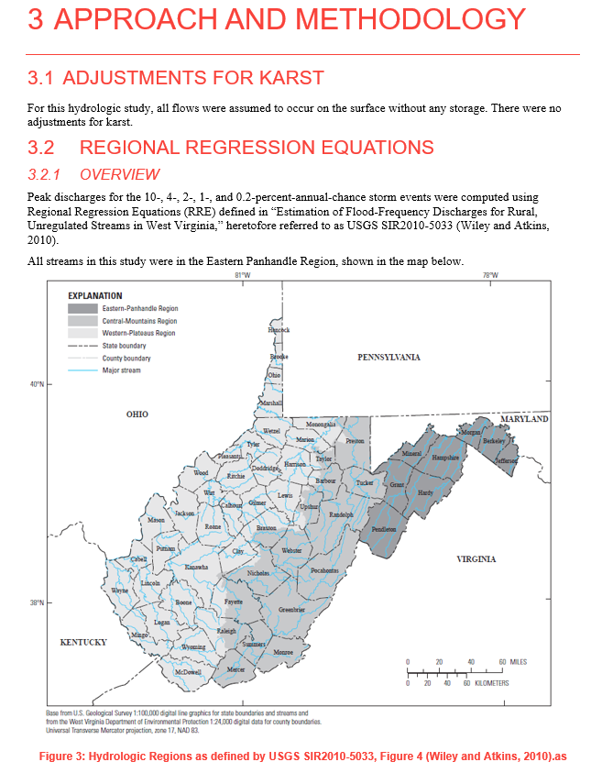
Hydrologic Analyses
Hydrologic study methods included:
USGS Regression Equations
Regression Equations Supplemented with USGS Gage Analysis (Bulletin 17C)
HEC-HMS 4.10, Rainfall-Runoff for Davis Road Run, Warm Spring Run, and Yellow Run.
A comprehensive Hydrology Report details the study methods for each reach and compares the effective and proposed discharges.
The hydrologic study methods will be summarized and published in the forthcoming FIS Report.
Sample page from the Risk MAP Hydrology Report
Notes:
The study used updated hydrologic analyses to estimate 1-percent-annual-chance flow rates.

Slide 18
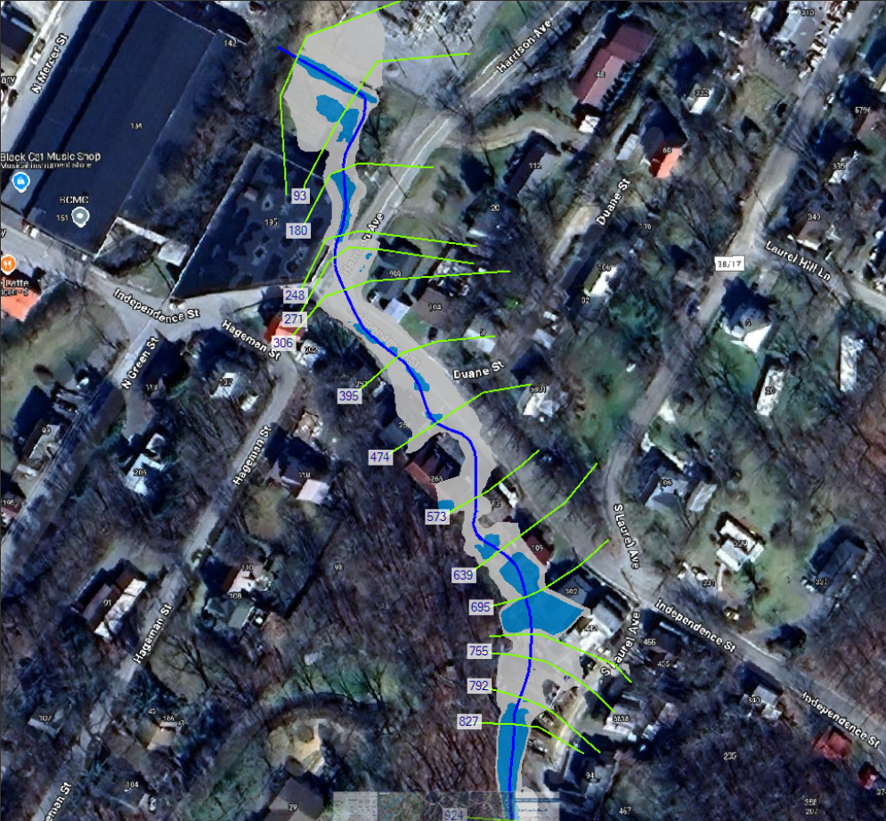
Hydraulic Analyses – Zone A
Approximate “Zone A” Base Level Study (165 miles)
Generally used in areas with lower development or lower development potential
Cross sections generated from LiDAR
Does not include channel bathymetry
No hydraulic structures are surveyed or modeled
FIRMs will not show Floodway or BFEs (but FIRM database will include cross sections and their associated water surface elevations in the FIRM GIS Database)
FIS Report will not show flood profiles for Zone A reaches

Slide 19
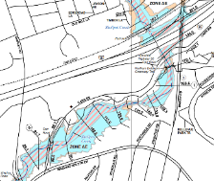
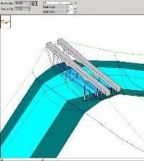
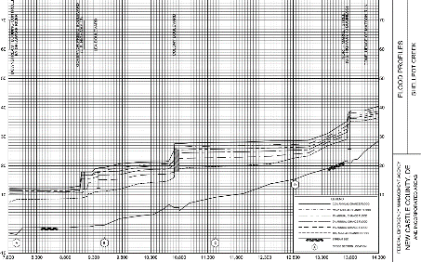
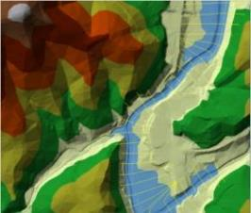
Hydraulic Analyses – Zone AE
Detailed “Zone AE” Study (22 miles)
Generally used in areas with higher development or higher development potential
Cross sections use information from survey and field reconnaissance
Include channel bathymetry
Structures are modeled (e.g., culverts, bridges)
Detailed hydraulic parameter refinement (coefficients, obstructions, Manning's ‘n’ values)
FIRMs will show Floodway, BFEs, 1% and 0.2%-annual-chance event floodplains
FIS Report will show flood profiles for 10-, 4-, 2-, 1-, 0.2-, and 1% Plus flood frequencies

Slide 20

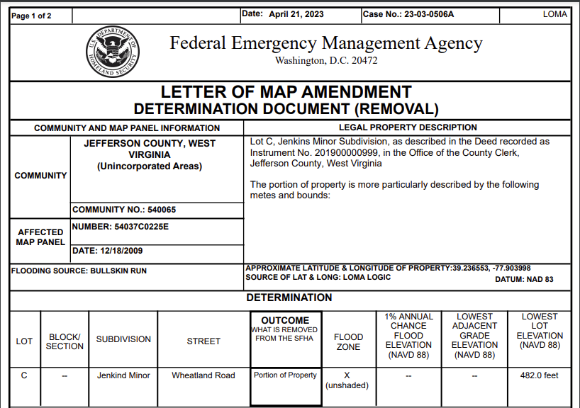
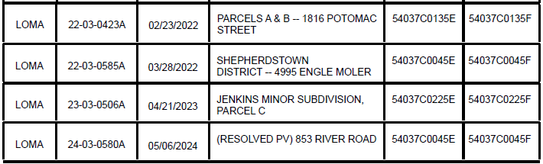

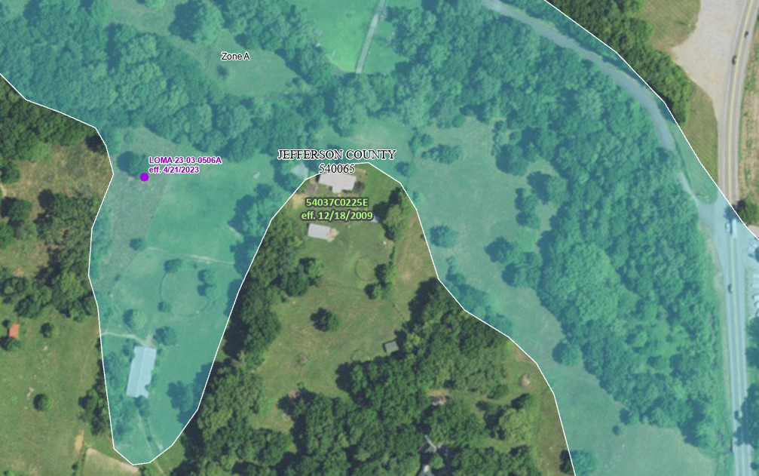
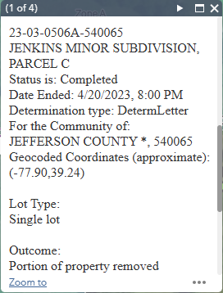
LOMCs and SOMAs
Summary of Maps Actions (SOMA)
Forthcoming with preliminary maps and again with Letters of Final Determination (LFDs)
Identifies previously issued Letter of Map Change (LOMCs) and how those determinations are impacted by the new mapping effort.

Slide 21
Study Impacts

Slide 22
Significant Impacts Overview
Compared to the effective FIRMs, widening and narrowing of draft 1%-annual-chance floodplain (SFHA) extents were observed throughout the county.
SFHA increases: Sleepy Creek
SFHA decreases: Cacapon Creek, Warm Spring Run
Extended study reaches (with drainage areas of 1 square miles and greater, and not on current effective FIRMs) result in new properties within the SFHA.
More structures will be mapped out than mapped in: -200/ +70
WV Flood Tool – SFHA Future Map Conditions*
Community | No Change SFHA | Mapped In SFHA | Mapped Out SFHA | Total Structures
Bath, Town of | 381 (+1 Floodway) | 206 (+1 Floodway) | 153 | 742
Morgan County, Unincorporated Areas | 39 (+6 Floodway) | 21 | 19 | 85
Total | 420 (+7 Floodway) | 227 (+1 Floodway) | 172 | 827
* Town of Hedgesville does not have any SFHA

Slide 23
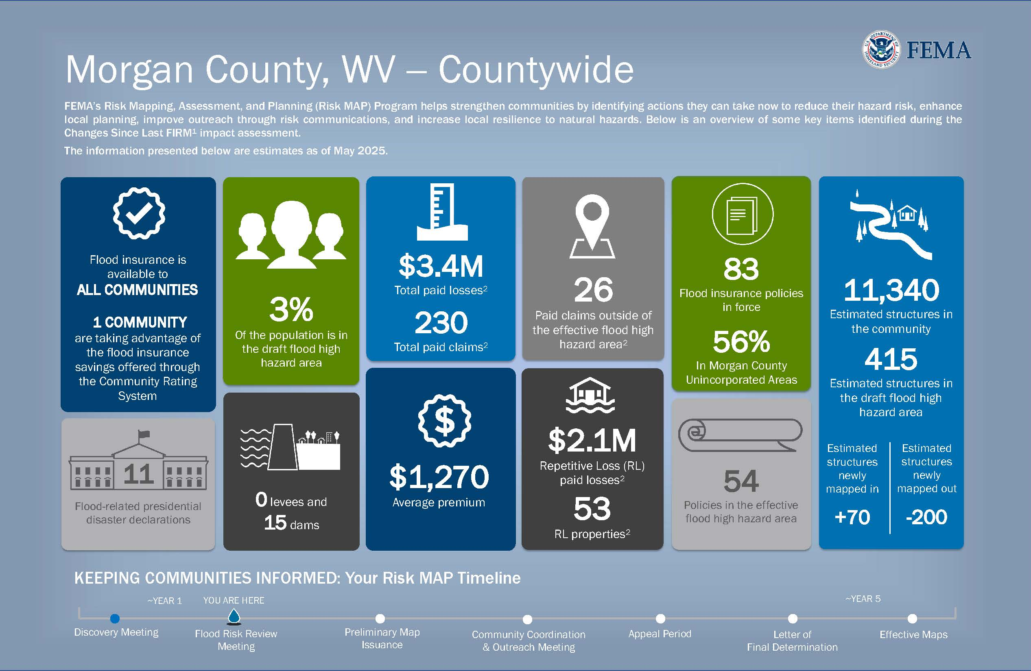
Flood Risk Dashboard
CLAIMS OUTSIDE OF THE SFHA
NFIP FLOOD CLAIM
PAYOUTS
NFIP FLOOD
POLICIES
AFFECTED RESIDENTS
HIGH-RISK
STRUCTURES
AVERAGE PREMIUM
REPETITIVE
LOSSES

Slide 24
Flood Risk Dashboard
Notes:
Messaging - how are you going to message to your community about these new maps.

Slide 25
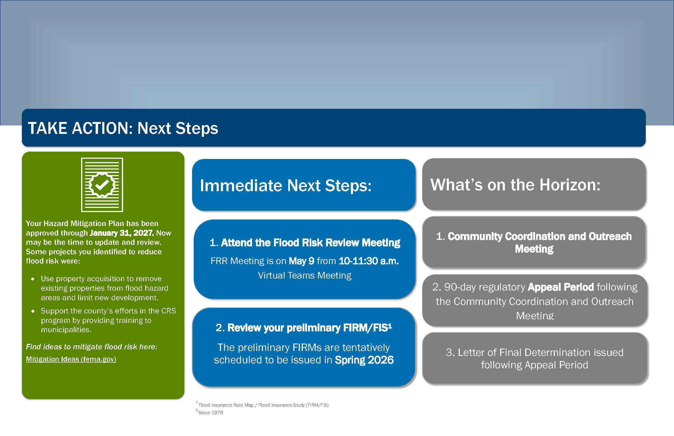
Flood Risk Dashboard (page 2)
Notes:
This is the second page of the jurisdictional dashboard.

Slide 26
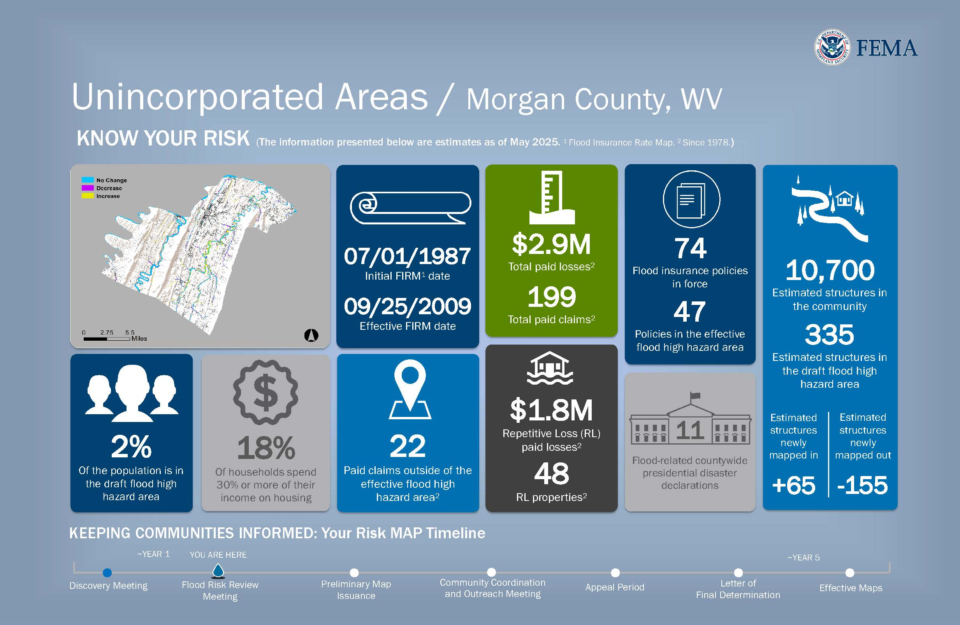

Flood Risk Dashboard
Notes:
Messaging - how are you going to message to your community about these new maps.

Slide 27
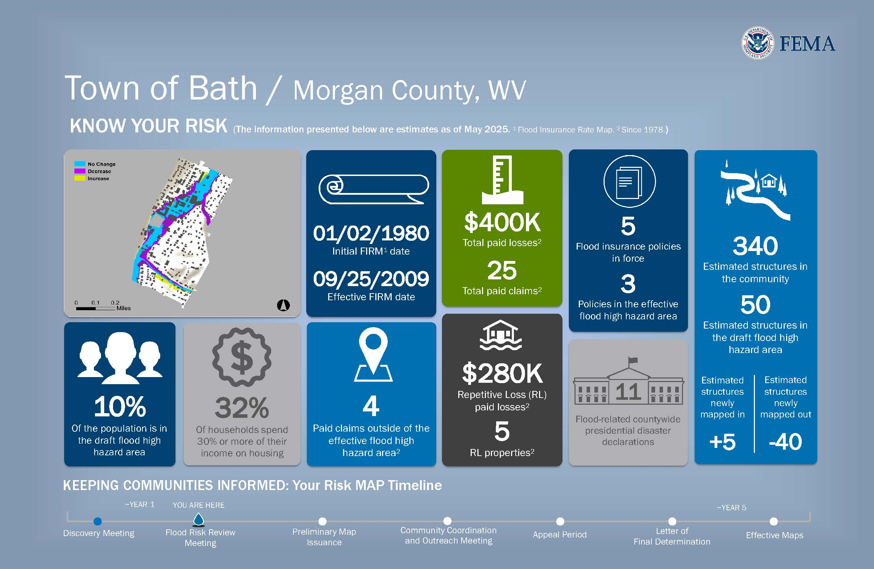
Flood Risk Dashboard
Notes:
Messaging - how are you going to message to your community about these new maps.

Slide 28
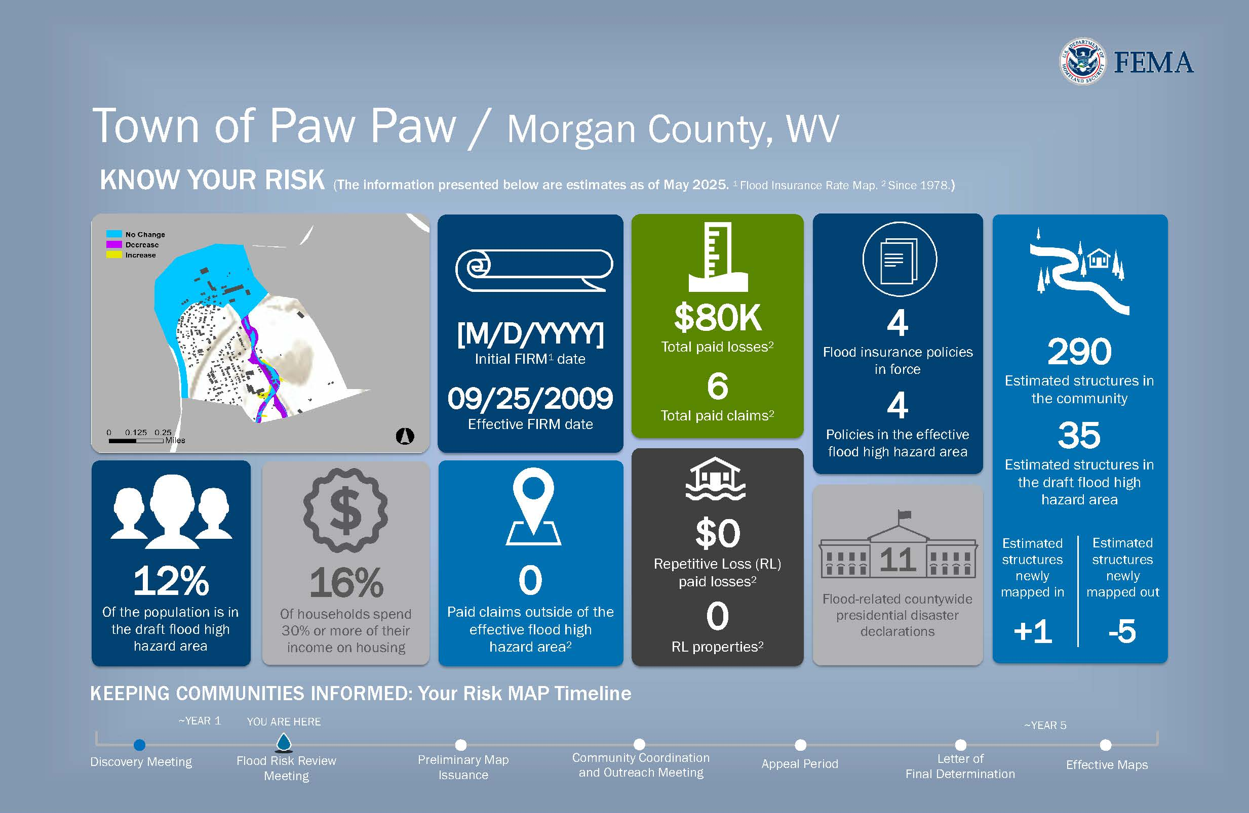

Flood Risk Dashboard
Notes:
Messaging - how are you going to message to your community about these new maps.

Slide 29
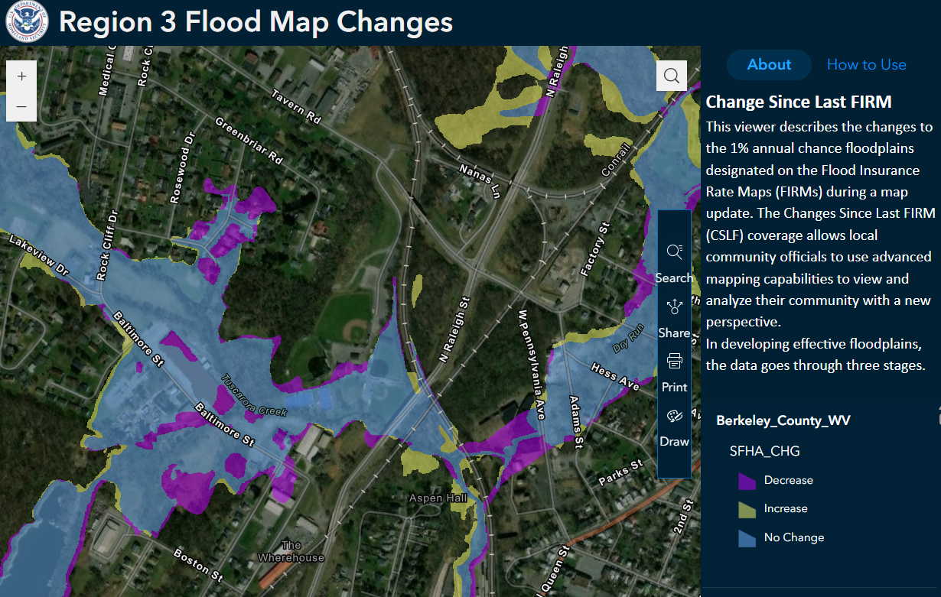
How Did the Floodplain Maps Change?
FEMA Region 3 Changes Since Last FIRM (CSLF) Viewer: https://arcg.is/1HmKLT1
Change in Floodplain Extents:
Purple – Decrease
Blue – Still Floodplain
Yellow – Increase
*Map view has scale-dependent layers

Slide 30
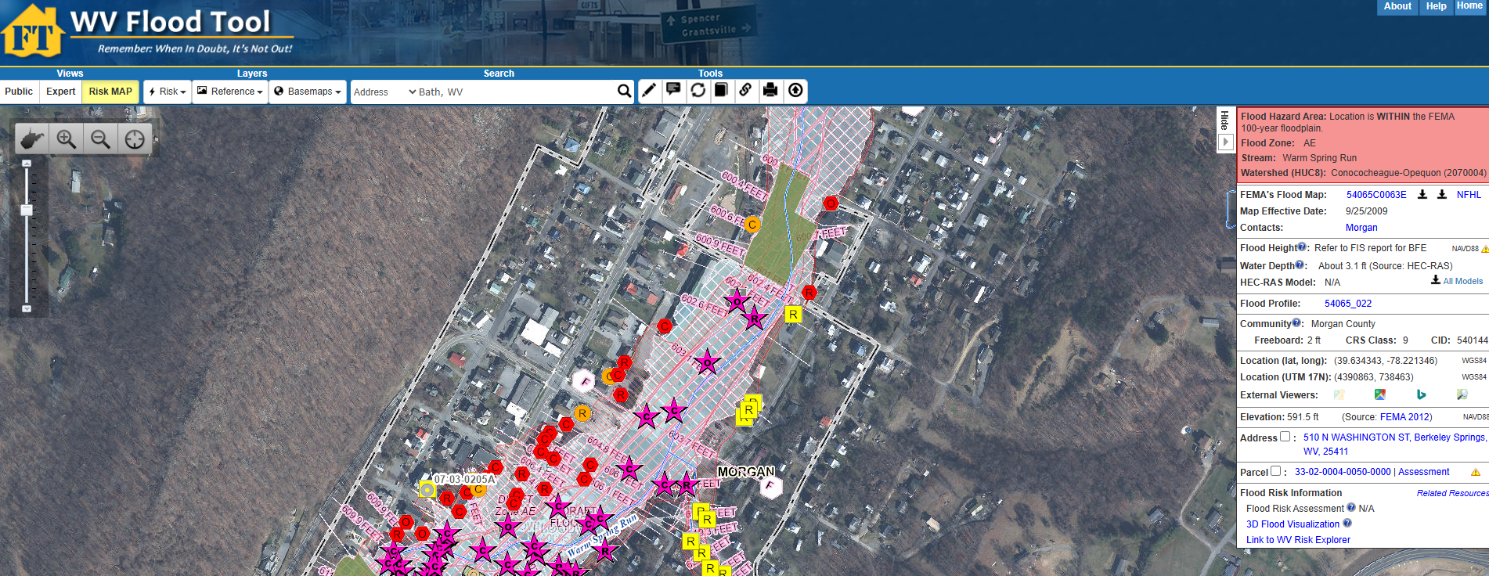
West Virginia Flood Risk Tool
WV Flood Tool (mapwv.gov)

Slide 31
Using Flood Risk Data to Identify and Reduce Risk

Slide 32
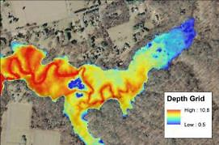
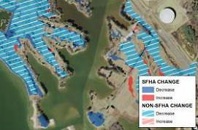
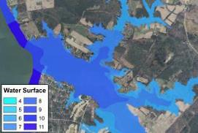
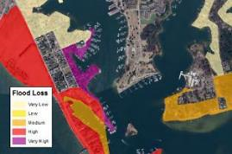
FEMA Flood Risk GIS Datasets
Flood Depth
and Analysis
Grids
Changes Since Last FIRM
Water Surface Elevation
Grids
Flood Risk
Assessment

Slide 33

Where to Find Flood Risk Data
FEMA’s Flood Map Service Center (MSC)
Here, you can view effective maps online. You can also download current effective flood hazard data and additional hazard and risk data.
https://msc.fema.gov/portal/home
National Flood Hazard Layer (NFHL)
This geospatial data viewer contains current effective flood hazard data.
https://www.fema.gov/flood-maps/national-flood-hazard-layer
State Flood Tool
This geospatial data viewer contains current effective flood hazard data and additional hazard and risk data.

Slide 34
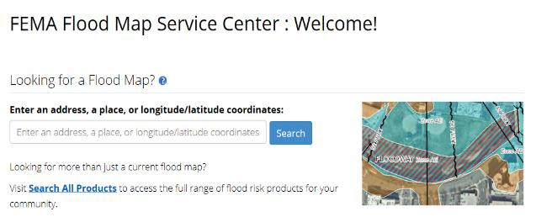
Where Can I Find My Flood Maps?
The FEMA Map Service Center (MSC) is the official public source for flood hazard information: https://msc.fema.gov/portal/home.
Enter an address for location search

Slide 35
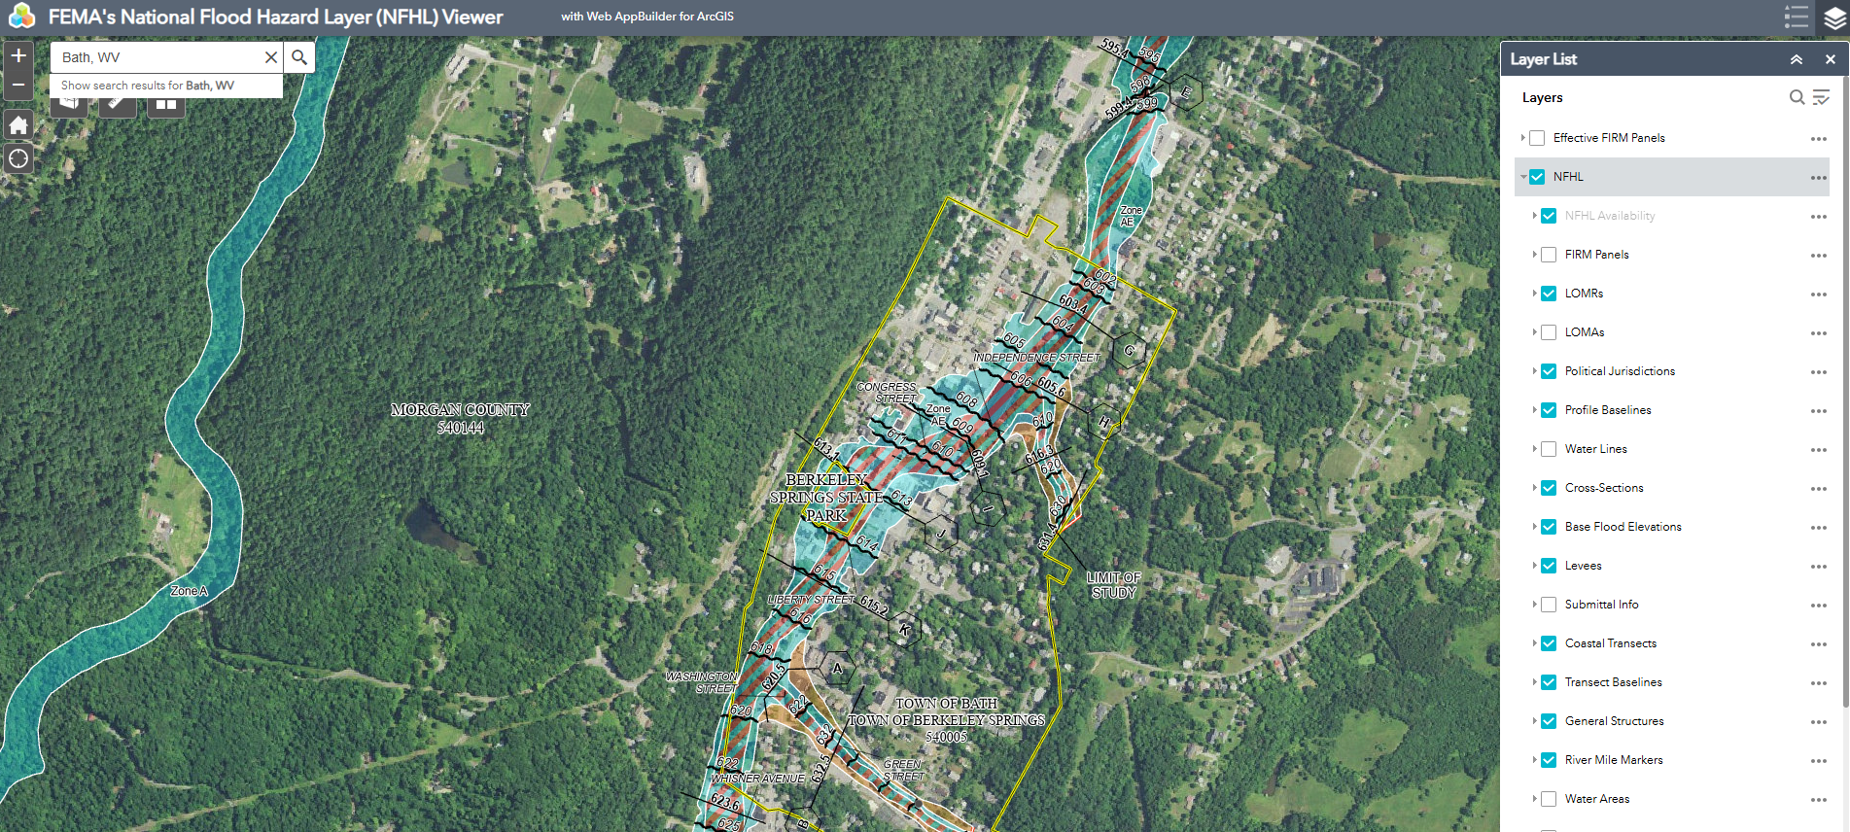
National Flood Hazard Layer
The NFHL shows the effective FEMA flood map data, including Letters of Map Revision (LOMRs).Visit https://www.fema.gov/national-flood-hazard-layer-nfhl for multiple options to view and download NFHL data.

Slide 36
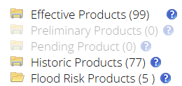
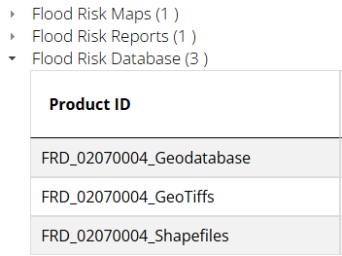
Additional Hazard and Risk Data
If additional hazard and risk data are available for your community, the MSC Search Results will allow you to expand the Flood Risk Products folder.

Slide 37
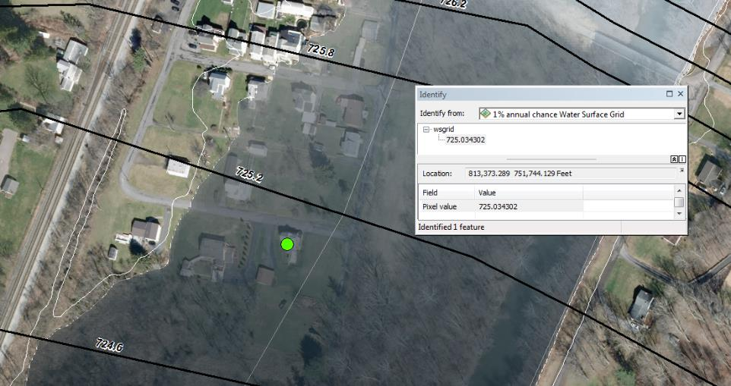
Water Surface Elevation Grids
Represents the continuous water surface elevations (as determined at modeled cross sections and interpolated between cross sections) for each of the modeled flood frequencies.

Slide 38
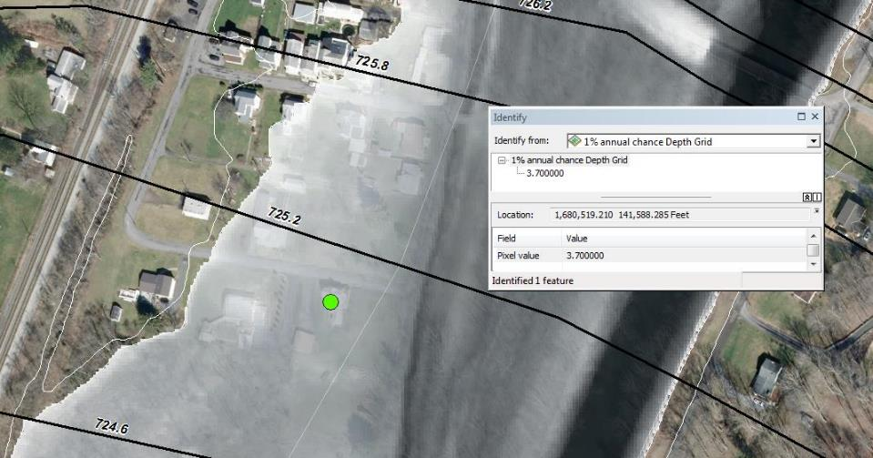
Depth Grids
Represents the difference between the ground surface elevation and the water surface elevations in feet for each of the modeled flood frequencies.

Slide 39
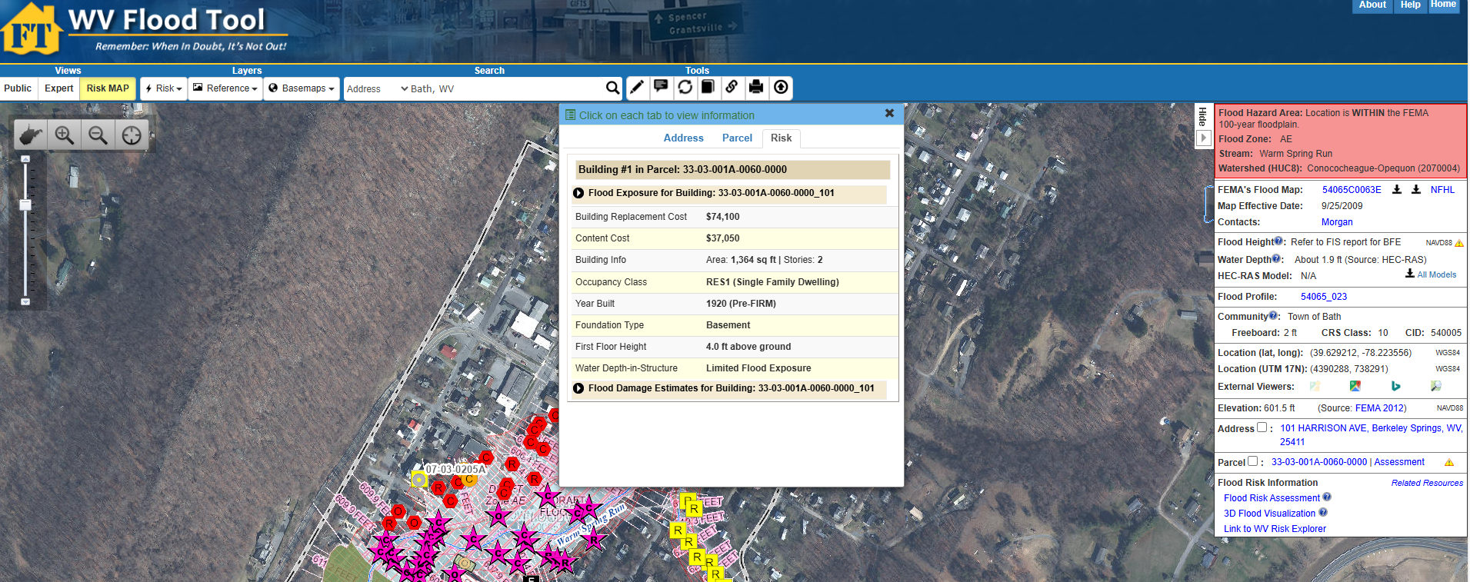

West Virginia Flood Tool
WV Flood Tool (mapwv.gov)

Slide 40
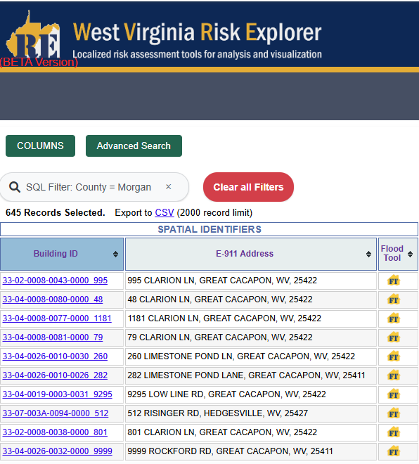
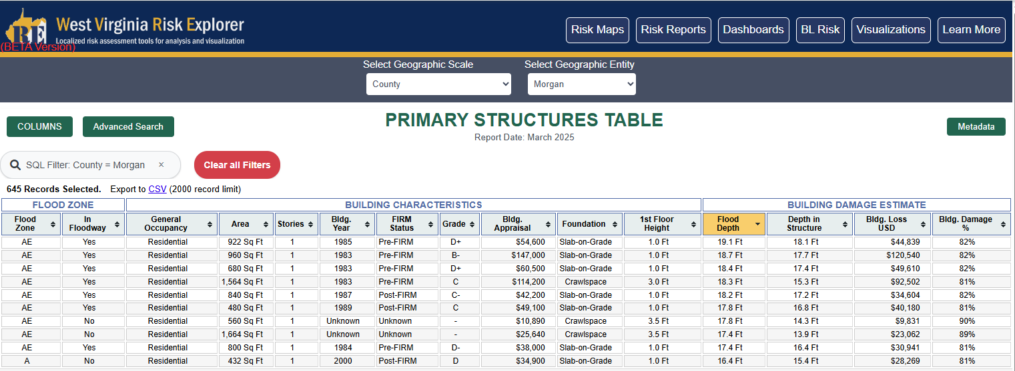
West Virginia Risk Explorer
New Building-Level Risk Tools enable further exploration of impacted buildings:
Berkeley Mapped-In Structures
Berkeley Mapped-Out Structures
Berkeley Risk Index (incl. Top 20% Risk Indicators Report)

Slide 41
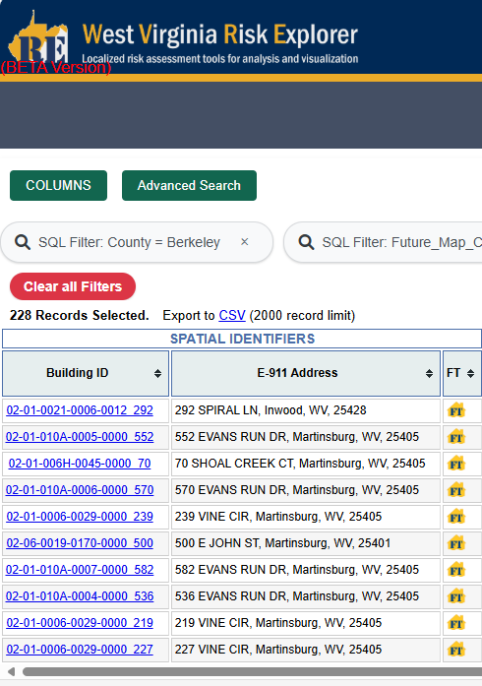
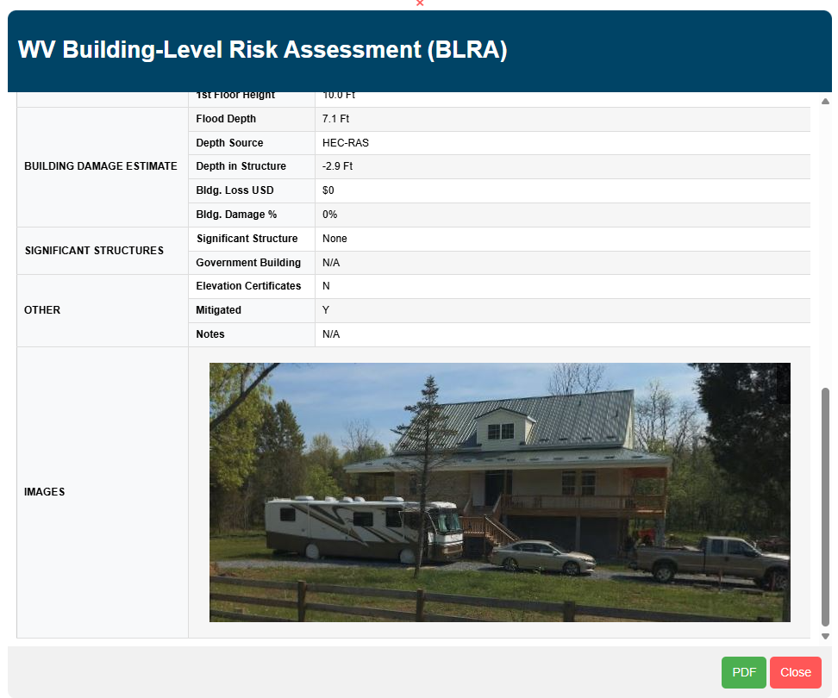
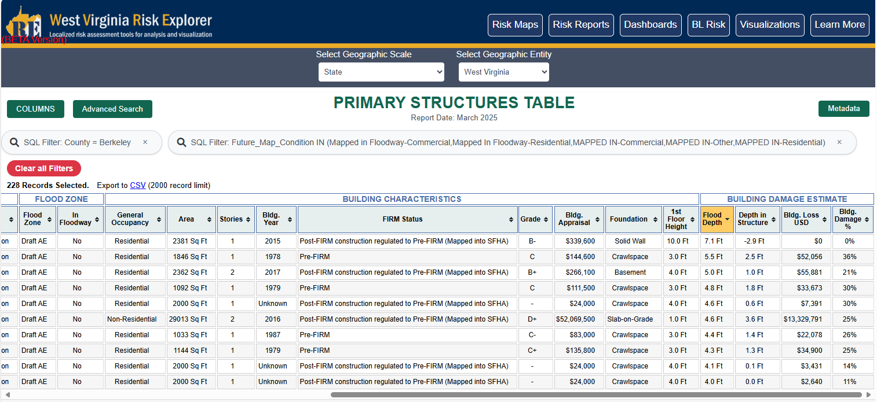
West Virginia Risk Explorer
New Building-Level Risk Tools enable further exploration of impacted buildings:
Berkeley Mapped-In Structures
Berkeley Mapped-Out Structures
Berkeley Risk Index (incl. Top 20% Risk Indicators Report)

Slide 42
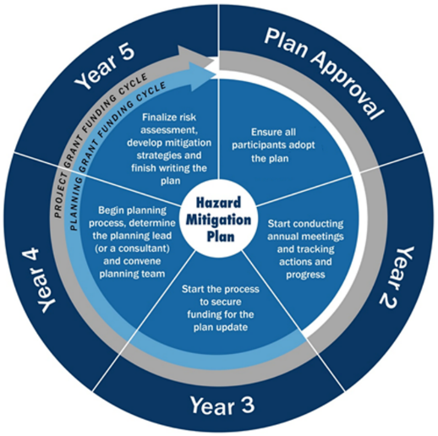
Flood Hazard Mitigation Planning
It’s time to update the risk assessment in your hazard mitigation plan
The Berkeley County HMP is here

Slide 43
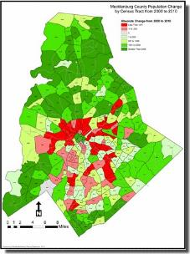
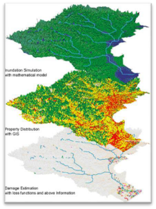

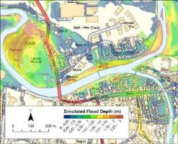
Using Flood Risk Data to Manage Development
Structure-based depth of flooding analyses
Prioritization of mitigation action
Residential/commercial density in the floodplain
Location/inundation area of historic events
Properties with insurance policies and as a percentage of the population
Areas of population growth
Areas requiring protection

Slide 44
Floodplain Management

Slide 45
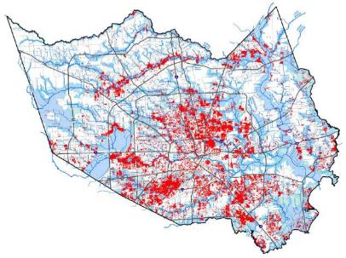
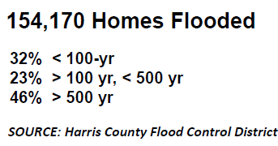
Flood Risk Doesn’t Stop at a Line
40% of all flood insurance claims come from outside high-risk areas.
Your community can regulate to standards higher than the NFIP minimum standards. Consider strengthening regulations using:
0.2%-annual-chance flood zone
“Freeboard” – require additional feet above a BFE
Buffer around SFHA
Flood depth grids
HURRICANE HARVEY
GREATER HOUSTON

Slide 46




Floodplain Management at FRR
Look at where there are changes to the SFHA in your community
Share with permitting, planning, and other colleagues to direct development outside of the SFHA today and in future
Consider higher standards or joining the Community Rating System to support your community
FRR:
SFHA:
Flood Risk Review
Special Flood Hazard Area
Notes:
It is not too early to plan ahead.

Slide 47


Floodplain Management Big Picture
Build it right and lower the impact of future flood losses while improving resiliency | Build it wrong and the result could be increased flood losses and higher flood insurance premiums
Notes:
Where it rains it can flood - A significant number of NFIP claims are outside the SFHA
Flood risk changes
FRR draft maps represent change for you community
Climate change could further increase flood risk in your community

Slide 48
Discussion

Slide 49
Timeline – Looking Ahead
Advisory Flood Height Modeling/Mapping
Risk MAP Study Notification
Preliminary Maps and CCO Meeting
Fall/Winter 2025
End of Appeal Period
90 days after Appeal Start
Updated Effective Maps
6 months after LFD
Current Effective Maps (Digital Conversion)
Kick-Off Meeting
Flood Risk Review Meeting
May 9, 2025
Appeal Period Start
Spring 2026
FEMA Issues Letter of Final Determination (LFD)
Fall/Winter 2026

Slide 50
Project Contacts – West Virginia
State NFIP/CTP Office:
Kevin Sneed
CTP Project Officer
304-957-2571
kevin.l.sneed@wv.gov
Julia Sears
State NFIP Coordinator
304-989-8330
julia.r.sears@wv.gov
Ginger Barnett
Chief of Mitigation and Recovery
304-414-7632
ginger.sc.barnett@wv.gov
FEMA Region 3:
Amanuel Ghebreegziabher FEMA Project Officer (202) 718-2759 amanuel.ghebreegziabher@fema.dhs.gov
Bill Kuhn Community Planner william.kuhn@fema.dhs.gov
Betsy Ranson
Floodplain Management Specialist (215) 347-0686
elizabeth.ranson@fema.dhs.gov
Bill Bradfield
Insurance Specialist (202) 880-5906 william.b.bradfield@fema.dhs.gov

Slide 51

Department of Homeland Security logo - FEMA

