Slide 1
Template Notes
The Flood Study Update section has more flexibility, It can be modified to reflect the engineering methodologies for this project. However, FEMA still wants some level of consistency.
Please keep the methodology section clear and concise.
Use bullet points, avoid too much text, and avoid tables showing methods for each stream.
There are typically 1-2 slides on hydrologic analyses and 2-5 slides on hydraulic analyses.
FEMA Region 3 has developed this template to:
Ensure some level of consistency between Risk MAP meetings and
Integrate key messages related to flood mapping, floodplain management, hazard mitigation planning and flood insurance.
Please do not add or remove content without consulting the Risk Analysis Branch Project Officer for this project.
This presentation template was last updated in Summer 2024, in coordination with Lee Brancheau, Mari Radford, Bobby Cobelli, Bill Bradford, and Benjamin Accurti.

Slide 2
FEMA Region 3
Flood Risk Review Meeting
Wyoming County May 30, 2025

Slide 3

Agenda
Welcome and Introductions
Where We Are - Draft Maps
Flood Study Update
Using Flood Risk Data to Reduce Risk
Floodplain Management
Discussion

Slide 4

Introductions
Please Introduce Yourself
Name.
Position.
Organization.

Slide 5
Where We Are – Draft Maps

Slide 6

3 Reasons We Are Here Today
To preview and discuss the updated Flood Insurance Study (FIS) report and Flood Insurance Rate Map (FIRM) for Mercer County, West Virginia
To examine the new study areas, discuss how the analysis and mapping have changed since the previous FIRM, and discuss current and future implications for these changes
To present a timeline of next steps

Slide 7

Timeline
Current Effective Maps
May 2006
Risk MAP Study Notification
August 2021
Preliminary Maps and CCO Meeting
End of Appeal Period
Updated Effective Maps
Discovery Meeting
Flood Risk Review Meeting
05/30/2025
Appeal Period Start
FEMA Issues Letter of Final Determination (LFD)
We are here!
Notes:
Notification means 620 letter?
Put a start at FRR and show we are here

Slide 8
Flood Study Update

Slide 9
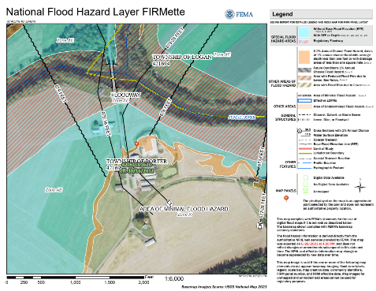
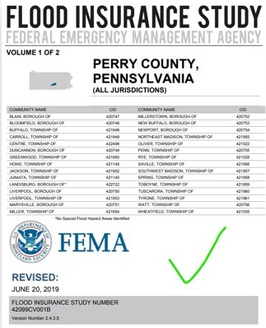
Flood Insurance Rate Maps and Studies
Key Terms:
Flood Insurance Rate Map (FIRM)
Flood Insurance Study (FIS) Report
Special Flood Hazard Area (SFHA)
Flood Zone
Base Flood Elevation (BFE)
Regulatory Floodway
Cross Section

Slide 10



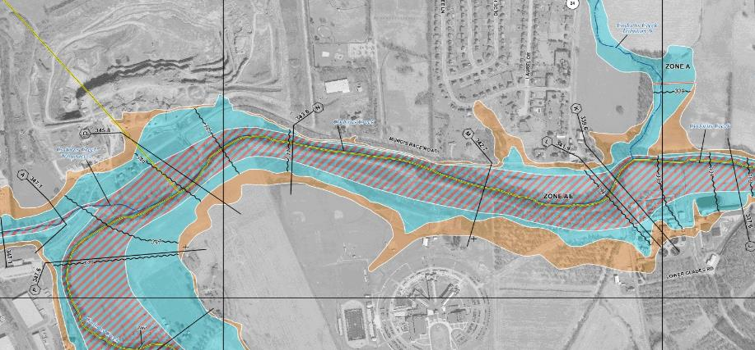
Typical FIRM Panel and Flood Zones
Zone AE
Floodway
Zone AE
Zone X
Shaded
Zone X
Zone A

Slide 11

Floodplain Map Overview
HIGH RISK (Special Flood Hazard Area) |  |  | Regulatory Floodway
 |  |  | 1%-Annual-Chance Flood Hazard Area with BFEs
 |  |  | 1%-Annual-Chance Flood Hazard Area without published BFEs
MODERATE RISK |  |  | 0.2%-Annual-Chance Flood Hazard Area
 |  |  | Cross Sections with 1%-Annual-Chance Water Surface Elevation Value
ZONE AE
ZONE A
Notes:
Discuss 1% floodplain and 0.2% floodplain, floodway, cross sections, and BFEs
“Cross sections now show water surface elevations.”
“Transparent fills over aerial photography”
“new maps will look different”

Slide 12
Floodplain Map Overview
HIGH RISK (Special Flood Hazard Area)
MODERATE RISK
 |  |  | Cross Sections with 1%-Annual-Chance Water Surface Elevation Value
Development is not allowed unless “no rise” in flood levels is certified
ZONE AE
Flood insurance is mandatory for structures with federally backed mortgages
ZONE A
Flood insurance is not mandatory
Notes:
It is highly recommended that owners get flood insurance in areas of moderate risk even though it is not required

Slide 13

Study Overview
Revised Modeling and Mapping, including:
Updated GIS-based regulatory products, including:
Updated FIRMs / GIS database / FIS report formats based on new FEMA guidelines and specifications
Used high-resolution topographic data (for modeling and mapping)
“Zone AE” Studies – 158 miles
Model-backed“Zone A” Studies – 263 miles
Notes:
Update the number of miles

Slide 14
Study Overview (continued)
Revised Modeling and Mapping, including:
Evaluation of Letters of Map Change (LOMCs)
Case-by-case results shown in a Summary of Map Actions (SOMA) that is sent to applicable communities with Preliminary Maps and Letters of Final Determination (LFDs)
Letters of Map Revision (LOMRs)
Letters of Map Amendment (LOMAs) – including rectified LOMA locations on the WV Flood Tool
Production of associated non-regulatory flood risk
Notes:
Presenter should define LOMC, LOMA, LOMR, and talk about reasons why some LOMCs might be revalidated, incorporated, or superseded.
We need to check if all these apply for wyoming

Slide 15
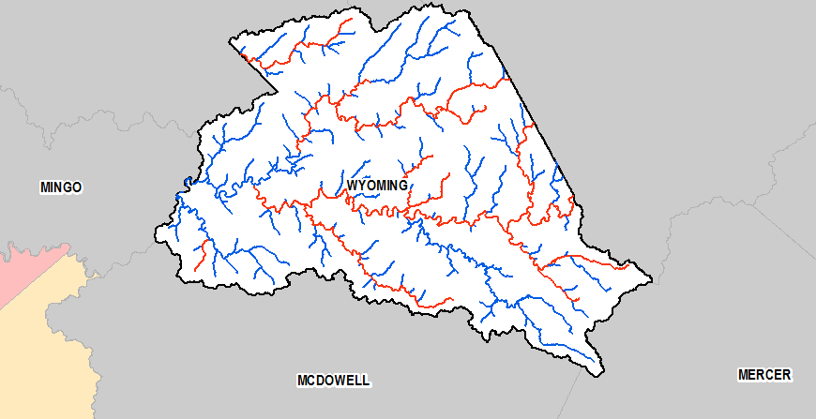
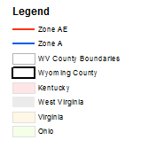
Study Area
The Project Area
Notes:
The legend has McDowell County

Slide 16

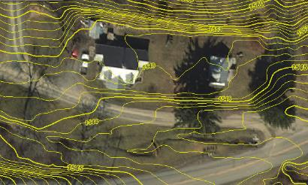
Topographic Data
2018-2020 LiDAR-Based Digital Elevation Model (DEM – 2’ contours on WV Flood Tool) LiDAR = Light Detection and Ranging
Uses light pulses and GPS to survey elevation data
Improves the level of detail for hydraulic modeling and floodplain delineation

Slide 17
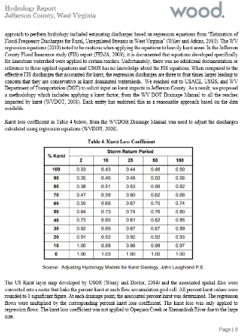
Hydrologic Analyses
Hydrologic study methods included:
USGS Regression Equations
Regression Equations Supplemented with USGS Gage Analysis (Bulletin 17C)
Regulated Flow Analysis
A comprehensive Hydrology Report details the study methods for each reach and compares the effective and proposed discharges.
The hydrologic study methods will also be published in the FIS Report.
Sample page from the Risk MAP Hydrology Report
Notes:
The study used updated hydrologic analyses to estimate 1-percent-annual-chance flow rates.

Slide 18
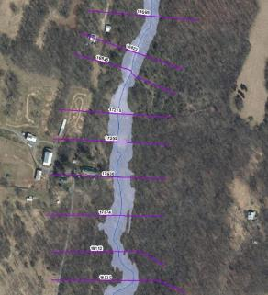
Hydraulic Analyses – Zone A
Approximate "Zone A" Base Level Study (263 miles)
Generally used in areas with lower development or lower development potential
Cross sections generated from LiDAR (automated processes)
Does not include channel bathymetry
No hydraulic structures are surveyed or modeled
FIRM will not show Floodway or BFEs (but FIRM database will include cross sections and their associated water surface elevations in the FIRM GIS Database)
FIS Report will not show flood profiles for Zone A reaches

Slide 19
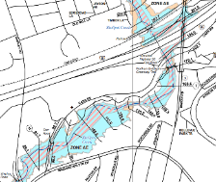
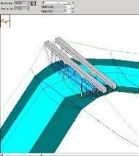
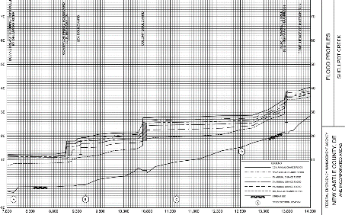
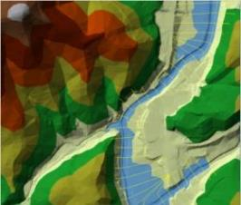
Hydraulic Analyses – Zone AE
Detailed "Zone AE” Study (158 miles)
Generally used in areas with higher development or higher development potential
Cross sections use information from survey and field reconnaissance
Include channel bathymetry
Structures are modeled (e.g., culverts, bridges)
Detailed hydraulic parameter refinement (coefficients, obstructions, Manning's ‘n’ values)
FIRM will show Floodway, BFEs, 1% and 0.2%-annual-chance event floodplains
FIS Report will show flood profiles for 10-, 4-, 2-, 1-, 0.2-, and 1% Plus flood frequencies

Slide 20
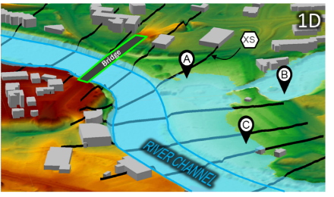
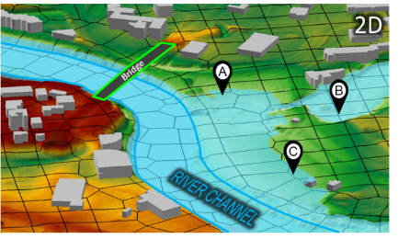
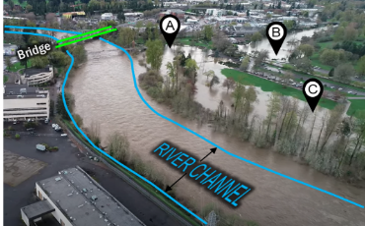
Hydraulic Analyses – 1D vs 2D
1D: most existing NFIP studies; confined flow; flow generally in one direction
2D: unconfined, split/diverted flows; flow in multiple directions; wide/flat floodplains; shallow flooding
Reality
Notes:
Remove this slide after Bob’s review because Wyoming does not have 2D

Slide 21
Study Impacts

Slide 22
Significant Impacts Overview
Compared to the effective NFHL, widening and narrowing of the 1%-annual-chance floodplain (SFHA) extent was observed throughout the county.
Extended study reaches (with drainage areas of 1 square miles and greater, and not on current effective FIRM) result in new properties within the SFHA.
Most streams experienced both increases and decreases when comparing the computed model WSELs to the current regulatory BFEs.
More structures will be mapped in than mapped out. Basic estimate: -423 / +972
Future Map Conditions
No Change SFHA | Mapped In SFHA | Mapped Out SFHA | Total Structures
2,089 | 972 | 423 | 3,061
Notes:
Structure in out . Consult with WV GIS center?
Ask ale if she updated them

Slide 23
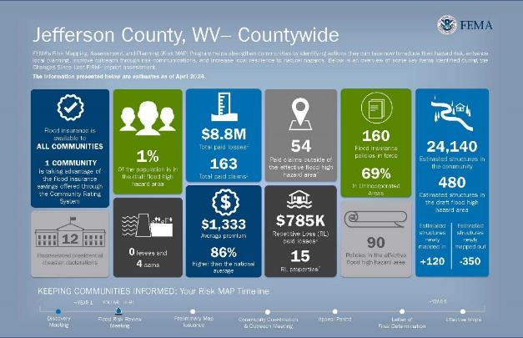
Flood Risk Dashboard
CLAIMS OUTSIDE OF THE SFHA
NFIP FLOOD CLAIM
PAYOUTS
NFIP FLOOD
POLICIES
AFFECTED RESIDENTS
HIGH-RISK
STRUCTURES
AVERAGE PREMIUM
REPETITIVE
LOSSES

Slide 24
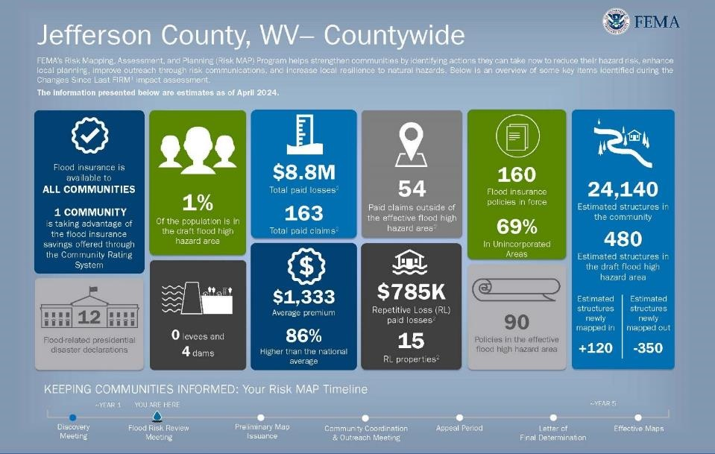
Flood Risk Dashboard (Example in slide. Will update later)
Notes:
Messaging - how are you going to message to your community about these new maps.
Update after Bob’s review

Slide 25
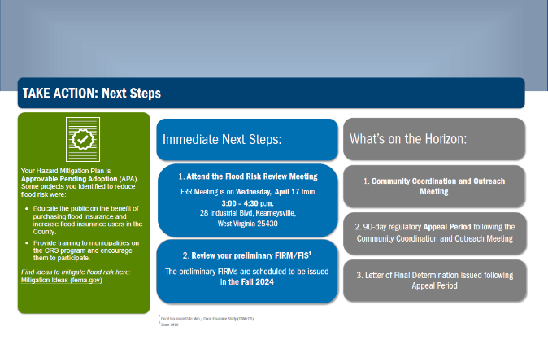
Flood Risk Dashboard (page 2)
HMP EXPIRATION INFO
STEPS BEFORE PRELIMINARY ISSUANCE
FLOOD MITIGATION ACTIONS
STEPS AFTER PRELIMINARY ISSUANCE

Slide 26
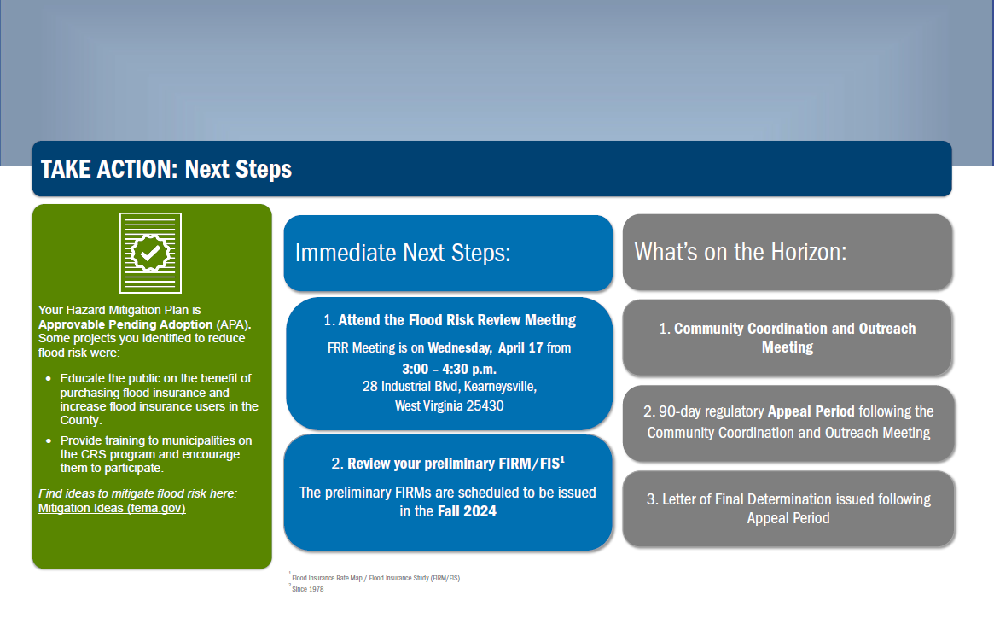
Flood Risk Dashboard (page 2)
Notes:
This is the second page of the jurisdictional dashboard.

Slide 27
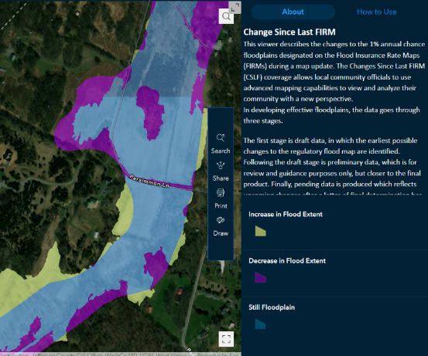
How Did the Floodplain Maps Change?
FEMA Region 3 Changes Since Last FIRM (CSLF) Viewer: https://arcg.is/1GS0T80
Change in Floodplain Extents:
Purple – Decrease
Blue – Still Floodplain
Yellow – Increase
*Map view has scale-dependent layers
Notes:
Update the link after William puts our data on the tool

Slide 28
Using Flood Risk Data to Identify and Reduce Risk

Slide 29
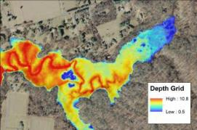
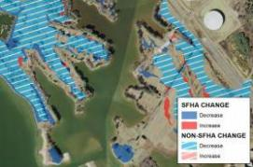
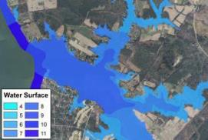
FEMA Flood Risk GIS Datasets
Flood Depth
Grids
Changes Since Last FIRM
Water Surface Elevation
Grids
Notes:
Removed Flood risk assessment picture. Don’t have it for upper guy but have it for Big Sandy

Slide 30

Where to Find Flood Risk Data
FEMA’s Flood Map Service Center (MSC)
Here, you can view effective maps online. You can also download current effective flood hazard data and additional hazard and risk data.
https://msc.fema.gov/portal/home
National Flood Hazard Layer (NFHL)
This geospatial data viewer contains current effective flood hazard data.
https://www.fema.gov/flood-maps/national-flood-hazard-layer
State Flood Tool
This geospatial data viewer contains current effective flood hazard data and additional hazard and risk data.

Slide 31
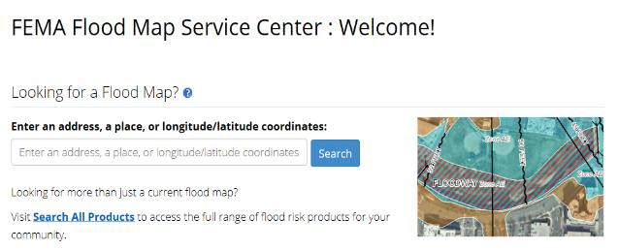
Where Can I Find My Flood Maps?
The FEMA Map Service Center (MSC) is the official public source for flood hazard information: https://msc.fema.gov/portal/home.
Enter an address for location search

Slide 32
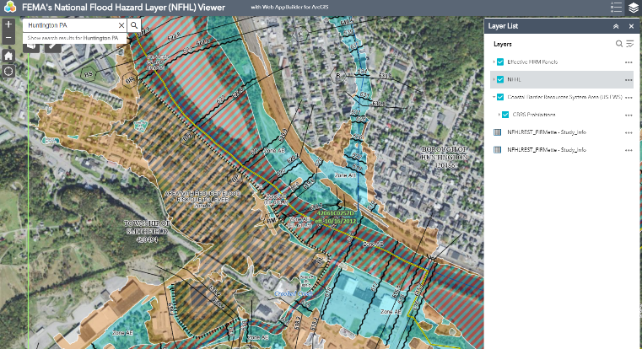
National Flood Hazard Layer
The NFHL shows the effective FEMA flood map data, including Letters of Map Revision (LOMRs).Visit https://www.fema.gov/national-flood-hazard-layer-nfhl for multiple options to view and download NFHL data.

Slide 33
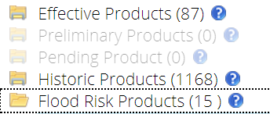

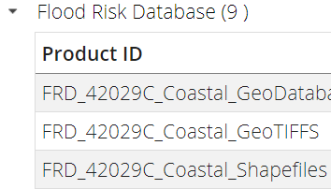
Additional Hazard and Risk Data
If additional hazard and risk data are available for your community, the MSC Search Results will allow you to expand the Flood Risk Products folder.

Slide 34
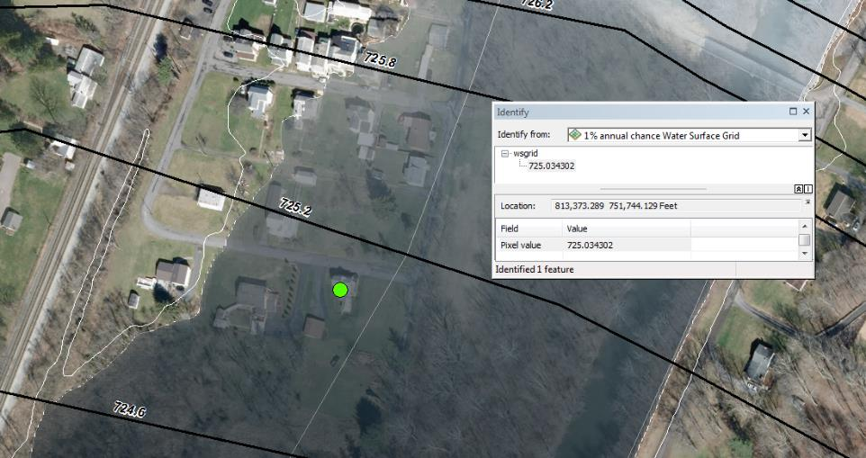
Water Surface Elevation Grids
Represents the continuous water surface elevations (as determined at modeled cross sections and interpolated between cross sections) for each of the modeled flood frequencies.

Slide 35
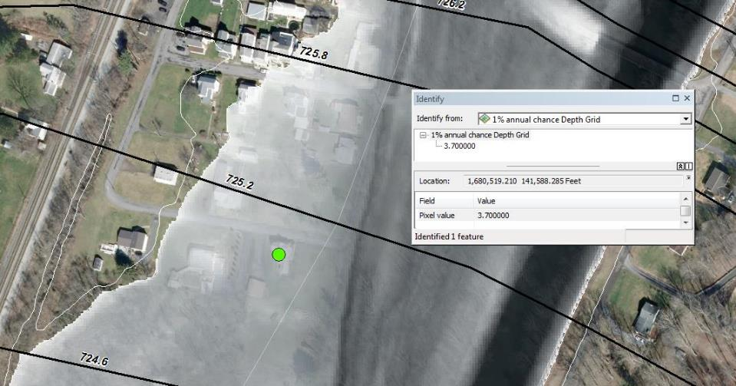
Depth Grids
Represents the difference between the ground surface elevation and the water surface elevations in feet for each of the modeled flood frequencies.

Slide 36
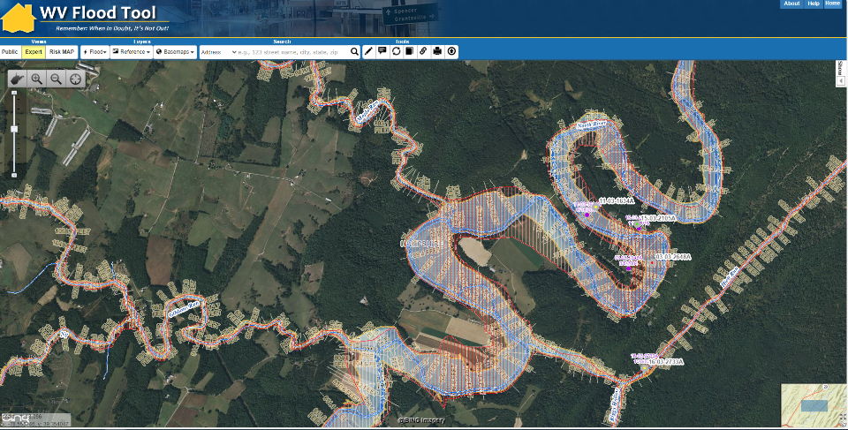
West Virginia Flood Risk Tool
WV Flood Tool (mapwv.gov)

Slide 37
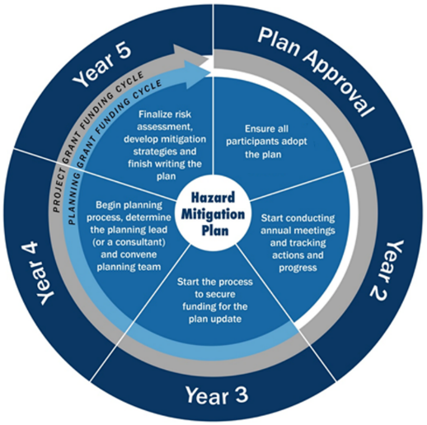
Flood Hazard Mitigation Planning
It’s time to update the risk assessment in your hazard mitigation plan
The West Virginia Region I HMP is here

Slide 38
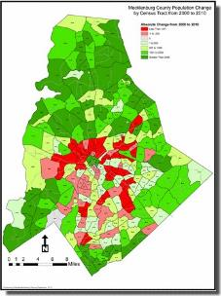
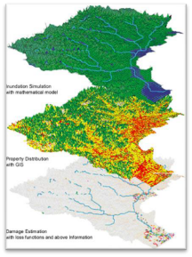

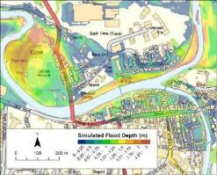
Using Flood Risk Data to Manage Development
Structure-based depth of flooding analyses
Prioritization of mitigation action
Residential/commercial density in the floodplain
Location/inundation area of historic events
Properties with insurance policies and as a percentage of the population
Areas of population growth
Areas requiring protection

Slide 39
Floodplain Management

Slide 40
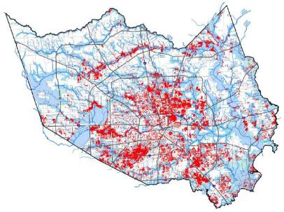
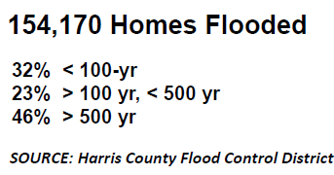
Flood Risk Doesn’t Stop at a Line
40% of all flood insurance claims come from outside high-risk areas.
Your community can regulate to standards higher than the NFIP minimum standards. Consider strengthening regulations using:
0.2%-annual-chance flood zone
“Freeboard” – require additional feet above a BFE
Buffer around SFHA
Flood depth grids
HURRICANE HARVEY
GREATER HOUSTON

Slide 41




Floodplain Management at FRR
Look at where there are changes to the SFHA in your community
Share with permitting, planning, and other colleagues to direct development outside of the SFHA today and in future
Consider higher standards or joining the Community Rating System to support your community
FRR:
SFHA:
Flood Risk Review
Special Flood Hazard Area
Notes:
It is not too early to plan ahead.

Slide 42


Floodplain Management Big Picture
Build it right and lower the impact of future flood losses while improving resiliency | Build it wrong and the result could be increased flood losses and higher flood insurance premiums
Notes:
Where it rains it can flood - A significant number of NFIP claims are outside the SFHA
Flood risk changes
FRR draft maps represent change for you community
Climate change could further increase flood risk in your community

Slide 43
Discussion

Slide 44
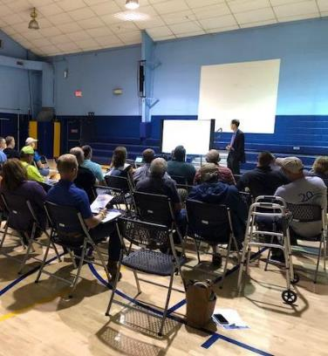
We want to hear from you!
30-day review and comment period
WV Flood Tool: https://www.mapwv.gov/flood
Review the materials we will be sending you
We are available to answer questions
Talk about mitigation actions in your community
Thank you for your participation!

Slide 45
Project Contacts – West Virginia
State NFIP/CTP Office:
Kevin Sneed
CTP Project Officer
(304) 957-2571
kevin.l.snead@wv.gov
Julie Sears
State NFIP Specialist
(304) 989-8330
julia.r.sears@wv.gov
FEMA Region 3:
Bob Pierson FEMA Project Officer [(215) 931-5650 robert.pierson@fema.dhs.gov
Bill Kuhn Community Planner william.kuhn@fema.dhs.gov
Betsy Ranson
Floodplain Management Specialist (215) 347-0686
elizabeth.ranson@fema.dhs.gov
Bill Bradfield
Insurance Specialist (202) 880-5906 william.b.bradfield@fema.dhs.gov

Slide 46


