Slide 1


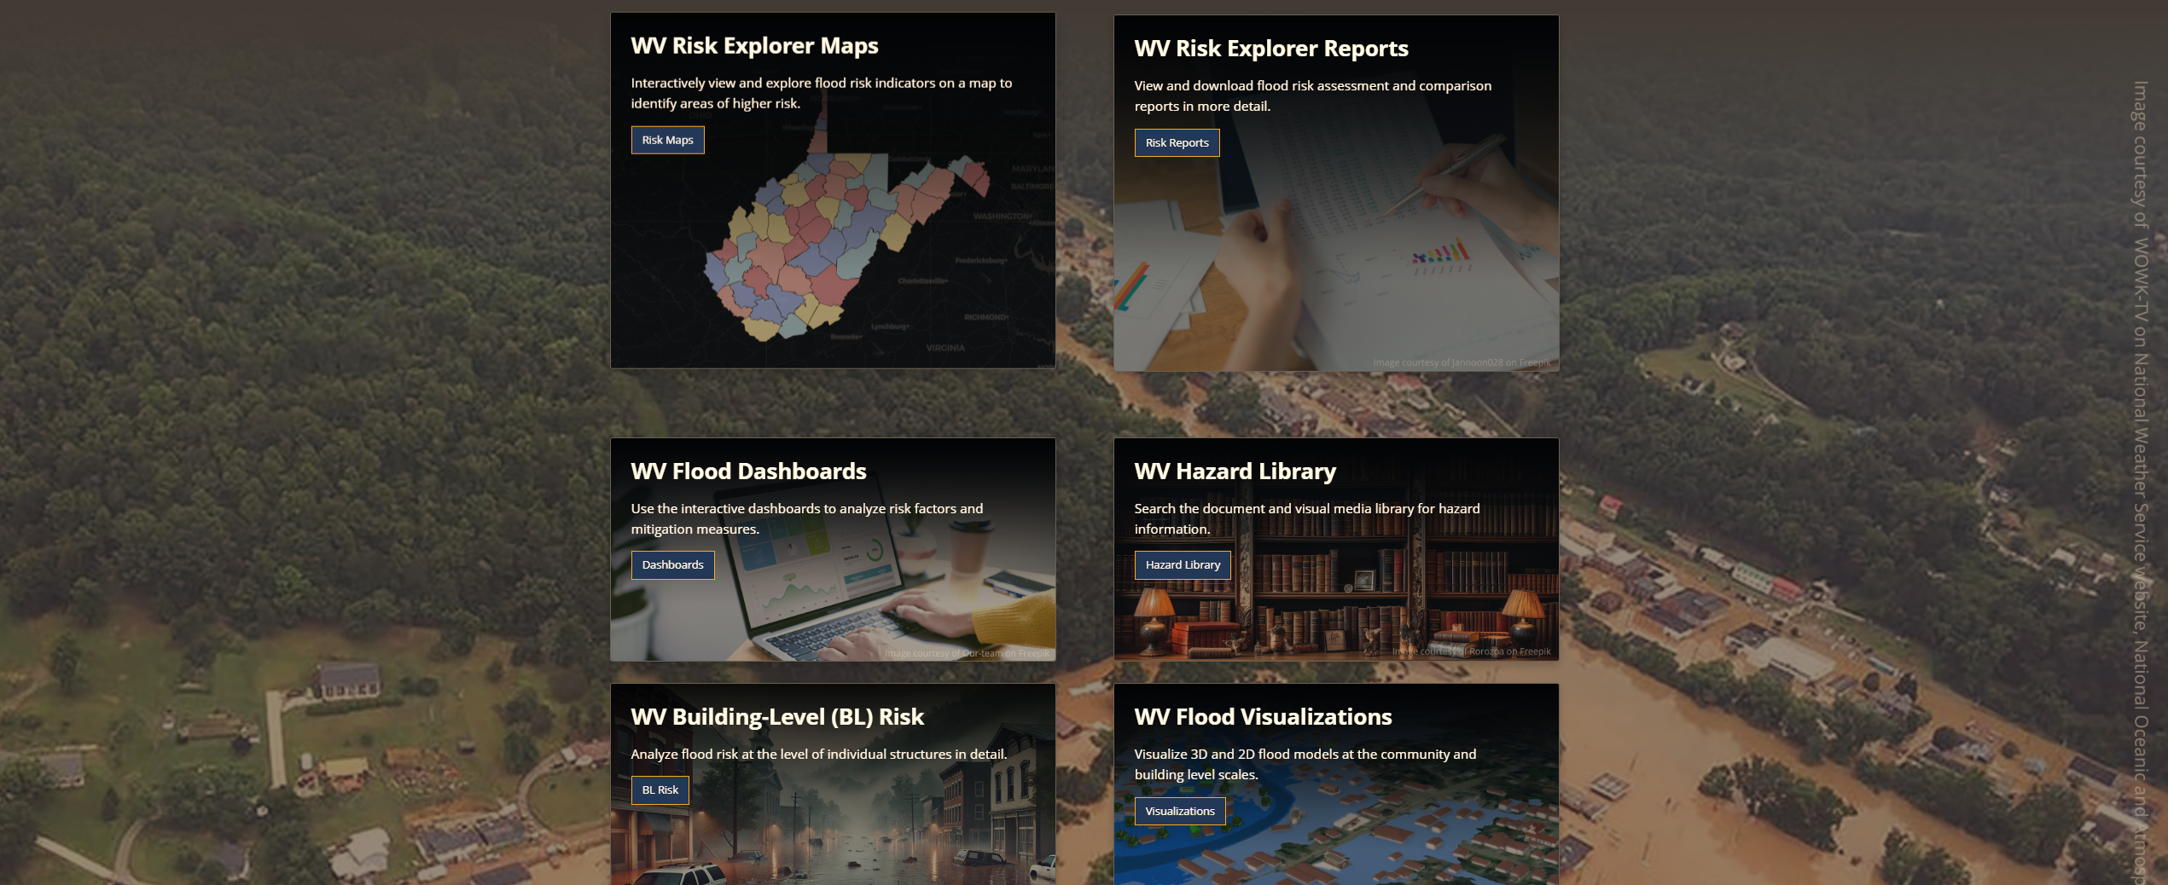
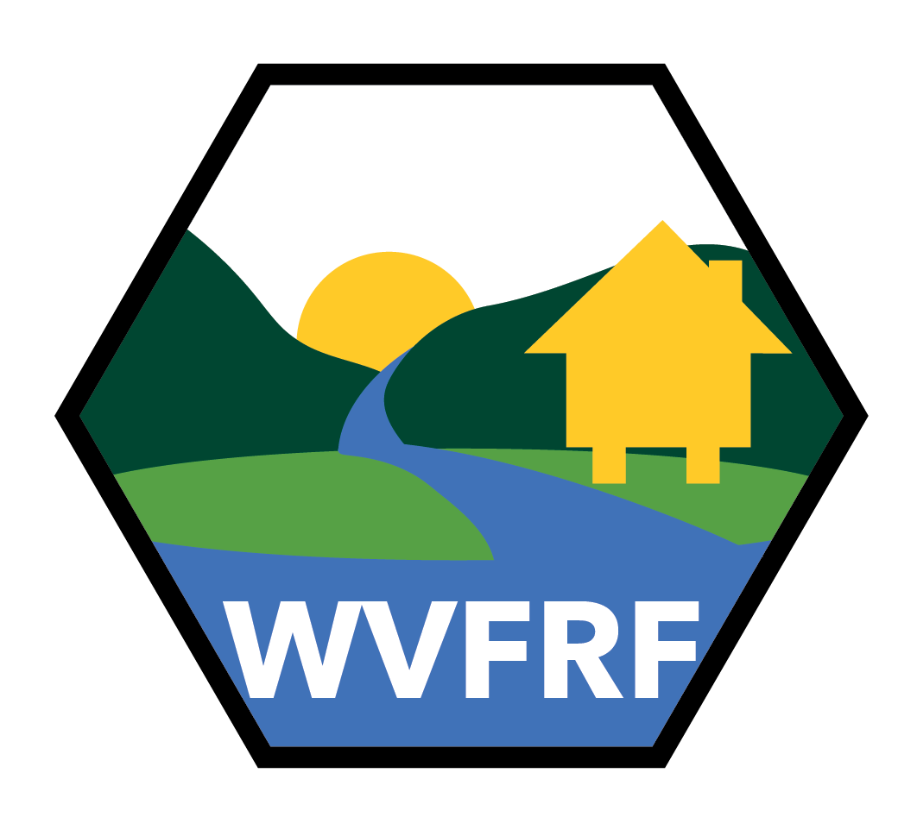
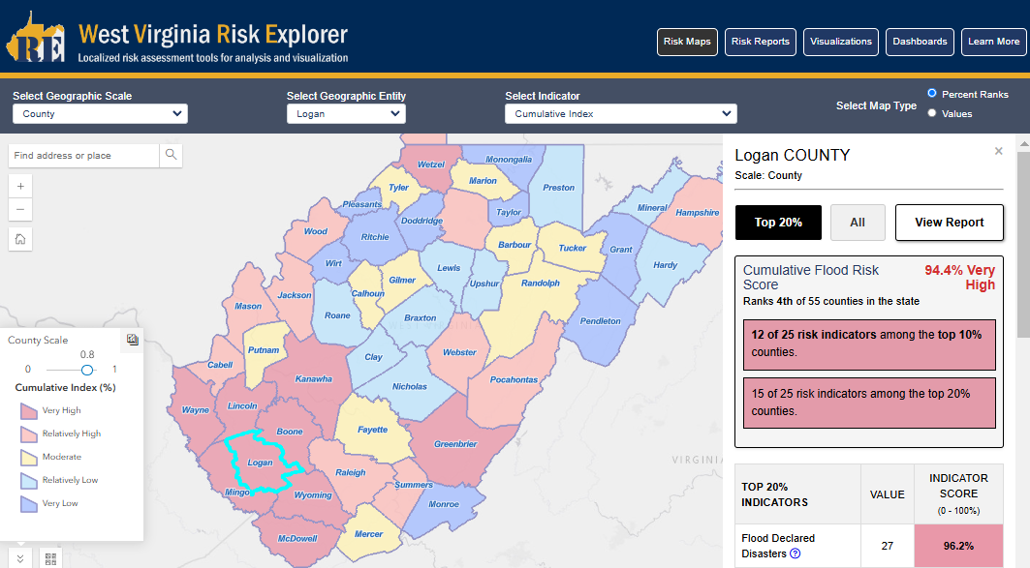
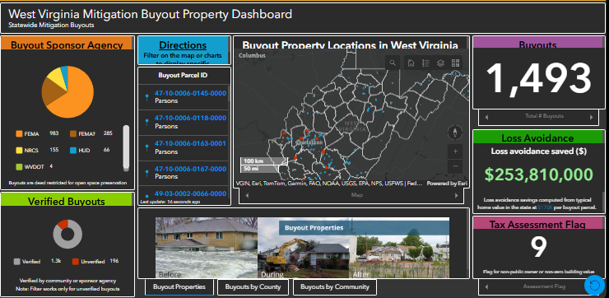
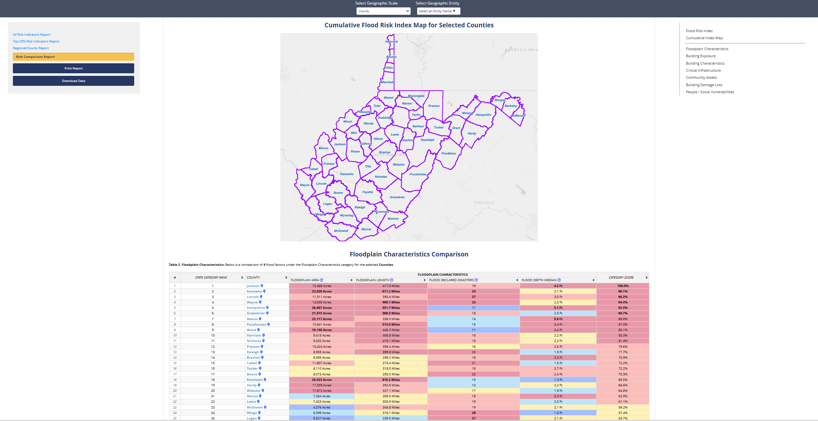
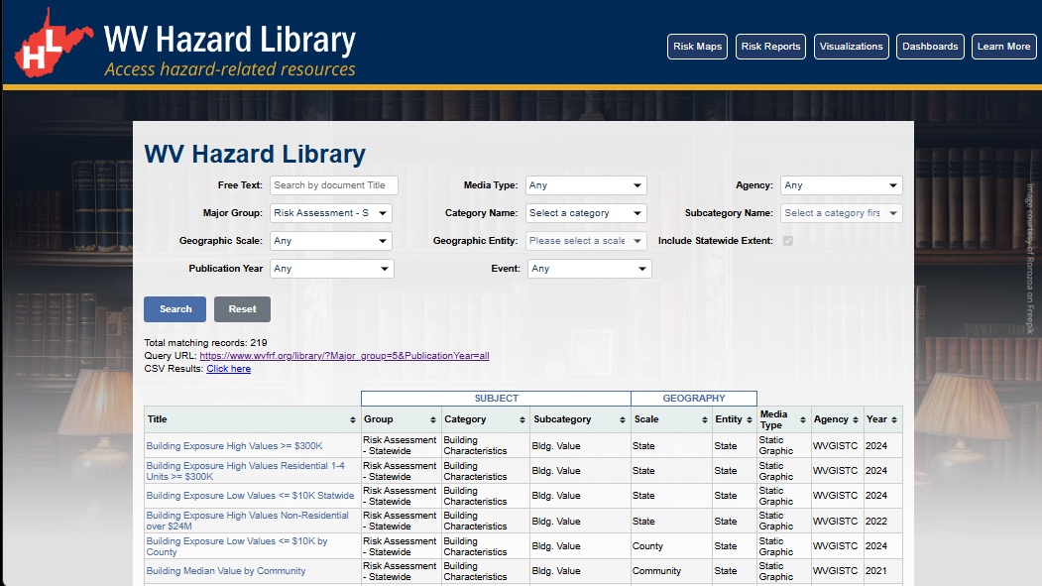
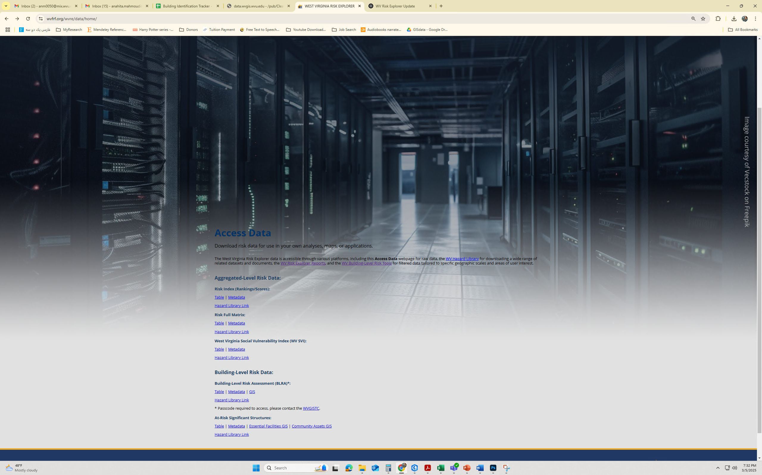
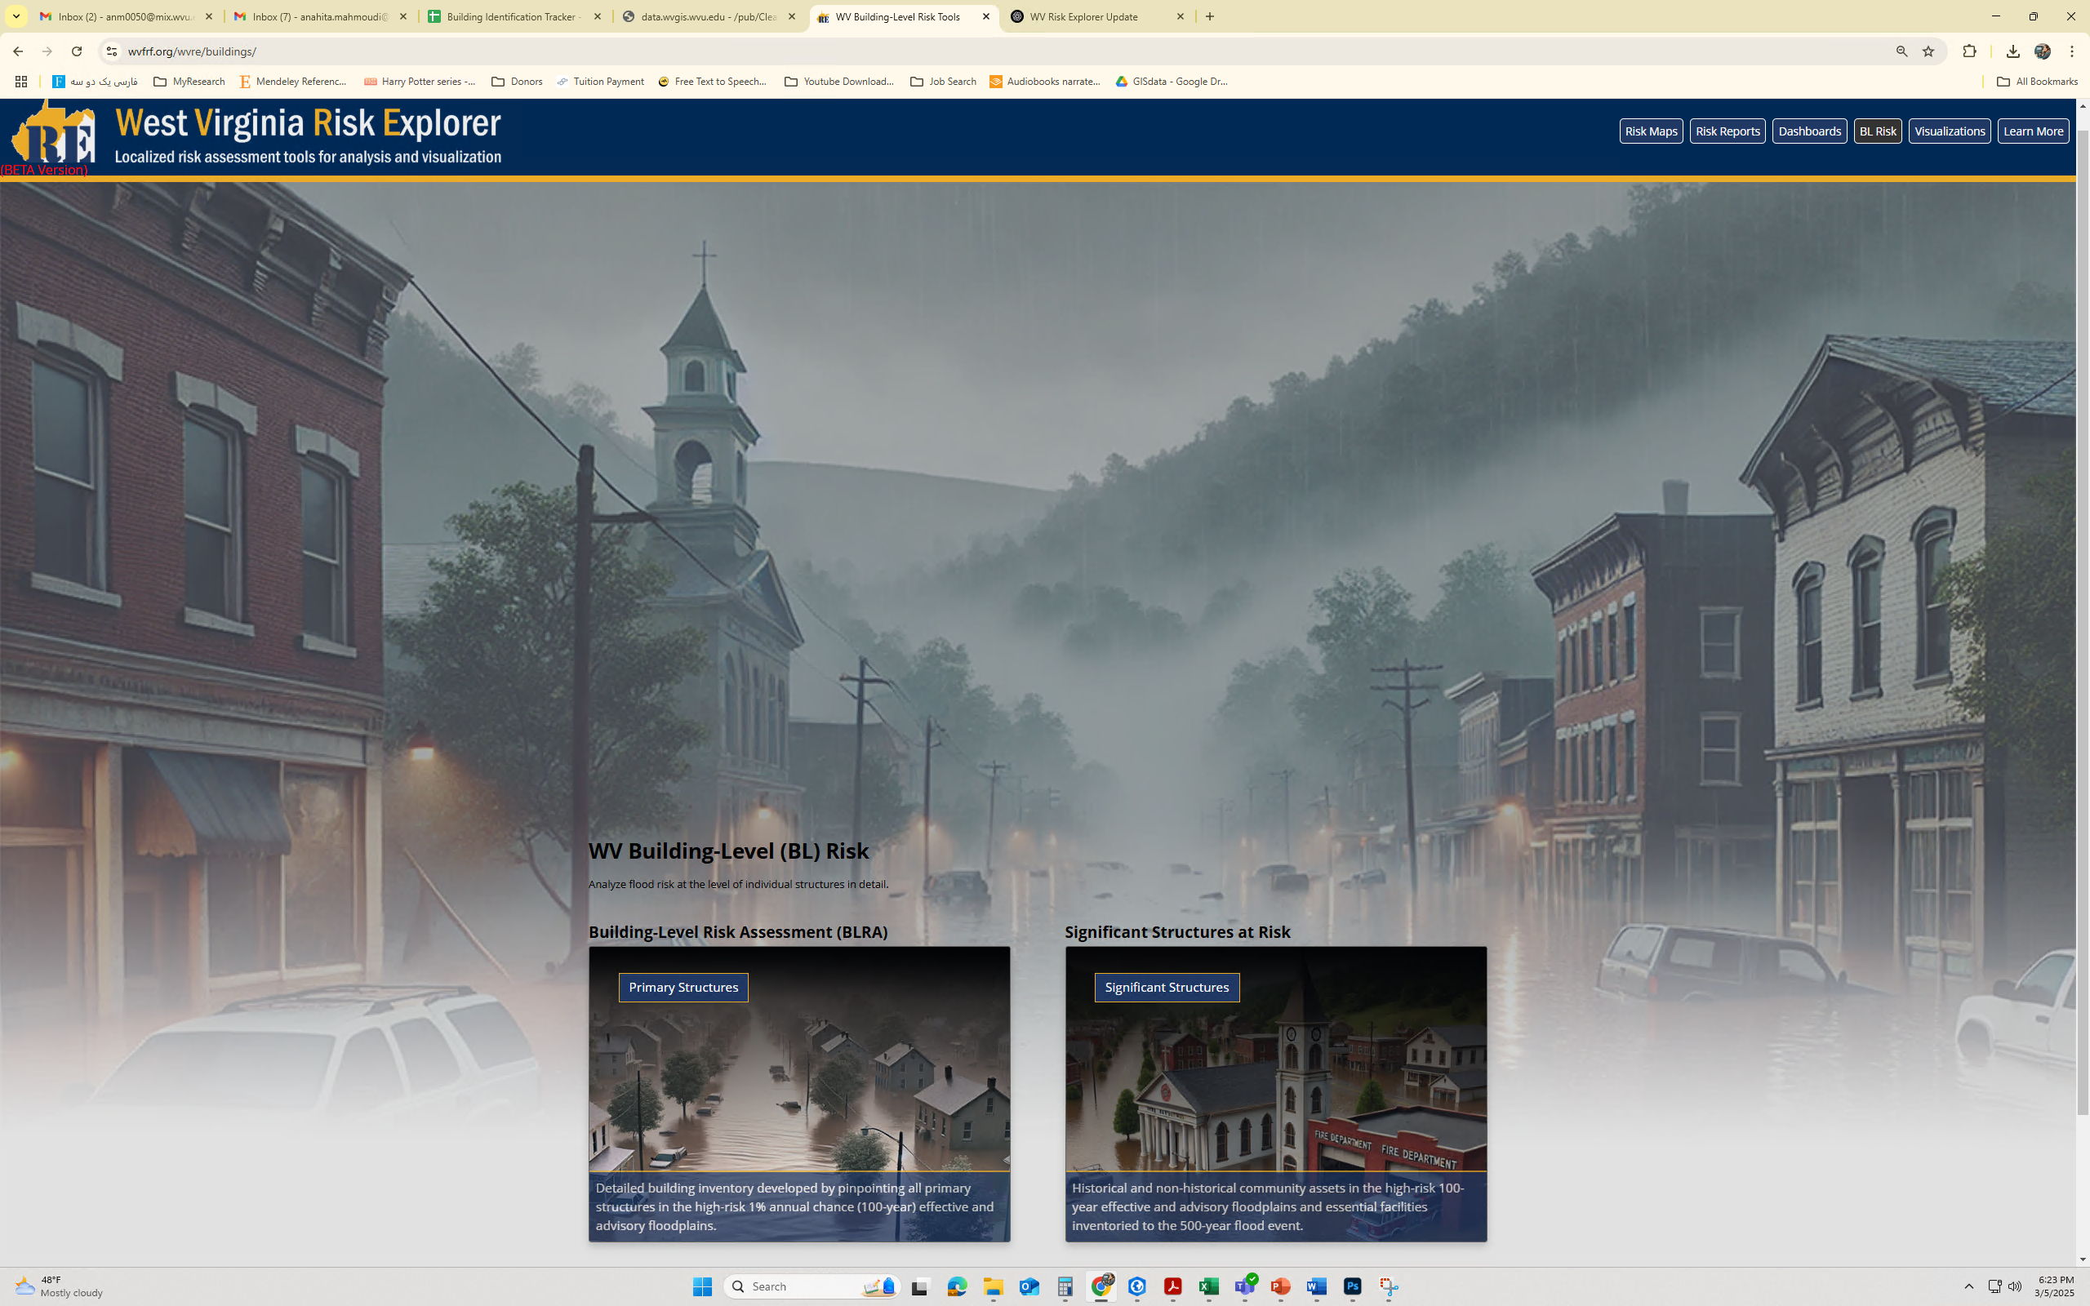
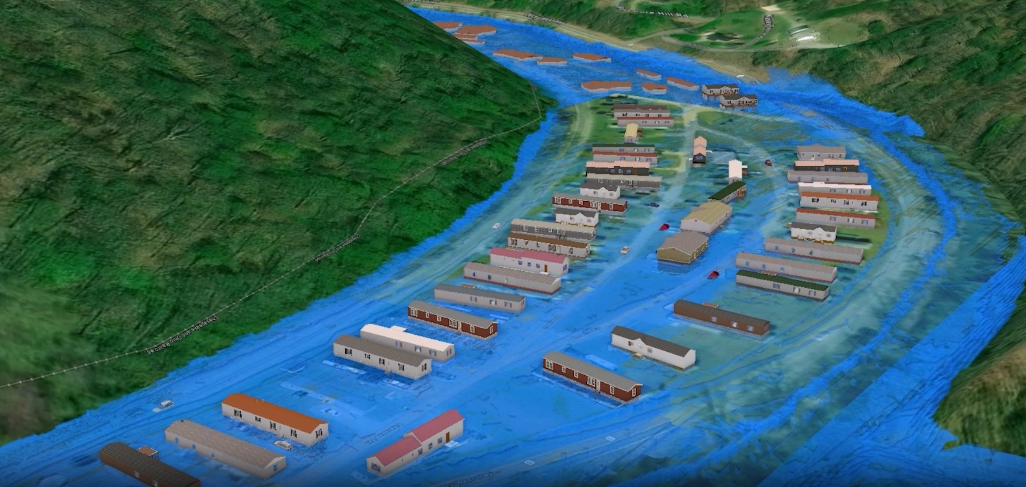
wvfrf.org/wvre
The West Virginia Risk Explorer (WVRE) is a localized suite of tools designed for flood risk assessment, analysis, and visualization aggregated across eight geographic scales along with detailed building-level tools. In addition to assessing risk, the WVRE includes specific tools to quantify and measure mitigation efforts at multiple scales.
The WVRE was developed as part of the West Virginia Flood Resiliency Framework (WVFRF) to help communities better understand and prepare for risk. Various stakeholder groups can use the tools to support more effective planning, preparedness, and response.
While many of the risk assessment datasets are generated at the building or property level and then aggregated at higher scales, the WVRE provides this opportunity to view and analyze riverine flood risk. Depending on the purpose and scales of analysis, users can explore flood risk data for validating floodplain management practices at the incorporated/unincorporated scales; identifying mitigation actions at the community level, hazard mitigation planning at the county or regional scales, resiliency planning at the statewide scale, initial Risk MAP discovery phase at the watershed scale, or loss of property and life at the river/stream scale.
WV Risk Explorer Tools – an advanced platform for risk assessment and visualization – offers:
Risk Maps
Interactively view and explore flood risk indicators on a map to identify areas of higher risk.
Risk Report
Dashboard
View and download flood risk assessment and comparison reports in more detail.
Use the interactive dashboards to analyze risk factors and mitigation measures.
Hazard Library
Search the document and visual media library for hazard information.
Building-Level (BL) Risk
Access Data
Analyze flood risk at the level of individual structures in detail.
Download risk data for use in your own analyses, maps, or applications.
Flood Visualizations
Visualize 3D and 2D flood models at the community and building level scales.

