Slide 1




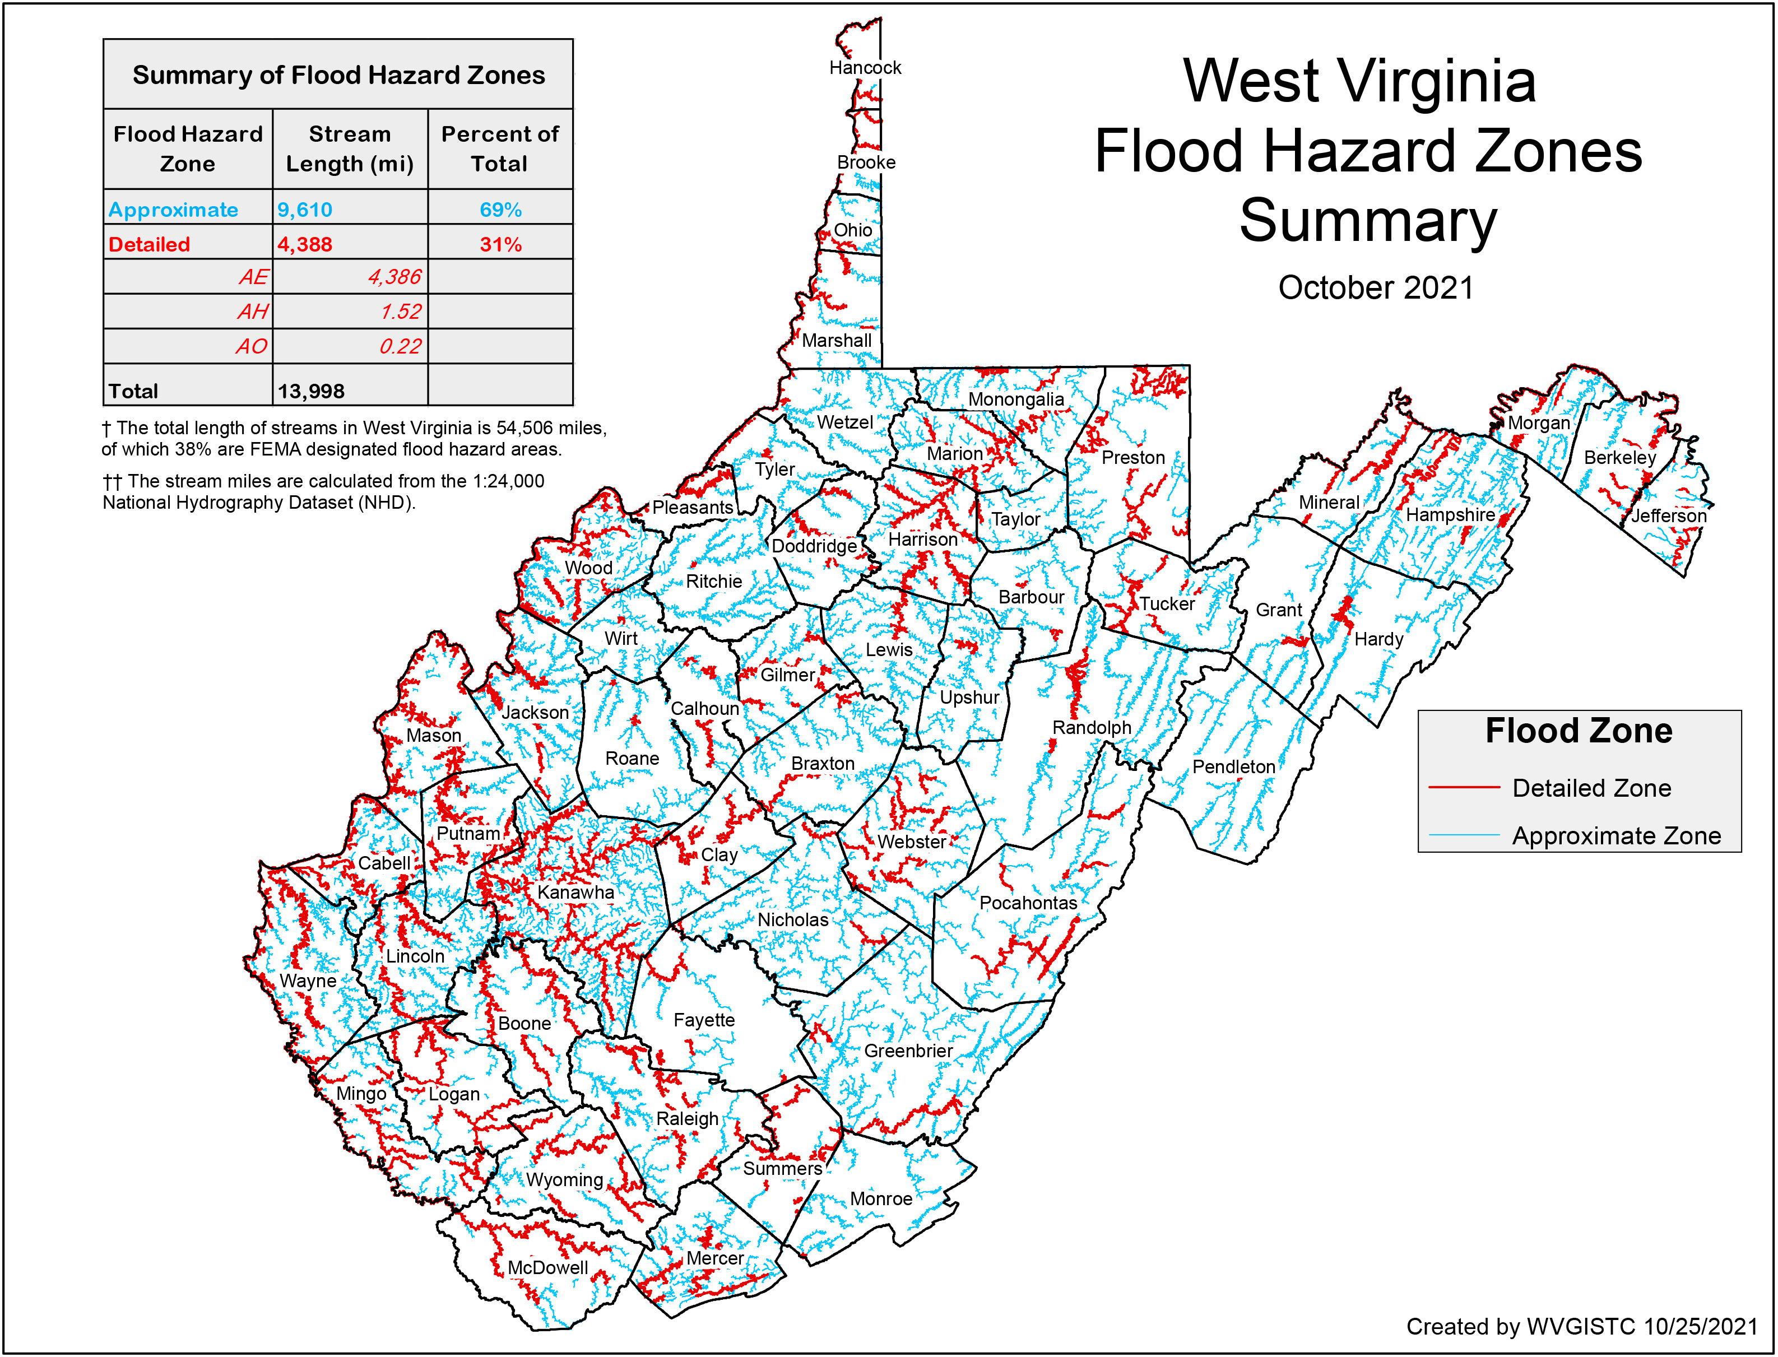
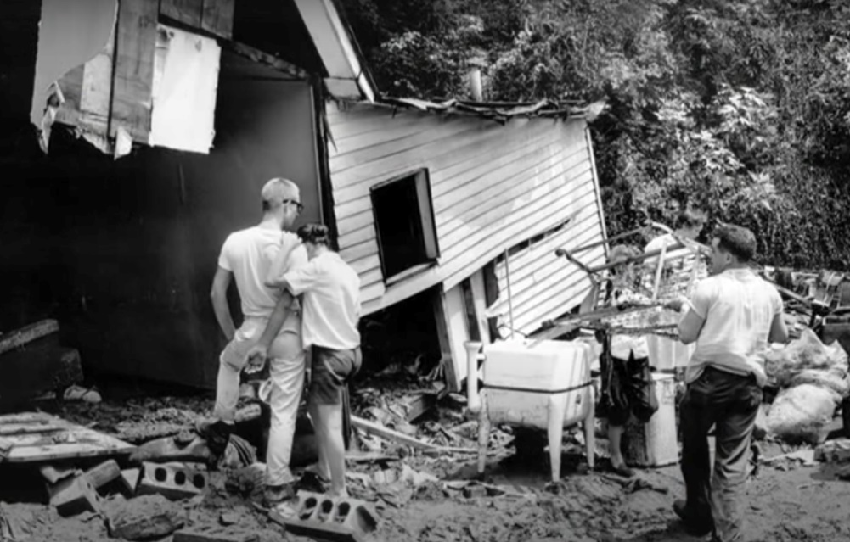
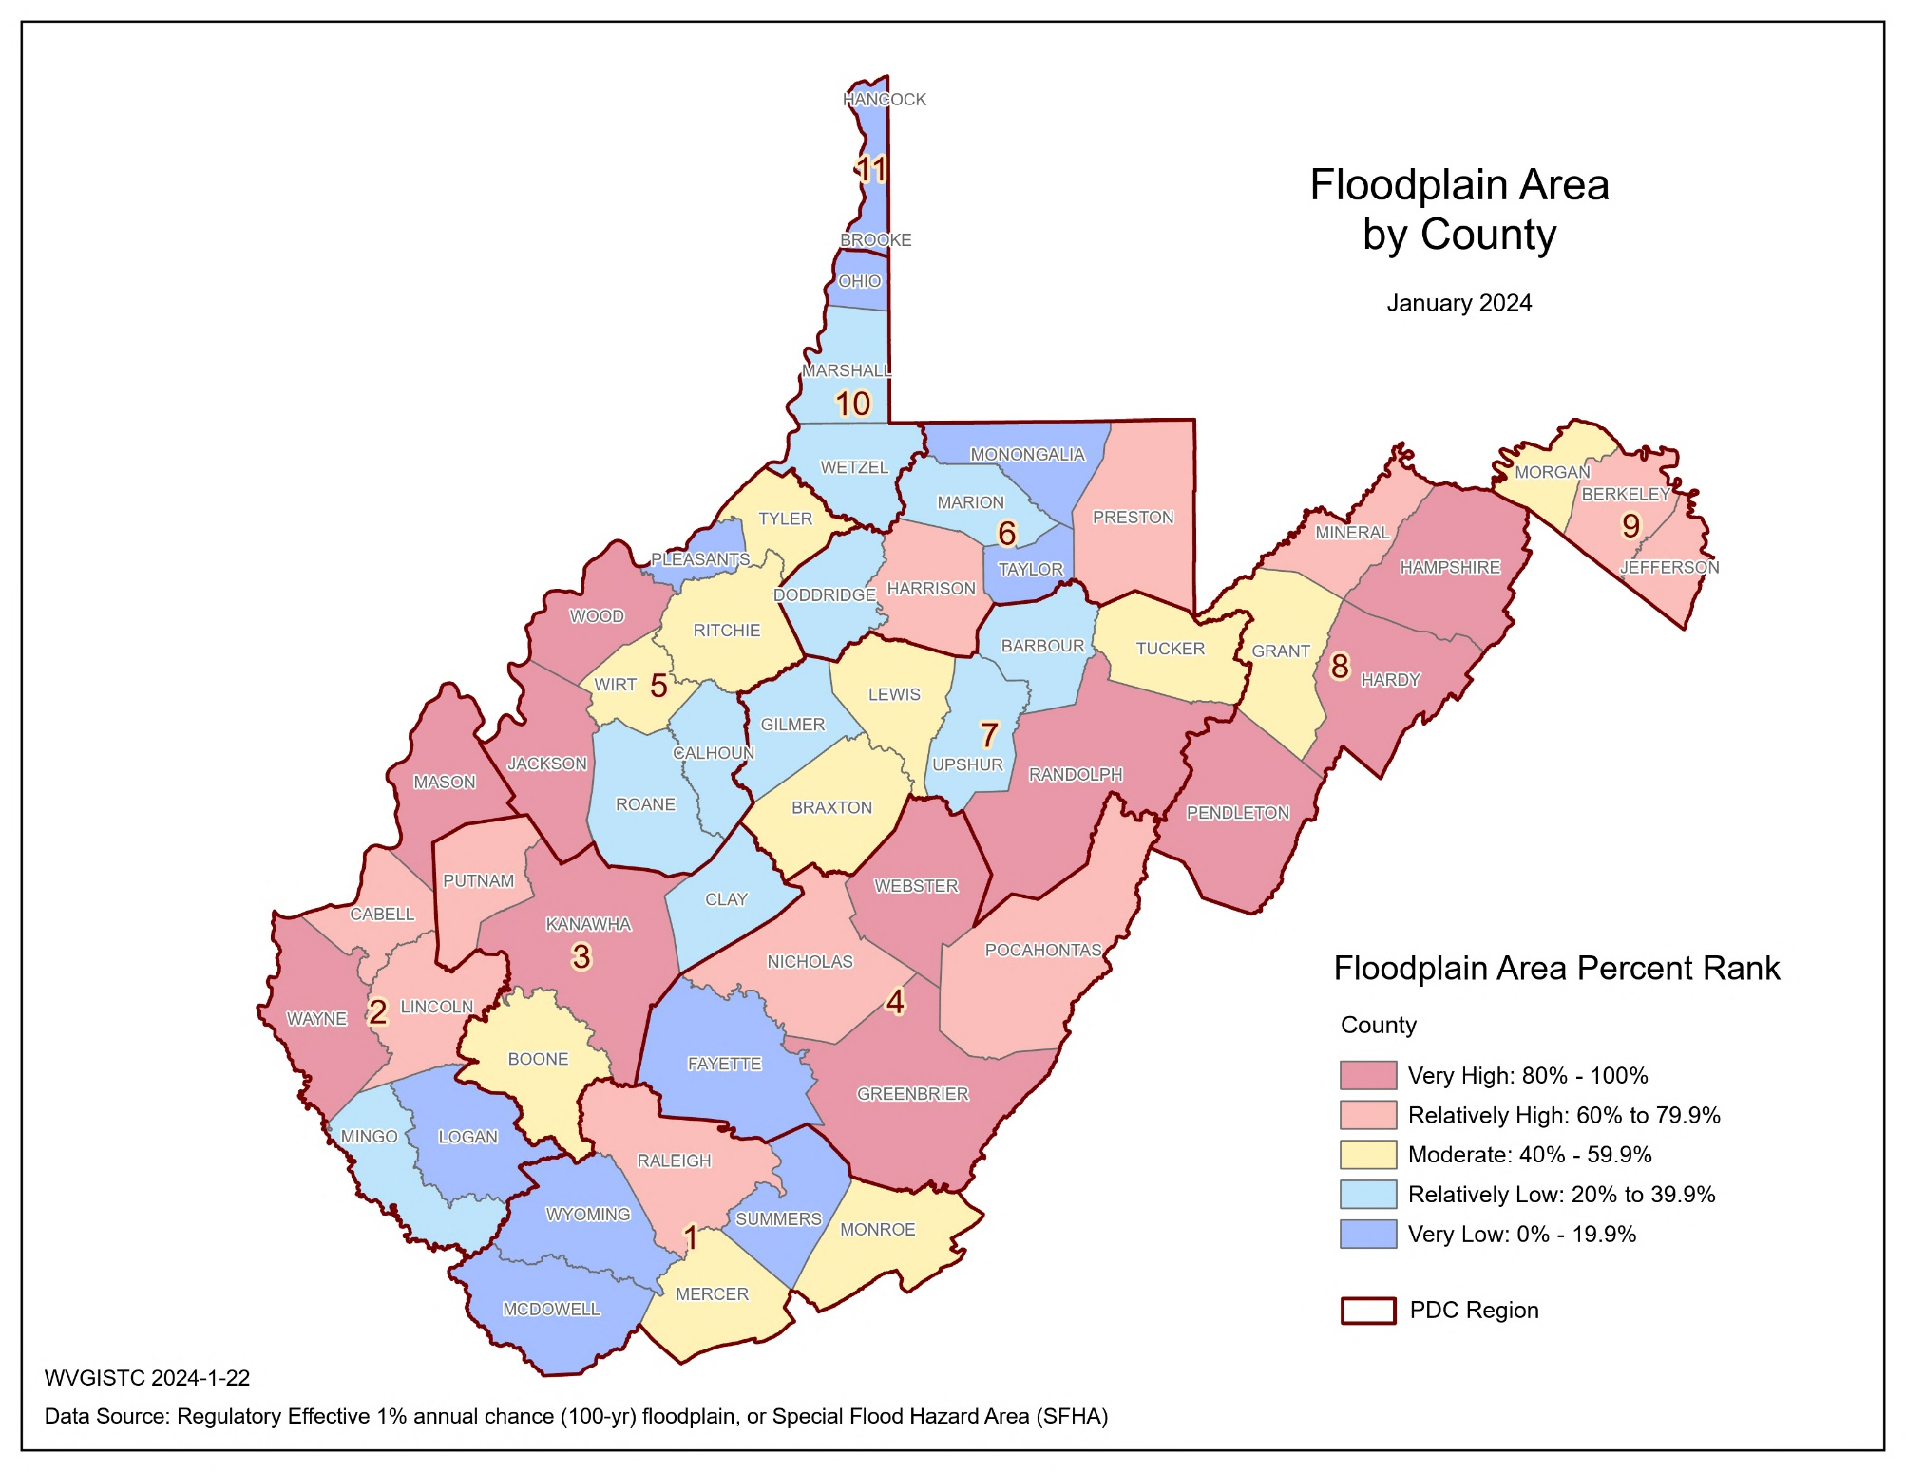
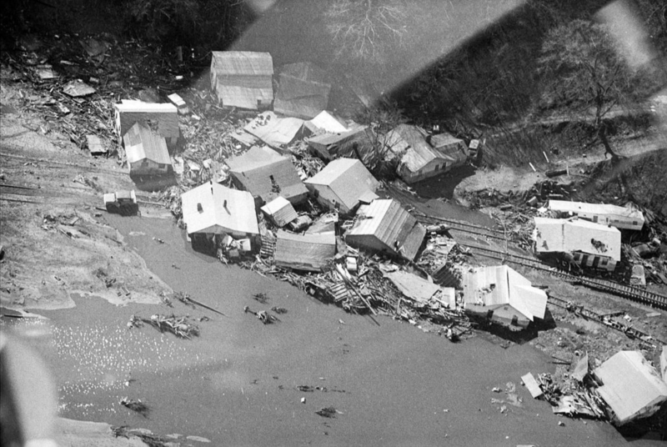
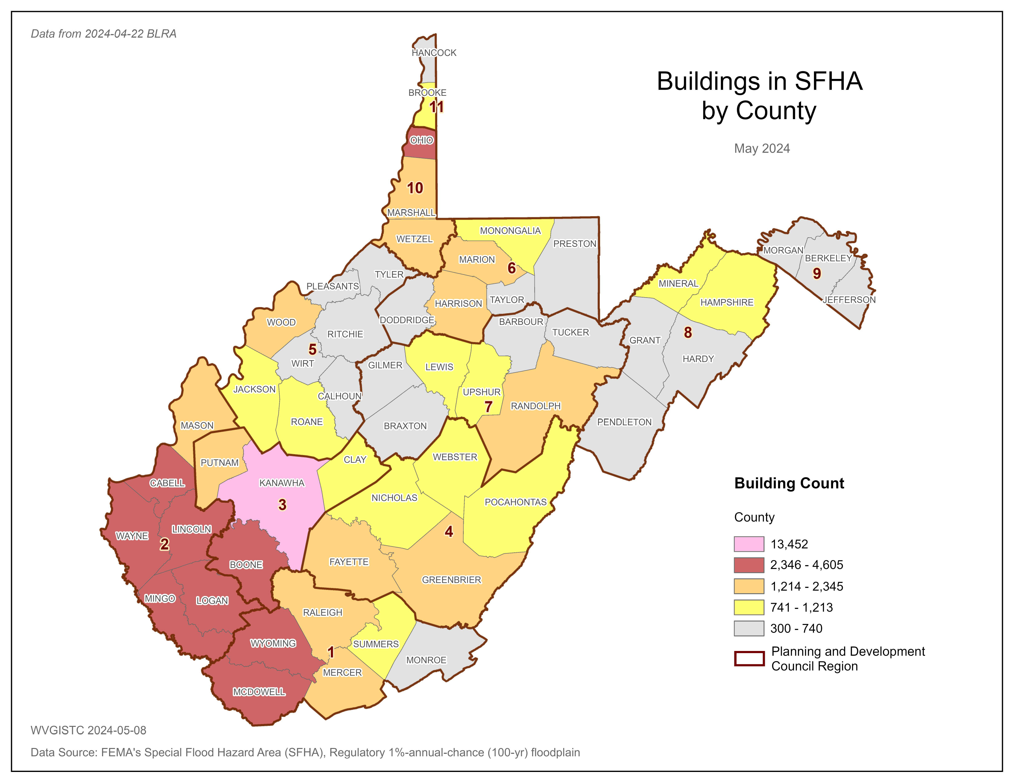
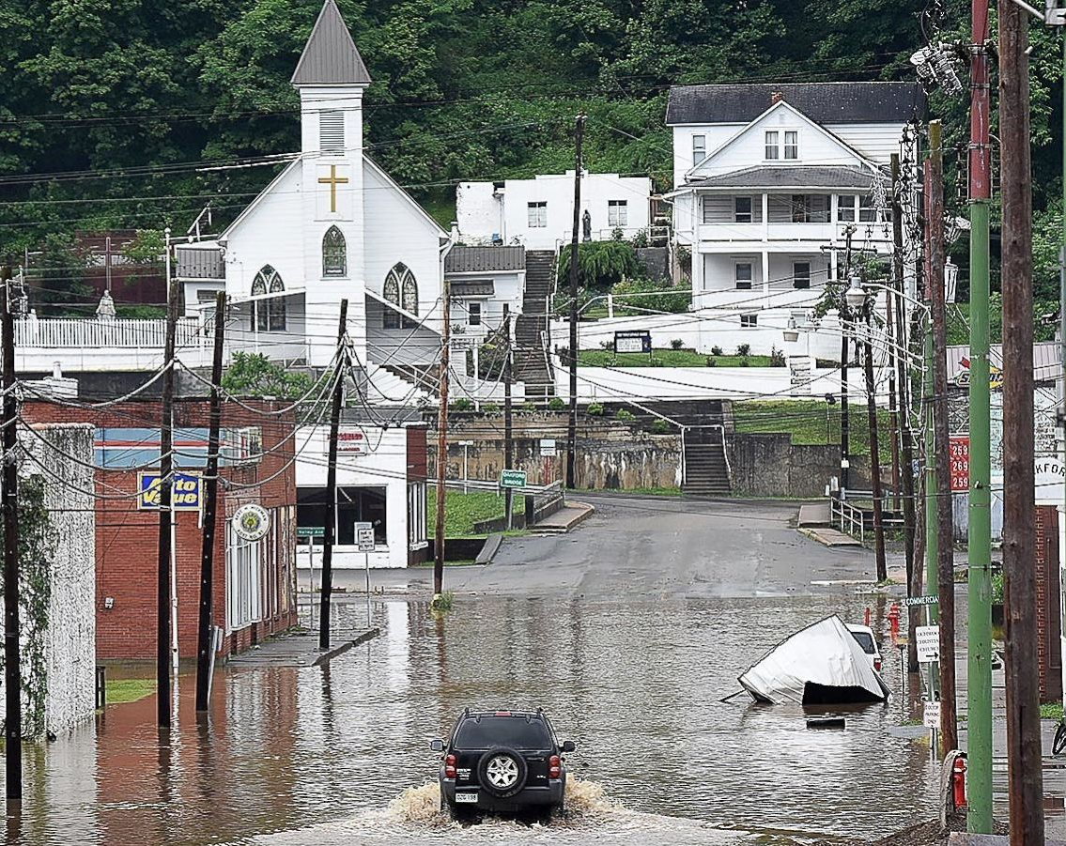
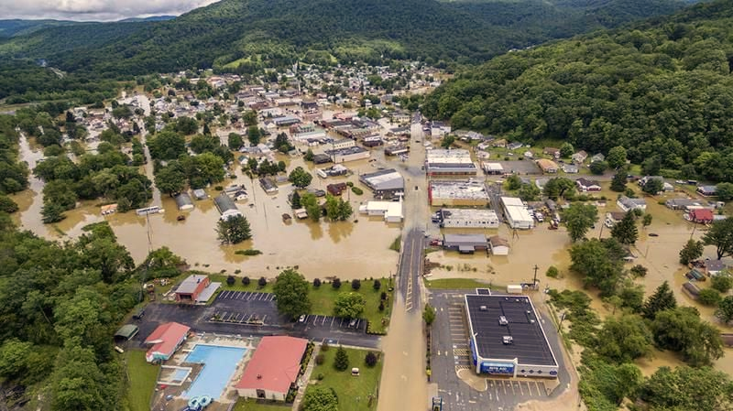
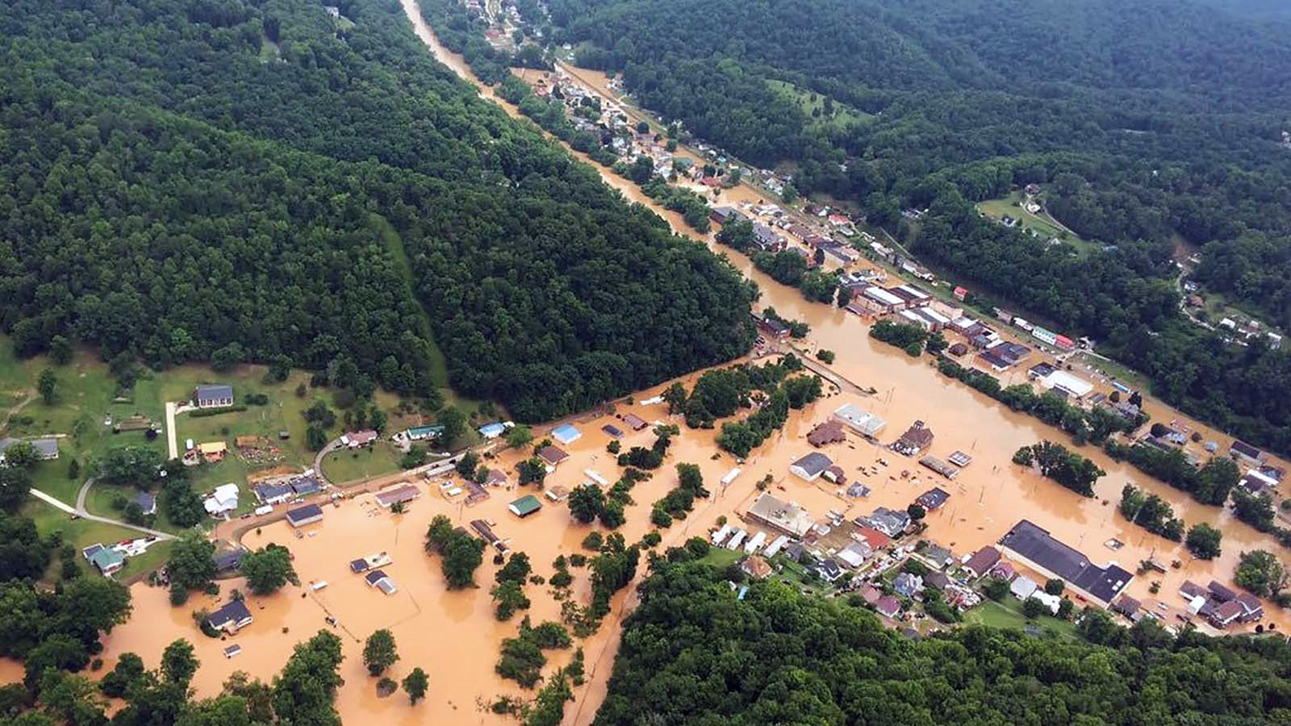
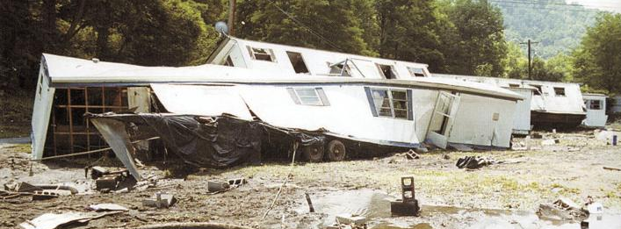
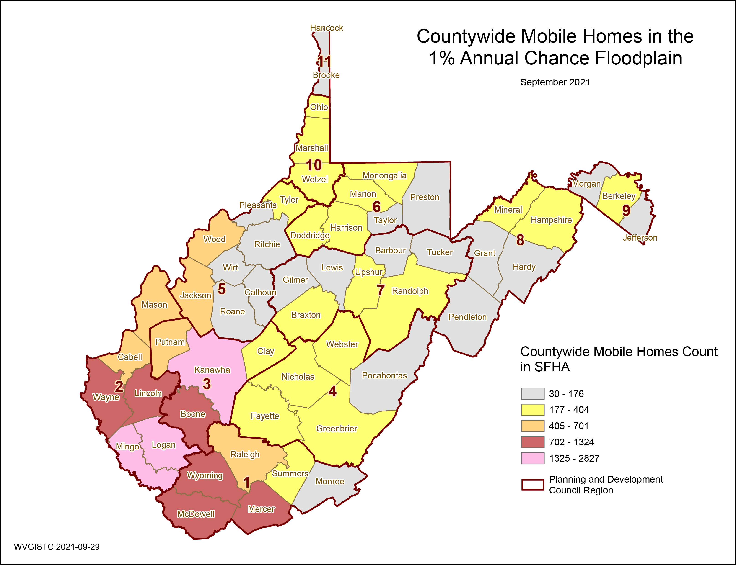
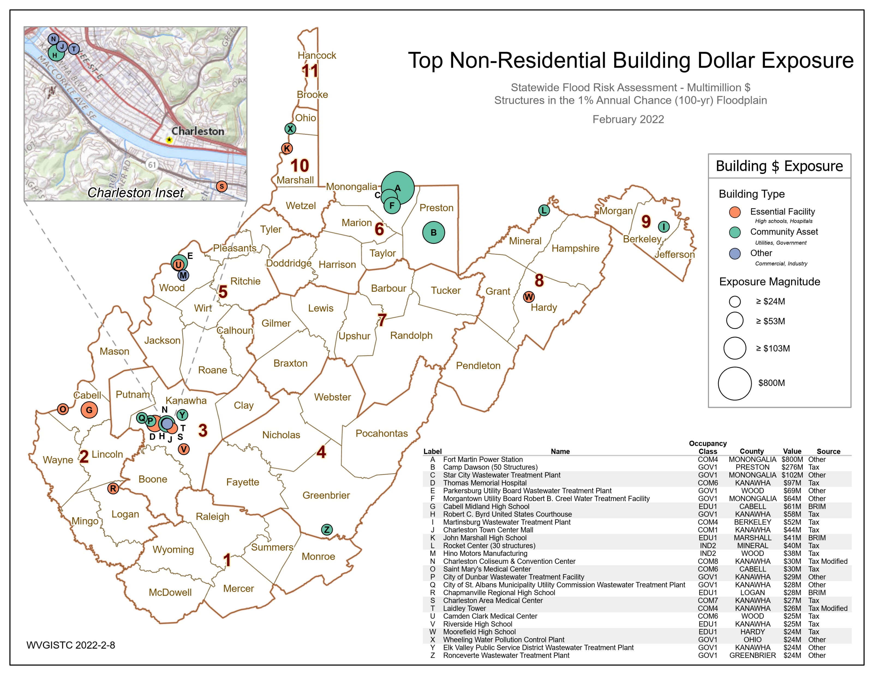
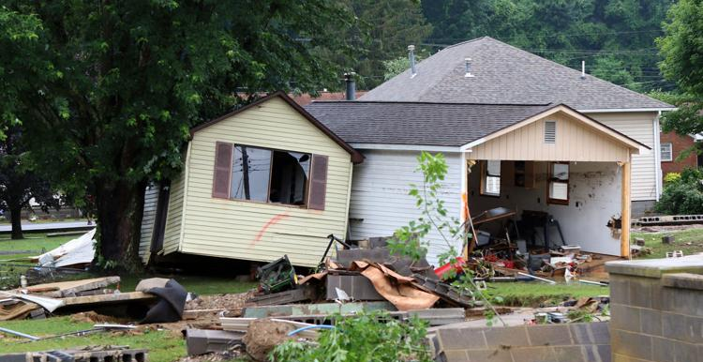
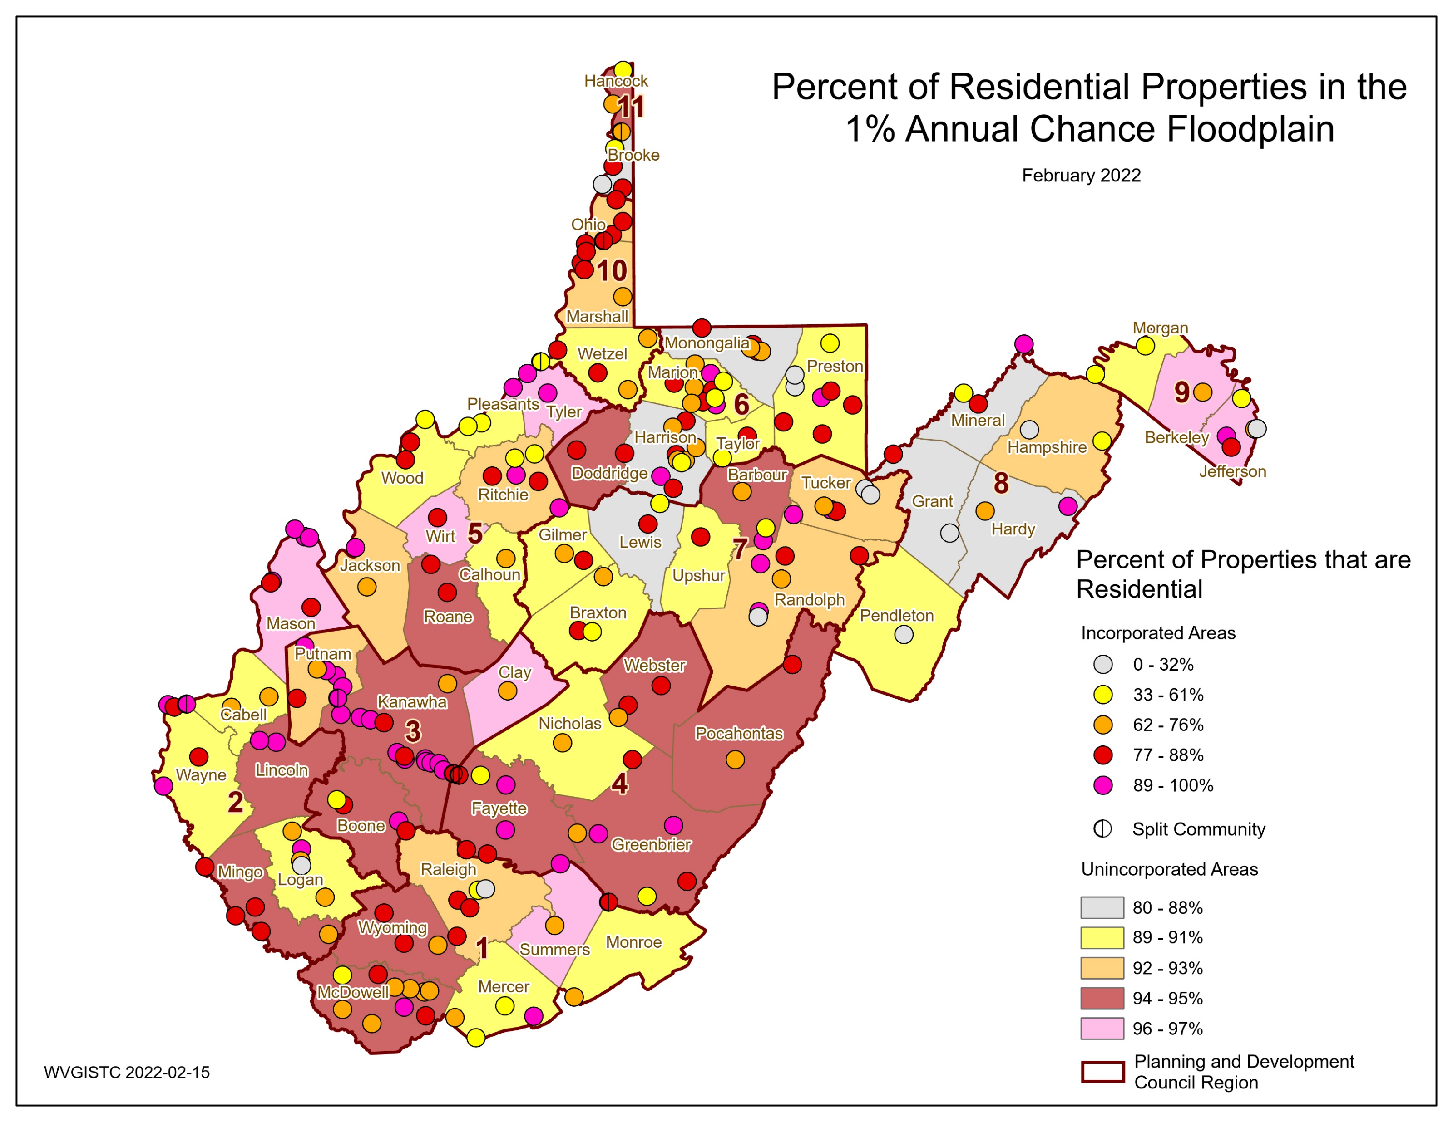
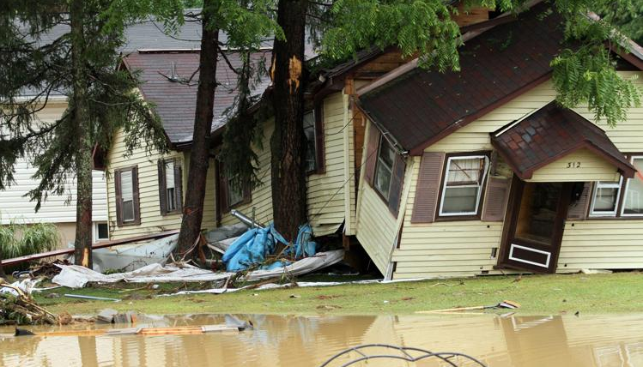
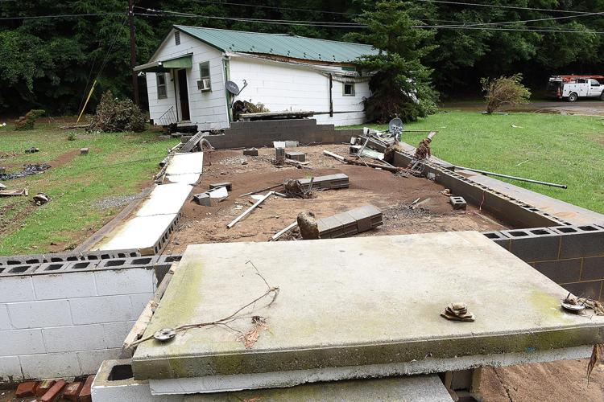
Statewide Flood Risk Assessment, WVFRF, Apr. 2025
General Information
Total Area: 15,500,454 acres
Total Structures: 1,118,761
Total Population: 1,801,049
Population Density: 74 /sq. mile
Number of Households: 711,352
Average Household Size: 2.5
Floodplain Characteristics
Floodplain Area: 528,635 acres of high-risk floodplain
Modified Area of Regulatory Floodplains (aSFHA) excluding large open water lakes (> 10 acres),
large rivers (bank-to-bank > 500 ft.), and federal lands (> 10 acres)
Floodplain Area Ratio: 3.4% of the state’s area lies within the Special Flood Hazard Area
Floodplain Length: 17,205 miles of high-risk floodplain
Floodplain Length Ratio: 0.0011 miles/acre
Top 5 Counties | Modified Total SFHA Area (acres)
Hampshire | 26,607
Kanawha | 23,929
Mason | 23,117
Greenbrier | 21,615
Randolph | 20,523
July 1961 (22 + 2 landslide fatalities), Kanawha County
31% of the state has mapped Detailed Flood Zones containing 65% of the buildings in Regulatory Floodplains
Flood Depth Median: 1.8 ft (base flood depth)
February 1972 (123 fatalities including 4 missing), Buffalo Creek
Total Federally-Declared Flood Disasters in the State since 1953: 64 event
Top 5 Counties | Building in SFHA
Kanawha | 13,452
Logan | 4,498
McDowell | 3,479
Mingo | 3,229
Boone | 3,094
Building Exposure
June 2016
(23 fatalities)
Building Floodplain Count: 82,408 Structures
Building Floodway Count: 8,237 Structures
Building Floodplain Ratio: 7.4% of Buildings in the state
Building Density: 0.16 /acre (in floodplain)
Buildings in High-Risk Effective Zones: 84,621
Buildings in High-Risk Advisory Zones: 13,315
Buildings in All High-Risk Floodplains: 97,936 (8.8% of WV Bldgs.)
Buildings in Estimated Depths of Greater than 10 ft: 2,088
Richwood
Rainelle
Clendenin
Building Characteristics (in High-Risk Floodplain)
Building Median Value: $38,200 (in floodplain)
Bldg. Mobile Homes Ratio: 27.5% of single-family dwellings in floodplain are manufactured homes
(Count: 23,315)
Bldg. Subgrade Basements Ratio: 24.8% of floodplain buildings have subgrade basements (Count: 24,323)
Building 1-Story Ratio: 84.0% of floodplain buildings have only one story (Count: 82,201)
Bldg. Year Pre-FIRM Ratio: 77.5% of floodplain buildings are Pre-FIRM or built with no FIRM in effect
(Count: 75,804)
Bldg. Year Minus Rated Post-FIRM Ratio: 5.8% of floodplain buildings are Post-FIRM with lowest floor
below Base Flood Elevation (BFE) (Count: 4,740)
Total Building Value in High-Risk Floodplain: $9,971M
Residential (1-4 Units) Building Count in High-Risk Floodplain: 86,732 (88.5% of total count)
Residential (1-4 Units) Building Value in High-Risk Floodplain: $4,344M (43.5% of total value)
Non-Residential (including Apartments) Building Count in High-Risk Floodplain: 11,204 (11.5% of total count)
Non-Residential (including Apartments) Building Value in High-Risk Floodplain: $5,627M (56.5% of total value)
Near Kimball, McDowell County, July 2001
Top 5 Counties | Mobile Home in SFHA
Kanawha | 2,705
Logan | 1,729
Mingo | 1,645
Boone | 1,310
Mercer | 1,147
Majority of Building Stock is RESIDENTIAL. Unincorporated Areas typically have higher residential building counts than Incorporated Places.
White Sulphur Springs, June 2016

Slide 2
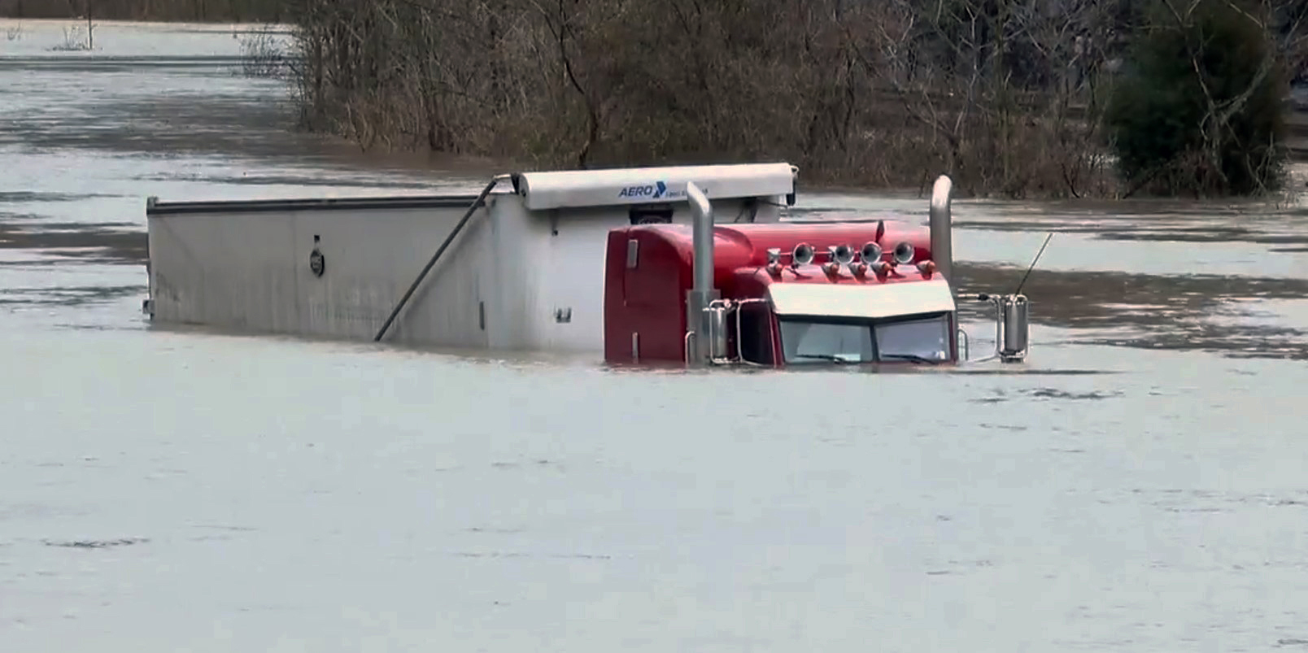

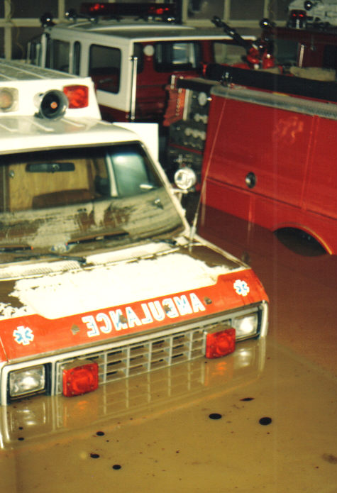
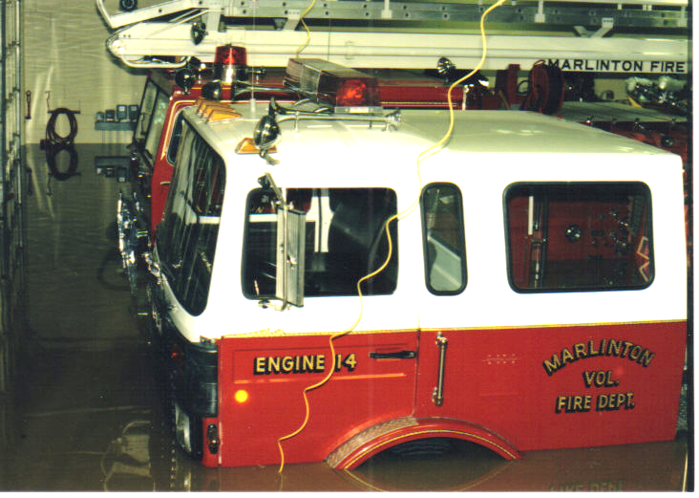
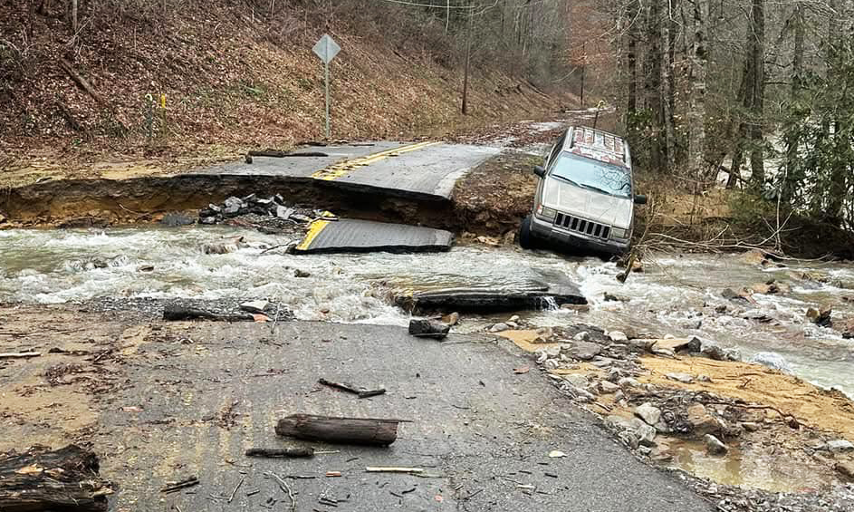
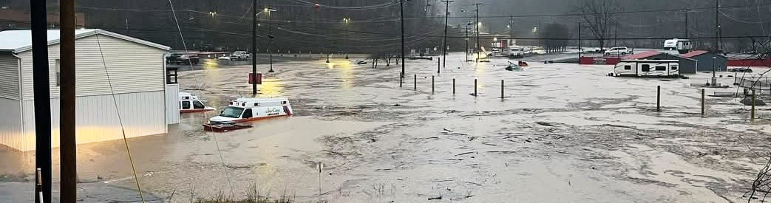
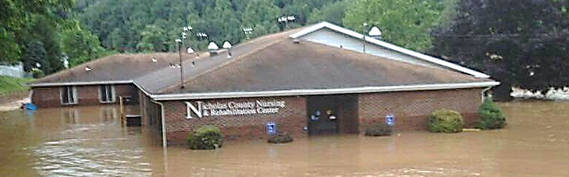

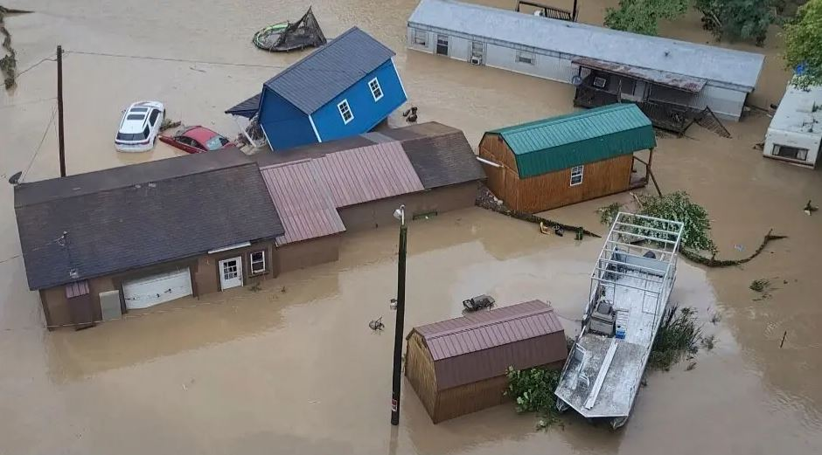
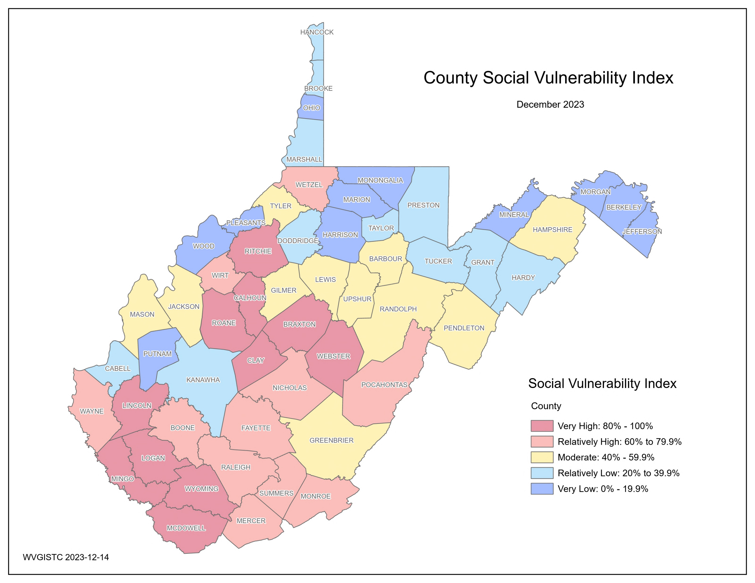
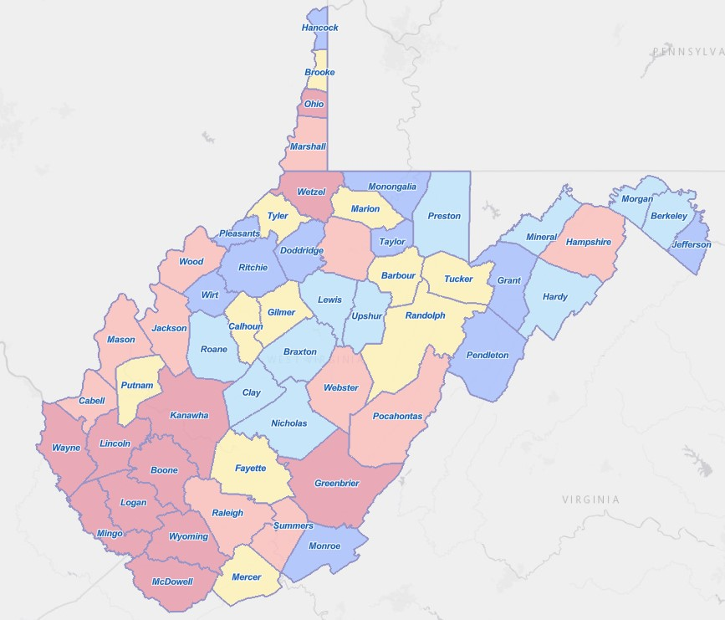
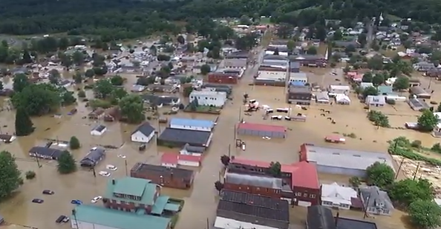
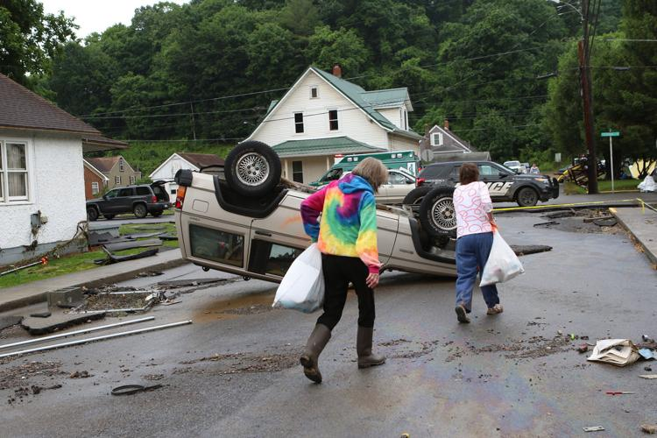
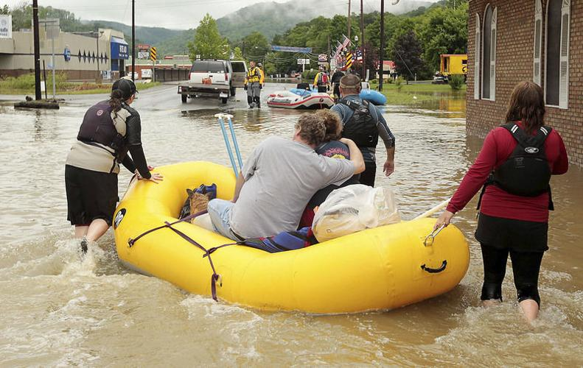
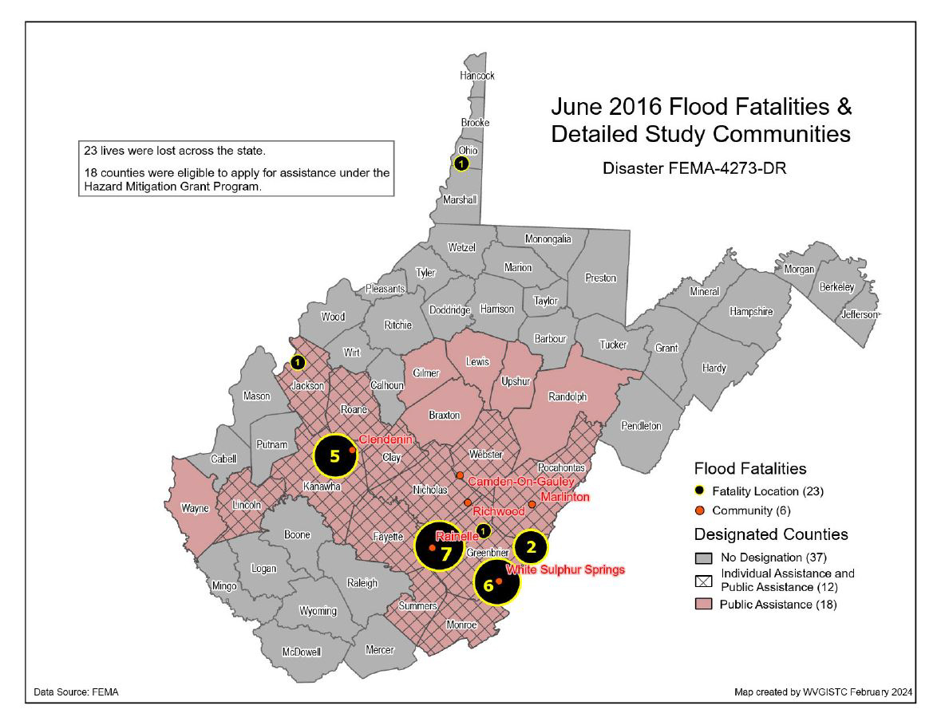
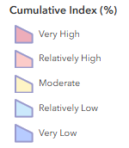
Statewide Flood Risk Assessment, WVFRF, Apr. 2025
Critical Infrastructure (in High-Risk Floodplain)
Essential Facilities: 489 of 1,696 essential facilities (28.8%) in moderate or high-risk floodplains
Most Vulnerable: 262
(schools, hospital, nursing homes, or other essential facilities in floodway or in estimated flood depths ≥ 3 ft)
88 of 312 (28%)
187 of 548 (34%)
10 of 54 (19%)
170 of 828 (21%)
15 of 67 (22%)
19 of 111 (17%)
Williamson, Mingo County, February 2025
Roads Inundated: 6,503 miles of total 109,052 miles (6%) estimated to be flooded by a 1% annual chance (100-year) major flood
Bridges Inundated: 2,603 of 7,349 public bridges (35%) can be inundated by a 1% annual chance flood.
Railroads Inundated: 617 miles of total 3,284 miles (19%) can be inundated by a 1%-annual-chance flood.
McDowell County, February 2025
Marlinton, November 1985
Richwood, June 2016
Most Vulnerable Non-Historical : 616
(in floodway or in estimated flood depths ≥ 3 ft)
At-Risk Community Assets
Welch, McDowell County, February 2025
Historical Community Assets: 2,758 in high-risk floodplain
Non-Historical Community Assets: 2,092 in high-risk floodplain
Post-Secondary
Building Damage Loss
1,450
21
24
423
166
94
2,664
8
Substantial Damage Count: 6,493 buildings substantially damaged (≥ 50% of appraised value) by a 1%-annual-chance (100-year) flood
Substantial Damage Ratio: 7.9% of buildings in floodplain substantially damaged by a major storm
Previous Damage Claims: 27,882 buildings with prior damage claims
Repetitive Loss Structures: 9,698 buildings with at least 2 paid flood losses, of more than $1,000 each, in any 10-year period since 1978
Total Estimated Building Loss: $858M (8.6% of total building value in high-risk floodplain)
Building Loss Median Value: $5,970
Total Estimated Debris: 521,283 tons
People / Social Vulnerabilities
Social Vulnerability Index
(WV SVI) (0% to 100%)
Combines indicators of:
Poverty Rate
Unemployment Rate
Vulnerable Ages Rate
Disability Rate
Population without a High School Diploma
Population Change
Median Housing Unit Value
Percentage of Mobile Homes in Housing Units
Top 5 Counties | WV SVI
McDowell | 100.0%
Wyoming | 98.1%
Mingo | 96.3%
Clay | 94.4%
Webster | 92.6%
Chesapeake, Kanawha County, August 2023
Population in Floodplain Ratio: 11.0% of the state’s population (198,888 persons) residing in the high-risk flood zone
Population Displaced Ratio: 6.6% of the state’s population (119,350 persons) displaced by a 1%-annual-chance (100-year) flood event
Short-Term Shelter Population: 23,003 persons
Short-Term Shelter Companion Pets: 6,411 (4,057 dogs and 2,354 cats)
Cumulative Risk Index
Top 10 Counties | WV Risk Index
Kanawha | 100.0%
Boone | 98.1%
McDowell | 96.2%
Logan | 94.4%
Mingo | 92.5%
Wyoming | 90.7%
Wayne | 88.8%
Wetzel | 87.0%
Lincoln | 85.1%
Ohio | 83.3%
Cumulative Risk Index by County
White Sulphur Springs, June 2016
Rainelle, June 2016
Rainelle, June 2016
2016 Flood Fatalities:
23 Victims
Three younger than 15 yrs.
Eleven 15 to 64 yrs.
Nine over 65 yrs.
Five with Health Conditions or Disabilities
Nine Risky Behavior

