Slide 1
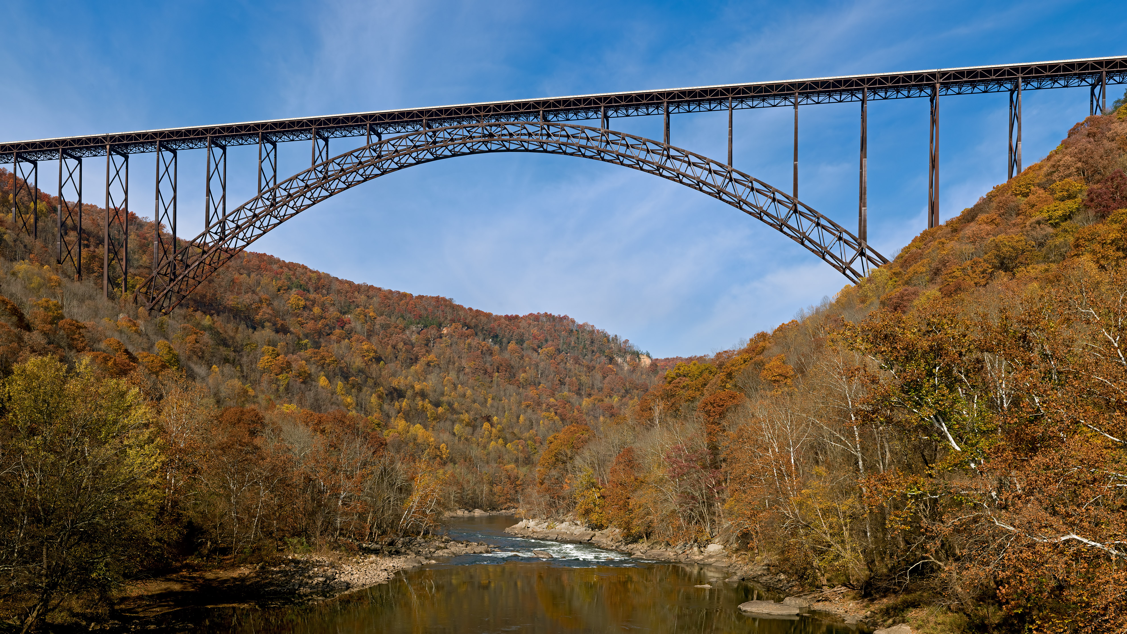
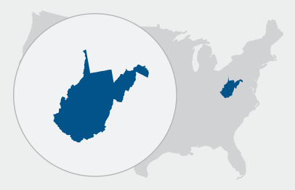
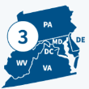
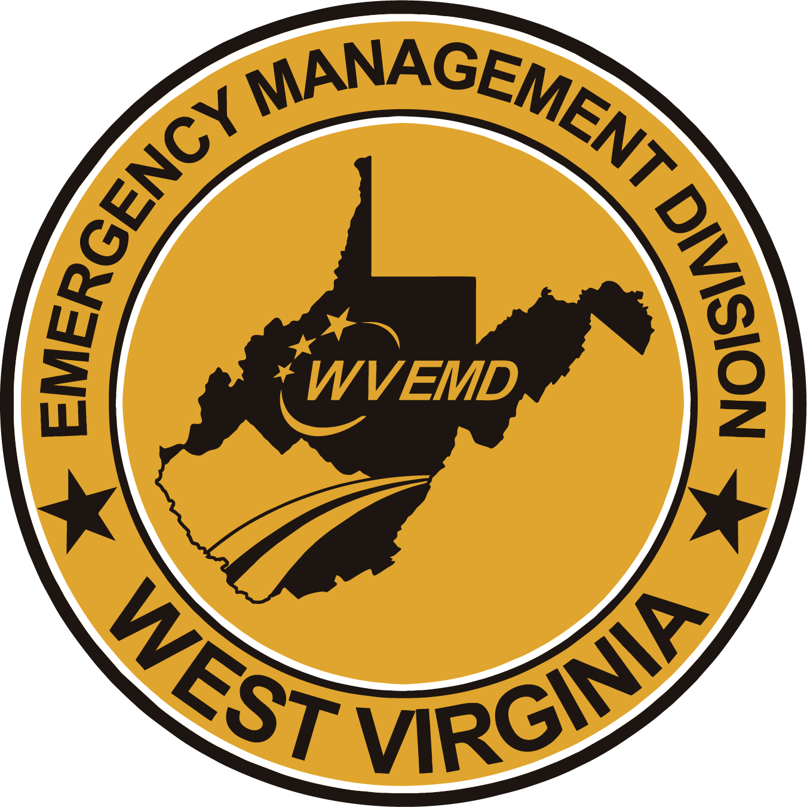
FEMA/WVEMD Disaster
Recovery Opportunities
Notes:
Title slide + Image Option 2

Slide 2
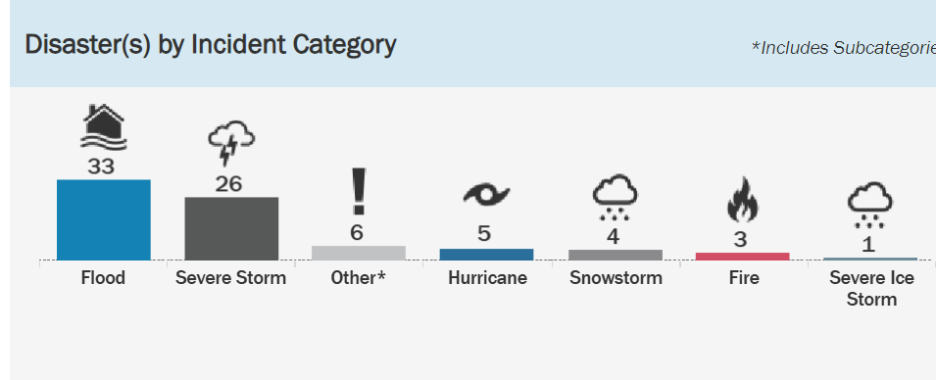
West Virginia Disaster Declaration Overview
Incidents can occur any month of the year resulting in Federal Disaster Declarations
Based on historical data, the months of March, May and August have recorded the highest number of incidents in West Virginia since 1954.
Robert T. Stafford Disaster Relief & Emergency Assistance Act (Stafford Act) of 1988

Slide 3
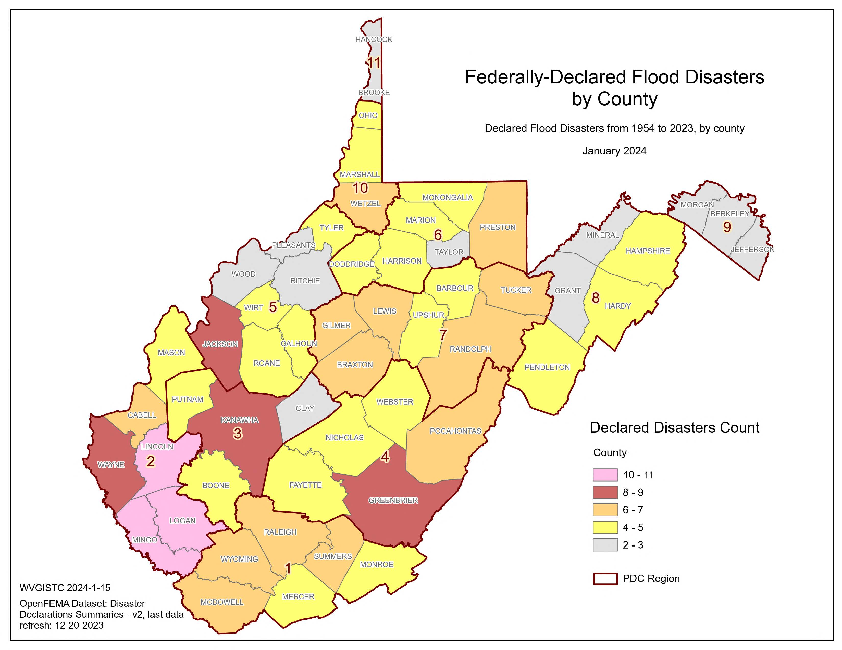
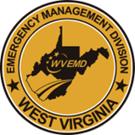
WV Top 10 Disaster Counties
County | No. of Declarations
Mingo | 11
Lincoln | 10
Logan | 10
Wayne | 9
Greenbrier | 9
Kanawha | 8
Jackson | 8
Cabell | 7
Randolph | 7
Wyoming | 7

Slide 4

Disaster # | Declaration Date | PA Obligation | MIT Obligation
DR-4273 | June 25, 2016 | $436,610,902.00 | $35,675,205.16
DR-4331 | August 18, 2017 | $11,790,234.45 | $2,682,701.63
DR-4359 | April 17, 2018 | $33,863,253.66 | $2,813,086.31
DR-4378 | July 12, 2018 | $2,225,874.68 | $162,949.00
DR-4455 | August 3, 2019 | 4,660,343.13 | $393,248.75
DR-4517 (COVID) | April 3, 2020 | $163,810,376.05 | $646,452.00
DR-4603 | May 13, 2021 | $5,867,014.41 | $700,100.00
DR-4605 | May 20, 2021 | $5,688,807.38 | $114,953.00
DR-4678 | November 28, 2022 | $945,006.33 | TBD
DR-4679 | November 28, 2022 | $738,149.95 | TBD
DR-4756 | January 30, 2024 | 4-5 Million (est) | $1,141,371 (est)
DR- 4783 | May 22, 2024 | 25-30 Million | TBD
DR-4787 | May 24,2024 | 10 Million | TBD
Presidential Declarations in WV (2016-Present)

Slide 5
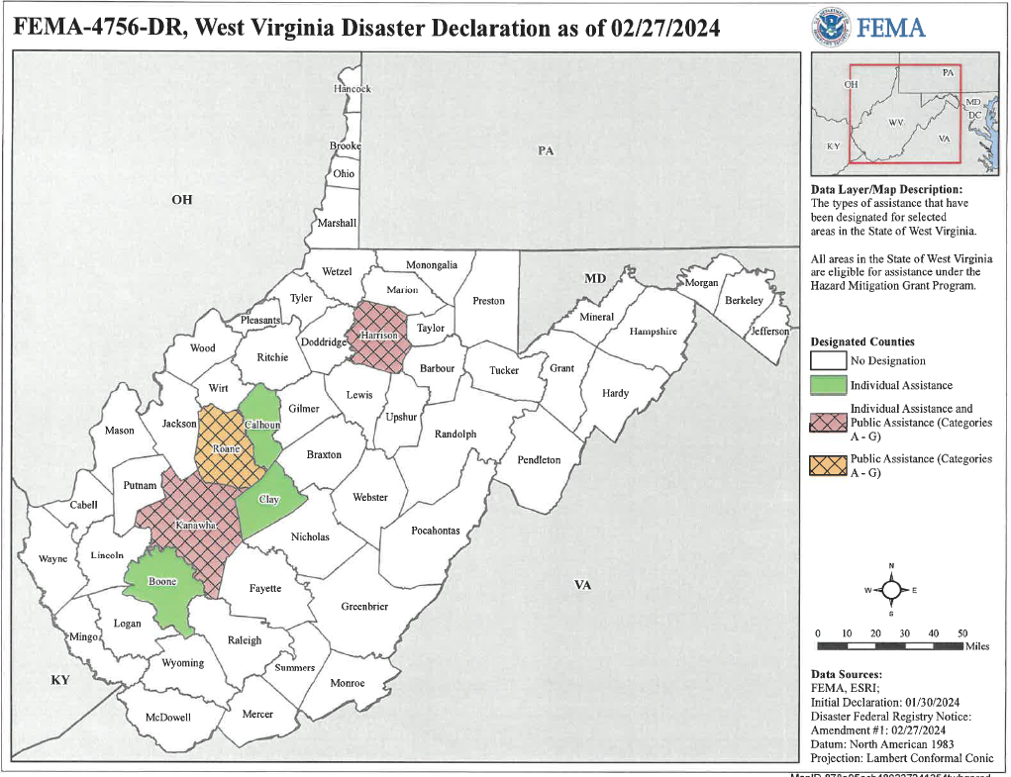

Slide 6
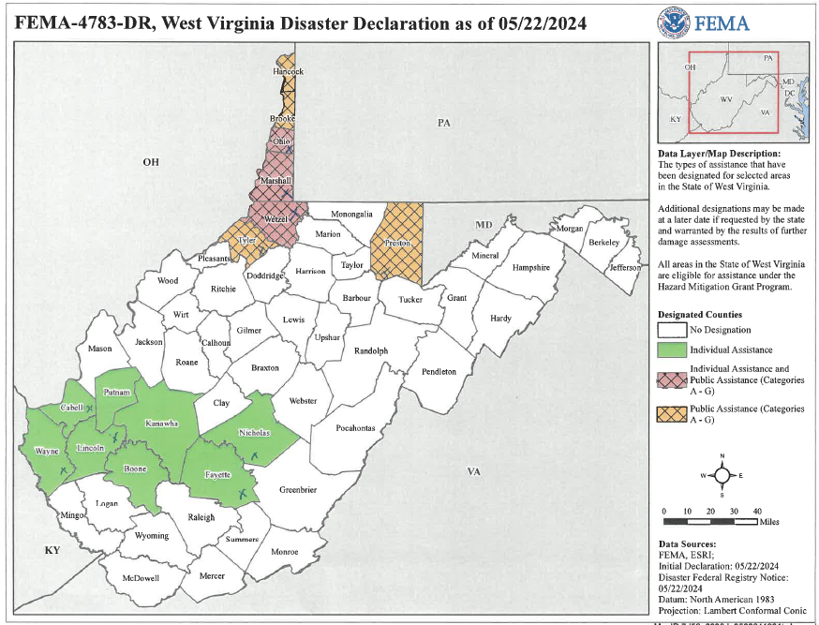

Slide 7
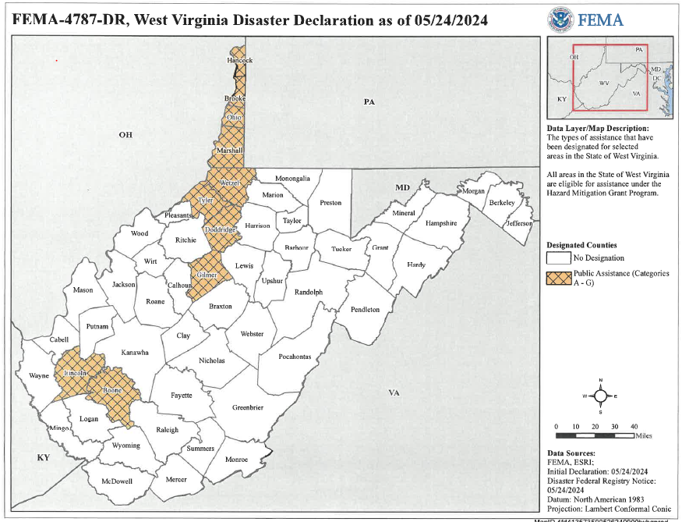

Slide 8
FEMA Mitigation Quick Facts
FEMA's hazard mitigation assistance provides funding for eligible mitigation measures that reduce disaster losses.
"Hazard mitigation" is any sustainable action that reduces or eliminates long-term risk to people and property from future disasters.
Mitigation planning breaks the cycle of disaster damage, reconstruction and repeated damage. Hazard mitigation includes long-term solutions that reduce the impact of disasters in the future.
Natural hazard mitigation saves $6 on average for every $1 spent on federal mitigation grants, according to an analysis by the National Institute of Building Sciences. An earlier (2005) study by NIBS found a benefit-cost ratio (BCR) of 4:1.

Slide 9

FEMA HMA Grant Funding Types
Annual Mitigation Grants
Building Resilient Infrastructure & Communities (BRIC)
Flood Mitigation Assistance ( NFIP requirement )
Congressionally Delegated Spending (CDS) formally LPDM
Post Disaster Mitigation Grants
Hazard Mitigation Grant Program (HMGP)
DR Flood Mitigation Assistance “Swift Current” ( NFIP holders)

Slide 10
Building Resilient Infrastructure & Communities (BRIC)
BRIC’s goal is to support communities through capability and capacity building; encouraging and enabling innovation; promoting partnerships; enabling large infrastructure projects; maintaining flexibility; and providing consistency
Eligible localized flood risk reduction efforts include measures that reduce flood losses for single structures or facilities, groups of structures, or whole neighborhoods.
Stormwater management projects, including the construction, installation or modification of culverts, drainage pipes, pumping stations, floodgates, bioswales, detention and retention basins, and other stormwater management facilities.
Flood diversion, storage measures, slope stabilization or grading to direct flood waters away from homes, schools, businesses, utilities or governmental facilities.

Slide 11

Building Resilient Infrastructure & Communities (BRIC)
FY 2023 Notification of Funding Opportunity Snapshot review
Set-asides for states/territories ($2M) and tribes ($50M) remain the same, FEMA has integrated new CDRZs into the program to better target federal spending on communities deemed most at risk from the effects of natural hazards and climate change.
Building codes are an essential part of mitigation and community resilience. For Fiscal Year 2023, the (BRIC) program has offered $ 2M "plus-up" funds for communities that incorporate eligible building code activities to proposed mitigation projects and planning.
For this grant cycle, $800 million is available for the Flood Mitigation Assistance (FMA) grant program and the $1 billion is available to the Building Resilient Infrastructure and Communities (BRIC) grant program. The application period was from Oct. 16, 2023 – Feb. 29, 2024.

Slide 12
FY 2023 Community Disaster Resilience Zones (CDRZ)
Congress passed the Community Disaster Resilience Zones Act in 2022.
The Act directed FEMA to take a data-based approach to designate and assist communities that are most at-risk and in-need with respect to natural disasters and climate impacts.
West Virginia has five CDRZs, located in Logan, Raleigh, McDowell counties.
The program aims to increase resilience efforts and preventative measures designed to address underserved communities most at risk to natural hazards.
CDRZs are eligible for Building Resilient Infrastructure and Communities (BRIC) grant funds at an increased federal cost share of up to 90%, compared to 75%.
RDPC One McDowell Co.GIS mapping critical project FEMA community Lifeline “Water”$500k application (90/10) Requiring $50k NFS.

Slide 13
FY 2023 Community Disaster Resilience Zones (CDRZ)
Designated communities are prioritized to receive BRIC Direct Technical Assistance and Benefit-Cost Analysis (BCA) assistance to support their BRIC project proposals.
West Virginia is eligible for a $2 million BRIC allocation for eligible activities such as project scoping, updates or creating hazard mitigation plans, or adopting and enforcing building codes.
FEMA has designated nearly 20% of the total BRIC allocation, including $400,000 per state, to be applied to applications submitted from designated zones.

Slide 14
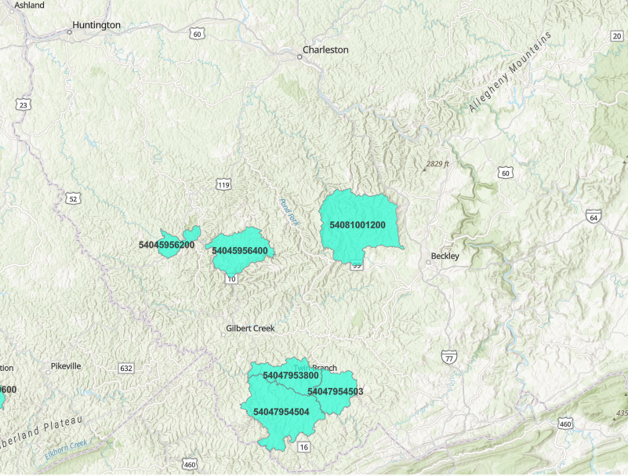
Community Disaster Resilience Zones (CDRZ)

Slide 15
Flood Mitigation Assistance and FMA (Swift Current)
Not available to all property owners.
Provides flood mitigation funding for buildings with a current National Flood Insurance (NFIP) insurance policy.
Structures must have history of repetitive or substantial damage from flooding documented as Severe Loss (SL) or Repetitive Loss (RL)
Eligible projects include:
  Property acquisition & structure demolition/relocation
  Structure Elevation
  Dry flood proofing of historic residential structures, non-residential structures
  Structural retrofitting of existing structures

Slide 16
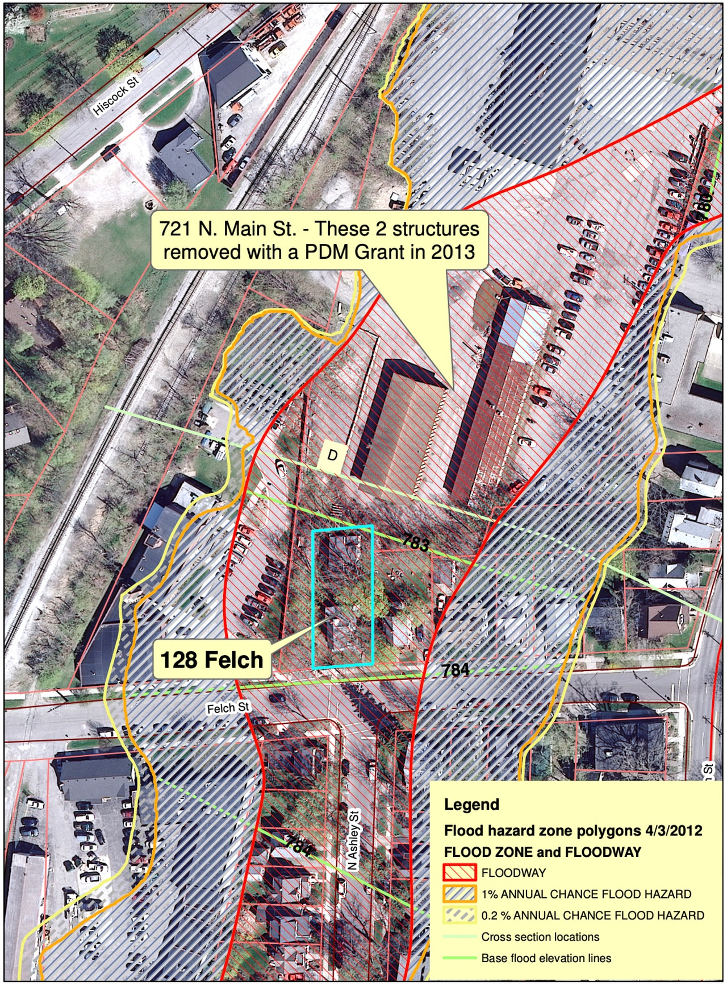
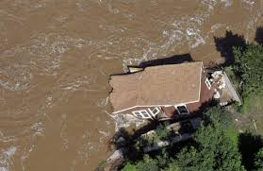

Slide 17
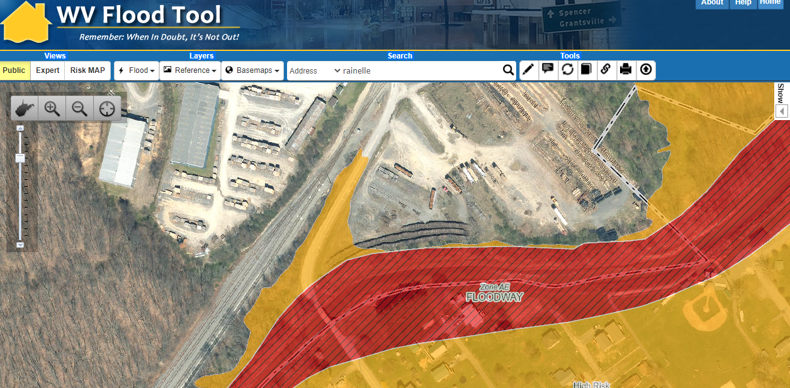

Slide 18

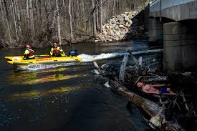
Mitigating Hazards to prevent SAR exposure

Slide 19
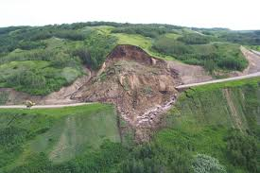
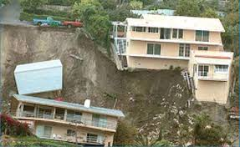

Slide 20
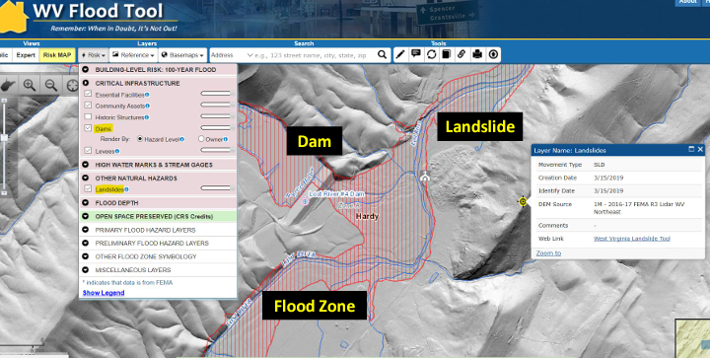

Slide 21
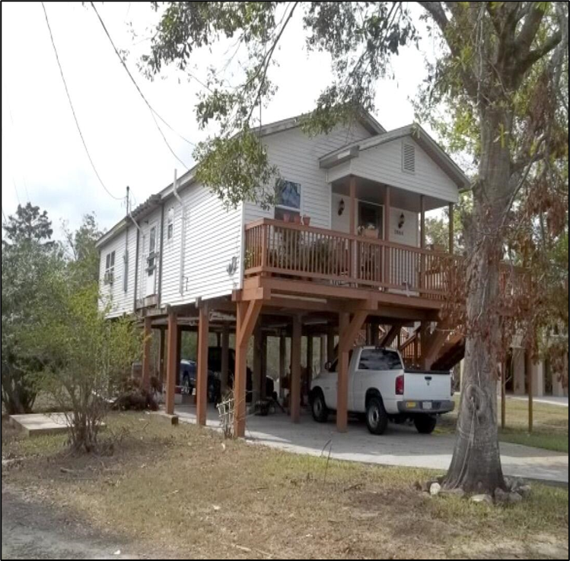
Mitigation Reconstruction Elevation
Mitigation reconstruction is the construction of an improved, elevated building on the same site where an existing building and/or foundation has been partially or completely demolished or destroyed.
These activities include either total or partial demolition of the structure and result in the construction of code-compliant and hazard-resistant structures on elevated foundation systems.
Elevation of utilities above flood hazard.

Slide 22
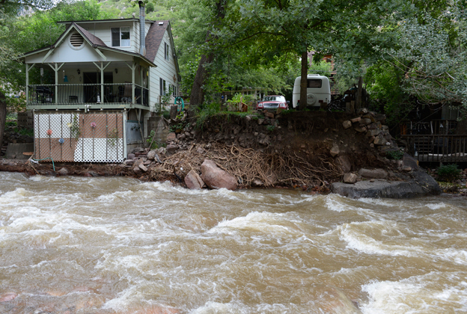
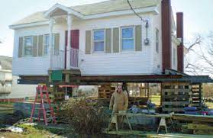

Slide 23
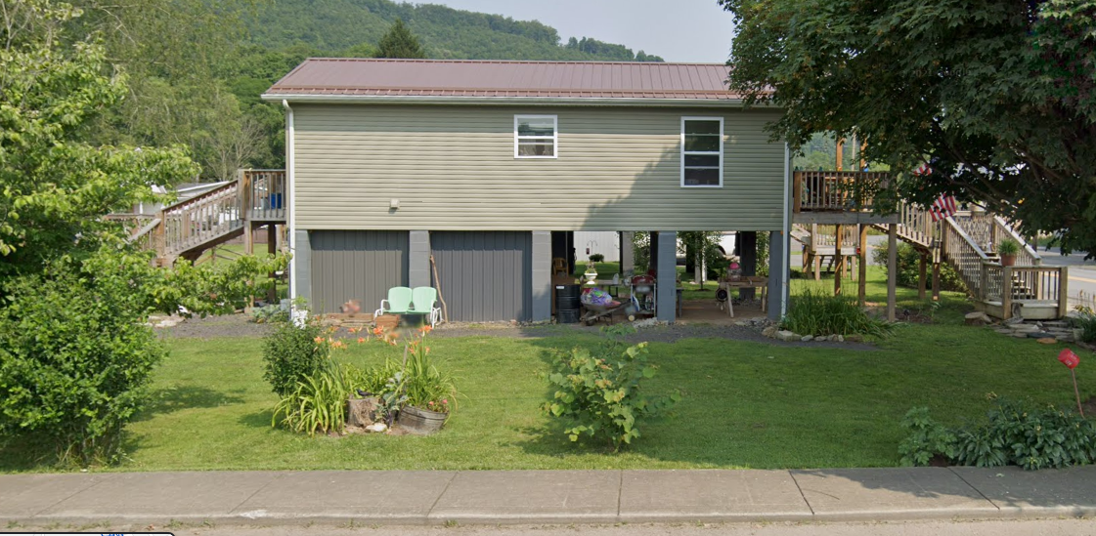
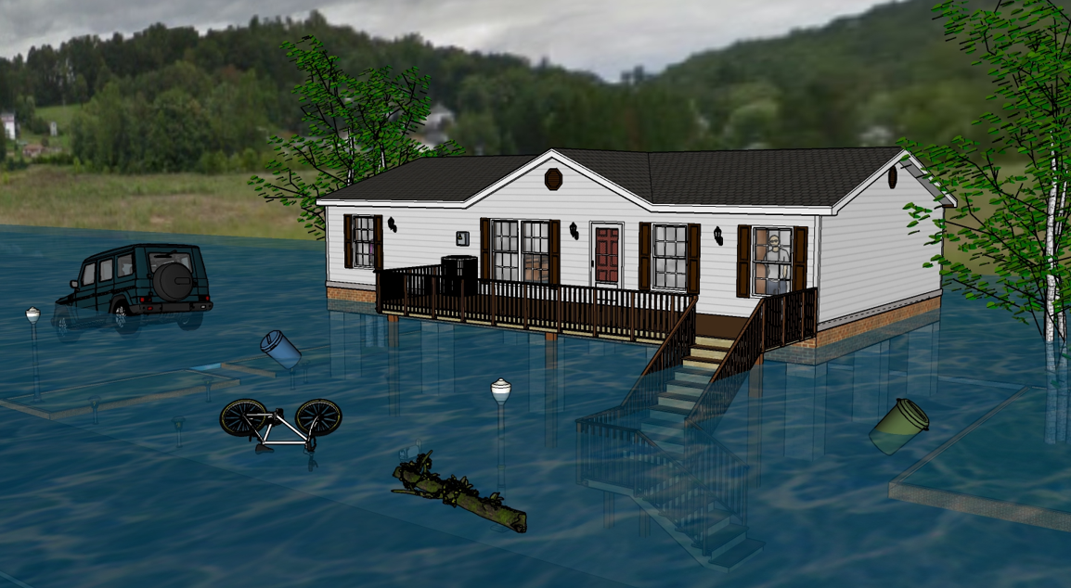
First Floor Height BELOW: FEMA/FSF 0.2-percent chance (500-yr) floods
First Floor Height ABOVE: FEMA 1% Chance (100-yr) flood; 2016 Flood HWM
Flood Depths marked on Mitigated Structure
FEMA
First Street Foundation (FSF)
USGS 2016 Flood High Water Mark
12.2’ (FSF 0.2% / 500-Yr )
9.9’ (FEMA; 0.2% / 500-Yr)
6.5’ (2016 High Water)
3.9’ (FEMA 1% / 100-Yr)
Flood Visualization (8 ft.)
Notes:
Segment 4. Building-scale flood visualizations at different flood frequencies and magnitudes
Or different flood depths or flood elevations can be visualized at the building level. New FEMA flood maps for the town of Rainelle reveal that the mitigated structure above is a risk for the 1%+ (100-yr plus) and 0.2-percent chance (500-yr) floods. Field verification of communities in Greenbrier County show that for most mitigation reconstruction implemented since the 2016 flood, residential structures - like this one in Rainelle shown here - were elevated to the proper design flood elevation in accordance with local floodplain management regulations. However, flood models show that certain elevated structures are still vulnerable to riverine flooding, such as a major 500-yr flood event or for models impacted by climate change.
<< GROUP 4 Flood Visualization at Building Level (3 slides) >>

Slide 24
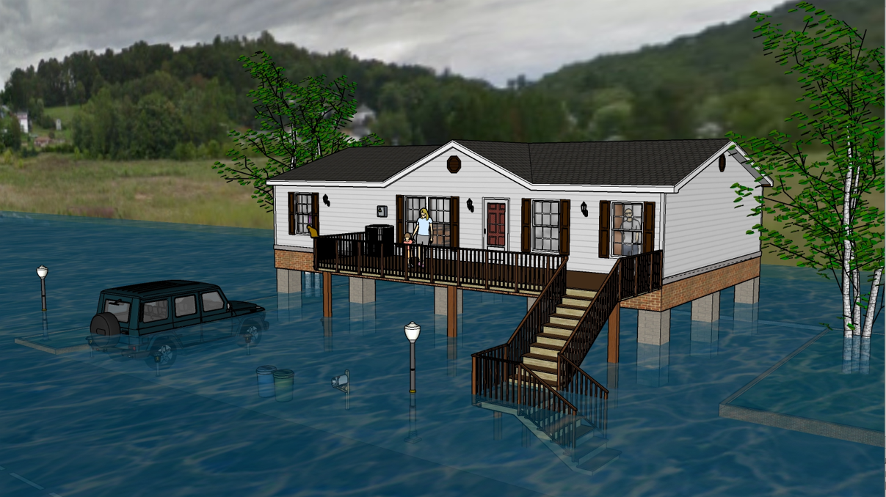
Flood Visualization 4 feet
First Floor Height ABOVE: 1% Chance (100-yr) flood

Slide 25
Hazard Mitigation Grant Program (HMGP)
This grant funding is available after a presidentially declared disaster and is 15% of the estimated aggregate amounts of disaster assistance.
State, local, tribal and territorial governments can use the grant to develop hazard mitigation plans or rebuild their communities in a way that reduces, or mitigates, future disaster losses.
Homeowners and businesses cannot apply for a grant. However, a local community may apply for funding on their behalf.
All state, local, tribal and territorial governments must develop and adopt hazard mitigation plans to receive hazard mitigation grant funding.

Slide 26
HMGP Project Examples
Developing or updating a FEMA approved state / local Mitigation Plan
Retrofitting existing buildings to make them less susceptible to damage from a variety of natural hazards.
Purchasing hazard prone property to remove people and structures from harm’s way.
Utility and infrastructure retrofits to reduce risk of failure caused by natural hazards.
Drainage improvements to reduce potential for flood damage.
Slope stabilization projects.
Aquifer storage and recovery, floodplain and stream restoration, flood diversion and storage, or green infrastructure projects.

Slide 27
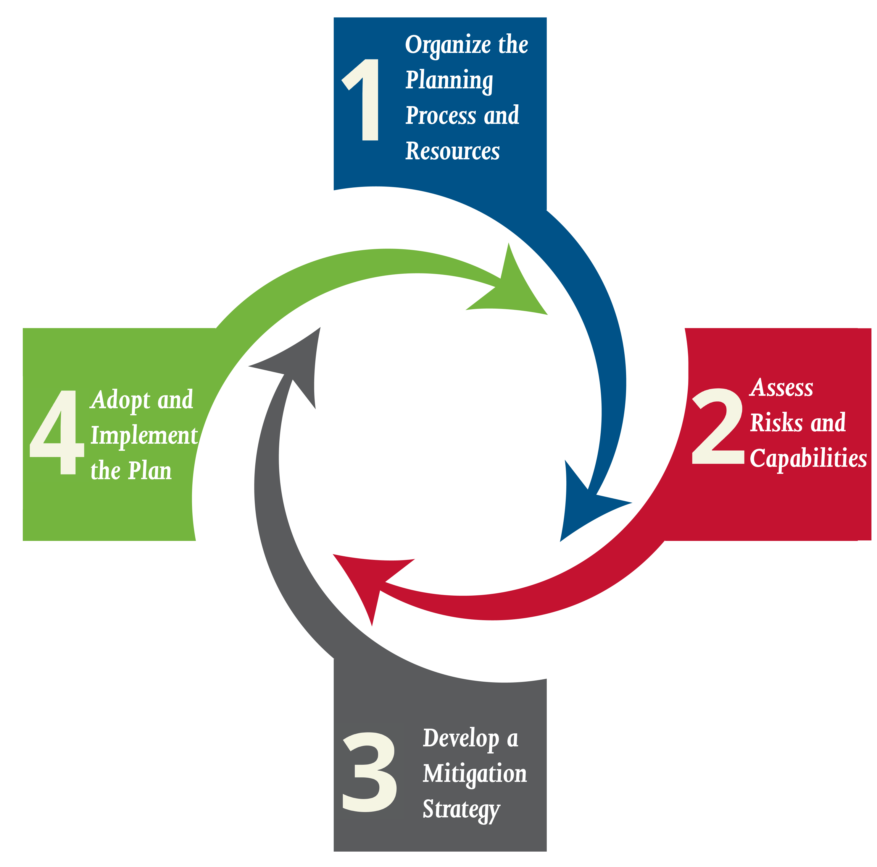
Hazard Mitigation Plans
Hazard mitigation planning reduces loss of life and property by minimizing the impact of disasters.
It begins with state, tribal and local governments identifying natural disaster risks and vulnerabilities that are common in their area.
After identifying these risks, they develop long-term strategies for protecting people and property from similar events. Mitigation plans are key to breaking the cycle of disaster damage and reconstruction.
Regional plan requirement to receive Stafford Act grant Funding.

Slide 28
Generator (Microgrid) Projects
Generators are eligible Critical infrastructure provided that they are cost effective, contribute to a long-term solution to the problem they are intended to address, and meet all other program eligibility criteria. (Must pass a BCA)
Critical facilities: include police and fire stations, hospitals, and water and sewer treatment facilities.
A generator that is a component of a larger project (e.g. elevation of a lift station) is also eligible for regular HMGP funding and the use of aggregation is permitted.
Portable generators are eligible provided that they meet all HMGP requirements as described in 44 CFR Section 206.434.
DR 4678 -4679 Generators applications will follow 2020 Guidance
Looking to diversify to microgrid resilience projects ( Partnership with WV DOE)

Slide 29
Project Scoping
Engineering Assessments : (Engineering, Environmental, Feasibility, and/or Benefit-Cost Analysis)
Projects that include environmental analysis and cost determination of future risk reduction benefits of a hazard mitigation project.
Activities designed to develop mitigation strategies and obtain data to prioritize, select, and develop complete applications in a timely manner that result in either an improvement in the capability to identify appropriate mitigation projects or in the development of an application-ready mitigation project.
Size up and develop future mitigation project applications

Slide 30
Annual FEMA Grant Funding Opportunities
Building Resilient Infrastructure and Communities (BRIC)
  FY 2023 $2 million state set aside, $2 million plus up building codes
  Larger projects submitted Competitive
Pre- Disaster Mitigation Congressionally Directed Spending (CDS)
  FY 2023 $17.8 Million awarded ( submitted ->congressional districts )
Flood Management Assistance (FMA)
  $1 million state set aside
  Larger projects submitted for competition
  Sub-applicants must be National Floodplain Insurance Plan (NFIP) holders
  Notification of Funding Opportunity (NOFO) found: Grants.gov

Slide 31
Post Disaster FEMA Grants
Hazard Mitigation Grant Program (HMGP)
  Percentage of FEMA Public Assistance, or Individual Assistance post disaster presidential declaration grant award.
  Can be used anywhere in the state, Ad Hoc projects
Flood Mitigation Assistance (FMA) Swift current
  New to West Virginia.
  Triggered by disaster reporting metrics
  State set aside 10 million, applicants must be NFIP policy holders
  Accepting applications, state deadline: May 1, 2024

Slide 32
HMA Grants allowable Hazard Mitigation Projects
Hazard Mitigation Plans / Warning systems
Engineer Studies / Scoping Projects
Acquisition Demolition ( Structure)
Mitigation Reconstruction / Elevation / relocation
Generators ( Micro-grids ) systems
Large Scale infrastructure: ( storm water, sewer, flood management)

Slide 33
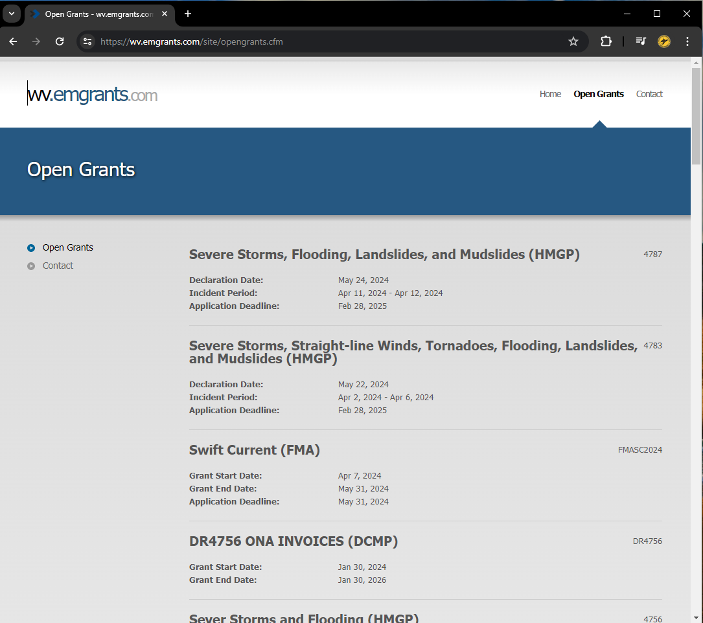
HMA Applications
Basic components
Applicant information: UEI
Problem description
Summary project information
Scope of work
Schedule:
Cost estimate: A budget for the project
Cost-effectiveness: BCA if Required
Environmental and historical considerations
Supporting documentation:
NFS worksheet

Slide 34
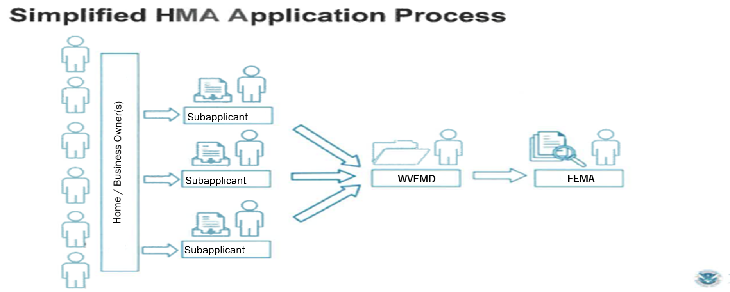
HMA application flow process

Slide 35
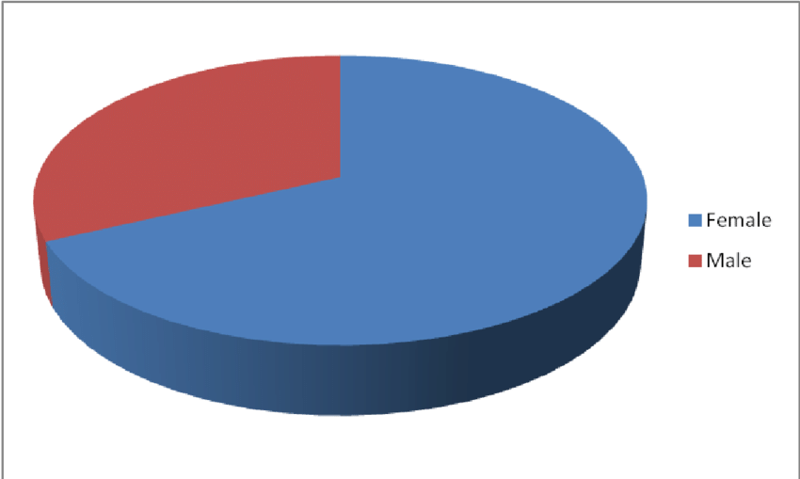
25 % Non-Federal Share Cost Share Requirement
Sub-Applicant
Community Investment→
Cash / or cash value
of In-kind services
25%
75%
Unlocks 75% Federal funding
Return on Investment (ROI)
5 %
Sub-Recipient Management Costs: (SRMC) 100% Federally Funded
The SMRC is 5% of the total project award provided externally of the
project budget us for sub-recipient management activities
COST SHARE Example: Total project Award $250k ( $62,500 NFS + 187,500 Fed ROI)-→ SMRC $12,500

Slide 36
Cash vs In-Kind Services
Cash ( Non-federal Identity)
  General or Special Levy Tax Revenue
  Community Fund Raising
  Private Donations
In-Kind
  Engineering / Labor / Admin services ( Hourly + rate)
  Equipment resources ( operating costs)
  Materials and Supplies ( Cash value)
  * Federal Funds, or Fed funded resources cannot be used as match

Slide 37
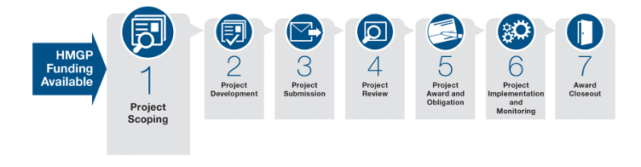
HMA Grant Award Life Cycle

Slide 38
Contact Information
Gabriel A. Reed
State Hazard Mitigation Officer
WV Emergency Management Division
. WVHMGP@wv.gov​
​304-558-5380​
Questions?

