Slide 1
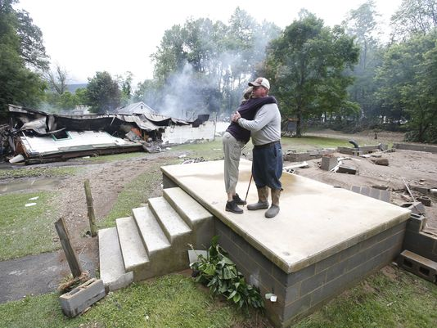
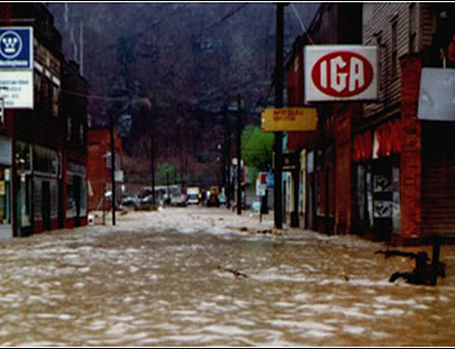
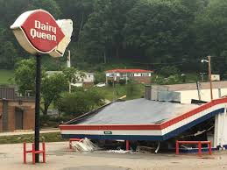
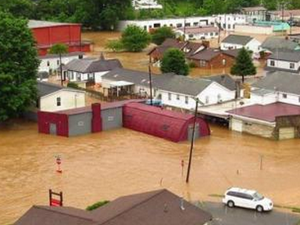
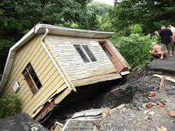
Statewide Flood Risk Assessment & WV Flood Tool – Community Engagement
(TEIF – Total Exposure in Floodplain)
Kurt Donaldson and Eric Hopkins
WV GIS Technical Center
West Virginia University
kdonalds@wvu.edu
May 15, 2023
WV Floodplain Manager Conference
← Devastating June 2016 Flood

Slide 2
WV Statewide Risk Assessment
Building Level Risk Assessment
& New Flood Maps

Slide 3
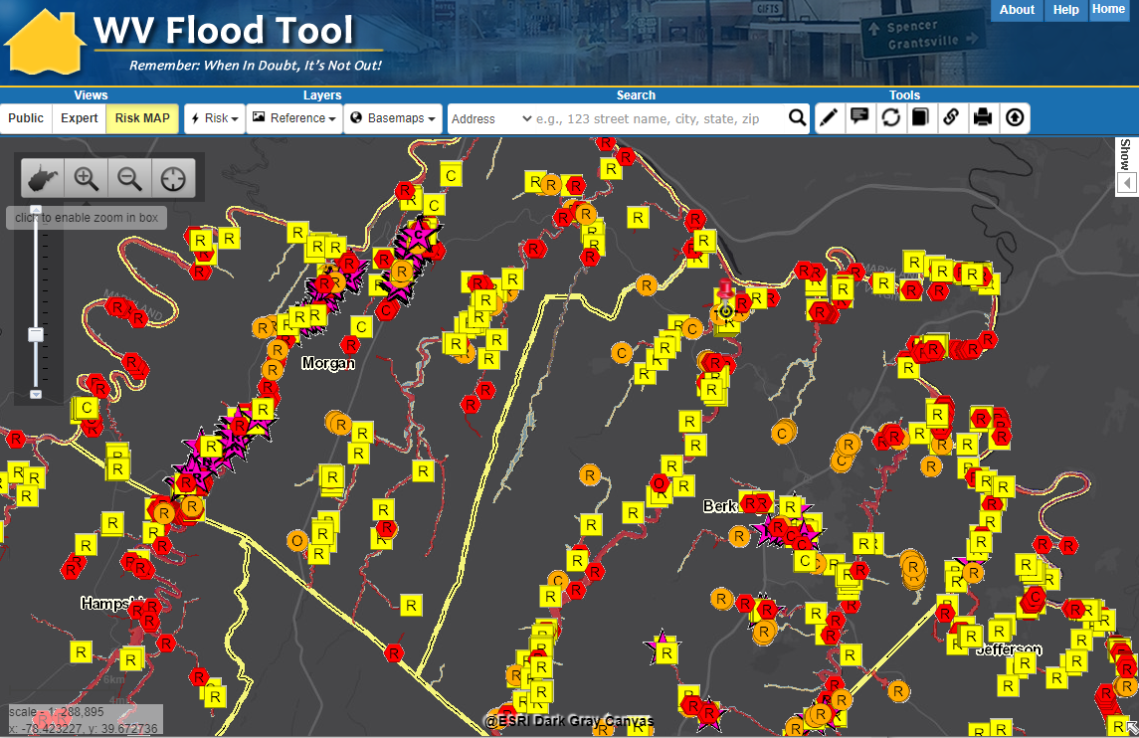
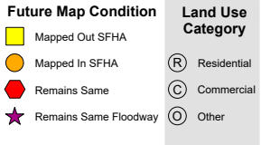
2021 R9 Floodplain Building Inventory
https://www.mapwv.gov/flood/map/?wkid=102100&x=-8680577&y=4786710&l=3&v=2

Slide 4
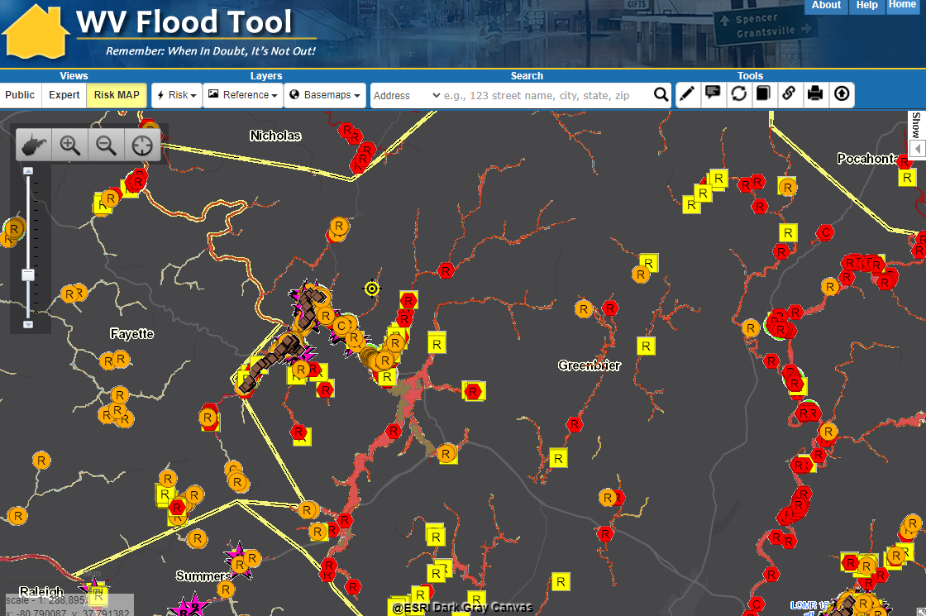
2021 R4 Floodplain Building Inventory
Refer to Overview and Other Resources about WV Flood Tool
Enhanced inventory of more than 98,000 building in high-risk floodplains completed by WVU in 2021 and published to WV Flood Tool
Vulnerability Risk Assessment
https://www.mapwv.gov/flood/map/?wkid=102100&x=-8985707&y=4589317&l=3&v=2

Slide 5
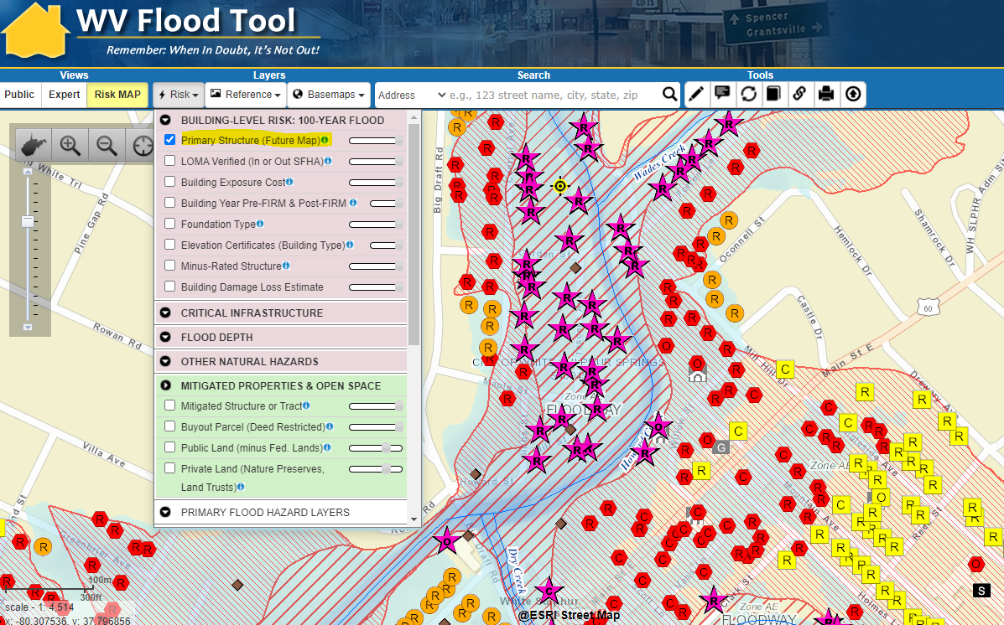
Floodplain Building-Level Risk
All Risk Assessment and Mitigation Layers are displayed on the RiskMAP View of the WV Flood Tool
High-Risk Effective & Advisory
1%-Annual-Chance (100-Yr) Floodplains
White Sulphur Springs
https://www.mapwv.gov/flood/map/?wkid=102100&x=-8938946&y=4550516&l=9&v=2

Slide 6
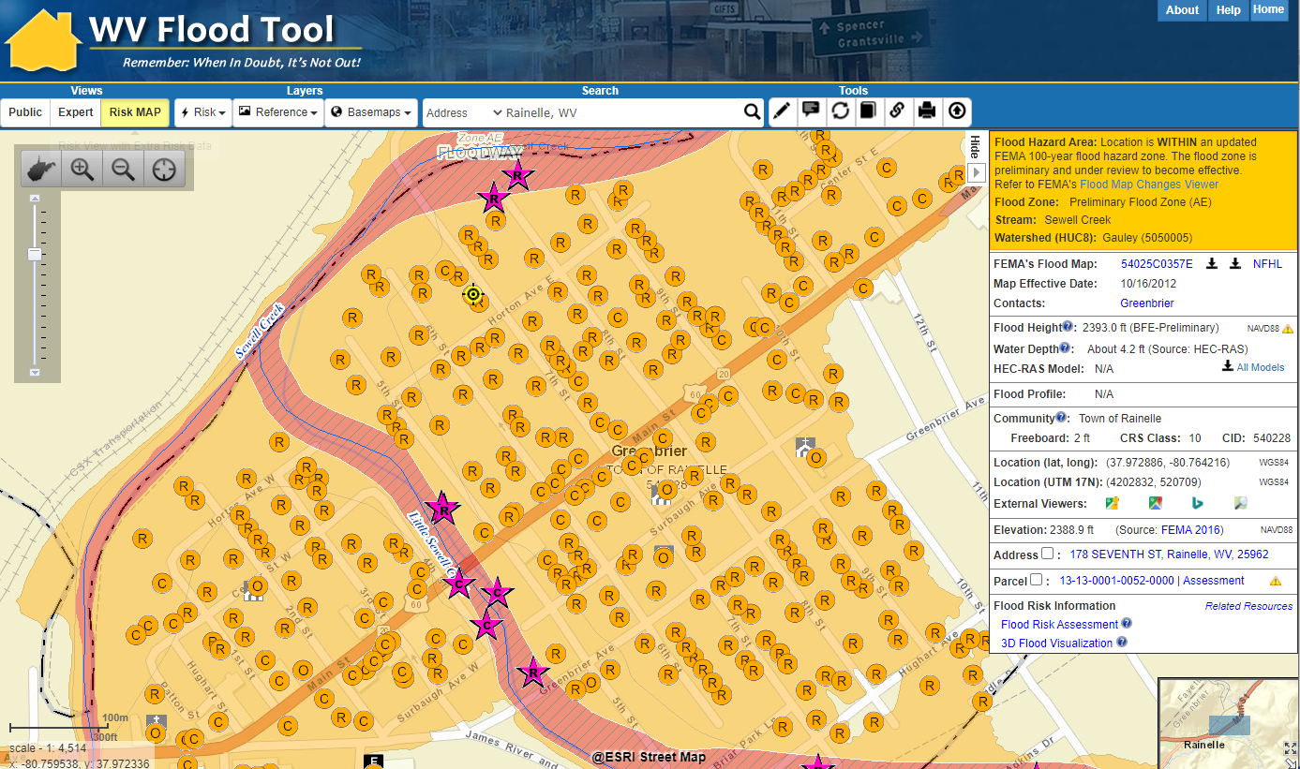
Preliminary NFHL (Rainelle, WV)
Rainelle, Greenbrier County
Example of mapped in structures to new SFHA from Preliminary Flood Study of Rainelle, WV. Mapped in structures (orange circles) and flood loss estimates are updated in the statewide Building Level Risk Assessment (BLRA).

Slide 7
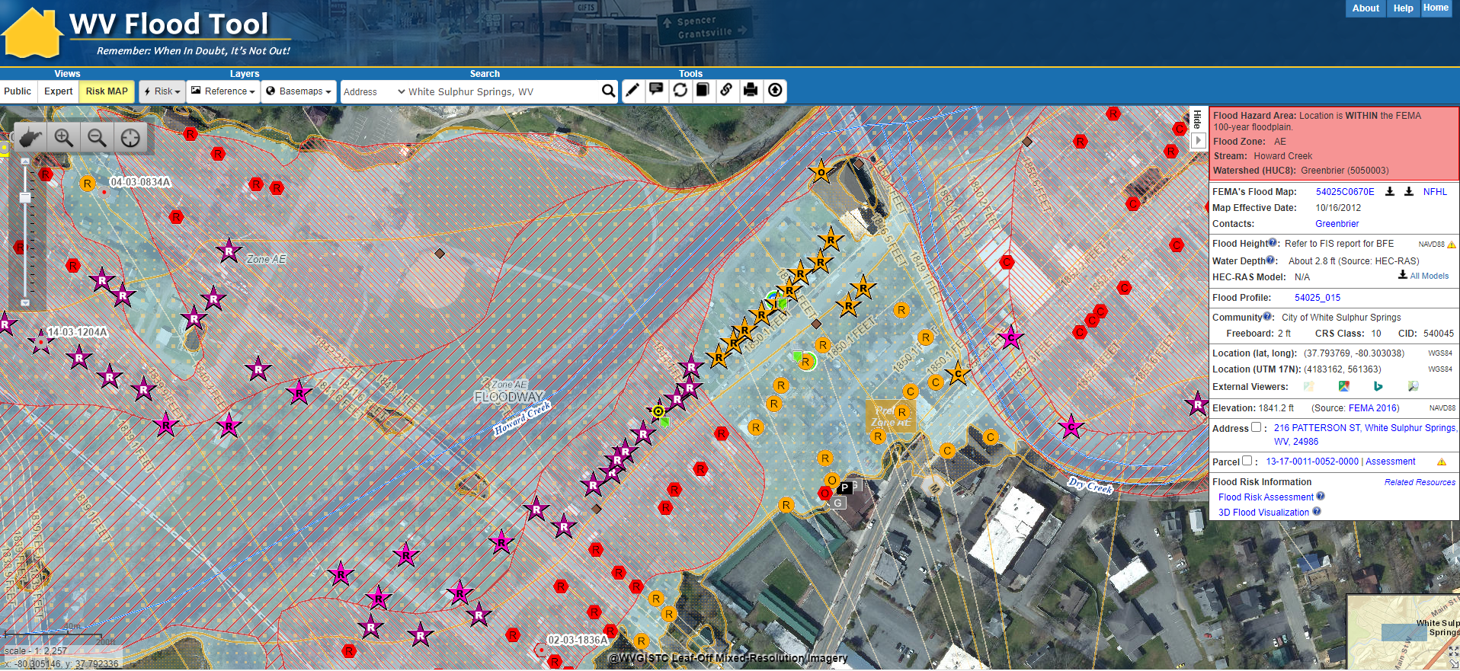
Future Building Conditions: Mapped in Floodway
White Sulphur Springs, Greenbrier County
Example of mapped in structures to new SFHA from Preliminary Flood Study of Rainelle, WV. Mapped in structures (orange circles) and flood loss estimates are updated in the statewide Building Level Risk Assessment (BLRA).

Slide 8
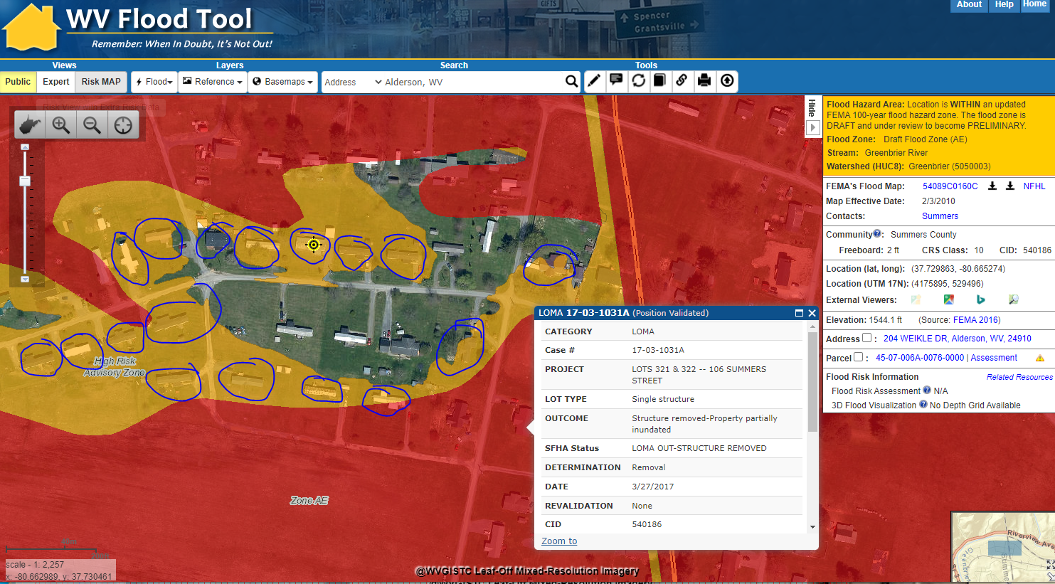
Draft NFHL (Summers County)
Draft NFHL
Example of mapped in structures to new SFHA from Preliminary Flood Study along Summer-Greenbrier county border near Glenray. Mapped in structures (orange circles) and flood loss estimates are updated in the statewide Building Level Risk Assessment (BLRA).

Slide 9
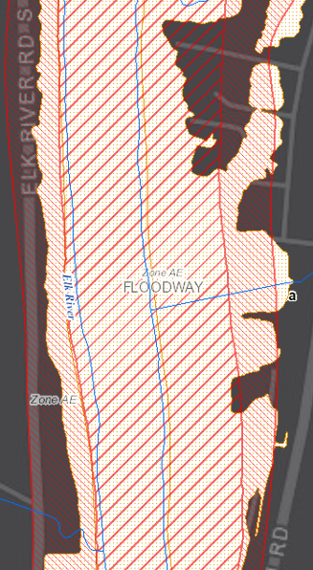
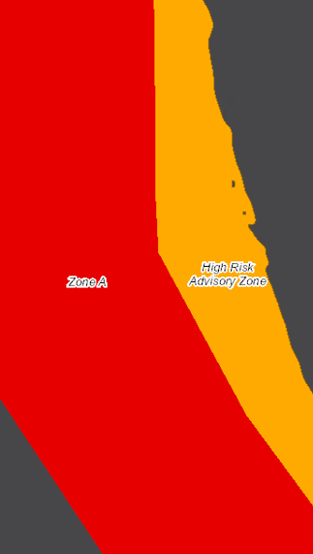
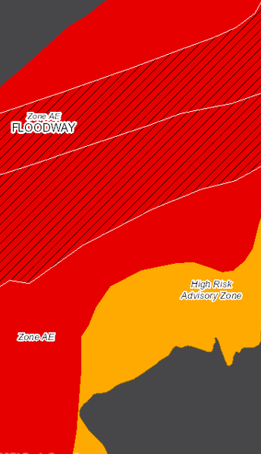
High Risk Advisory Zones
More info on High-Risk Advisory Zones
Preliminary NFHL
Advisory A
Updated AE
Preliminary NFHL
Advisory A
Updated AE

Slide 10
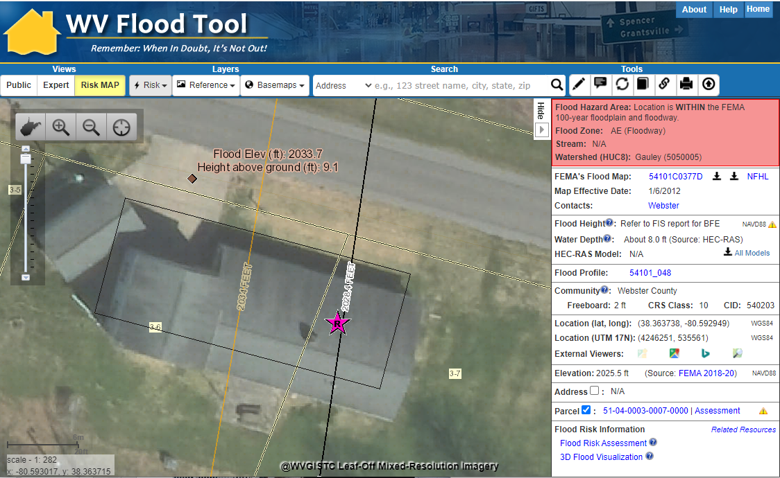
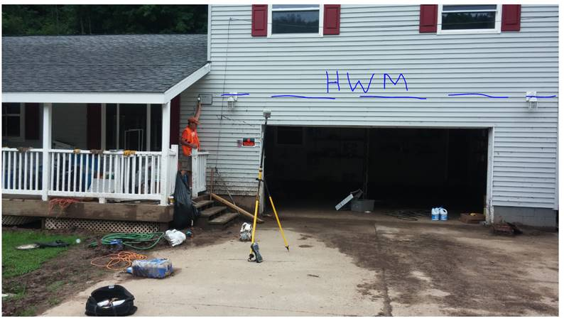
New FEMA Flood Maps – BFE Change
FEMA is creating new flood maps for select communities in Region 4 which will alter the floodplain boundaries and base flood elevations. The new flood maps will affect the at-risk building inventories as well. The BFE is increasing 6 feet at this location.
Gauley River
The June 2016 Flood High-Water Mark was 9.1 feet for Building 51-04-0003-0007-0000_91 located near the town Camden-On-Gauley (Webster County) on the Gauley River. The Base Flood Elevation is increasing by 6 feet on the new FEMA flood maps for this location.

Slide 11

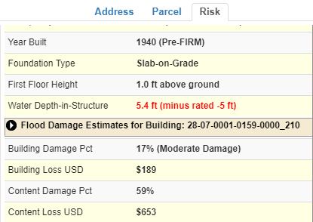
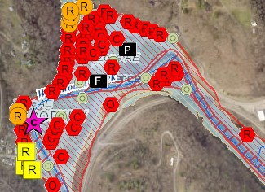
WV Building-Level Flood Risk Assessment
BUILDING INVENTORY
Primary Building
Identification &
Hazus Attributes
Essential Facilities & Community Assets
FLOOD LOSS MODELS
Open Hazus FAST
Flood Depths
Building Damage Estimates
COMMUNITY ENGAGEMENT
Risk Assessment
Data Verification
Mitigation Actions Identified
BLDG. LEVEL RISK ASSESSMENT (BLRA) DATABASE
Building Level & Community Level Outputs
Building-Level Flood Risk Assessments support:
Hazard Mitigation Plans
Floodplain Management
Community Assisted Visits
Community Rating System
BLRA Cycle and Methodology
1
Benefits
More detailed and accurate assessments
Automated scripts generate outputs quickly
Cost savings through efficiencies
Helps multiple stakeholders
Comprehensive Building Risk Spatial Database
4
Building-Level Risk Assessment (BLRA) Cycle
2
3
Methodology
Consistent methodology statewide
Semi-automated workflows
Continuous cycle to improve and update assessments
Tabular Output
Map Output
Published to WV Flood Tool

Slide 12

Building Inventory
GIS Specialist conducting Building Inventory

Slide 13
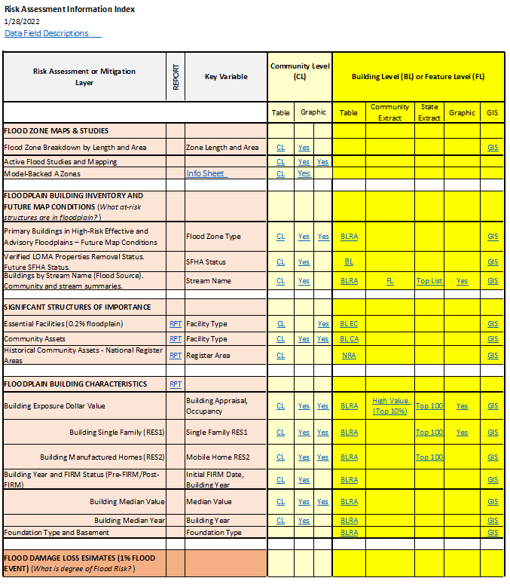
Access Risk Assessment Info
Use the Risk Information Index to access Data and Products
Building Level Risk Assessment (BLRA) Products
GIS Files
Tables (Excel)
  Community Level (CL)
  Building (or Feature) Level (BL) with links to online maps
    Table Extracts
    Top Lists
Maps
  Interactive Web Maps
  Graphics and Maps
Reports (Word Docs)
3D Flood Visualizations
Most of the risk assessment data can be viewed on the RiskMAP View of the WV Flood Tool

Slide 14
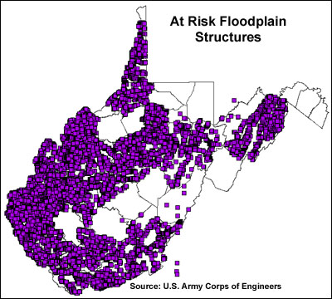
2002 USACE Building Inventory
Building Inventories
Nearly 20 years ago more than 80,000 structures in the floodplain were inventoried by the Pittsburgh District Army Corps of Engineers using statewide 1996-99 1-meter resolution Digital Orthophoto Quarter Quads. A combination of FEMA's Q3 and DFIRM floodplain data (available for 37 of the 55 counties) was overlaid onto DOQQ's.
<< USACE Inventoried Floodplain Structures >>
http://wvgis.wvu.edu/data/dataset.php?ID=230

Slide 15
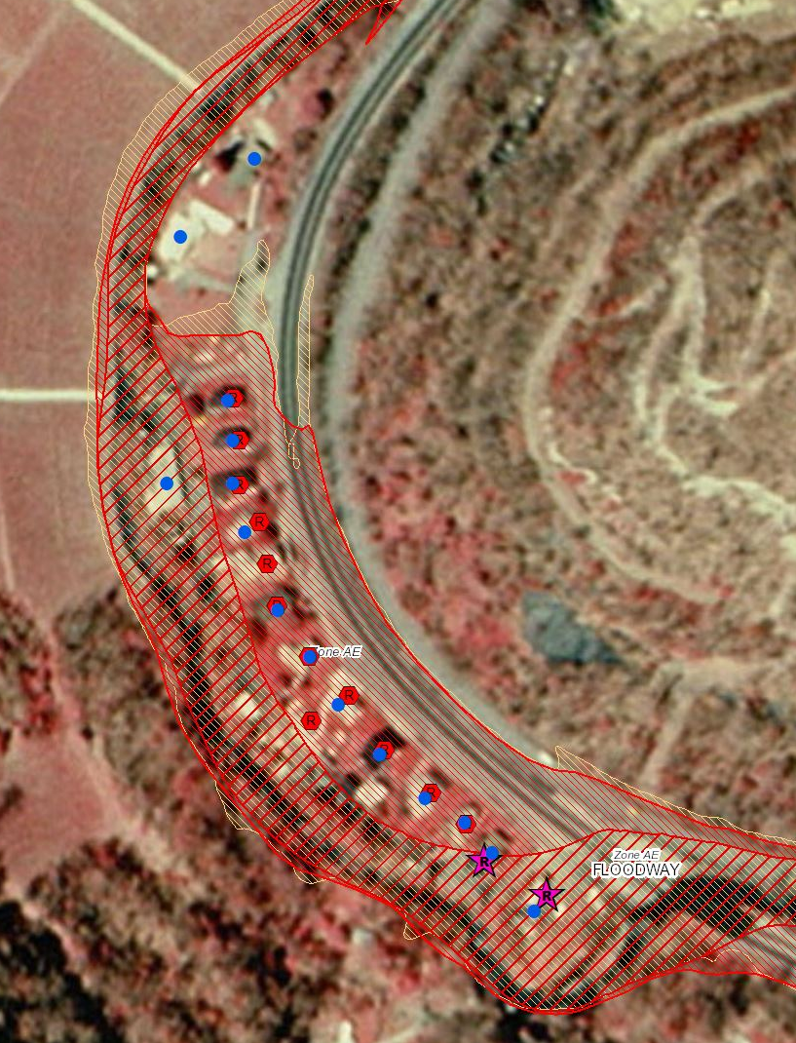
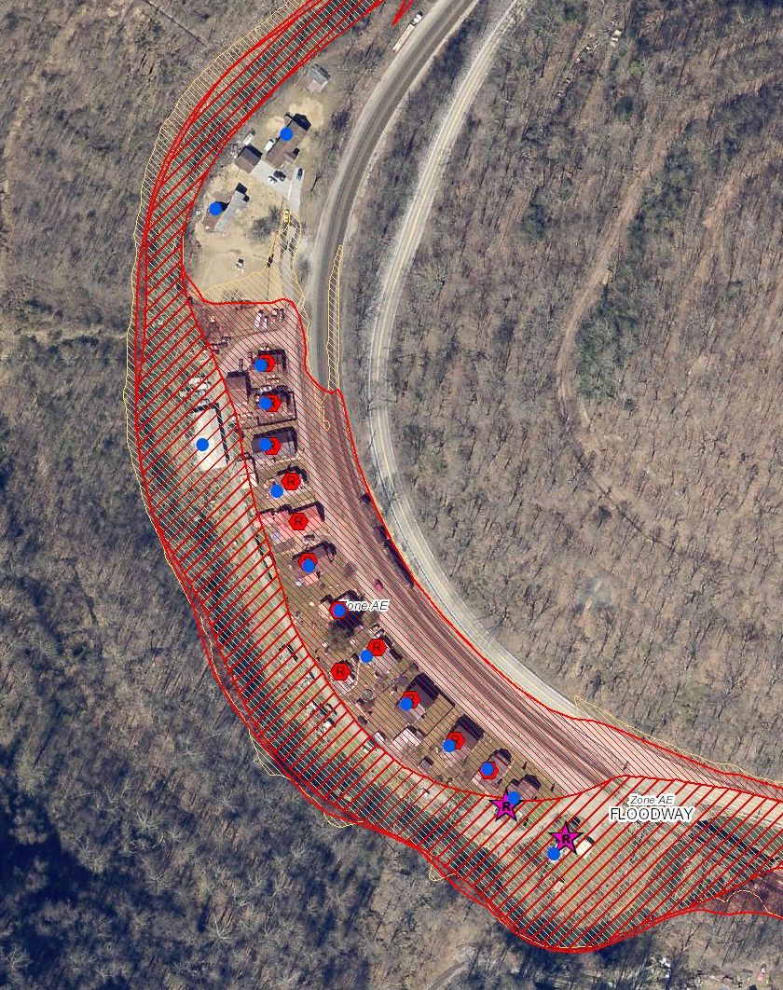
Statewide Building Inventories
https://www.mapwv.gov/flood/map/?wkid=102100&x=-9070843&y=4497058&l=11&v=2
1998 Aerial Imagery
2018 Aerial Imagery
Elkhorn Creek, McDowell County
2002 USACE Inventory
2021 WVU Inventory

Slide 16
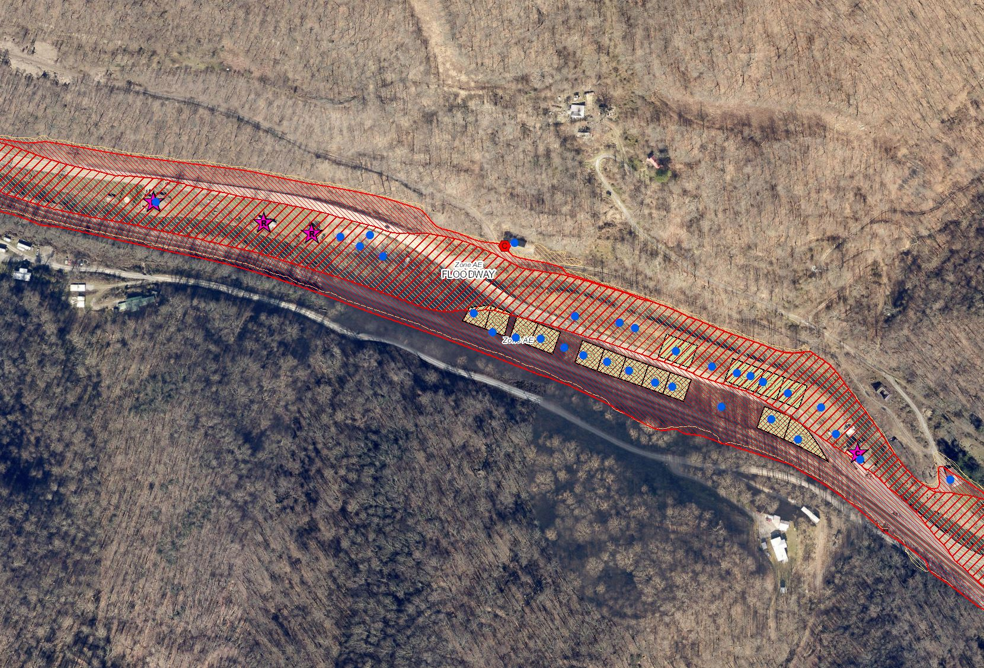
USACE 2002 Building Inventory
https://www.mapwv.gov/flood/map/?wkid=102100&x=-9069713&y=4496689&l=10&v=2
Buyout Properties since
2002 USACE Inventory
2002 USACE Inventory
Elkhorn Creek, McDowell County

Slide 17
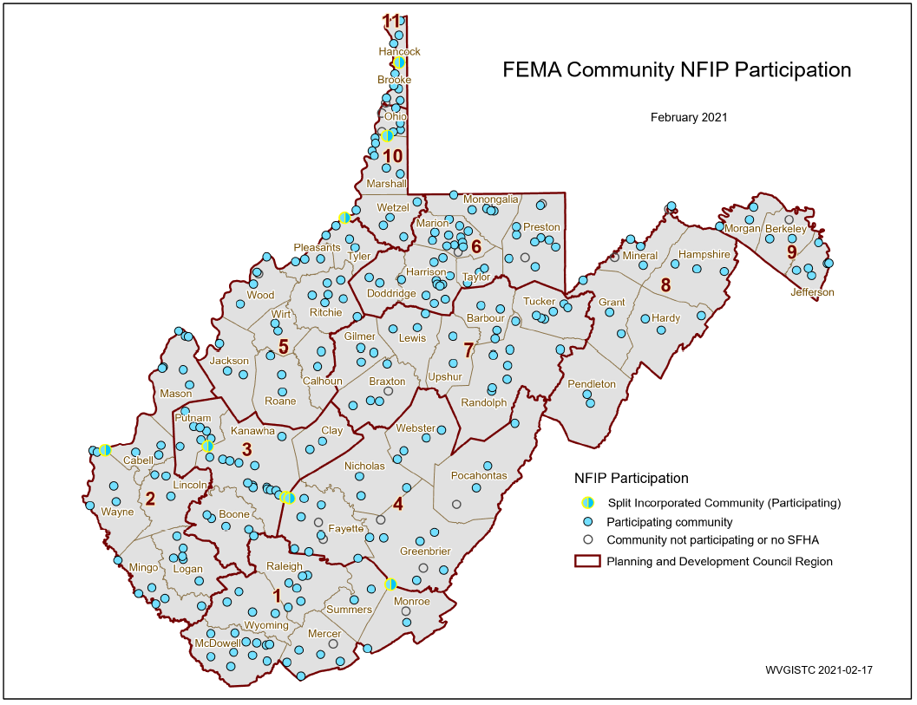
Statewide Hazard Assessment
213 incorporated areas
+55 unincorporated areas
268 NFIP Communities
+18 no SFHA communities
286 WV Communities
+ 8 split communities
294 Statistical Geographies
294 Statistical Geographies form
286 Communities which form
55 Counties which form
11 PDC Regions which form
1 Statewide Flood Risk Assessment
94% of WV Communities have Special Flood Hazard Areas (SFHA)
268 Flood-Prone Communities
SPLIT COMMUNITY | COUNTY 1 | COUNTY 2
Alderson | Greenbrier | Monroe
Huntington | Cabell | Wayne
Montgomery | Fayette | Kanawha
Nitro | Kanawha | Putnam
Paden City | Tyler | Wetzel
Smithers | Fayette | Kanawha
Wheeling | Marshall | Ohio
Weirton | Brooke | Hancock
PDF Map

Slide 18
Statewide Building Inventory
Building Estimates
84,351 structures in SFHA
13,996 structures in “High-Risk” Advisory (Orange Zones)
354 Essential Facilities in High-Risk Flood Zones
(K-12 Schools, 911 Centers, Police/Fire Stations Depts., Hospitals, Nursing Homes)
38 Essential Facilities in Regulatory Floodway
503 Essential Facilities total in both high and moderate risk floodplains
Buildings
Pre-FIRM/Post-FIRM
67% are Pre-FIRM (majority)
26% are Post-FIRM
7% are unknown
Based on Building Year of assessment data
Community | Buildings in SFHA
Kanawha County* | 8,890
Logan County* | 5,247
Mingo County* | 3,393
Boone County* | 3,313
Wheeling** | 2,836
Lincoln County* | 2,563
McDowell County* | 2,408
Raleigh County* | 2,252
Mercer County* | 2,233
Wyoming County* | 2,226
Wayne County* | 2,221
Putnam County* | 1,902
Cabell County* | 1,887
Charleston | 1,872
Wood County* | 1,562
Fayette County* | 1,528
Randolph County* | 1,268
Greenbrier County* | 1,182
Marion County* | 1,162
Huntington** | 1,148
All ESSENTIAL FACILITIES SHOULD BE FIELD VERIFIED
Top 20 Communities
Building Counts by Flood Zone

Slide 19
Countywide Building Counts (Top 20)
Primary buildings in the High-Risk effective and advisory 1%-annual chance (100-yr) floodplains
Rank | County | Region # | BUILDING TYPE |  |  |  | HIGH-RISK FLOOD ZONES |  |  | Floodplain Building Ratio
 |  |  | % Resi-dential | % Com-mercial | % Other | % Unknown | Effective | Advisory | Total Bldg. Count
1 | KANAWHA | 3 | 89% | 7% | 3% | 1% | 12,847 | 2,071 | 14,918 | 15%
2 | LOGAN | 2 | 87% | 9% | 3% | 2% | 4,539 | 939 | 5,478 | 30%
3 | MCDOWELL | 1 | 87% | 5% | 3% | 5% | 3,678 | 1,395 | 5,073 | 26%
4 | BOONE | 3 | 78% | 6% | 3% | 13% | 3,727 | 1,068 | 4,795 | 39%
5 | MINGO | 2 | 86% | 5% | 5% | 4% | 3,114 | 749 | 3,863 | 24%
6 | OHIO | 10 | 85% | 9% | 5% | 0% | 3,142 | 175 | 3,317 | 17%
7 | WYOMING | 1 | 90% | 5% | 4% | 1% | 2,019 | 1,145 | 3,164 | 24%
8 | CABELL | 2 | 86% | 7% | 5% | 2% | 2,368 | 518 | 2,886 | 7%
9 | GREENBRIER | 4 | 78% | 8% | 12% | 2% | 1,714 | 1,004 | 2,718 | 12%
10 | RALEIGH | 1 | 84% | 8% | 8% | 1% | 2,350 | 363 | 2,713 | 6%
11 | LINCOLN | 2 | 83% | 3% | 14% | 1% | 2,555 | 91 | 2,646 | 22%
12 | WAYNE | 2 | 89% | 4% | 5% | 2% | 2,421 | 219 | 2,640 | 12%
13 | WOOD | 5 | 87% | 7% | 6% | 0% | 2,463 | 103 | 2,566 | 6%
14 | MERCER | 1 | 89% | 6% | 4% | 1% | 2,295 | 206 | 2,501 | 7%
15 | PUTNAM | 3 | 85% | 5% | 10% | 0% | 2,066 | 384 | 2,450 | 9%
16 | WETZEL | 10 | 71% | 7% | 21% | 1% | 2,006 | 91 | 2,097 | 21%
17 | MASON | 2 | 67% | 4% | 27% | 3% | 1,859 | 95 | 1,954 | 13%
18 | RANDOLPH | 7 | 78% | 7% | 11% | 4% | 1,697 | 225 | 1,922 | 11%
19 | HARRISON | 6 | 80% | 6% | 13% | 1% | 1,475 | 409 | 1,884 | 5%
20 | FAYETTE | 4 | 85% | 7% | 7% | 1% | 1,254 | 551 | 1,805 | 7%
Top 5 Counties with highest building counts: Kanawha (14,918), Logan (5,478), and McDowell (5,073), Boone (4,795), and Mingo (3,683)
Top 5 counties with highest percentage of countywide buildings in the high-risk floodplains: Boone (39%), Logan (30%), McDowell (26%), Wyoming (24%), Mingo (24%), and Lincoln (22%)

Slide 20
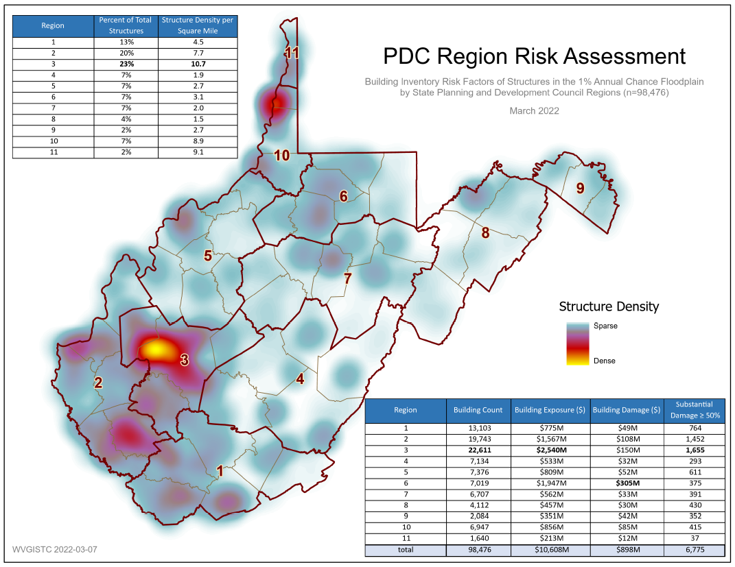
Building Risk by Region
Regions 10 and 11 high density
Region 3
Highest % and Density
Regions 1, 2, and 3 comprise 56% of flood-risk buildings
PDF Map

Slide 21
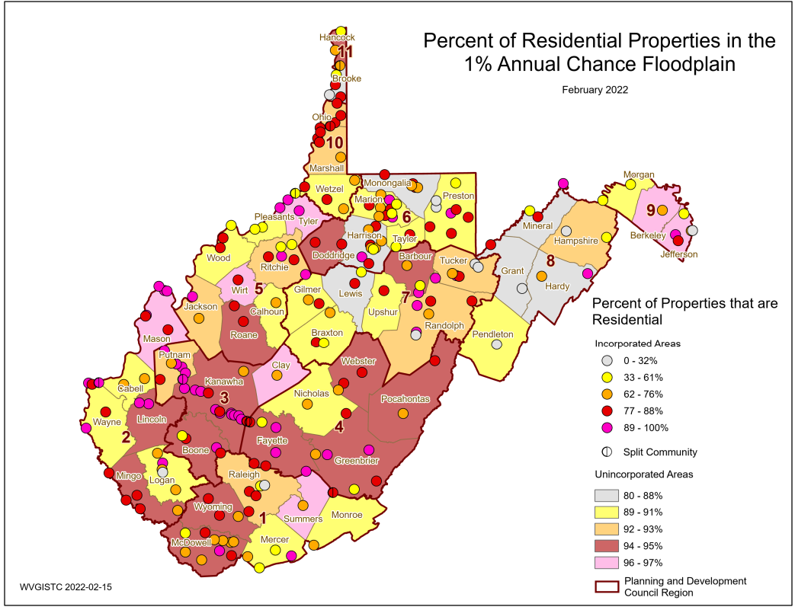
Residential % of Building Stock
Majority of Building Stock is RESIDENTIAL. Unincorporated Areas typically have higher residential building counts than Incorporated Places.
PDF Map

Slide 22
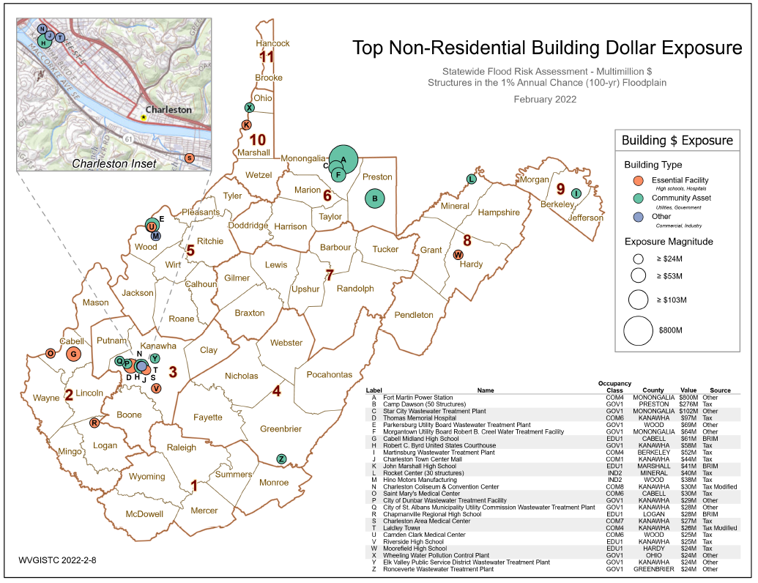
Non-Residential Building Exposure
Top non-residential structure in the 1%-annual-chance floodplain with the highest building value for REGION 4 is the Ronceverte Wastewater Treatment Plant ($24M)
PDF Map

Slide 23
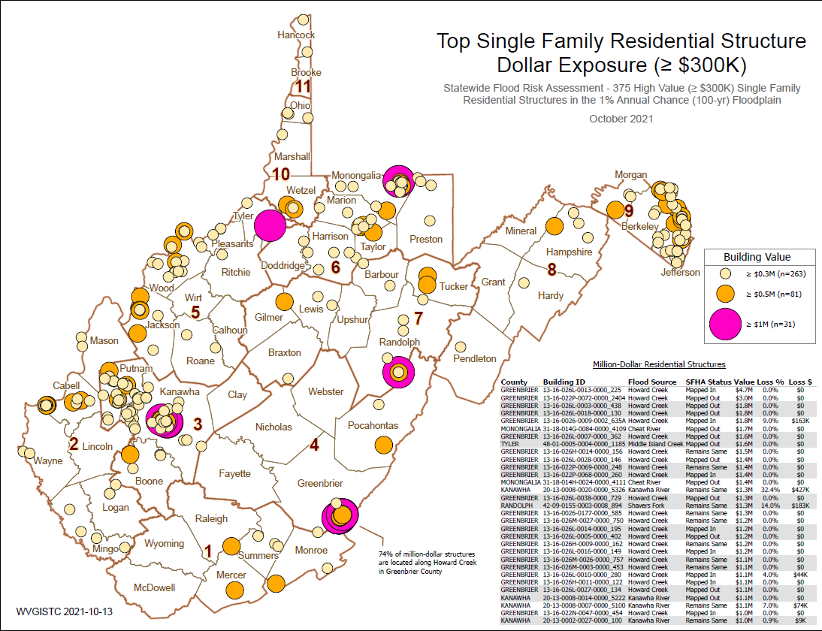
Residential: Top Single-Family $ Exposure
74% of million-dollar RESIDENTIAL structures in State are located along Howard Creek in Greenbrier County
Howard Creek
PDF Map

Slide 24
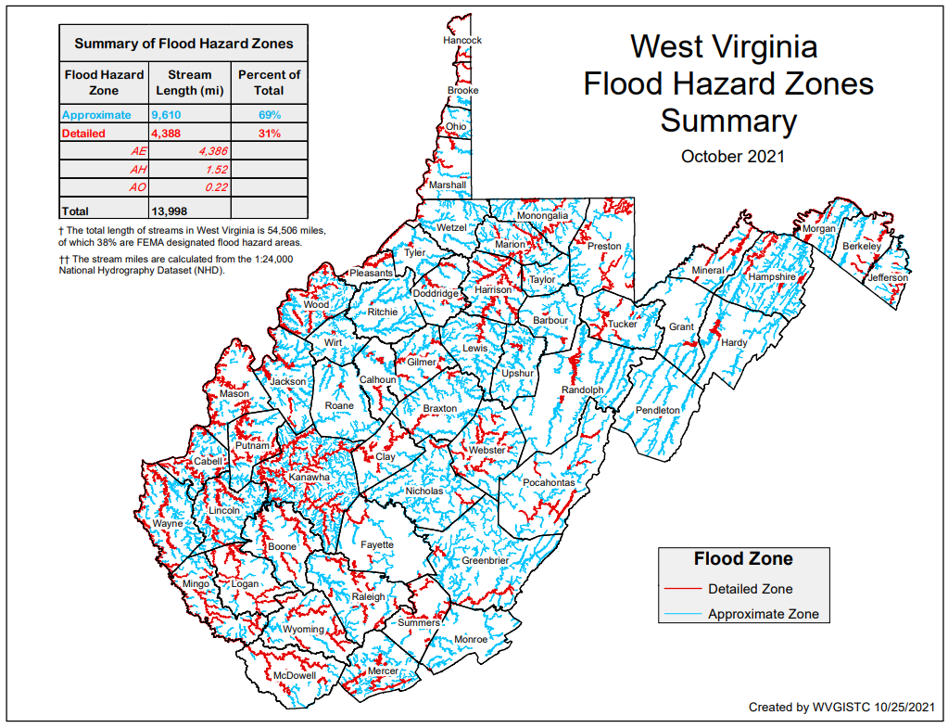
Building Stock in Flood Zones
Although only 31% of the State has mapped Detailed Flood Zones (AE / AO / AH), the Detailed Flood Zones contain 65% of the Building Stock Located in SFHA. Most of the buildings are in mapped Detailed Flood Zones.
FLOOD HAZARD ZONES
Stream Miles Length
69% Approximate A
31% Detailed Zones
Special Flood Hazard Area
84,351 buildings
35% in Approximate Zone A
65% in Detailed Zone AE (9% in Regulatory Floodway)
BUILDINGS IN NON-REGULATORY ZONES
13,966 Structures (14%) mapped in High-Risk Zone Advisory A / AE
98,317 Total High-Risk
BUILDINGS IN SHADED X
Moderate Risk
44,415 structures in 500-YR floodplains
9,718 structures in Levee Protected Zones
PDF Map

Slide 25
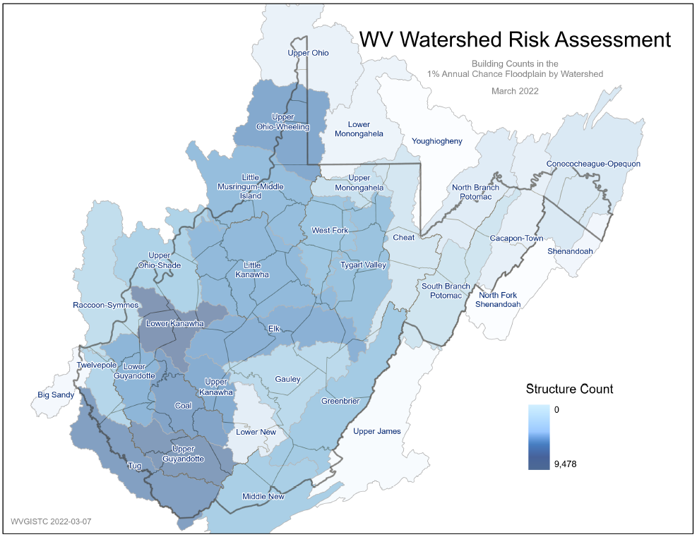
Building Risk by Watershed
Lower Kanawha Watershed
has highest building count, building exposure, and damage loss estimate
PDF Map

Slide 26
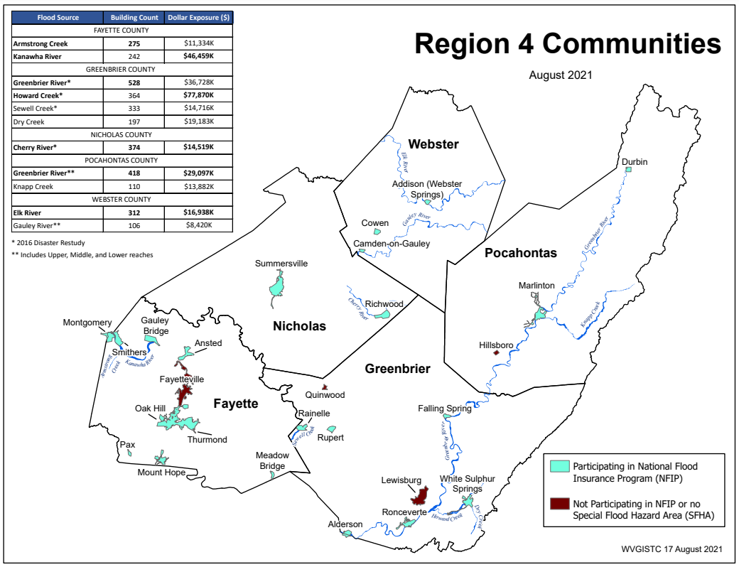
R4 Building Risk by Flood Source
Building Counts and Building Exposure $ Values by Stream Name
Flood Sources | Building Count | Dollar Exposure ($)
FAYETTE COUNTY
Armstrong Creek | 275 | $13,334K
Kanawha River | 242 | $46,459K
GREENBRIER COUNTY
Greenbrier River* | 528 | $60,728K
Howard Creek* | 364 | $94,870K
Sewell Creek* | 333 | $14,716K
Dry Creek | 197 | $19,183K
NICHOLAS COUNTY
Cherry River* | 374 | $15,719K
POCAHONTAS COUNTY
Greenbrier River** | 418 | $29,097K
Knapp Creek | 110 | $13,882K
WEBSTER COUNTY
Elk River | 312 | $16,938K
Gauley River** | 106 | $8,420K
* 2016 Disaster Restudy
Greenbrier River totals for Greenbrier and Pocahontas counties: 946 buildings in 1% floodplain, $90M dollar exposure
Greenbrier River in Region 4 has the most structures in the 1%-annual-chance floodplain
Howard Creek in Greenbrier County has the highest building dollar exposure of all communities in Region 4
Computed for 1% (100-yr) floodplain
RA Tables: Buildings by River/Stream Name
Region 4 PDF Map Primary Flood Sources

Slide 27
Zone A Building Cluster Analysis
Flood Map Discovery:
Zone A conversion to Detailed Zone AE

Slide 28
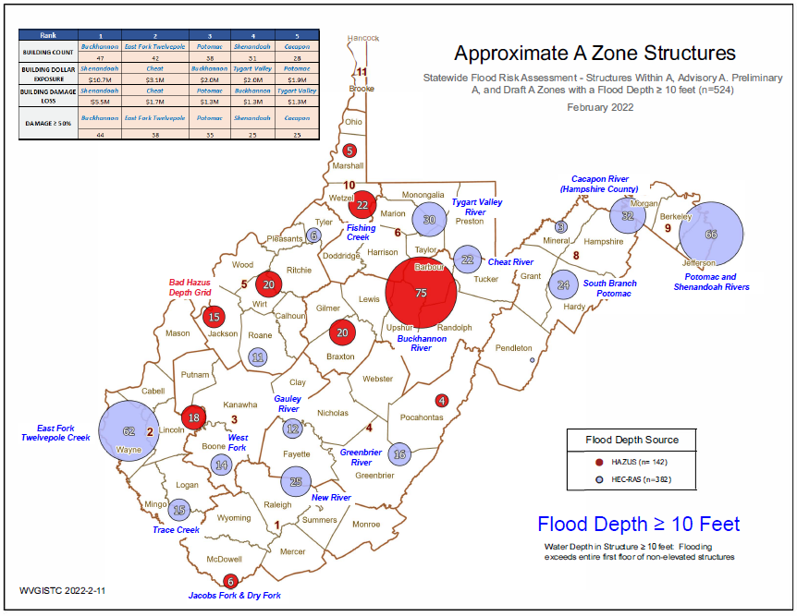
Potential Detailed Flood Studies
Objective: Evaluate potential Approximate A Zone rivers/streams for more comprehensive Detailed Flood Studies where clusters of buildings with high damage potential exist. The cluster analysis identifies a higher density (or higher development) of structures located in the Approximate A Zone. Refer to Zone A Cluster Analysis for more information.
Zone A Cluster PDF Tax Maps

Slide 29
Potential Detailed Flood Studies
Rank | 1 | 2 | 3 | 4 | 5
BUILDING COUNT | Buckhannon | East Fork Twelvepole | Potomac | Shenandoah | Cacapon
 | 47 | 42 | 38 | 31 | 28
BUILDING DOLLAR EXPOSURE | Shenandoah | Cheat | Buckhannon | Tygart Valley | Potomac
 | $10.7M | $3.1M | $2.0M | $2.0M | $1.9M
BUILDING DAMAGE LOSS | Shenandoah | Cheat | Potomac | Buckhannon | Tygart Valley
 | $5.5M | $1.7M | $1.3M | $1.3M | $1.3M
DAMAGE ≥ 50% | Buckhannon | East Fork Twelvepole | Potomac | Shenandoah | Cacapon
 | 44 | 38 | 35 | 25 | 25
Water Depth in Structure ≥ 10 feet: Flooding exceeds entire first floor of non-elevated structures
River/Stream Name | Flood Depth Value (ft.) | Web Link | County | Flood Depth Source | Hazard Occupancy Code | Building Exposure ($)
Shenandoah River | 33.0 | FT | JEFFERSON COUNTY | HEC-RAS | COM8 | 532,300
South Branch Potomac | 28.5 | FT | HARDY COUNTY | HEC-RAS | RES2 | 1,710
Gauley River | 24.3 | FT | FAYETTE COUNTY | HEC-RAS | RES1 | 9,000
Beech Fork | 24.2 | FT | WAYNE COUNTY | HEC-RAS | GOV1 | 496,266
New River | 20.6 | FT | FAYETTE COUNTY | HEC-RAS | RES1 | 18,100
Highest Building Flood Depth for Approximate A Zone Rivers/Streams (table extract). Sorted on building flood depth. Click on Flood Tool map link to view location.
Zone A Cluster Analysis

Slide 30
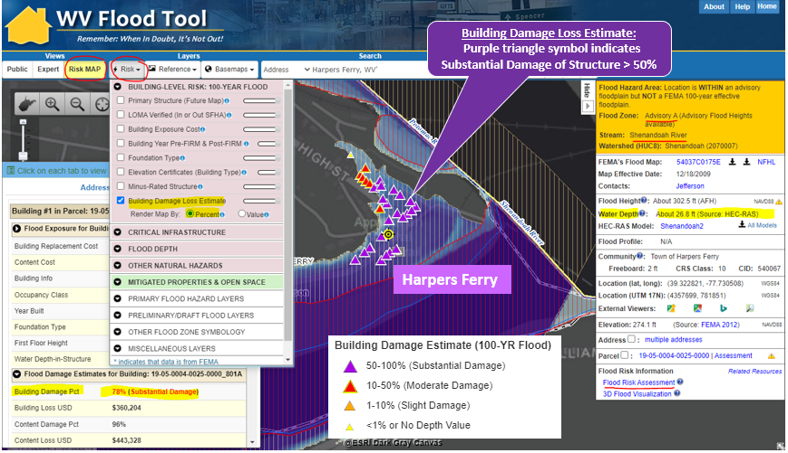
Potential Detailed Flood Studies
WV Flood Tool’s Risk MAP View – Building Damage Loss Estimate Percent Layer: In the Risk MAP View of the WV Flood Tool, the risk assessment layer, Building Damage Loss Estimate (%), provides a relationship between high flood depths and flood loss estimates of substantially damaged structures
(> 50% damage). High building-level damage percentages typically correlate to structures in Approximate A Zones with high base flood depths for a 1% annual chance flood.
Zone A Cluster Analysis

Slide 31
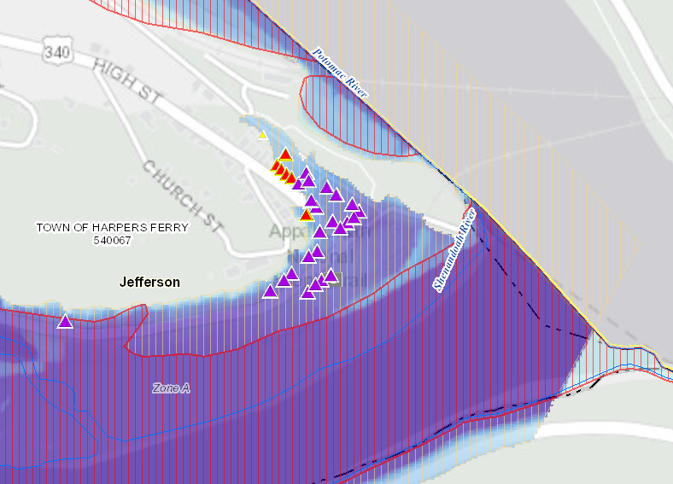
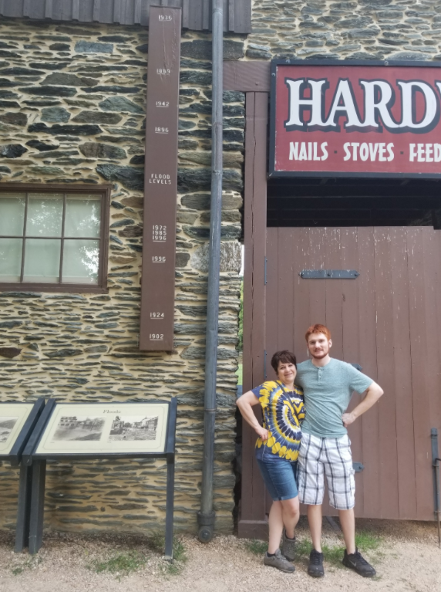
Potential Detailed Flood Studies
Shenandoah River (Harpers Ferry) Zone A Cluster
A high-value wastewater treatment plant is associated with the high building exposure values of this Zone A cluster. Building 19-05-0004-0025-0000_744 has high-water marks on building side.
Harpers Ferry, WV
High Water Marks
Building Damage Loss Estimate:
Purple triangle symbol indicates Substantial Damage of Structure > 50%
https://www.mapwv.gov/flood/map/?wkid=102100&x=-8652936&y=4767965&l=11&v=2
Zone A Cluster Analysis

Slide 32
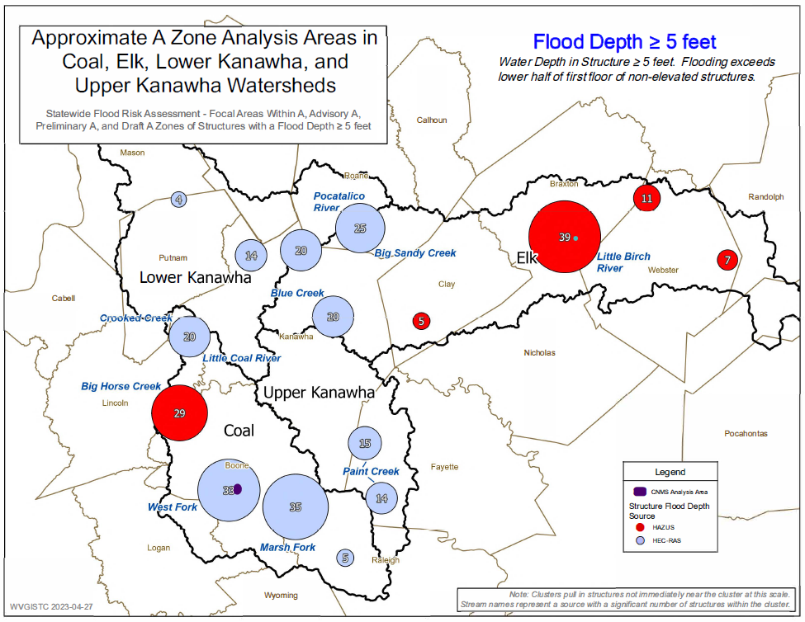
Potential Detailed Flood Studies – Kanawha Basin
Zone A Cluster PDF Tax Maps

Slide 33
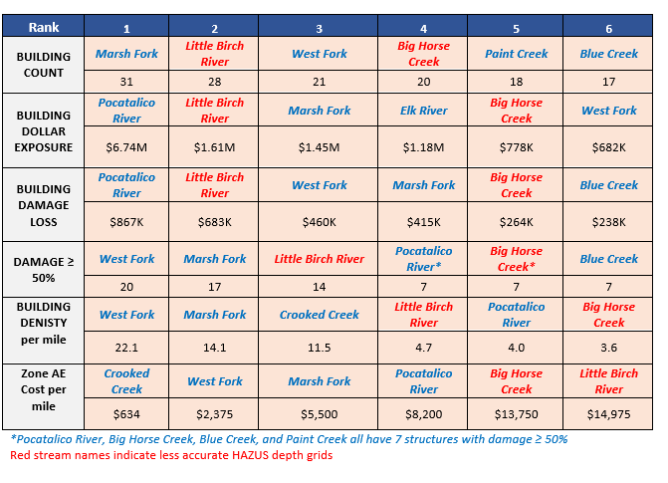
Potential Detailed Flood Studies – Kanawha Basin

Slide 34
WV Risk Assessment – Community Engagement
Elevation Certificates
Buyout Properties
Mitigated Structure Verification
Potential Structures for Mitigation
SFHA Outreach Letters to Property Owners
Preload Structures in FEMA SDE Software

Slide 35
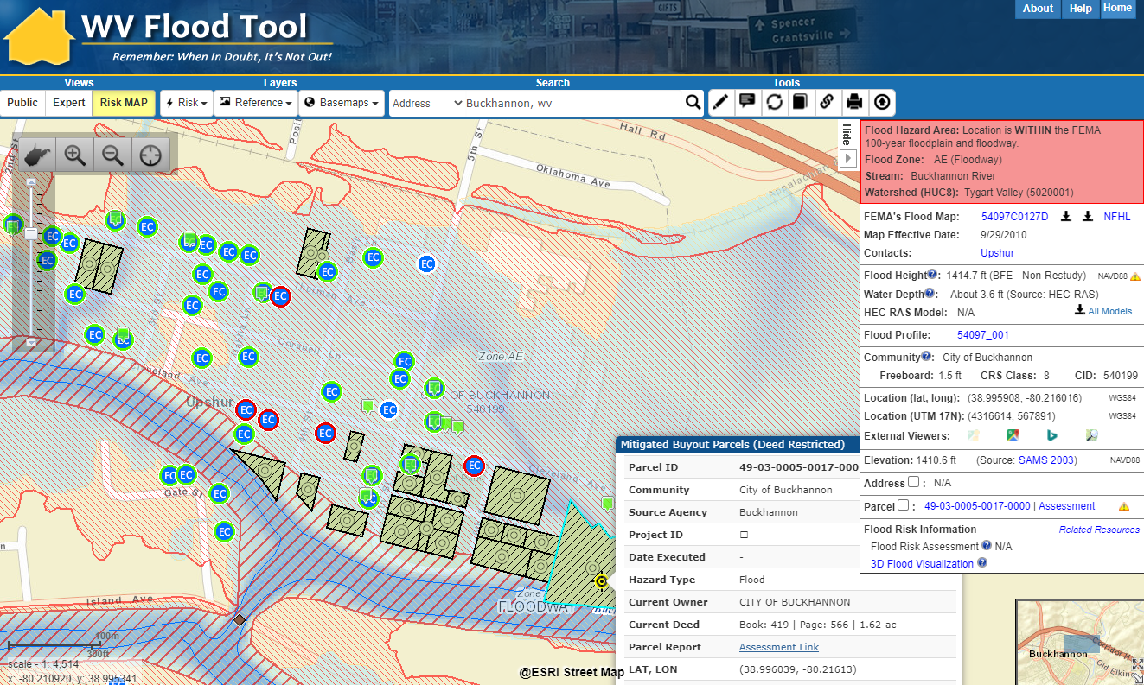
Buyout Properties - Verification
Buckhannon, WV
Elevation Certificate
of Elevated Structure (Bldg. Diagrams 5-8)
Verify
MITIGATED STRUCTURE
Verify
BUYOUT PROPERTY Parcel
https://mapwv.gov/flood/map/?wkid=102100&x=-8929946&y=4721378&l=10&v=2

Slide 36
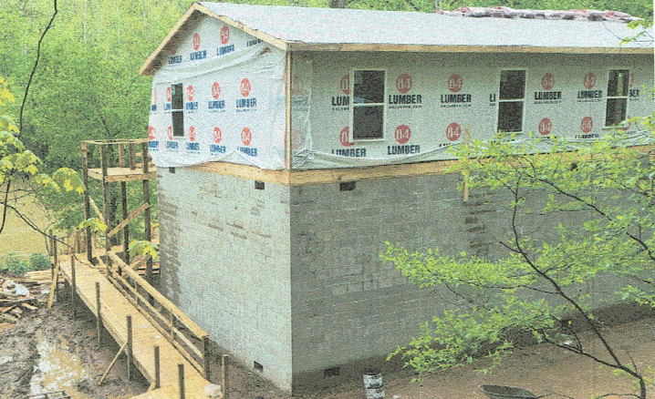
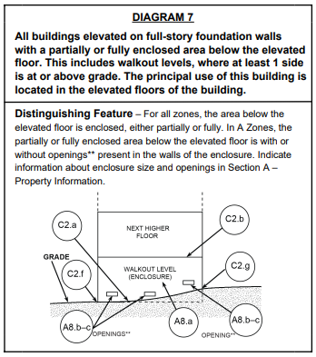
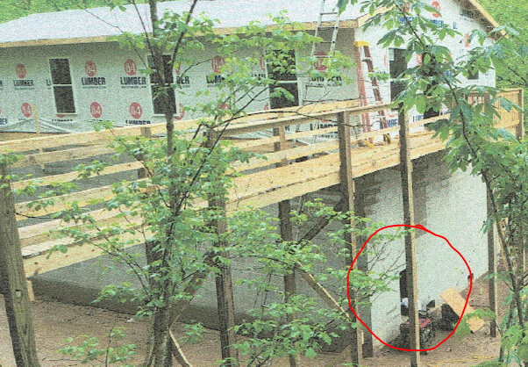
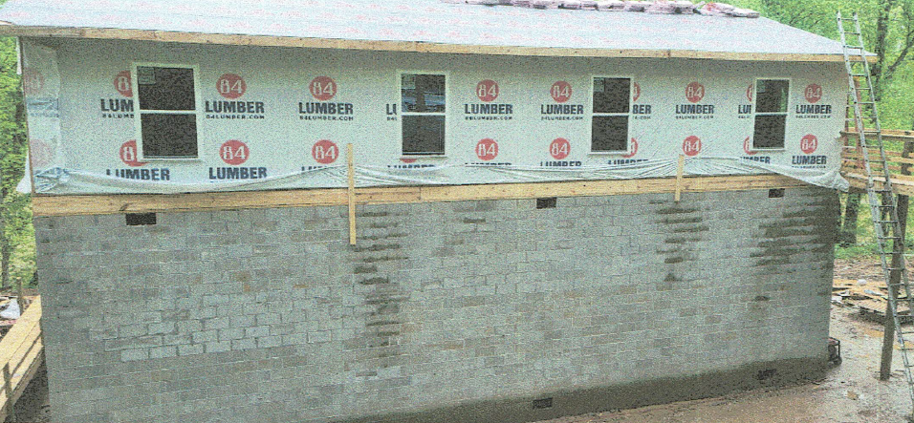
Elevation Certificate of Mitigated Structure
Elevated Building on Solid Foundation Walls (Full-Story)
Walkout Opening
Full-Story Enclosure
Building 08-06-0006-0058-0001 on the Elk River in Clay County

Slide 37
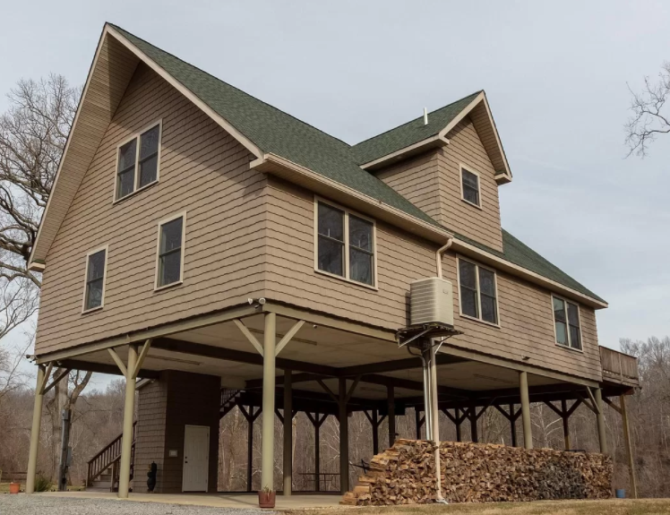
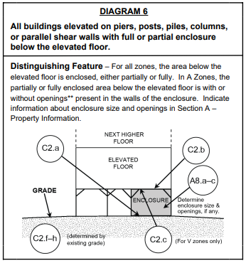
Mitigated Structure – EC Bldg. #6
Building Diagram 6: Elevated Building with Enclosure (using piers, piles, posts)
Partial Enclosure

Slide 38
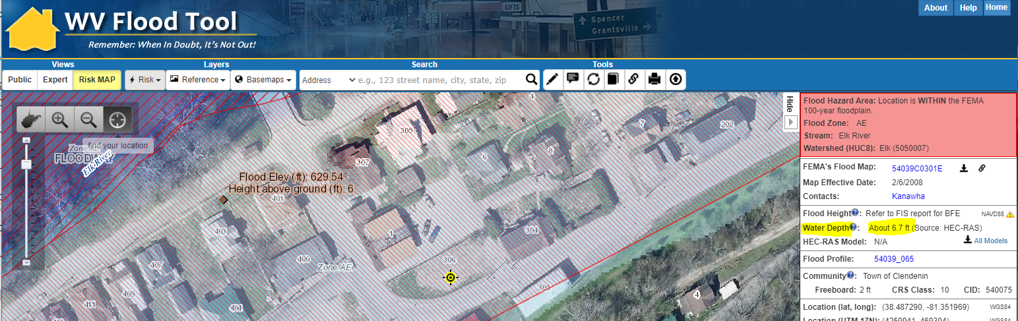
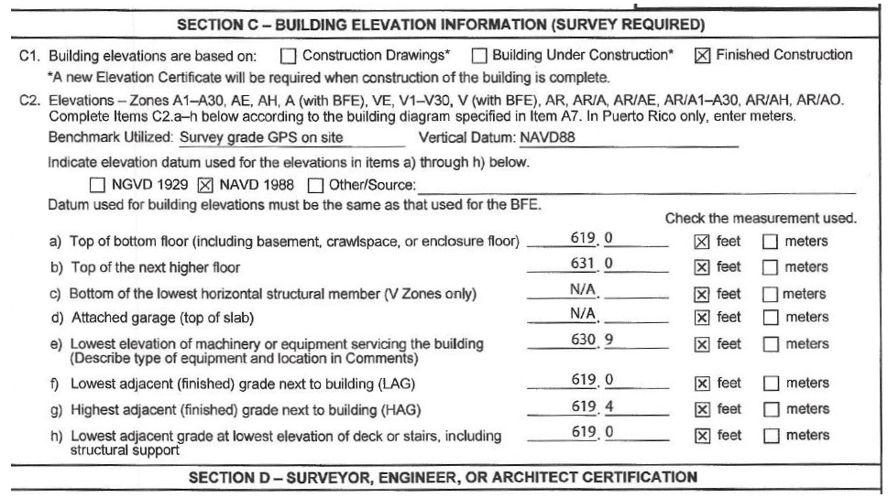
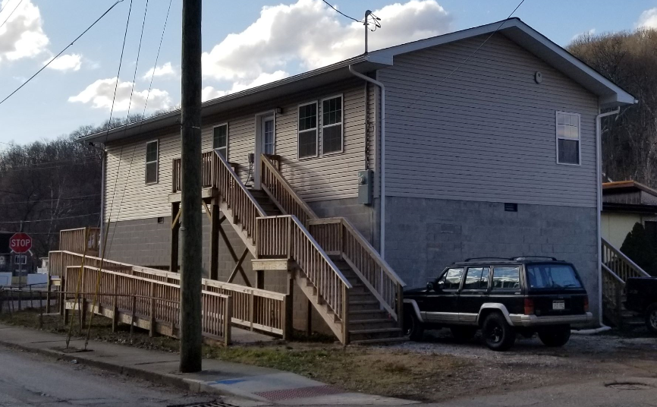
Mitigated Structure – EC First Floor Height - #7
Use Elevation Certificates and Building Pictures to identify Residential Elevated Structures > 5 ft.
Base Flood Depth
is 6.7 ft.
Newly built Elevated Structure not shown on aerial imagery
Elevation Certificate (Diagram 7)
631.0 ft. (C2b) – 619.0 ft. (C2f) = 12 ft.
19 steps x 7” rise = 11 ft.
16 blocks x 8” = 11 ft.
Building Picture
https://www.mapwv.gov/flood/map/?wkid=102100&x=-9056061&y=4648497&l=12&v=1

Slide 39
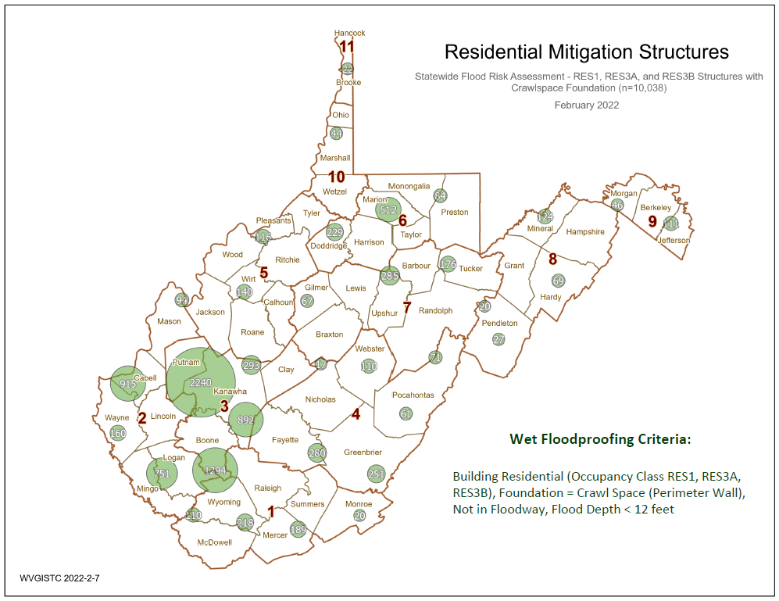
Potential Structures for Wet Floodproofing
Source Graphic

Slide 40
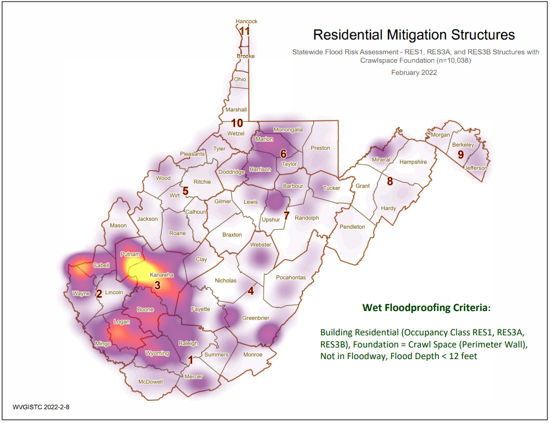
Potential Structures for Wet Floodproofing
Source Graphic

Slide 41

Community Risk Assessment Data Verification
Use Building-Level (BL) Tables to identify Most Vulnerable Structures
Statewide BLRA (GIS)
BLRA County Tables organized by region
BLRA Data Extract Tables: High Building Value, High Damage Loss, High Minus Ratings
BLRA Statewide Top Lists: Building Value, Flood Depth, Damage Loss $, Damage Loss %, Minus Rated, Mitigated Structures
Risk Indicator Matrices: Exposure and Damage Loss Matrices of Risk Indicators

Slide 42



Preload Structures into SDE
Incorporate 1% Floodplain Building Risk Assessment Inventory into Mitigation and NFIP/CRS Management Activities
STEP 1: Community preloads Floodplain Properties into FEMA’s Substantial Damage Estimator software
STEP 2: Community performs practice Substantial Damage Assessments for Residential and Non-Residential Properties
Greenbrier County has 2,225 Structures that can be uploaded
SDE Upload Files and Instructions

Slide 43


SFHA Map Change Letters
Incorporate 1% Floodplain Building Risk Assessment Inventory into Mitigation and NFIP/CRS Management Activities
White Sulphur Springs has 68 buildings being mapped into the SFHA
Hardy County
Risk MAP
Kanawha County - Elk River PMR
Greenbrier County Risk MAP
FEMA Region 3 Toolkit for New Flood Studies
Mail Merge Template for SFHA Mapped-in Structures

Slide 44
Detailed Flood Studies
Greenbrier County Study
Rainelle
White Sulphur Springs

Slide 45




WV Flood Tool’s Risk Map View
White Sulphur Springs’ primary structures viewable on the Risk MAP View of the WV Flood Tool. Symbol letters indicate general occupancy (Residential, Commercial, Other Non-Residential).
Residential Structure in Floodway
Bldg. 13-17-0008-0139-0000
Buyout Property
Building
Exposure
Street View Image
Base Flood Depth – 3D Visualization
HAZUS Loss Estimate
Notes:
Segment 1. Visualizing flood risk and resiliency factors graphically on the WV Flood Tool
The Study Teams analysis of flood risk and resiliency factors were presented for feedback at the Community Focus Group meetings in November, and these factors can be integrated into a suite of existing and forthcoming web-based tools for building community flood resilience. Here are just a few examples of the tools we’ve been developing.
In this example, the public can view and visualize building damage estimates for unmitigated residential structures located in the floodway.
Flood risk information can be viewed interactively on the WV Flood Tool map at the building level….

Slide 46








Community Flood Risk Dashboard
FLOOD RISK FACTORS
Hazard
Ratio of Floodplain to Community Area: 9.2%
Incorporated Community Median: 10.2%
Federally Declared Flood Disasters in Greenbrier County since 1989: 9
Statewide County Median: 12
Rainelle,
WV
Greenbrier County
Exposure
Physical
Human
Total Buildings in High-Risk Floodplains: 338
Incorporated Community Median: 59
Estimated Population
Residing in High-Risk
Floodplains: 582
Incorporated Community Median: 114
Newly Mapped in Structures: 329
Newly Mapped out Structures: 0
Total Building Value in Floodplains: $16,120K
Incorporated Community Median: $6,417K
Estimated Population Displaced by Flooding:
492
Incorporated Community Median: 56
Total At-Risk Residential Structures: 251
Incorporated Community Median: 44
Total Estimated Building Loss: $997K
Incorporated Community Median: $240K
Estimated Population in Need of Short-Term Shelters: 123
Incorporated Community Median: 12
Vulnerability
Mobile Homes
in Floodplains: 14
Incorporated Community Median: 5
Critical Buildings in Floodplains (Essential Facilities and Non-Historical Community Assets): 8
Incorporated Community Median: 3
Renters Ratio
in Floodplains: 39%
Incorporated Community Med.: 35%
Social Vulnerability Index (SVI)
of Greenbrier County: 0.55
Statewide County Median: 0.48
Notes:
Segment 2. Flood risk factor statistics summarized by a Community Flood Risk Dashboard
Or flood factors can be summarized statistically in a community risk dashboard that summarizes hazard, exposure, and vulnerability statistics for the built-environment and population in high-risk flood zones.

Slide 47


FEMA 10% Annual Chance (10-year) Rainelle, WV
0 ft.
FLOOD DEPTH
35 ft.
96% probability of flooding at least once over 30 years
Notes:
FEMA 10year Aerial.
Segment 4. Building-scale flood visualizations at different flood frequencies and magnitudes
Or different flood depths can be visualized at the building level. New flood models for the town of Rainelle reveal that the elevated structure shown here is still vulnerable to riverine flooding, such as a major 500-yr flood event or for flood models impacted by climate change.
<< GROUP 4 Flood Visualization at Building Level (4 slides) >>
Segment 3. Viewshed-scale flood visualizations at different flood frequencies and magnitudes
Flood visualization products effectively communicate various flood characteristics to the public. Inundation maps at the viewshed or bird’s eye level portray riverine flood models of different flood frequencies and magnitudes. Flood models can be visualized at the community or viewshed map scale as seen here…
<< GROUP 3: Flood Visualization at Viewshed Level (5 slides) >>
Flood Visualizations and movies are performed at different map scales from viewshed views seen here to the flood impacts at the building level.

Slide 48

FEMA 4% Annual Chance (25-year) Rainelle, WV
0 ft.
FLOOD DEPTH
35 ft.
71% probability of flooding at least once over 30 years
Notes:
FEMA 25year Aerial

Slide 49

FEMA 2% Annual Chance (50-year) Rainelle, WV
0 ft.
FLOOD DEPTH
35 ft.
45% probability of flooding at least once over 30 years
Notes:
FEMA 50year Aerial

Slide 50

FEMA 1% Annual Chance (100-year) Rainelle, WV
0 ft.
FLOOD DEPTH
35 ft.
26% probability of flooding at least once over 30 years
Notes:
FEMA 100year Aerial

Slide 51

FEMA 0.2% Annual Chance (500-year) Rainelle, WV
0 ft.
FLOOD DEPTH
35 ft.
6% probability of flooding at least once over 30 years
Notes:
FEMA 500year Aerial

Slide 52


Mitigation Reconstruction (Rainelle, WV)
First Floor Height BELOW: FEMA/FSF 0.2-percent chance (500-yr) floods
First Floor Height ABOVE: FEMA 1% Chance (100-yr) flood; 2016 Flood HWM
Flood Depths marked on Mitigated Structure
FEMA
First Street Foundation (FSF)
USGS 2016 Flood High Water Mark
12.2’ (FSF 0.2% / 500-Yr )
9.9’ (FEMA; 0.2% / 500-Yr)
6.5’ (2016 High Water)
3.9’ (FEMA 1% / 100-Yr)
Flood Visualization (8 ft.)
Notes:
Segment 4. Building-scale flood visualizations at different flood frequencies and magnitudes
Or different flood depths or flood elevations can be visualized at the building level. New FEMA flood maps for the town of Rainelle reveal that the mitigated structure above is a risk for the 1%+ (100-yr plus) and 0.2-percent chance (500-yr) floods. Field verification of communities in Greenbrier County show that for most mitigation reconstruction implemented since the 2016 flood, residential structures - like this one in Rainelle shown here - were elevated to the proper design flood elevation in accordance with local floodplain management regulations. However, flood models show that certain elevated structures are still vulnerable to riverine flooding, such as a major 500-yr flood event or for models impacted by climate change.
<< GROUP 4 Flood Visualization at Building Level (3 slides) >>

Slide 53

Flood Visualization 4 feet
First Floor Height ABOVE: 1% Chance (100-yr) flood

Slide 54

Flood Visualization 7 feet
First Floor Height ABOVE: 2016 Flood High Water Mark

Slide 55

Flood Visualization 10 feet
First Floor Height BELOW: 0.2% Chance (500-yr) Flood Models

Slide 56


Pre-Disaster 2016 Aerial View
White Sulphur Springs
Imagery of June 2016
Flood
Resiliency Factors
Image courtesy of Google Earth Pro
Notes:
Segment 4. Building-scale flood visualizations at different flood frequencies and magnitudes
Or different flood depths can be visualized at the building level. New flood models for the town of Rainelle reveal that the elevated structure shown here is still vulnerable to riverine flooding, such as a major 500-yr flood event or for flood models impacted by climate change.
<< GROUP 4 Flood Visualization at Building Level (4 slides) >>

Slide 57



Structures Removed Post-Disaster
White Sulphur Springs
Imagery of June 2016
Building REMOVED (Vacant Parcel)
Image courtesy of Google Earth Pro & Google Street View

Slide 58



Buyout Parcels (Deed Restricted)
White Sulphur Springs
Imagery of Oct. 2019
Buyout Property
ACQUISITION or Buyout Property
Image courtesy of Google Earth Pro & Google Street View

Slide 59


Non-Mitigated Repaired Structures
White Sulphur Springs
Imagery of Oct. 2019
Substantially Damaged Structure Repaired
REPAIRED of Substantially Damaged (>50%) Building
Image courtesy of Google Earth Pro & Google Street View

Slide 60



Mitigated Reconstruction
White Sulphur Springs
Imagery of Oct. 2019
Elevated Structure (with flood vents)
Mitigation RECONSTRUCTION
Image courtesy of Google Earth Pro & Google Street View

Slide 61

Mitigated and Non-Mitigated Properties
White Sulphur Springs
Imagery of Oct. 2019
Flood
Resiliency Factors
Building REMOVED (Vacant Parcel)
ACQUISITION or Buyout Property
REPAIRED of Substantially Damaged (>50%) Building
Mitigation RECONSTRUCTION
Image courtesy of Google Earth Pro

Slide 62


Flood Mitigation Map
White Sulphur Springs
Map
Legend
Notes:
Segment 5. Measuring Flood Resiliency Factors.
Other flood resiliency factors, such as the net cumulative tax assessment of floodplain building values pre- and post-disaster, along with loss avoidance studies of elevated structures and property buyouts, were calculated.

Slide 63

Areas of Mitigation (AoMI) Interest
PDF Map

Slide 64
Community Recovery: Building Value Recovery
White Sulphur Spring
Rainelle
COMMUNITY | 2015 | 2016 | 2017 | 2018 | 2019 | 2020 | 2021 | 2022
Rainelle (n=326) | 13.1 Million | 13.3 Million | 5.0 Million | 9.4 Million | 11.0 Million | 11.1 Million | 11.3 Million | 12.3 Million
White Sulphur Springs (n=409) | 22.6 Million | 23.0 Million | 13.4 Million | 21.5 Million | 22.4 Million | 22.9 Million | 26.2 Million | 29.2 Million

