Slide 1
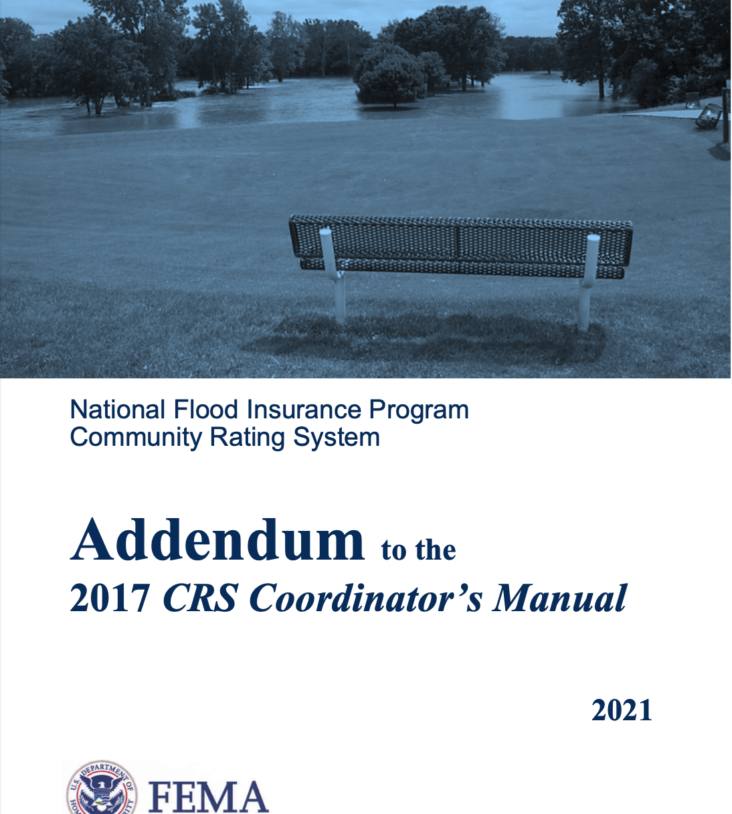
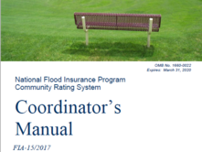
CRS: You Are Closer Than You Think

Slide 2


Melissa Mitchell, CFM Floodplain Management Analyst (302) 283-2265 melissa.mitchell@tetratech.com
June 13, 2024
Logan, West Virginia
West Virginia Floodplain Management Association

Slide 3
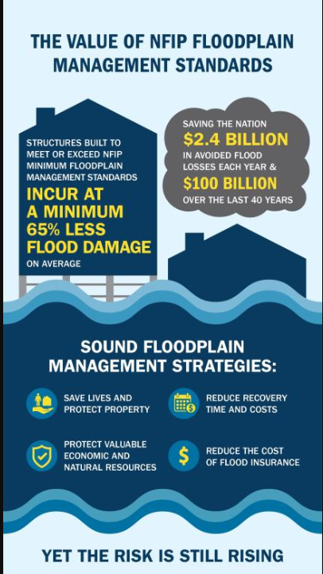
CRS: You Are Closer Than You Think
The NFIP provides flood insurance to property owners, renters and businesses
The NFIP works with communities required to adopt and enforce floodplain management regulations that help mitigate flooding effects
Federal Disaster Assistance: The National Flood Insurance Program and Other Federal Disaster Assistance Programs Available to Individuals and Households After a Flood

Slide 4
CRS: You Are Closer Than You Think
FLOODPLAIN ADMINISTRATOR
Understand natural and beneficial functions of the floodplain;
Understand risk analysis and map interpretation;
Understand the impacts of building in the floodplain;
Stay current with floodplain management trends and activities by taking continuing education classes;
Understand the rules and regulations of floodplain management;
Provide guidance on local conditions and development;
Provide guidance to officials and citizens on floodplain management and describe the risks involved in building in the floodplain as well as the beneficial uses of the floodplain; and
Have attained a level of knowledge of floodplain management that allows them to perform a variety of flood preventive activities in the community.
https://wvfma.org/cfm-program

Slide 5
CRS: You Are Closer Than You Think
MODERN BUILDING CODES
The cost-effectiveness of modern building codes in strengthening disaster resilience
Every $1 spent on mitigation, new code construction saves $11 in disaster repair and recovery
FEMA considers modern building codes to be within 2 versions/6 years
2024 and 2021 ICC Series as of January 2025

Slide 6
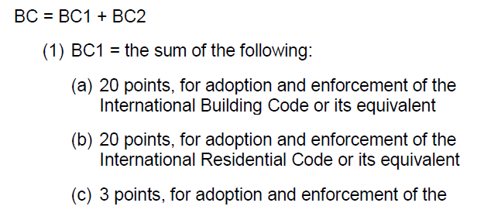
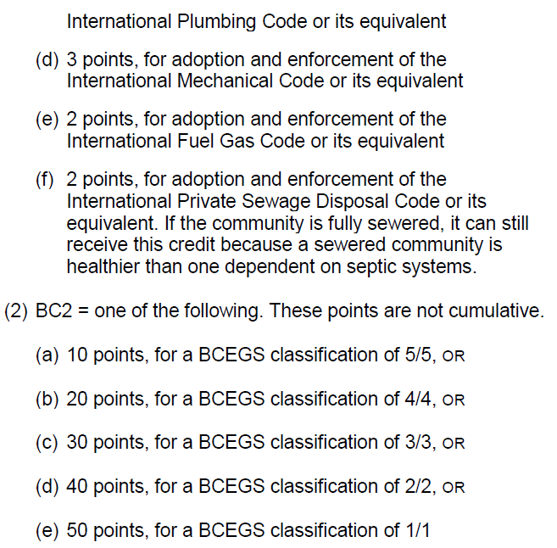
CRS: You Are Closer Than You Think
BUILDING CODES AND CRS
West Virginia is moving towards adopting the
2021 ICC Series
If the Building Code (BC1) is verified to meet the CRS program prerequisites, up to 48 points can be assigned under CRS Activity 430 – Higher Regulatory Standards
If the community participates in the Building Code Effectiveness Grading Schedule (BCEGS) and receives a classification that is creditable in CRS, up to 50 points can be assigned under CRS Activity 430 – Higher Regulatory Standards

Slide 7
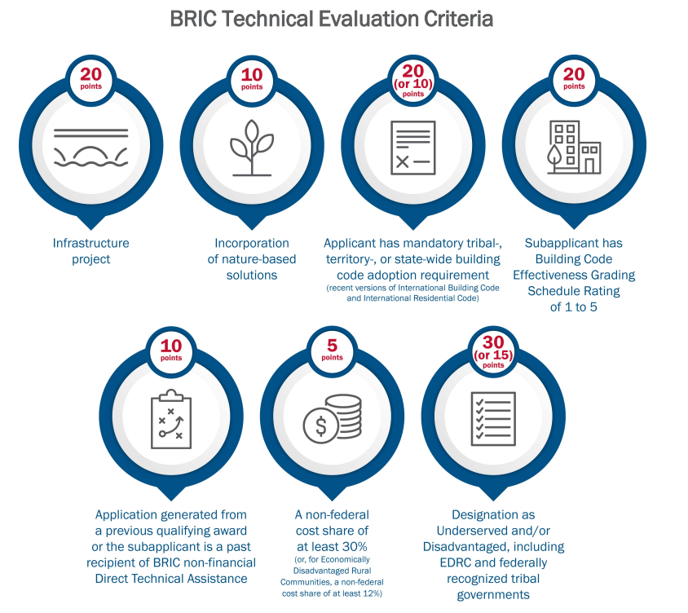
CRS: You Are Closer Than You Think
BUILDING CODES AND GRANT OPPORTUNITIES
Building Resilient Infrastructure and Communities (BRIC)
Applications are reviewed under the Technical Evaluation Criteria
Modern building codes and participation in the BCEGS program can aid in a more competitive BRIC application BRIC Technical Criteria (fema.gov)

Slide 8
CRS: You Are Closer Than You Think
BCEGS AND INSURANCE DISCOUNT
Municipalities with effective codes that are well enforced should demonstrate better loss experience, and insurance rates can reflect that
Rating discount is assessed for each community based on building code adoptions
Modern building codes lessening catastrophe-related damage. Lowering insurance costs provides an incentive for communities to enforce their building codes
Provides an incentive for communities to enforce their building codes

Slide 9

CRS: You Are Closer Than You Think
CRS PROGRAM PREREQUISITES
In good standing with the NFIP
310: Elevation Certificates
Required to collect, review, correct, and maintain construction certificates for development within the regulated floodplain
502: Repetitive Loss Category
Required to implement specific projects based on your RL Category

Slide 10
CRS: You Are Closer Than You Think
IN GOOD STANDING WITH THE NFIP
Community Assistance Visit (CAV) with the State and/or FEMA Region
CAV consists of a tour of the floodplain, an inspection of community permit files, administrative procedures, enforcement, and meetings with local appointed and elected officials
Technical assistance to the community and assuring that the community is adequately enforcing its floodplain management regulations
FEMA or the State will work with the community to help them bring their program into compliance with NFIP requirements Community Assistance Visit (CAV) | FEMA.gov

Slide 11
CRS: You Are Closer Than You Think
CRS ACTIVITY 310- ELEVATION CERTIFICATES
CRS participating communities are required to collect, review, and maintain construction certificates
Construction certificates are reviewed to a higher standard
Program prerequisite verified annually
Requires standard operation procedures. Creditable SOPs will be assigned 38 points under CRS Activity 310- Elevation Certificates

Slide 12
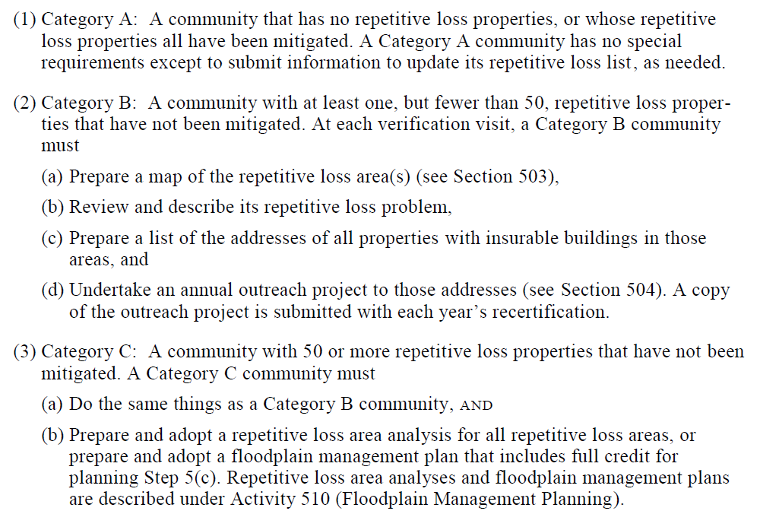
CRS: You Are Closer Than You Think
CRS ACTIVITY 502- REPETITIVE LOSS CATEGORY
There is no CRS credit assigned to Activity 502
Credit would be assigned to CRS Activity 330-Outreach Projects, up to 36 points for the required annual letter for Category B and C communities
Up to 382 points may be realized under CRS Activity 510 for a CRS creditable Hazard Mitigation Plan and/or up to 140 points for a CRS creditable Repetitive Loss Area Analysis

Slide 13
CRS: You Are Closer Than You Think
CRS AND GRANT OPPORTUNITIES
FEMA Go, grant application program
CRS Classification is a data collection point
BRIC technical score includes higher standards for the primary hazard they have identified in their supplication and that their project intends to mitigate. Examples:
Prohibition of fill within the floodway and/or floodplain
Requiring at least 2 feet of freeboard in all Special Flood Hazard Areas
Prohibition of siting/placement of critical facilities within the 0.2% annual-chance-floodplain (aka 500-year floodplain)

Slide 14
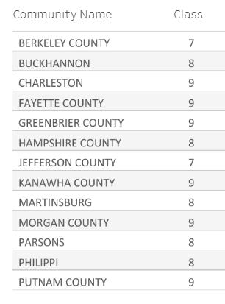
CRS: You Are Closer Than You Think
CRS AND NFIP INSURANCE DISCOUNT
Participation in the CRS program is the ONLY discount applied to National Flood Insurance Program flood insurance policies
Flood insurance discount ranges from 5-45%
Contact Tim for a summary of your community’s policy and premiums

Slide 15
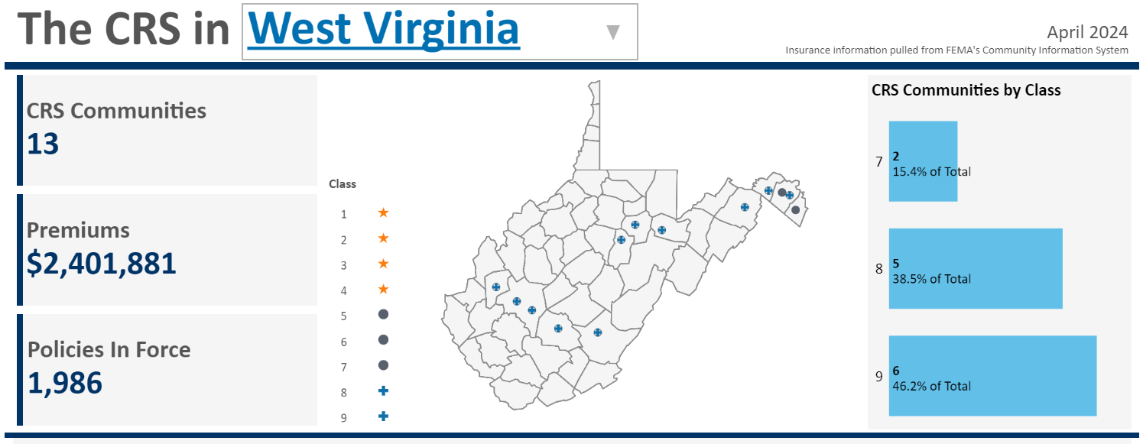
CRS: You Are Closer Than You Think
CRS IN WEST VIRGINIA CRS State Profiles | CRS Data Visualizations (crsviz.com)

Slide 16
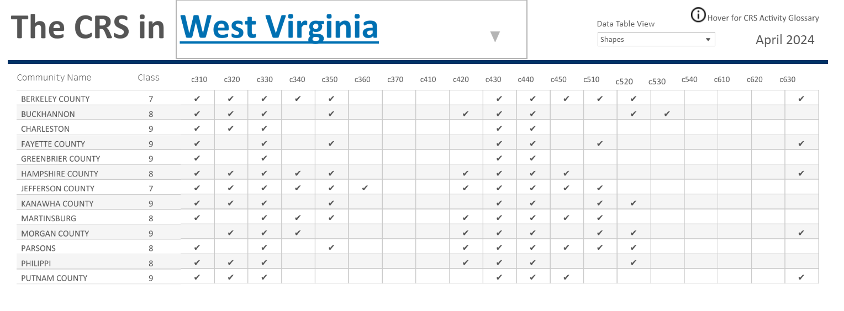
CRS: You Are Closer Than You Think
CRS IN WEST VIRGINIA CRS State Profiles | CRS Data Visualizations (crsviz.com)

Slide 17
CRS: You Are Closer Than You Think
CRS IN WEST VIRGINIA- CRS CLASS 9
CRS Activity 310- Elevation Certifications (38 points)
CRS Activity 330- Outreach Projects (up to 200 points)
CRS Activity 430 – Higher Regulatory Standards (up to 2,462 points). *Impact adjustments may apply
CRS Activity 440 – Additional Map Data (up to 160 points)
CRS Activity 502 – Repetitive Loss Category (0 points)

Slide 18
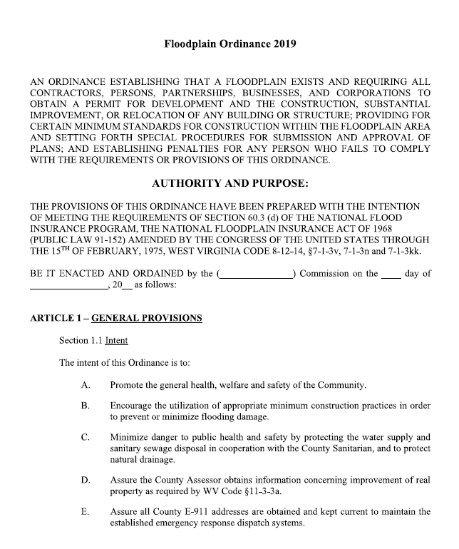
CRS: You Are Closer Than You Think
CRS IN WEST VIRGINIA- CRS Activity 430
CRS Class 8 and higher must meet the 2021 CRS Addendum for residential freeboard enforcement
Including manufactured homes
Including machinery and equipment
Minimum 1’ freeboard to all listed above
Freeboard enforcement must be demonstrated by a review of current development within the SFHA by EC or other construction certificate

Slide 19
CRS: You Are Closer Than You Think
CRS IN WEST VIRGINIA- CRS Activity 430
2019 Sample Model State Flood Damage Prevention Ordinance and State Based Building Codes:
Sample model ordinance recommends 2’ freeboard for residential, manufactures homes, machinery and equipment
American Society of Civil Engineers-24 as referenced in the IBC/IRC (not amended out or weakened) ASCE-24 meets the 2021 CRS Addendum freeboard requirements at the minimum 1’ freeboard
NFIP floodplain development regulations are incorporated in the ICC series

Slide 20
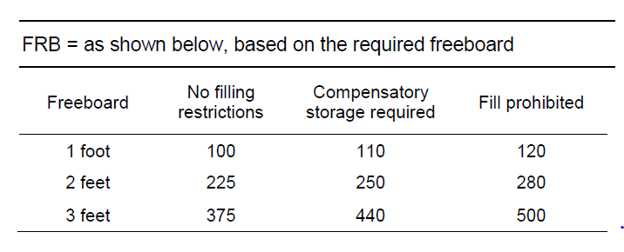
CRS: You Are Closer Than You Think
CRS IN WEST VIRGINIA- CRS Activity 430

Slide 21
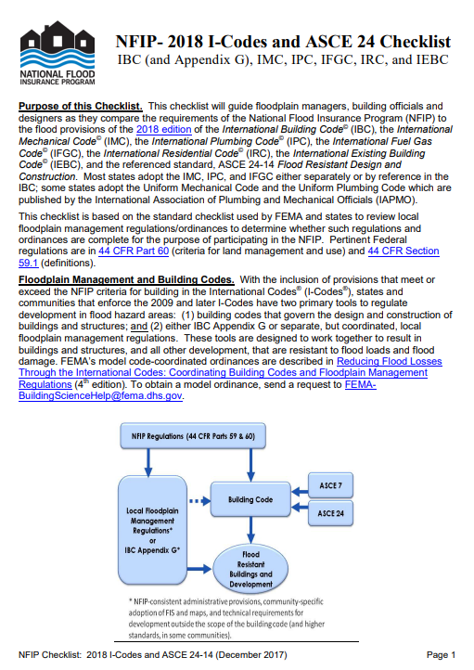
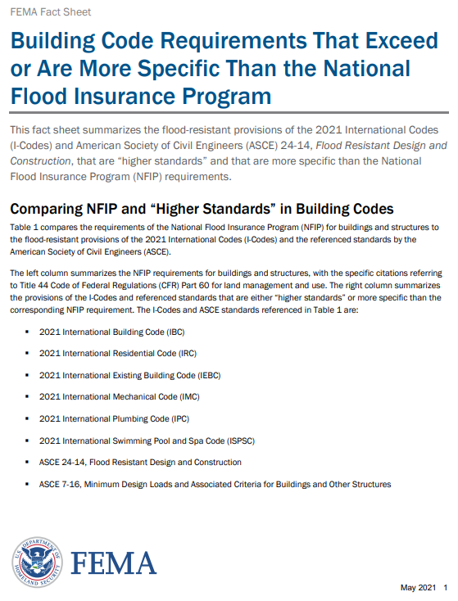

CRS: You Are Closer Than You Think
CRS IN WEST VIRGINIA- CRS Activity 430
Significant Building Code Requirements That Exceed or Are More Specific Than the National Flood Insurance Program (fema.gov)
NFIP - 2018 I-Codes/ASCE 24 Checklist (fema.gov)

Slide 22
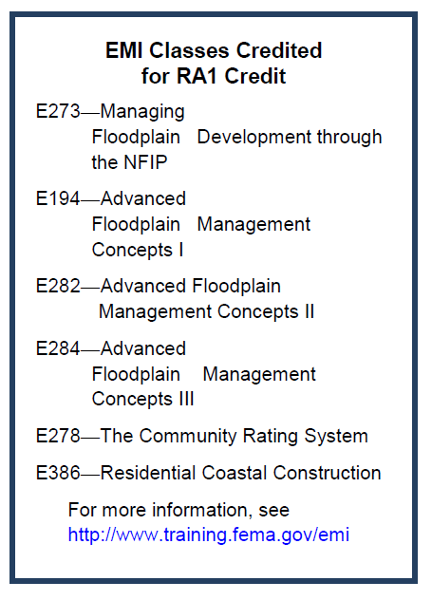
CRS: You Are Closer Than You Think
CRS IN WEST VIRGINIA- Continuing Education
6 Emergency Management Institute courses eligible for CRS credit under Regulations Administration under CRS Activity 430- Higher Regulator Standards
Credit criteria to be verified

Slide 23
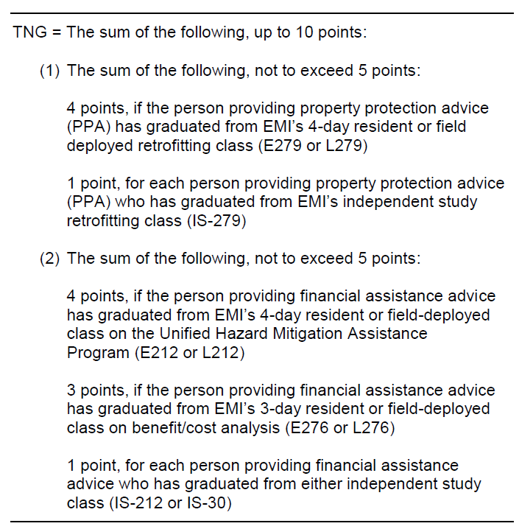
CRS: You Are Closer Than You Think
CRS IN WEST VIRGINIA- Continuing Education
5 Emergency Management Institute courses eligible for CRS credit under Advisory Training, CRS Activity 360.
Credit criteria to be verified.

Slide 24
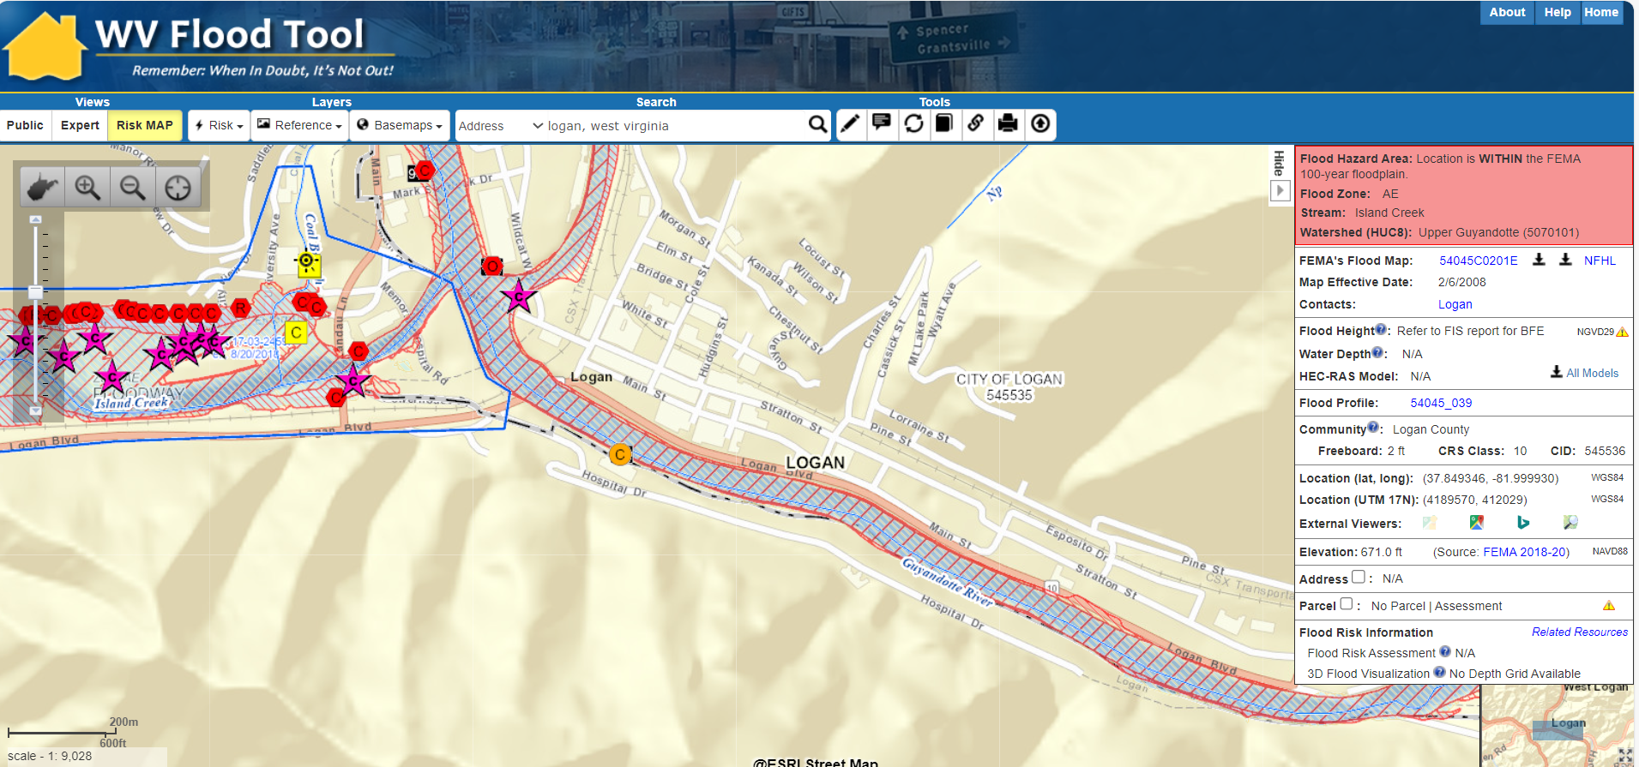
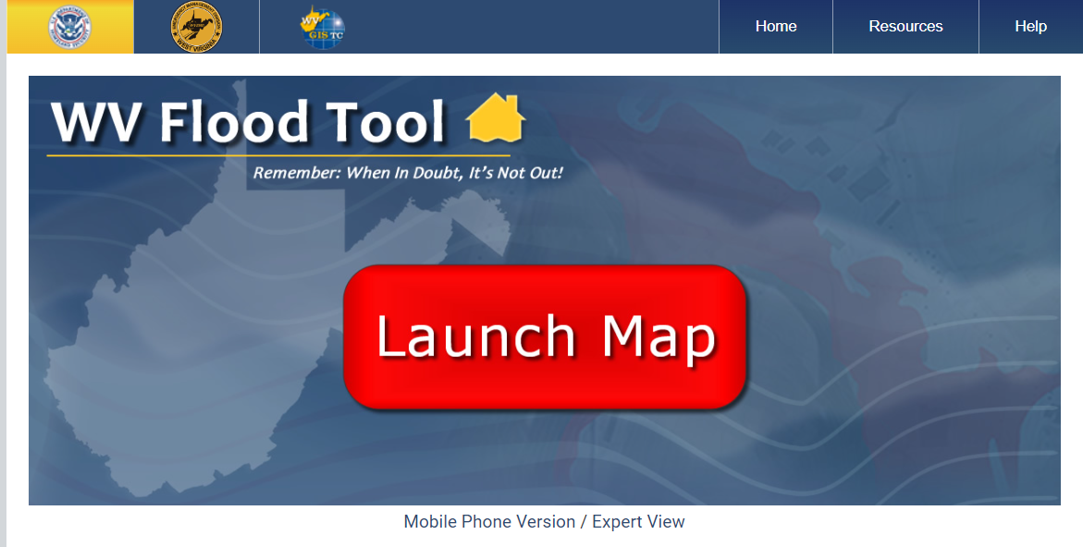
CRS: You Are Closer Than You Think
CRS IN WEST VIRGINIA- CRS Activity 440

Slide 25
CRS: You Are Closer Than You Think
CRS IN WEST VIRGINIA- CRS Activity 440
AMD1 = 20 points, for showing the SFHA boundaries, corporate limits, streets, and parcel or lot boundaries (a data base management program must show whether a parcel is in the SFHA)
AMD2 = 26 points, for a GIS layer that shows buildings, building outlines, or building footprints (a data base management program must show whether the primary building on the lot is in the SFHA), and the building information is kept up to date to reflect new construction
AMD3 = 12 points, for showing floodways or coastal high hazard areas (a data base management program must show whether either the parcel or the primary building is in the floodway or coastal high hazard area) AMD4 = 12 points, for showing base flood elevations
AMD4 = 12 points, for showing base flood elevations
AMD5 = 10 points, for including FIRM zone attributes (e.g., A3, VE, etc.)

Slide 26
CRS: You Are Closer Than You Think
CRS IN WEST VIRGINIA- CRS Activity 440
AMD6 = 10 points, for showing the 500-year floodplain elevations or boundaries (a data base management program must show whether the parcel is in the 500-year floodplain)
AMD7 = 12 points, for showing areas of the community subject to other natural hazards, such as landslides, subsidence, stream migration, and soils unsuitable for septic fields (a data base management program would show whether the parcel is subject to another hazard)
AMD8 = EITHER: (a) 8 points, if the community’s GIS includes topographic contour lines, OR (b) 10 points, if the system includes topographic contour lines at a smaller contour interval than that provided on available U.S. Geological Survey digital orthophoto quarter quads (DOQQ). In those areas where there are no DOQQs, the credit is provided if the contour interval is smaller than that on the area’s USGS quadrangle maps
AMD9 = 6 points, for including updated floodplain data in the tax assessment data base

Slide 27
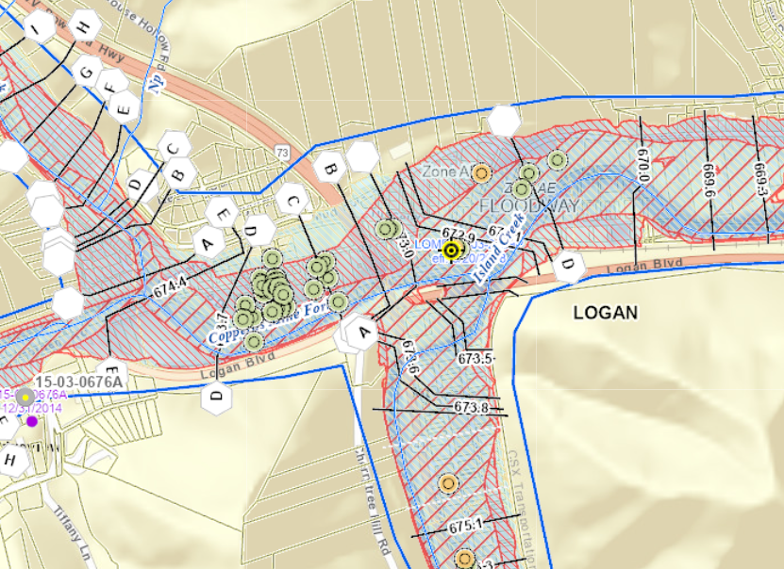
CRS: You Are Closer Than You Think
CRS IN WEST VIRGINIA- CRS Activity 440
AMD10 = 6 points, for including overlays or layers for all FIRMs in effect after the date of the community’s application to the Community Rating System (CRS)
AMD11 = 8 points, for other overlays or data bases used for regulation or mitigation programs, including incorporating and maintaining layers from Hazus-MH (see Figure 510-2) and the community’s repetitive loss areas (see Section 503)
AMD12 = 14 points, for areas with natural floodplain functions (e.g., wetlands, designated riparian habitat)
AMD13 = 14 points, for including building elevation data. The data must be in digital format, not scanned pictures of Elevation Certificates. The points are prorated in the same manner as Elevation Certificates are prorated in WEB4 (Section 352.c)

Slide 28
CRS: You Are Closer Than You Think
CRS IN WEST VIRGINIA- CRS CLASS 9
CRS Activity 310- Elevation Certifications (38 points)
CRS Activity 330- Outreach Projects (36 points)
CRS Activity 430 – Higher Regulatory Standards (225 points*)
CRS Activity 440 – Additional Map Data (145 points)
CRS Activity 502 – Repetitive Loss Category (0 points)
Totals 444 points
Need 500+ points to meet the CRS Class 9 threshold

Slide 29
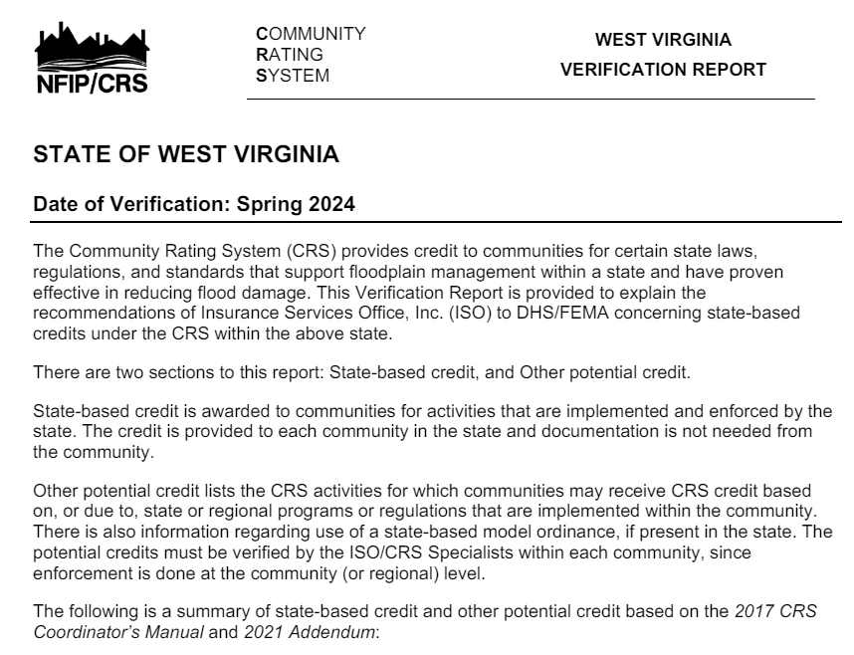
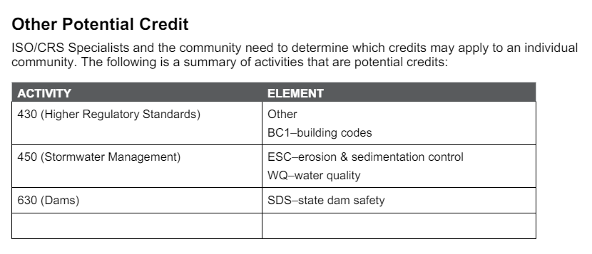
CRS: You Are Closer Than You Think
CRS IN WEST VIRGINIA- CRS CLASS 9

Slide 30
CRS: You Are Closer Than You Think
CRS IN WEST VIRGINIA- CRS CLASS 9
CRS Activity 430 – Higher Regulatory Standards
2’ Freeboard enforced (225 points*)
Adopted and enforced State Building Codes
The West Virginia State Building Code is based on the 2018 International Building Code and 2018 International Residential Code. The state has also adopted 2018 International Mechanical Code and 2018 International Fuel Gas Code and 2018 International Plumbing Code (45 points)
Enforce the positive drainage standards in the IRC/IBC (10 points)
CRS Activity 450- Stormwater Management
Enforce erosion control standards for any land disturbed or at minimum, enforce erosion control standards for 1 acre or greater of disturbed land (40 points for any/10 points for
1 acre or larger)

Slide 31
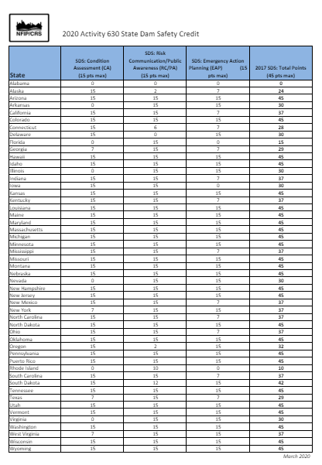
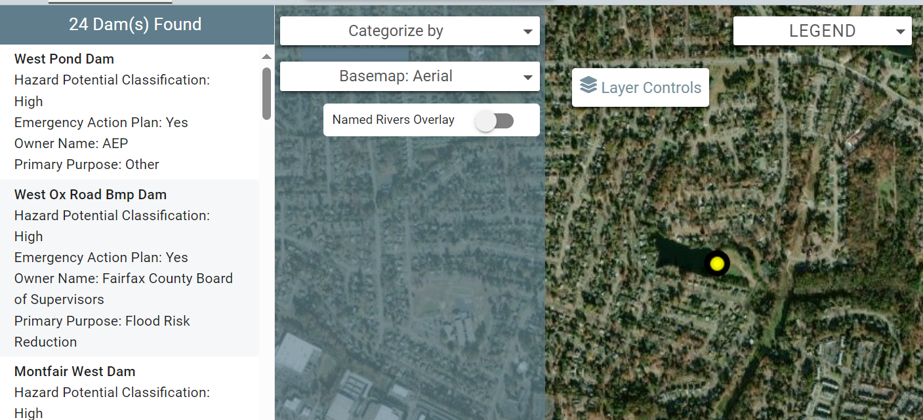
CRS: You Are Closer Than You Think
CRS IN WEST VIRGINIA- CRS CLASS 9
CRS Activity 630- Dams
If there is at least 1 high-hazard dam, where if there was a breach, would impact at least 1 insurable structure
37 points can be assigned to Activity 630- State Dam Safety
https://crsresources.org/files/600/630_sds_credit.pdf

Slide 32
CRS: You Are Closer Than You Think
CRS IN WEST VIRGINIA- CRS CLASS 9
CRS Activity 310- Elevation Certifications (38 points)
CRS Activity 330- Outreach Projects (36 points)
CRS Activity 430 – Higher Regulatory Standards (225 points*)
2018 IBC/IRC fuel and mechanical (45 points)
Enforcing positive drainage from IBC and IRC (10 points)
CRS Activity 440 – Additional Map Data (145 points)
CRS Activity 450 – Erosion Control (10 points)
CRS Activity 502 – Repetitive Loss Category (0 points)
CRS Activity 630 – State Dam Safety (37 points)
Totals 509 points
Need 500+ points to meet the CRS Class 9 threshold
Community Growth Adjustment (CGA) NOT included in the estimate of credit
Point multiplier to the 400 series

Slide 33
CRS: Program Prerequisite to CRS Credit
Questions?
Request your repetitive loss data contact FEMA Region III
Bobby Cobelli | (202) 674-9244 |bobby.cobelli@fema.dhs.gov
Request your NFIP flood insurance policy count and premium data
Tim Keaton, NFIP Coordinator OF THE YEAR
(304) 414-7659 | tim.w.keaton@wv.gov
West Virginia ISO CRS Specialist, Chelly Hall, crsresources.org/100-2/

Slide 34


CONTACT INFORMATION
CRS recertification and verification support
Repetitive Loss Area Analysis
Hazard Mitigation Plans
Floodplain Management Plans
Substantial Damage Management Plans
Substantial Damage Response Plans
Grant Writing and Grant Management
Course Instructor
Melissa Mitchell, CFM
Floodplain Management Analyst
Melissa.Mitchell@tetratech.com
(302) 283-2265
Notes:
.

