Slide 1
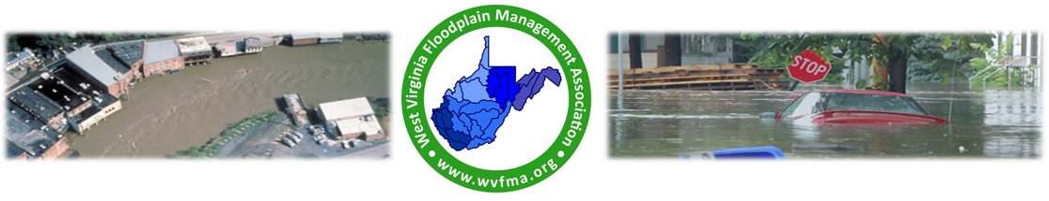
AI Technology & Flooding
Enhancing Resilience, Prediction, and Response
WV Floodplain Management Association Conference
June 2025

Slide 2

Why We’re Here
Flooding is WV’s most common hazard.
Traditional tools lack real-time decision support.
AI offers faster, smarter insights.

Slide 3

Agenda
• Why AI?
• Real-World Examples
• Tools We Can Use
• Challenges & Next Steps

Slide 4
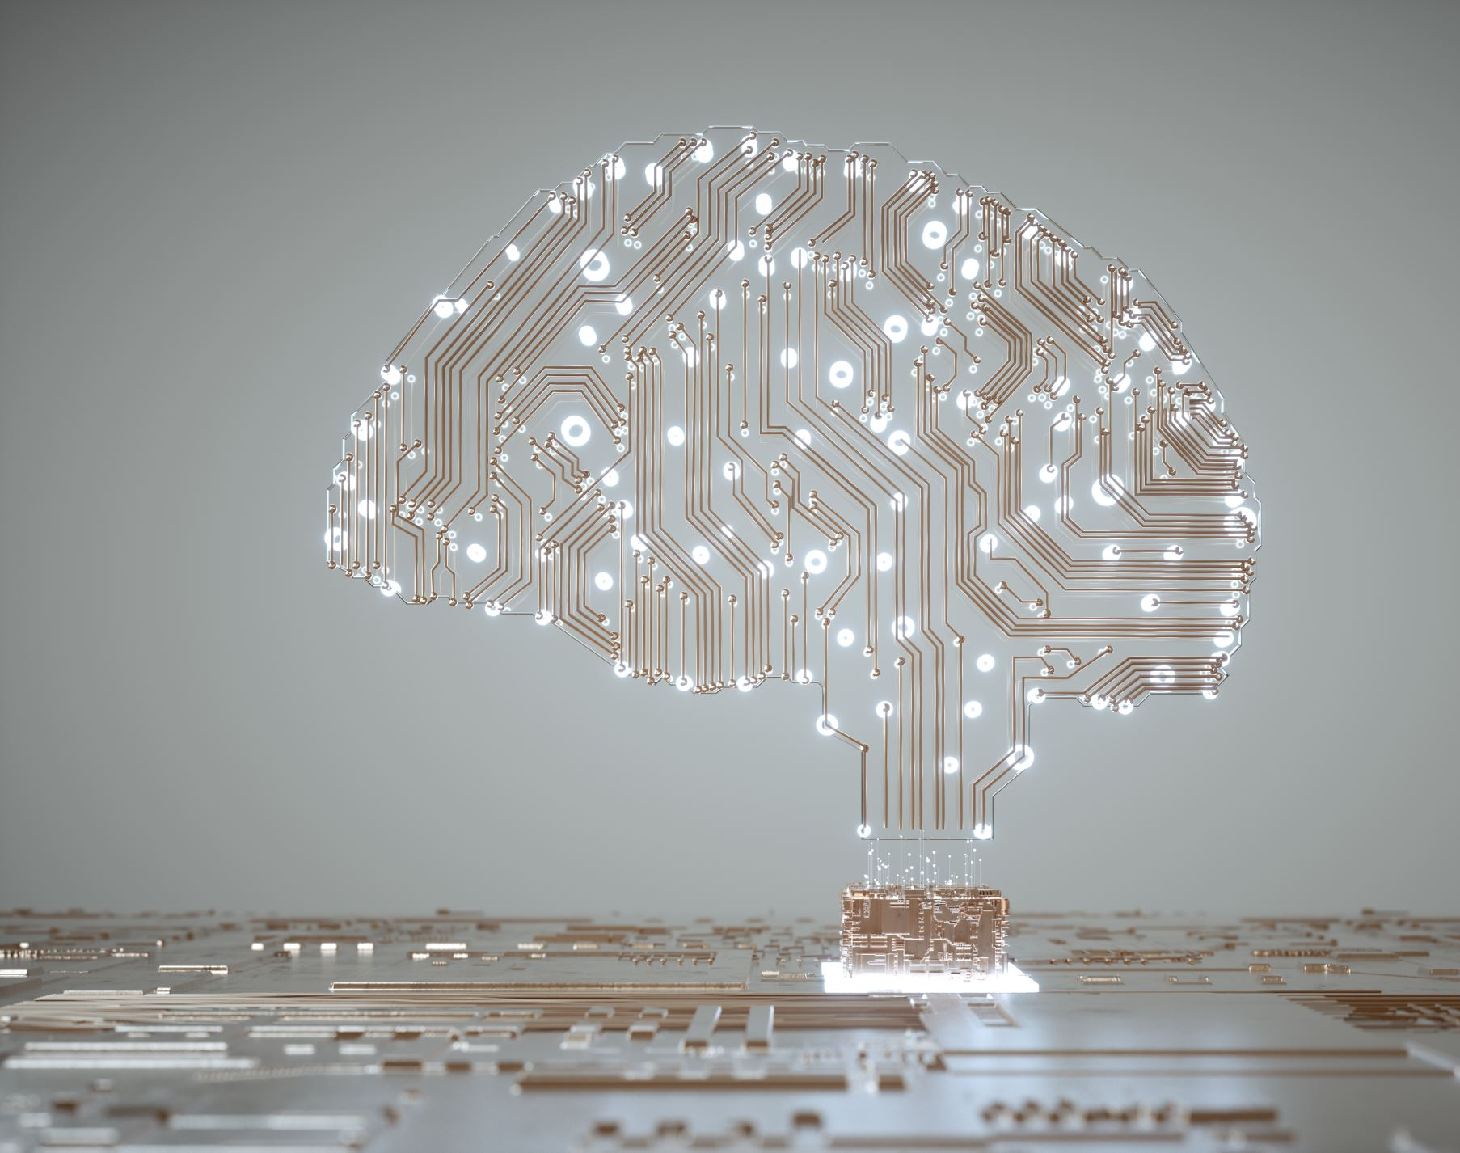
What is AI?
Definition of AI
Types of AI: Narrow AI and General AI
Everyday Interaction with AI
Notes:
Artificial Intelligence, or AI, is the field of computer science that focuses on creating systems capable of performing tasks that normally require human intelligence. These tasks include things like visual perception, speech recognition, decision-making, and language translation.
AI systems are designed to mimic human cognitive functions. The goal is to build machines that can perform complex tasks with a level of autonomy.
There are two main types of AI:
Narrow AI (Weak AI): This type of AI is designed to perform a specific task, like facial recognition or internet searches. Siri and Alexa are examples of Narrow AI. These systems are highly specialized and cannot perform tasks outside their designated functions.
2. General AI (Strong AI): General AI refers to systems that possess the ability to perform any intellectual task that a human can. It would have generalized human cognitive abilities. This level of AI remains theoretical and has not yet been achieved.
Everyday Interaction:
You interact with AI more often than you might think. For example, every time you use Google, ask Siri a question, or get a recommendation on Netflix, you’re interacting with AI systems designed to enhance your experience by understanding your preferences.

Slide 5

How AI Works Behind the Scenes
Machine Learning
Natural Language Processing (NLP)
Computer Vision
Notes:
Talking Points:
• Machine Learning is a subset of AI that involves training algorithms on large datasets to recognize patterns and make decisions. It’s like teaching a machine to learn from experience. For example, spam filters in your email use machine learning to identify and block unwanted messages.
• Machine Learning models improve over time as they process more data. This is why services like predictive text or recommendation engines become more accurate the more you use them.
• NLP enables AI to understand, interpret, and generate human language. This is what powers chatbots, voice assistants like Alexa, and even translation services. For instance, when you speak to Siri, NLP processes your words, understands the intent, and responds appropriately.
• An example of NLP in action is sentiment analysis, which can assess whether the tone of a written review is positive or negative.
• Computer Vision allows machines to interpret visual information from the world, such as recognizing faces in a photo or identifying objects in a video. This technology is essential for applications like facial recognition on your phone or for autonomous vehicles navigating through traffic.
• For example, Google Photos uses computer vision to automatically categorize your pictures based on the objects and people in them.

Slide 6

AI in Daily Life – Home and Personal Devices
Voice Assistants (e.g., Siri, Alexa)
Streaming Services (e.g., Netflix, Spotify)
Smart Home Devices
Notes:
• Devices like Siri on your iPhone or Alexa in your home are powered by AI. These systems use voice recognition to understand and respond to your commands. For instance, you might ask Alexa to play a song, and it quickly retrieves and plays your requested track.
• Voice assistants also learn over time. They adapt to your speech patterns and preferences, improving their accuracy and usefulness with each interaction.
• Netflix and Spotify use AI algorithms to recommend content. When you finish watching a show, Netflix suggests others based on your viewing history, which is analyzed by AI to predict what you might enjoy next.
• These recommendations are constantly refined as you continue to use the service, creating a highly personalized experience.
• Smart thermostats like Nest use AI to learn your heating and cooling preferences over time, automatically adjusting to save energy and maintain comfort.
• Security systems with AI can distinguish between regular visitors and potential intruders, sending you alerts only when necessary.

Slide 7
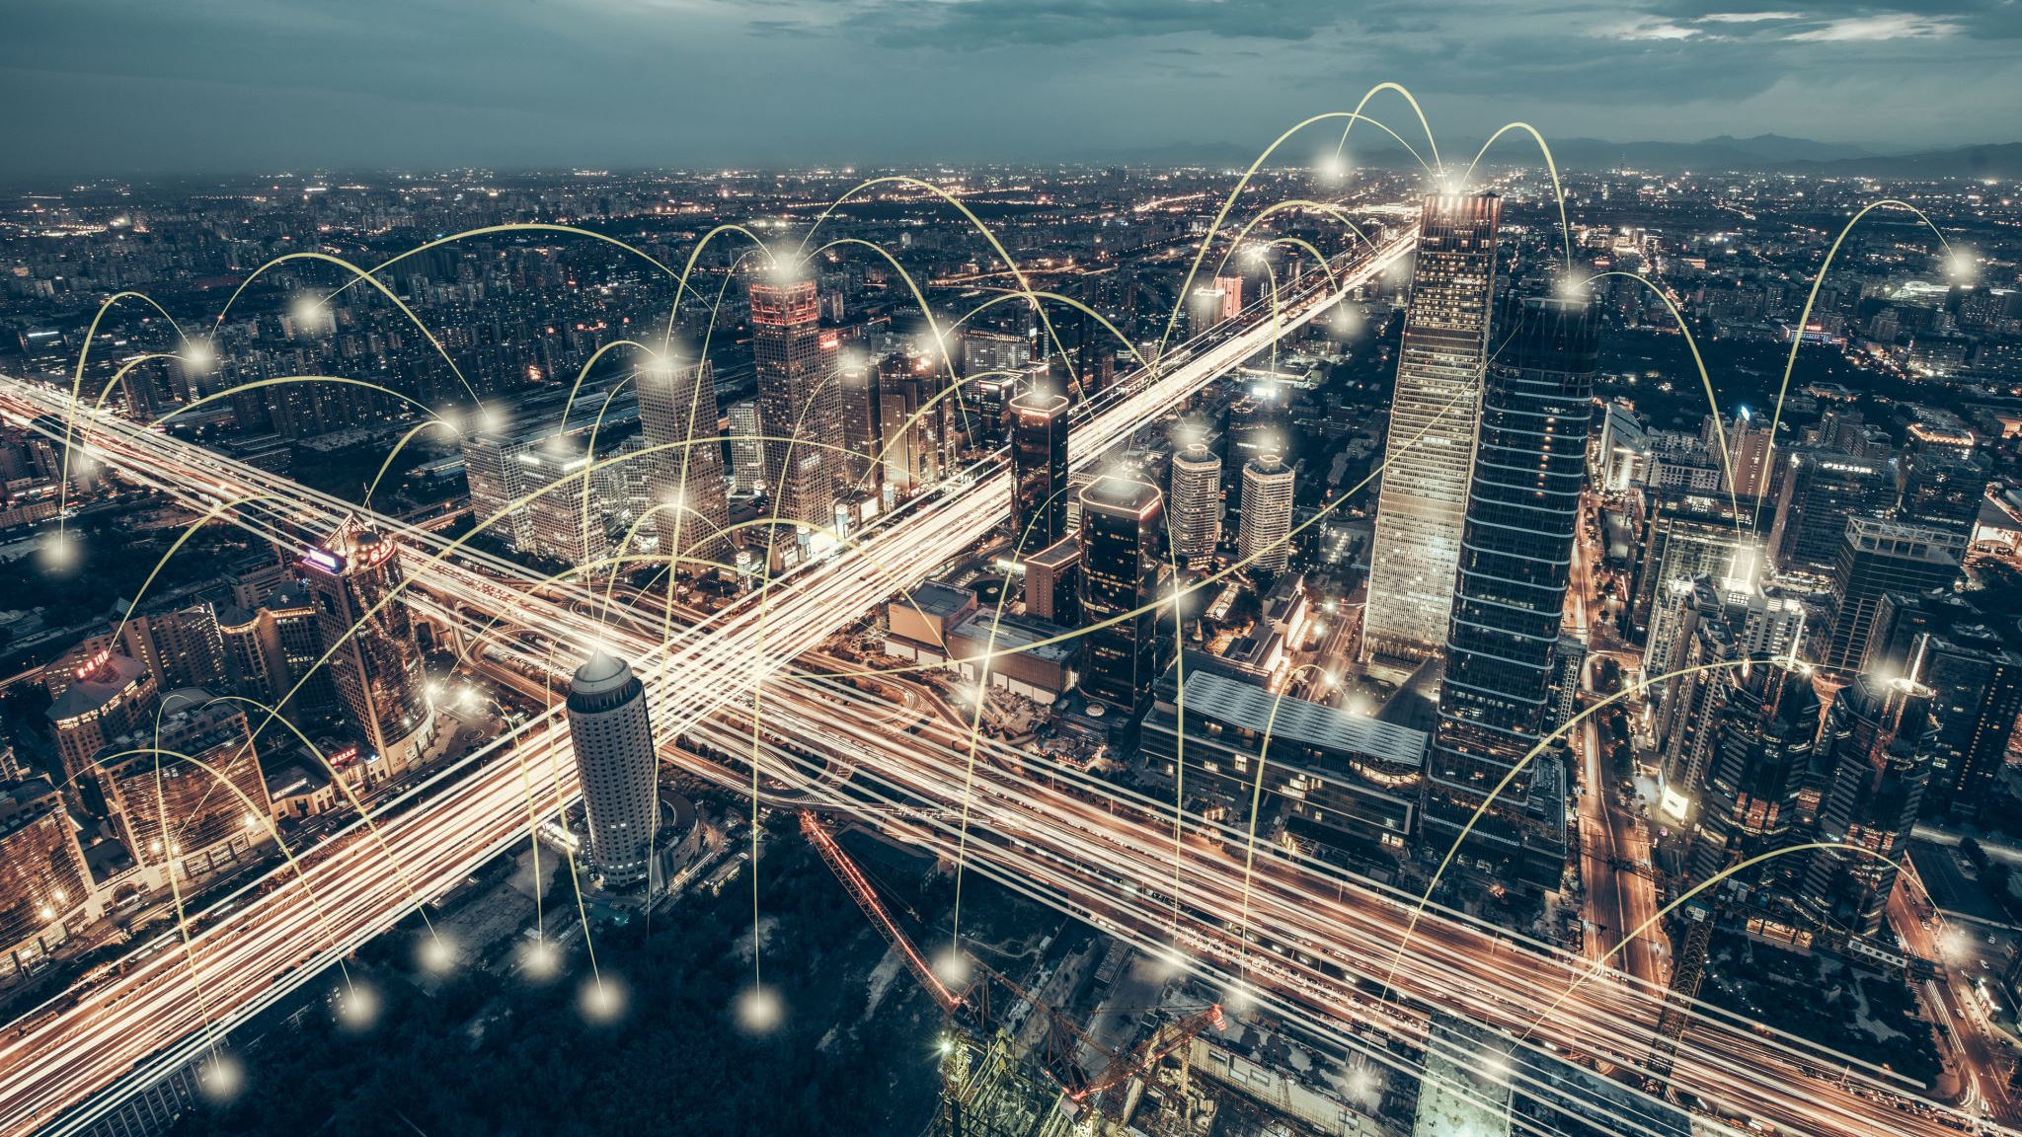
AI in Daily Life – Online and Social Media
Search Engines
Social Media
E-commerce
Notes:
• “When you type a query into Google, AI algorithms determine which results are most relevant to you. These algorithms consider factors like your search history, location, and even the time of day to rank results.”
• “For instance, if you often search for restaurants, Google might prioritize local eateries in your results.”
• “Platforms like Facebook and Twitter use AI to curate your newsfeed. The AI analyzes your interactions—such as likes, shares, and comments—to show you more of the content that keeps you engaged.”
• “This personalization can create echo chambers, where you predominantly see content that aligns with your views, potentially limiting exposure to diverse perspectives.”
• “Amazon and other online retailers use AI to recommend products. If you’ve ever noticed that the site seems to know exactly what you’re looking for, that’s AI at work, analyzing your previous purchases and browsing history.”
• “Chatbots in customer service are another example. They use AI to answer common questions, helping to streamline the shopping experience.”

Slide 8

AI in Daily Life – Transportation and Navigation
GPS and Navigation (e.g., Google Maps, Waze)
Ride-Sharing Services (e.g., Uber, Lyft)
Autonomous Vehicles
Notes:
• “Applications like Google Maps and Waze rely on AI to provide real-time traffic updates, suggest faster routes, and even predict travel times. The AI analyzes data from millions of users to identify traffic patterns and road conditions.”
• “For example, if there’s a traffic jam on your usual route home, Google Maps might reroute you to avoid delays.”
• “Uber and Lyft use AI to match drivers with passengers. The AI takes into account the driver’s location, traffic conditions, and the passenger’s destination to find the optimal match.”
• “AI also helps in dynamic pricing, where the cost of a ride increases during high-demand periods, such as rush hour or bad weather.”
• “Self-driving cars are one of the most ambitious applications of AI. These vehicles use AI to process data from cameras, sensors, and GPS to navigate roads, avoid obstacles, and make decisions in real-time.”
• “While fully autonomous vehicles are still in development, they represent the future of transportation, promising to reduce accidents and improve traffic efficiency.”

Slide 9

Why AI? Why Now?
More data + more weather volatility = greater risk.
AI enables real-time processing of radar, sensors, satellite, and social media.

Slide 10

What AI Brings to Flood Management
• NIWA: Flood forecasts in 1–2 minutes
• Google: 7-day flood forecasts in 80+ countries
Link

Slide 11
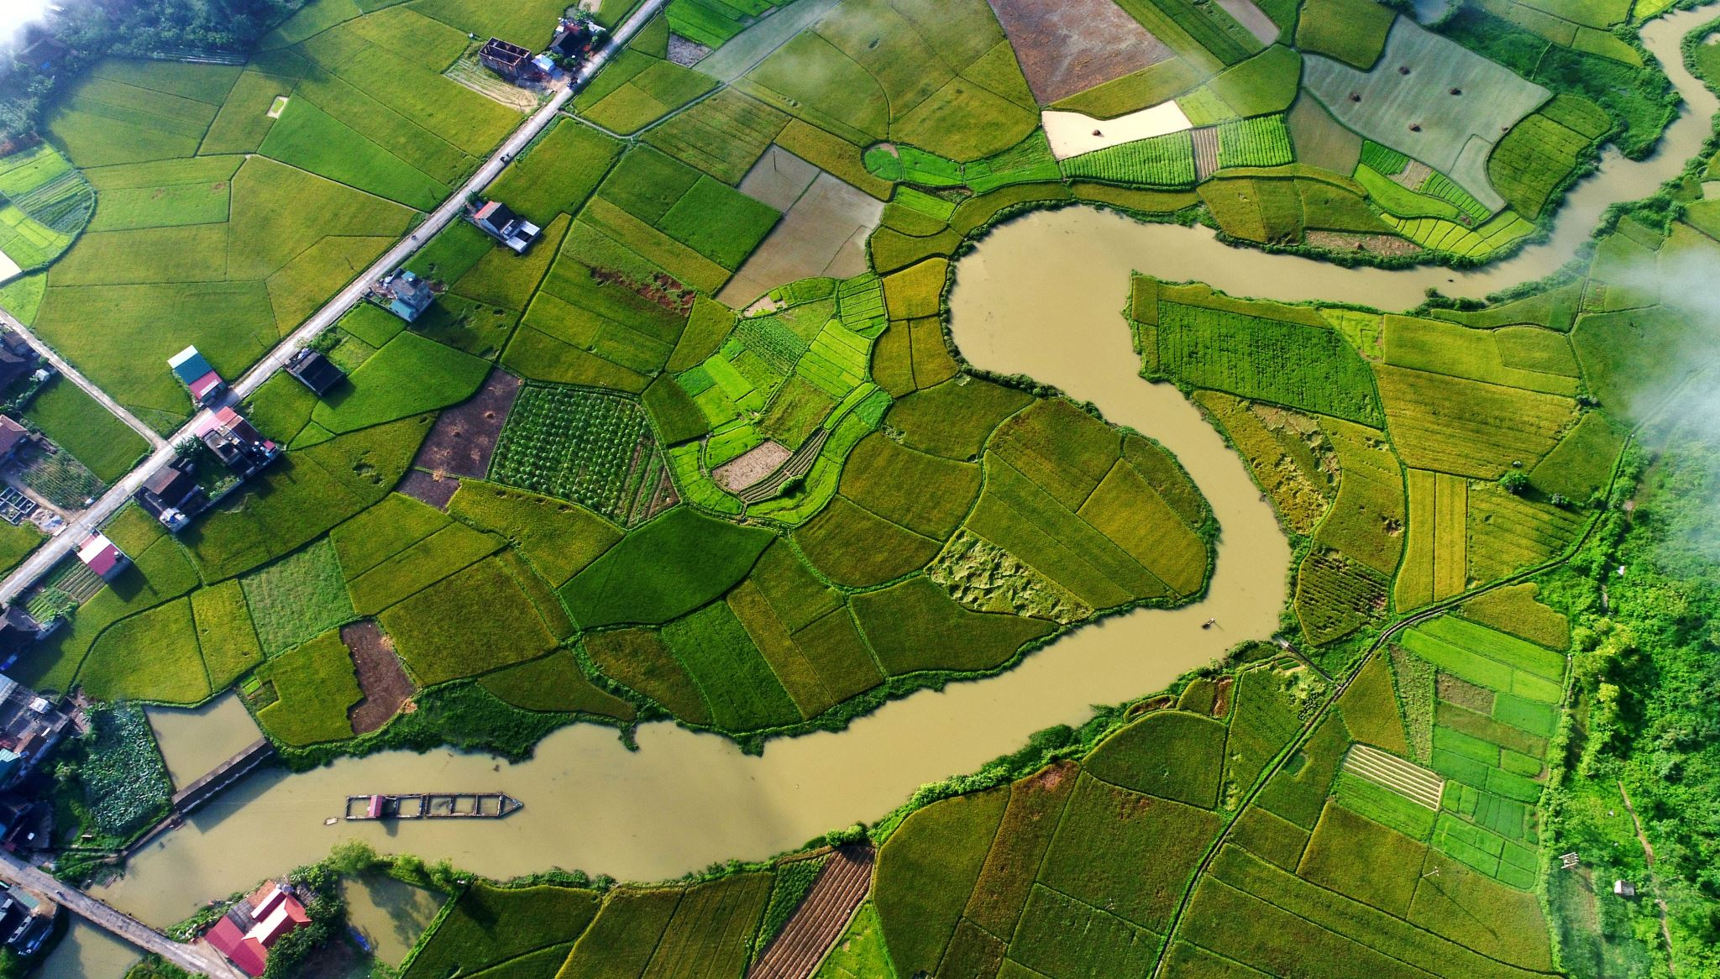
Google Flood Forecasting Overview
Launched in India, now covers Africa, Asia, Latin America
Over 100M alerts sent
Live Tool

Slide 12

How It Works
Uses LSTM & Manifold Learning models
Trained per river basin using satellite and river gauge data

Slide 13
India/Bangladesh Case Study
2021: 350M+ people reached
Alerts sent via SMS, YouTube, Maps, and Android push

Slide 14
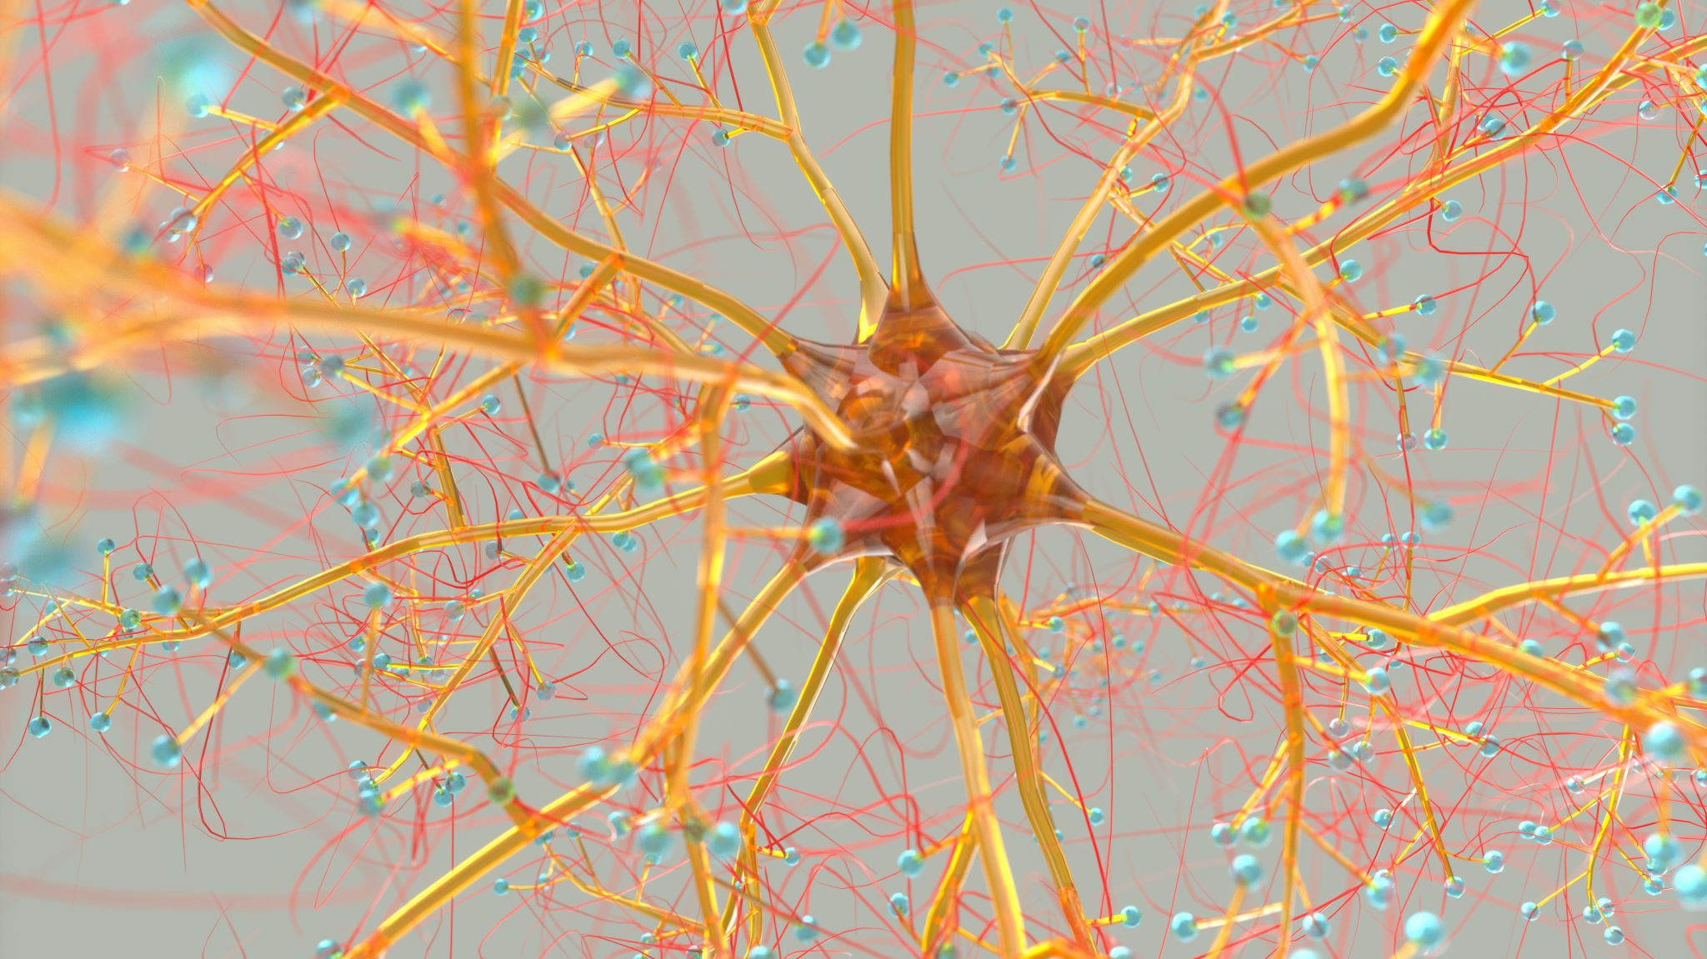
NeuralFlood Example
County-level susceptibility mapping (~87% accuracy)
Link: https://www.frontiersin.org/journals/water/articles/10.3389/frwa.2023.1291305/full

Slide 15

Takeaway: AI = Faster, Smarter, Broader
Real-time, scalable, and supports human decision-making

Slide 16

West Virginia’s Current Tools
WV Flood Tool: FEMA NFHL + LiDAR + parcel risk
WV Flood Tool Link

Slide 17
WV Flood Tool + AI Potential
Add predictive overlays for 10-year or 50-year events
Real-time simulation and alerting possible

Slide 18

Digital Twin Flood Modeling
Alzette Basin (Luxembourg): daily updated 3D flood model
Link
Can be adapted for WV watersheds

Slide 19

Data Needed to Get Started
Rainfall, elevation, stream gauges, land use, soil data
WV GIS Tech Center, FEMA, WVU = key partners

Slide 20
What AI Can’t Do (Yet)
Does not predict dam/levee failures or underground drainage collapse
Still requires expert validation

Slide 21
Explainability and Trust
Complex models = difficult to interpret
Use NIST AI RMF for transparent AI practices
Link: https://www.nist.gov/itl/ai-risk-management-framework

Slide 22

Resource Constraints
AI requires data, compute, skills
Use cloud platforms like Google Earth Engine
Link: https://earthengine.google.com/

Slide 23

Ethical and Equity Considerations
Ensure rural and vulnerable communities are not excluded
AI should be used transparently and inclusively

Slide 24

Summary of Use Cases
• Google Flood Forecasting
• NeuralFlood risk mapping
• Urban flash flood AI
• WV Flood Tool enhancements

Slide 25

Key Takeaways
AI is already being used effectively worldwide
WV is well-positioned to take advantage
Let’s lead in AI-enhanced flood resilience

Slide 26

Discussion & Q&A
What are your local data resources?
What challenges do you face in flood planning?
Are you interested in pilot projects?

Slide 27


My Contact Information
Matt Gregg
wv8mat@icloud.com
304-460-5913

