Slide 1
HAZARD MITIGATION PLANNING Lessons from 20+ Years of Writing Plans
West Virginia Floodplain Managers Association
2025 Conference ~ June 13, 2025

Slide 2
AGENDA
Intra-Cycle Planning Process
Expirations
Lessons
Regulations & Guidance
HMP Scope
Where do the data come from?
“Plan to Plan” Coordination
Engagement vs. Extraction
So what?
Q&A

Slide 3
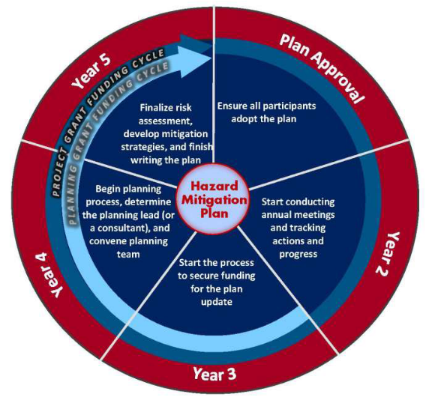
Intra-Cycle Planning Process
General
Plans require updates and re-adoption every five years.
“The Wheel” identifies other activities that can support a more robust hazard mitigation program.
Annual meetings
Secure funding
Leave time for a thorough planning process!

Slide 4
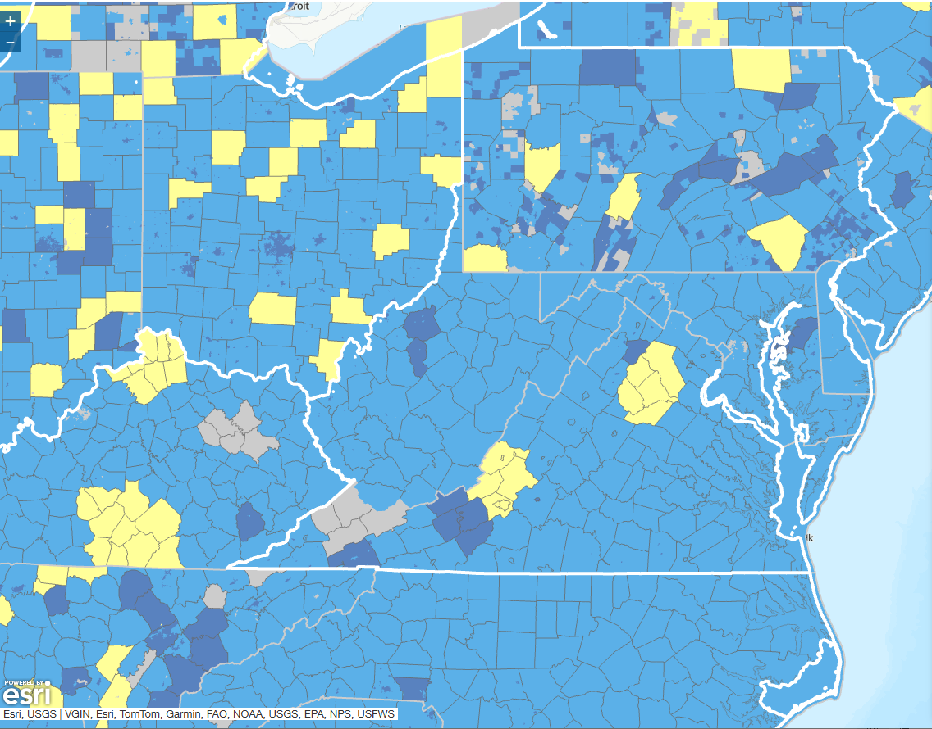
Expirations
Region 1: 08/09/2027
Region 2: 09/05/2029
Region 3: 10/19/2027
Region 4: 09/06/2027
Region 5: 01/12/2028
Region 6: 08/12/2029
Region 7: 04/02/2029
Region 8: 08/26/2029
Region 9: 01/31/2027
Region 10: 11/08/2027
Region 11: 08/11/2029
Jefferson County: 07/17/2029
National Status Map: https://www.fema.gov/emergency-managers/risk-management/hazard-mitigation-planning/status
Notes:
Latest WV State Plan: October 2023

Slide 5
LESSONS

Slide 6
Lesson 1: Change is Inevitable (Regulations & Guidance)
Robert T. Stafford Disaster Relief & Emergency Assistance Act
National Flood Insurance Program (NFIP)
High Hazard Potential Dams (HHPD) Program
FEMA Policy 104-008-7 (Note Items B.1.b and B.2.d related to the HMP as an eligibility criterion)
Local Mitigation Planning Policy Guide, FP-206-21-002 (effective April 11, 2025)
Local Mitigation Planning Handbook (June 2025)
Notes:
Regulations
Recommended pre-2002/2003, but then an approved/adopted plan was tied to funding
Ebb and flow for municipal requirements for multi-jurisdictional plans
NFIP has been a part of it, but as plan updating cycles have come and gone, there’s become more and more need to integrate what a community does to manage the NFIP into the plans
Not just that you participate, but need to detail how you participate
What’s in the FP ordinance?
How is it made available?
What types of technical assistance do you make available?
How do you enforce it, from permitting through monitoring construction?
What’s your education program for your community’s NFIP look like?
Addition of high-hazard dams
Guidance
2002 to 2013: How-to Series
2013: First comprehensive local mitigation planning guide (in place through 2023)
2022: Policy guidance issued
2023: New local mitigation planning handbook
2025: New policy guidance (rescinding portions of the 2023 update) led to updated local mitigation planning handbook (released last week!)
Loose Summary of Changes in the Policy Guide and Latest LMPH
A2-a. The plan is not required to include organizations that “work directly with and/or provide support to underserved communities and socially vulnerable populations, among others.”
A3-a. The plan is not required to include “underserved communities.”
B1-e. The plan is not required to include “climate change (e.g., long-term weather patterns, average temperature and sea levels).”
B2-a. The plan is not required to include “underserved communities and socially vulnerable populations.”
B2-b. The plan is not required to describe “the effects of climate change” or “the makeup of socially vulnerable populations.”
C4-a. The plan is not required to include mitigation actions that “benefit underserved communities and socially vulnerable populations.”
E1-a. The plan is not required to include “climate change” or “shifts in the needs of underserved communities or gaps in social equity.”
You may include these elements since it has always been the case that a local jurisdiction can go beyond applicable FEMA mitigation planning requirements, but they will not be reviewed by FEMA.
Resources
Stafford Act: https://www.fema.gov/disaster/stafford-act
NFIP Requirements in the HMP: See Section 5.3 within the Local Mitigation Planning Handbook
HHPD: https://www.fema.gov/grants/mitigation/learn/dam-safety/rehabilitation-high-hazard-potential-dams
FP-206-21-002: https://www.fema.gov/sites/default/files/documents/fema_hmd_local-mitigation-planning-policy-guide_2025.pdf
Local Mitigation Planning Handbook: https://www.fema.gov/sites/default/files/documents/fema_hmd_2025-local-mitigation-planning-handbook_06122025.pdf

Slide 7
Lesson 2: Words Matter…and So Do Numbers (HMP Scope)
New Buzz Phrase: “Mitigation planning is risk-informed decision making” (FEMA, 2025, p. 5).
What has to be in the hazard mitigation plan?
Risk assessment → Here’s the data. The risk assessment is the tool that informs you of the risk to support your decision making.
Action plan → What are you going to do about that risk? These projects are evidence of the decisions you’ve made.
Can include identifying areas where you need additional information
Can include folding more or new partners into the process
Does include the process you’ll use to keep the plan current
Notes:
Hazard mitigation is any sustained action taken to reduce or eliminate long-term risk to life and property from hazards.
You will often hear “reduce or eliminate loss” as a definition of mitigation.
What is it that we’re trying to achieve with mitigation? I have recently advocated for the term risk-reduction when talking about the goals, borrowing the term more from the insurance industry than from the previous two versions of the local mitigation planning handbook. Further, let’s dive a bit more into “risk-informed decision making”. (And this is where we can move to the risk assessment discussion.)

Slide 8

Notes:
Requirement: Natural Hazards
More than flooding!
Be creative! Push yourself beyond risk-informed decision making associated with more than just the natural hazards.
Usual Suspects: Hazmat, Urban Fire, Radiological, Transportation Incidents, Civil Disturbance
Think about the interaction between these hazards…rarely do they occur in a vacuum! When you allow yourself to break out from neat definitions of the hazards, it becomes easier to examine how they unfold and what contributes to your risk.

Slide 9
Lesson 3: Speaking of the Numbers…They’re All Around Us (Now, where do the data come from?)

Slide 10

Notes:
Here’s an image of what many of us think of when we hear things like “data analysis,” “statistics,” “formulas,” etc.
And yes, there is a lot of available quantitative data to support the descriptions of the hazards and our risks.
Loss figures (dollars and lives)
Magnitudes and other severity indicators
Probabilities
Estimators
Exposures (property values, assessed values, National Risk Index, etc.)
Simple means and averages
Comparisons
Even in some cases, you might see high-brow statistics like regression analyses (though these would most likely be cited by a mitigation plan, not calculated as part of one)
These types of data enhance a mitigation plan, but here’s the secret (and, thus, the lesson). These numbers really can’t tell the whole story.

Slide 11

Notes:
For the whole story, what’s in your head is necessary.
Rich, qualitative data
Get at the nuance associated with what actually happens
The QL pieces can be the selling points when the numbers don’t quite get it there
Telling the story can reveal potential projects
Listening to stories can push you beyond your default thinking

Slide 12
Lesson 4: Tap Into the Potential for Layering Plans (“Plan to Plan” Coordination)
Multi-Jurisdictional Plan
Benefits
Cost-effective
Cross-boundary consideration of risk
Allows for the identification of collaborative, inter-jurisdictional mitigation actions
Cons
Sacrifice a level of detail
Balcony-level descriptions and aggregated data are less useful for tactical decision making
It’s not just the hazard mitigation plan!
Comprehensive, land use, community and economic development, transportation, stormwater management, source water protection…
Notes:
Key Point: Congruence between plans. Don’t be so siloed that you are unaware of what other planning initiatives suggest. Be mindful of the implications of what those other plans suggest.
EX: If an economic development entity wants to develop parcels that are known to be at risk to a hazard, the conversation doesn’t always have to be about not developing there. Layering the plans helps partners understand that, perhaps for this hazard, part of the development plan needs to include resilient construction. For other hazards, avoidance may be the best course of action.
Putting this into practice requires you to ask a lot of questions, talk to a lot of people, etc.

Slide 13
“Plan to Plan” Coordination (cont.)
VERTICAL INTEGRATION
State Plan
Regional (Your) Plans
HORIZONAL INTEGRATION
Your Plans
Your Neighbor’s Plans
Other Community Plans
Notes:
Key Point: Think about the congruence of your plans with others that are on the horizontal axis, but also be mindful of how your plans will likely feed content to plans “higher” than yours. Conversely, look to plans “lower” than yours for ideas.

Slide 14

Lesson 5: It Really Is About the People (Engagement vs. Extraction)
Notes:
Curiosity is under-rated.

Slide 15
So what?
YOU are the emissary.
Notes:
YOU are the emissary.
In West Virginia, most of the impacts are from flooding, and you are the ones that understand it (perhaps) as much as anyone in your community. You carry the message of mitigation and risk reduction to your constituents. You carry it to your boards and supervisors. In the planning process, you carry it to the PDC and the planner working on the document.

Slide 16
So what?
YOU are the emissary.
Your stories matter as much as your data.
Notes:
YOU are the emissary.
In West Virginia, most of the impacts are from flooding, and you are the ones that understand it (perhaps) as much as anyone in your community. You carry the message of mitigation and risk reduction to your constituents. You carry it to your boards and supervisors. In the planning process, you carry it to the PDC and the planner working on the document.
Your stories matter as much as your data.
Numbers tell a story. We all guess that a higher dollar in the “losses” category equals a “bigger” or “worse” event. When we calculate risk reduction, those numbers are important. But your words sell the point. Huge losses are more devastating when you put a face with them. When you contextualize them.

Slide 17
So what?
YOU are the emissary.
Your stories matter as much as your data.
But don’t forget about that data!
Notes:
YOU are the emissary.
In West Virginia, most of the impacts are from flooding, and you are the ones that understand it (perhaps) as much as anyone in your community. You carry the message of mitigation and risk reduction to your constituents. You carry it to your boards and supervisors. In the planning process, you carry it to the PDC and the planner working on the document.
Your stories matter as much as your data.
Numbers tell a story. We all guess that a higher dollar in the “losses” category equals a “bigger” or “worse” event. When we calculate risk reduction, those numbers are important. But your words sell the point. Huge losses are more devastating when you put a face with them. When you contextualize them.
But don’t forget about that data!
It’s not just having the numbers available. It’s about accuracy. It’s being mindful that you’ll need the numbers, but it’s sometimes difficult (if not impossible) to get them after the fact.

Slide 18
So what?
YOU are the emissary.
Your stories matter as much as your data.
But don’t forget about that data!
Learn to think in terms of data.
Notes:
YOU are the emissary.
In West Virginia, most of the impacts are from flooding, and you are the ones that understand it (perhaps) as much as anyone in your community. You carry the message of mitigation and risk reduction to your constituents. You carry it to your boards and supervisors. In the planning process, you carry it to the PDC and the planner working on the document.
Your stories matter as much as your data.
Numbers tell a story. We all guess that a higher dollar in the “losses” category equals a “bigger” or “worse” event. When we calculate risk reduction, those numbers are important. But your words sell the point. Huge losses are more devastating when you put a face with them. When you contextualize them.
But don’t forget about that data!
It’s not just having the numbers available. It’s about accuracy. It’s being mindful that you’ll need the numbers, but it’s sometimes difficult (if not impossible) to get them after the fact.

Slide 19
So what?
YOU are the emissary.
Your stories matter as much as your data.
But don’t forget about that data!
Learn to think in terms of data.
Just participate!
Notes:
YOU are the emissary.
In West Virginia, most of the impacts are from flooding, and you are the ones that understand it (perhaps) as much as anyone in your community. You carry the message of mitigation and risk reduction to your constituents. You carry it to your boards and supervisors. In the planning process, you carry it to the PDC and the planner working on the document.
Your stories matter as much as your data.
Numbers tell a story. We all guess that a higher dollar in the “losses” category equals a “bigger” or “worse” event. When we calculate risk reduction, those numbers are important. But your words sell the point. Huge losses are more devastating when you put a face with them. When you contextualize them.
But don’t forget about that data!
It’s not just having the numbers available. It’s about accuracy. It’s being mindful that you’ll need the numbers, but it’s sometimes difficult (if not impossible) to get them after the fact.
Learn to think in terms of data.
No, I don’t mean grow into your inner nerd (unless that’s your thing). Train yourself to see connections between data. Start asking questions about what data you need or want. Be curious about proxies.
Just participate!
None of this means anything if you don’t show up and be a part of the process.

Slide 20





THANK YOU!
Dr. Jeffery W. Harvey, CEM
jharvey@jhcpreparedness.com or jefferyharvey@ucwv.edu
304-473-1009 (o) or 304-613-5292 (c)
Jeffery Harvey
@JHConsultingLLC
@jwharvey1978
@findjeffness.bsky.social

