Slide 1
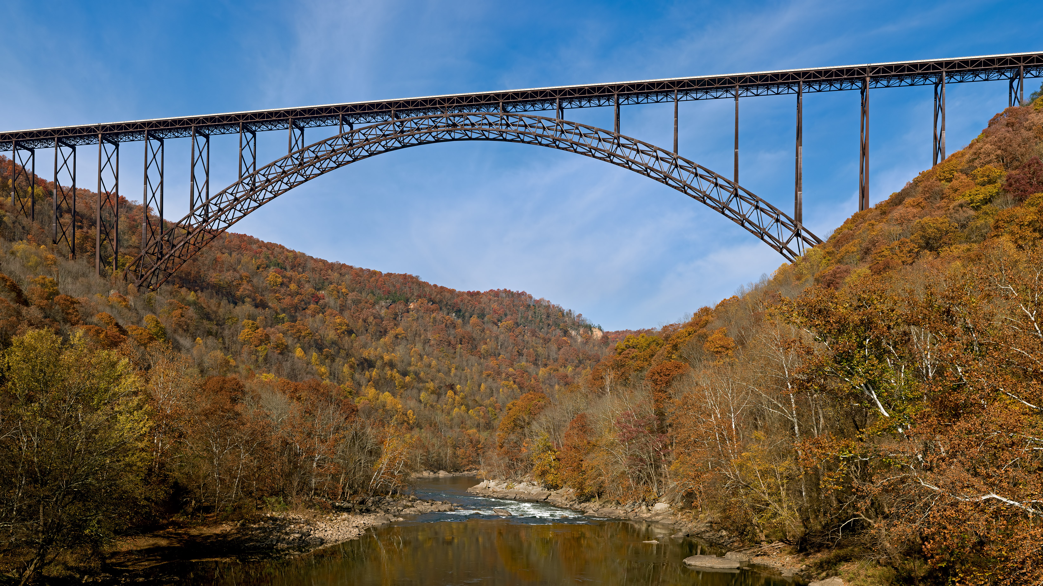
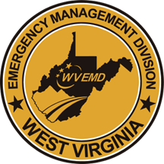
Hazard Mitigation
Notes:
Title slide + Image Option 2

Slide 2
“While natural disasters capture headlines and national attention short-term, the work of recovery and rebuilding is long-term.”
-Sylvia Mathews Burwell
“An ounce of prevention is worth a pound of cure.”
-Benjamin Franklin

Slide 3
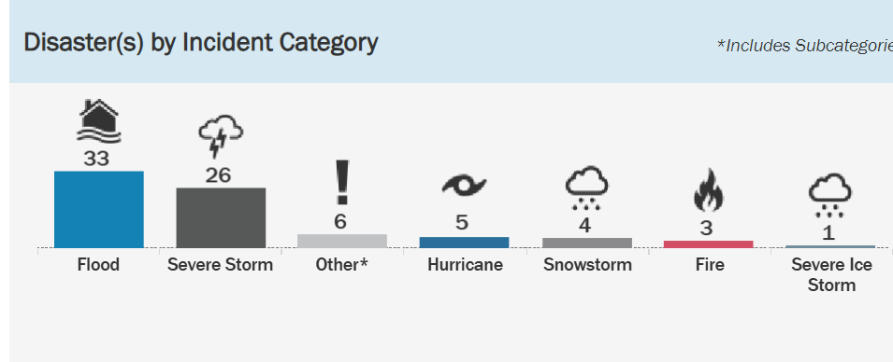
West Virginia Disaster Declaration History
Incidents can occur any month of the year.
Based on historical data, the months of March, May and August have recorded the highest number of incidents in West Virginia since 1954.

Slide 4
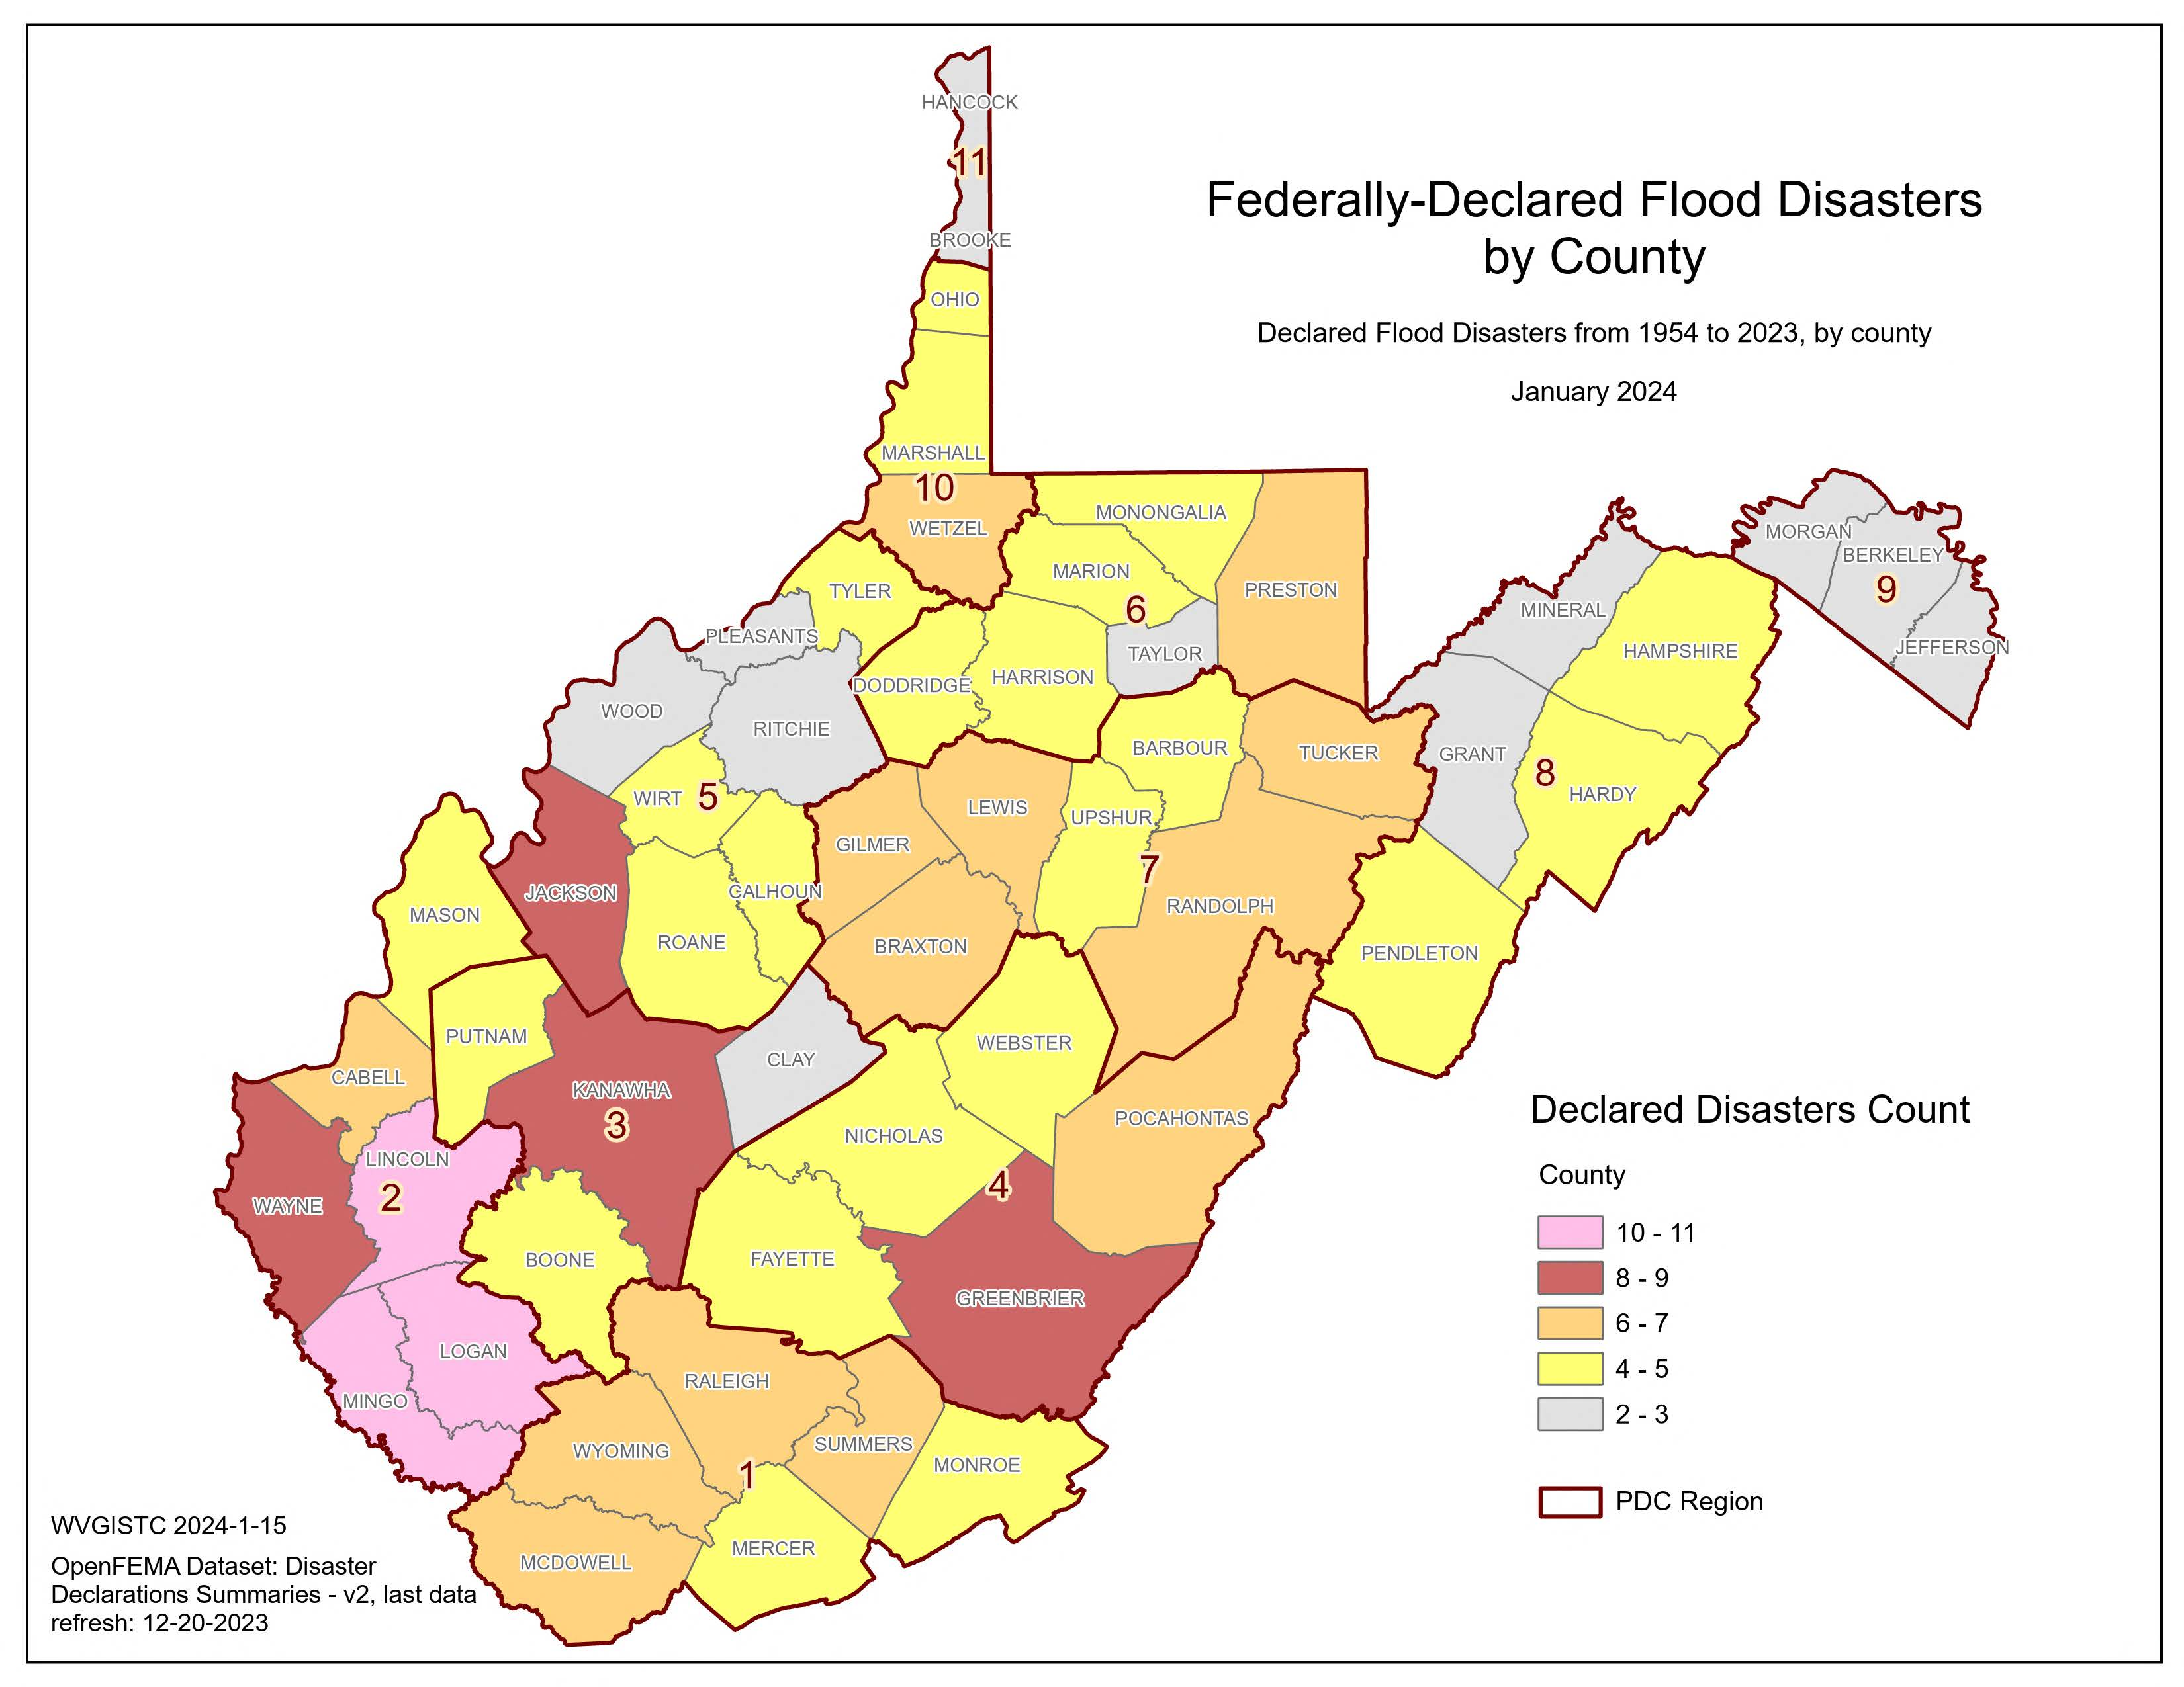
WV Top 10 Disaster Counties
County | No. of Declarations
Mingo | 11
Lincoln | 10
Logan | 10
Wayne | 9
Greenbrier | 9
Kanawha | 8
Jackson | 8
Cabell | 7
Randolph | 7
Wyoming | 7

Slide 5
Major Disaster Declarations in West Virginia
Disaster | Declaration Date | Mit Obligation
DR-4273 | June 25,2016 | $35,675,205.16
DR-4331 | August 18, 2017 | $2,682,701.63
DR-4359 | April 17, 2018 | $2,813,086.31
DR-4378 | July 12, 2018 | $162,949.00
DR-4455 | August 3, 2019 | $393,248.75
DR-4517 (COVD) | April 3, 2020 | $646,452.00
DR-4603 | May 13, 2021 | $115,953.00
DR-4605 | May 20,2021 | $114,953.00
DR-4678 | November 28, 2022 | $72,707.00
DR-4679 | November 28,2022 | $4,455,434.68
DR-4756 | January 30, 2024 | $1,668,243.00
DR-4783 | May 3, 2024 | $4,720,161.00
DR-4787 | May 22, 2024 | $2,635,021.00
DR-4851 | December 9,2024 | $679,650.00
DR-4861 | February 25,2025 | $6,779,101.00

Slide 6
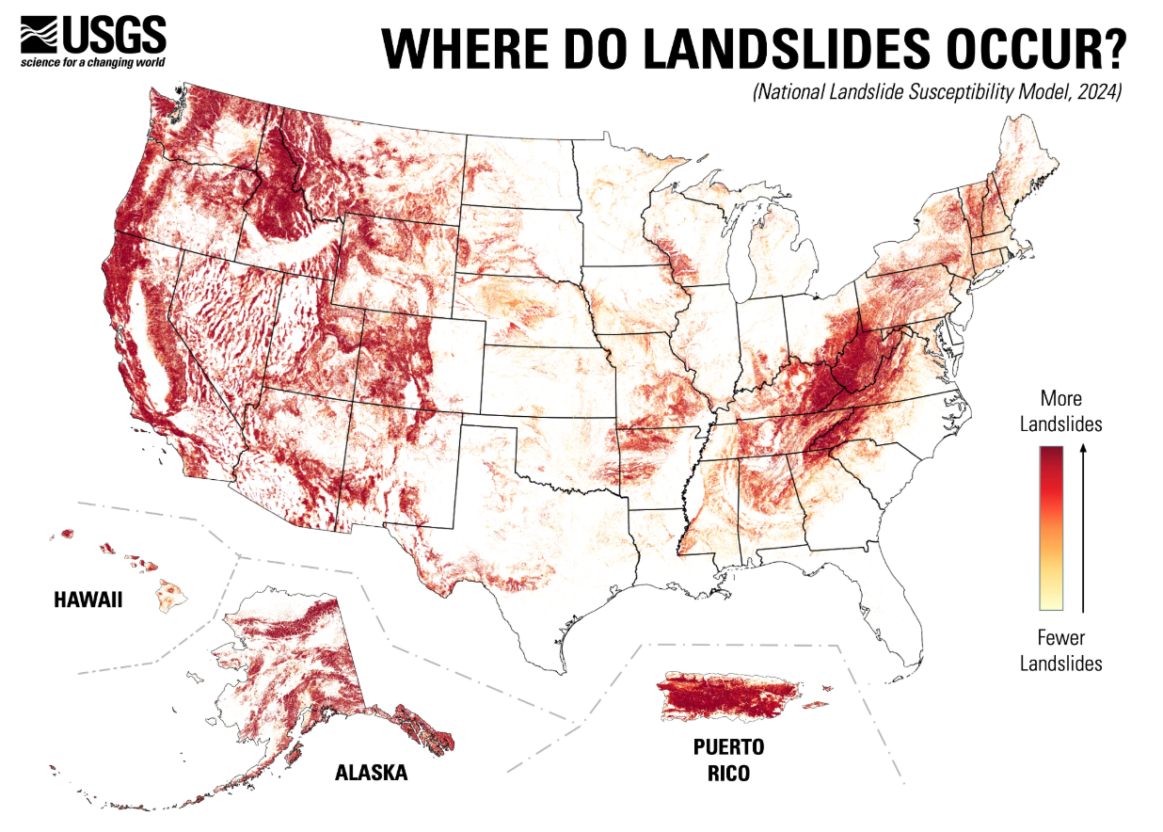
Landslides: Continuing Hazard In West Virginia

Slide 7
Hazard Mitigation Grant Program (HMGP)
This grant funding is available after a presidentially declared disaster and is 15% of the estimated aggregate amounts of disaster assistance provided through Public Assistance and Individual Assistance programs.
State, local, tribal and territorial governments can use the grant to develop hazard mitigation plans or rebuild their communities in a way that reduces, or mitigates, future disaster losses.
Homeowners and businesses cannot apply for a grant. However, a local community may apply for funding on their behalf.
All state, local, tribal and territorial governments must develop and adopt hazard mitigation plans to receive hazard mitigation grant funding.
All WV regions have approved HM plans!

Slide 8
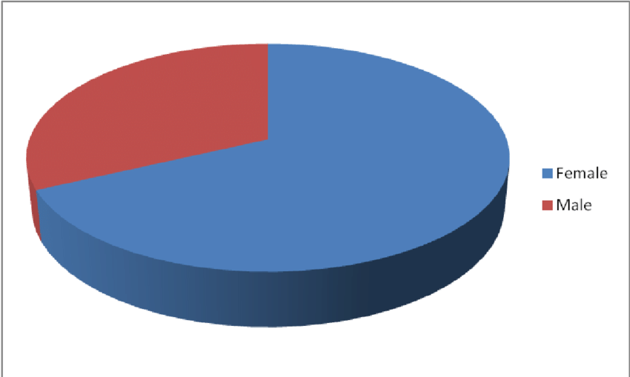
Cost Share Requirement
25%
Non-Federal Cost Share
75%
Federal Cost Share
5 %
Sub-Recipient Management Costs: (SRMC) 100% Federally Funded
The SMRC is 5% of the total project award provided externally of the
project budget and is for sub-recipient grant management activities.
COST SHARE Example: Total project Award $250k ($62,500 Non-Federal Share + $187,500 Federal Share) and SRMC of $12,500 100% Federally funded

Slide 9
Cash vs. In-Kind Services
Cash (Non-federal Identity)
General or Special Levy Tax Revenue
Community Fund Raising
Private Donations
In-Kind
Engineering / Labor / Admin services (Hourly + rate)
Equipment resources (Operating costs)
Materials and Supplies (Cash value)

Slide 10
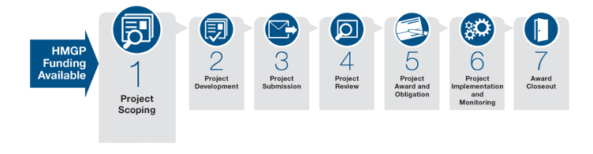
HMA Grant Award Life Cycle

Slide 11
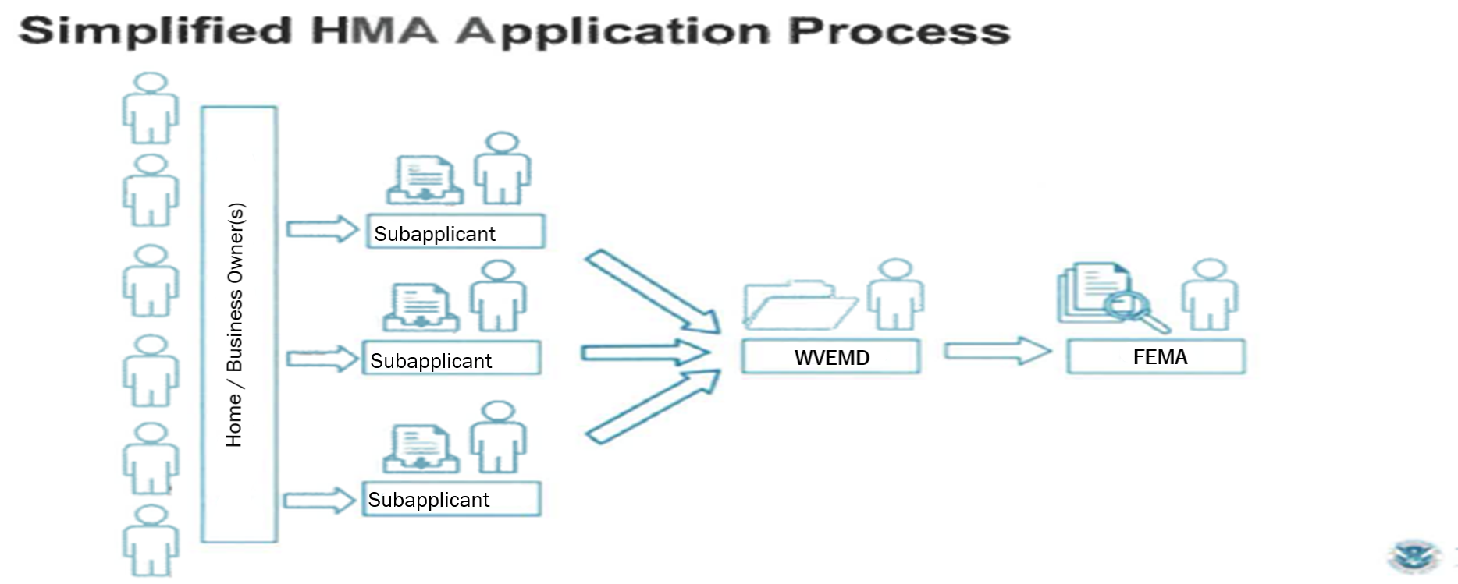
HMA application flow process

Slide 12
Flood Mitigation Assistance (FMA) and Flood Mitigation Assistance Swift Current Grants
FMA is an annual nationwide competitive grant program that provides funding to states, local communities, federally recognized tribes, and territories. Funds can be used for hazard mitigation projects that reduce or eliminate the risk of flood damage to structures insured by the National Flood Insurance Program (NFIP).
Structures must have a history of repetitive or substantial damage from flooding.
Cost share for Repetitive Loss (RL) properties can be 90% Federal/10% Non-Federal share.
Cost share for Severe Repetitive Loss (SRL) properties can be 100% Federal share.
Swift Current is activated following a declared disaster once certain damage thresholds and other criteria have been met. Activation is contingent upon available funding.

Slide 13
Flood Mitigation Assistance (FMA) and Flood Mitigation Assistance Swift Current Grants
Eligibility
The sub-applicant (locality) must be participating in the NFIP and not be withdrawn, on probation, or suspended.
The property and structure identified in the sub-application must have an NFIP policy in effect before, during, and after the mitigation project completes.
The NFIP policy must be maintained throughout the completion of the mitigation project activity and for the life of the building, regardless of flood zone.

Slide 14
Types of Hazard Mitigation Projects
Acquisition/Demolition projects involves the community or other eligible entity purchasing homes and/or commercial structures and the underlying property, demolishing all structures, and maintaining the property as open space in perpetuity.
Elevation projects allow a home or structure to be raised so potential floodwaters may flow underneath.
Flood Control/Flood risk reduction projects are designed to eliminate or reduce the frequency and extent of flood events. Flood sources for these projects could be riverine or rainfall events or a combination of those sources. This can include projects involving greenspace, water control systems such as channels or berms or other flood prevention projects which reduce flooding impacts to homes and communities. This can also include warning systems.

Slide 15
Types of Hazard Mitigation Projects
Hazard Mitigation Plan Updates includes requests to update or develop Hazard Mitigation Plans.
Mitigation Reconstruction is the construction of an improved, elevated building on the same site where an existing building and/or foundation has been partially or completely demolished or destroyed. These activities include either total or partial demolition of the structure and result in the construction of code-compliant and hazard-resistant structures on elevated foundation systems.
Project Scoping (Engineering, Environmental, Feasibility, and/or Benefit-Cost Analysis) are projects that include environmental analysis and cost determination of future risk reduction benefits of a hazard mitigation project. Activities designed to develop mitigation strategies and obtain data to prioritize, select, and develop complete applications in a timely manner that result in either an improvement in the capability to identify appropriate mitigation projects or in the development of an application-ready mitigation project.

Slide 16
Types of Hazard Mitigation Projects
Retrofit projects are modifications to existing structures to reduce or eliminate the risk of future damage and to protect inhabitants. Retrofits can be structural or non-structural and can be done for a range of hazards.
Stabilization and Restoration projects reduce risk to structures or infrastructure from erosion and landslides, by installing erosion control measures such as geotextiles, stabilizing sod, rip rap, vegetative buffer strips or other activities such as preserving mature vegetation, decreasing slope angles or other means of slope anchoring.
Safe Room/Shelters projects are designed and constructed to provide immediate life-safety protection for people from severe wind events, including hurricanes, tsunamis and tornadoes.
Utility/Infrastructure Protection projects are ones that elevates, moves or improves a critical infrastructure such as elevating a pumping station or enhancing power poles to resist fire and/or wind. Generators may also be eligible.

Slide 17
EM Grants Registration
The link to register for EM Grants is https://wv.emgrants.com/
Click 'register'
Request Type - New User Requesting Access
User Type - "I am a representative for an applicant organization"
Applicant Organization - Choose correct organization
Request permission level- Applicant (Full Access)
Reason for Requested Access- To help write the grant application
Position- primary or authorized agent
*Contact the State when you have completed the request so that we may grant you access

Slide 18
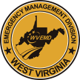
Contact Information WV Emergency Management Division . WVHMGP@wv.gov​ ​304-558-5380​
Questions?

