Slide 1

WVEMD IFLOWS Integrated Flood Observation and Warning System Andy Teter- IFLOWS Supervisor

Slide 2
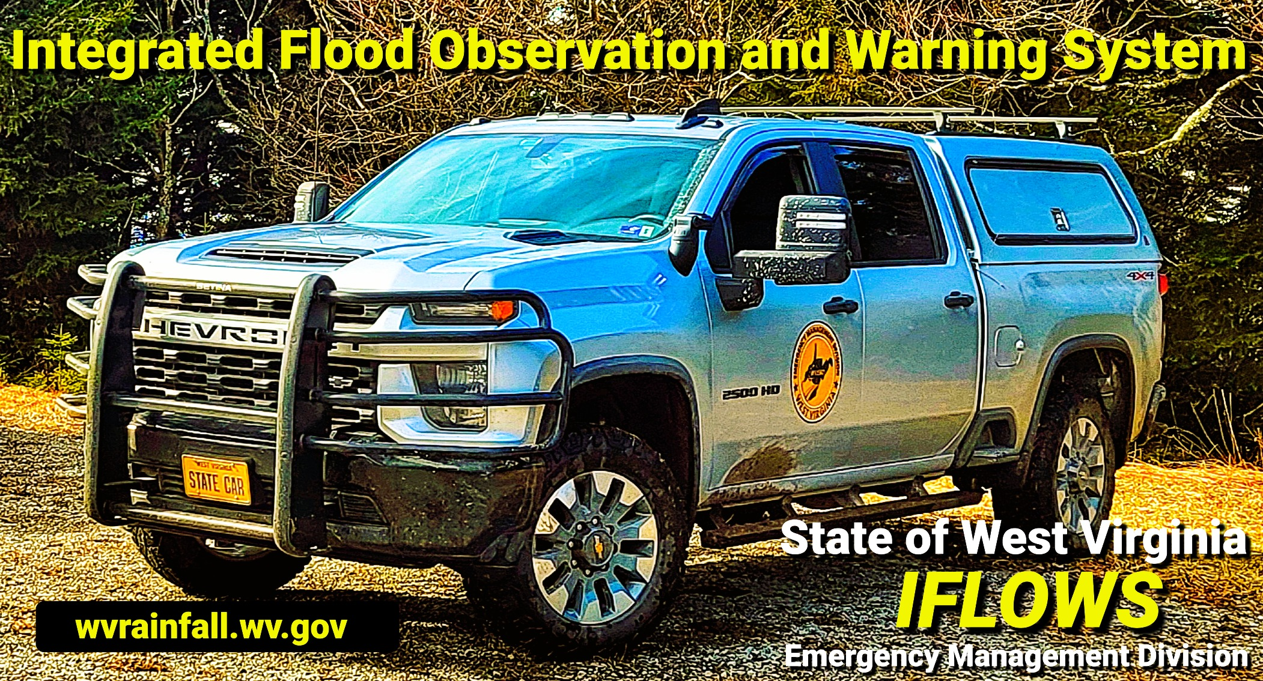
Weather RADAR / Stream Gauges
Introduction to IFLOWS
ClimaVision RADAR
Stream Gauge Additions
Conclusion
QUESTIONS / COMMENTS

Slide 3

IFLOWS OVERVIEW ---------------

Slide 4
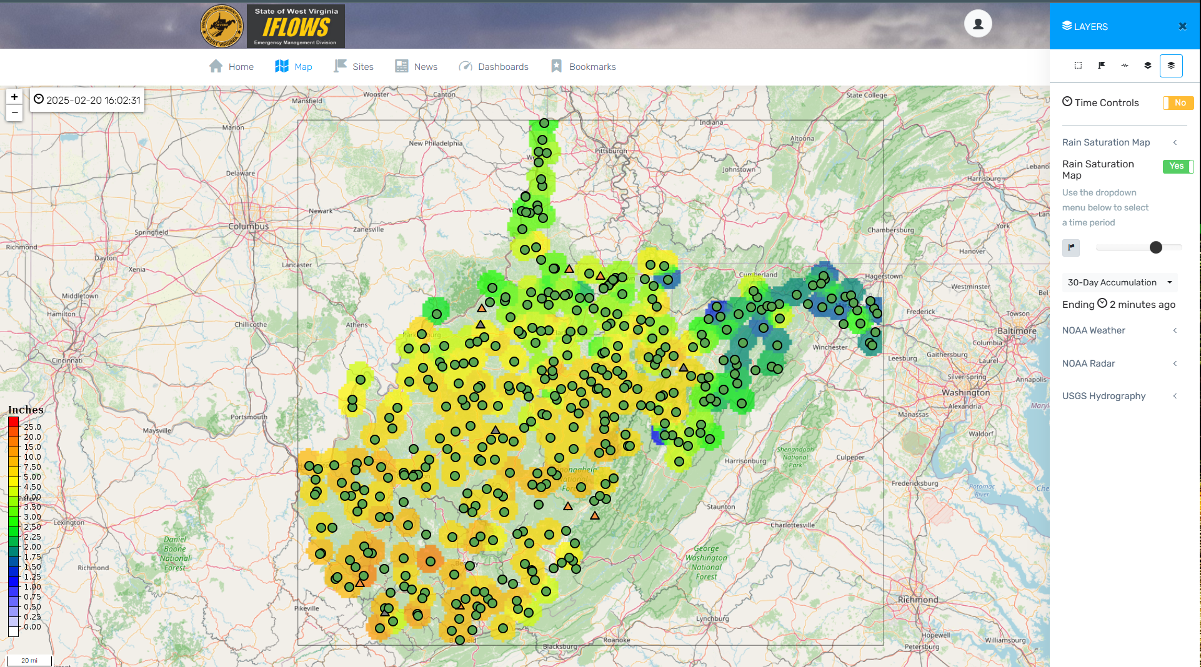
Introduction to WVEMD IFLOWS integrated flood observation and warning system
System consists of 3 Collection Points- Coon, Romney, Wayne (Soon to be Added- Rich Mtn)- 237 Active Rain/Weather stations- VHF Radio telemetry- System Upgrade in process
ONLY State Flood Warning System in the Country that is Fully Installed/Maintained by State Employees- One of the Largest in the Country
Website – wvrainfall.wv.gov
Local benefits of the website
Post Event data acquisition for FEMA / Insurance claims (recent Flooding in West Virginia)

Slide 5
CLIMAVISION What is it ?

Slide 6
ClimaVision RADAR
Private Company
Local Benefits
ClimaVision is a private company, building weather RADAR units and strategically placing them where the National Weather Service(NWS) RADAR is underperforming:
Current COOP with the NWS
Filling Low Level Data Voids
Removes the costly infrastructure burden of owning, maintaining, and operating your own RADAR system and allows more entities to benefit from additional weather surveillance information
App access 24 hours a day
Scientific Data Analysis
More accurate active, local weather RADAR
Able to ACT instead of REACT

Slide 7
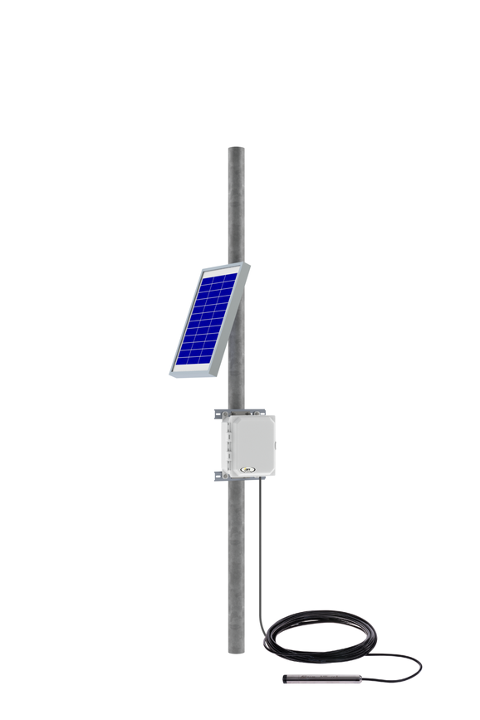
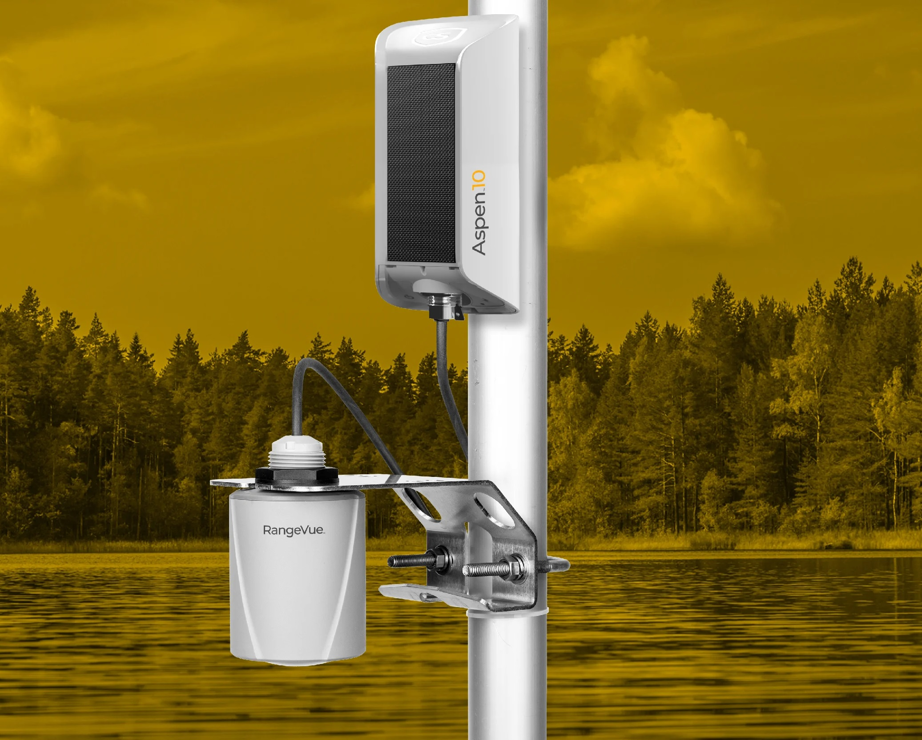
Stream gauge additions
Preparing Build Out
Why not use Current USGS Model ???
Locate streams of need
Receiving Requests from County OEMs
Prepare Site Specific Quotes
VERY COSTLY INSTALLATION AND YEARLY MAINTENANCE COSTS: $2,500 to $25,000 / year
May take a multi year study to create NWS thresholds
GOES Satellite Data Transmission Latency
Equipment Owned/Maintained by a Federal Agency- Tax Payer $$$

Slide 8
WVEMD IFLOWS- Plan and Cost Estimate
Equipment | Estimated Cost | Yearly Cost to County | Customized to County Needs
Simple Stream gauge/Cellular | $3200-$4900 | $155-$225/data*** (Possibly Lower) | 100%
Simple Stream VHF-WVEMD | $6400 | $0 | 100%
Simple Stream Iridium Sat. | $5000-$6400 | $650*** | 100%
Quotes In Hand Today |  | Cellular Plan depends on Manufacturer
ONE Time cost to County for Equipment Purchase***
WVEMD IFLOWS Technicians Install/Maintain/Repair/Replace Equipment throughout the equipment lifespan
Custom Alarms and Warnings
Data displayed 24/7 at wvrainfall.wv.gov

Slide 9
Closing statement
ClimaVision Project
Stream Gauge Addition
Preliminary Stage of Development
Concept and Planning
Cost $$$
Dependent on # of Local and State Partners signed up- No Cost Estimates at this time
Beneficial??
Are you interested in further discussion?
Enhanced Warning
Local Customization
County picks the sites of need
County Reimburses WVEMD for Equipment Cost
Cellular/Iridium Sat. Data- possible County responsibility, but still working to eliminate or reduce cost of this option- VHF NO COST to County

Slide 10
THANK YOU
Andy Teter
West Virginia Emergency Management
IFLOWS Supervisor
681-205-4337
andrew.d.teter@wv.gov
wvrainfall.wv.gov

