Slide 1



Individual Assistance

Slide 2
Public Assistance (PA) vs. Individual Assistance (IA)
*These programs are only available under a Federal Disaster Declaration*
Public Assistance (PA)
Funds provided to local/state governments and some private non-profits to help communities (public infrastructure) recover from a disaster
Individual Assistance (IA)
Funds provided to individuals and households who have expenses/serious needs not covered by insurance caused by a disaster

Slide 3
What types of expenses/issues can IA potentially assist with?
Uninsured and Underinsured Personal Property Losses
Medical, Dental, Legal,
Child Care, and Funeral Expenses
Emergency
Home
Repairs
Temporary
Housing
Transportation, Moving,
and
Storage

Slide 4






Declaration Process
6. The declaration is approved/denied
SPECIFICATION
1. Stress importance of Survey123 to survivors
Disaster Happens
5. FEMA sends request to Presidential Office
2. WVEMD processes Survey123 submissions
4. If eligible, declaration request sent through Governor’s Office to FEMA
3. Calculate and review damages

Slide 5
Why Survey123?
Single system of record to capture all damages related to events
Records AFN (Access and Functional Needs/Disability) and Immediate Needs info
Submissions help to show a better picture of each county’s situation including types of damages
Pictures and narrative submissions help to classify level of damage for FEMA consideration
Asks questions like “Do you need a muck out?” “Do you need tarping?” so those things can be addressed quickly
FEMA’s calculations require figures for Renter vs. Owner, % of impacted households that have flood insurance (for flooding events), etc. All this info can be collected via Survey123
The survey asks if the damaged home is a primary or secondary home; FEMA does not cover secondary homes (e.g. vacation homes)

Slide 6

Filling out Surveys for Locals
If you are completing the survey for someone in your county, please include:
Their name
Their phone number
Their address
Owner vs. Renter
Homeowners? Flood Insurance?
PICTURES!

Slide 7
What Happens after Declaration Approval
DSA (Disaster Survivor Assistance) will be the first on the ground. Teams go door to door in the counties to help spread the word and get survivors registered. Team leads must speak with the County EM (or designee) before field work begins. DSA also speaks with the County after the field work is completed.
The DRC (Disaster Recovery Center) will be set up next. WVEMD coordinates with County EMs weeks before a declaration is approved to find either a mobile site or a fixed site. FEMA will get all necessary contracts and start working on building out the DRC for operations that could last up to 60 days.

Slide 8
After a Disaster Happens…
Call and/or email the IA Coordinator, in addition to your WVEMD Liaison, and let me know about the situation.
If the county performs IDAs (Initial Damage Assessments), please let the IA Coordinator know they are happening so WVEMD can coordinate expectations and plan teams for potential follow up. Please send them to the IA Coordinator once they are completed.
Pass out the Survey123 papers with the QR code in flood buckets and during IDAs.
If individuals have a difficult time with the QR code, they can always call WV 211 for assistance.

Slide 9
Non-Compliance (N-Comp)
If a home has been previously involved in a Federal Disaster Declaration and received help, most of the time FEMA puts that home and a group of homes around it in a Group Flood Insurance Policy (GFIP).
After 3 years of FEMA covering the flood insurance, the owner/renter is responsible for getting flood insurance for the property.
If another Federal Disaster Declaration happens, and the property does not have flood insurance, FEMA will not offer financial assistance for the home damage.

Slide 10
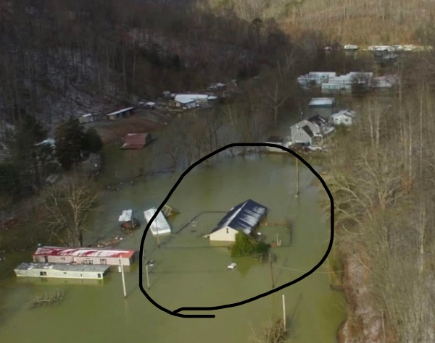
Example of a Non-Compliant property after the February 15, 2025 flooding.

Slide 11
Did you know?
You may choose higher coverage limits by purchasing an SFIP (Standard Flood Insurance Policy) at any point during the term of your GFIP. However, buying a SFIP will void your GFIP– you can not have both.
FEMA can still potentially offer financial assistance for certain needs if you are N-Comp. These can include things that any insurance would typically not cover such as:
Damaged water wells or septic systems
Rental Assistance
Medical, dental, or funeral expenses

Slide 12
Contact Information
Ehrin Starcher
Individual Assistance Coordinator
Ehrin.K.Starcher@wv.gov
304-414-7688

