Slide 1
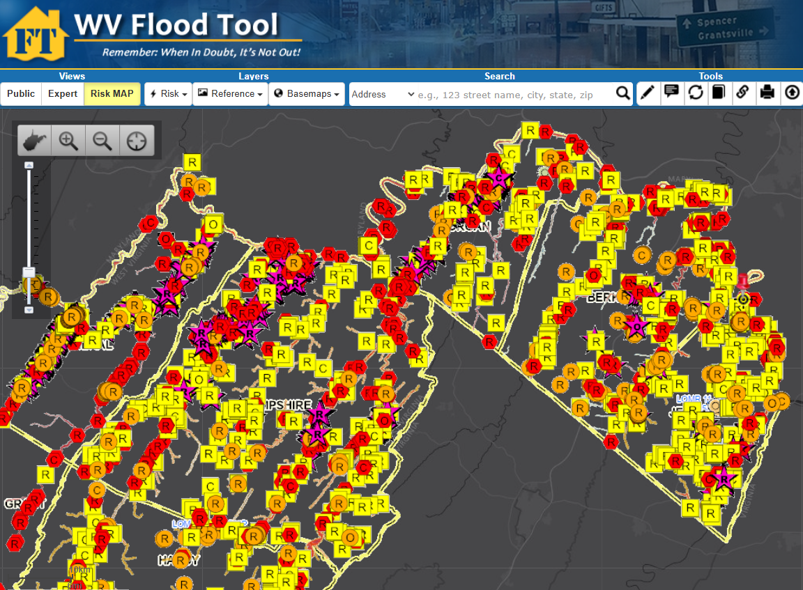
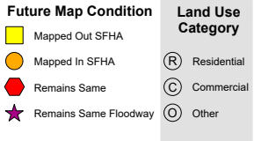
New Flood Maps
Floodway
Kurt Donaldson
WV GIS Technical Center
West Virginia University
kdonalds@wvu.edu
Difference between FEMA’s 2009 and 2024 flood studies

Slide 2
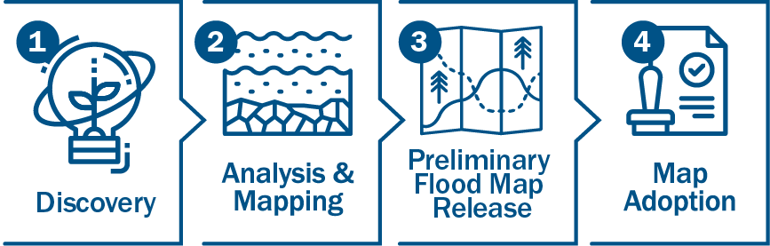
Mapping: Risk MAP Process
FEMA is responsible for mapping our country’s flood risk. The agency and its partners do this by making Flood Insurance Rate Maps, or flood maps.
Risk Mapping, Assessment and Planning, Risk MAP, is the process used to make these maps.
Risk MAP Process
Discovery: Initial meetings to assess needs and scope the flood map project.
Analysis & Mapping: Data collection, modeling, and creating the draft and preliminary maps.
Preliminary Flood Map Release: Sharing the preliminary maps with communities and the public, followed by a 90-day appeal period.
Map Adoption: Communities adopt the new maps into their floodplain management ordinances, which happens after all appeals are resolved and a six-month compliance period has passed.

Slide 3

Risk MAP Timeline
Current Effective Maps
Risk MAP Study Notification
Preliminary Maps
and
CCO Meeting
End of Appeal Period
Updated Effective Maps
Discovery Meeting
Draft Maps
and
Flood Risk Review Meeting
Appeal Period Start
FEMA Issues Letter of Final Determination (LFD)
A Risk MAP project, from start to finish, can take up to 5 or more years to complete

Slide 4
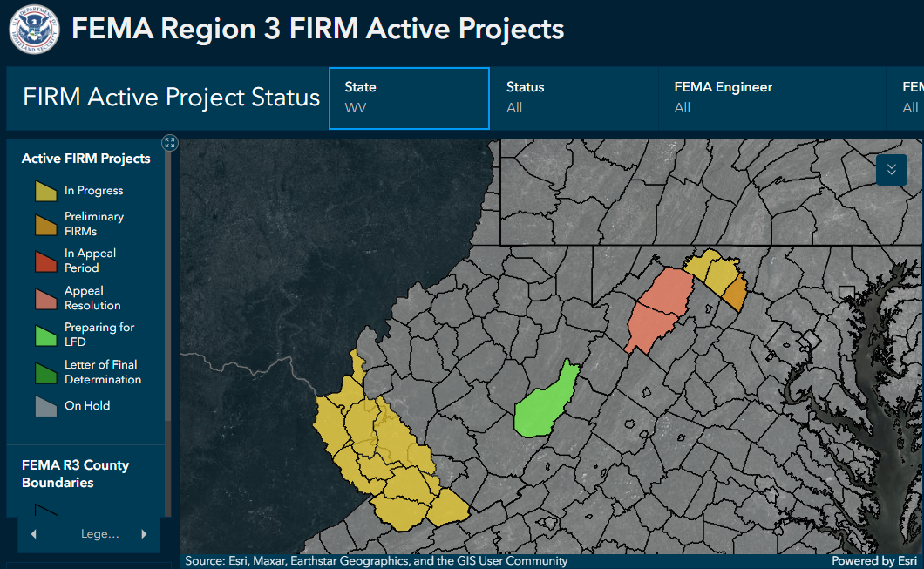
Risk MAP: In Progress
In Progress
Counties
Berkeley
Cabell
Lincoln (Partial)
Logan (Partial)
McDowell
Mercer
Mingo
Morgan
Raleigh (Partial)
Wayne
Wyoming
Watershed Coal
Preliminary
Hampshire
Hardy
Jefferson
Pocahontas
Status Graphic
New flood maps are currently being created for 27% of counties in state

Slide 5
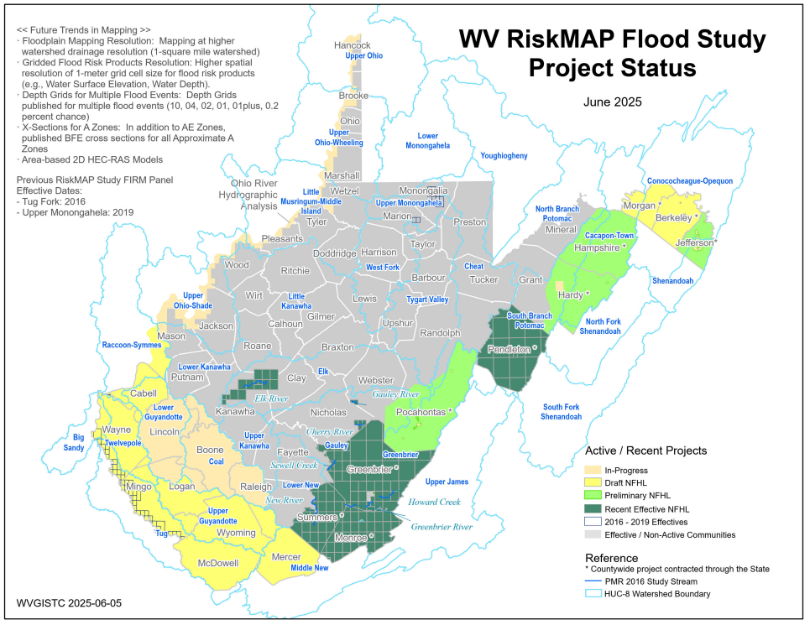
Risk MAP: In Progress & Recent Effective
In Progress
Counties
Berkeley
Cabell
Lincoln (Partial)
Logan (Partial)
McDowell
Mercer
Mingo
Morgan
Raleigh (Partial)
Wayne
Wyoming
Watershed Coal
Preliminary
Hampshire
Hardy
Jefferson
Pocahontas
2021-25 Effective
Greenbrier
Kanawha (Elk River)
Monroe
Nicholas (Cherry R.)
Pendleton
Summers
Webster (Gauley R.)
Risk MAP Status
Status Graphic

Slide 6
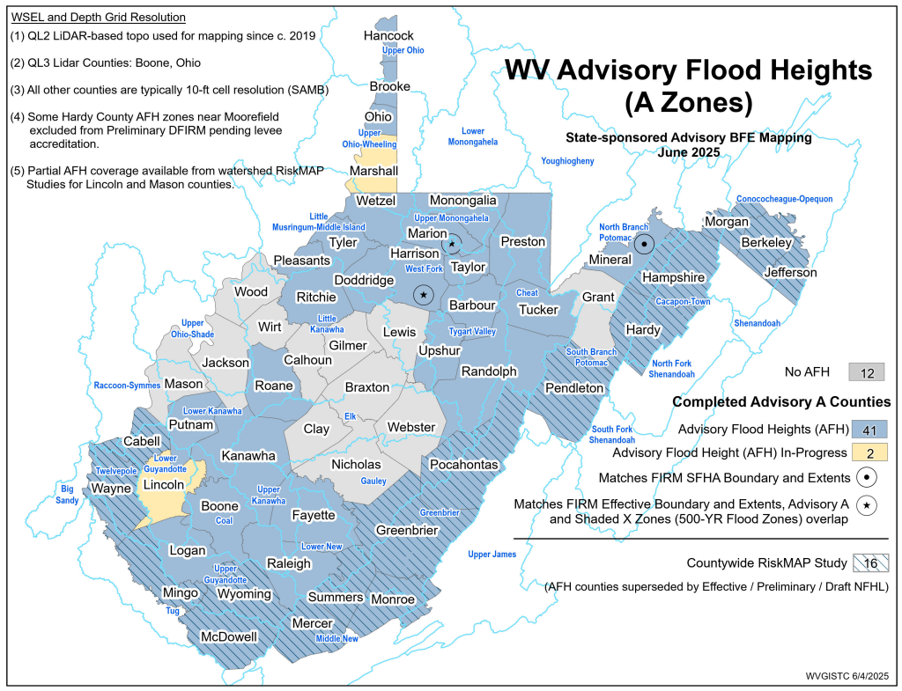
Mapping Advisory Flood Heights (AFH)
County | Stream Length (mi)- Zone A | Approx. Zone A % | MAS Funded | Target AFH Completion
BRAXTON | 250 | 87% | Pending | 2028
CALHOUN | 111 | 79% | Pending | 2028
CLAY | 87 | 54% | Pending | 2028
GILMER | 146 | 69% | Pending | 2028
GRANT | 127 | 90% | Pending | 2029
JACKSON | 292 | 73% | Pending | 2028
LEWIS | 271 | 91% | Pending | 2028
LINCOLN | 273 | 71% | Yes | 2027
MARSHALL | 92 | 59% | Soon? | 2025
MASON | 85 | 29% | Pending | 2028
NICHOLAS | 387 | 94% | Pending | 2028
WEBSTER | 190 | 60% | Pending | 2028
WIRT | 179 | 98% | Pending | 2028
WOOD | 230 | 57% | Pending | 2028
 | 2,720
WV NFIP Goal since 2010 to attain statewide AFH coverage!
14 counties with no AFH

Slide 7
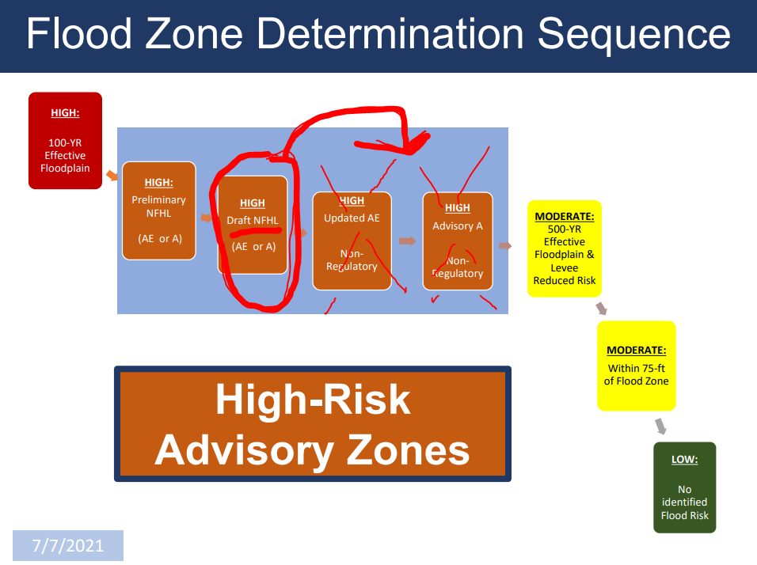
Preliminary/Draft National Flood Hazard Layers (NFHL) replaces non-regulatory Advisory floodplains

Slide 8
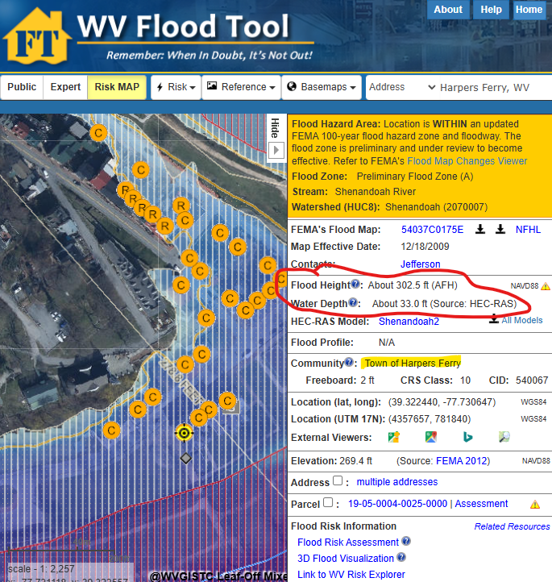

Map Changes – Harpers Ferry
Harpers Ferry: BFE change minus 24 ft.
Notes:
The preliminary FIRM shows flood risk zones in a community, including Special Flood Hazard Areas (SFHAs), subject to inundation by the base (1%-percent-annual-chance) flood. The 1%-annual-chance flood is also referred to as the 100-year flood.
Communities like Harpers Ferry should review its preliminary Flood Insurance Rate Map (FIRM) where structures are being mapped into a high-risk Special Flood Hazard Area, and where the base flood elevation is decreasing by 24 feet due to the revised 1%-annual-chance backwater effect where Shenandoah River meets the larger Potomac River.

Slide 9
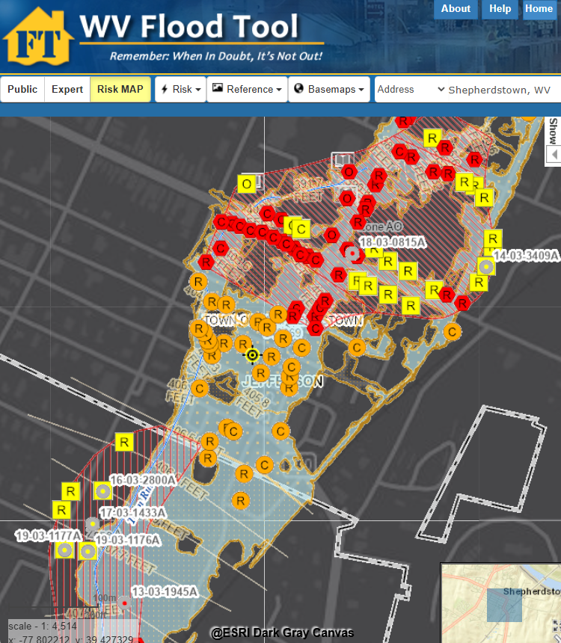
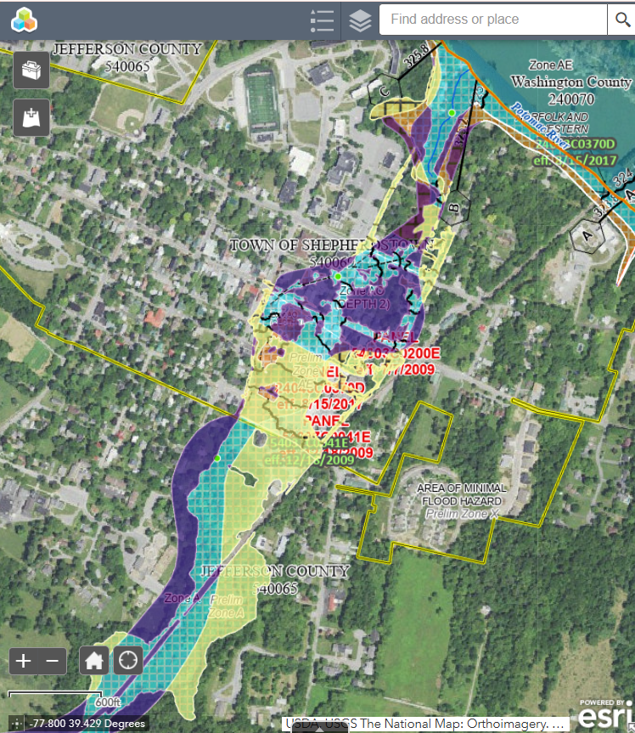
Map Changes - Shepherdstown
Harpers Ferry: BFE change minus 24 ft.
Shepherdstown: WV Flood Tool
Shepherdstown: FEMA Change Viewer
Notes:
Preliminary maps show the high-risk floodplain of Shepherdstown is changing dramatically, and consequently these floodplain boundary changes between the current 2009 effective and 2024 preliminary flood maps should be viewed using the WV Flood Tool’s Risk MAP View (SFHA Building Changes - Building Changes Since Last FIRM) and FEMA’s Changes Since Last FIRM (CSLF) Viewer. Shepherdstown has nearly 30 structures being mapped into the updated Special Flood Hazard Area, and so it is the community’s responsibility to notify property owners and other stakeholders that they will be affected by the map changes.

Slide 10
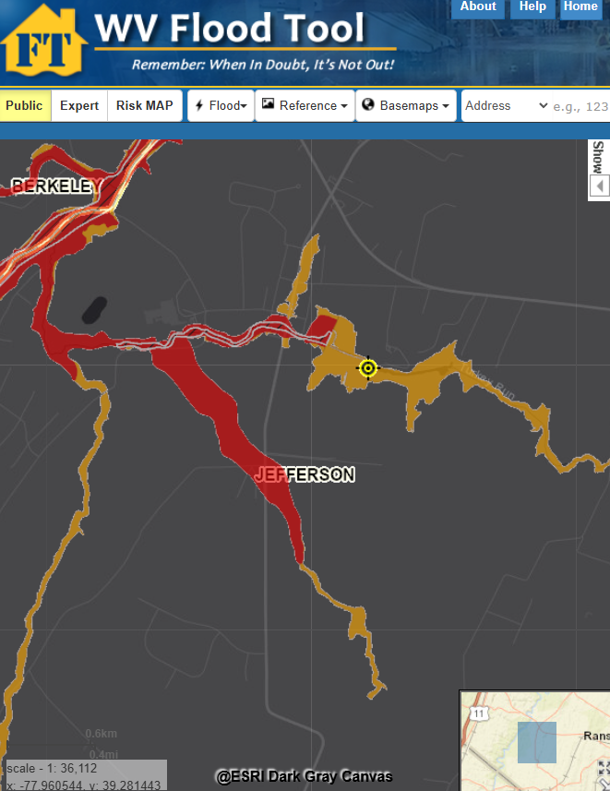
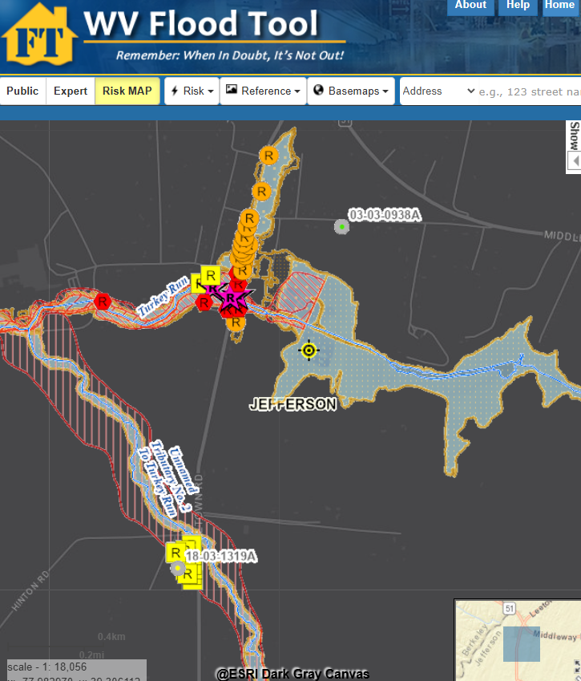
Map Changes – Jefferson County
Floodway
WV Flood Tool Public View
WV Flood Tool (Risk MAP View)
Notes:
Preliminary map changes for Jefferson County Unincorporated show “mapped-in structures” (orange symbol color) along streams where studies have been extended; or “mapped-out” structures (yellow symbol color) along existing streams due to more accurate topographic data and updated hydrologic/hydraulic flood studies.

Slide 11
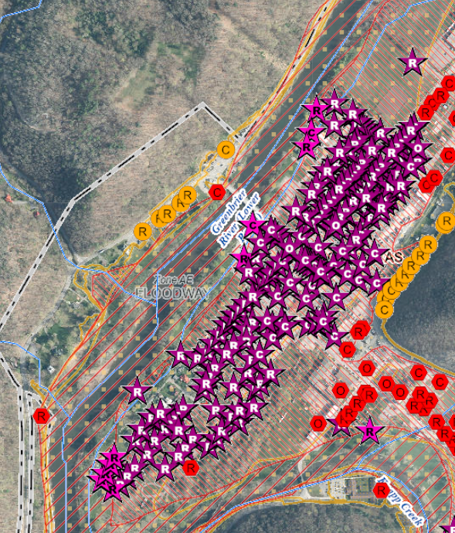
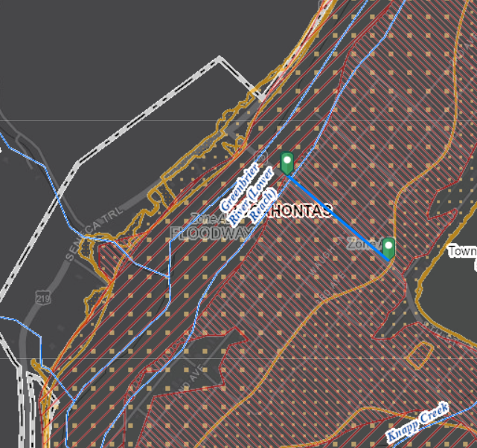
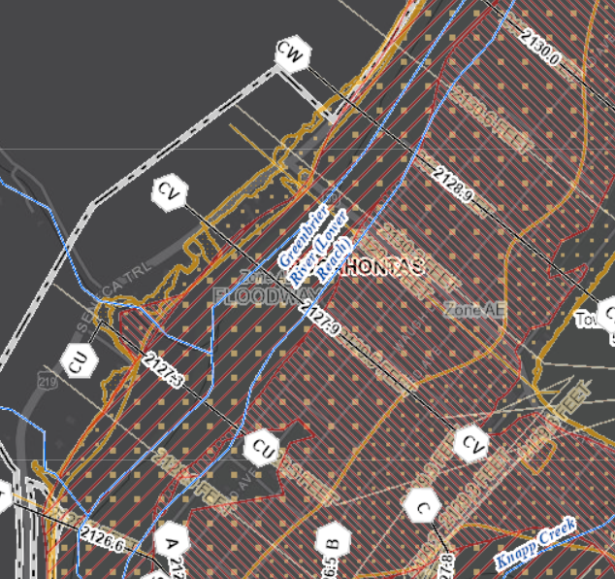
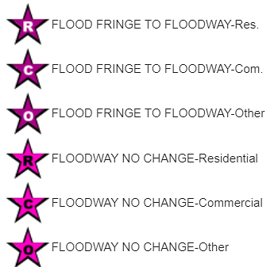
Buildings in Preliminary Floodway
Floodway Increase in Marlinton
Buildings in the floodway channel of a stream or close to the flood source, will be subject to the greatest flood depths, highest velocities, and greatest debris potential.
Community | Buildings in Preliminary Floodway | Buildings in Effective Floodway | Net Change in Floodway
Marlinton | 190 | 14 | + 176
Floodway width expanded significantly
up to 300 yards (900 ft)
Base Flood Elevation increased
to about 2 feet
2130.6 - 2128.9
= 1.7 ft
300 yd
Flood Tool Link

Slide 12

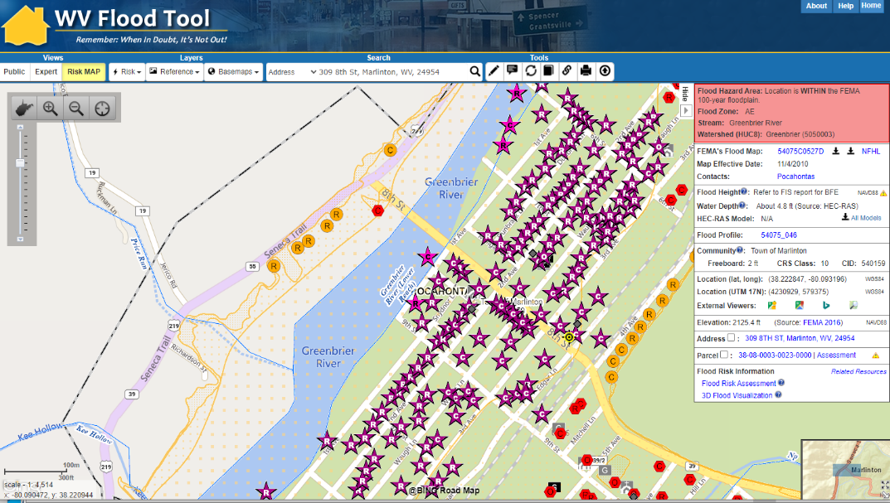
Risk Indicators: (Marlinton)
High-Risk Effective & Advisory
1%-Annual-Chance (100-Yr) Floodplains
WV Flood Tool link
Top 10% rankings among 229 incorporated places
Marlinton
BUILDING COUNTS: Marlinton has the highest number of structures in the floodway of all incorporated places
Floodway
1

Slide 13
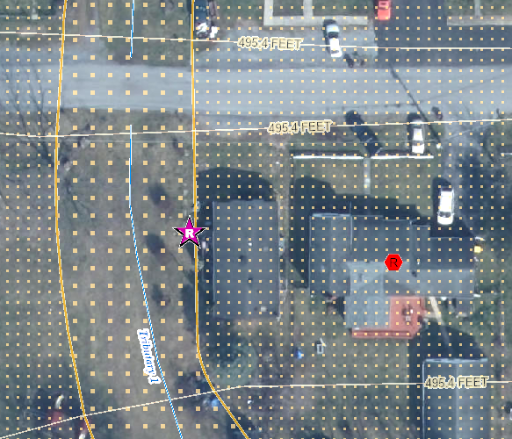
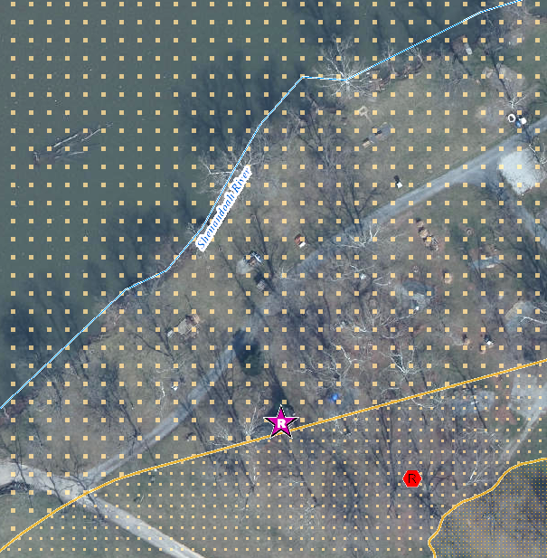
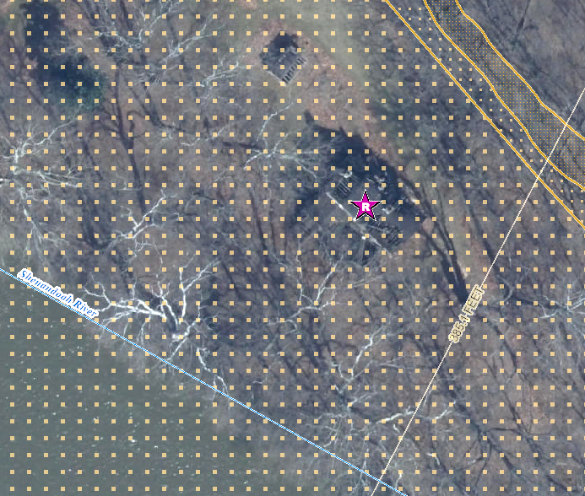
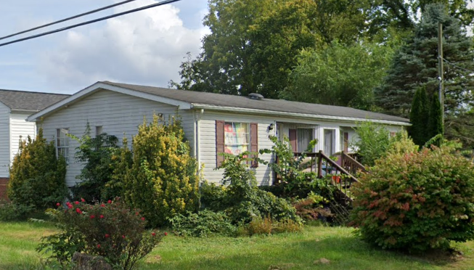
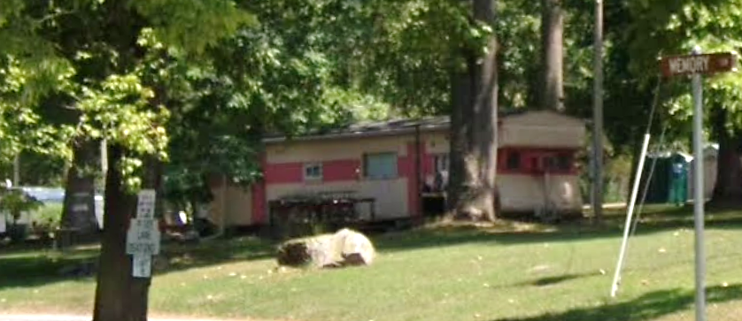
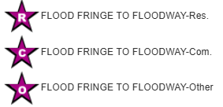
Buildings Mapped into Floodway
Single Family Dwelling in Jefferson County* (FD: 14.0 ft)
$8K; Minus Rated: 10.3 ft; Year Built: 1979 (Pre-FIRM)
(Building ID: 19-06-008F-0007-0000_457)
Structures mapped from Floodplain Fringe into Floodway
Double-wide Mobile Home in Ranson (FD: 2.2 ft)
$33K; Year Built: 1993 (Post-FIRM)
(Building ID: 19-08-0006-0019-0001_407)
Single-wide Mobile Home in Jefferson County* (FD: 7.0 ft)
$25K; Minus Rated: 3.5 ft; Year Built: Unknown
(Building ID: 19-02-0020-0031-0000_30)
Notes:
Communities should also notify property owners being mapped into a much higher risk flood zone of the Special Flood Hazard Area (SFHA), known as the Regulatory Floodway, or the main channel of the river/stream where floodwaters are likely the deepest and with the highest velocities. Before a local permit can be issued for proposed development in the floodway, a “No-Rise/No Impact” certification must be submitted by a professional engineer licensed in West Virginia to ensure a proposed project won’t increase flood levels.

Slide 14
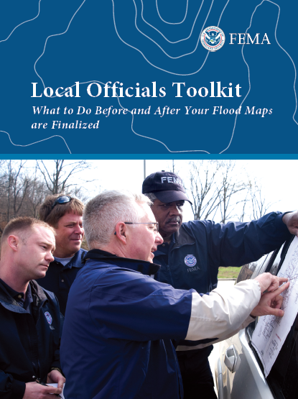
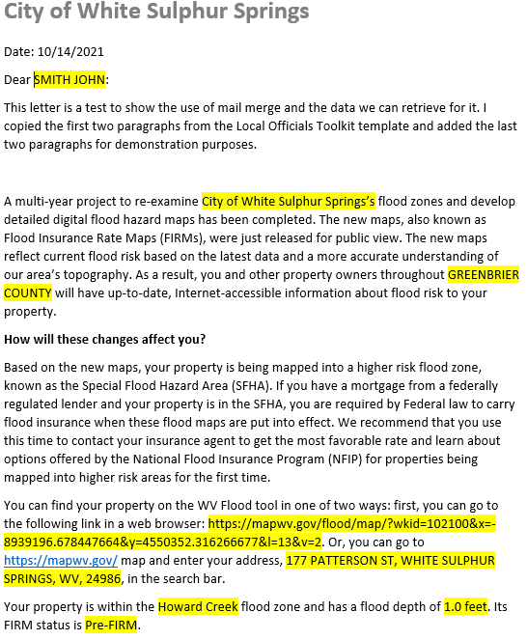
Risk Communications: SFHA Map Change Letters
Incorporate 1% Floodplain Building Risk Assessment Inventory into Mitigation and NFIP/CRS Management Activities
Counties which recently sent outreach letters to homeowners:
Hardy County
Risk MAP
Kanawha County - Elk River PMR
Greenbrier County Risk MAP
Jefferson County and Shepherdstown have 55 and 29 buildings, respectfully, mapped into the SFHA
FEMA Region 3 Toolkit for New Flood Studies
Mail Merge Template for SFHA Mapped-in Structures
Notes:
Communities should contact the State NFIP Office for technical support in creating outreach letters for property owners affected by the map changes. Based on mail merge templates, outreach letters on community letterhead can be generated for all (1) SFHA Mapped-In, (2) Mapped-In Floodway, and (3) SFHA Mapped-Out structures shown on the WV Flood Tool’s RiskMAP View (www.mapwv.gov/Flood). All the communities must do is download the files, then print, validate, and mail the letters. CRS communities like Jefferson County Unincorporated should be eligible for credit points for this outreach activity.
For the SFHA mapped-out letters, it is important to have this text included in the letter template: "If you do currently have flood insurance, you should not cancel your flood insurance before the new flood maps are officially adopted by the community. Moreover, if you have a federally-backed mortgage, NEVER cancel your flood insurance before consulting your mortgage lender!“
Another useful resource about the Regulatory Update is FEMA’s Risk Communication Guidebook for Local Officials.
https://www.fema.gov/sites/default/files/documents/fema_region-6_risk-communications-guidebook_112023.pdf#page=25

Slide 15
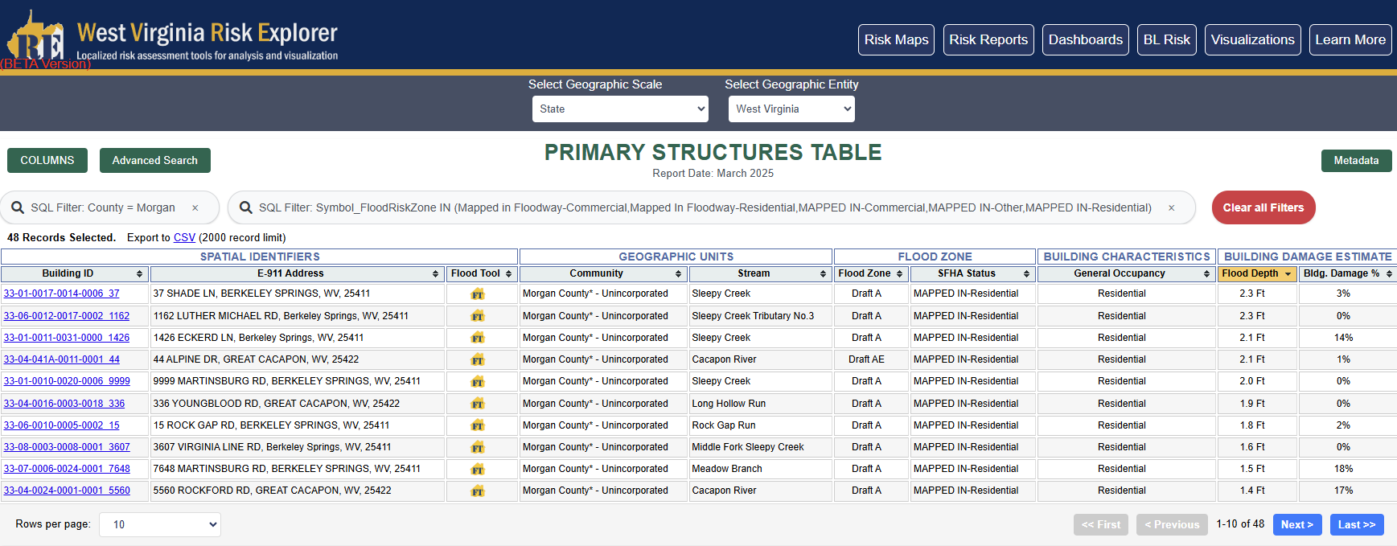
West Virginia Risk Explorer
New Building-Level Risk Tools enable further exploration of impacted buildings:
  Morgan Mapped-In Structures
  Morgan Mapped-Out Structures
  Morgan Risk Index (incl. Top 20% Risk Indicators Report)
Mapped into SFHA

Slide 16
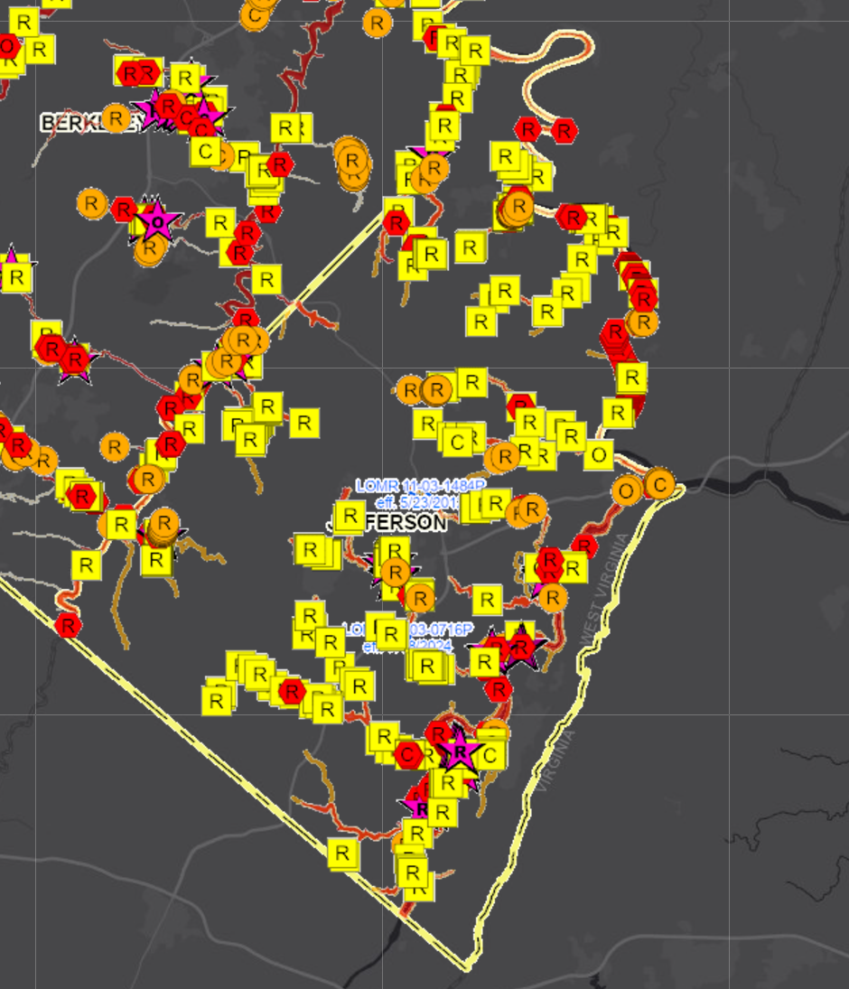
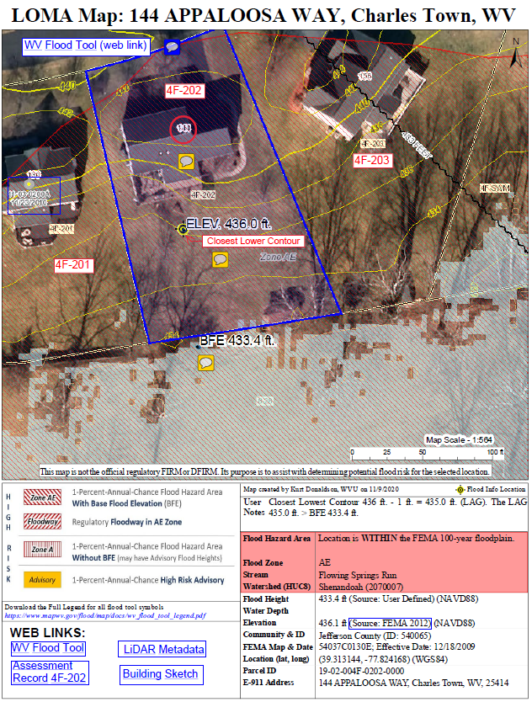
SFHA Buildings Changes: LOMAs for Mapped Out
Jefferson County
Mapped-out structures of the SFHA may qualify for LOMAs
Floodway
276
Mapped Out SFHA
WV Flood Tool LiDAR LOMA:
Instructions | Guide
All building symbols in the floodplain fringe will become “red color” once flood maps are effective
Notes:
Before the preliminary FIRMS become effective, property owners with structures that are mapped out of the SFHA (yellow square symbols on WV Flood Tool’s RiskMAP View) may be eligible for a LiDAR Letter of Map Amendment (LOMA).
It is estimated that 276 structures are mapped out of the SFHA for the entire county. If applicable, LiDAR data can replace the requirement to submit certified elevation information for LOMAs, which can create a cost savings for property owners requiring mandatory flood insurance. If property owners want to expedite the removal of their structure from the SFHA, then refer to the information links regarding LiDAR LOMAs for more guidance.

Slide 17
Buildings Mapped-In / Out of Preliminary SFHA
Floodway
Difference between FEMA’s 2009 and 2024 flood studies
Notes:
The WV Flood Tool’s Risk MAP View shows the future building status change according to the new flood maps:
• Mapped Out SFHA (yellow square symbol). Communities should notify property owners of map-in SFHA changes. Additionally, these structures may be candidates for LiDAR LOMAS.
• Mapped In SFHA (orange circle symbol). Communities should notify property owners of map-out SFHA changes.
• No Change - Remains Same in SFHA (red hexagon symbol).
• Floodway (star symbol)

Slide 18
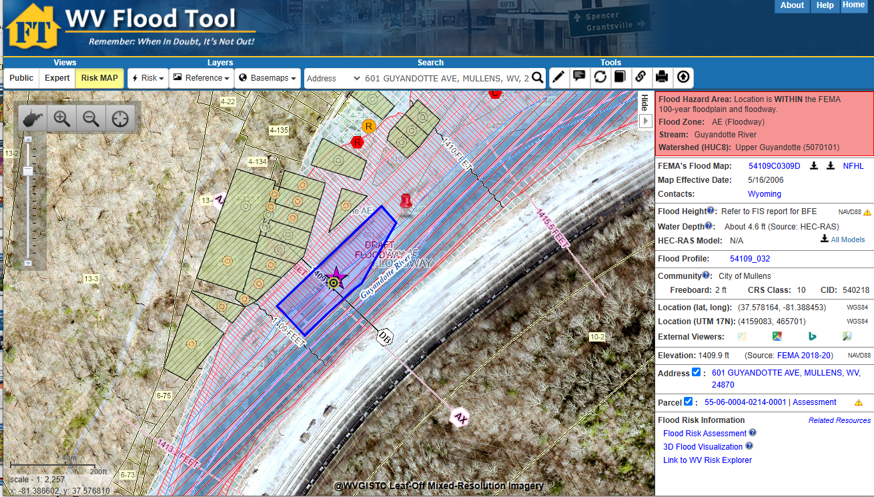
DEMO
Flood Tool Link

