Slide 1
WV DOT GIS DAY – November 2019
Kurt Donaldson and Frank LaFone

Slide 2
Spatial Data Development
Parcels

Slide 3
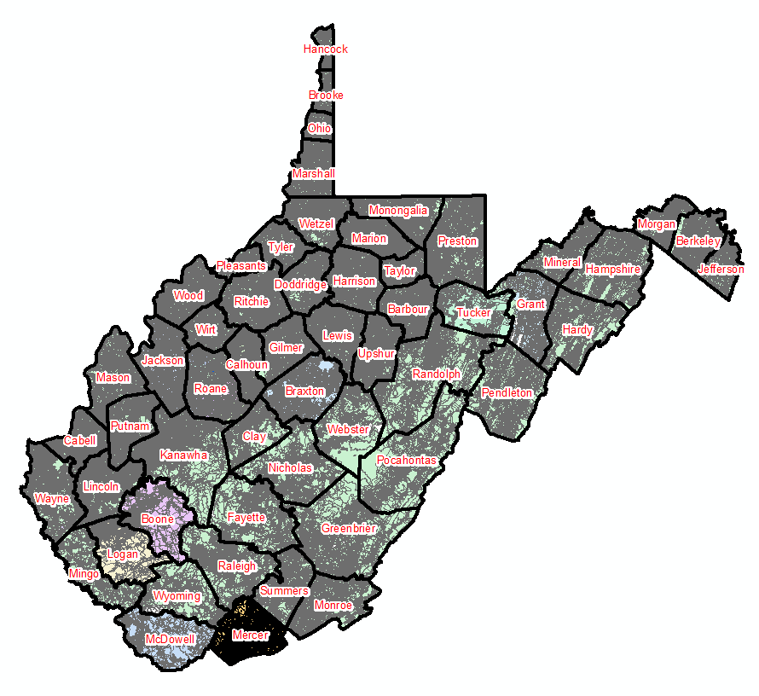
Statewide Digital Parcel File
599 Tax Districts
347 Districts
252 Corporations
Digital Parcel Sources
Assessor Offices (primary)
E-911 Offices
State Tax Department

Slide 4

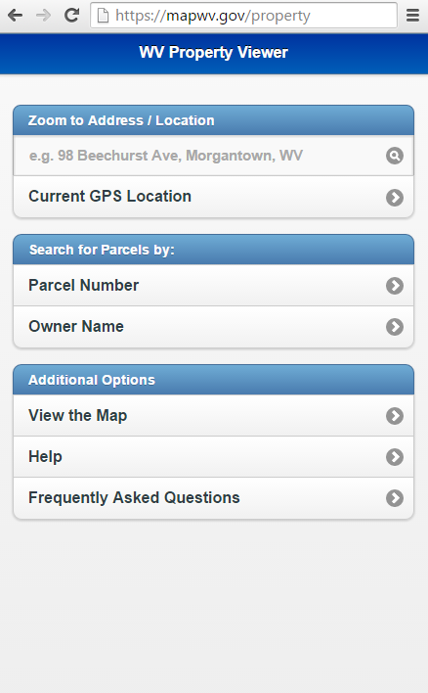
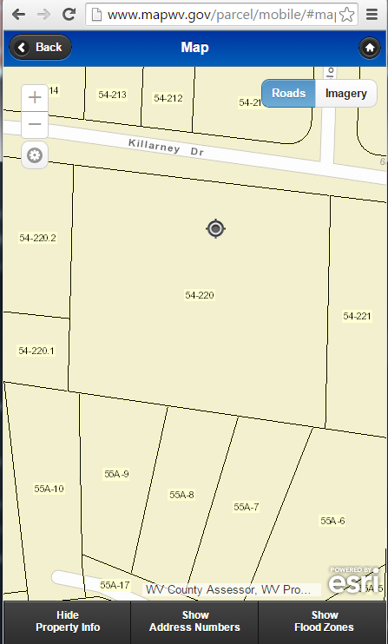
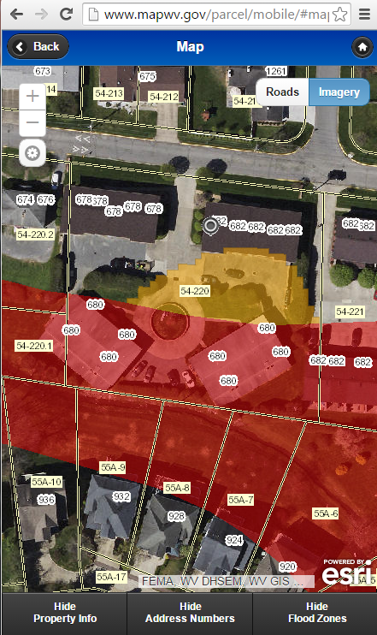
WV Property Viewer (Mobile)
www.mapwv.gov/property
682 Killarney Drive, Morgantown, WV
Mobile Home Page
Zoom to E-911 Address
Toggle Layers of Interest

Slide 5
Web Assessment Reports
Ownership
Building Characteristics
Building Identification
Building Sketch Diagrams
Outbuildings
Cost Values
Land Use
Tax Class (Owner Occupied)
Sales History
Parcel History

Slide 6
Assessment Building Info
West Virginia Parcel Property Class Breakdown for Tax Year 2017
Code | Property Class | # of Parcels | Percent (%)
R | Residential | 1,164,470 | 79.61%
F | Farm | 121,384 | 8.30%
A | Apartment | 3,222 | 0.22%
C | Commercial | 65,784 | 4.50%
I | Industrial | 3,105 | 0.21%
X | Exempt | 97,773 | 6.68%
U | Utility | 192 | 0.01%
Other | Not classified | 6,837 | 0.47%
 |  | 1,462,767 | 100.00%
Assessment records are important for building inventories and are used to estimate the total building exposure ($) and building loss ($) for multi-hazards. Often building inventories and corresponding loss estimates are organized by property class.

Slide 7
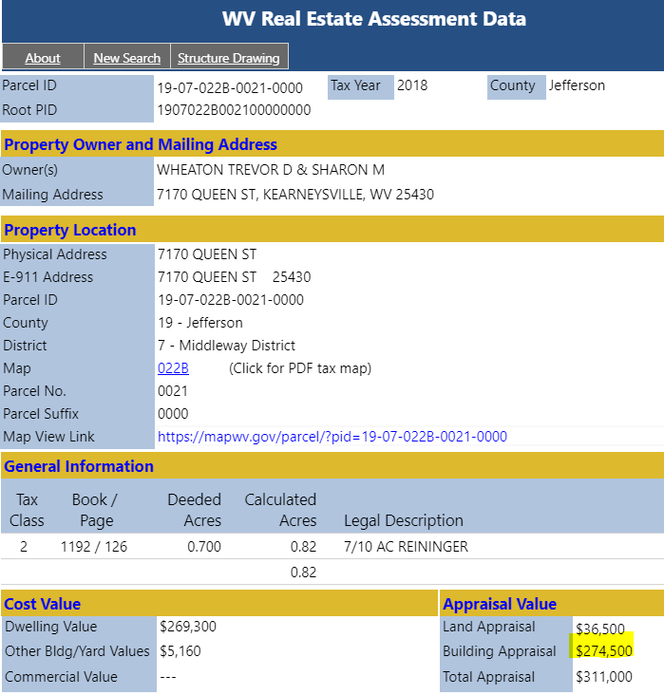
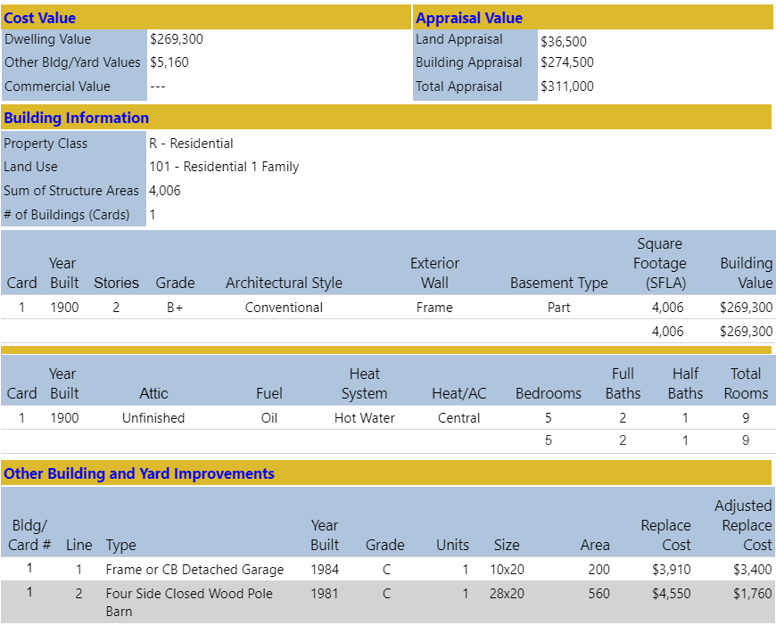
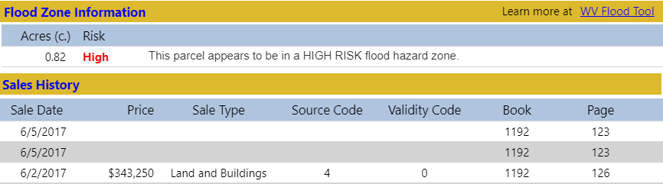
Building 19-07-022B-0021-0000_7170
Main Building Information
Owner and Property Location
Outbuildings
Legal Description
Cost Values
Property Intersect Flood Zone
http://mapwv.gov/Assessment/Detail/?PID=1907022B002100000000
Web Parcel Assessment Report
for Building Identification, Building Characteristics, and Cost Values

Slide 8
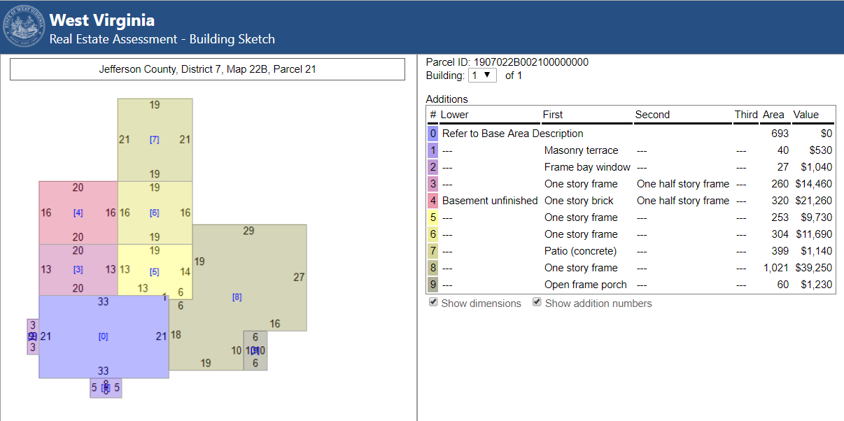
Building 19-07-022B-0021-0000_7170
http://mapwv.gov/Assessment/Detail/?PID=1907022B002100000000
Building Sketch Diagram (main area and additions)
Building Sketches from parcel assessment records are available for all Residential and Farm properties. Very useful for Building Identification.

Slide 9
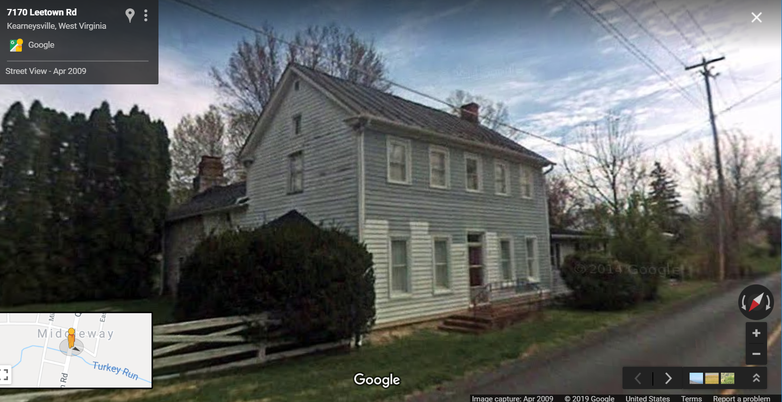
Building 19-07-022B-0021-0000_7170
Flood Tool External Link to Google Street View

Slide 10
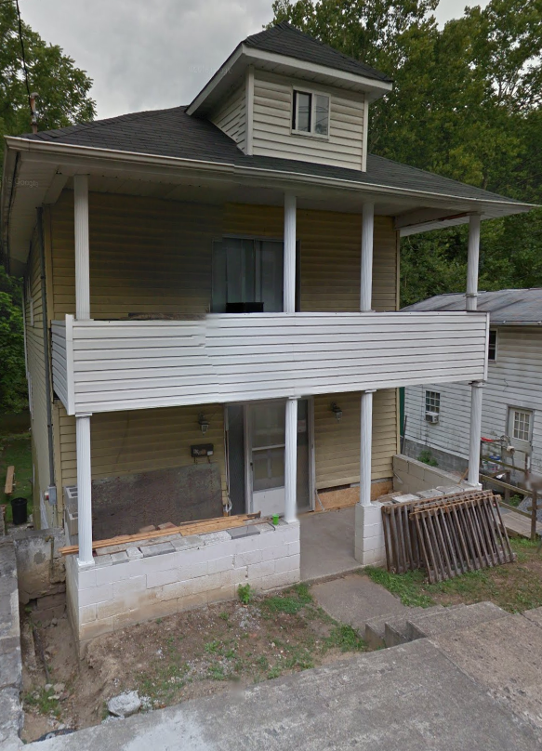
Parcels link to Owner/Building Info
Residential or Farm Property
DESCRIPTION
GIS Parcel ID | 31-10-0029-0130-0000
Legal Description | BL 12-1/2 LOT 10
Acreage (deed) | 0.0373
Tax Year | 2015
Tax Class | 4
Deed Book / Page | 1259 / 45
PROPERTY OWNER(S)
Property Owner(s) | Smith John
629 PENNSYLVANIA AVE, Morgantown, WV, 26501
https://www.mapwv.gov/flood/map/?wkid=102100&x=-8899684&y=4811867&l=13&v=0
BUILDING INFORMATION
Property Class Type | R- Residential
Land Use | 101 - Residential 1 Family
Year Built | 1911
Architectural style | Conventional
Exterior Wall | Aluminum
Stories | 2
Total Rooms | 8
Building Grade | C
Basement Type | Full
Structure Area | 1,320
Building (card) Number | 1
# of main BLDGs (cards) | 1
APPRAISED VALUES
Land Appraisal | $33,200
Building Appraisal | $29,000
Total Appraisal | $62,200

Slide 11
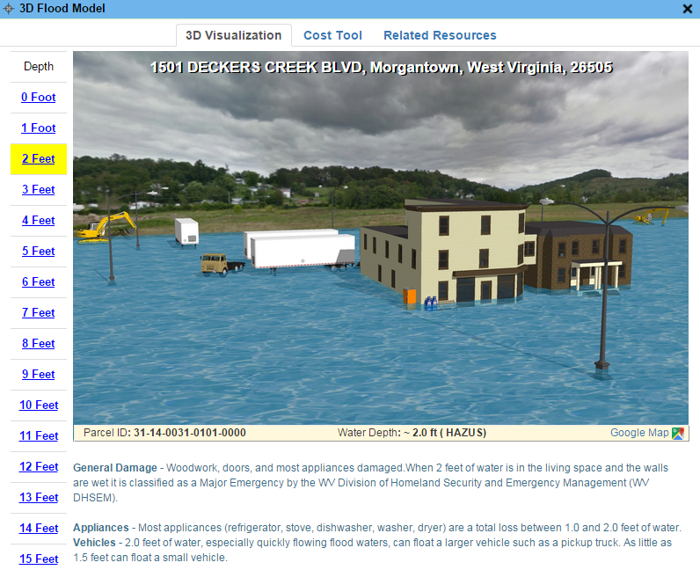
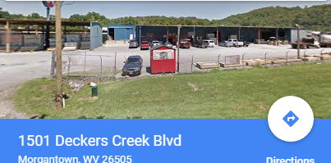
Parcels link to Owner/Building Info
Commercial or Industrial Property
DESCRIPTION | 84 Lumber
GIS Parcel ID | 31-14-0031-0101-0000
Legal Description | 5.0922 AC;SABRATON
Acreage (deed) | 5.09
Deed Book / Page | 1376 / 234
PROPERTY OWNER(S)
Property Owner(s) | SPIRIT SPE PORTFOLIO
1501 DECKERS CREEK BLVD, Morgantown, West Virginia, 26505
https://www.mapwv.gov/flood/map/?v=0&pid=31-14-0031-0101-0000
BUILDING INFORMATION
Property Class Type | C- Commercial
Land Use | 373 - Retail-Single Occupancy
Year Built | 1994
Stories | 2
Exterior Wall | Brick or Stone
Construction Type | Pre-Engineered Steel
Building Grade | D+
Basement Type | None
Business Living Area | 15,255
Cubic Feet | 292,380
Use Type | 34-Retail Store, 82- Multi-Use Office
COST VALUES
Other Bldg/Yard Values | $67,020
Commercial Value | $227,700
APPRAISED VALUES
Land Appraisal | $378,800
Building Appraisal | $294,700
Total Appraisal | $673,500

Slide 12
Spatial Data Development
Elevation

Slide 13
Elevation
Elevation
New FEMA-Purchased LiDAR-Derived Products published on WV Flood Tool
  1-foot contours
  1-meter resolution Digital Elevation Model (DEM)
Source Elevation Metadata
https://www.mapwv.gov/floodtest/docs/WV_FloodTool_ElevationSource_Metadata.pdf

Slide 14
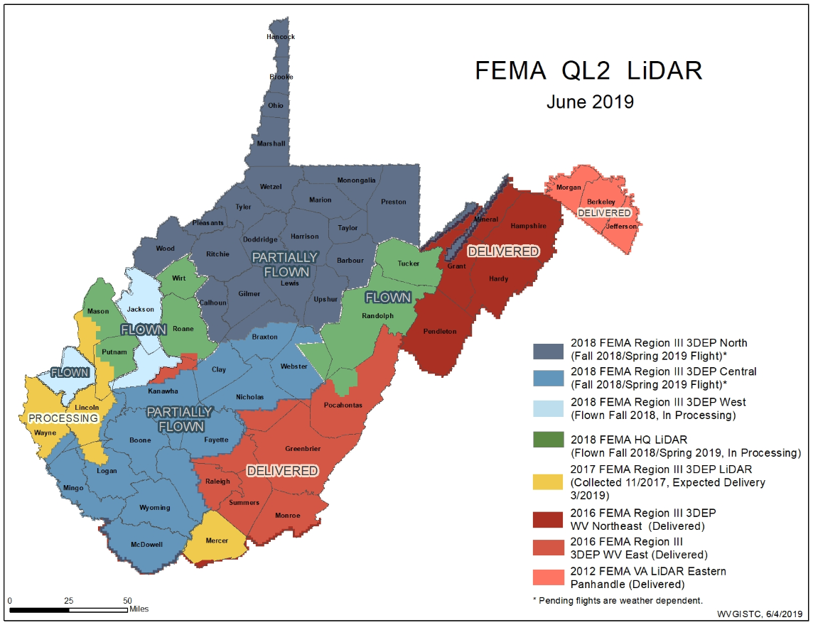
Hi-Resolution Elevation Data – 1 Ft Contours
Elevation data can be accessed through State Data Clearinghouse - www.mapwv.gov/lidar
New statewide FEMA elevation data worth an estimated $5 million dollars

Slide 15

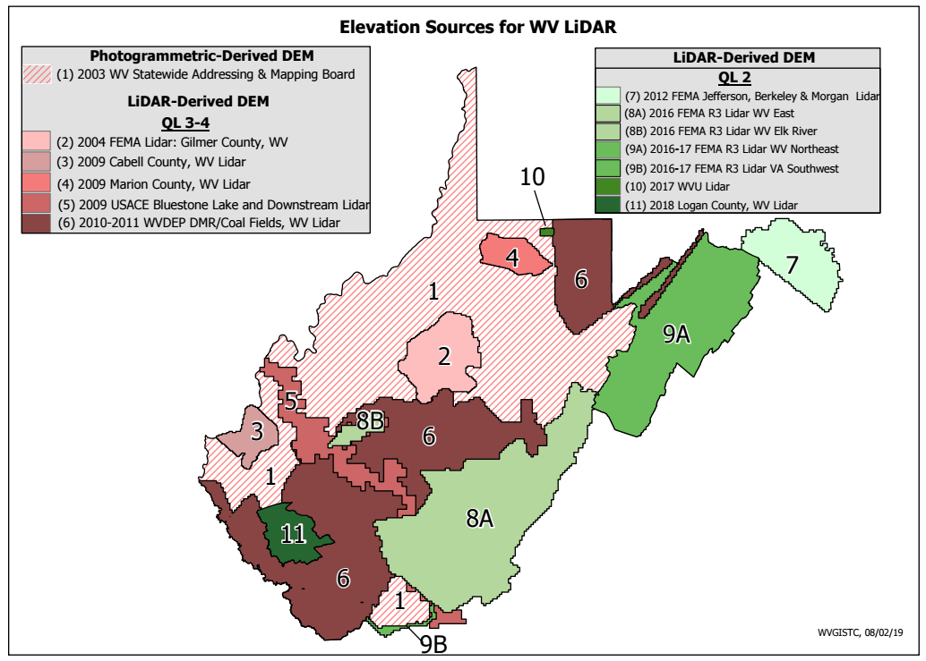

Elevation Source
Source: FEMA 2016
Source Table
Source Graphic
Elevation Metadata
WV Elevation Source Listing and Graphic: https://www.mapwv.gov/floodtest/docs/WV_FloodTool_ElevationSource_Metadata.pdf

Slide 16
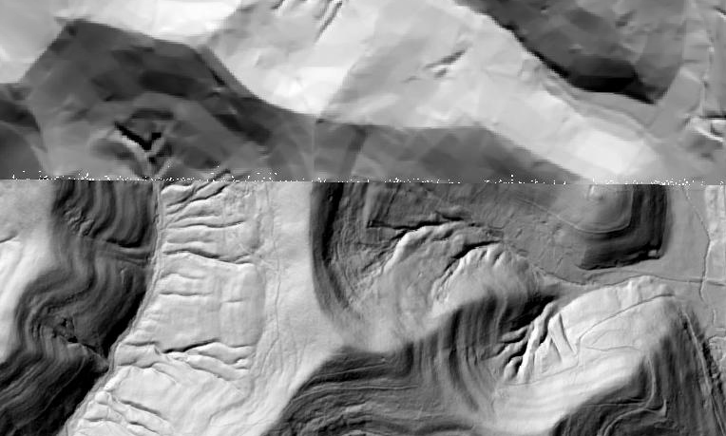
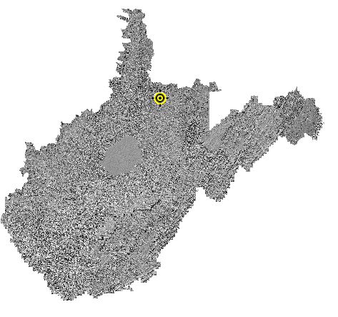
Statewide Elevation Layers
Elevation Grids, Hillshade Grids, Contours, used for Flood Depths, Imagery Orthorectification
Layer | Source | Coverage
SAMB | 2003 SAMB, 3-meter, 10-foot contours | Statewide
Lidar | Lidar, 2-foot or 1-foot contours | Select Areas
SAMB ELEVATION
WV DEP SAMB-Lidar Hillshade
LIDAR ELEVATION

Slide 17

High Resolution Elevation
New FEMA LiDAR-Derived Contours are 10x better than 2003 Statewide Elevation Data Set
SAMB Elevation
10 FT Contours
FEMA LiDAR
1 FT Contours

Slide 18
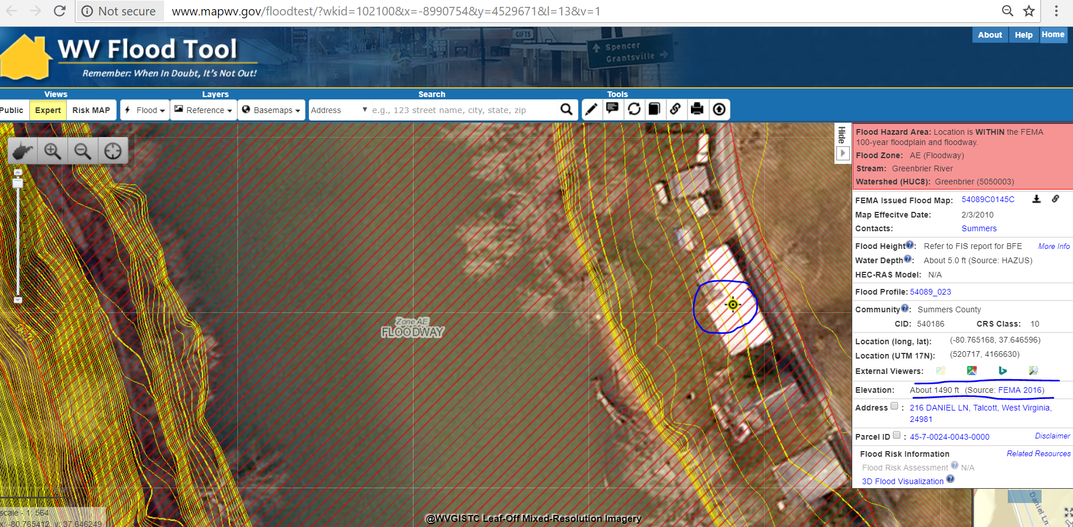
LiDAR-Derived 1-FT Contours
The WV Flood Tool Allows Users to View:
Ground Elevation 1-M DEM Value/1-Ft. Contour, Water Depth, and Flood Height (WSEL) if available
Source: FEMA 2016
FEMA-purchased elevation data can be accessed through State Data Clearinghouse www.mapwv.gov/lidar or the U.S. Geological Survey’s The National Map

Slide 19
Spatial Data Development
Aerial Imagery

Slide 20
New Aerial Imagery
2018 USDA National Agriculture Imagery Program (NAIP) (2-ft pixel resolution)
2019 County Leaf-Of Aerial Imagery
(4-inch pixel resolution)
Imagery can vary greatly in resolution. Pixel resolution refers to the actual distance on the ground that each pixel represents in the orthophotography. For example, four-inch pixel resolution means that each pixel in the image covers four inches on the ground.

Slide 21
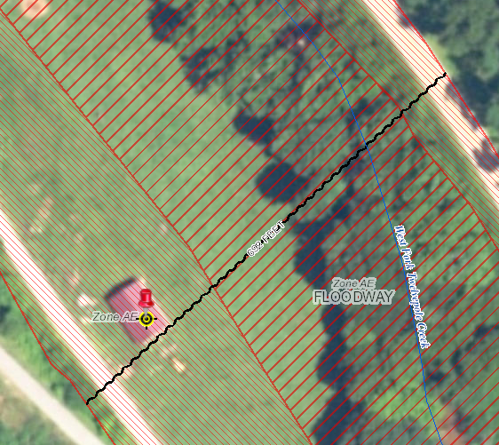
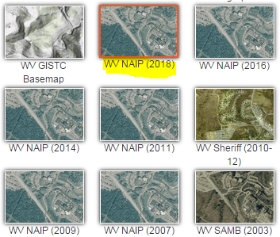
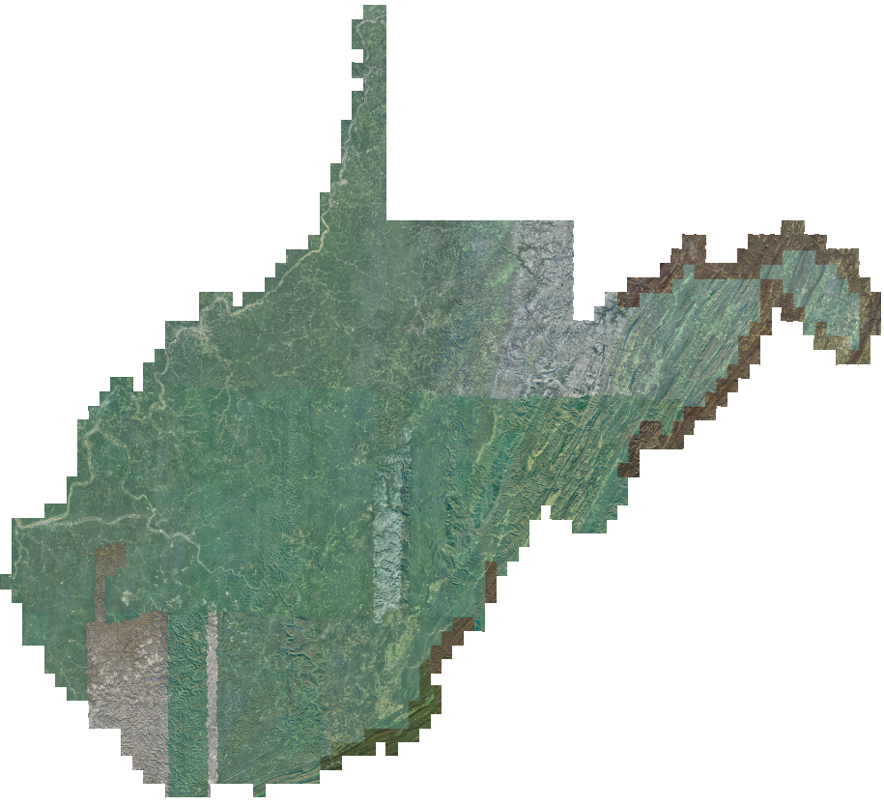
New 2018 NAIP Aerial Imagery
Choose WV NAIP (2018) from Base Map Layers Pulldown Menu
http://www.mapwv.gov/floodtest/?wkid=102100&x=-9176629&y=4583554&l=13&v=1
2-Foot Pixel Resolution
Statewide Coverage
2018 NAIP

Slide 22
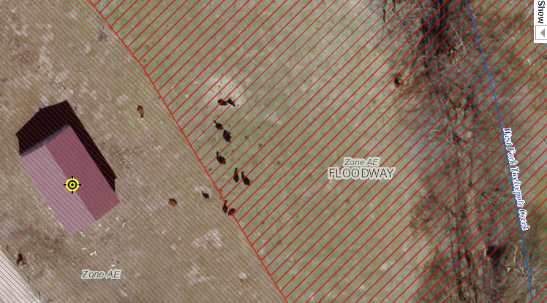
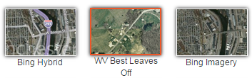
New 2019 Leaf-Off Aerial Imagery
http://www.mapwv.gov/floodtest/?wkid=102100&x=-9176629&y=4583554&l=13&v=1
4-inch Resolution Leaf-Off Aerial Imagery
Braxton
Calhoun
Clay
Gilmer
Harrison
Jackson
Monongalia
Pocahontas
Roane
Monongalia
Wayne
More 2019 county aerial imagery to be added
4-Inch Pixel Resolution
Choose WV Best Leaves Off Base Map
Cows in the Floodway
West Fork Twelvepole Creek, Wayne County

Slide 23
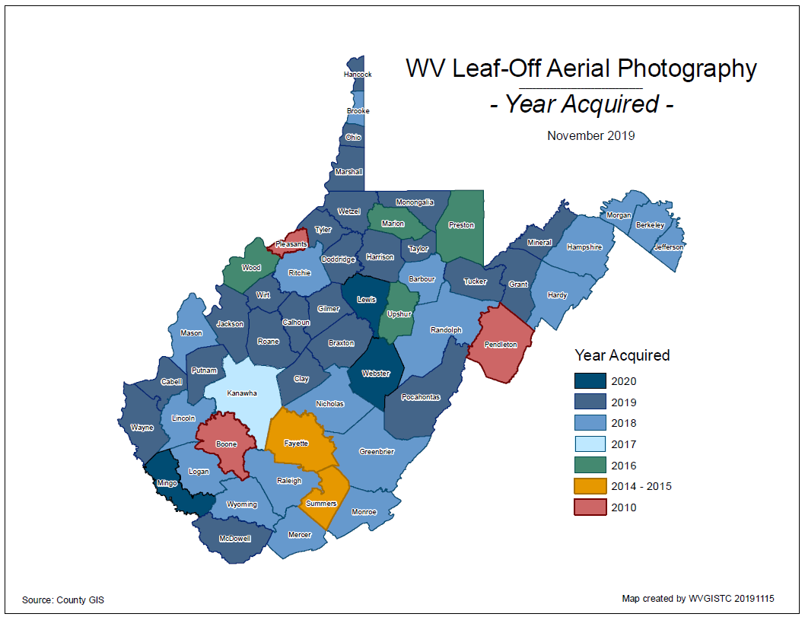
County Imagery – Year Acquired

Slide 24
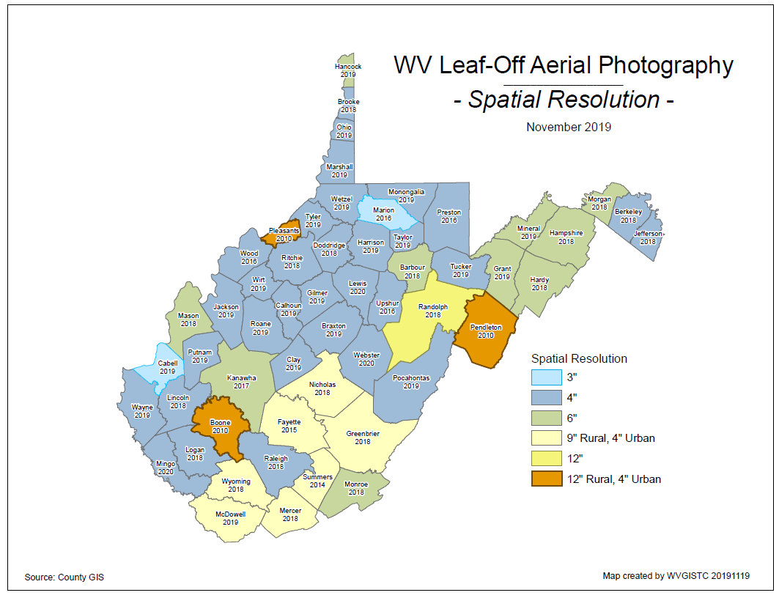
County Imagery – Spatial Resolution

Slide 25
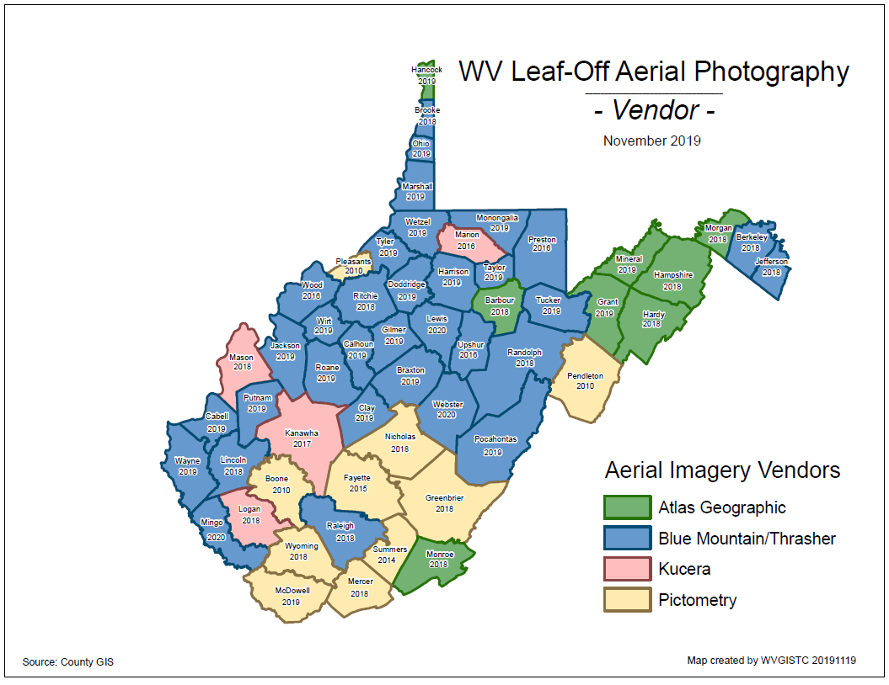
County Imagery – Vendor

Slide 26
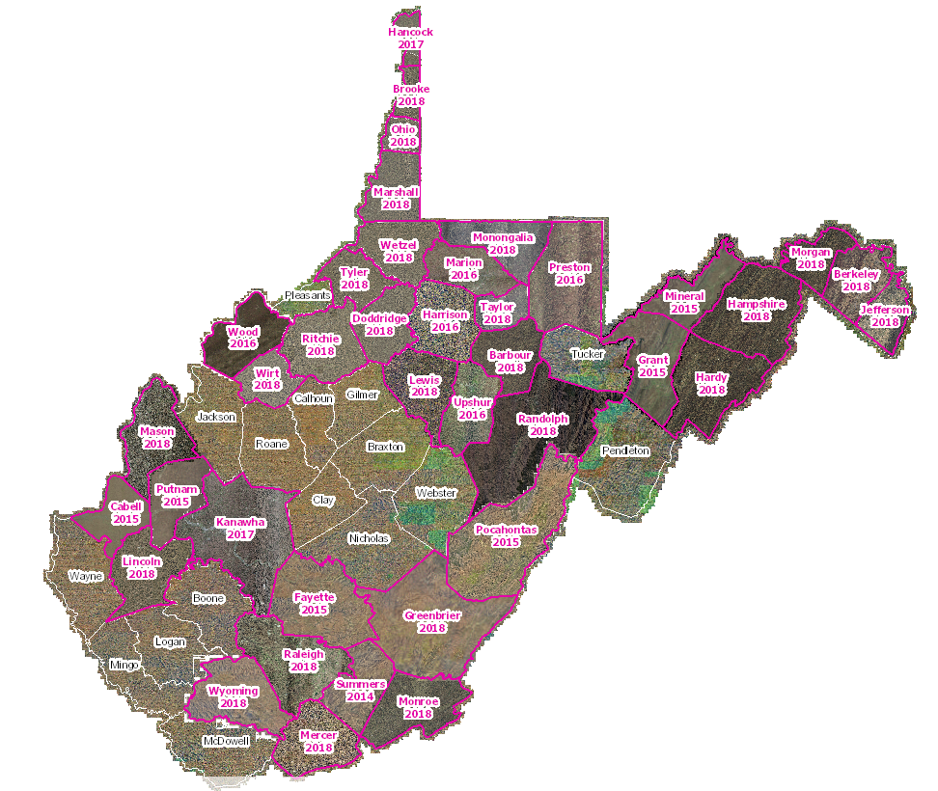
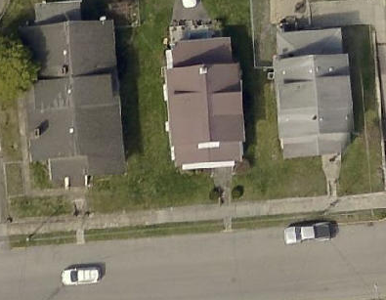
Leaf-Off Aerial Imagery Web Service
https://services.wvgis.wvu.edu/arcgis/rest/services/Imagery_BaseMaps_EarthCover/wv_imagery_WVGISTC_leaf_off_mosaic/MapServer?f=jsapi
Counties provide leaf-off imagery
for State Imagery Web Service
2018 Mercer County
Aerial Imagery

Slide 27
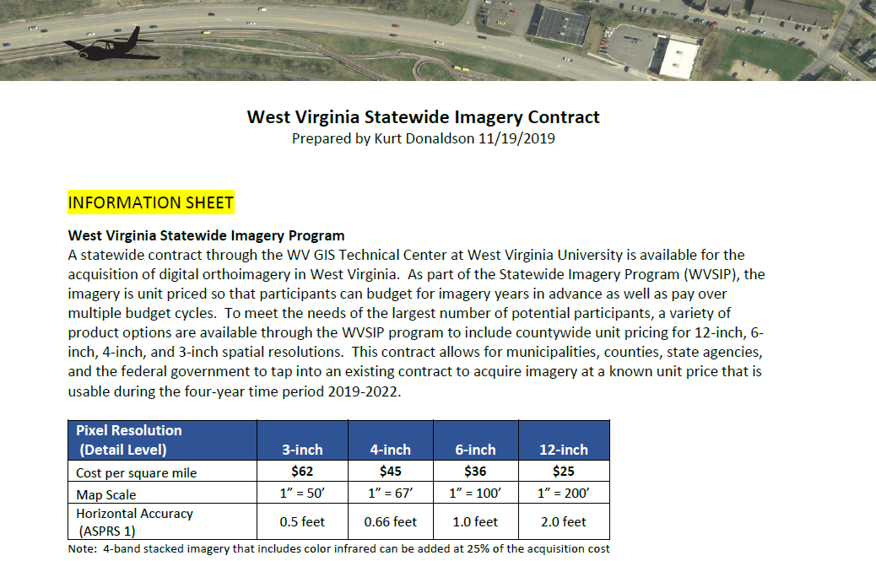
State Imagery Contract (2019-22)
Statewide Contract –
Unit Prices

Slide 28
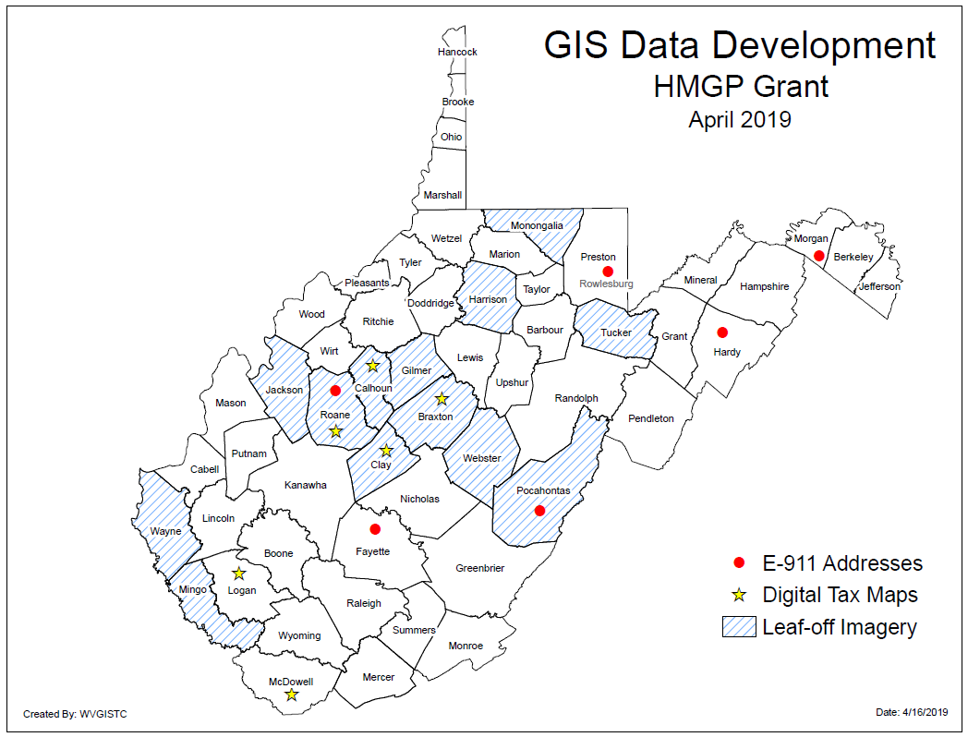
FEMA Grant – GIS Development
Statewide Parcel and Addressing Contract

Slide 29
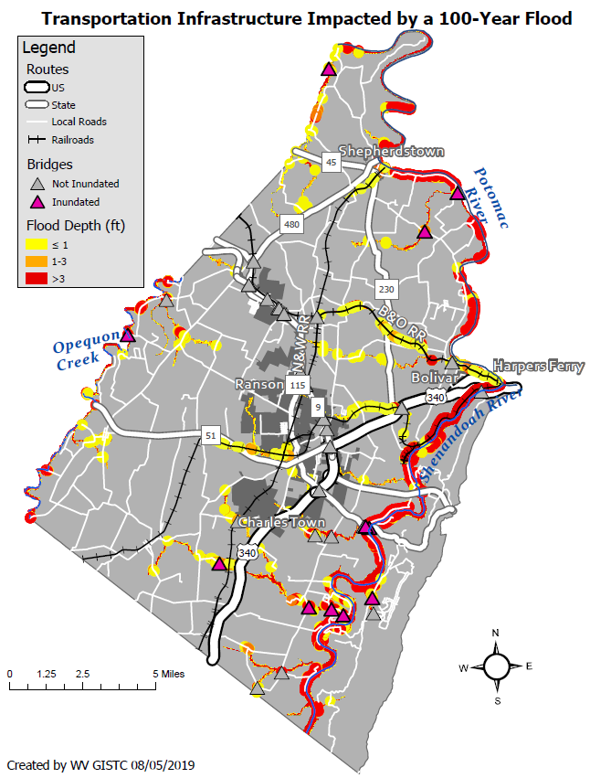
Transportation Infrastructure
Jefferson County, West Virginia
WATER DEPTH | VEHICLES
<= 1 foot | A foot of water will float many vehicles.
1 – 3 feet of water | Two feet of water will carry away most vehicles. Three feet of water will easily float a bus.
> 3 feet | All vehicles incur substantial water damage and can be carried away by flood waters.
WATER DEPTH | RESCUE RESPONSE
<= 1 foot | Response focused on those who need additional assistance.
1 – 3 feet of water | A high-water vehicle rescue limit is about 3 feet.
> 3 feet | Boats and helicopters are required to perform high water rescues when water depths exceed three feet. The risk to people increases with higher water velocities and flood depths.
Sample Flood Hazard Map on Transportation Infrastructure

Slide 30
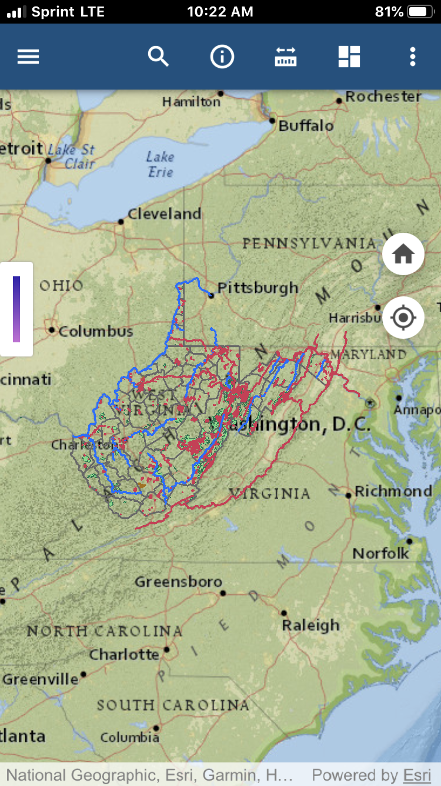
Trail Mobile Application - Prototype

Slide 31
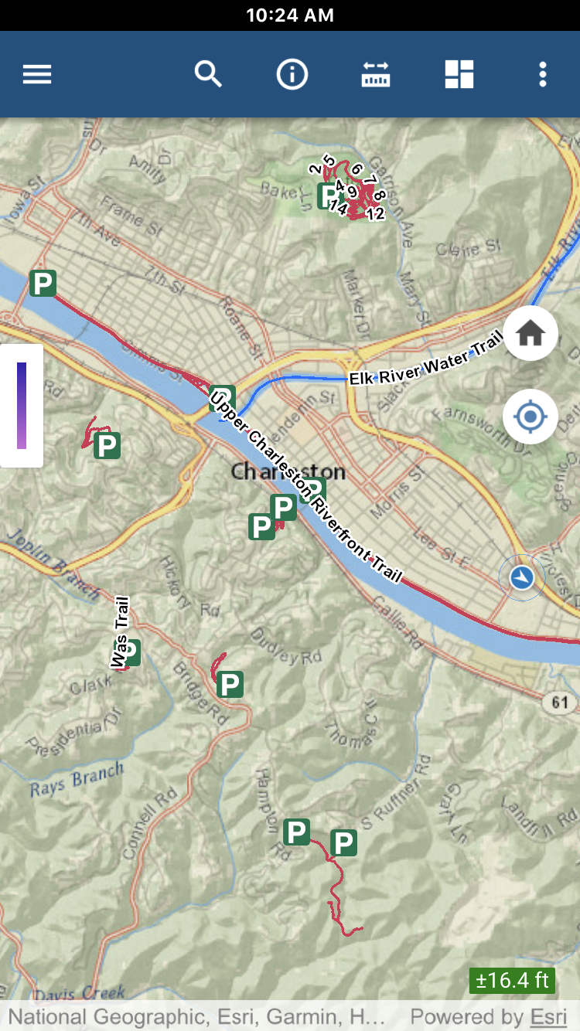
Trail Mobile Application

Slide 32
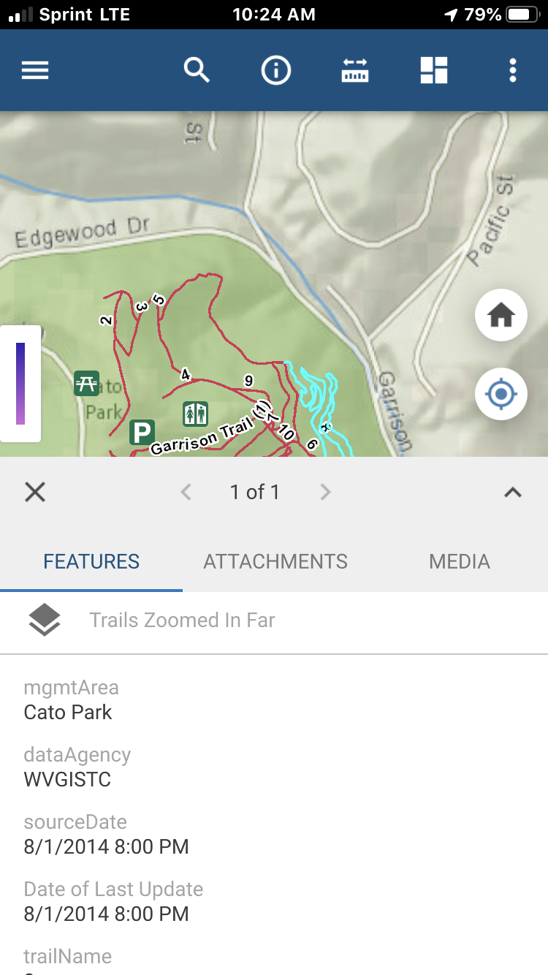
Trail Mobile Application

Slide 33
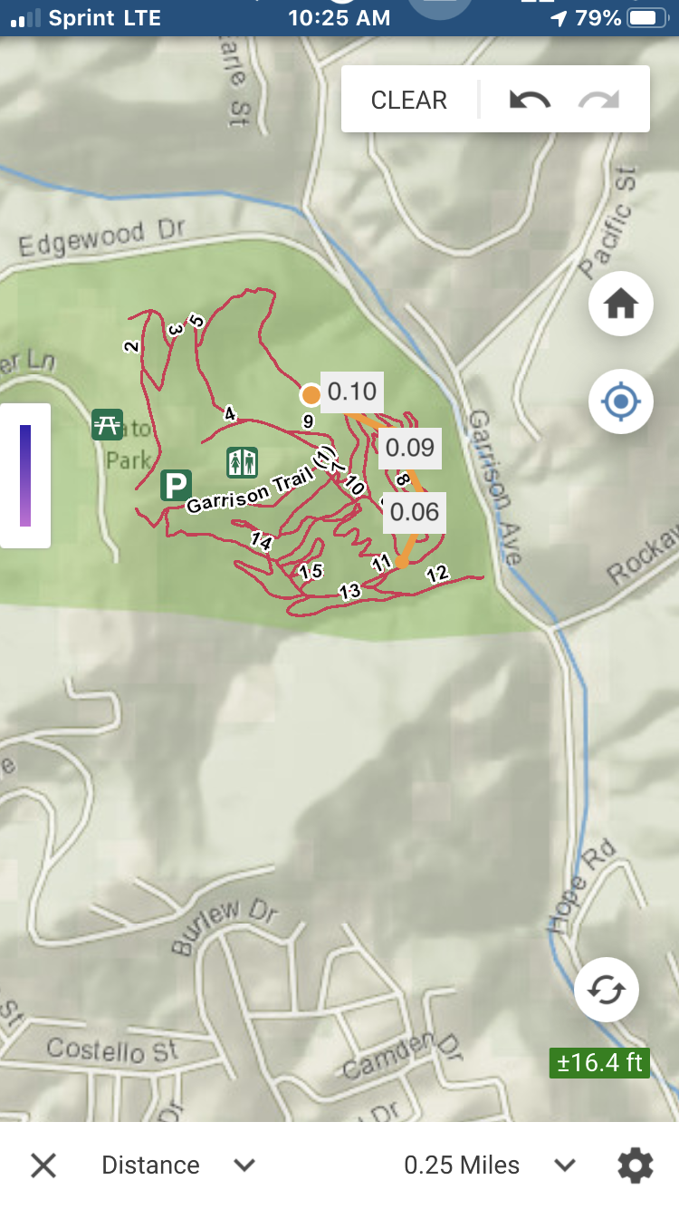
Trail Mobile Application

