Slide 1
WV DOT GIS DAY – November 2020
Kurt Donaldson

Slide 2
WV Trail Inventory
Trail Inventory and Applications

Slide 3
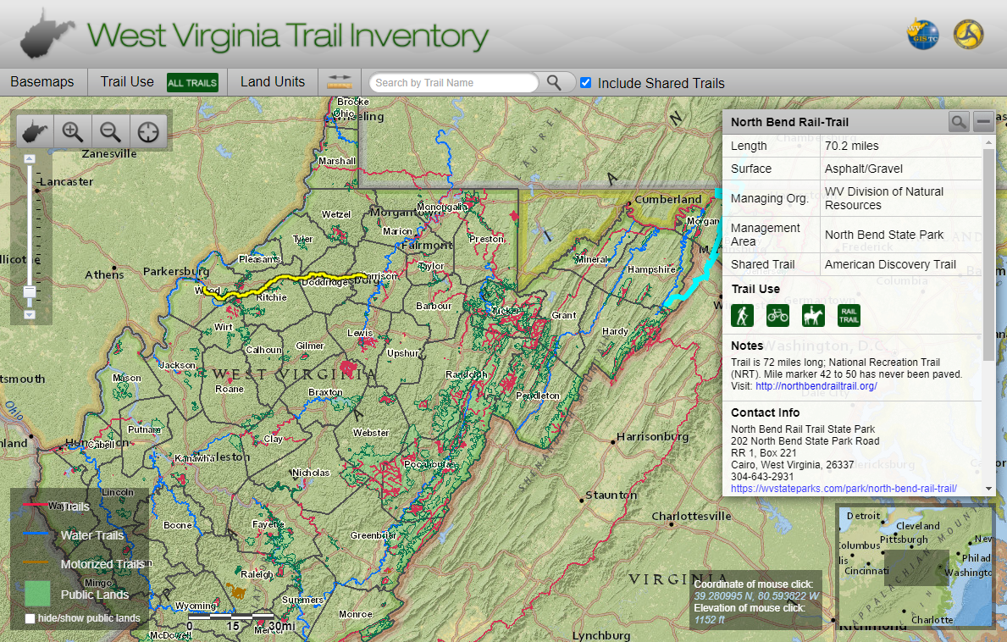
WV Trail Inventory
https://www.mapwv.gov/Trails

Slide 4
WV Trail Inventory
 | Non-Motorized | Motorized | Sum
Total Number | 3,359 | 430 | 3,789
Total Distance (Mi) | 4,609 | 705 | 5,314
 | Bluewater | Whitewater | Sum
Total Number | 21 | 276 | 297
Total Distance (Mi) | 1,264 | 2,111 | 3,373

Slide 5
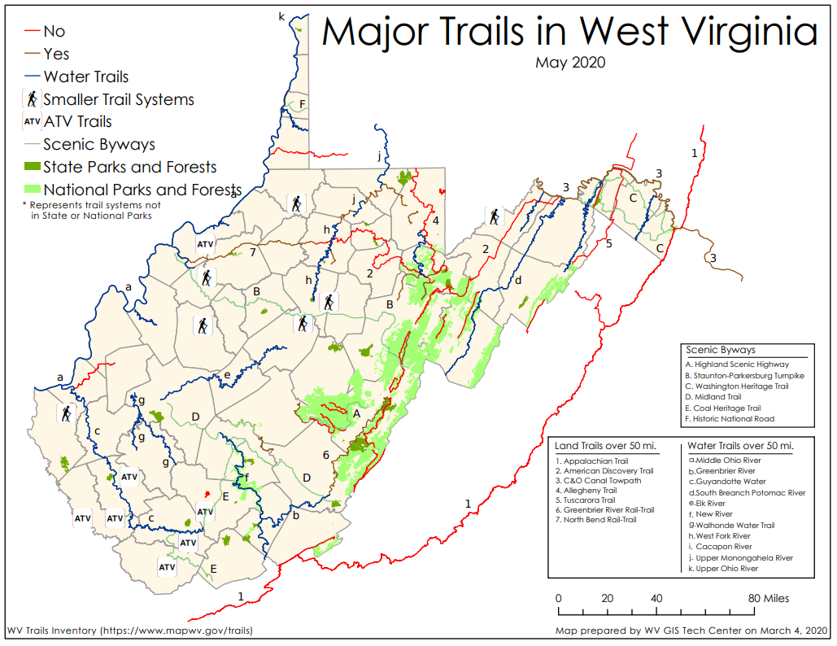
Land Trails

Slide 6
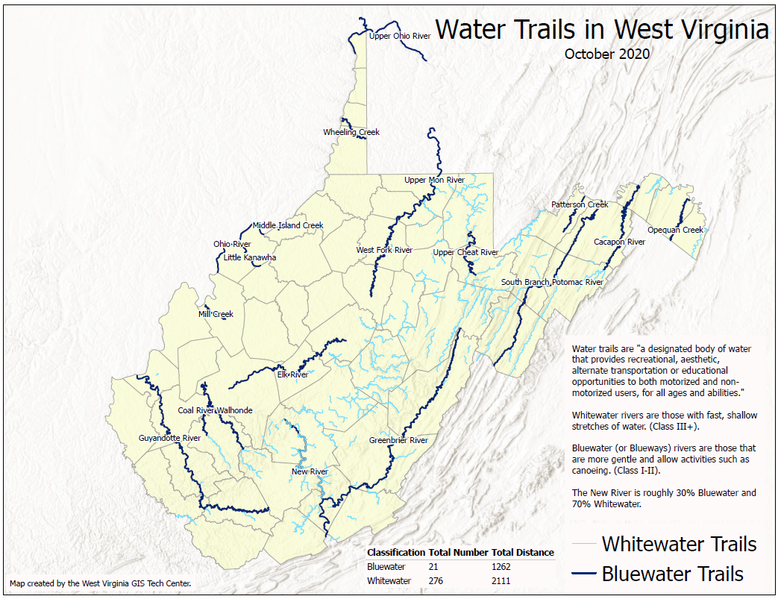
Water Trails
Need to verify Bluewater trails designated by WV DOT Recreational Trail Advisory Board

Slide 7
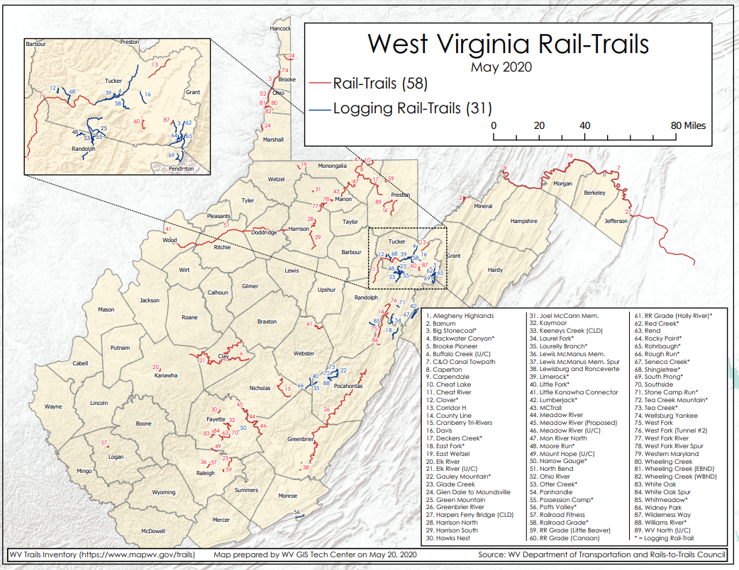
Rail-Trails

Slide 8


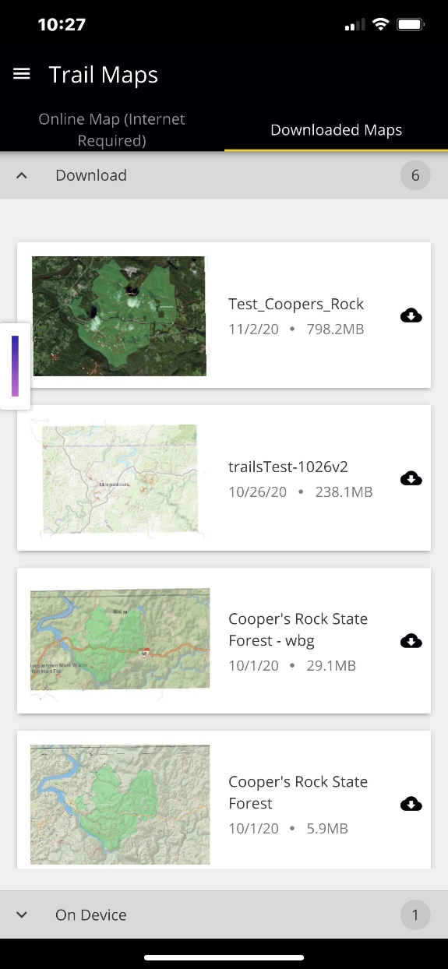
The New Trails Application: Starting Up and Choosing Your Mode
Trail Mobile Application - Prototype
Start up
Online Maps
Downloadable Maps

Slide 9
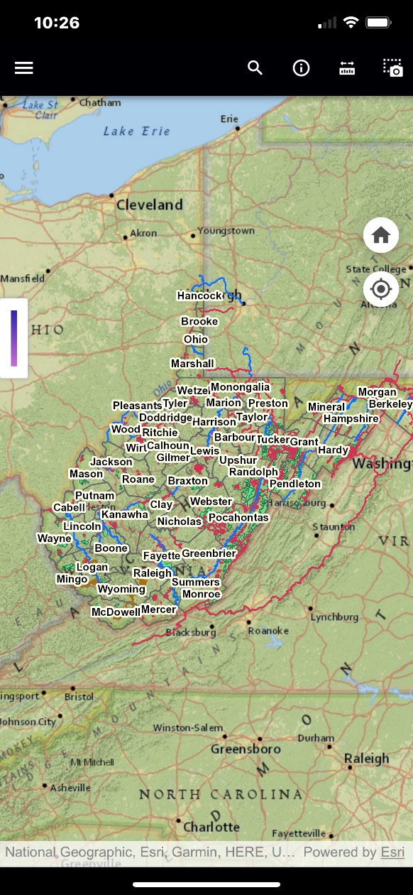
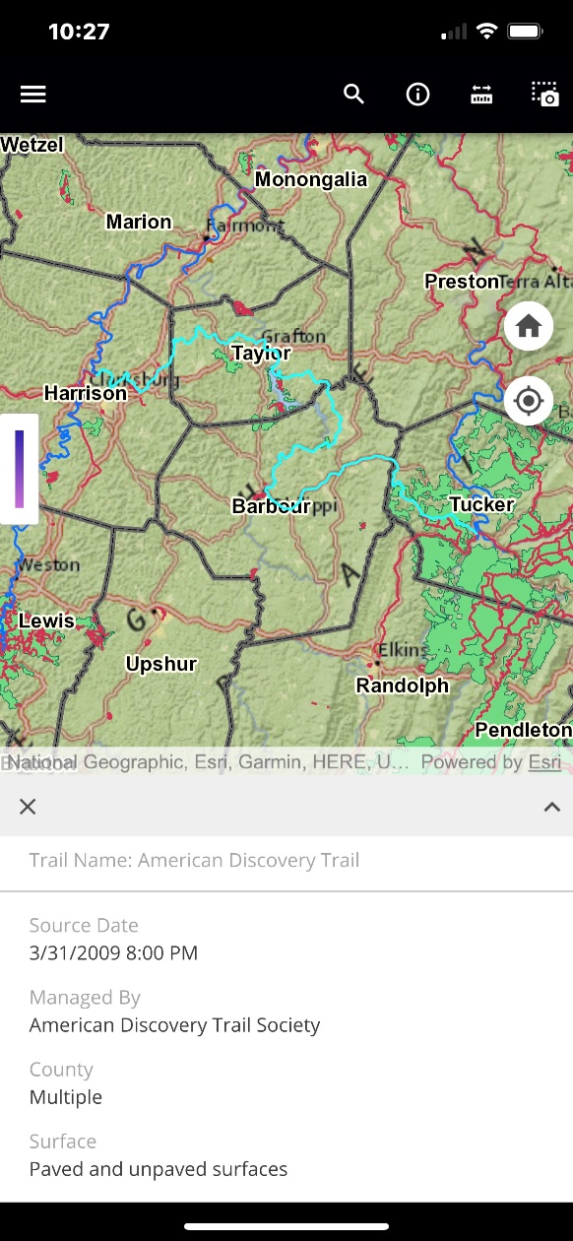
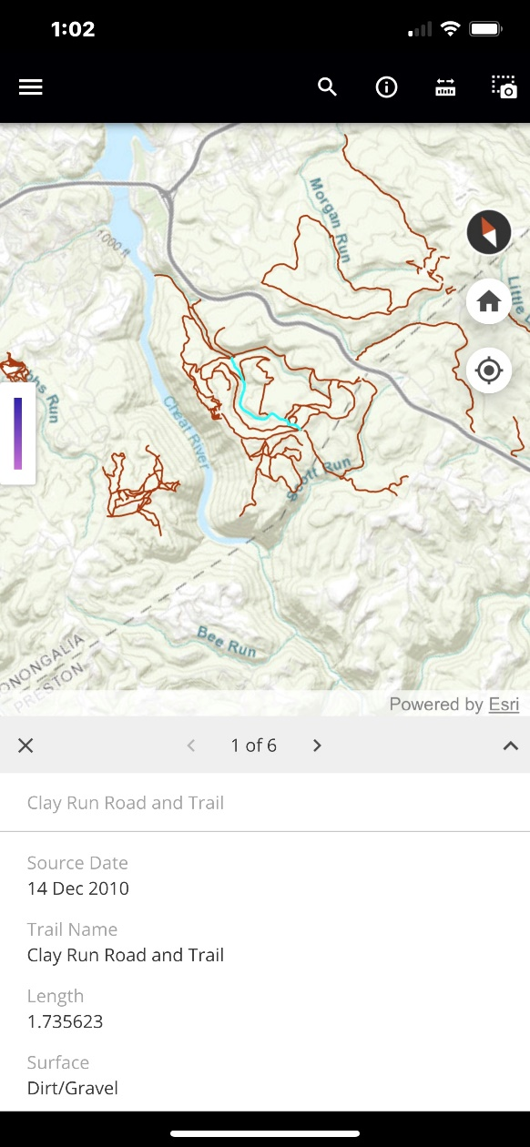
The New Trails App: Online and Offline Maps
Trail Mobile Application
Both Maps
Same Data Source
Same Symbology
Same Tools
Different Backgrounds
Online Maps
Requires Connection
Uses same source as web map
Offline Maps
Download individual park maps
Optimized for download
Published periodically
Online Map
Offline Map

Slide 10
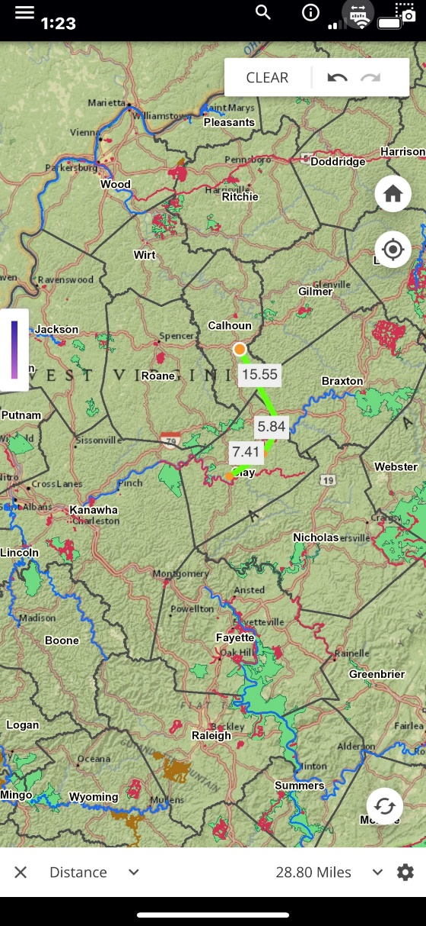
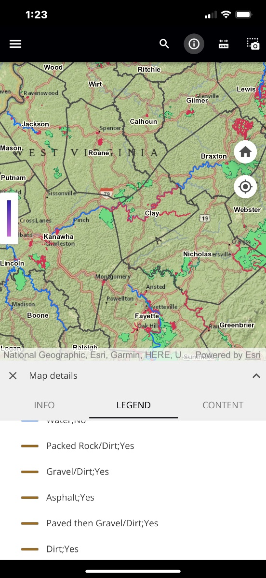
The New Trails App: Tools
Trail Mobile Application
Tools Include:
Measure multipoint distances and areas
Take and share Screen Shots
Search for location by name
Zoom to current location
Download additional maps – switch between them on the fly!

Slide 11
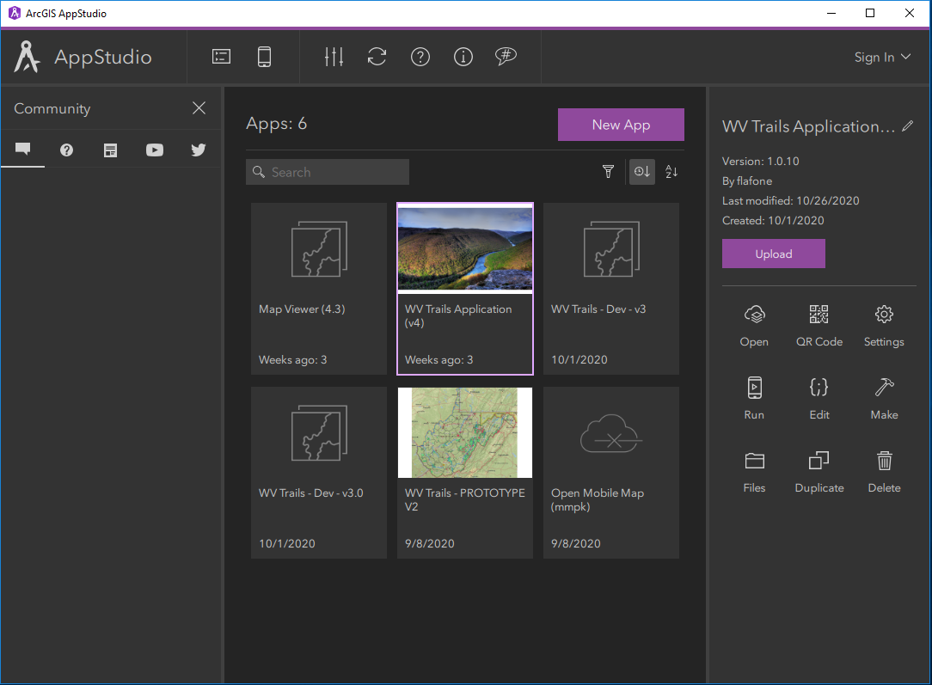
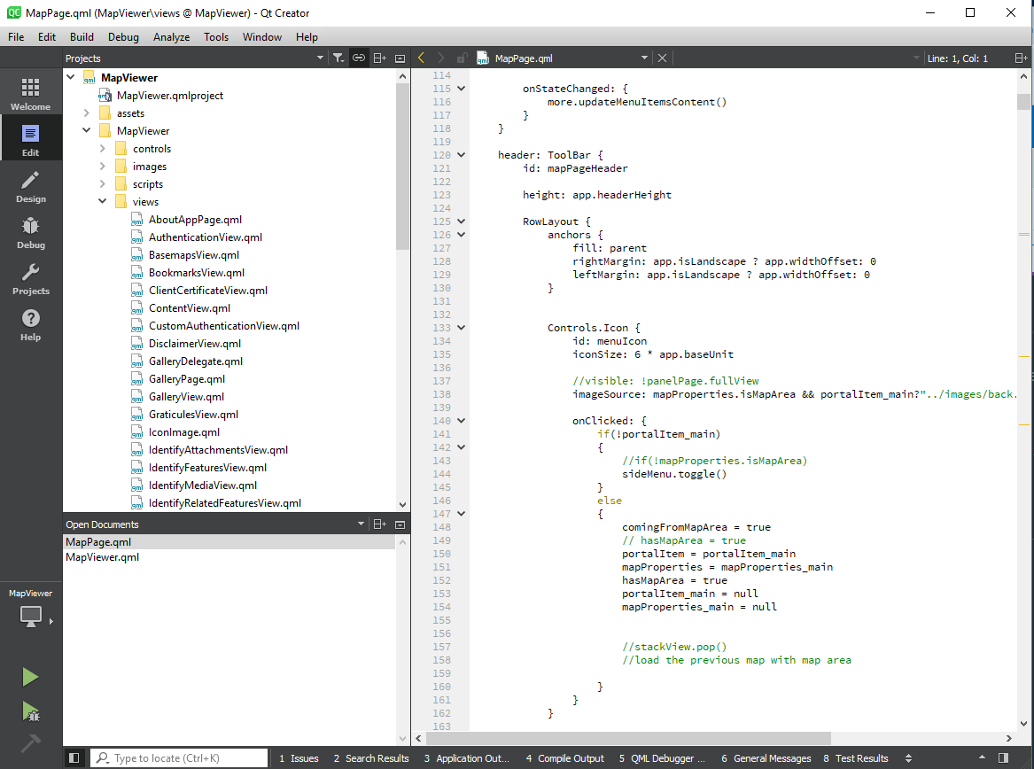
The New Trails App: Development Environment
Trail Mobile Application
Developed in ArcGIS App Studio
Cross platform development
Makes apps for iOS, Android, native Windows, and native MacOS with a check of a box.
Develop once, deploy everywhere
Uses Qt programming language
Like JavaScript but different
Analogy: Portuguese to Spanish
Model, View, Container development pattern
Powerful and comparatively rapid deployment of applications
…. With some limitations
Not all functions available, although more being brought online every week
Cannot easily integrate non-GIS functions/platforms/data (which is not an issue for this project)

Slide 12
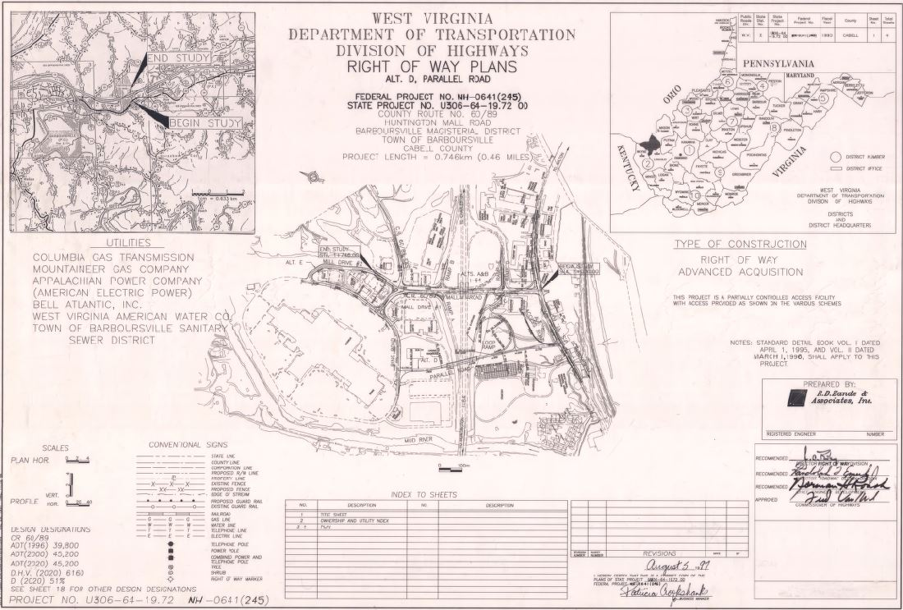
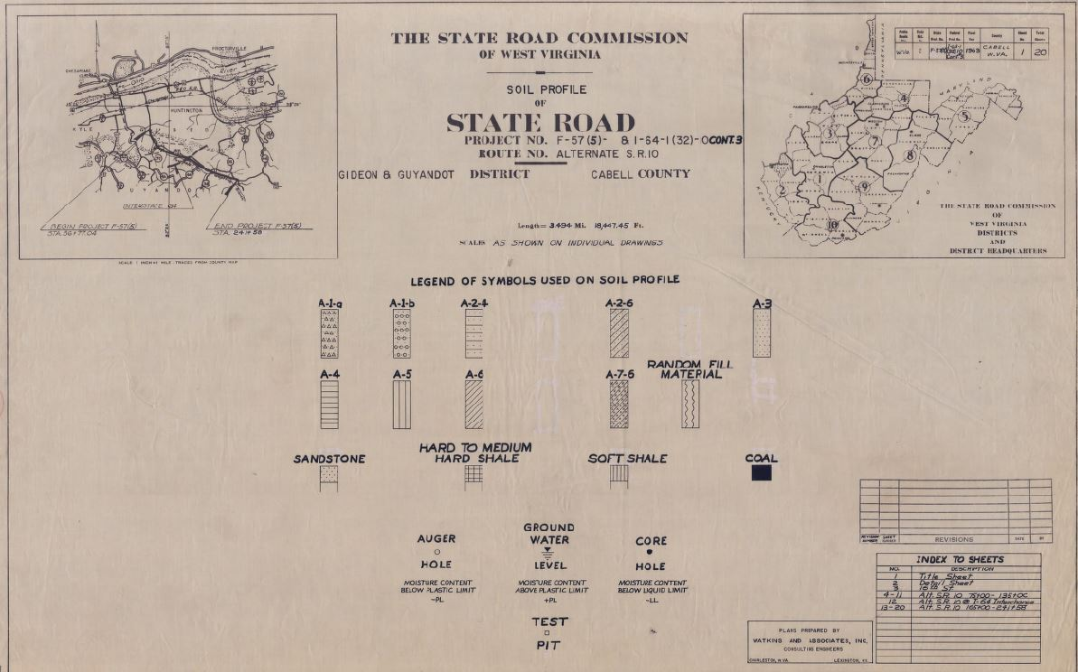
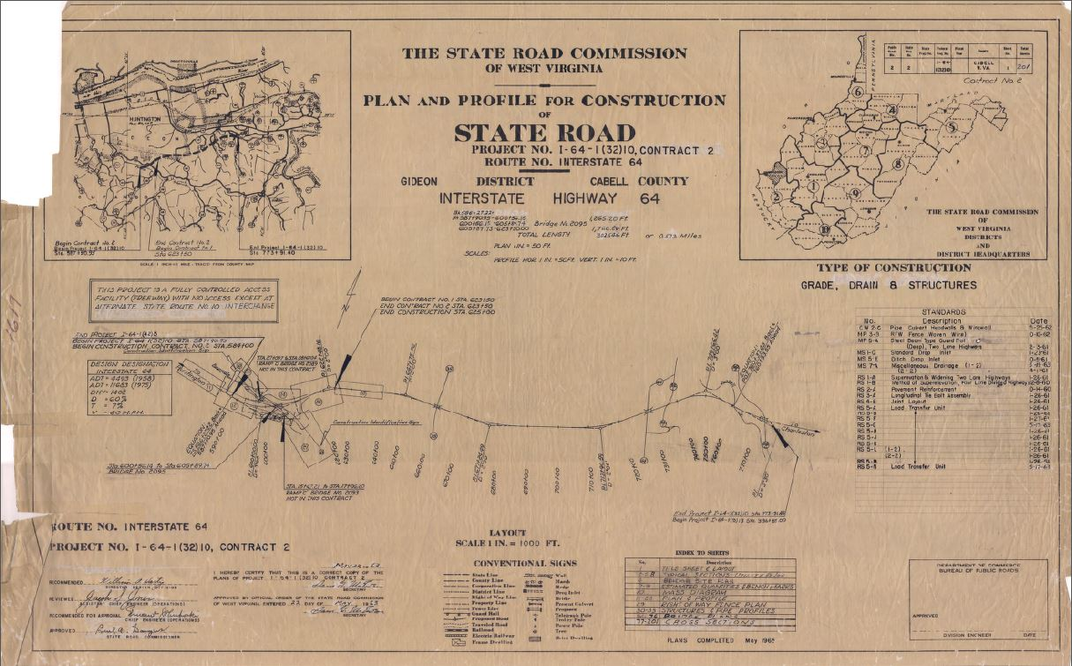
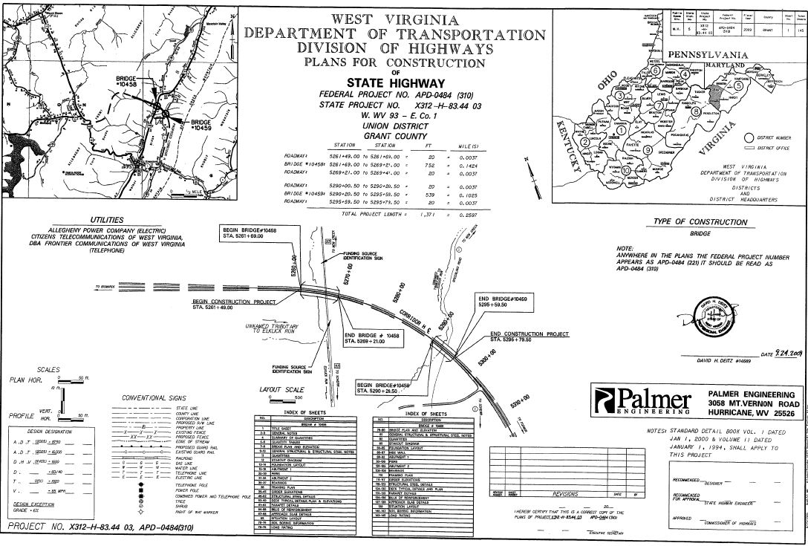


WV DOT Scanning Project

Slide 13
WV DOT Plan Scanning Project
Improved Management and Archival System
Electronic database manages the plan sets and associated documents
Eliminates lost drawings, misfiled drawings, and deterioration of drawings
Long-term digital storage integrated with ProjectWise content management system
Consolidates record plan sets in one location in digital database
Engineering plans, right of way plans, shop drawings, bridge plans, and roadway plans stored in multiple physical locations
Faster and Easier Access to Drawings
By anyone, at any time, from anywhere.
Improved document accessibility for both internal and external users
Access by non-spatial or spatial map queries

Slide 14

WV DOT Plan Scanning Project
Estimated Engineering and Right of Way divisions currently store approximately 1500 drawers and 200 rolled sets of plans.
Includes shop drawings, bridge plans, roadway plans, design calculations, and other files in the District 1 storage room.

Slide 15
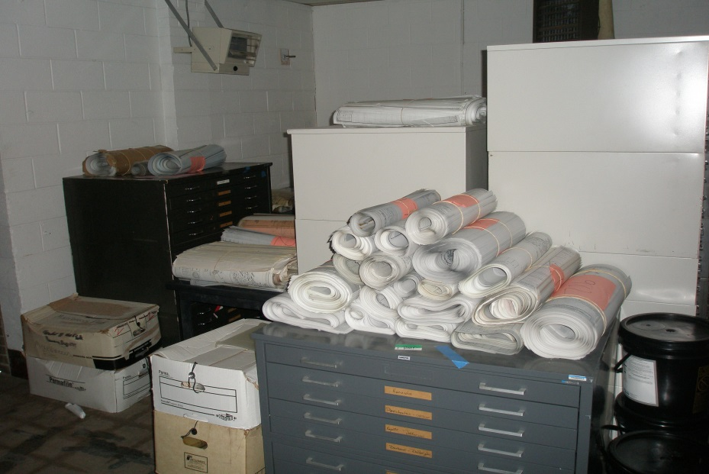
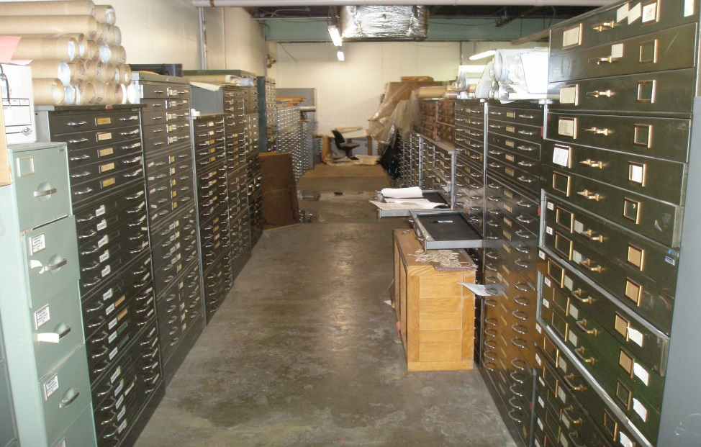
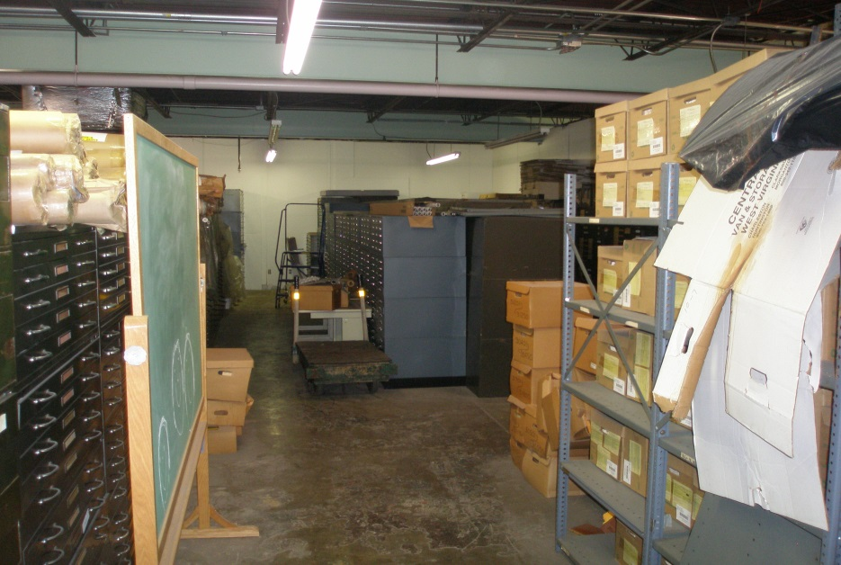
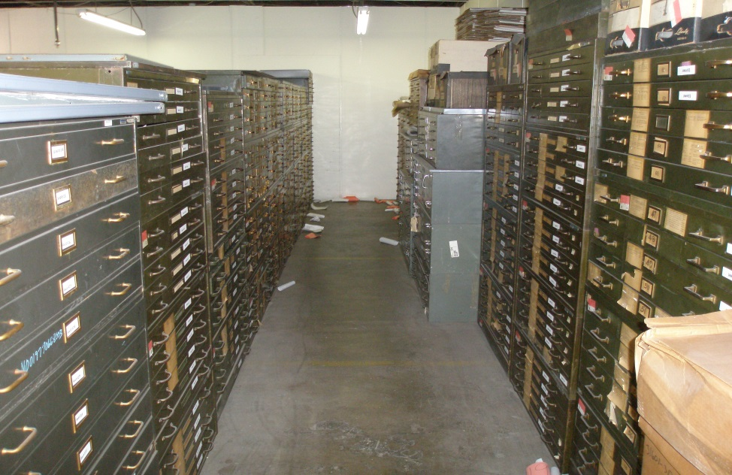
WV DOT Plan Scanning Project

Slide 16
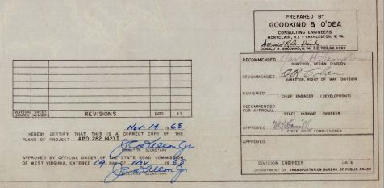
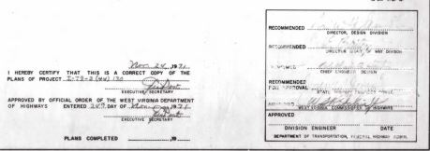

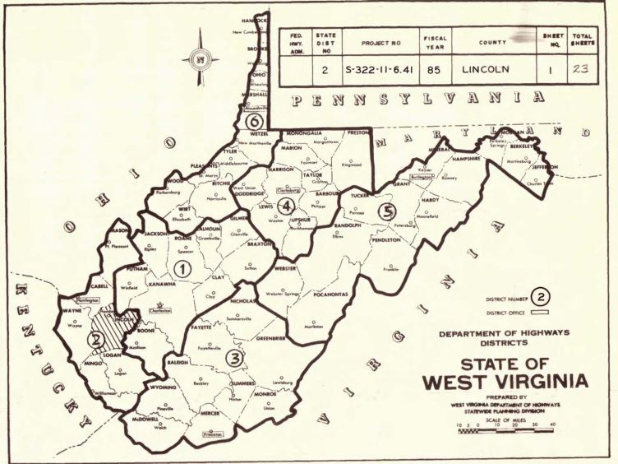
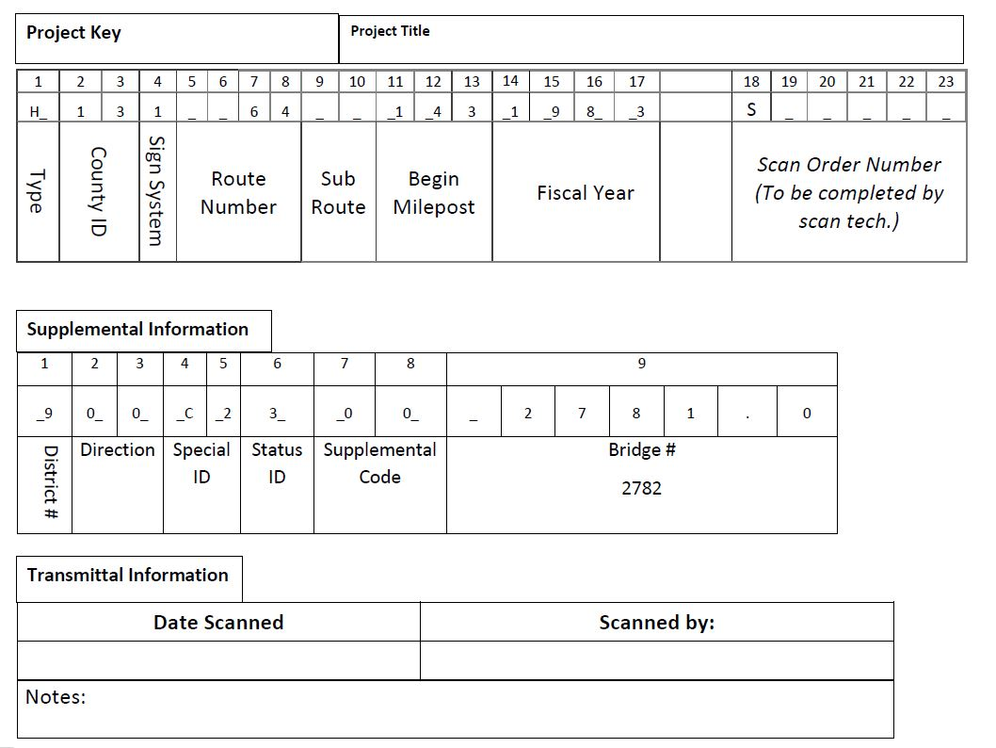

Transmittal Sheet
Developing the project key

Slide 17
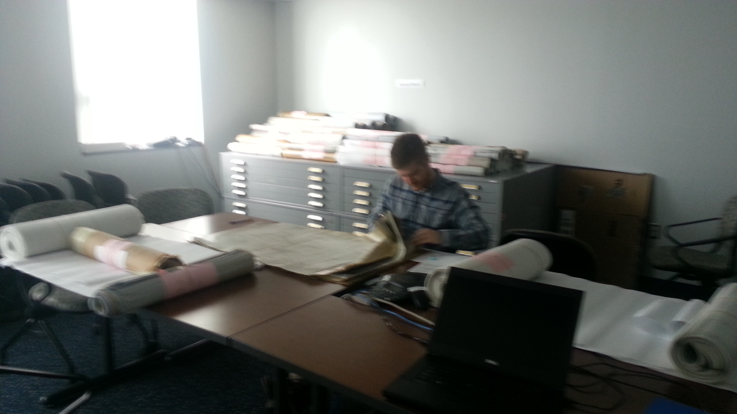
Plan Set Preparation

Slide 18
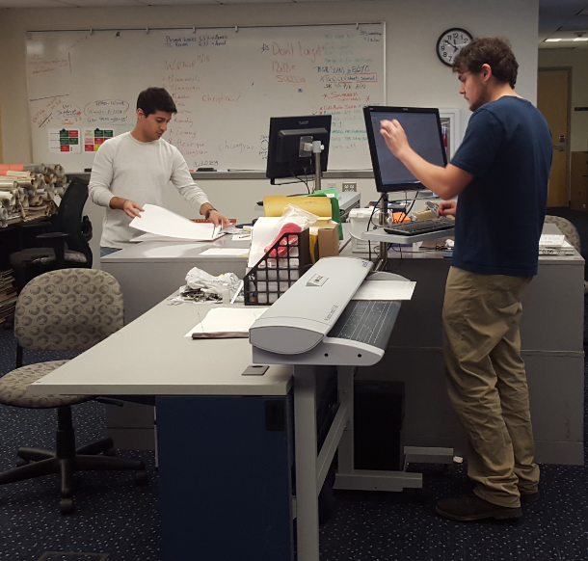



WV DOT Scanning Project
Scanning and Processing
Scanning
Scanning
Image Processing
Scanning

Slide 19
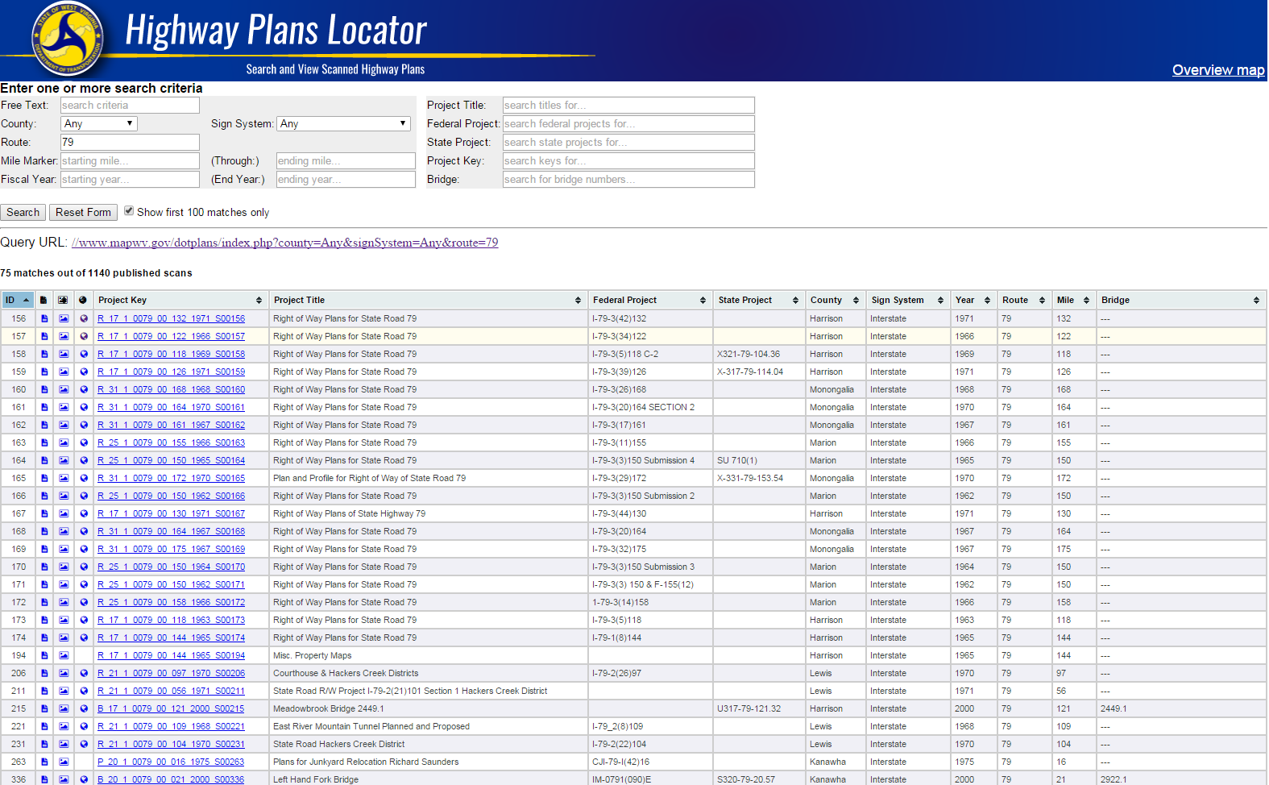
Highway Plans Locator
https://www.mapwv.gov/dotplans
Plan sets range in date between 1900 and 2014

Slide 20
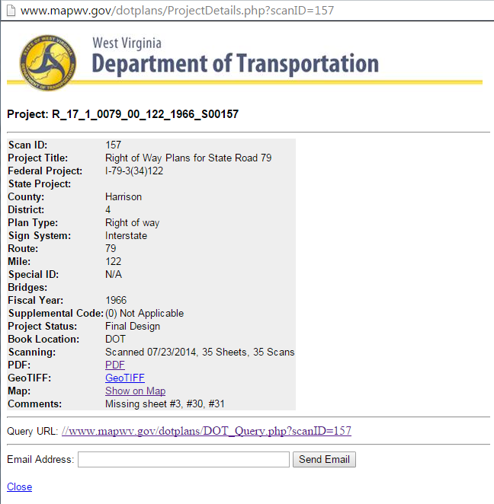
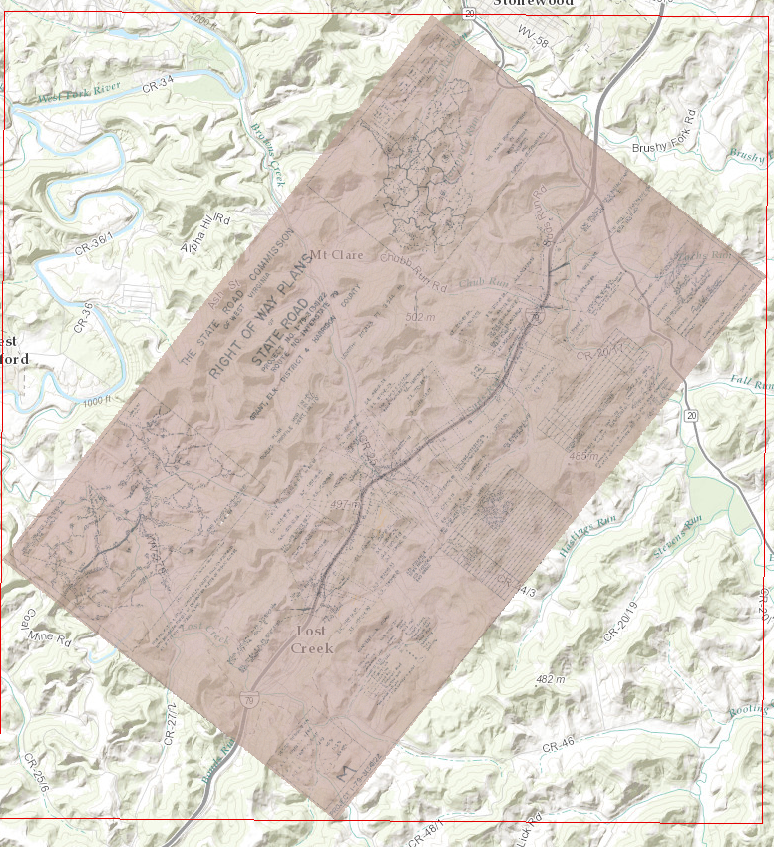
Non-Spatial and Spatial Searches
Online Highway Plans Locator
Detailed Record
Map It View

Slide 21
Microsoft SQL Server & Enterprise ArcGIS Geodatabase
System Design

Slide 22
Microsoft SQL Server & Enterprise ArcGIS Geodatabase
System Features
Multi-user ability
Used for recording scanning activity
Supports web feature mapping and image services
Updates are made automatically; not necessary to re-publish ArcGIS services in order to add new scan rasters
Backups are run using SQL Server Agent process
Geodatabase contains 3 primary objects
Raster mosaic as source of image service
Feature class of map footprints
Database view for published plans and web-based query interface
Python scripts automate processes
Renaming files
Calculate map extents
Copying GeoTiffs to publication folder
Building raster mosaic
Building footprints

Slide 23
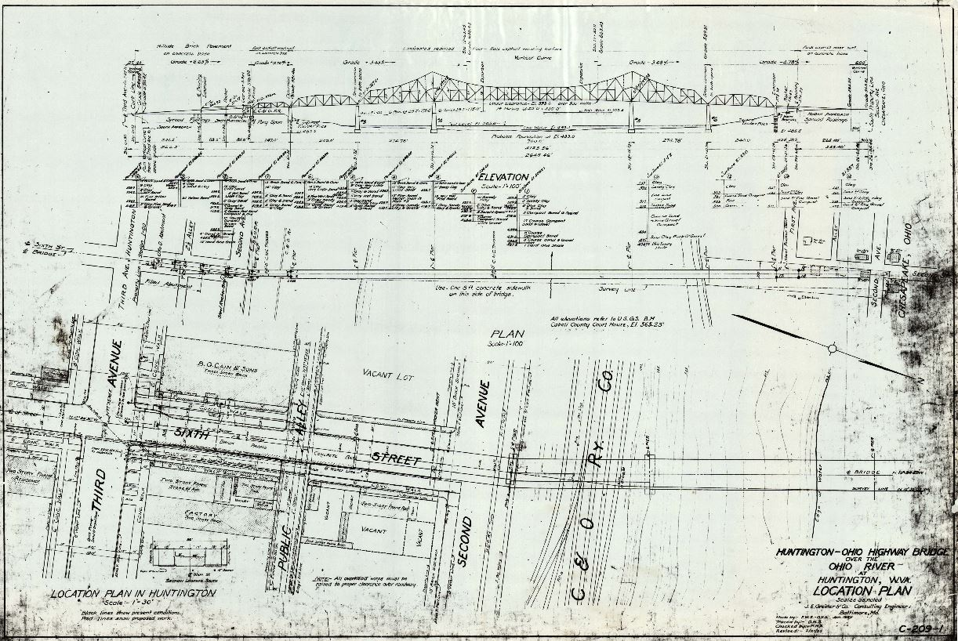
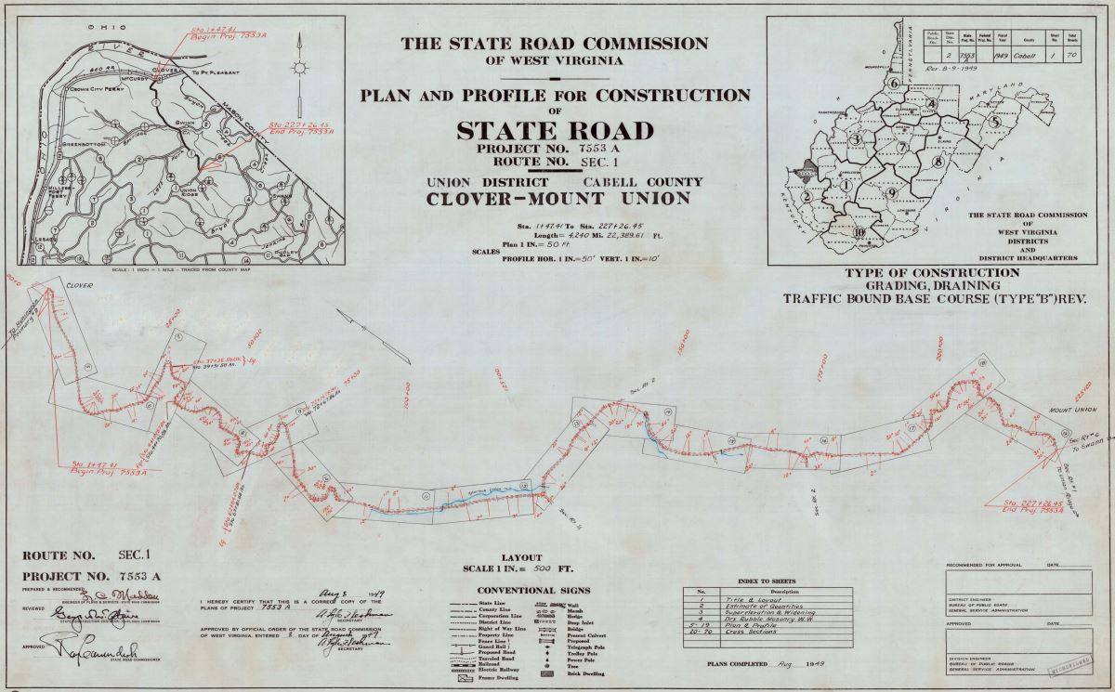
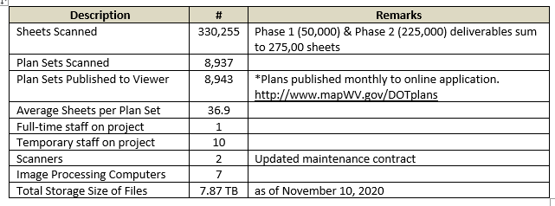
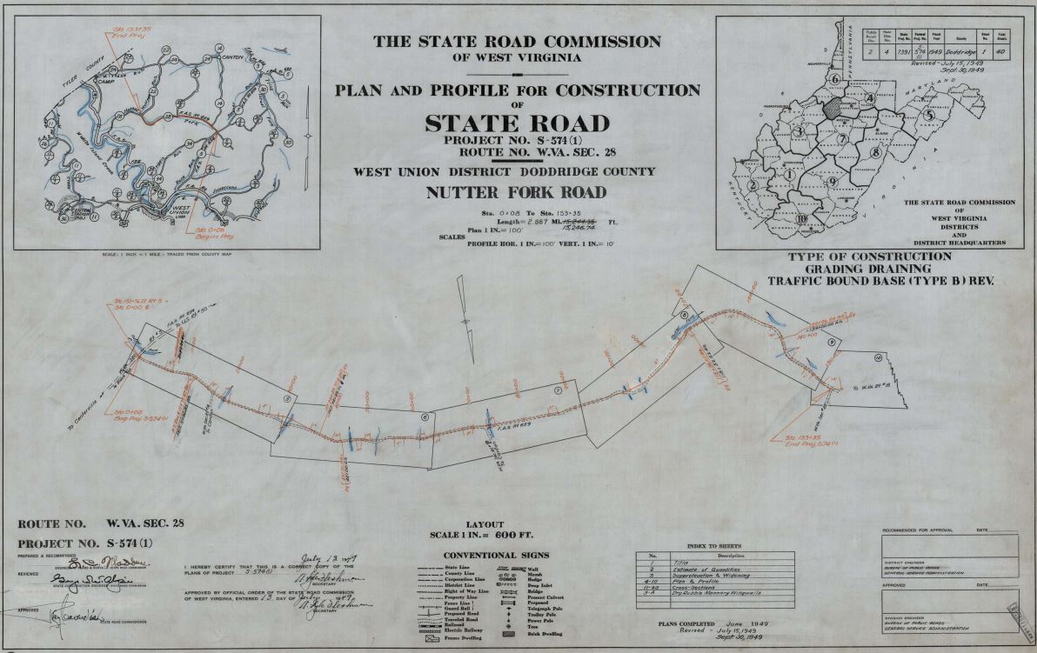
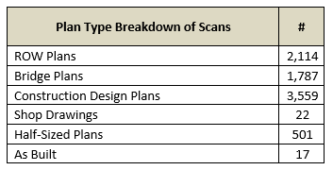
Transmittal Sheet
Scanning progress report for November 2020

Slide 24
Other Projects
Other Projects

Slide 25
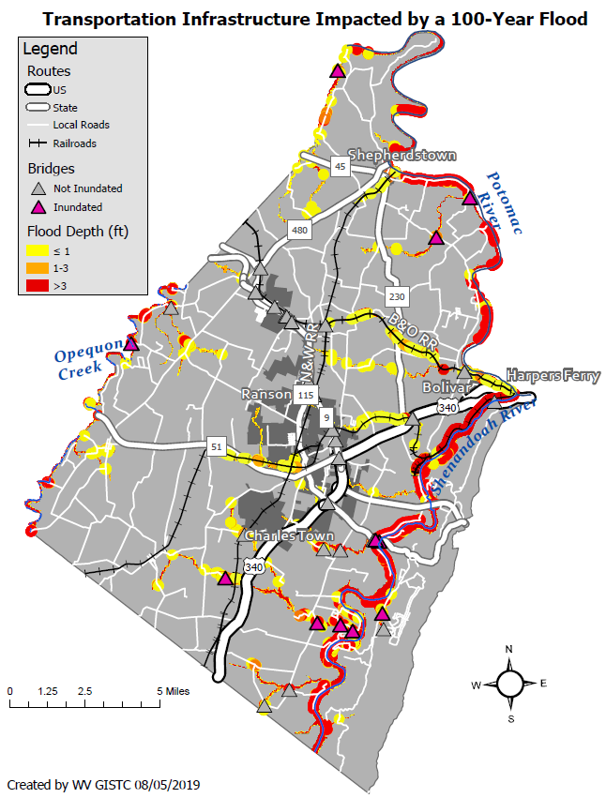
Transportation Infrastructure Impacted by 100-Year Flood
Jefferson County, West Virginia
WATER DEPTH | VEHICLES
<= 1 foot | A foot of water will float many vehicles.
1 – 3 feet of water | Two feet of water will carry away most vehicles. Three feet of water will easily float a bus.
> 3 feet | All vehicles incur substantial water damage and can be carried away by flood waters.
WATER DEPTH | RESCUE RESPONSE
<= 1 foot | Response focused on those who need additional assistance.
1 – 3 feet of water | A high-water vehicle rescue limit is about 3 feet.
> 3 feet | Boats and helicopters are required to perform high water rescues when water depths exceed three feet. The risk to people increases with higher water velocities and flood depths.
Sample Flood Hazard Map on Transportation Infrastructure

Slide 26
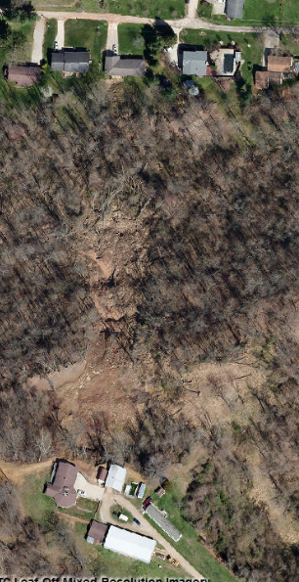
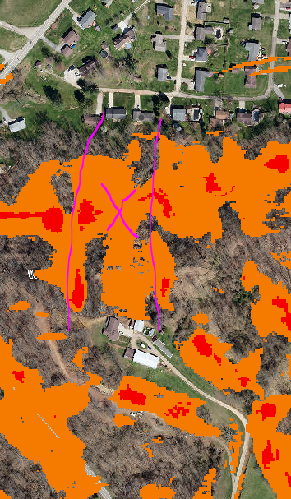
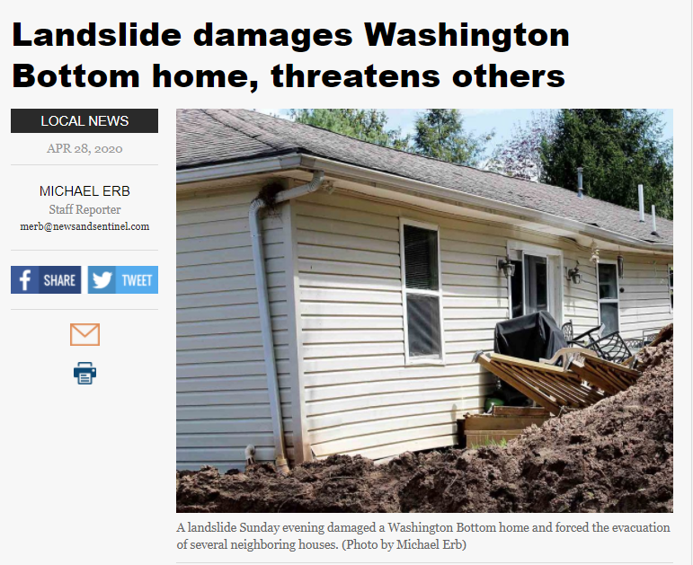
Landslide Susceptibility Maps
April 2020 Landslide
Wood County
Higher Risk

Slide 27
Spatial Reference Layers
Elevation Update

Slide 28
Elevation (High Resolution)
New FEMA Elevation LiDAR: Grant, Hampshire, Hardy, Mineral, Pendleton, Mercer; partial coverage Lincoln, Mason, Putnam, Wayne Counties
2017-18 FEMA-Purchased LiDAR
1-foot contours; 1-meter resolution Digital Elevation Model (DEM)
Berkeley and Morgan Counties
Created 2-foot contours from 2012 FEMA-Purchased LiDAR DEM and published to WV Flood Tool. Jefferson County published previously
Logan County
2018 County-Purchased LiDAR
Published 1-foot resolution DEM to WV Flood Tool
Elevation Products on WV Flood tool
Statewide 1 to 3-meter Digital Elevation Model
Statewide Hillshade (grayscale 3D representation of the surface)
1-ft and 2-ft Contours cached to 1:282 Map Scale (computer caching ongoing)
Updated Source Elevation Metadata https://www.mapwv.gov/lidar-metadata

Slide 29
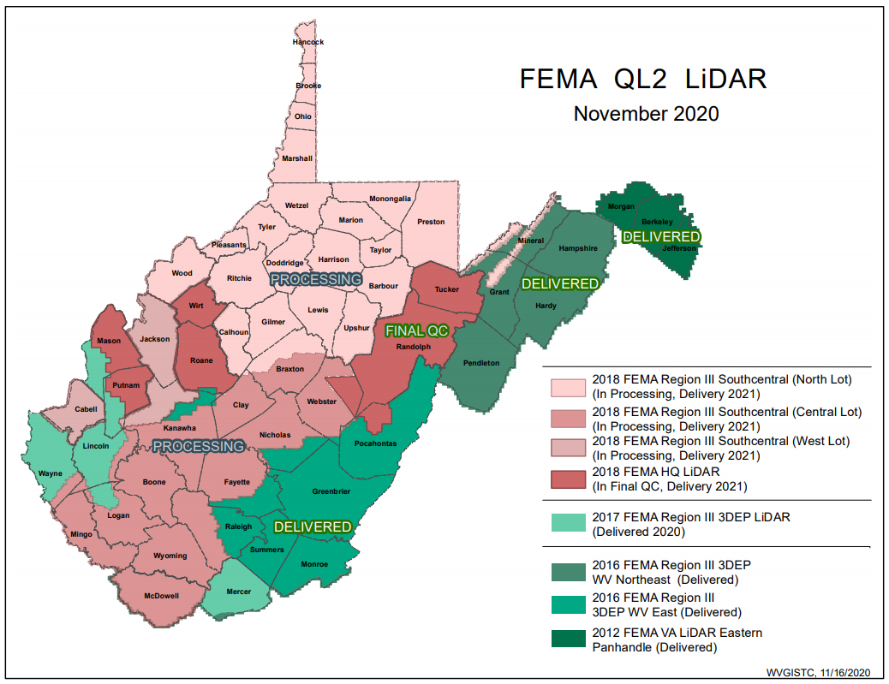
FEMA Purchased LiDAR Coverage
FEMA has purchased $10 million in QL2 LiDAR and entire State should be processed and delivered by 2021
Quality 2 (QL2) LiDAR support 1-foot contours
https://data.wvgis.wvu.edu/pub/RA/_resources/Status/FEMA-purchased_LidarCoverage.pdf

Slide 30
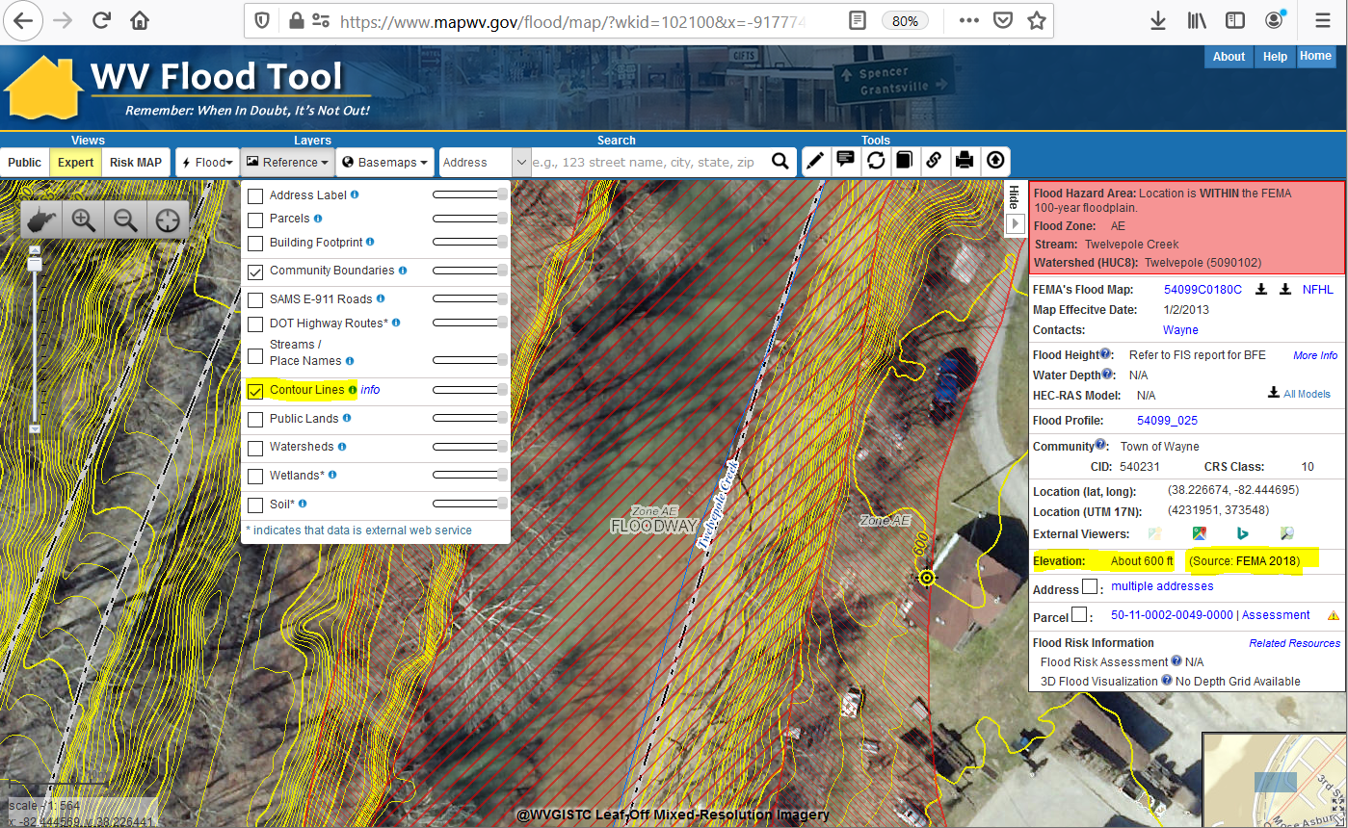
Ground Elevation: 1-ft. Contours
https://www.mapwv.gov/flood/map/?wkid=102100&x=-9177701&y=4611497&l=13&v=1
Make Contour Lines visible under REFERENCE LAYERS
1-FOOT CONTOUR ELEVATION VALUE OF 600 FEET MATCHES 1-METER GRID SURFACE ELEVATION OF 600 FEET DISPLAYED IN QUERY RESULTS PANEL
1-ft Contours Display at two Highest Zoom Levels (1:564 and 1:282 Map Scales)
Elevation: 600 ft.
Source: FEMA 2018
600 ft.
1-foot contours published for 10 counties
FEMA LiDAR-Derived Products: 1-Meter DEM and 1-Foot Contours

Slide 31
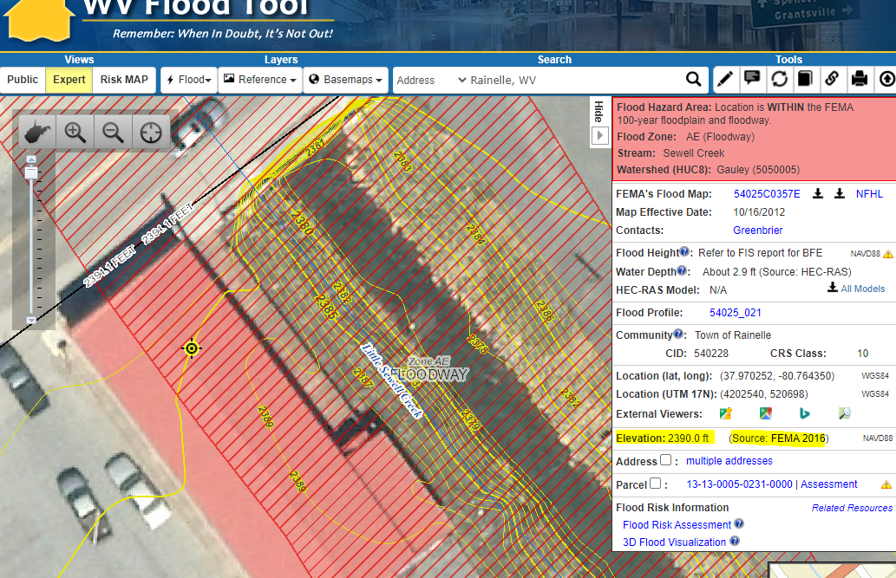
Ground Elevation: 1-ft. Contours
FEMA LiDAR-Derived Products: 1-Meter DEM and 1-Foot Contours
High-resolution aerial imagery and elevation contours cached at 15 map level scales from 1: 4,622,324 to 1:282
1:282
Map Scale
Elevation: 2390 ft.
Source: FEMA 2016
Contour Elevation: 2390 ft.
1-ft Contours Display at two Highest Zoom Levels (1:564 and 1:282 Map Scales)
1-FOOT CONTOUR ELEVATION VALUE OF 2390 FEET MATCHES 1-METER GRID SURFACE ELEVATION OF 2390 FEET DISPLAYED IN QUERY RESULTS PANEL

Slide 32
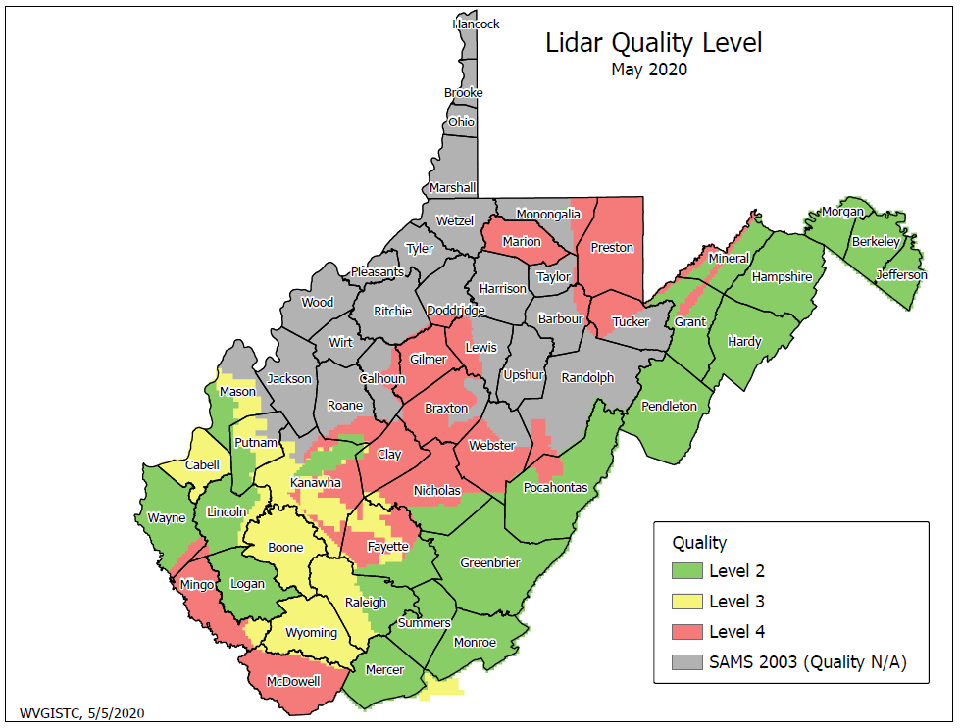
Does My Community Have LiDAR?
In 2021, FEMA-purchased QL2 LiDAR should be available for the entire State
Presently not all communities have LiDAR data available. To be used in a LOMA request, LiDAR data must meet or exceed the U.S. Geological Survey (USGS) Quality Level 3 accuracy requirement. To learn more about this requirement, view the elevation source metadata for the WV Flood Tool.

Slide 33
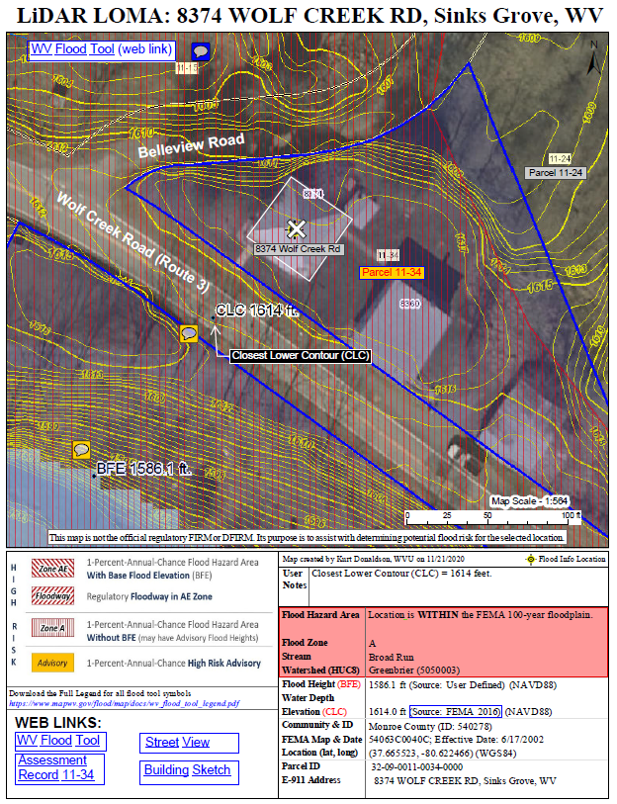
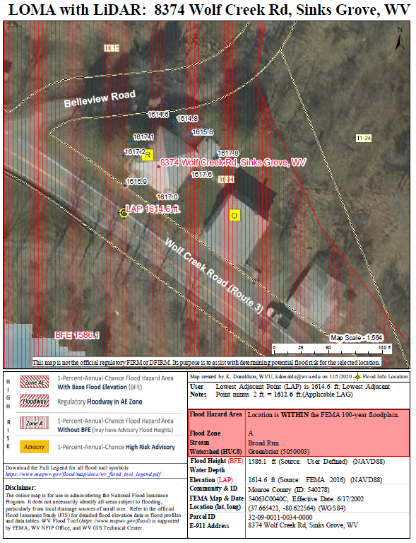
WV Flood Tool (LAG Methods)
Contours (Elevation Contours Reference Layer)
Point Data (Flood Query Results Panel)
The LAG derived from the Point Cloud Method should be close and in-line with the LAG from the Contour Method
CLC 1614 ft.
LAP 1614.6 ft.
Parcel 32-09-0011-0034-0000
Applicable LAG is 1613’ (closest lower contour of 1614’ – 1’)
Applicable LAG is 1612.6’
(lowest adjacent point 1614.6’ – 2’)

Slide 34
Spatial Reference Layers
Aerial Imagery Update

Slide 35
New Aerial Imagery
2020 County Leaf-Of Aerial Imagery (17 Counties)
2019 County Leaf-Of Aerial Imagery (20 Counties)
2018 USDA National Agriculture Imagery Program (NAIP) 2-ft pixel resolution. Statewide Coverage.
24 Counties have tapped into the State Aerial Imagery Contract supported by the Hazard Mitigation Grant for the acquisition of 2019-21 leaf-off imagery. Most counties were captured at 4-inch resolution. Imagery resides in the public domain.
Imagery can vary greatly in resolution. Pixel resolution refers to the actual distance on the ground that each pixel represents in the orthophotography. For example, four-inch pixel resolution means that each pixel in the image covers four inches on the ground.

Slide 36
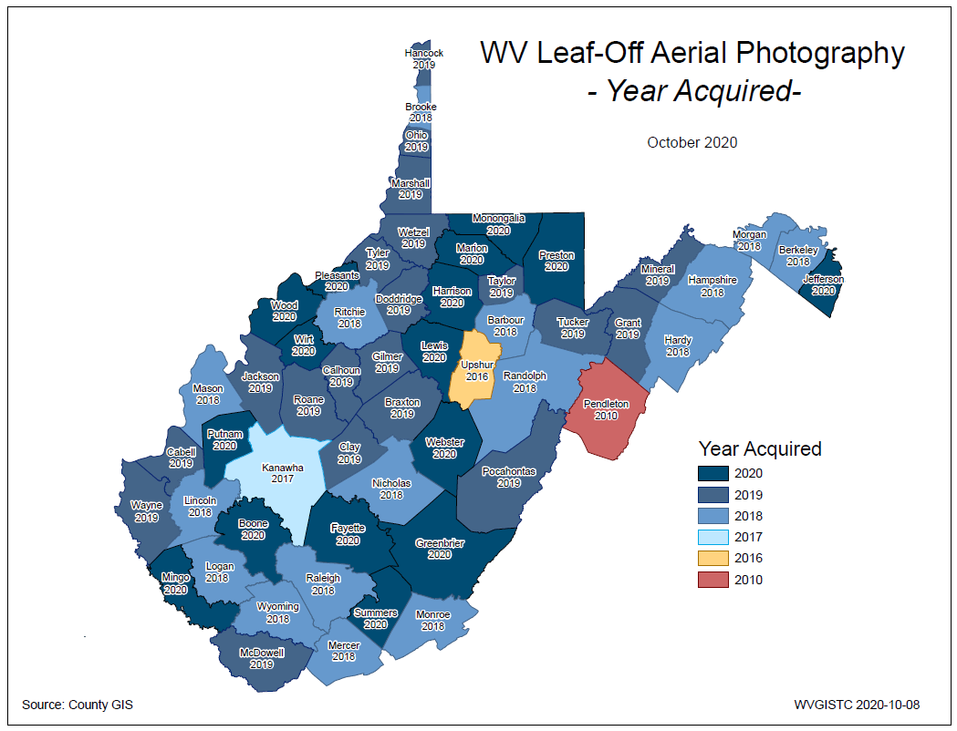
County Aerial Imagery (2020)
New 2020 Imagery
Berkeley
Boone County
Fayette County
Greenbrier County
Harrison County
Jefferson County
Lewis County
Marion County
Monongalia
Mingo County
Pleasants County
Putnam County
Summers County
Taylor
Webster County
Wood County
Wirt County
Year | Number
2010 | 3
2014 | 1
2016 | 3
2017 | 2
2018 | 19
2019 | 20
2020 | 17
2021 | 1
Ideally, leaf-off imagery should not be older than 5 years. Imagery is important for identifying at-risk structures and accurate disaster mapping.
Select counties for 2019-21 received funding support through HMGP grant

Slide 37
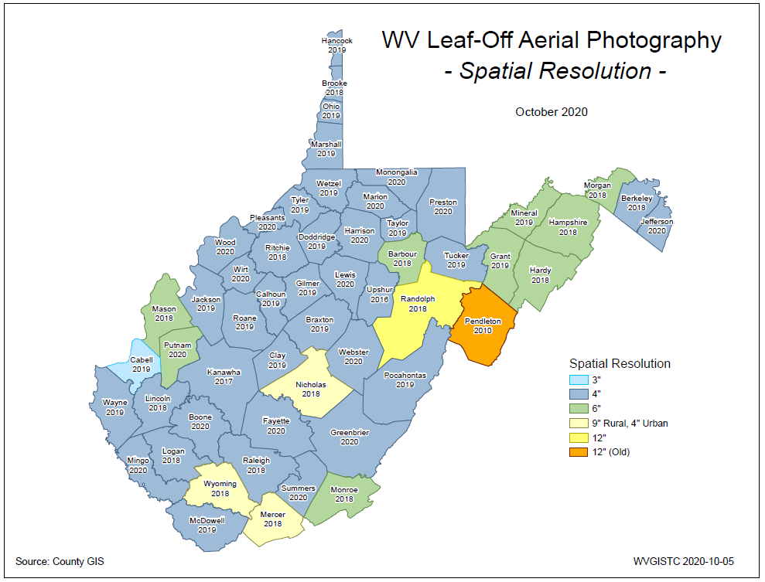
County Imagery Resolution(2020)
Aerial Imagery of most counties (91%) is captured at a countywide spatial cell resolution of 6 inches or higher
Select counties for 2019-21 received funding support through HMGP grant

Slide 38
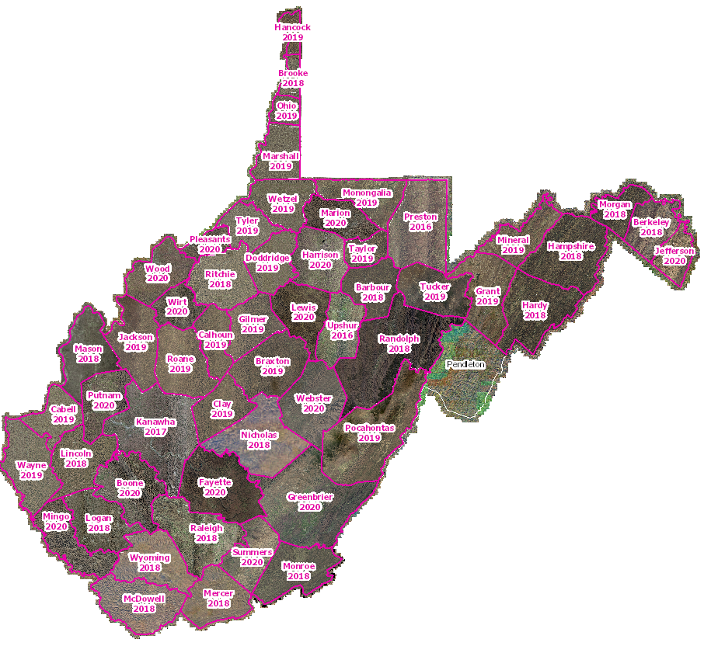
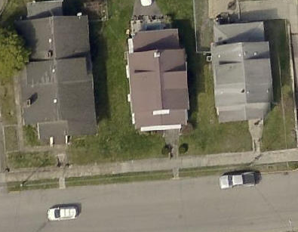
Leaf-Off Aerial Imagery Web Service
https://services.wvgis.wvu.edu/arcgis/rest/services/Imagery_BaseMaps_EarthCover/wv_imagery_WVGISTC_leaf_off_mosaic/MapServer
Counties provide leaf-off imagery
for State Imagery Web Service
Cached to 1:282 Zoom Level or Map Scale
2020 Harrison County Aerial Imagery

Slide 39
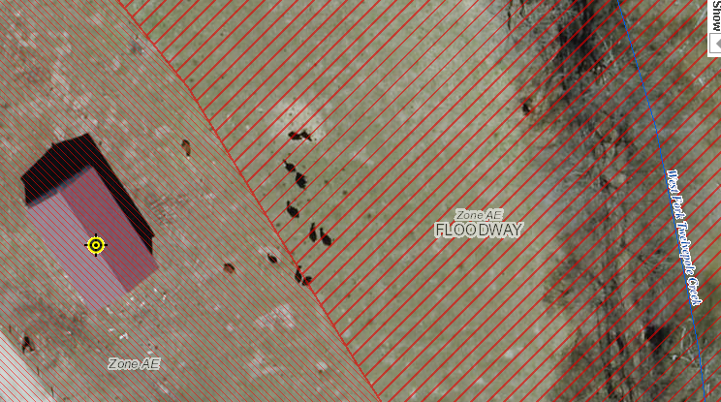
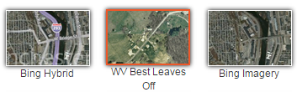
New 2019 Leaf-Off Aerial Imagery
http://www.mapwv.gov/floodtest/?wkid=102100&x=-9176629&y=4583554&l=13&v=1
New 2019 Imagery
on Flood Tool
Braxton
Cabell
Calhoun
Clay
Doddridge
Gilmer
Harrison
Jackson
Marshall
Monongalia
Ohio
Pocahontas
Putnam
Roane
Taylor
Tucker
Tyler
Wayne
Wetzel
Wirt
4-Inch Pixel Resolution
Choose WV Best Leaves Off Base Map
Cows in the Floodway
West Fork Twelvepole Creek, Wayne County

Slide 40
Spatial Data Development
Parcels Update

Slide 41

Statewide Digital Parcel File
599 Tax Districts
347 Districts
252 Corporations
WV Property Tax Division provides annual update

Slide 42




WV Property Viewer (Mobile)
www.mapwv.gov/property
682 Killarney Drive, Morgantown, WV
Mobile Home Page
Zoom to E-911 Address
Toggle Layers of Interest

Slide 43

Improved Property Parcel Mapping
Logan County
Parcel 23-02-0109-0019-0004
High Risk Advisory Zone
Parcel Geometry Map Accuracy Improved
1322 WEST FORK RD TRLR, WEST FORK, WV, 25508
https://mapwv.gov/parcel/?pid=23-02-0109-0019-0004

Slide 44


WV Property Search: Deed Book
“Prior Ownership” WV Property Search: www.mapwv.gov/property
Search Query Parameters for Prior Ownership using Deed Book/Page No.
LOMA 97-03-298A, Project ROUTE 27/3 - DILLON CREEK
Correct LOMA Location
9 miles
Wrong LOMA Location
https://map1.msc.fema.gov/data/54/L/97-03-298A-540160.pdf?LOC=d08f245a47f18e659f1b75b1515425b6
LOMA 97-03-298A is not located south of Kingwood, but 9 miles to the northwest in Preston County.
The WV Property Search Tool located the correct parcel through a Deed Book Number and Page search.

Slide 45

WV Property Search: Deed Book
“Prior Ownership” WV Property Search: www.mapwv.gov/property
Search Query Parameters for Prior Ownership using Deed Book/Page No.
LOMA 97-03-298A, Project ROUTE 27/3 - DILLON CREEK
Search Parameters | Value
County | Preston
Deed Book Number | 505
Deed Book Page | 177
LOMA 97-03-298A is not located south of Kingwood, but 9 miles to the northwest in Preston County.
The WV Property Search Tool located the correct parcel through a Deed Book Number and Page search.

Slide 46




WV Property Search: Deed Book
LOMA 97-03-298A, Project ROUTE 27/3 - DILLON CREEK
Deed Book: 505/177
https://mapwv.gov/assessment//Detail/?PID=39020013008400010000
Correct parcel location of LOMA 97-03-298A was identified by a prior owner and Deed Book Number 505/177 back to year 2008

Slide 47

WV Property Search: Deed Book
“Prior Ownership” WV Property Search: www.mapwv.gov/property
LOMA 97-03-298A, Project ROUTE 27/3 - DILLON CREEK
https://www.mapwv.gov/flood/map/?wkid=102100&x=-8882817&y=4797874&l=11&v=1
Route 27/3
Positionally Verified
LOMA 97-03-298A
Parcel Detailed Report
See Parcel History in Assessment Report
Dillan Creek
1 Acre
Prior Deed 505 / 177
Correct positional location of LOMA 97-03-298A verified with LOMA Document by Deed Number (505/177), Parcel Size (1 acre), Flood Source (Dillon Creek), and Highway Number 27/3.

Slide 48
Spatial Reference Layers
E-911 Addresses

Slide 49

Statewide E-911 Addresses
Missing Address Site Numbers
Berkeley Springs, WV
WV Emergency Management Division manages the Statewide Addressing and Mapping System (SAMS)

Slide 50


E-911 Addresses
Improved Addresses Uploaded to WV Flood Tool
HMGP Addressing Improvement Projects
Marlinton, WV

Slide 51
Unique Spatial Identifiers
Building and Parcel Identifiers
Building Identifier: The E-911 Address Number, combined with the Parcel Identifier, forms the Building Identifier for identifying structures for flood risk assessments, building pictures, LOMAs, Elevation Certificates, etc.

Slide 52

Building Identification
10/11/2020
01-08-0011-0069-0000_604 (Parcel ID + Address Number)
Parcel ID: 01-08-0011-0069-0000
Address: 604 S Main Street
604 S Main Street

Slide 53

Bldg. 01-08-0011-0069-0000_604
SHARE LINK
604 S Main Street, Philippi, WV
Address: 604 Main St, Philippi, WV 26416
Parcel ID: 01-08-0011-0069-0000
X,Y COORD.
ADDRESS
Building ID:
(Parcel ID + Address No.)
01-08-0011-0069-0000_604
PARCEL
Share Link: https://www.mapwv.gov/flood/map/?wkid=102100&x=-8909292&y=4742427&l=12&v=1

Slide 54
Building Spatial Identifiers
Collect multiple spatial identifiers to verify location
Parcel | 01-08-0011-0069-0000
01 | - | 08 | - | 0011 | - | 0069 | - | 0000
County |  | District |  | Map |  | Parcel |  | Suffix
Address | 604 S Main St, Philippi, West Virginia, 26416
Building Identifier | 01-08-0011-0069-0000_604
X,Y Coordinate | 39.144752, -80.033529
Google Plus Code (11-digit) | 86FX4XV8+VHF
Share MAP URL Link | https://www.mapwv.gov/flood/map/?wkid=102100&x=-8909292&y=4742427&l=12&v=1
Share Parcel Assessment URL Link | http://www.mapwv.gov/Assessment/Detail/?PID=01080011006900000000
Notes: Owner Name from assessment records and Building Pictures (elevation certificates) can be helpful for property identification purposes
Proper Building and Property Identifiers are important for exchanging building-level data efficiently among local, state, and federal partners (including UDFs, LOMAs, Mitigated Buyout Properties, Elevation Certificates, Repetitive Loss Structures, etc.)
= Unique Identifiers

Slide 55


Building Unique Identifier
Parcel ID | 01-08-0011-0069-0000
01 | - | 08 | - | 0011 | - | 0069 | - | 0000
County |  | District |  | Map |  | Parcel |  | Suffix
Address | 604 S Main St, Philippi, West Virginia, 26416
Building Identifier (Parcel ID + Address No.) | 01-08-0011-0069-0000_604
Link to Property Record
Link to Structure Record

Slide 56
Contact Information
WVU GIS Technical Center West Virginia University Kurt Donaldson, GIS Manager kurt.donaldson@mail.wvu.edu, phone: (304) 293-9467

