Slide 1
WV DOT GIS DAY – November 2021
Kurt Donaldson & Frank LaFone

Slide 2
WV Trail Inventory
Trail Inventory and Applications

Slide 3
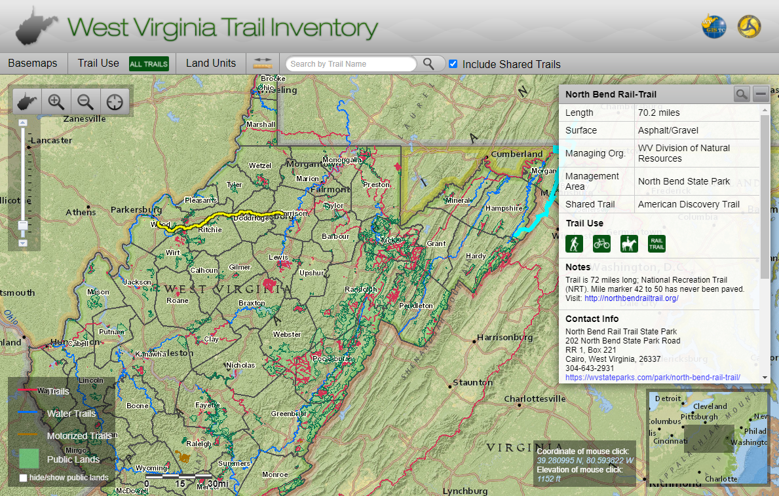
WV Trail Inventory
https://www.mapwv.gov/Trails

Slide 4
WV Trail Inventory
September 2021
 | Non-Motorized | Motorized | Sum
Total Number | 3,373 | 430 | 3,803
Total Distance (Mi) | 3,959 | 706 | 4,665
 | Flatwater | Whitewater | Sum
Total Number | 22 | 275 | 297
Total Distance (Mi) | 1,241 | 2,105 | 3,346
Motorized
Non-Motorized
LAND TRAILS
WATER TRAILS

Slide 5
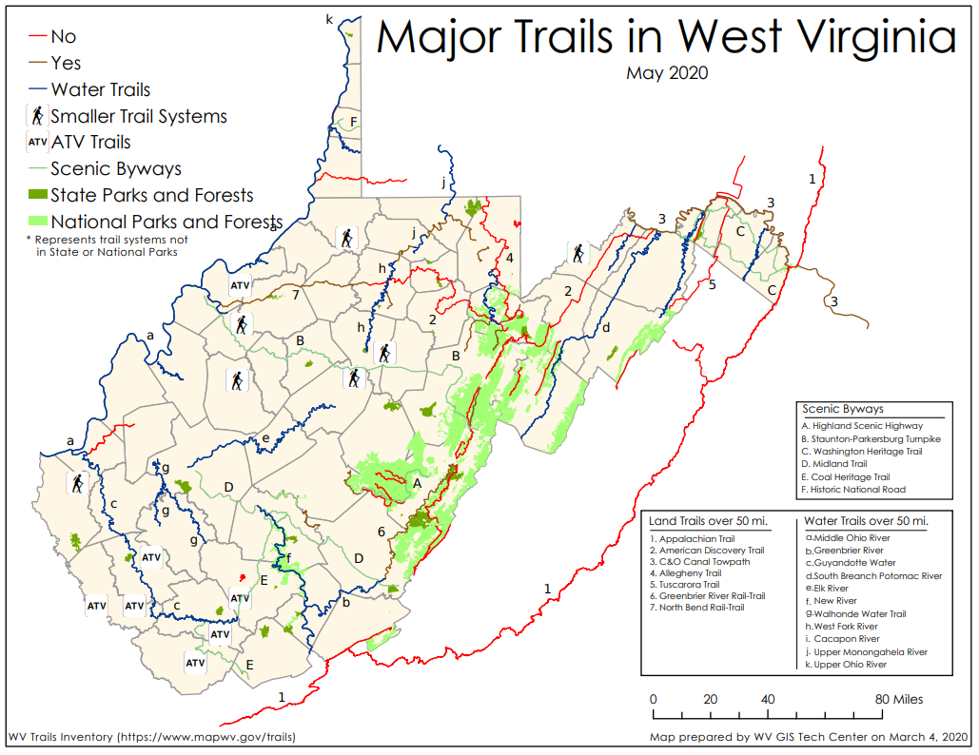
Land Trails

Slide 6
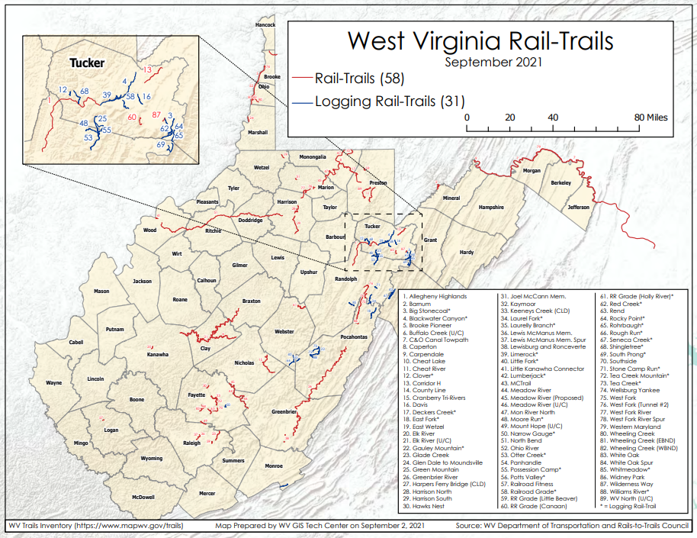
Rail-Trails (n=89)

Slide 7
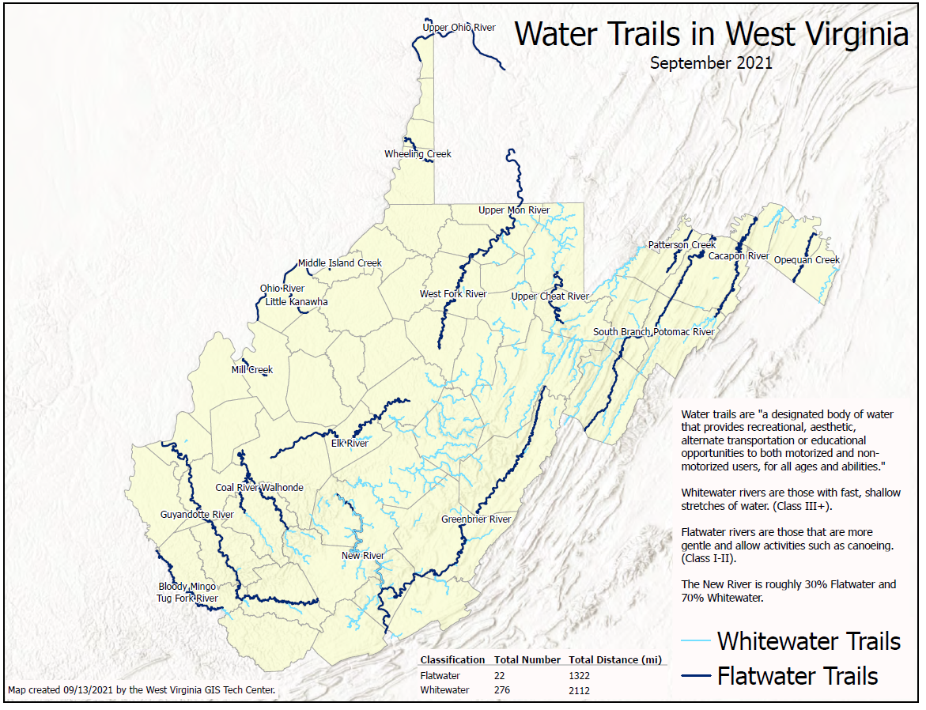
Water Trails
Verifying Flatwater Trails designated by WV DOT Recreational Trail Advisory Board

Slide 8
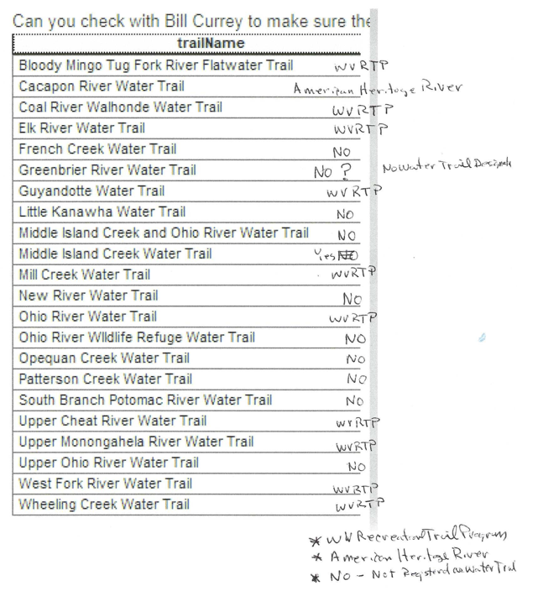
WVRTP Official Designation
Flatwater Trails
Bill Currey, Chair, Flatwater Trails Commission, co-founder and chairman of nonprofit Coal River Group
The commission was created by the West Virginia Legislature in 2020 to support a growing demand for water-based trails in West Virginia.
Tim Sedosky is the current contact at DOH for the WV Recreational Trails Program.

Slide 9
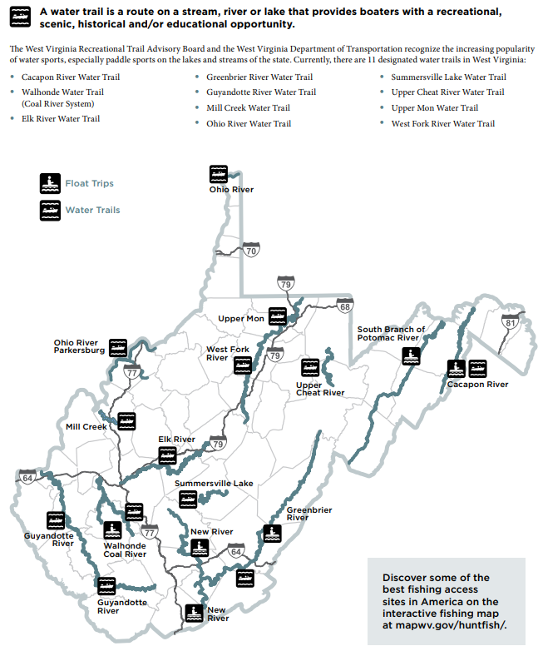
Flatwater Trails – Fishing Regulations
WVDNR is using the Statewide Trail Inventory to report Flatwater Trails for WV DNR Fishing Regulations
<< Trail Geodatabase Update >>
trailSurface = Water for "Float Trips" but added trailSurface = Flatwater for official "Water Trails"
Updating Page 19 of the
WV DNR Fishing Regulations
Jessica Perkins, GISP
GIS & Technical Support Program Manager
Wildlife Resources Section, WVDNR

Slide 10
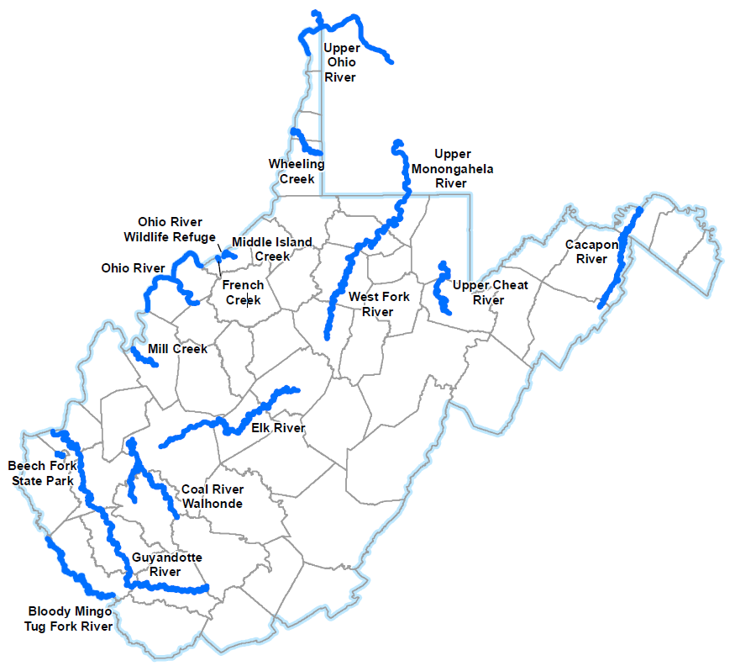
WV DNR Flatwater Trails Map
Revised Flatwater Trails Map for WVD NR Fishing Regulations (Page 19)

Slide 11

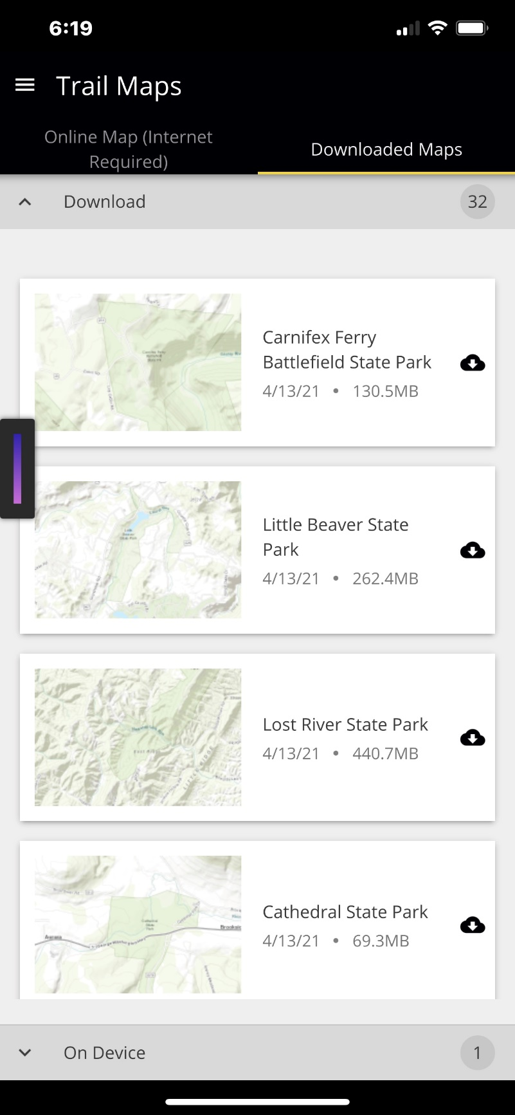
Standalone Trail Mobile Application
Offline Maps by State Parks
Start Screen
Offline Trails List

Slide 12
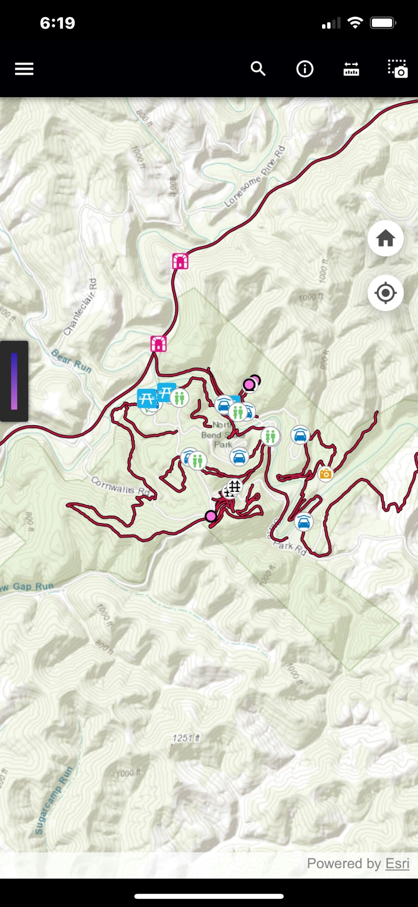
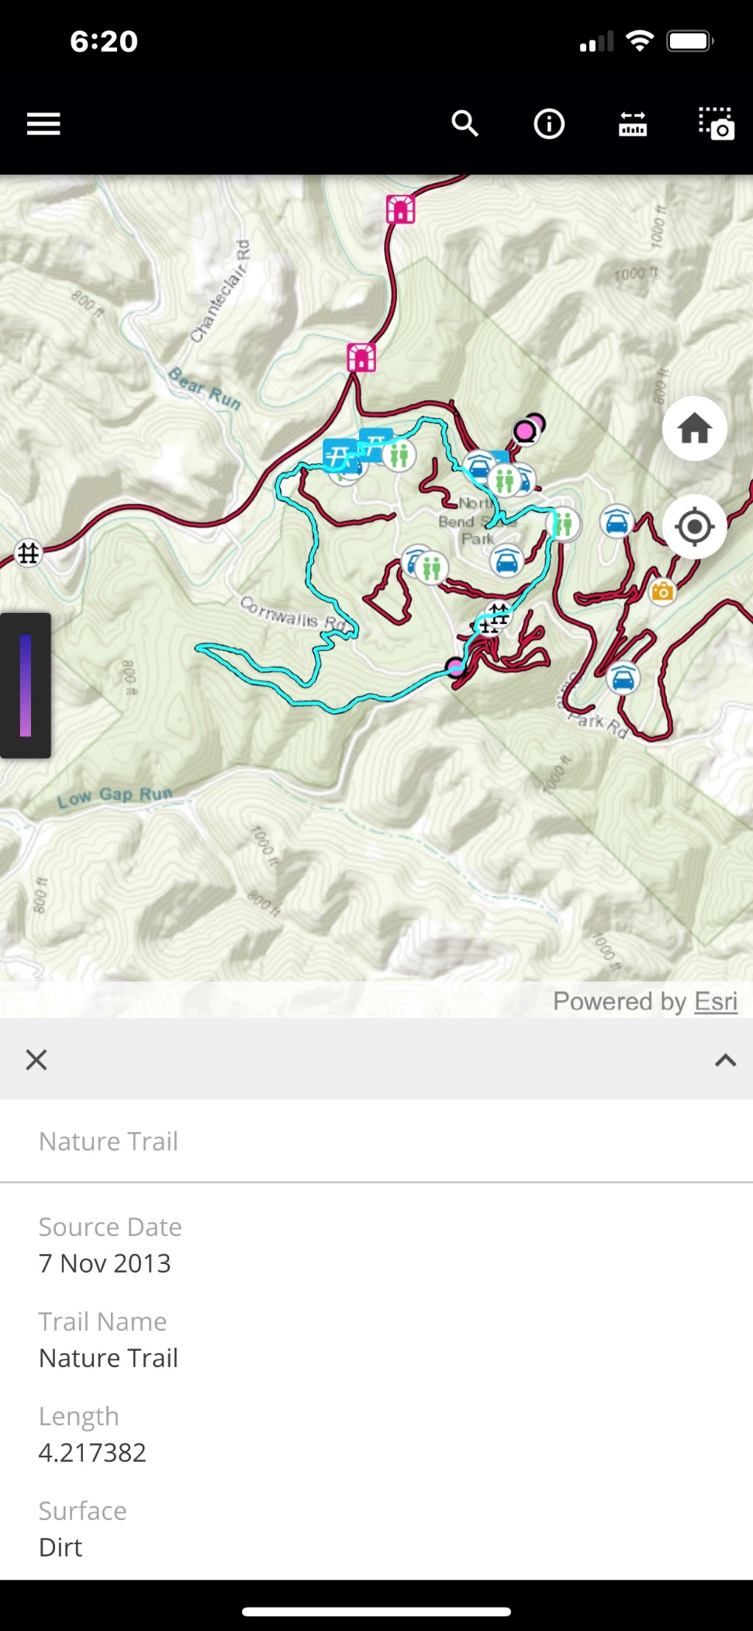
Trail Mobile Application
Offline Maps Use Same Data As Online Map
Normal Map Display
Identify Individual Trails and Showing Attributes

Slide 13
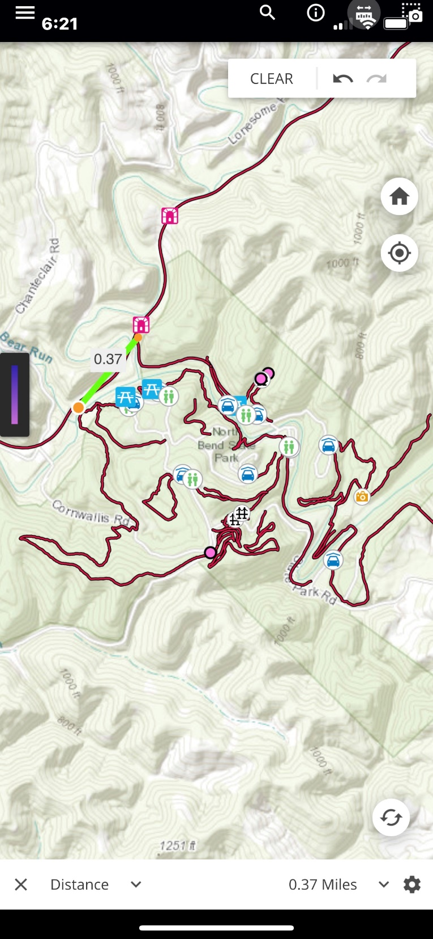
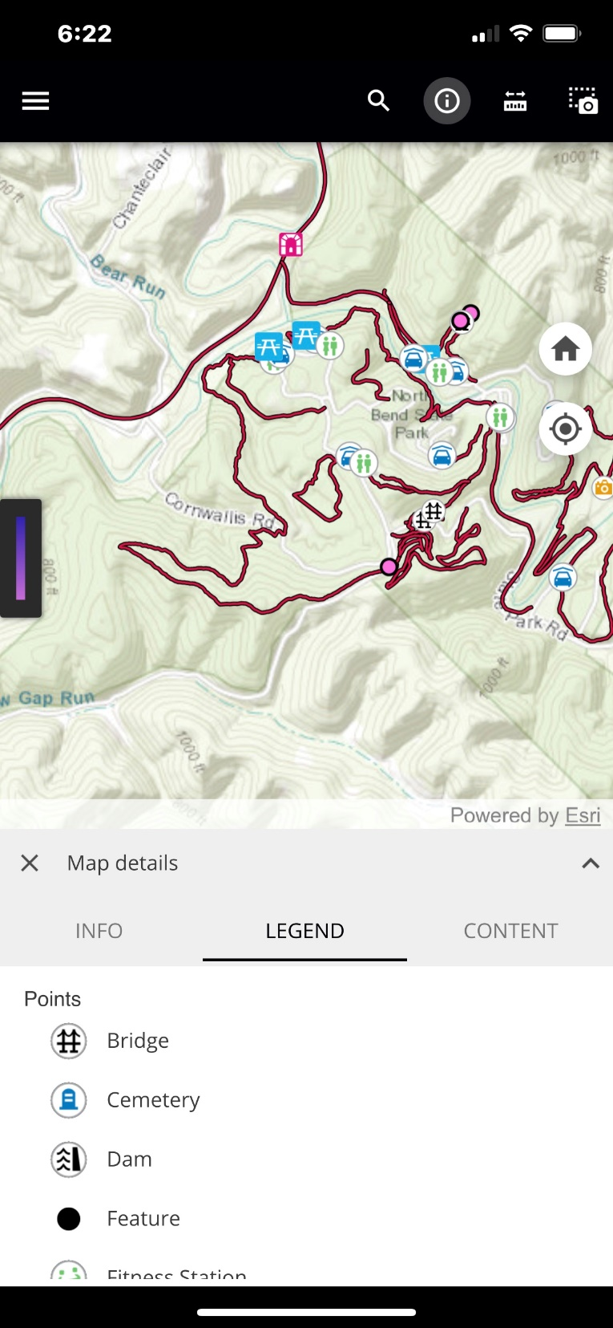
Trail Mobile Application
Measuring Distances (miles or feet)
Legend View – layers can be turned on/off

Slide 14
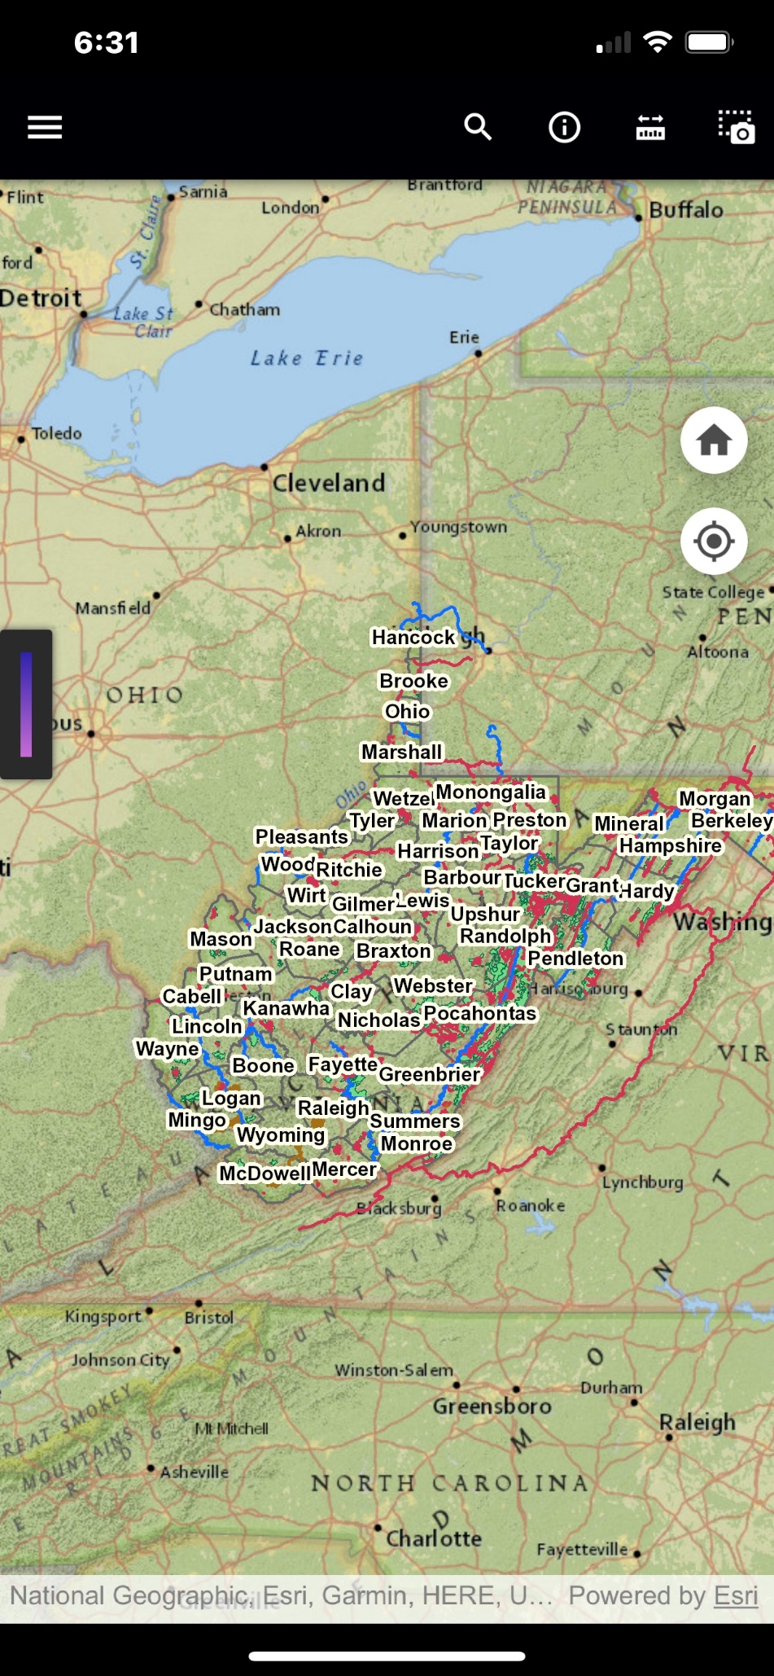
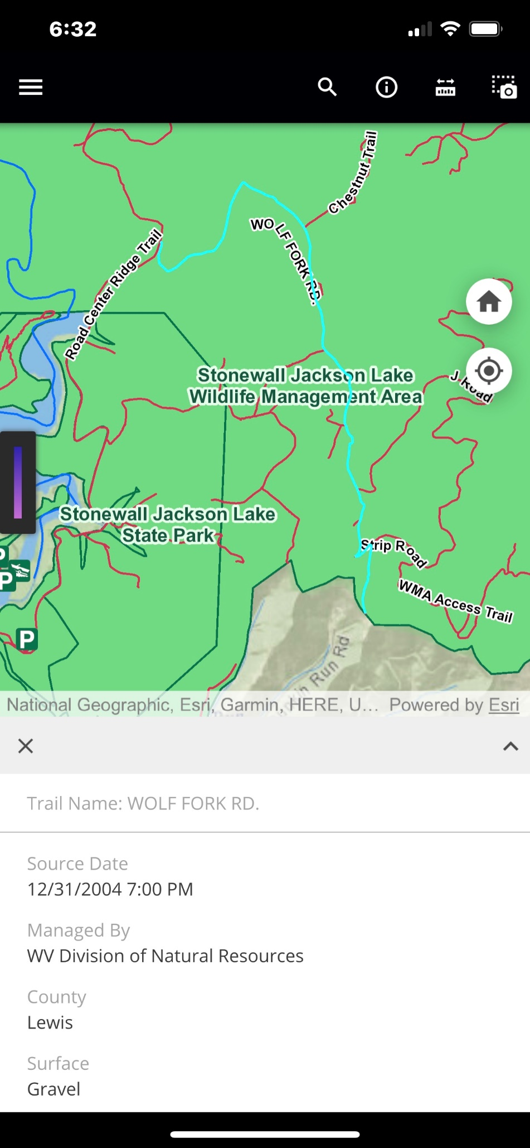
Trail Mobile Application
Online Map – Connects To Same Server As Web Map
Same Attribute Display as Web Map

Slide 15
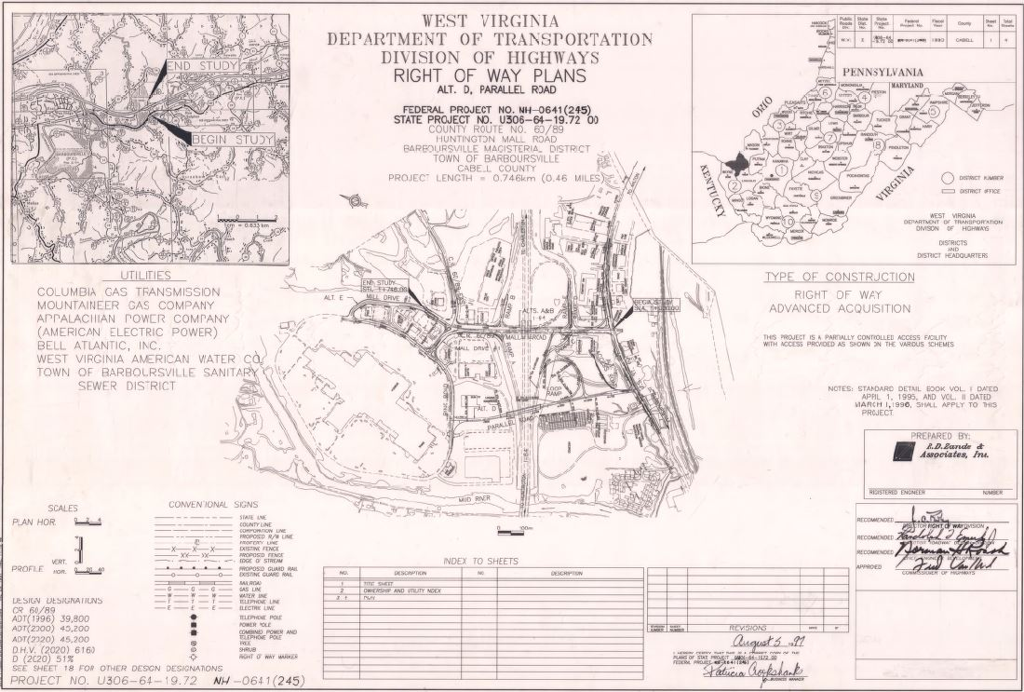
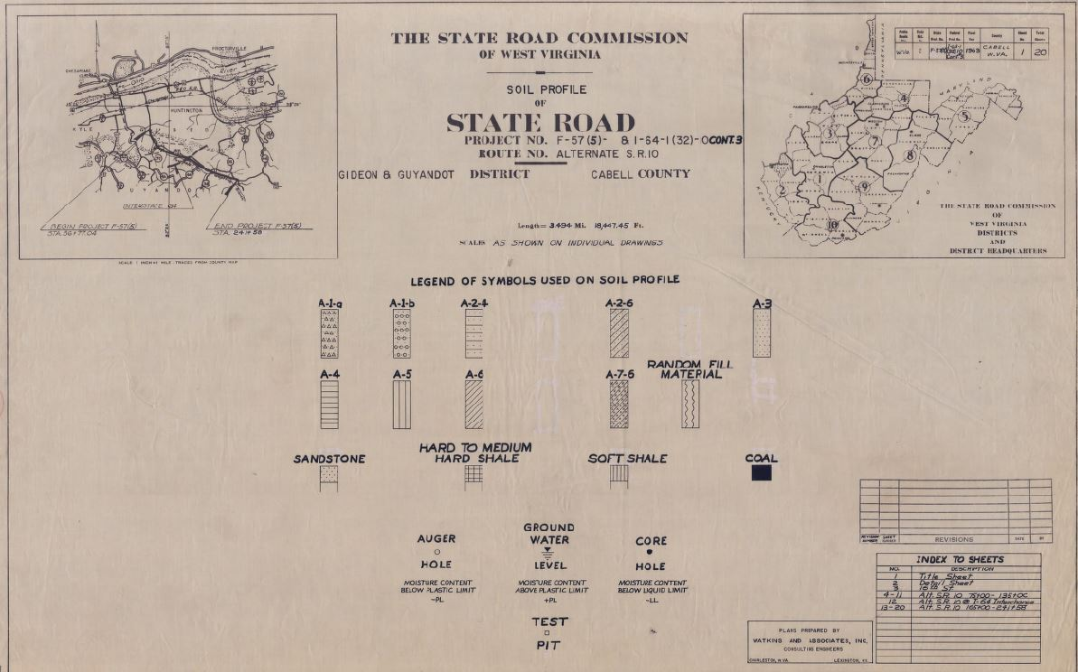
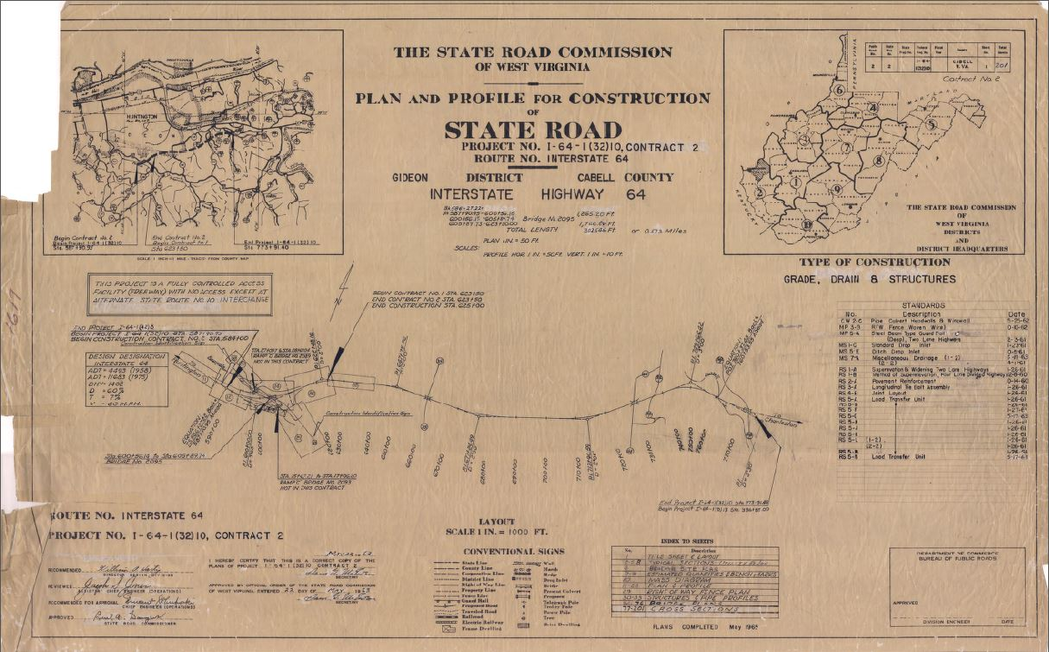
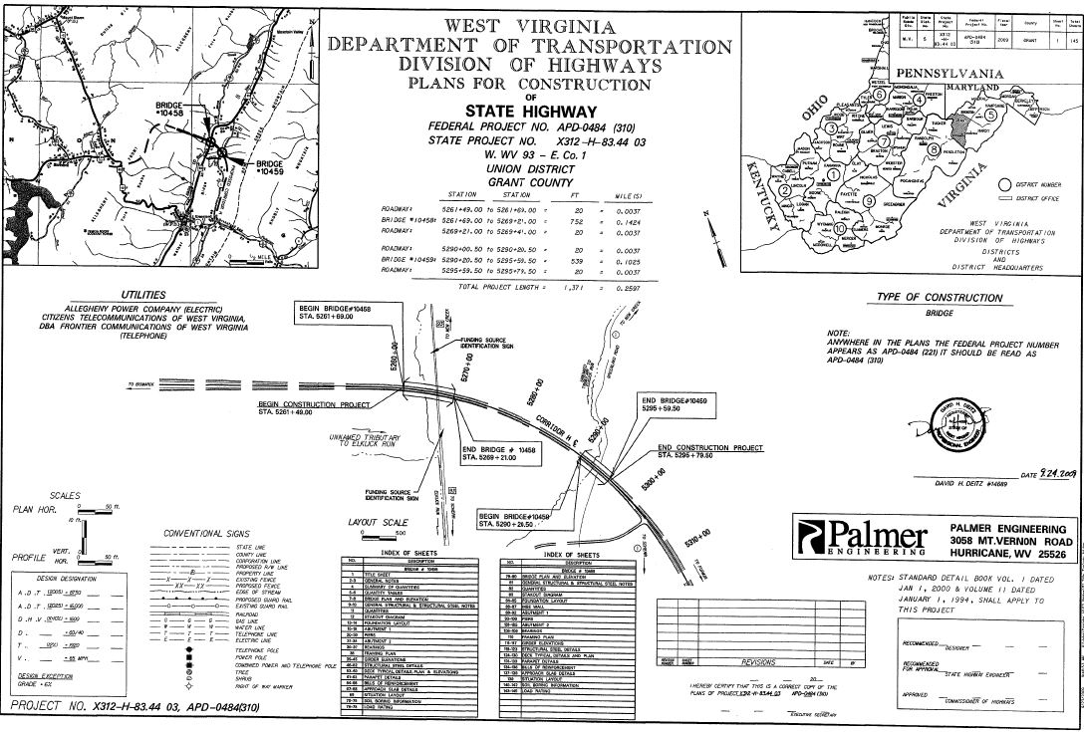


WV DOT Scanning Project

Slide 16
WV DOT Plan Scanning Project
Improved Management and Archival System
  Electronic database manages the plan sets and associated documents
  Eliminates lost drawings, misfiled drawings, and deterioration of drawings
  Long-term digital storage integrated with ProjectWise content management system
  Consolidates record plan sets in one location in digital database
    Engineering plans, right of way plans, shop drawings, bridge plans, and roadway plans stored in multiple physical locations
Faster and Easier Access to Drawings
  By anyone, at any time, from anywhere.
  Improved document accessibility for both internal and external users
  Access by non-spatial or spatial map queries

Slide 17
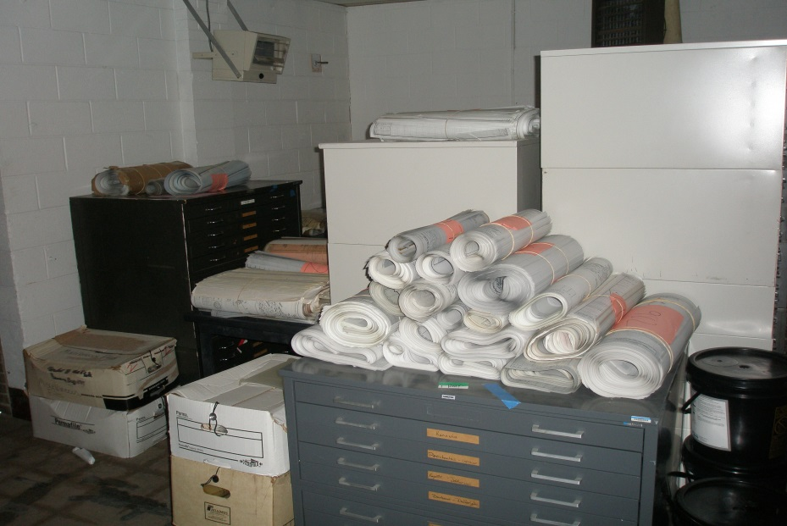
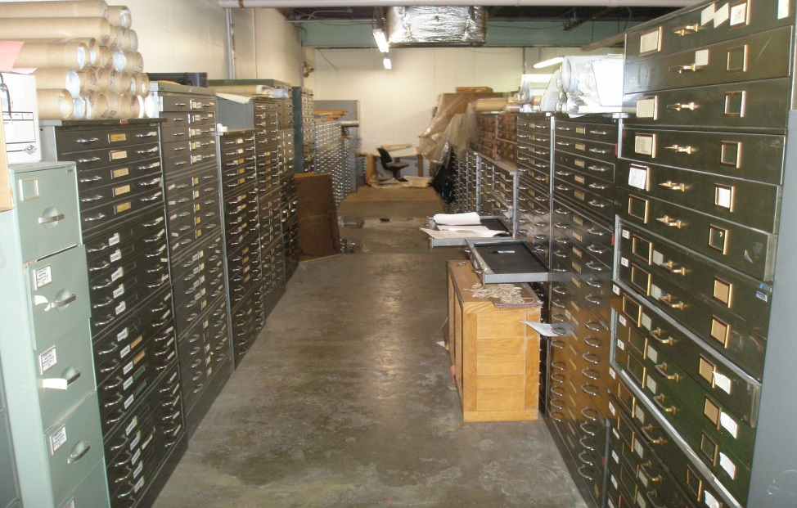
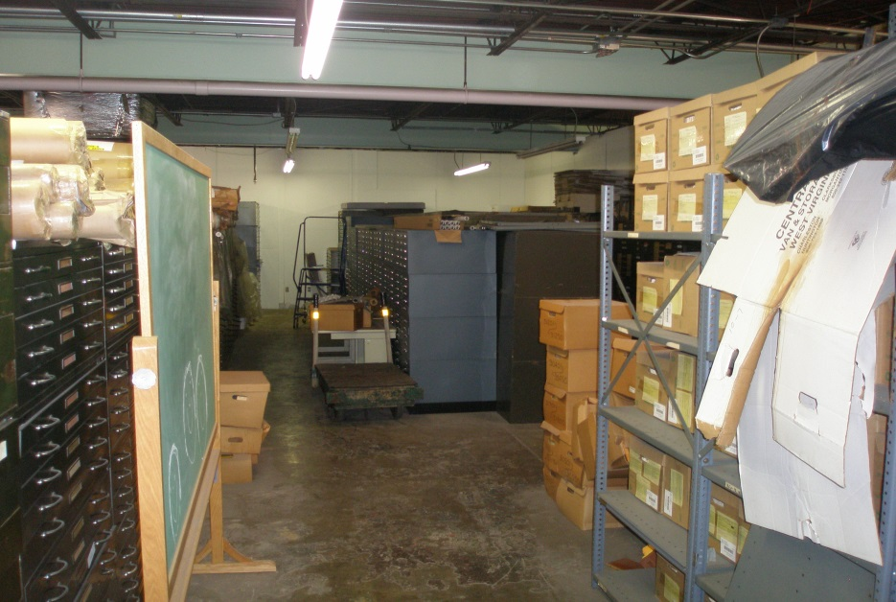
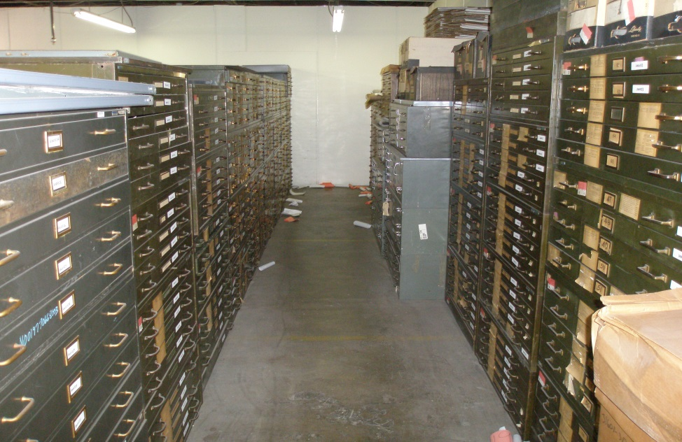
WV DOT Plan Scanning Project

Slide 18
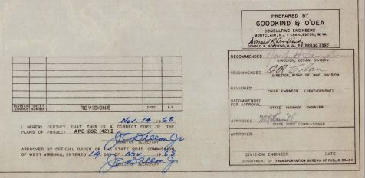
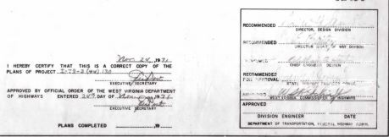
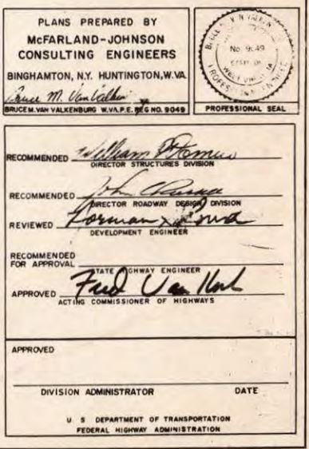
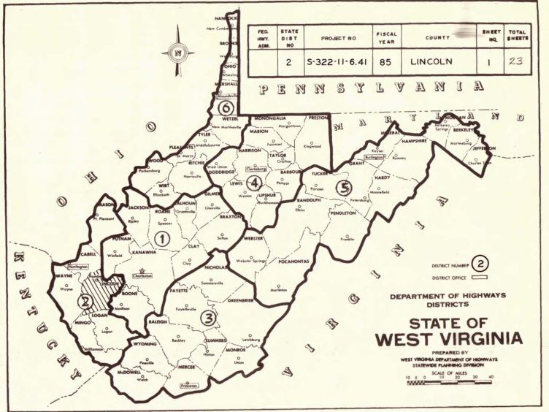
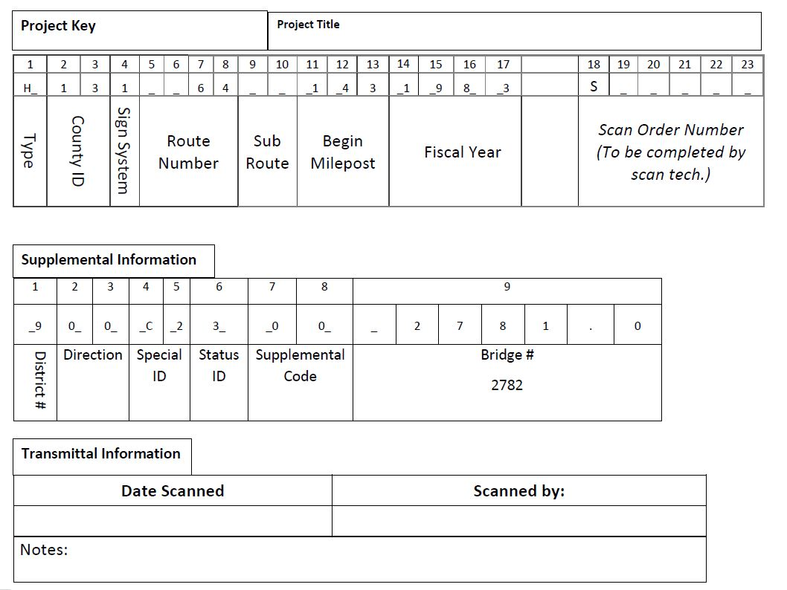
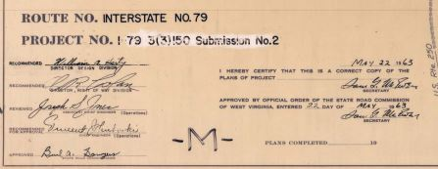
Transmittal Sheet
Developing the project key

Slide 19
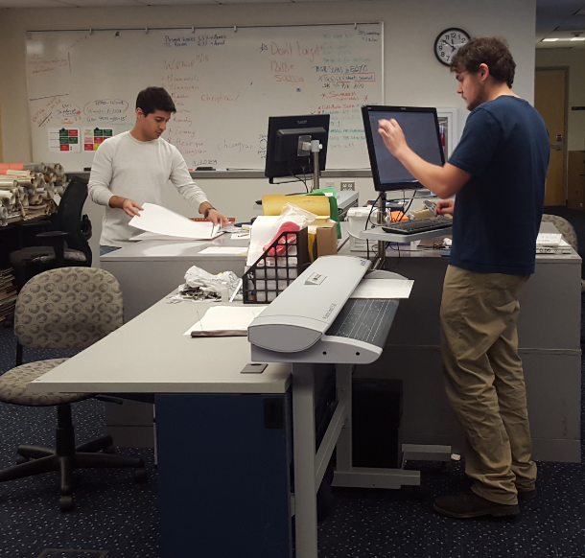


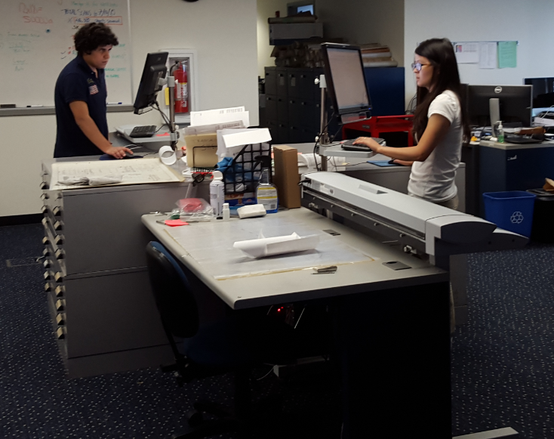
WV DOT Scanning Project
Scanning and Processing
Scanning
Scanning
Image Processing
Scanning

Slide 20
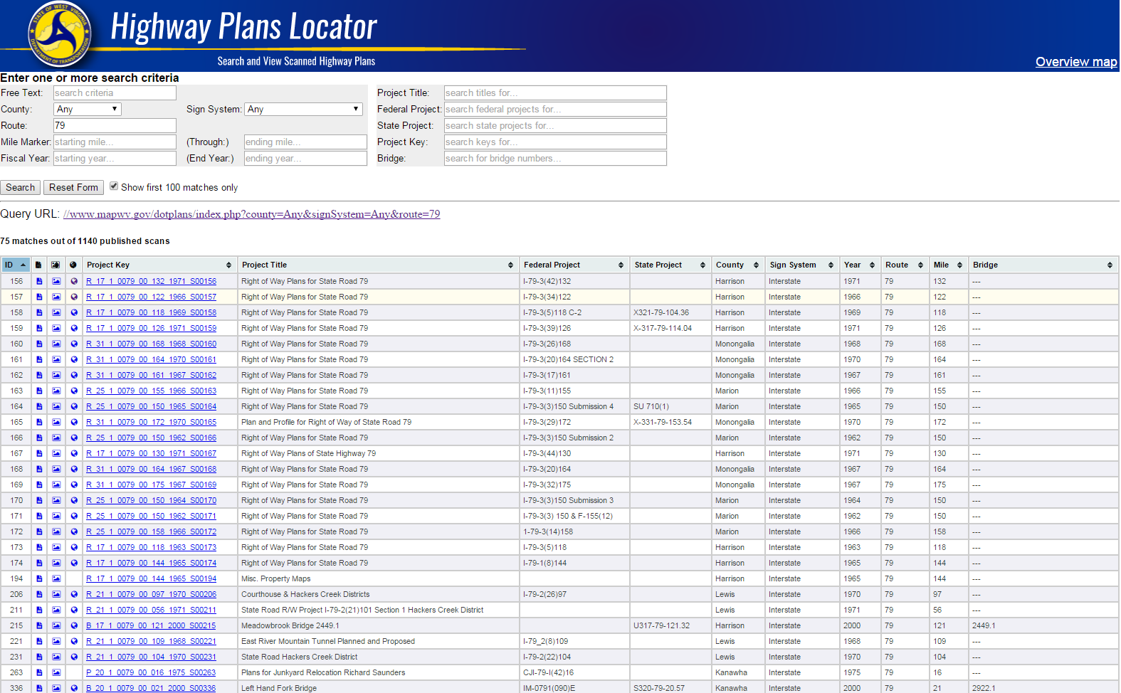
Highway Plans Locator
https://www.mapwv.gov/dotplans
Plan sets range in date between 1900 and 2014

Slide 21
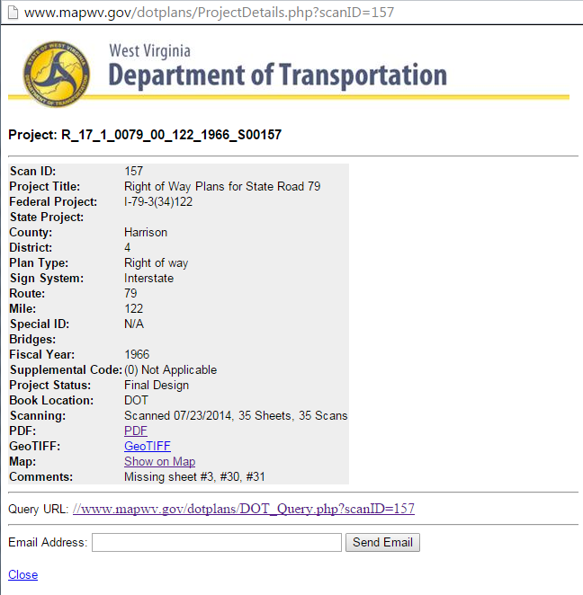
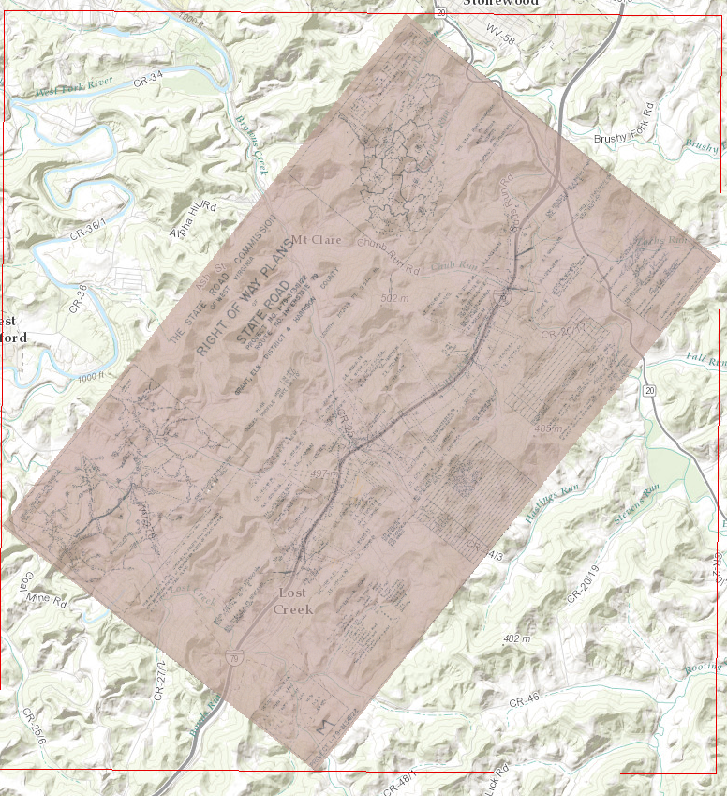
Non-Spatial and Spatial Searches
Online Highway Plans Locator
Detailed Record
Map It View

Slide 22
Microsoft SQL Server &
Enterprise ArcGIS Geodatabase
System Design

Slide 23
Microsoft SQL Server &
Enterprise ArcGIS Geodatabase
System Features
Multi-user ability
Used for recording scanning activity
Supports web feature mapping and image services
Updates are made automatically; not necessary to re-publish ArcGIS services in order to add new scan rasters
Backups are run using SQL Server Agent process
Geodatabase contains 3 primary objects
  Raster mosaic as source of image service
  Feature class of map footprints
  Database view for published plans and web-based query interface
Python scripts automate processes
  Renaming files
  Calculate map extents
  Copying GeoTiffs to publication folder
  Building raster mosaic
  Building footprints

Slide 24
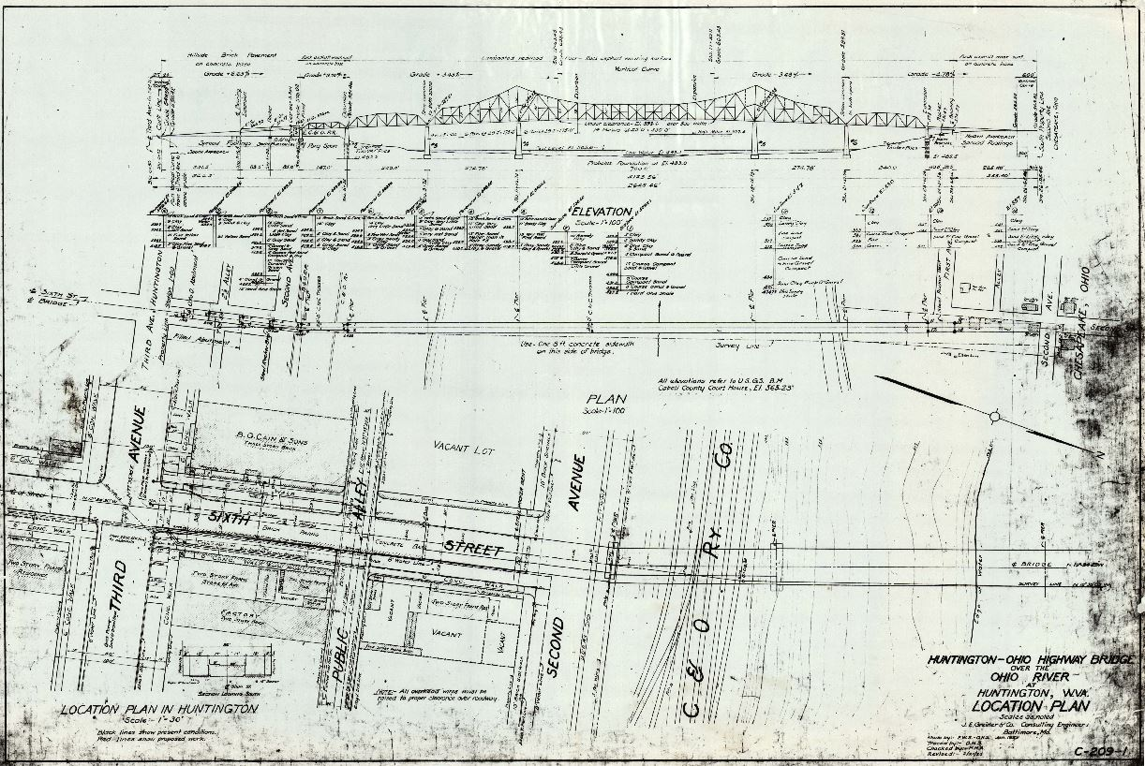
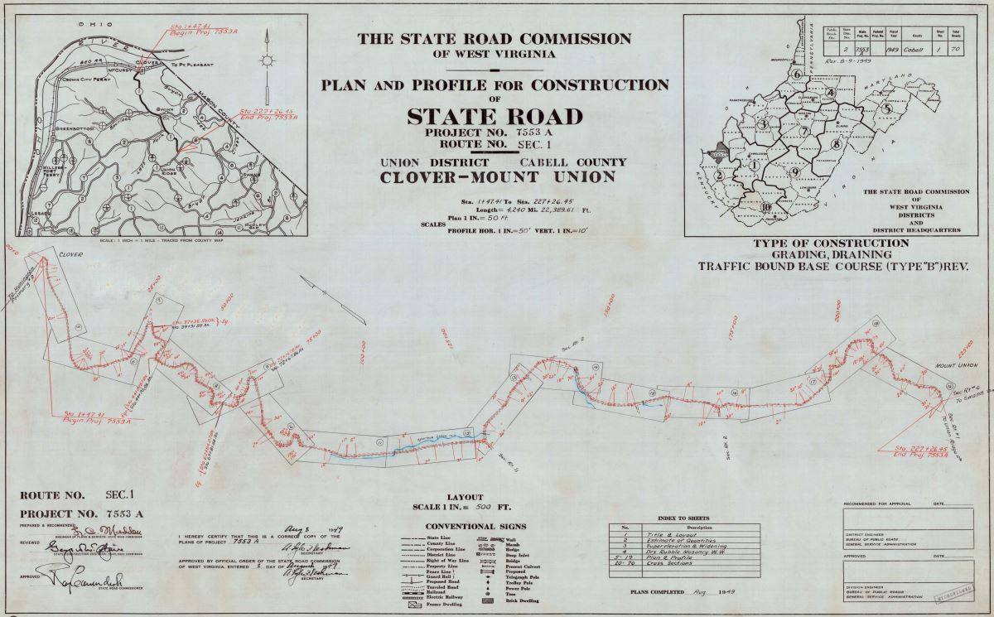
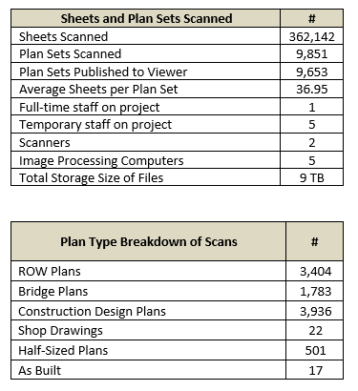
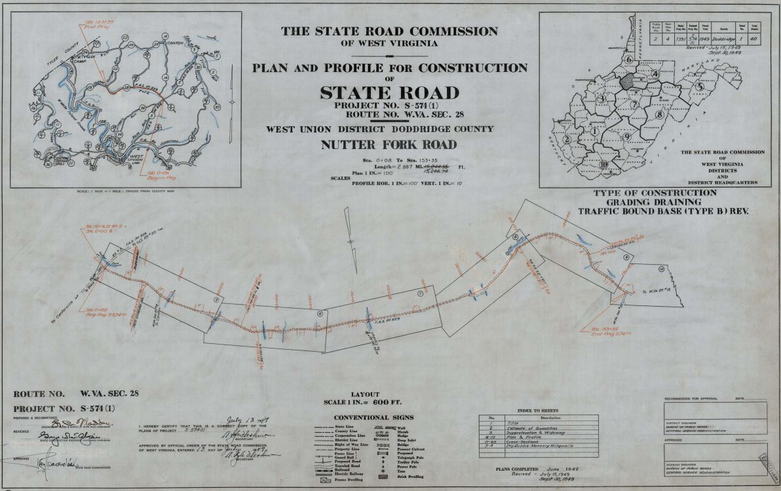
Scanning Progress
Scanning progress report for November 2021

Slide 25

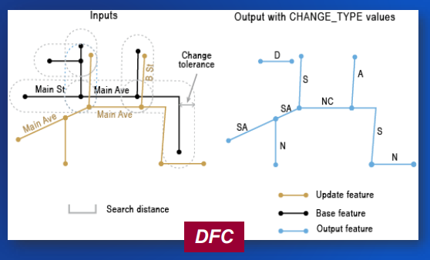
WV DOT-SAMS Road Conflation
Change Detection and Conflation
Pilot to integrate Statewide Address and Mapping and WV DOT roads

Slide 26
Other Projects
Other Projects

Slide 27
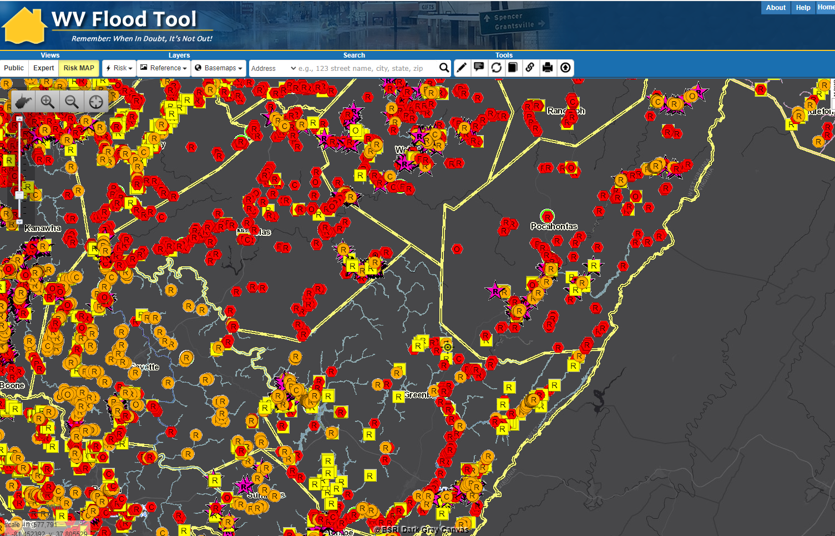
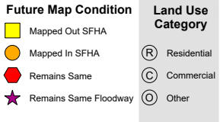
Statewide Flood Risk Assessment
Milestone:
Statewide Inventory of Structures in
100-Yr Floodplain
Webster
Pocahontas
Nicholas
Flood
Vulnerability Risk Assessment
Greenbrier
Fayette

Slide 28
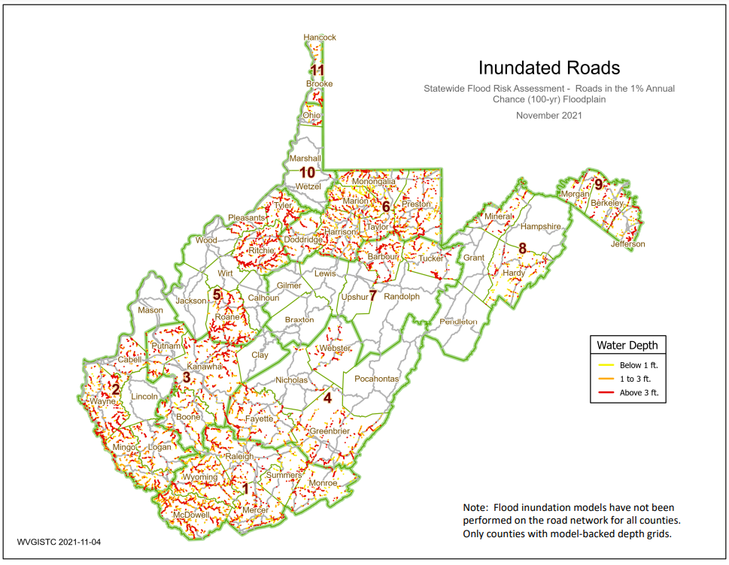
Transportation Flood Models
Roads
Railroads
Bridges

Slide 29
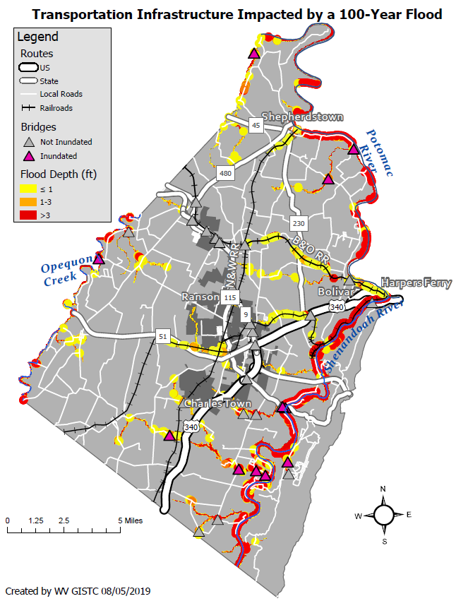
Transportation Infrastructure Impacted by 100-Year Flood
Jefferson County, West Virginia
WATER DEPTH | VEHICLES
<= 1 foot | A foot of water will float many vehicles.
1 – 3 feet of water | Two feet of water will carry away most vehicles. Three feet of water will easily float a bus.
> 3 feet | All vehicles incur substantial water damage and can be carried away by flood waters.
WATER DEPTH | RESCUE RESPONSE
<= 1 foot | Response focused on those who need additional assistance.
1 – 3 feet of water | A high-water vehicle rescue limit is about 3 feet.
> 3 feet | Boats and helicopters are required to perform high water rescues when water depths exceed three feet. The risk to people increases with higher water velocities and flood depths.
Sample Flood Hazard Map on Transportation Infrastructure

Slide 30
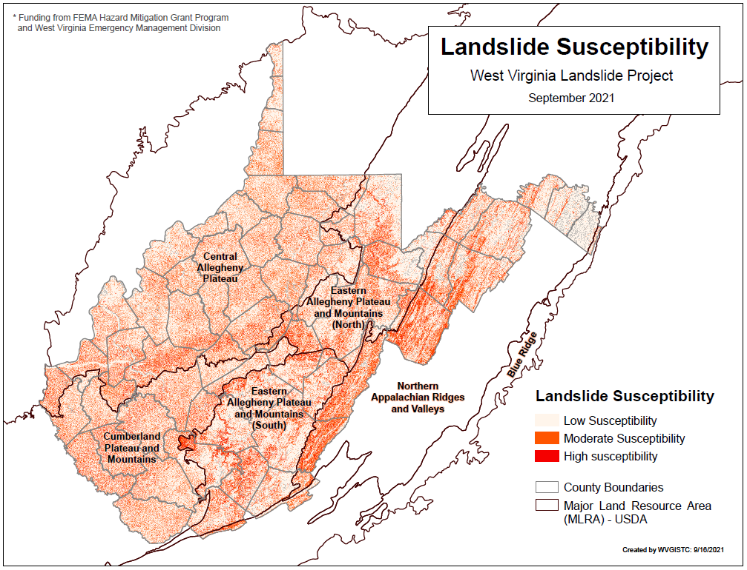
Landslide Susceptibility

Slide 31
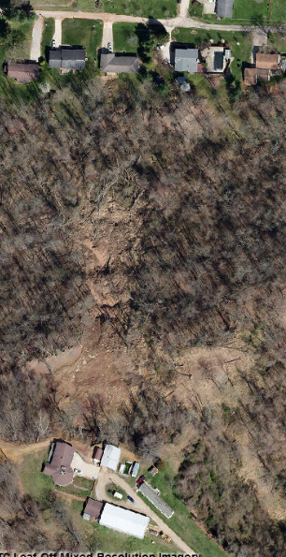
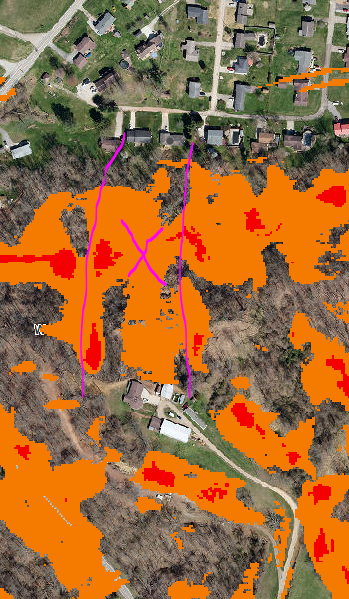
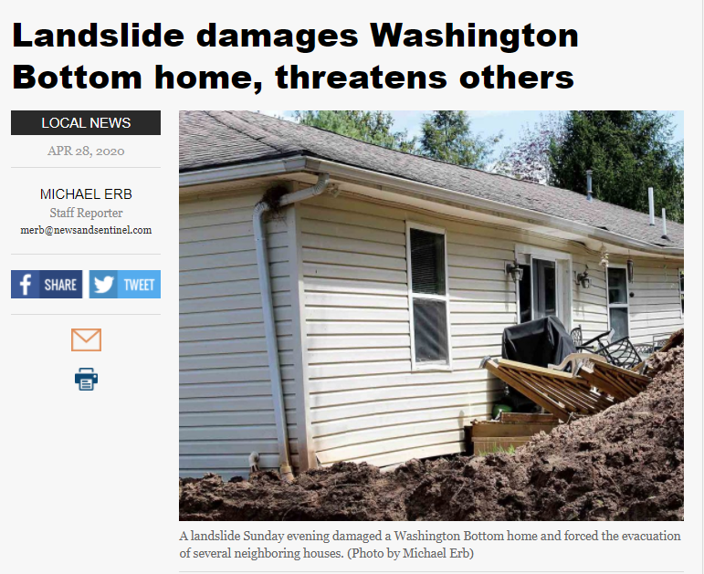
Landslide Susceptibility Maps
April 2020 Landslide
Wood County
Higher
Risk

Slide 32
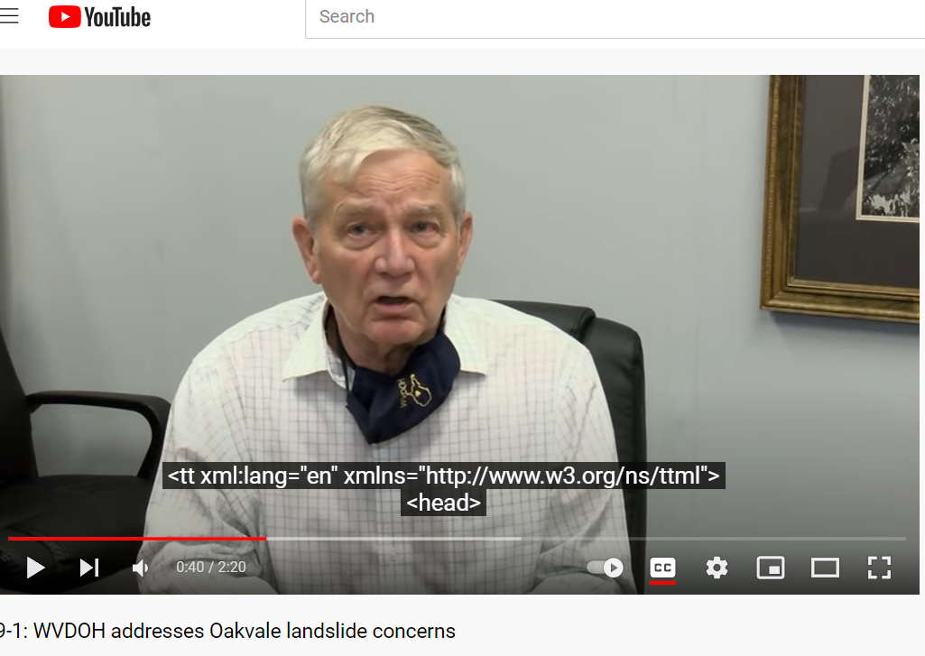
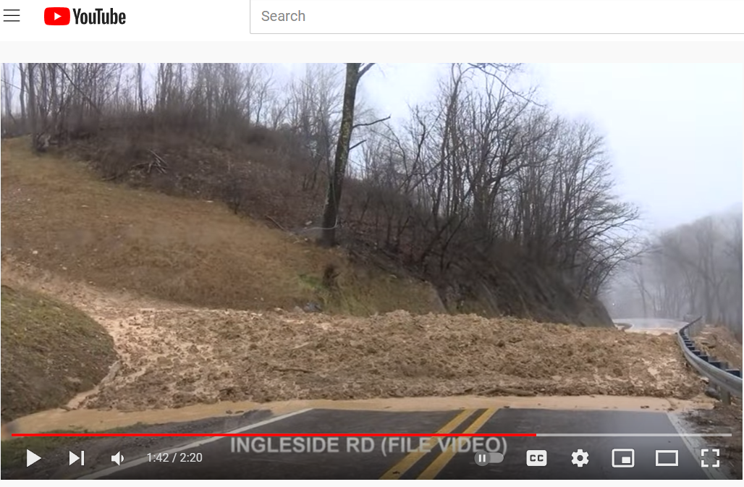
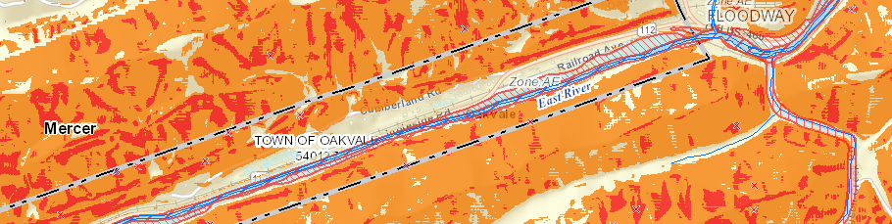
Landslide Susceptibility Maps
2020 Landslide (Mercer County)
https://www.youtube.com/watch?v=vWSUWKeoKNo

Slide 33
Reference Layers
Reference Layers
Elevation (FEMA purchase)
Aerial Imagery (Local Counties)
E-911 Addresses (WV EMD)
Parcels / Assessment Records (WV Property Tax)
Building Footprints (Computer Generated?)
9/2021 Update

Slide 34
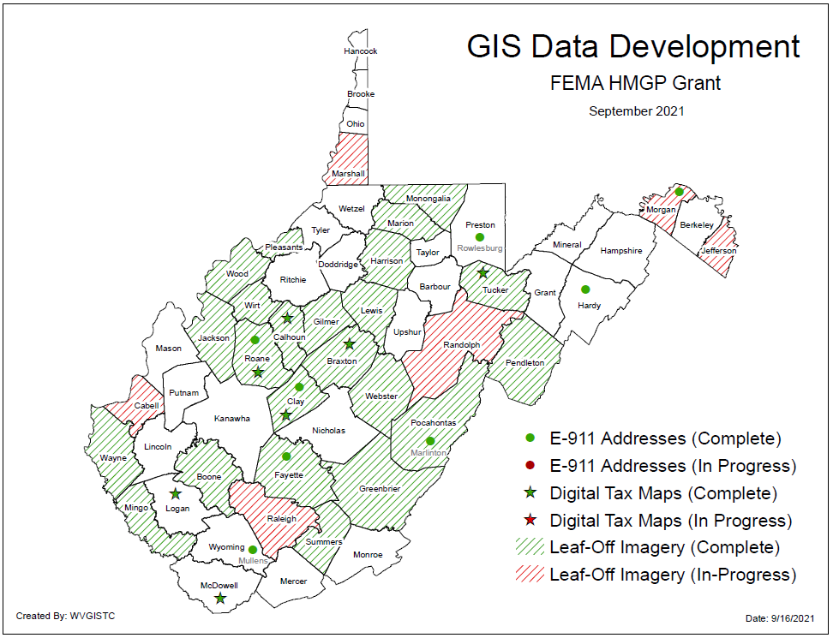
State Contracts for GIS Development
GIS Data Development: Parcels, E-911 Addresses, & Aerial Imagery

Slide 35
Spatial Reference Layers
Elevation Update

Slide 36
Elevation (High Resolution)
Statewide FEMA Elevation LiDAR QL2
  1-foot contours; 1-meter resolution Digital Elevation Model (DEM)
  Download from https://data.wvgis.wvu.edu/elevation/
Elevation Map Services (MapWV.gov) or WV Flood Tool Viewer
  Statewide 1-meter Digital Elevation Model
  Statewide 1-meter Hillshade (grayscale 3D representation of the surface)
  1-ft and 2-ft Contours cached to 1:282 Map Scale (computer caching ongoing)
Updated Source Elevation Metadata
https://www.mapwv.gov/lidar-metadata
Milestone:
Statewide QL2 LiDAR obtained

Slide 37


Statewide Elevation Layers
Elevation Grids, Hillshade Grids, Contours, used for Flood Depths, Imagery Orthorectification
Layer | Source | Coverage
SAMB | 2003 SAMB, 3-meter, 10-foot contours | Statewide
Lidar | Lidar, 2-foot or 1-foot contours | Select Areas
SAMB ELEVATION
WVGISTC LiDAR Hillshade
LIDAR ELEVATION

Slide 38

Statewide Hillshade Basemap Product
A hillshade is a grayscale 3D representation of the surface
Hillshade Basemap

Slide 39

High Resolution Contours
New FEMA LiDAR-Derived Contours are 10x better than 2003 Statewide Elevation Data Set
SAMB Elevation
10 FT Contours
FEMA LiDAR
1 FT Contours

Slide 40


Statewide Hillshade Basemap Product
A hillshade is a grayscale 3D representation of the surface
Hillshade Basemap

Slide 41

Ground Elevation: 1-ft. Contours
https://www.mapwv.gov/flood/map/?wkid=102100&x=-9177701&y=4611497&l=13&v=1
Make Contour Lines visible under REFERENCE LAYERS
1-FOOT CONTOUR ELEVATION VALUE OF 600 FEET MATCHES 1-METER GRID SURFACE ELEVATION OF 600 FEET DISPLAYED IN QUERY RESULTS PANEL
1-ft Contours Display at two Highest Zoom Levels (1:564 and 1:282 Map Scales)
Elevation: 600 ft.
Source: FEMA 2018
600 ft.
1-foot contours published for 10 counties
FEMA LiDAR-Derived Products: 1-Meter DEM and 1-Foot Contours

Slide 42

Ground Elevation: 1-ft. Contours
FEMA LiDAR-Derived Products: 1-Meter DEM and 1-Foot Contours
High-resolution aerial imagery and elevation contours cached at 15 map level scales from 1: 4,622,324 to 1:282
1:282
Map Scale
Elevation: 2390 ft.
Source: FEMA 2016
Contour Elevation: 2390 ft.
1-ft Contours Display at two Highest Zoom Levels (1:564 and 1:282 Map Scales)
1-FOOT CONTOUR ELEVATION VALUE OF 2390 FEET MATCHES 1-METER GRID SURFACE ELEVATION OF 2390 FEET DISPLAYED IN QUERY RESULTS PANEL

Slide 43

FEMA Purchased LiDAR Coverage
FEMA has purchased $10 million in QL2 LiDAR for entire state
Quality 2 (QL2) LiDAR support 1-foot contours
LiDAR captured 2012-20 time frame
https://www.mapwv.gov/lidar-metadata

Slide 44
Spatial Reference Layers
Aerial Imagery Update

Slide 45
New Aerial Imagery
2018 USDA National Agriculture Imagery Program (NAIP) 2-ft pixel resolution. Statewide Coverage. 2020 NAIP Coverage?
2018-22 County Leaf-Of Aerial Imagery (Statewide Contract)
Milestone:
Replaced all of
2010-12 Sheriffs Imagery with current Local Imagery
Over 30 Counties have tapped into the State Aerial Imagery Contract supported by the Hazard Mitigation Grant for the acquisition of 2019-22 leaf-off imagery. Most counties were captured at 4-inch resolution. Imagery resides in the public domain.
Imagery can vary greatly in resolution. Pixel resolution refers to the actual distance on the ground that each pixel represents in the orthophotography. For example, four-inch pixel resolution means that each pixel in the image covers four inches on the ground.

Slide 46

County Aerial Imagery (2021)
New 2021 Imagery
Cabell
Doddridge
Marion County
Monongalia
Pendleton
Putnam
Wayne
Wetzel
Year | Number
2010 | 3
2014 | 1
2016 | 3
2017 | 2
2018 | 19
2019 | 20
2020 | 17
2021 | 8
Ideally, leaf-off imagery should not be older than 5 years. Imagery is important for identifying at-risk structures and accurate disaster mapping.
Select counties for 2019-21 received funding support through HMGP grant
https://data.wvgis.wvu.edu/pub/RA/_resources/Status/CountyImageryYearAcquired.pdf

Slide 47


Leaf-Off Aerial Imagery Web Service
https://services.wvgis.wvu.edu/arcgis/rest/services/Imagery_BaseMaps_EarthCover/wv_imagery_WVGISTC_leaf_off_mosaic/MapServer
Counties provide leaf-off imagery
for State Imagery Web Service
Cached to 1:282 Zoom Level or Map Scale
2021 Harrison County
Aerial Imagery

Slide 48


New County Leaf-Off Aerial Imagery
http://www.mapwv.gov/floodtest/?wkid=102100&x=-9176629&y=4583554&l=13&v=1
4-Inch Pixel Resolution
Choose WV Best Leaves Off Base Map
Cows in the Floodway
West Fork Twelvepole Creek, Wayne County

Slide 49
Spatial Data Development
Parcels Update

Slide 50

Statewide Digital Parcel File
Milestone: In 2021 all 55 counties migrated from paper to digital tax maps
599 Tax Districts
347 Districts
252 Corporations
WV Property Tax Division provides annual update

Slide 51


Parcel Mis-Alignment Map Errors

Slide 52




WV Property Applications
Web Visits
Property
Viewer
Detailed
Property Report
Parcel Property
Viewer
Flood Tool
WV Property Viewer
www.mapwv.gov/parcel
WV Property Search
www.mapwv.gov/
assessment
Property Search Tool

Slide 53
Spatial Reference Layers
E-911 Addresses

Slide 54

Statewide E-911 Addresses
Putnam County, WV
Authoritative Source for Correct Addresses is E-911 Office – NOT Tax Assessor Geodatabases

Slide 55

County Geocoding Match Rates
Countywide match rate should be 90% or higher

Slide 56

County Redistricting - Precincts
Voter Precinct redistricting support for County Clerk Offices
Voting Precinct 2
Voter Registration System recorded as Precinct 2 error
instead of
Precinct 1
Voting Precinct 1

Slide 57
Contact Information
  WVU GIS Technical Center
  West Virginia University
  Kurt Donaldson
  kurt.donaldson@mail.wvu.edu, phone: (304) 293-9467
  Frank Lafone, GIS Manager
  Frank.LaFone@mail.wvu.edu, phone: (304) 293-9466

