Slide 1
Local Contributions to State/Federal Datasets
WVDOT Transportation GIS User Day Meeting
Wednesday, November 16, 2016
Charleston, WV
Kurt Donaldson, WV GIS Technical Center, West Virginia University
Todd Fagan, Jefferson County GIS/Addressing Office
Aaron Cox, Hampshire County Commission

Slide 2

Kurt Donaldson
WV GIS Technical Center
West Virginia University

Slide 3
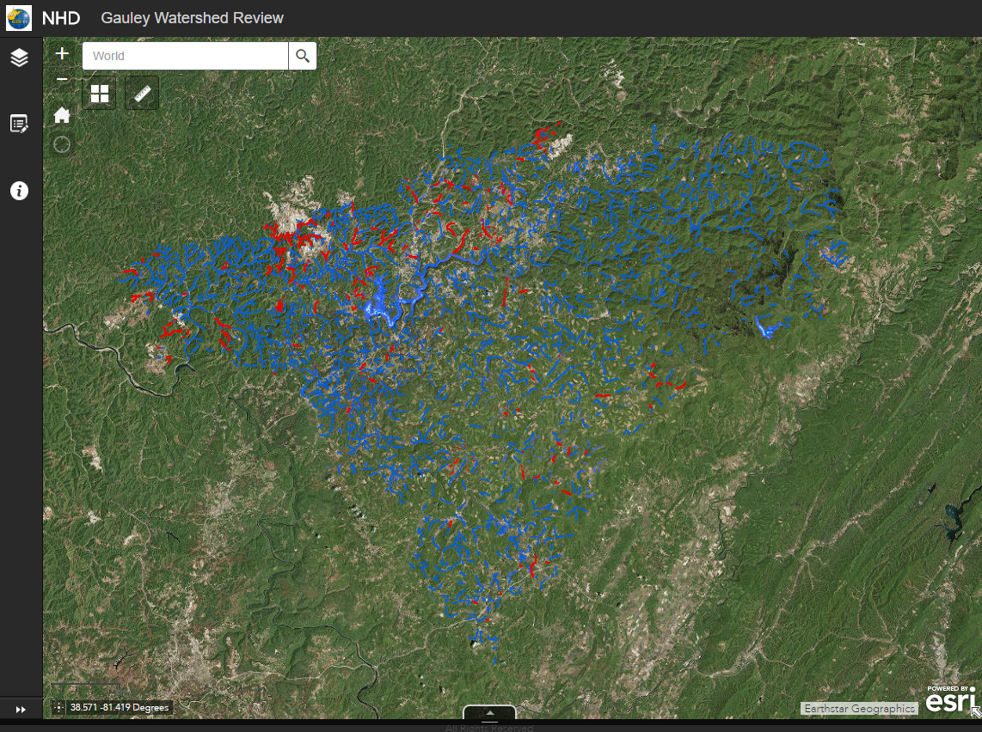
National Hydrography Dataset
Official nationwide digital National Hydrography Dataset
Local
Counties and other local Stakeholder – Sub-Stewards
Validate NHD layers or provide information for edits
State
Federal
WV GIS Tech Center– State Stewart
Identify, edit and update NHD dataset
USGS – National Steward
Verify & update NHD (http://nhd.usgs.gov/stewardship.html)
Funded by the EPA Exchange Network Grant Program
Aerial Imagery
Gauley Watershed
Benefits in contributing to NHD are:
Consistent and accurate information for public and commercial map viewers (Google, Bing, etc.)
Federal, state, and local agency coordination and data exchange
Planning for hydrologic modeling, environmental protection, resource management, fisheries management, mapping, emergency response, WBD, HEM (Human exposure modeling)
Web Tool for Validating NHD

Slide 4
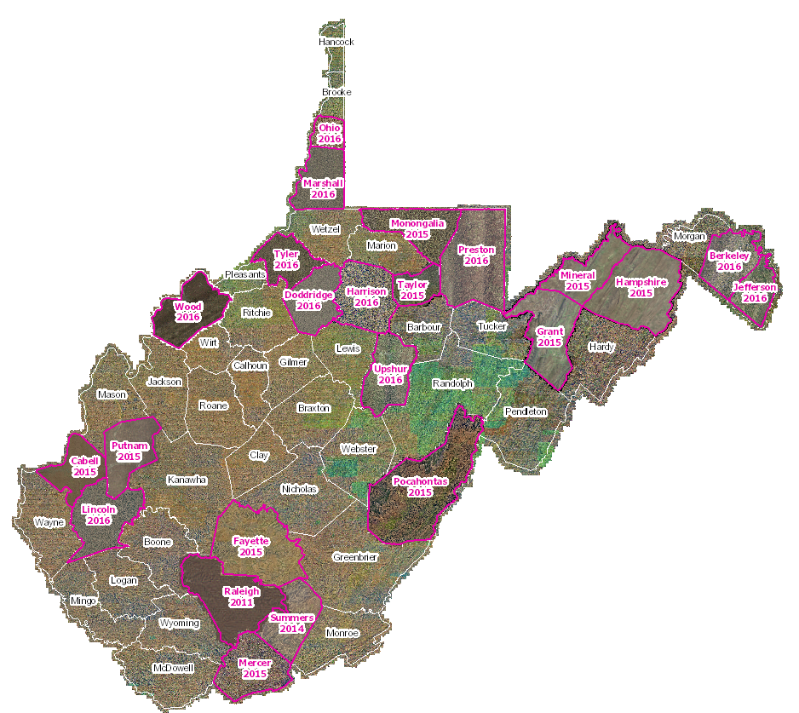
National Hydrography Dataset
Official nationwide digital National Hydrography Dataset
Local
Counties and other Local Stakeholder
Validate NHD layers or provide information for edits
State
Federal
WV GIS Tech Center– State Stewart
Identify, edit and update NHD dataset
USGS – National Steward
Verify & update NHD (http://nhd.usgs.gov/stewardship.html)
Funded by the EPA Exchange Network Grant Program
Leaf-Off Aerial Imagery
State-level integration of imagery
23 counties have provided high-res leaf-off imagery (2011-16)

Slide 5
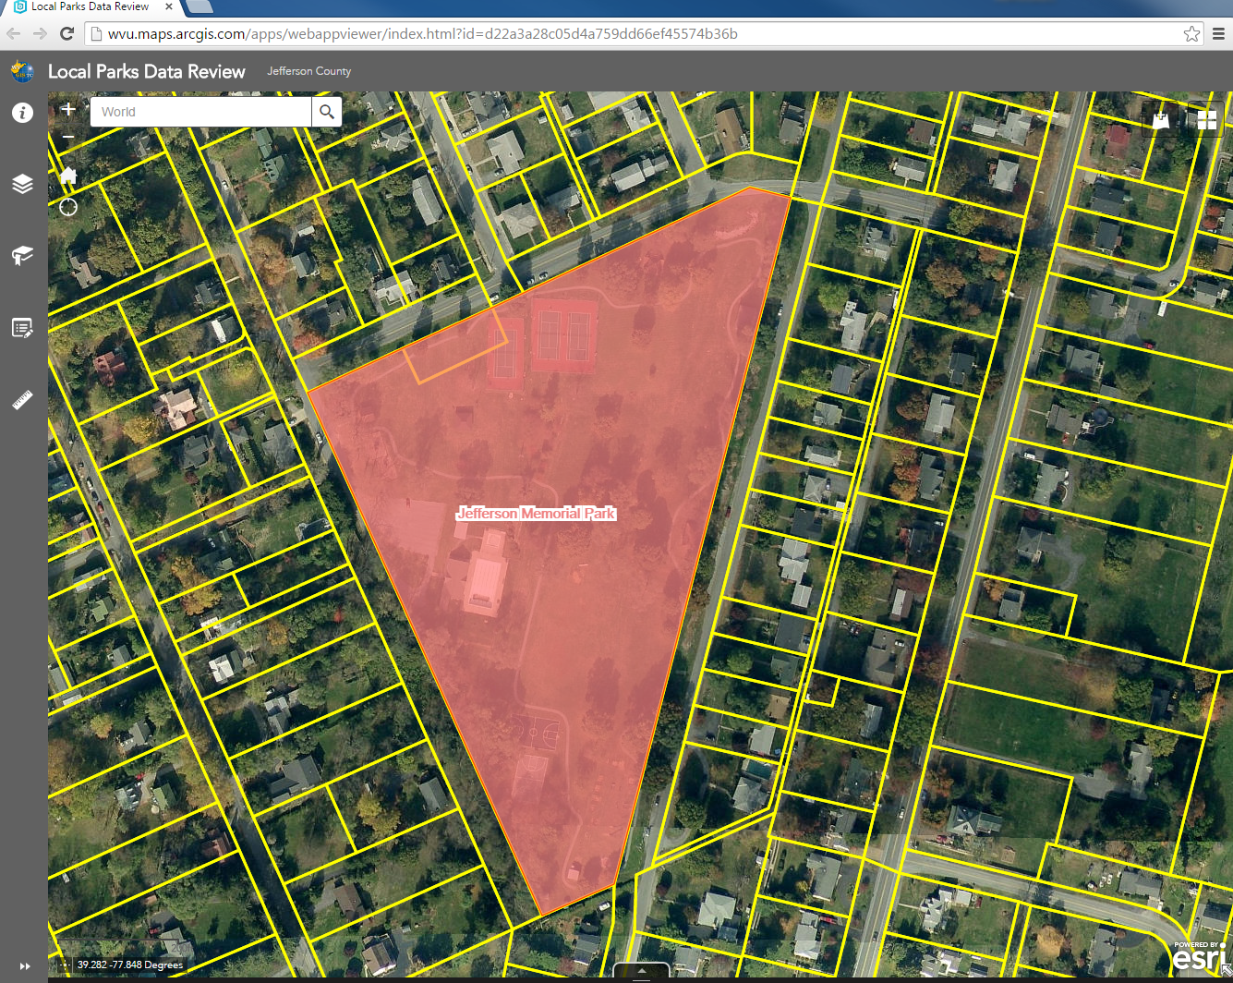
PAD-US National Inventory of Protected Areas
Official nationwide inventory of public parks and other protected open space in US
Local
Local Public Lands
Key Local GIS Layer: Parcels
State
Federal
WVGISTC State-Level Integration
Compile & Validate using ArcGIS Online Web Tool
USGS PAD-US
National Database (http://gapanalysis.usgs.gov/padus/)
Jefferson Memorial Park
Benefits in contributing to national PAD are:
Public land information for recreation, wildlife activities, etc.
Consistent and accurate information for public and commercial map viewers (Google, Bing, etc.)
Federal, state, and local agency coordination and data exchange
Measurement of conservation accomplishment
Facility, climate, energy, corridors planning
Ecological and watershed assessments
Web Tool for Validating Local Parks

Slide 6
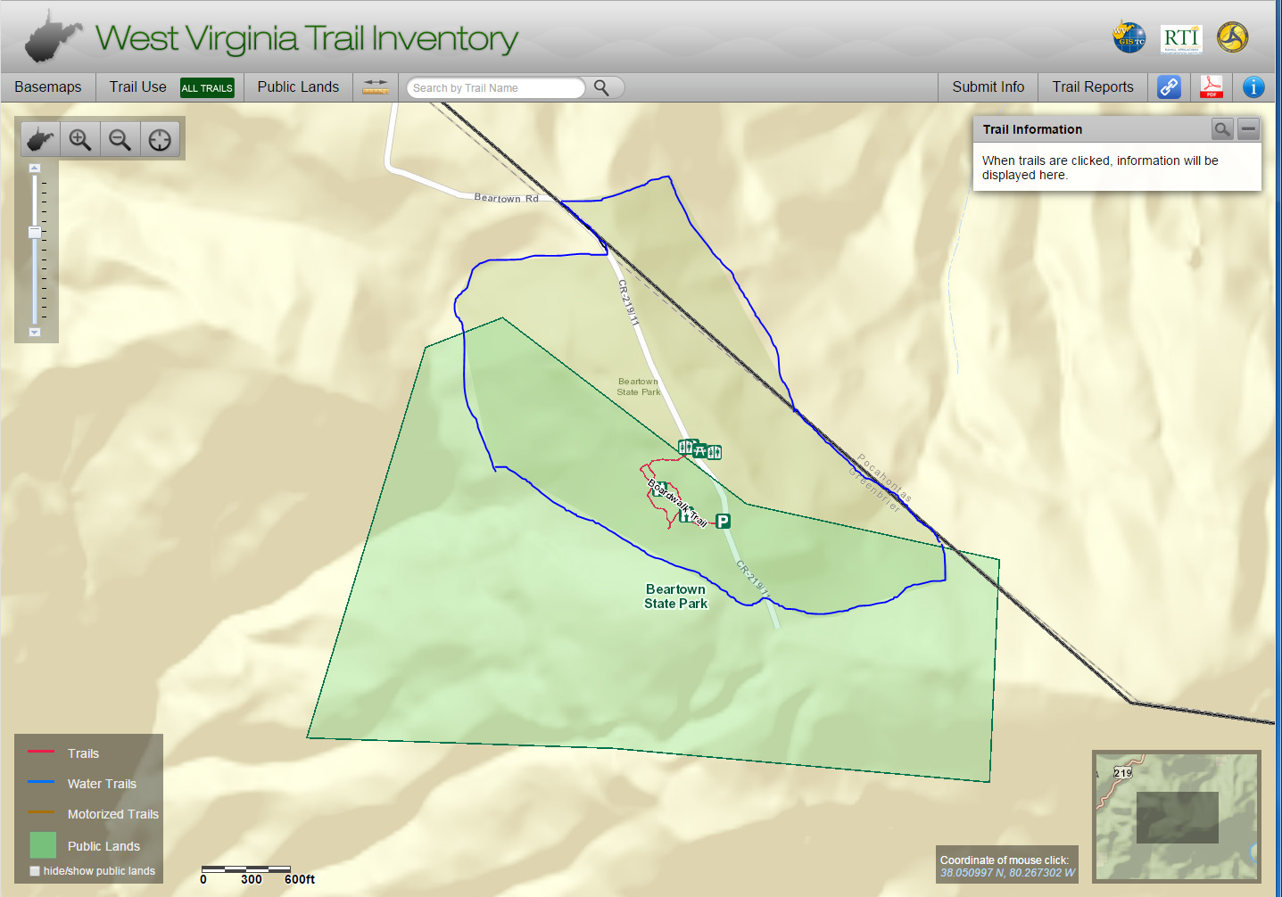
PAD-US National Inventory of Protected Areas
Official nationwide inventory of public parks and other protected open space in US
Local
Local Public Lands
Key Local GIS Layer: Parcels
State
Federal
WVGISTC State-Level Integration
Compile & Validate using ArcGIS Online Web Tool
USGS PAD-US
National Database (http://gapanalysis.usgs.gov/padus/)
Beartown
State Park
Benefits in contributing to national PAD are:
Public land information for recreation, wildlife activities, etc.
Consistent and accurate information for public and commercial map viewers (Google, Bing, etc.)
Federal, state, and local agency coordination and data exchange
Measurement of conservation accomplishment
Facility, climate, energy, corridors planning
Ecological and watershed assessments

Slide 7
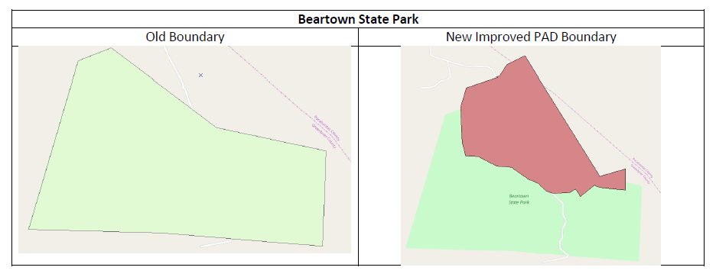
PAD-US National Inventory of Protected Areas
Official nationwide inventory of public parks and other protected open space in US
New Improved Boundary
Old Beartown
State Park
Boundary

Slide 8
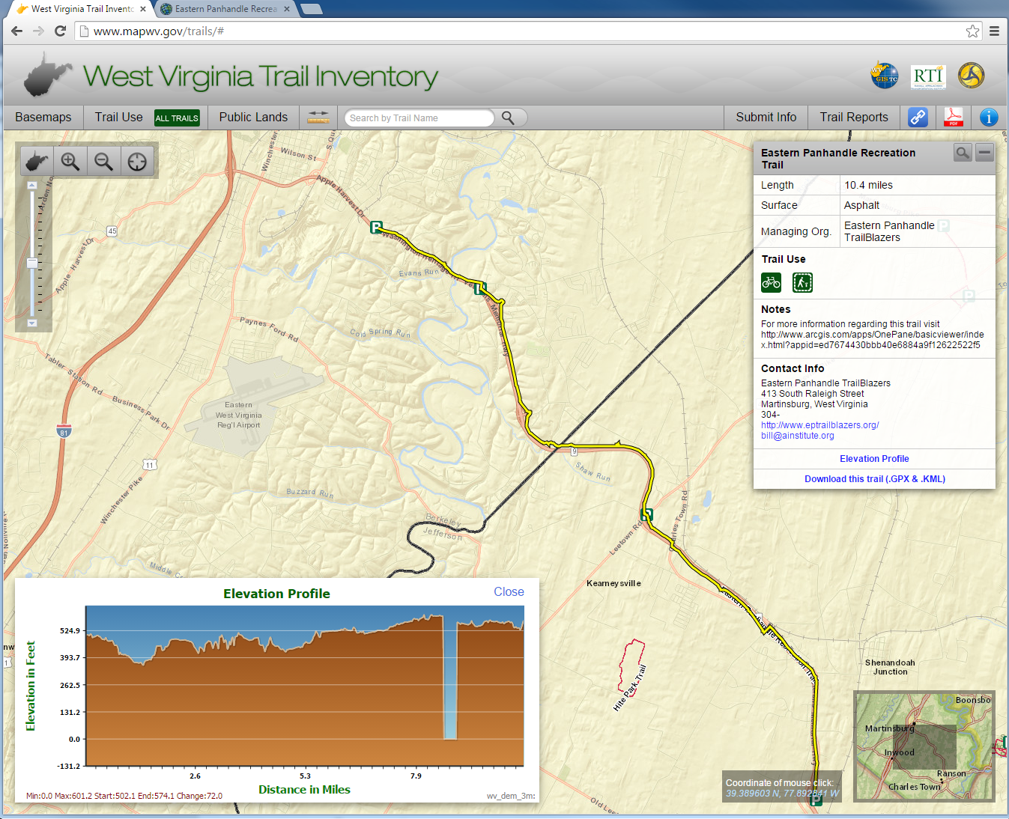
Trails for The National Map
A collaborative effort of the USGS and other federal, state, and local agencies to improve and deliver topographic information for the US.
Local
Local Trails
Key Local GIS Layer: Trails, Aerial Imagery
State
Federal
WV DOT / WVGISTC State-Level Integration
Compile & Validate Trails (http://www.mapwv.gov/trails)
USGS National Map
National Topographic Map (http://nationalmap.gov)
Eastern Panhandle
Recreation Trail
Jefferson Memorial Park
Benefits in contributing to State/National Databases:
Sponsored by WV DOT, over 5,000 miles of publicly accessible trails are in the WV Trail Inventory
Consistent and accurate information for public and commercial trail map applications
Multi-organization trail planning
Customized trail maps (brochures, map kiosks, etc.)
Trail statistics, trail use, etc.
Download .GPX & .KML files
Inclusion in national databases like The National Map
Web Tool for Validating Local Trails
Web Tool for Validating Local Parks
Hite Park
Trail

Slide 9
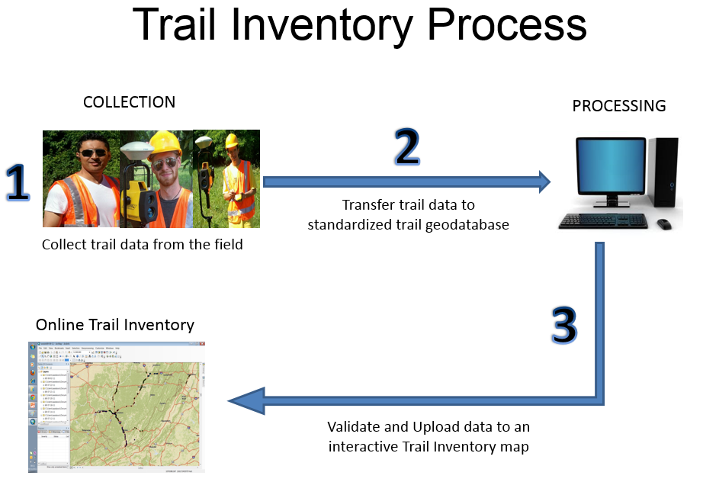
WV Trail Inventory – Process
WV DOT Sponsored Project
Data validated by local stewards, collected and compiled at state level, input for national trail inventories

Slide 10
Trails for The National Map
A collaborative effort of the USGS and other federal, state, and local agencies to improve and deliver topographic information for the US.
National Trail Inventory
WV Trail Inventory
USFS Trails
NPS Trails
State Public Land Trails
Local Public Land Trails
Motorized Trail Systems
Other Trail Stystems
Local
Local Trails
Key Local GIS Layer: Trails, Aerial Imagery
State
Federal
WV DOT / WVGISTC State-Level Integration
Compile & Validate Trails (http://www.mapwv.gov/trails)
USGS National Map
National Topographic Map (http://nationalmap.gov)
Benefits in contributing to State/National Databases:
Sponsored by WV DOT, over 5,000 miles of publicly accessible trails are in the WV Trail Inventory
Consistent and accurate information for public and commercial trail map applications
Multi-organization trail planning
Customized trail maps (brochures, map kiosks, etc.)
Trail statistics, trail use, etc.
Download .GPX & .KML files
Inclusion in national databases like The National Map

Slide 11
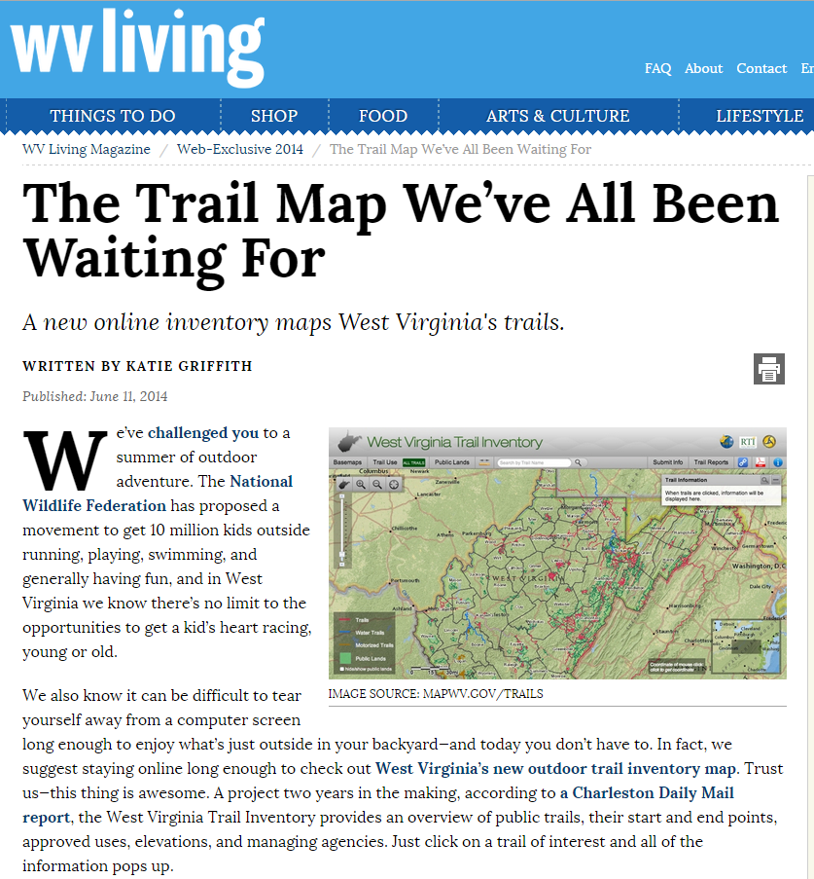

WV Trail Inventory – Press Coverage
WV DOT Sponsored Project
Wonderful West Virginia (June 2016)
WV Living (June 2014)

Slide 12
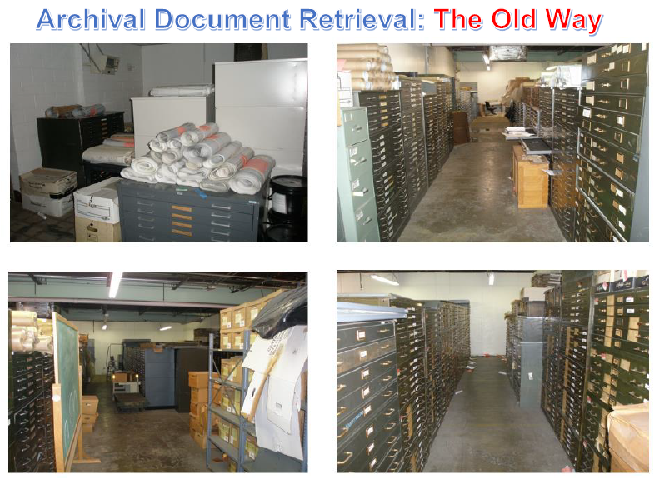
Highway Plan Scanning Project
WV DOT Sponsored Project

Slide 13

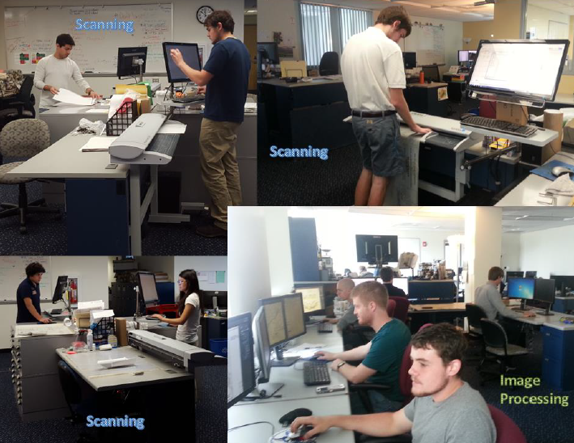
Highway Plan Scanning Project
WV DOT Sponsored Project

Slide 14
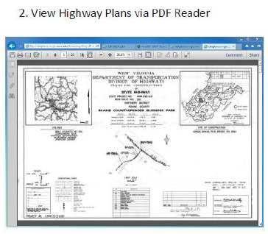
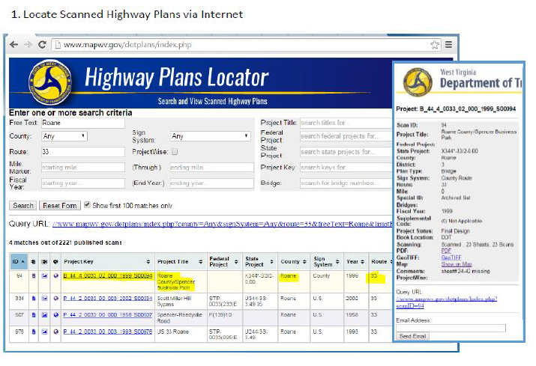
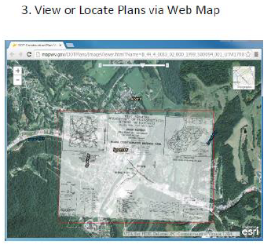
Highway Plan Scanning Project
WV DOT Sponsored Project

Slide 15
Highway Plan Scanning Project
WV DOT Sponsored Project
WV DOT ProjectWise
Scanned Plans Locator
Central Office Archival Scans
Digital Plan Sets
District Office Archival Scans
Integration of Paper & Digital Plan Sets
Online Search and Access

Slide 16
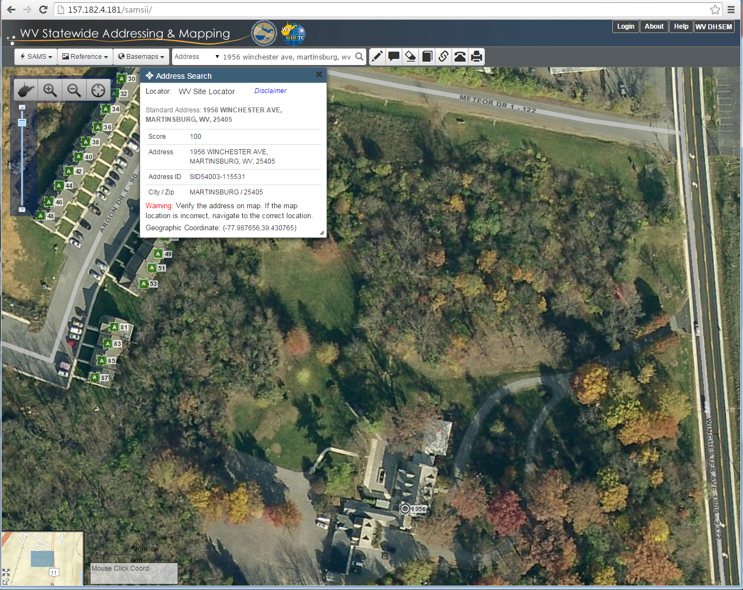
Addresses/Road Centerlines for Federal Agencies
Statewide Addressing and Mapping System (SAMS): A collaborative effort of the federal, state, and local agencies to improve addresses and road centerline information information for the US.
Local
Local Addresses
Key Local GIS Layer: Addresses and Road Centerlines
State
Federal
WV DHSEM / WVGISTC State-Level Integration
Compile & Validate Web Tool (http://wvsams.mapwv.org/samsii)
US Census / US DOT / USGS
Incorporated into state & federal databases for multiple uses
WV DOT highway integration in future
Web Tool for Validating & Editing Addresses
Benefits in contributing to State/National Databases:
Consistent and accurate information for public and commercial applications (emergency response, geocoding services, census takers, transportation planning, etc.)
Online address edit tools for low-resource counties, import tools for high-resource counties
1956 Winchester Ave, Martinsburg, WV

Slide 17
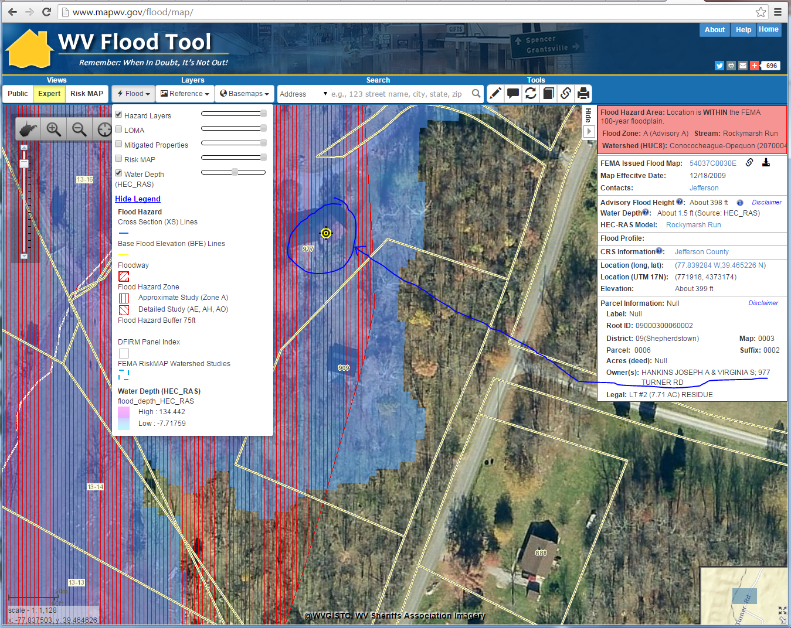
FEMA Flood Maps
A collaborative effort of the federal, state, and local agencies to improve flood determinations
Local
Local Data Layers
Key Local GIS Layer: Parcels, Addresses, Leaf-Off Imagery, Elevation
State
Federal
WV DHSEM / WVGISTC State-Level Integration
Flood Determination Tool (http://www.mapWV.gov/Flood)
FEMA
Authoritative tool for flood determinations in West Virginia
977 Turner Rd, Shepherdstown, WV
Web Tool for Validating & Editing Addresses
Benefits in contributing to WV Flood Tool
Better flood determinations for local floodplain managers and the public
Incorporates best local data for referencing locations and flood determinations
More refined flood risk assessments and mitigation planning for communities
1956 Winchester Ave, Martinsburg, WV
Web Tool for
Flood Determinations

Slide 18
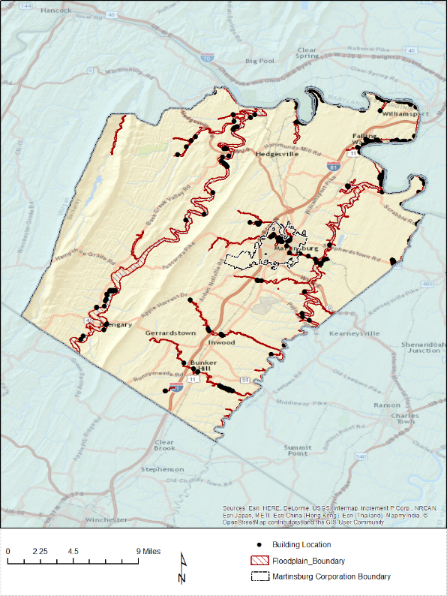
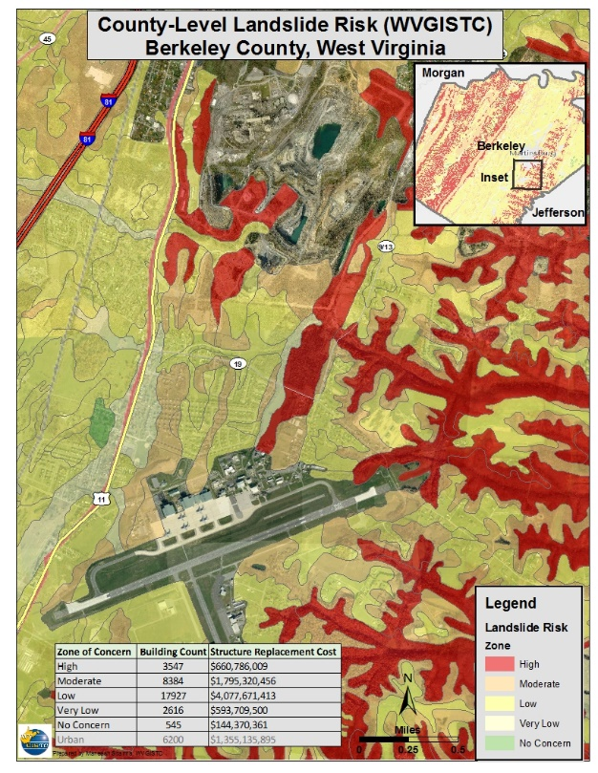
Local Data for FEMA Hazard Risk Assessments
A multi-organization collaboration of local, regional, state, federal, and private sector partners
for comprehensive hazard mitigation planning
Local
Local Data Layers:
Key Local GIS Layers: Addresses, Parcels, Building Footprints, Aerial Photos, Local Critical Infrastructure Datasets
State
Federal
WV DHSEM / WVGISTC State-Level Integration
Provide technical support services for hazard assessments
FEMA / USACE / EPA
Hazard mitigation planning and implementation at local, state, and national levels
State-level integration of regional hazard plans and datasets
Berkeley County
Benefits in contributing local data to statewide coordinated risk assessment services:
Improved comprehensive risk assessment studies
Better exchange of risk assessment data and models
Integration into regional, state, and national plans
Increased capacity within regions and counties so they depend less on outside contractors to complete local hazard mitigation plans. Provide longevity and continuity measures for future risk assessment studies.
Flood Risk Assessment
Landslide Risk Assessment

Slide 19
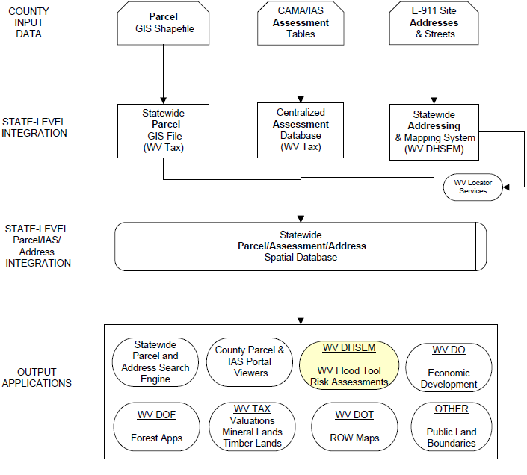
Best Available Site-Specific Data
GIS Parcels
CAMA Records
GIS Addresses
Statewide integration of multiple local data sources, especially (1) parcels, (2) CAMA assessment records, and (3) E-911 addresses
Parcel/Assessment/Address Spatial Database

Slide 20
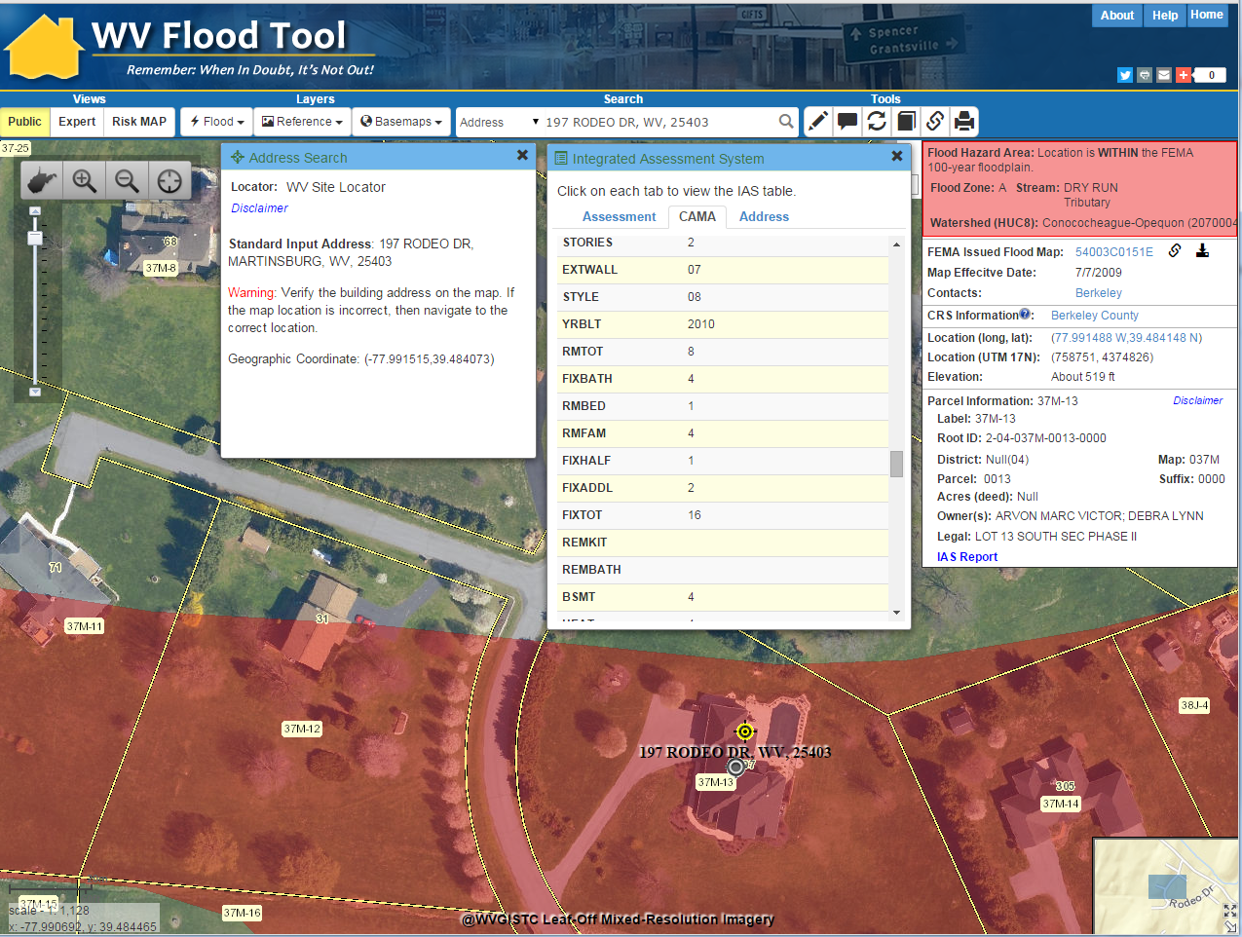
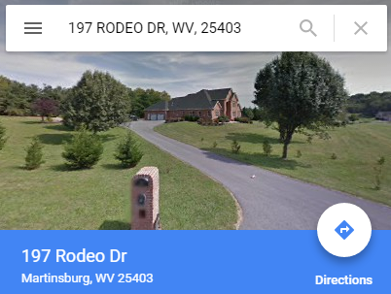
Seamless Data Integration
FEMA MAP LINK
Local Data Sources
GIS ADDRESS
OWNER
INFO
GEOCODE ADDRESS
GEOCODE ADDRESS
CAMA
BLDG
INFO
GIS PARCEL
2016 AERIAL PHOTOS
CAMA Assessment
AERIAL PHOTOS
197 Rodeo Drive, Martinsburg, WV
External Map Links
GOOGLE MAP LINK
GOOGLE MAP LINK
GIS ADDRESS
GIS PARCEL
FEMA MAP LINK
WV Flood Tool Beta

Slide 21
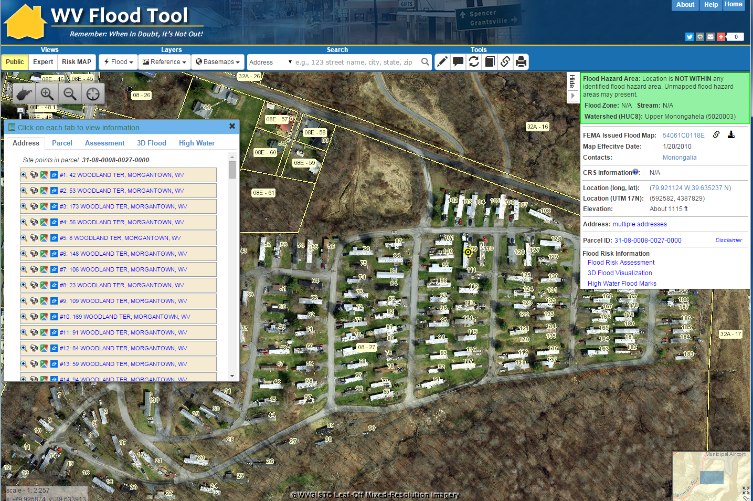
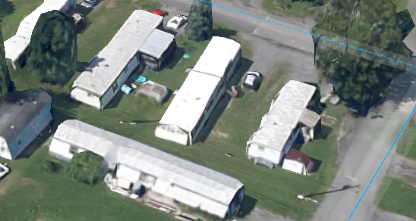
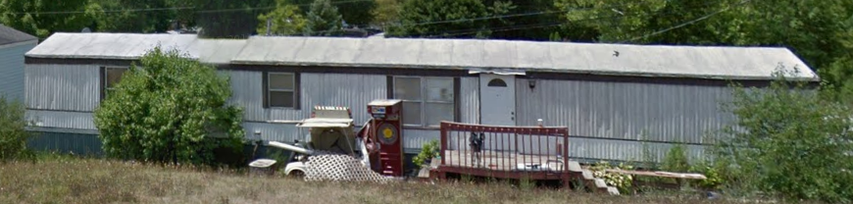
Address: 109 Woodland Terrace
Parcel ID: 8-8-8.27

Slide 22
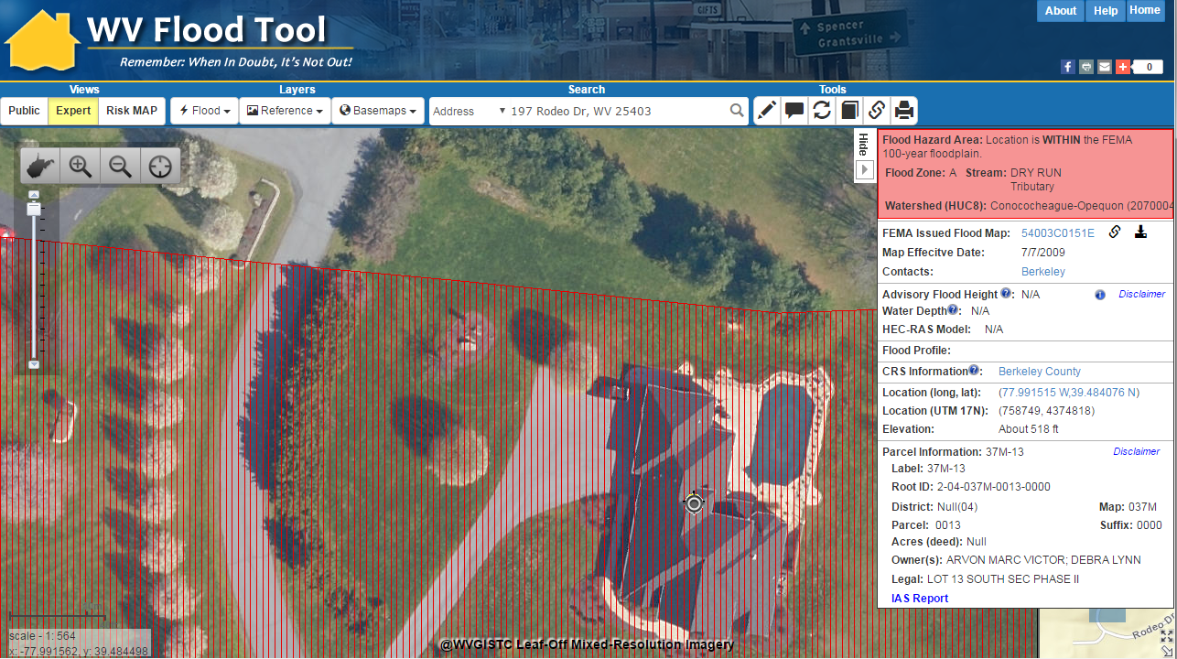
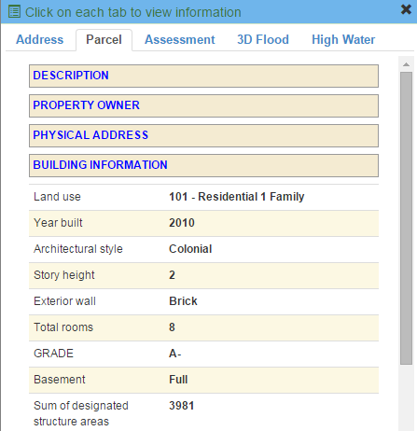
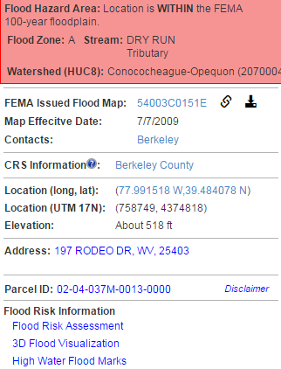

1% Flood Impact, 11-ft. Water Depth
3D Flood Visualization of Structure at
197 Rodeo Drive
WV Flood Tool Conceptual Slide

Slide 23

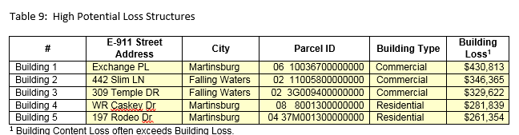
Statewide Data Integration on Parcel ID
Building Damage
Loss Estimates $$$
Flood Risk Assessments
GIS Parcel Feature Class
Flood Risk Assessment
3D Flood Sketch / Typical Damage
IAS/CAMA Records
Hi-Water Flood Marks
197 Rodeo Dr.
197 Rodeo Dr.

Slide 24
Todd Fagan
Jefferson County GIS/Addressing Office

Slide 25
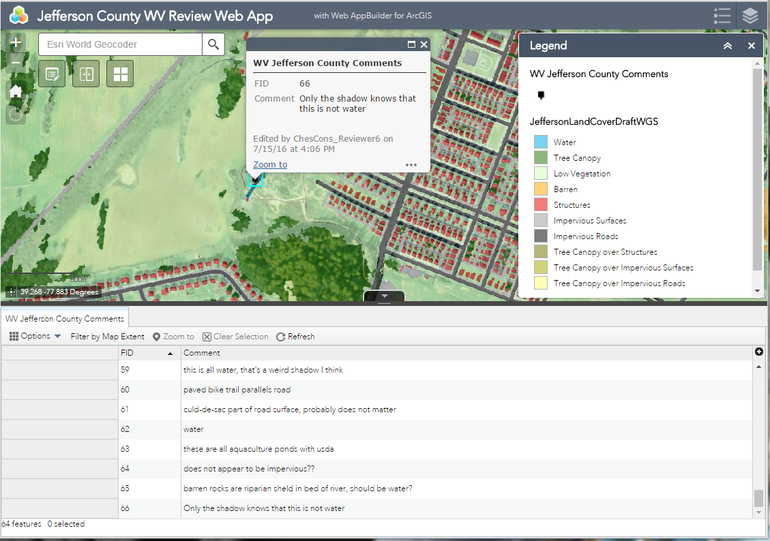
Local Data for National Land Cover Dataset
A multi-organization collaboration of local, regional, federal, non-profit, and private sector partners
for updating land cover classes and environmental modelling
Local
Local Data Layers:
Key Local GIS Layers: Roads, Building Footprints, Aerial Photos, Railroads, Impervious Surfaces, Trails
Region
Federal
Chesapeake Bay Program partnership / State of Maryland
NPS / EPA / Chesapeake Bay Program
Update NLCD and incorporation into Phase 6 TMDL Models
Accuracy Assessments
Validate LC layers or provide information for edits
Develop high resolution land cover classes for entire Chesapeake Bay watershed
Benefits in contributing local data to NLCD:
Better estimates on amounts of nutrients and sediments transported to the Chesapeake Bay
Improve and refine Phase 6 models to inform actions needed to restore the Chesapeake Bay and to meet TMDL pollution limits.
Local use in water resource and environmental planning, targeting of restoration/conservation efforts and public education and outreach
Web Tool for Validating & Editing Land Cover Classes
Land Cover Updates
TMDL Models
Jefferson County

Slide 26
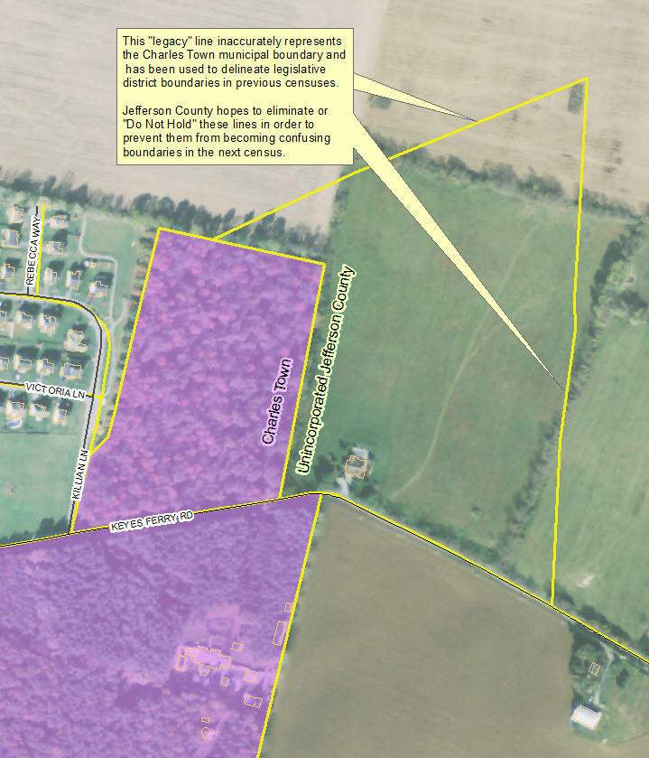
2016 Block Boundary Suggestion Program
Census program to allow local input into how blocks are drawn
Local
Local Public Data
Key Local GIS Layers: Roads, Subdivisions, City Limits
State
Federal
WV State Senate
US Census Bureau
National Databases (http://www.census.gov/main/www/access.html)
Uses Census data as basis for Election Redistricting
BBSP Verification
Benefits in contributing to BBSP are:
Permanent deletion of poorly drawn, illogical, non-visible edges that may be used as 2020 blocks and subsequently chosen as election district boundaries
Easier effort in local magisterial redistricting, voting precinct delineation, polling place selection, and ultimately voter registration
Minimizes neighborhood splitting and voter confusion
Propagates more accurate data to other census data sets to help 2020 decennial census takers and any user who downloads the data
Jefferson County

Slide 27
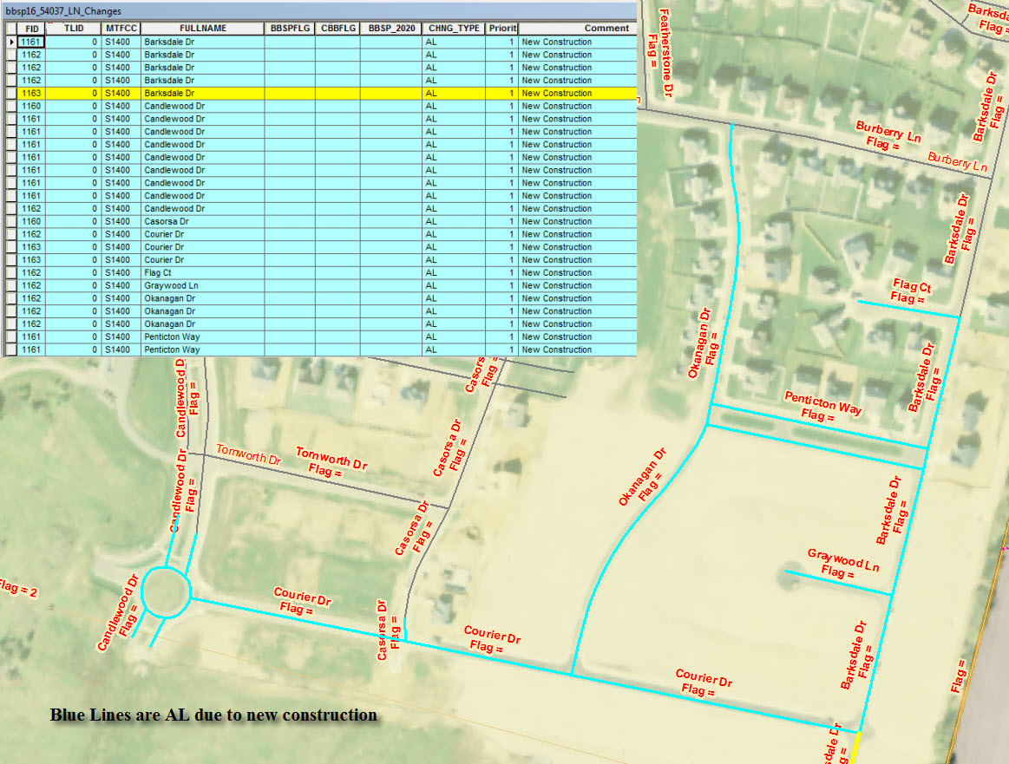
2016 Block Boundary Suggestion Program
NEW CONSTRUCTION

Slide 28
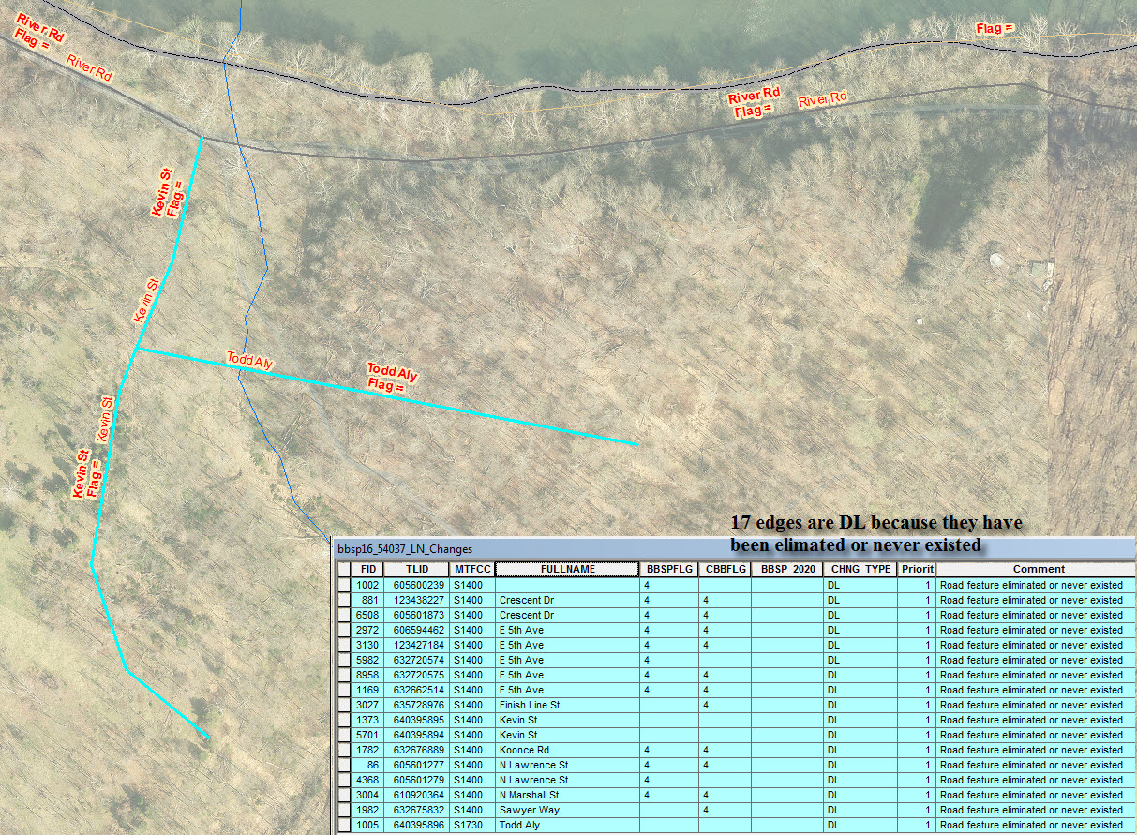
DELETE FEATURES

Slide 29
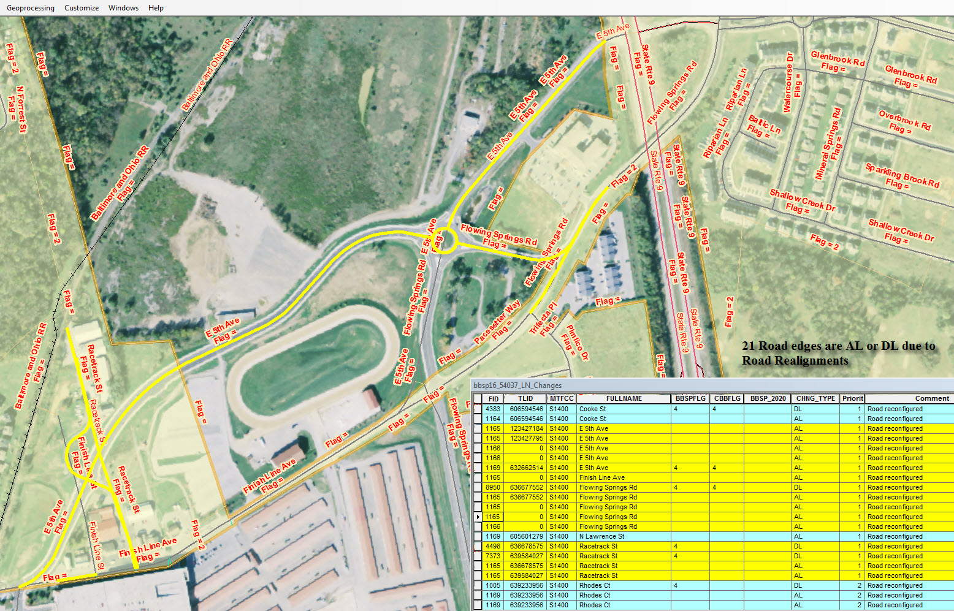
ROAD REALIGNMENT

Slide 30
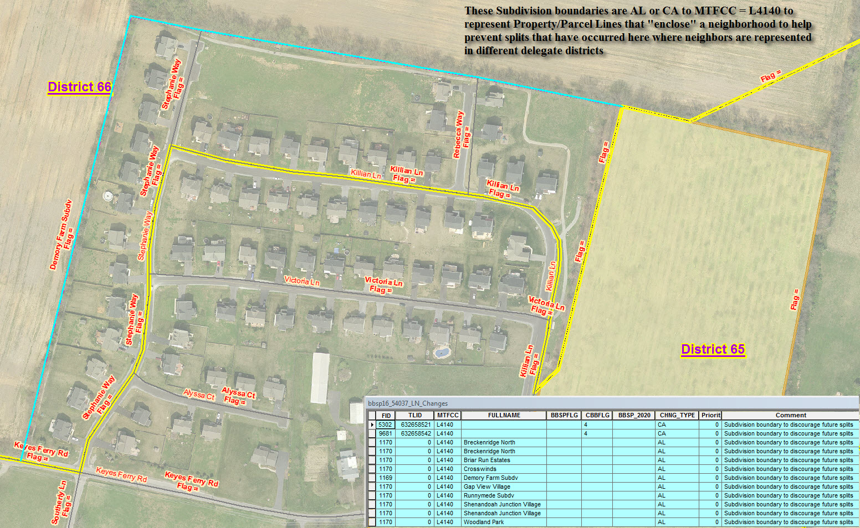
SPLIT NEIGHBORHOODS

Slide 31
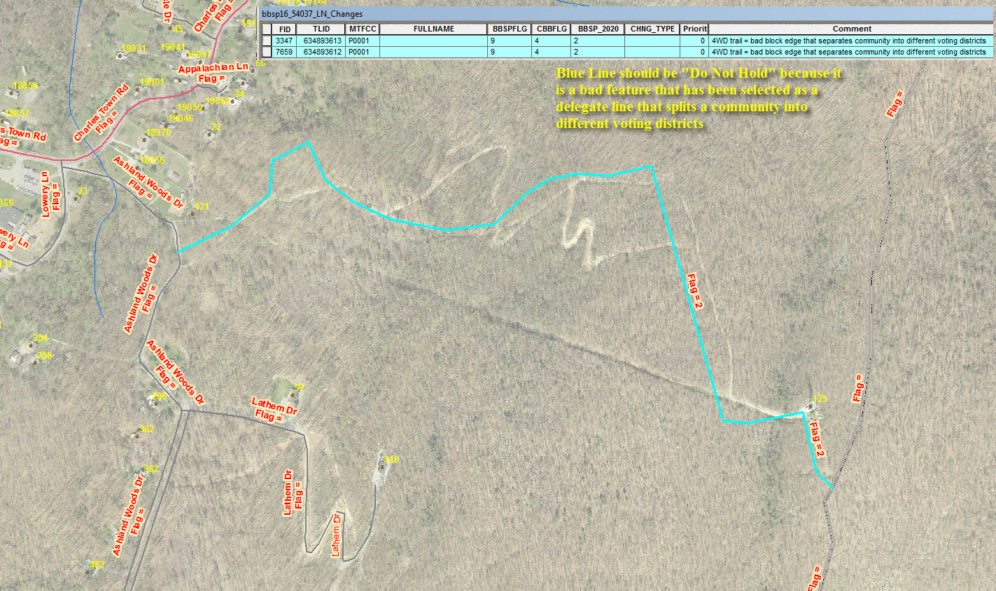
NON-INTUITIVE BLOCK BOUNDARY

Slide 32
Aaron Cox
Hampshire County Commission

Slide 33
Hampshire County Assisting with the
2016 West Virginia flood
23 deaths (Greenbrier 15, Kanawha 6, Jackson and Ohio 2)
8 to 10 inches of rain falling over a period of 12 hours
Flood tied for 7th among Deadliest floods in West Virginia history
Deadliest flash flood event in the United States since the 2010
National Weather Service, “this rainfall qualifies as a 1,000 year event for parts of Fayette, Nicholas, and Greenbrier Counties”
State of Emergency for 44 WV Counties

Slide 34
Local
Parcels
State
Federal
IAS CAMA Data Tables
FEMA DFIRMs
SDE Forms
Addresses
Centerlines
Location embedded data in photographs
Benefits in contributing to State/National Databases:
Availability of Data in a timely manner dramatically reduces input time into the FEMA damage assessment system
Locally Available Data on a state level can help Emergency Response Preparedness and Response

Slide 35
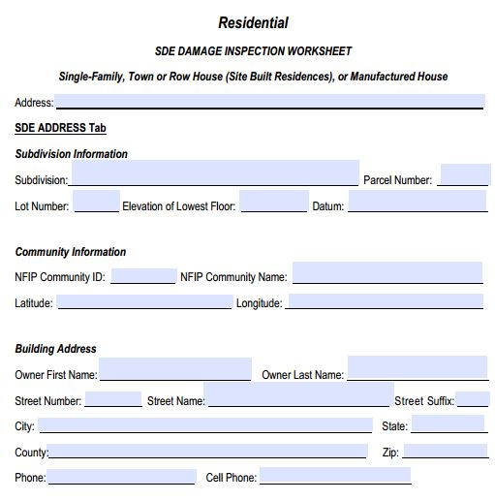
Substantial Damage Inspection Worksheet

Slide 36
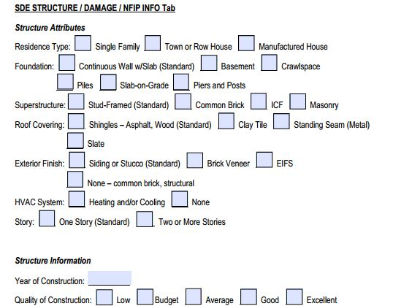
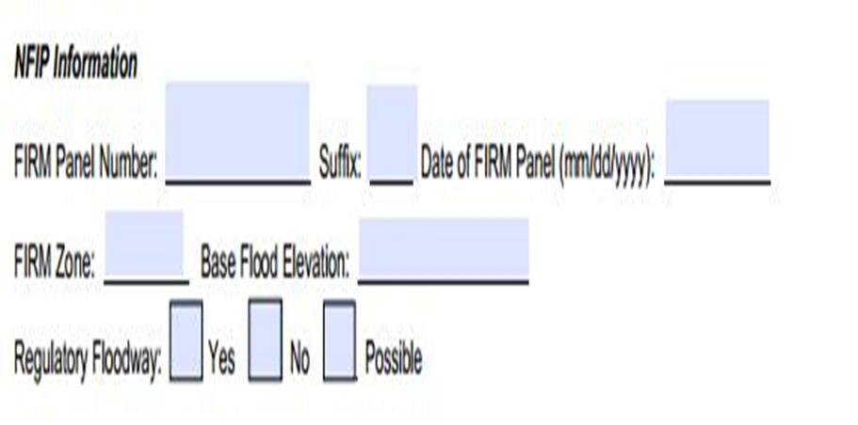
Substantial Damage Inspection Worksheet

Slide 37
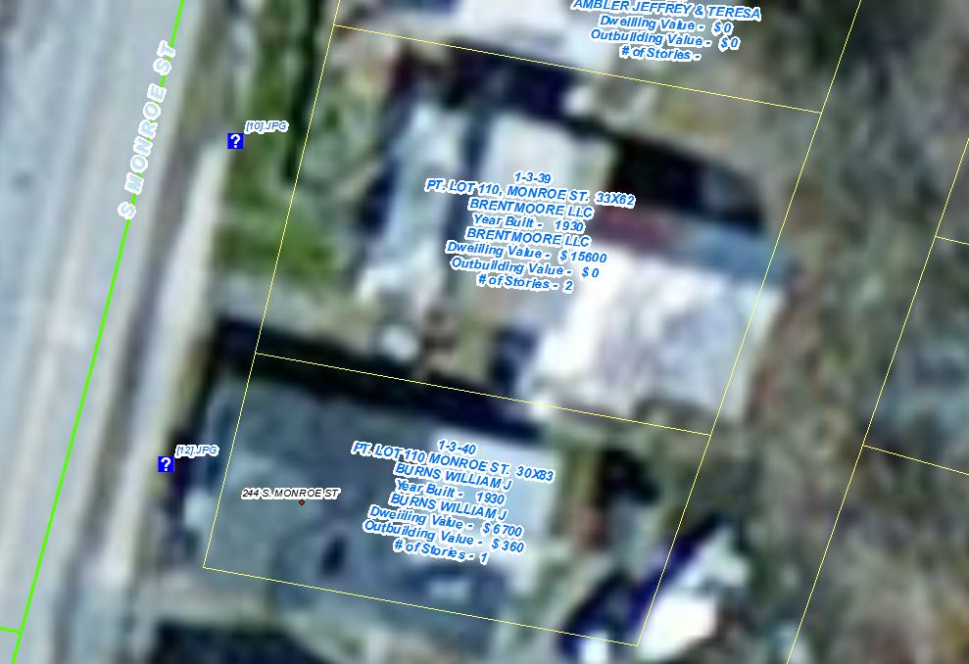
Labeling Solution

Slide 38
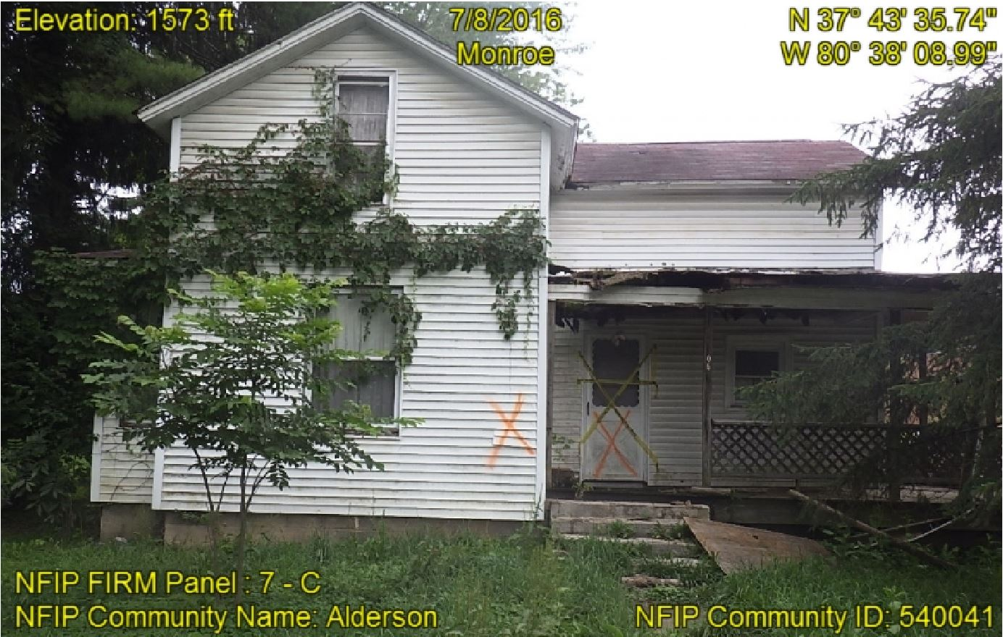
Image Capture Solution

Slide 39

Local Contributions to State/Federal Datasets
Success Through Partnerships
Questions?
Wednesday, November, 2016
Charleston, WV

