Slide 1
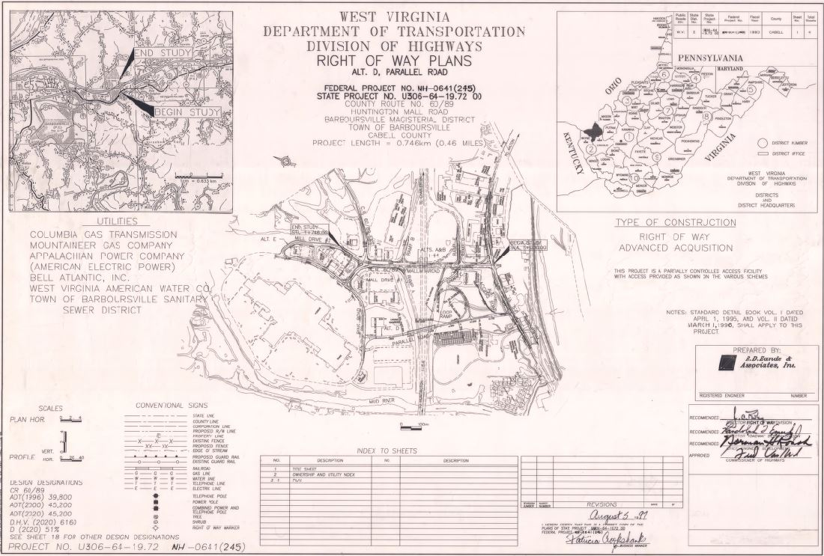
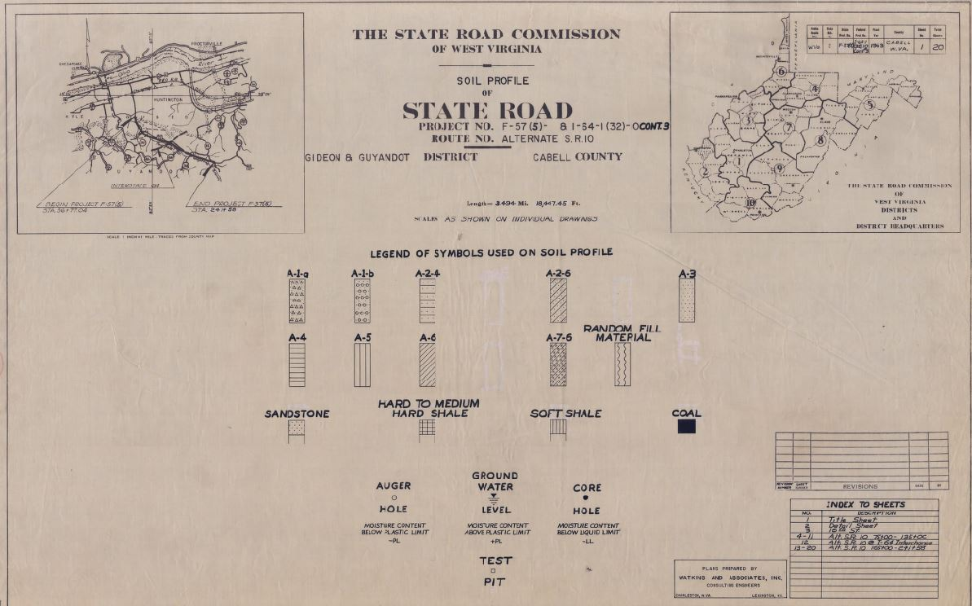
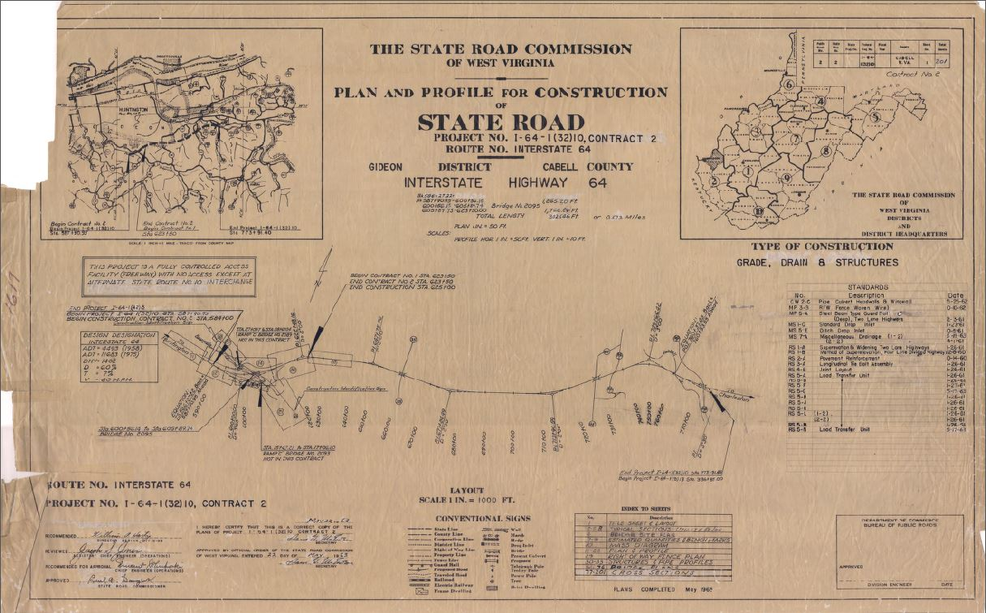
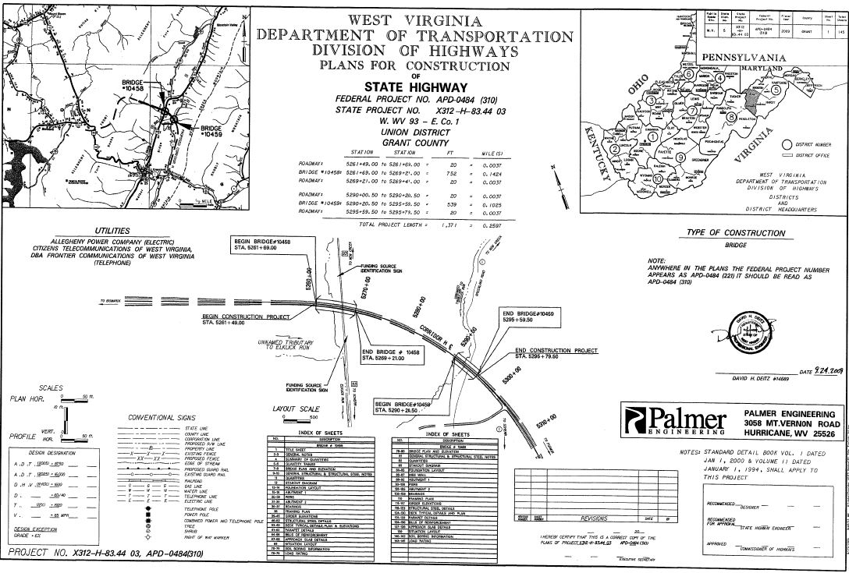


WV DOT Scanning Project

Slide 2

The West Virginia GIS Technical Center (WVGISTC) is scanning West Virginia Department of Transportation (DOT) large format highway plan sheets into digital raster images.
For every highway plan set a single Adobe PDF file is created along with spatially referencing the index map.
An online application for managing, searching, viewing, and downloading all scanned highway plans is maintained.
  Provides a fast discovery and online retrieval of the electronic highway plans.

Slide 3
WV DOT Scanning Project
The justification – Why do we need this system?
Improved Management and Archival System
  Electronic database manages the plan sets and associated documents
  Eliminates lost drawings, misfiled drawings, and deterioration of drawings
  Long-term digital storage integrated with ProjectWise content management system
  Consolidates record plan sets in one location in digital database
    Engineering plans, right of way plans, shop drawings, bridge plans, and roadway plans stored in multiple physical locations
Faster and Easier Access to Drawings
  By anyone, at any time, from anywhere.
  Improved document accessibility for both internal and external users
  Access by non-spatial or spatial map queries

Slide 4
How does this project benefit the Department of Highways overall business processes?
  Enables the WVDOH to digitally store, retrieve, and share full scale plan sets along with their supporting engineering documentation in a geospatial interface for easy retrieval from multiple locations on many different fixed or mobile devices.

Slide 5

WV DOT Scanning Project
Engineering and Right of Way divisions currently store approximately 1500 drawers and 200 rolled sets of plans.
Currently we have shop drawings, bridge plans, roadway plans, design calculations, and other files in our District 1 storage room.

Slide 6
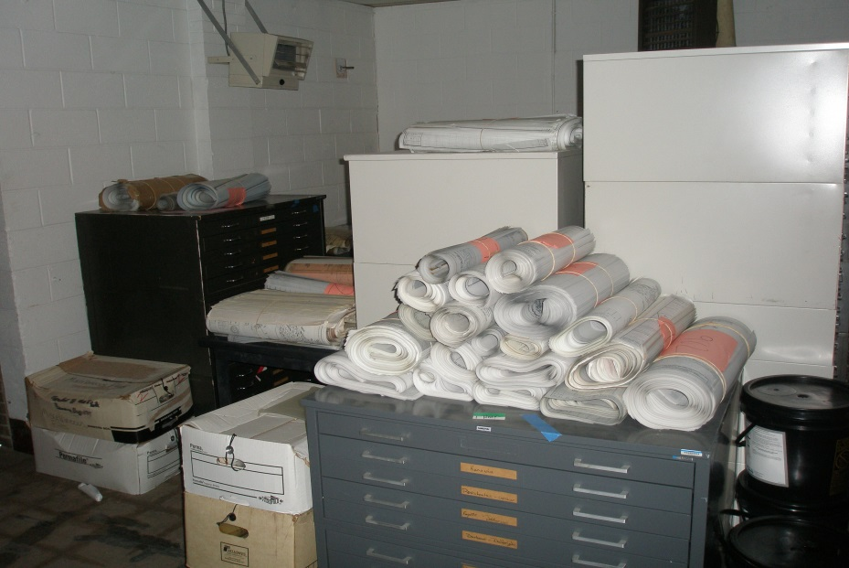
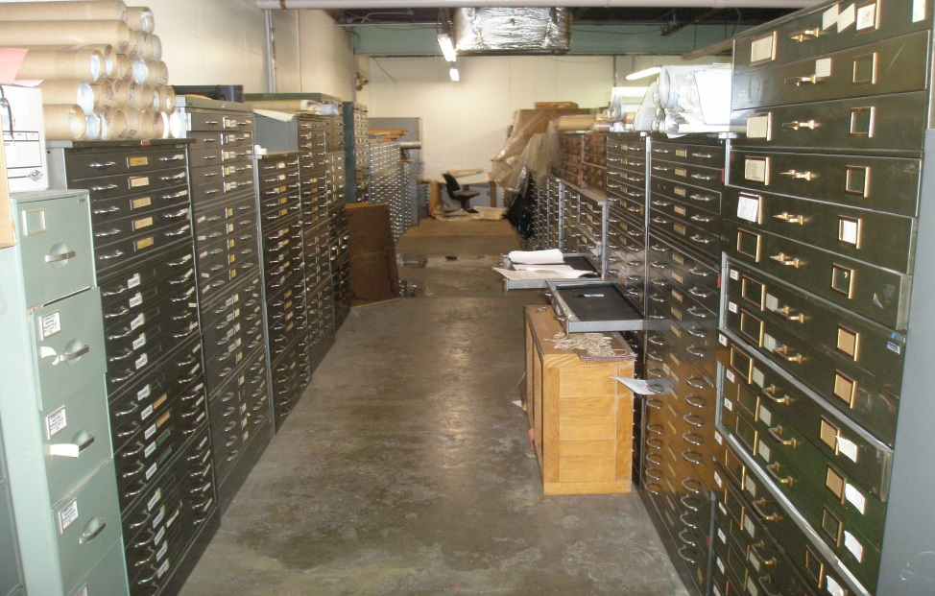

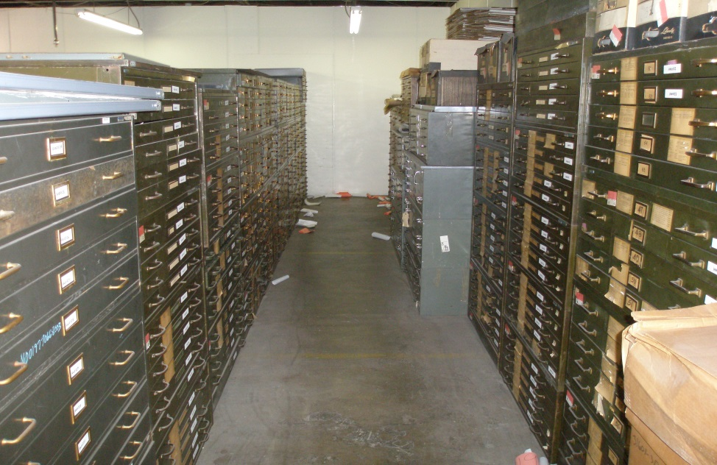
WV DOT Scanning Project

Slide 7


Slide 8
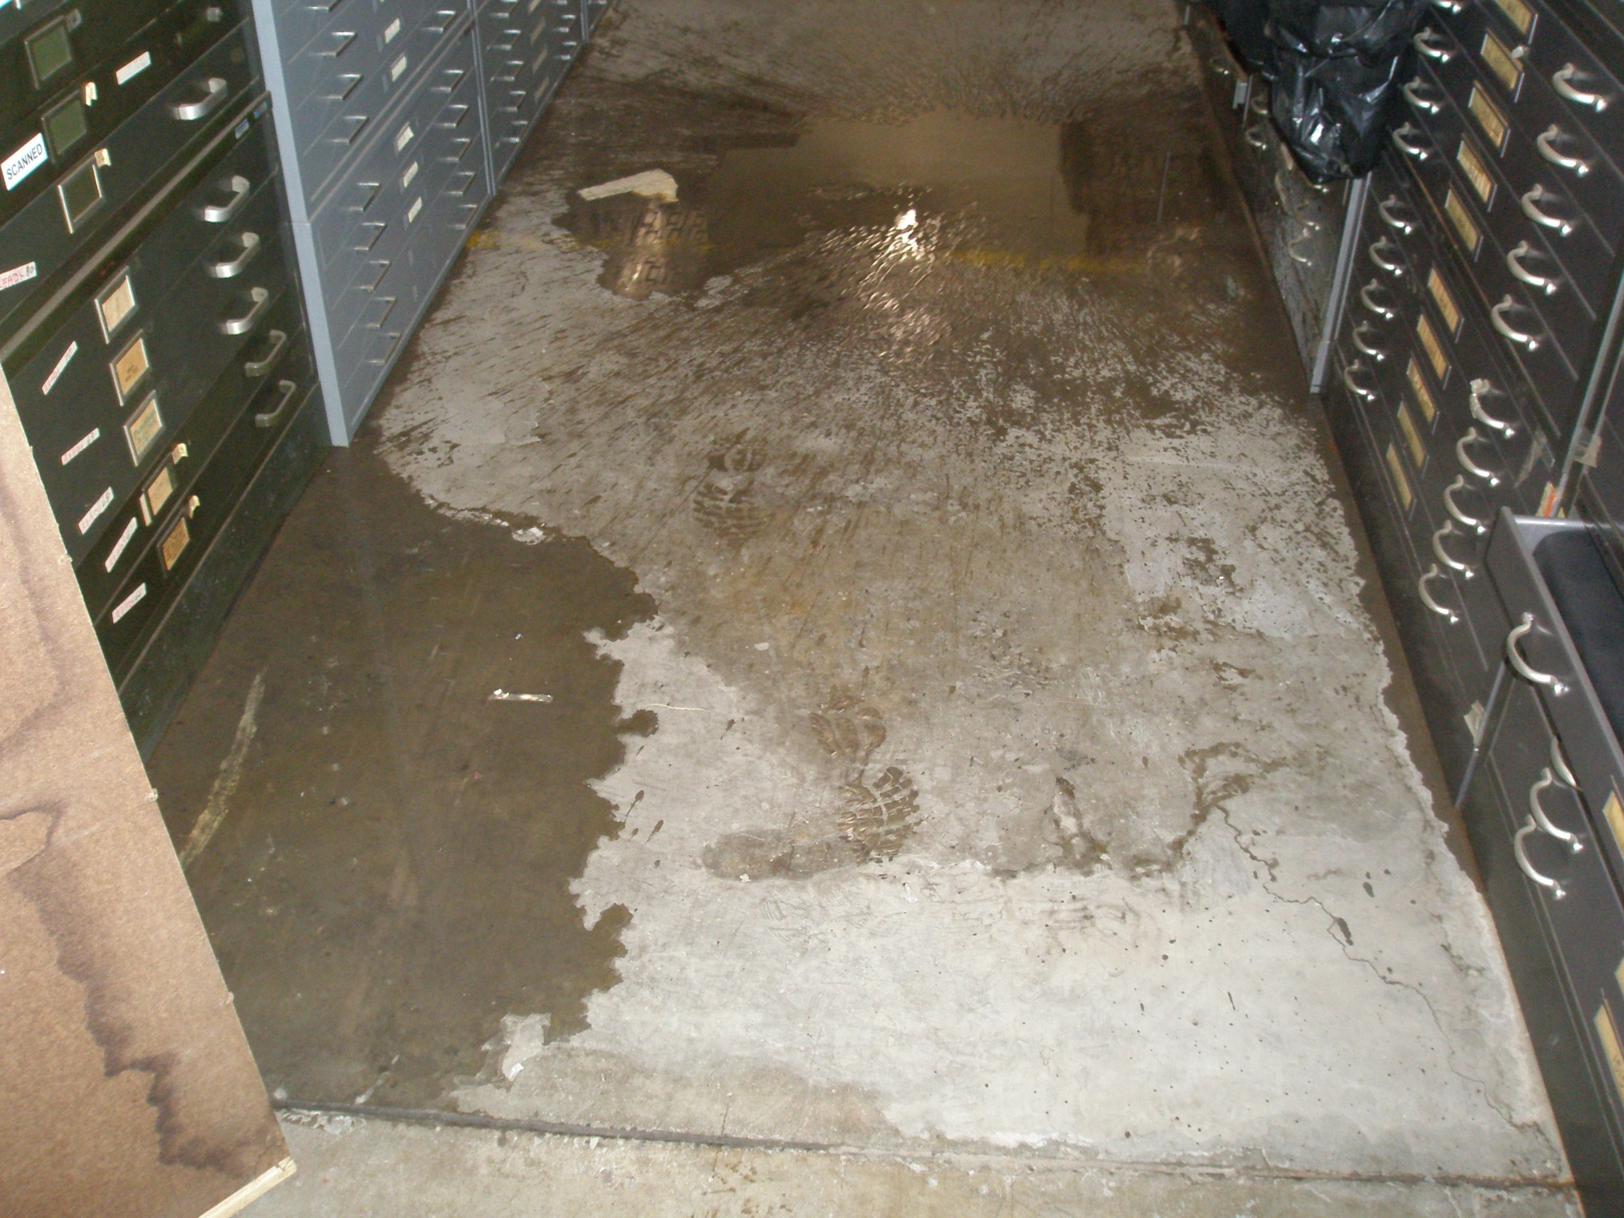
Water leak

Slide 9
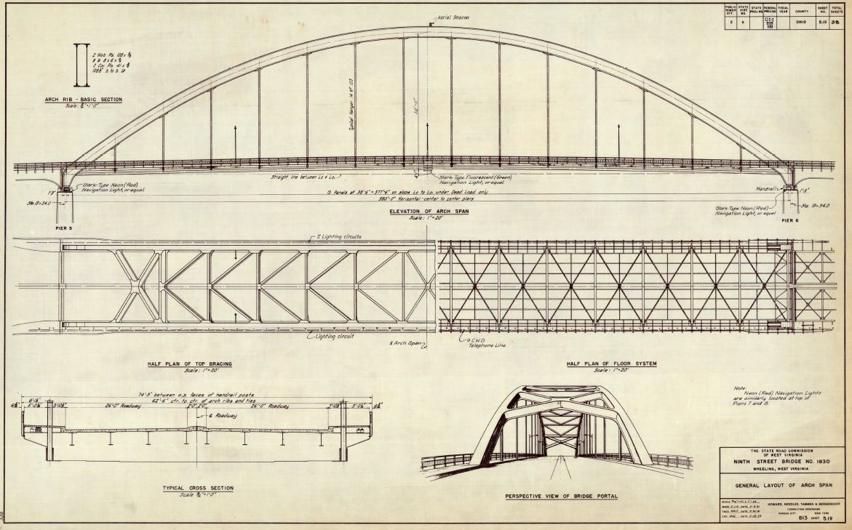
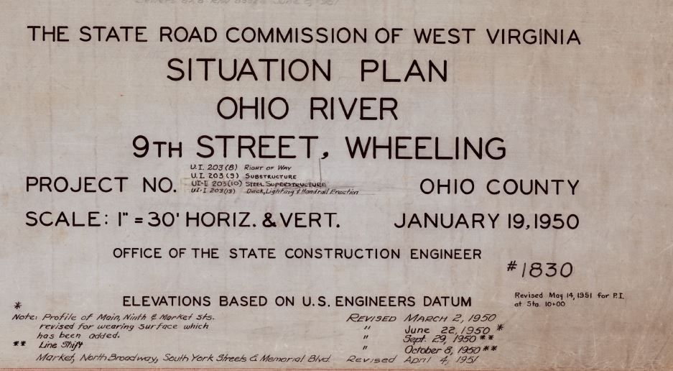
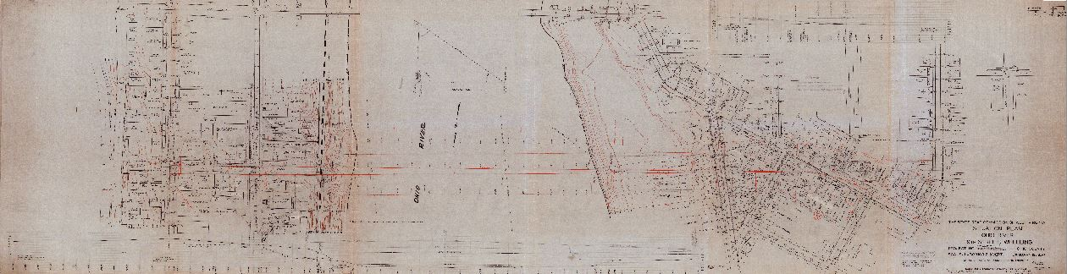

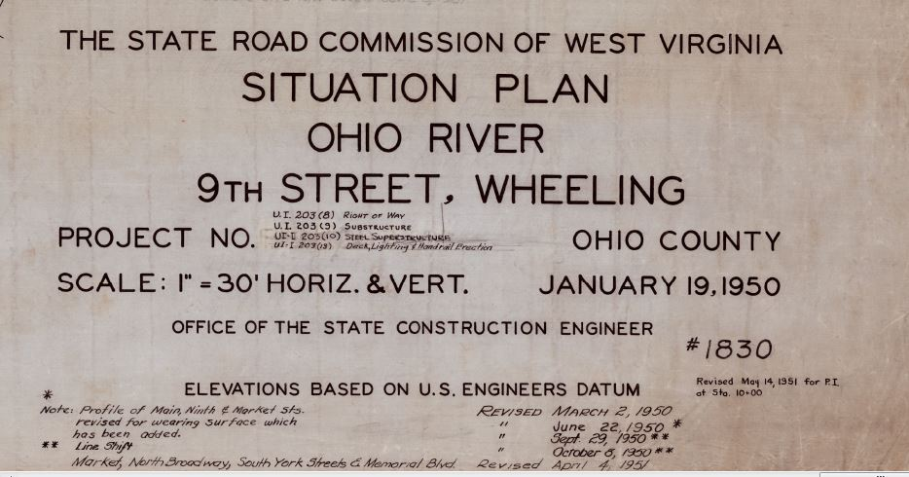
WV DOT Scanning Project

Slide 10
Scanning Project Process
Book Preparation and File Naming
Scanning
Image Processing (semi-automated)
  Crop Images & Create PDF Book
Geo-reference Index Map
Quality Control
  Page sequence, scan orientation, image quality
Publish to Web Application (automated)
  Via SQL Server and ArcGIS Server

Slide 11



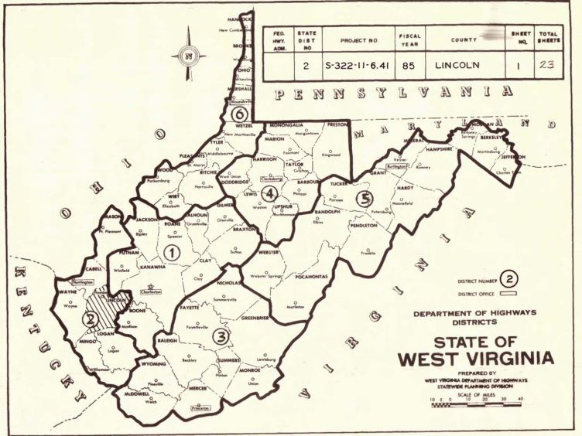
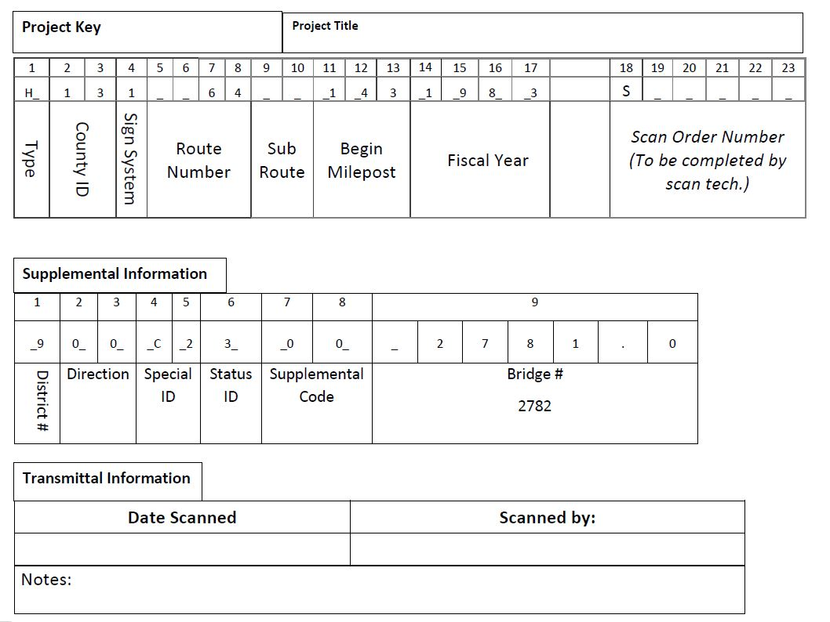

Transmittal Sheets
Developing the project key

Slide 12
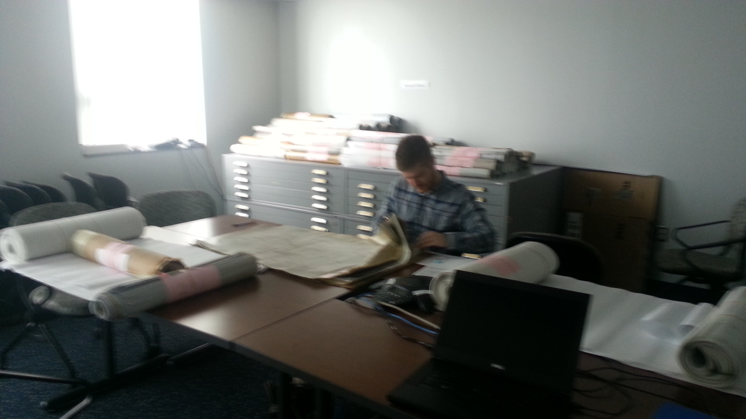
Plan Set Preparation

Slide 13




WV DOT Scanning Project
Scanning
Scanning
Image Processing
Scanning

Slide 14
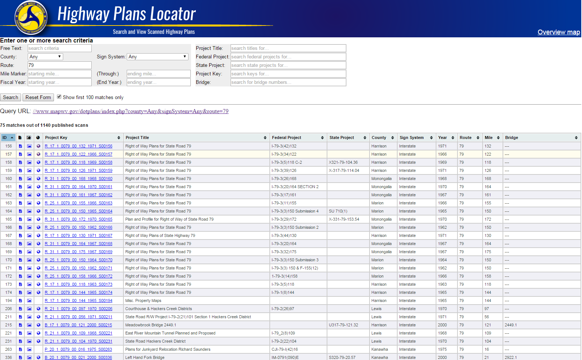
Online Highway Plans Locator

Slide 15
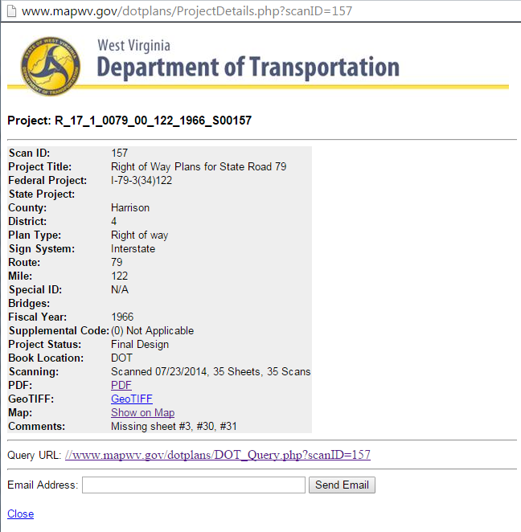
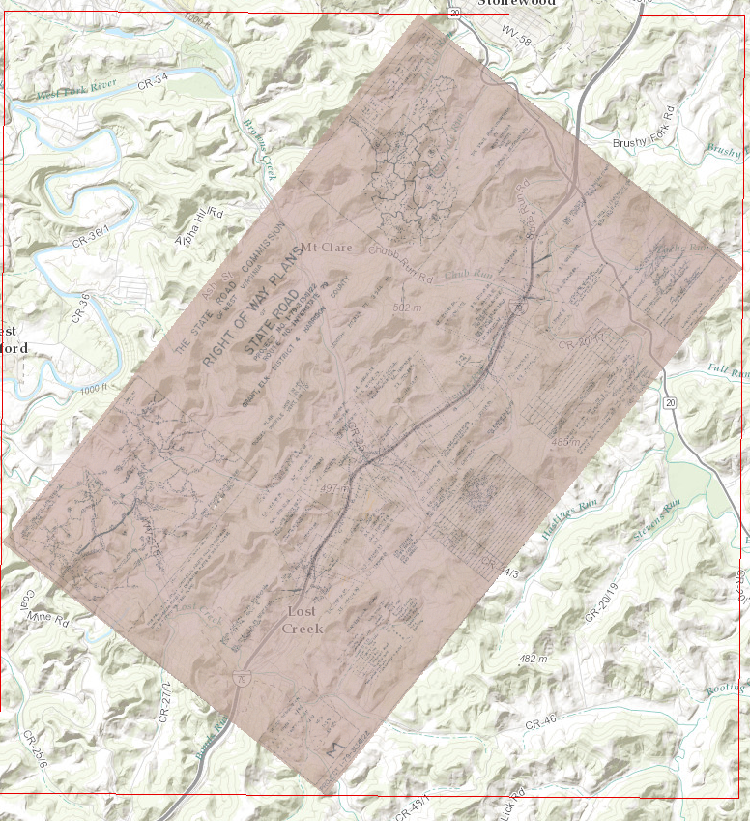
Online Highway Plans Locator
Detailed Record
Map It View

Slide 16
Microsoft SQL Server &
Enterprise ArcGIS Geodatabase

Slide 17
Microsoft SQL Server &
Enterprise ArcGIS Geodatabase
Multi-user ability
Used for recording scanning activity
Supports web feature mapping and image services
Updates are made automatically; not necessary to re-publish ArcGIS services in order to add new scan rasters
Backups are run using SQL Server Agent process
Geodatabase contains 3 primary objects
  Raster mosaic as source of image service
  Feature class of map foot prints
  Database view for published plans and web based query interface
Python scripts automate processes
  Renaming files
  Calculate map extents
  Copying GeoTiffs to publication folder
  Building raster mosaic
  Building footprints

Slide 18
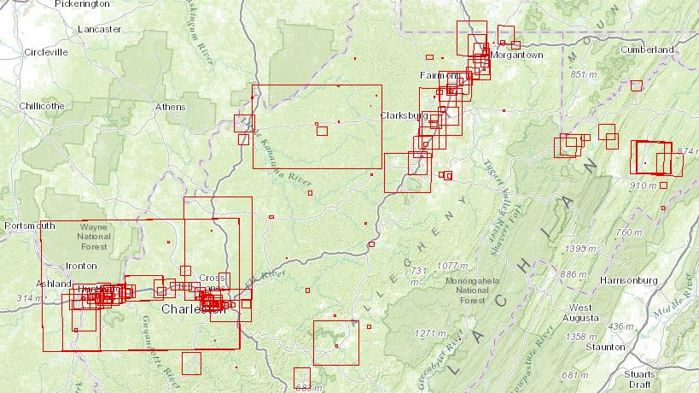
WV DOT Scanning Project
Initial scans were isolated to Right of Way plans on I-64 and I-79.

Slide 19

WV DOT Scanning Project
2105 Summer Students on Scanning Project

Slide 20
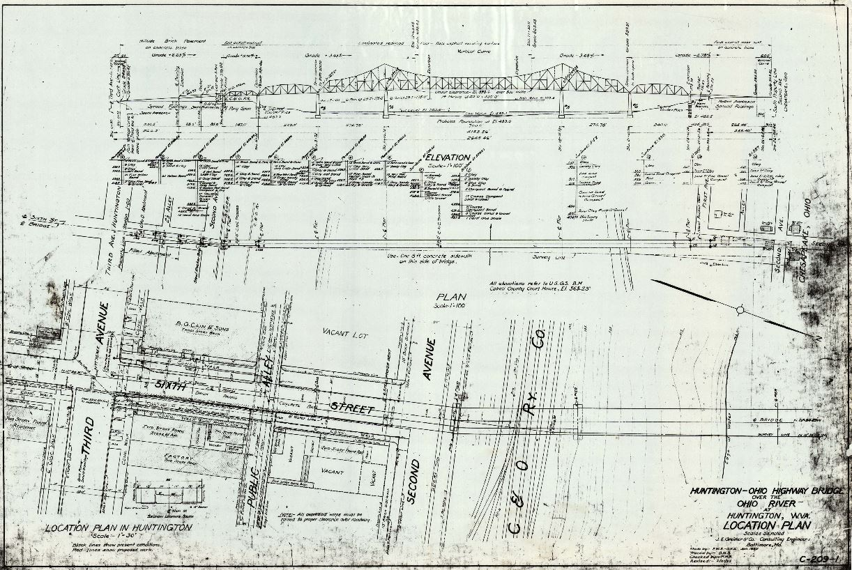
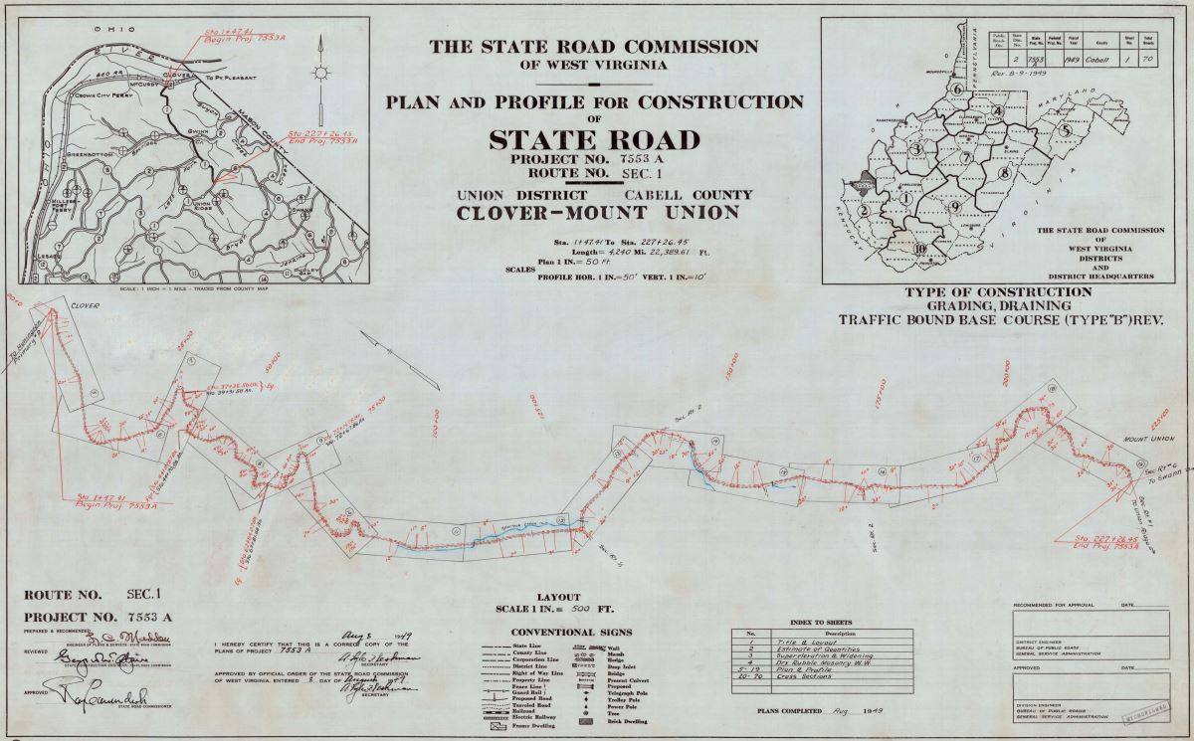
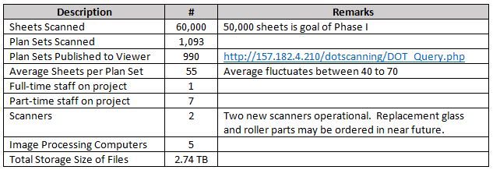
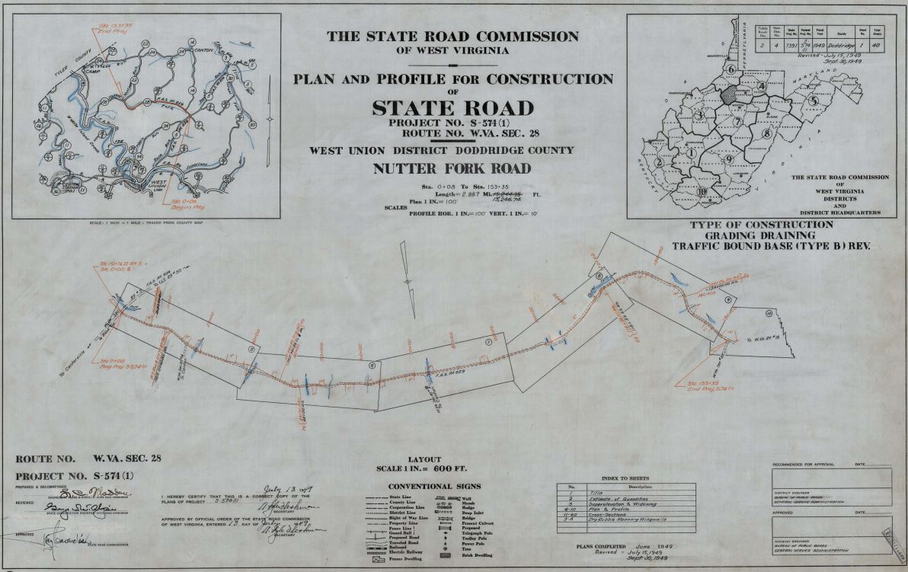
WV DOT Scanning Project
Scanning progress report for September 2015

Slide 21
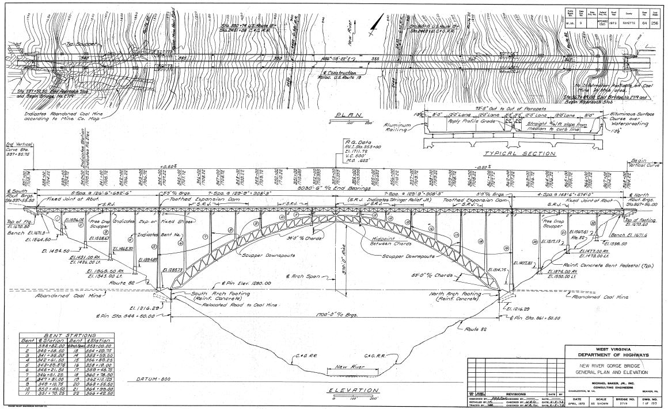
WV DOT Scanning Project

Slide 22

50K Scan Party

Slide 23

50K Scan Party

Slide 24



New River Gorge

Slide 25
WV DOT Scanning Project
Phase 2 Highlights and Enhancements
DOT Scanning Database:
  fix records that have missing or incorrect information
Customized Spatial Viewer
DOT ProjectWise Integration
Scanned Files Stored on DOT Server

Slide 26
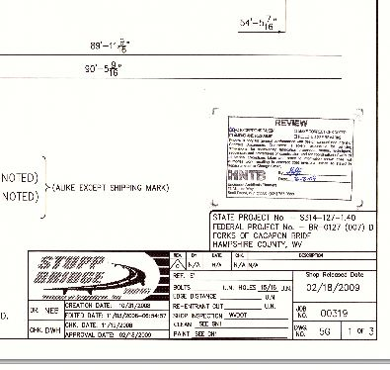
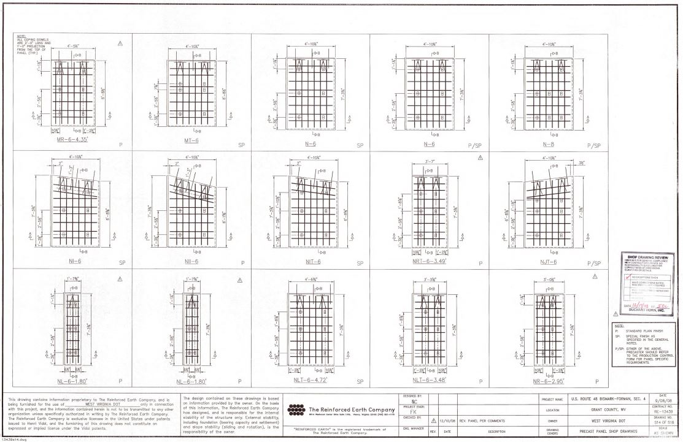
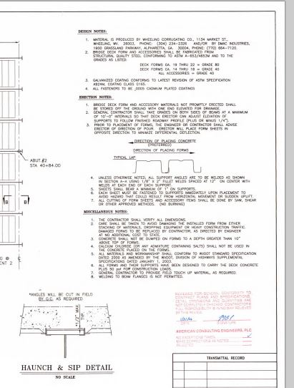
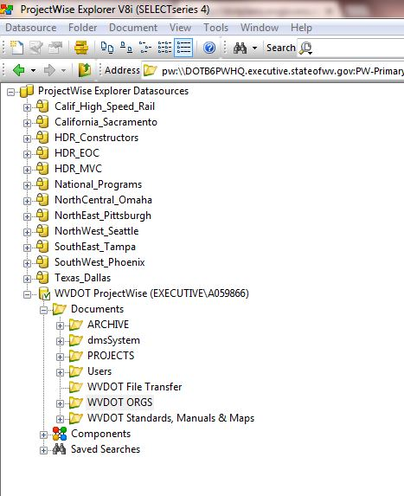
WV DOT Scanning Project
ProjectWise Integration

Slide 27
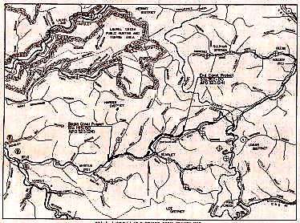

WV DOT Scanning Project
The Highway Plan Locator – Search and View
http://www.mapwv.gov/DOTplans/index.php

