Slide 1
Statewide Flood Risk Assessment
Shelter Modeling for WV

Slide 2
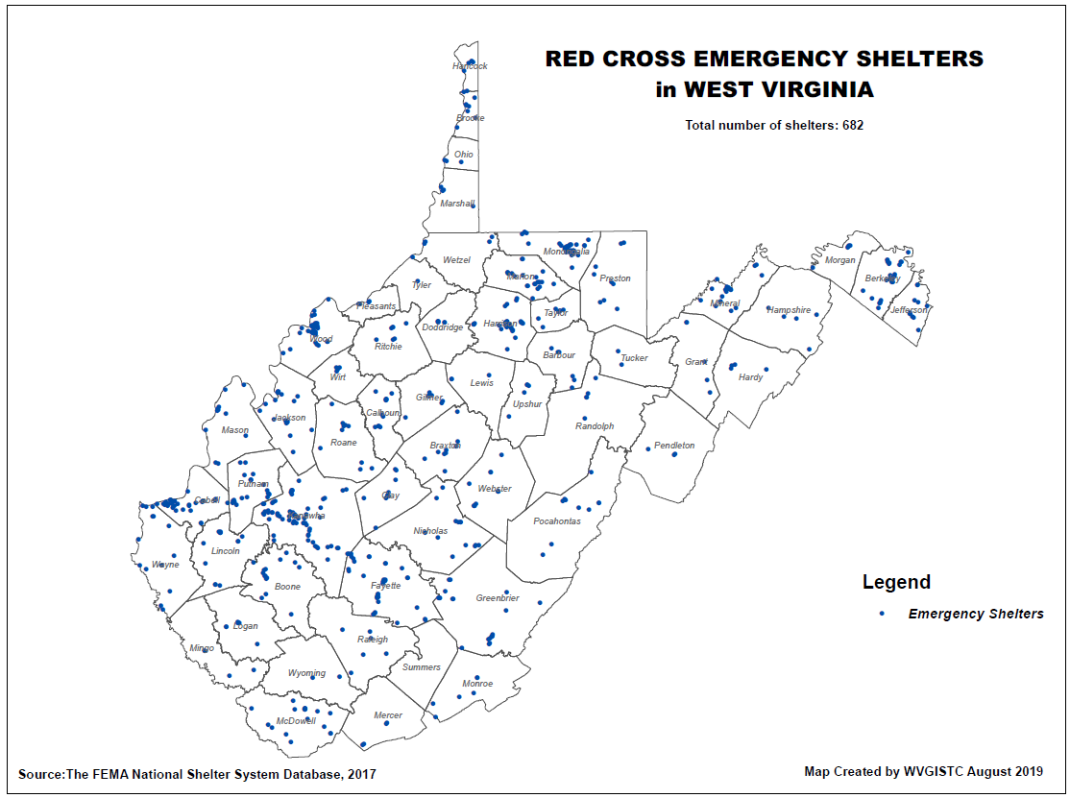
Red Cross Shelters

Slide 3
Statewide Flood Risk Assessment
Shelter Modeling for WV
2016 June Flood: Shelter Database Information Requested
Shelter Names and Locations for WV 2016 Flood
Number of people housed at each shelter
Period of time people stayed at shelter
Any other useful sheltering statistics for population displacement and short-term shelter models
The communities where people came from (towns, unincorporated areas, address, county etc.)
Household breakdown statistics of Displaced Population (see next slide)

Slide 4
Statewide Flood Risk Assessment
Shelter Modeling for WV
2016 June Flood: Household Information Requested of Displaced Population for 2016 Flood – Can be aggregated into classes
Income (HH Income < $20K; $20K-$30K; $30K-$50K; $50K-$60K; HH Income > $60K)
Ethnicity (White, African American, Hispanic, Asian/Other)
Age (Age < 15, 15 < Age < 65, Age > 65)
Housing Information:
  House Ownership Type (Owned or Rental)
  Occupancy Class Type (Single family, Multi-family, Mobile Home, etc.)
  House Geography (Urban versus Rural Location)
Also companion pet data (dogs, cats) or other animal information if available

Slide 5
Goal: Add Shelter Model to Hazus FAST
ORIGINAL MODEL:
The expert-based short-term shelter model developed by Harrald et al. (1989) at George Washington University for the earthquakes in Northern California in a contract with the American Red Cross
Reference:
  Harrald, J. R., Al-Hajj, S., Fouladi, B., & Jeong, D. (1994). Estimating the demand for sheltering in future earthquakes. Unpublished paper, Department of Engineering Management, the George Washington University, Washington, DC.
Socio-economic variables for shelter model weighted by experts:
Income (In five classes from $10,000 to $35,000)
Ethnicity (White, African American, Hispanic, Asian/Other)
Age (Under or above 65)
Residence Type (Owned, Rental, Vacation)
Modified and applied to floods in "Flood Model Hazus-MH Technical Manual", Chapter 13 removing ethnicity and residence type
VARIABLES:
Objective: Incorporate Population Displacement and Short-Term Shelter Needs in FEMA’s Open Hazus script

Slide 6
Proposed Shelter Model
Building-Level
Building-Level
Assessment Records
Population
Displacement
Building Characteristics
Occupancy Class
Flood Depth Value >=1 ft
Based on limitations of physical access
Community-Level
Average Household Size
Short-term Shelter Needs
Community-Level
Shelters used up to 3 weeks
U.S. Census Data
Population & Household Size
Income
Age
Ethnicity
Housing Characteristics
Can be used in the future models

Slide 7
Shelter Model – Displacement
BASE MODEL: Flood Model Hazus-MH Technical Manual
MODIFICATIONS: Scale of calculations changed to buildings
DATA:
Hazard Occupancy Code and Flood Depth Value for Jefferson County at the scale of buildings (Building Inventory)
Average Household Size of the communities from census data (2017 American Community Survey (ACS) 5-Year Estimates downloaded from "American Fact Finder“)
METHOD:
Extraction of the buildings located in flood zones with the depth value of 1 ft or more
Estimating the number of the residential units in each building using the occupancy code
Calculation of the estimated residing population in each building using the average household size of the community
Adding the population of the buildings in each community

Slide 8
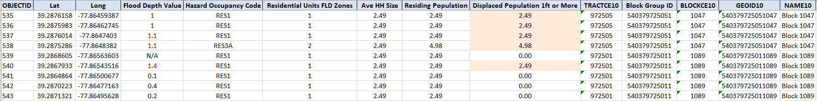

Shelter Model – Displacement
DEFINED EQUATION:
$${\#DI}_{IN}=\sum_{j=1}^{n}{{(ResUNIT}_{IN}×{AveHHSize}_{COMM})}$$
Where:
#DI_{IN} = the number of displaced individuals as a result of inundation with the depth equal or more than 1 foot
ResUNIT_{IN}= the number of residential units in each building located within the area of inundation with the depth equal or more than 1 foot
AveHHSize_{COMM}= the average household size of the community where the building is located
j= the number of residential buildings within the flooded area with the depth equal or more than 1 foot
A part of the population displacement table at building level

Slide 9
Shelter Needs
BASE MODEL: Flood Model Hazus-MH Technical Manual
MODIFICATIONS: Income classes updated based on the inflation rate
DATA:
Displaced Population estimated in the previous part
Household Income and Age from census data (2017 American Community Survey (ACS) 5-Year Estimates downloaded from "American Fact Finder“)
METHOD:
Based on "Flood Model Hazus-MH Technical Manual", Chapter 13, at the scale of communities:
Calculation of the percentage of households in the income classes:
- IM1: HH Income per year < $20,000
- IM2: $20,000 <= HH Income per year < $30,000
- IM3: $30,000 <= HH Income per year < $50,000
- IM4: $50,000 <= HH Income per year < $60,000
- IM5: $60,000 <= HH Income per year
Calculation of the percentage of individuals in the age classes:
AM1: Less than 15 years
AM2: 15 to 64 years
AM3: 65 years or more

Slide 10
Shelter Needs
MODIFICATIONS TO INCOME CLASSES:
The inflation rate of 1990 to 2017 (1.87) was slightly changed while applying to make the intervals match the census data
Income Class | Original and Hazus Models | Modified Model
IM1 | HH Income < $10,000 | HH Income < $20,000
IM2 | $10,000 <= HH Income < $15,000 | $20,000 <= HH Income < $30,000
IM3 | $15,000 <= HH Income < $25,000 | $30,000 <= HH Income < $50,000
IM4 | $25,000 <= HH Income < $35,000 | $50,000 <= HH Income < $60,000
IM5 | $35,000 <= HH Income | $60,000 <= HH Income

Slide 11
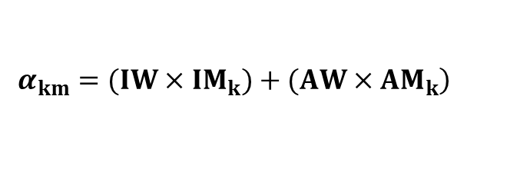
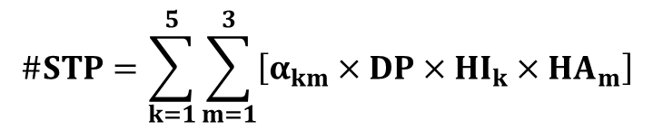
Shelter Needs
USED EQUATIONS:
$$\#STP=\sum_{k=1}^{5}{\sum_{m=1}^{3}{\left[α_{km}×DP×{HI}_{k}×{HA}_{m}\right]}}$$
Where:
#STP = Number of people using established shelters
α_{km} = a constant calculated as below
DP = Displaced population by inundation with equal or more than 1 foot depth (from the previous stage)
HI_{k} = Percentage of population in the k^{th} income class
HA_{m} = Percentage of population in m^{th} age class
$$\left.α_{km}=(IW×{IM}_{k})+(AW×{AM}_{k}\right)$$
Where:
IW = Shelter category weight for income (0.8)
AW = Shelter category weight for age (0.2)
IM_{k} = Relative modification factor for income (calculated using table 13.2 in the manual)
AM_{m} = Relative modification factor for age (calculated using table 13.2 in the manual)

Slide 12
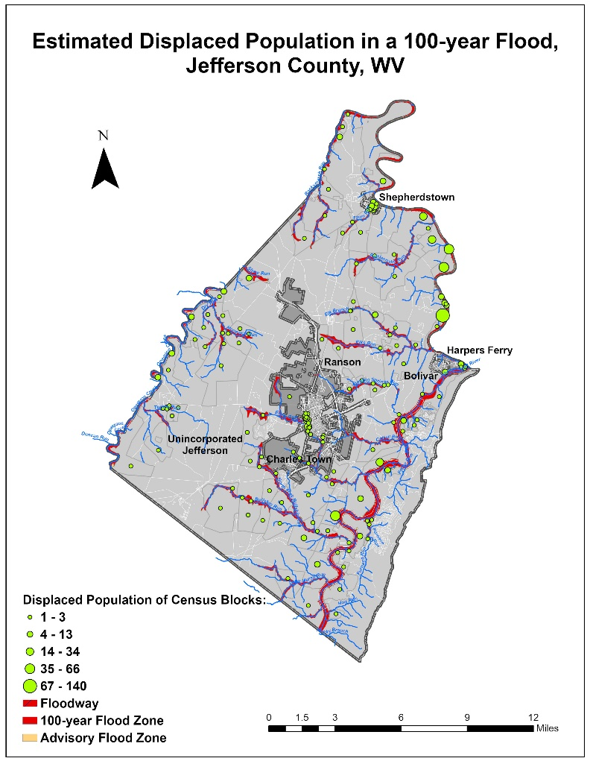
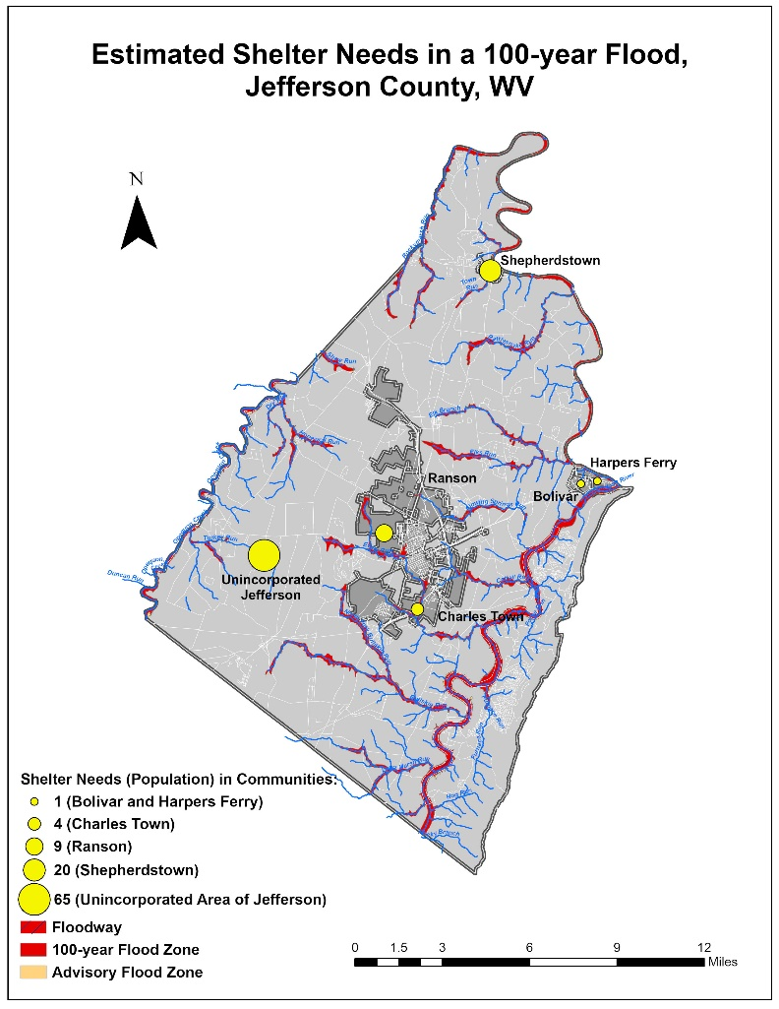
Jefferson County Pilot – Results
740 People Displaced
100 People Need Shelter
# | CID | Census ID | Community Name | County | Incorporated / Unincorporated | Total Population | Residential Units in Flood Zones | Average Household Size | Population Residing in Flood Zones | Percentage of Population Residing in Flood Zones | Estimated Displaced Population (Inundation >= 1 ft) | Percentage of Population in Flood Zones Displaced | Estimated Population in Need of Shelter (Inundation >= 1 ft) | Percentage of Population in Flood Zones in Need of Shelter
1 | 540065 | _ | JEFFERSON COUNTY * | JEFFERSON COUNTY | Unincorporated | 41,907 | 501 | 2.6 | 1322 | 3.2% | 549 | 41.5% | 65 | 4.9%
2 | 540030 | 5408932 | BOLIVAR, TOWN OF | JEFFERSON COUNTY | Incorporated | 1,246 | 3 | 2.4 | 7 | 0.6% | 7 | 100.0% | 1 | 15.7%
3 | 540066 | 5414610 | CHARLES TOWN, CITY OF | JEFFERSON COUNTY | Incorporated | 5,766 | 24 | 2.5 | 60 | 1.0% | 22 | 37.5% | 4 | 6.1%
4 | 540067 | 5435284 | HARPERS FERRY, TOWN OF | JEFFERSON COUNTY | Incorporated | 236 | 6 | 2.1 | 13 | 5.3% | 10 | 83.3% | 1 | 10.1%
5 | 540068 | 5466988 | RANSON, CITY OF | JEFFERSON COUNTY | Incorporated | 4,945 | 81 | 2.7 | 215 | 4.4% | 51 | 23.5% | 9 | 4.3%
6 | 540069 | 5473468 | SHEPHERDSTOWN, TOWN OF | JEFFERSON COUNTY | Incorporated | 1,573 | 61 | 1.7 | 104 | 6.6% | 100 | 96.7% | 20 | 19.4%
7 | Total in county |  |  | Jefferson County | _ | 55,673 | 676 | _ | 1721 | 3.1% | 740 | 43.0% | 100 | 5.8%

Slide 13
Future Directions
Include more variables relevant to housing characteristics in the shelter model such as:
Housing Ownership Type (Owned or Rental)
Occupancy Type (Single family, Multi-family, & Mobile Home)
Geography: Urban versus Rural
Research and review the actual shelter data of floods provided by the American Red Cross to test the model
Data preparation for unincorporated areas missing in the census data by subtracting the demographic data of the communities from those of the county
Automate data processing of the required variables for displacement and shelter estimations
Customize Open Hazus “FAST” Flood Assessment Structure Tool including population displacement and shelter needs
“… the task of estimating and preparing for shelter demand is still very challenging.” (Dr. John Harrald, 2019)
“The results of all modeling efforts should be interpreted with a degree of skepticism.” (Harrald et al., 1994, p.13)
“Any model is a selective representation of reality.” (Harrald et al., 1994, p.14)

